Slide 1
Strategic Planning
April 2025
Notes:
2:15 – 3:00pm
Tracy

Slide 2

Benefits of Strategic Planning
Be proactive vs reactive
Set direction of Chapter
Determine priorities
Align resources (i.e. volunteer time) to goals of Chapter
Encourages accountability

Slide 3
Setting Goals | Objectives | Strategies
Goal
Objectives
Strategies
An accomplishment you are trying to reach-an outcome; broad and general in nature
How the goal will be accomplished
Define the steps to
achieve an objective
Example
Example
Example
Improve Communications to our Members
Develop a unified marketing program for all education programs by 9/1/2026
Submit event requests to One HFMA at least 60 days in advance of webinars so members will find out about education opportunities early.

Slide 4
Goal | Objective | Strategy Flowchart
GOAL
(Ex. Improve Member Communications)
OBJECTIVE #1
(Ex. Develop marketing for all education programs by 9/1/2026)
OBJECTIVE #2
(Ex. Create a social media presence for our Chapter by 12/1/2026)
OBJECTIVE #3
(Ex. Increase online readership by 30%
by 3/1/2027)
STRATEGY #1
(Create Volunteer Coordinator Role/Position)
STRATEGY #1
STRATEGY #1
STRATEGY #2
(Request Canva graphics for event promotion)
STRATEGY #2
STRATEGY #2
STRATEGY #3
(Articles in newsletter about annual conference)
STRATEGY #3
STRATEGY #3

Slide 5
Strategy Framework Examples

Slide 6
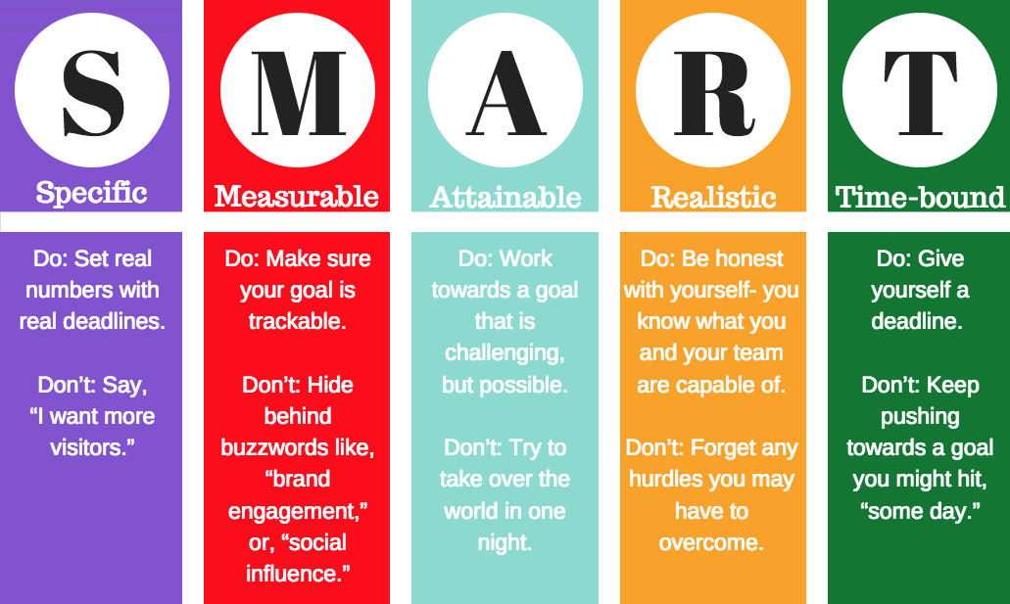

Slide 7
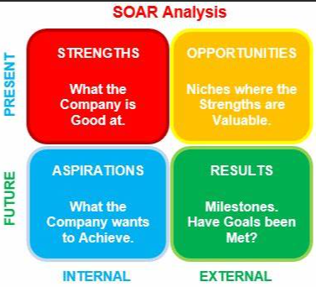
SOAR Analysis
Strengths: What are your current strengths or advantages?
Opportunities: What opportunities for growth or improvement exist?
Aspirations: What are your hopes, dreams, or long-term goals?
Results: What tangible outcomes do you want to achieve?

Slide 8
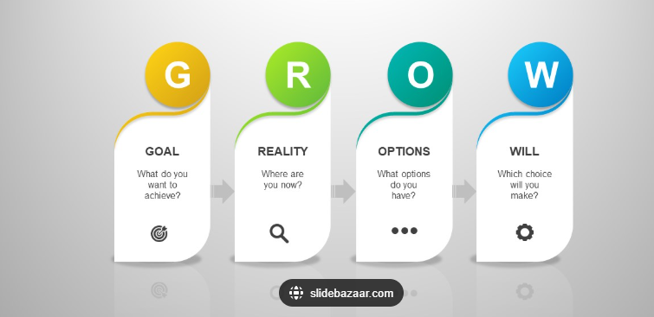
GROW Model
A coaching framework that helps break down goals into actionable steps.

Slide 9
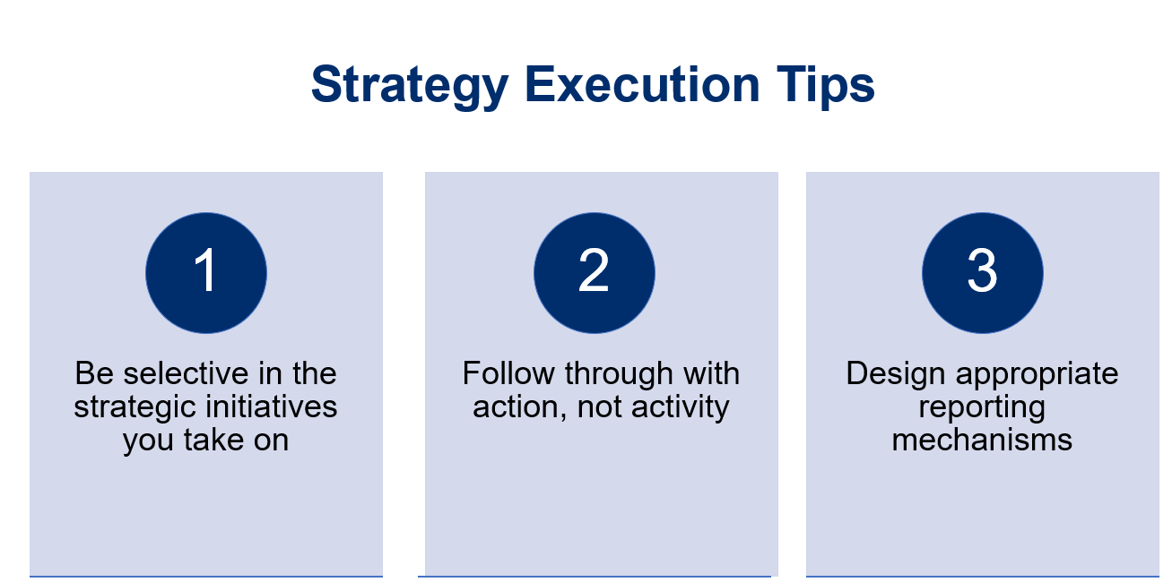

Slide 10

What questions do you have?

