Slide 1
Chapter Resource Center
April 2025

Slide 2

Chapter Resource Center
Access provided to those listed in a leadership position for the current year
President can update roster with any changes throughout year
Access for next year provided 60 days prior to effective date (i.e. April 1st)
Log in to hfma.org, then go to Chapter Resource Center at bottom of home page
Notes:
Updates ensure communication goes to correct person in chapter
Email Volunteer Exp Team to remove someone from roster

Slide 3
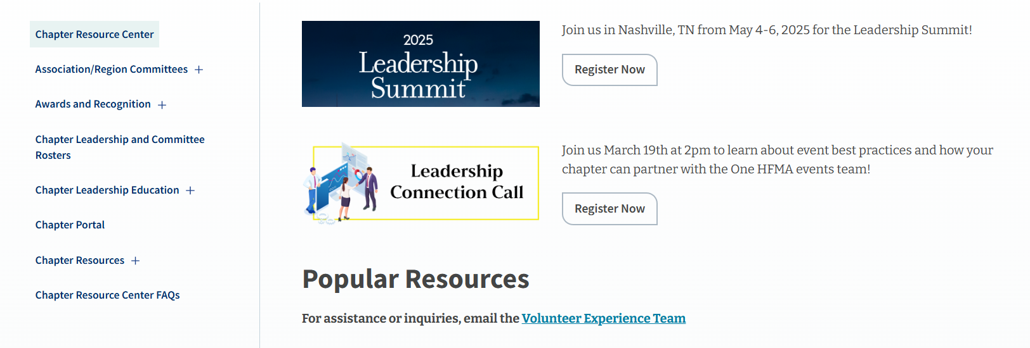
Landing Page
Notes:
Walk about the landing page:
Top banners – LC Call [Date and topic of next call, Summit (when reg is open)]
Sections on left hand side (Chapter Resources, Awards and Recognition, etc)
LOTS of info, especially in Chapter Resources
Click on + to expand to see sub-headings
Chapter Portal – Access limited further to Officers and committee chairs for Certification, Communication (incl Social Media), Founders, Membership, (incl Enterprise & Directory) Programs, Sponsorship
Chapter Leadership and Committee Rosters – Go here to make any additions to your roster during the year (email our team to remove anyone)
FAQs
Popular Resources (next slide)

Slide 4
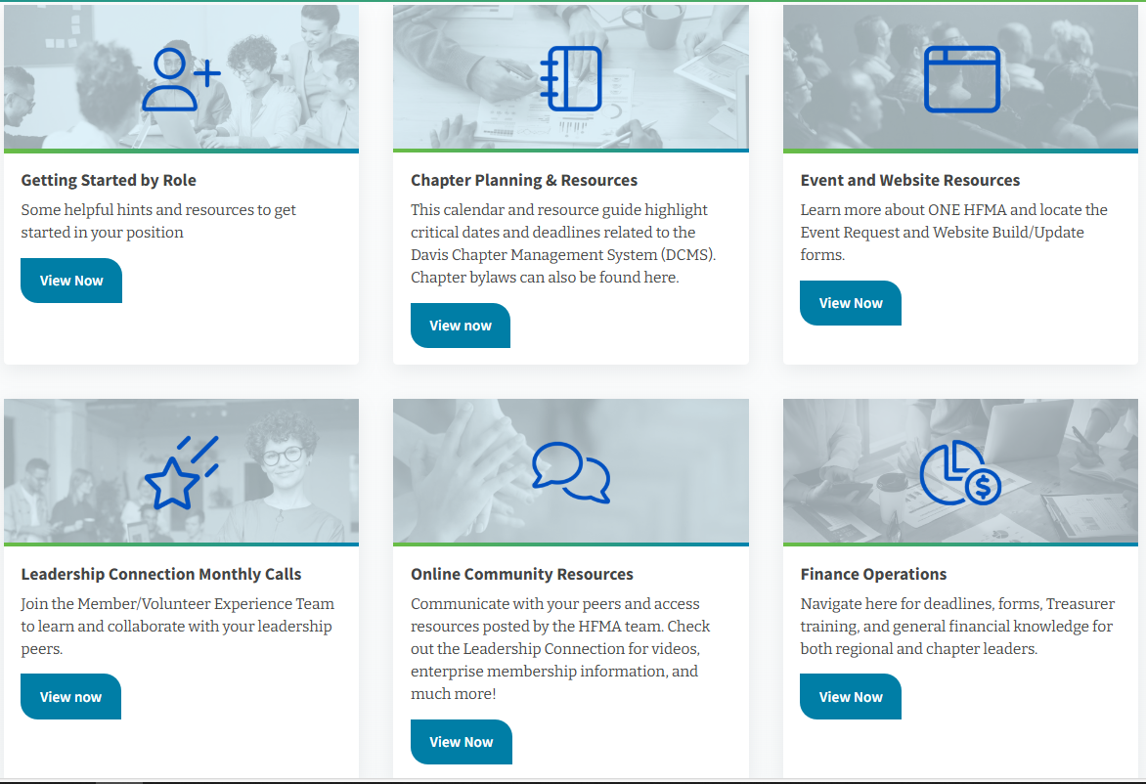
Popular Resources

Slide 5
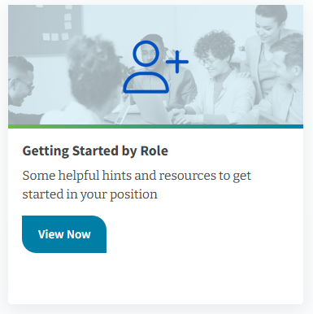
Getting Started by Role
Helpful information for key roles within the Chapter
Officers – President, PE, Secretary, Treasurer
Other key positions:
Events/Program
Membership
Communications
Member Engagement
Notes:
Treasurer role training – May Leadership Connection Call, assigned training module in LMS, Finance Ops page on CRC

Slide 6
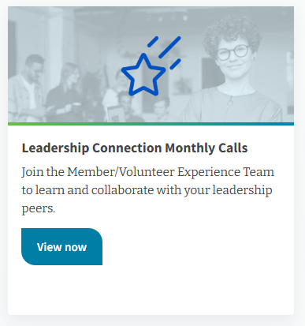

Monthly Leadership Connection Calls
Third Wednesday of the month at 2pm
All chapter leaders invited to attend!
Topics to be covered are usually posted on the Chapter Resource Landing page a few weeks prior, in the Leadership Connection community the week before as well as on social media
Enterprise Team provides an update at the beginning of each meeting (new organizations, orientations, and renewals)
Register Today!

Slide 7
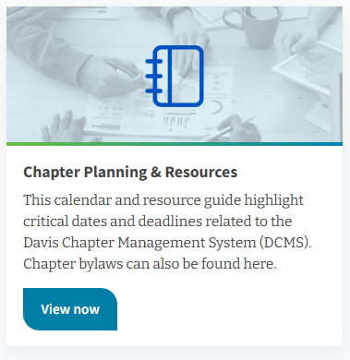
Chapter Planning & Resources
Dates to Remember
Key dates for leaders to track
Links to helpful resources on Chapter Resource Center
DCMS policy
All requirements/due date for chapters
Need to meet requirements to be eligible for the Success Awards
Chapter Bylaws
All information about bylaws in this area
Chapter’s current bylaws
Model bylaws

Slide 8

Dates to Remember
Print and keep handy!
Includes DCMS requirements as well as other items to keep track of
HFMA Officer Speaker Requests
Member Engagement Awards
Success Awards
Financial/Treasurer

Slide 9
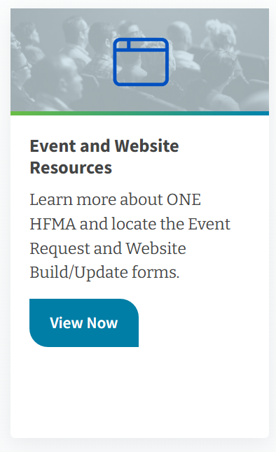
Event and Website Resources
One HFMA Project Plan
Support available and timelines
Event/Survey Form
Anything event related (live, virtual, or digital), including adding to the chapter events calendar
Survey not related to an event
Annual and event sponsorships
Website Request & Update Form
Updates to website (i.e. President’s Message, Leadership page, Sponsorship)
Add content to website (i.e. new section or page)
Notes:
EVERYTHING events/program related!

Slide 10
Event Resources Highlights
Speaker Request Forms
HFMA Officer (Board, CEO)
HFMA Staff
“Walk in Slides”
Customize to use during meetings, webinars, and conferences
Promote event sponsors as well as upcoming events
Certificate of Insurance Request
Submit at least 30 days before needed
Allow 48-72 hours for response

Slide 11
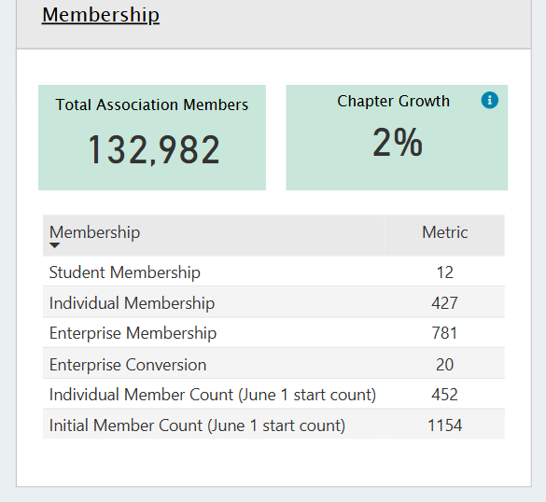
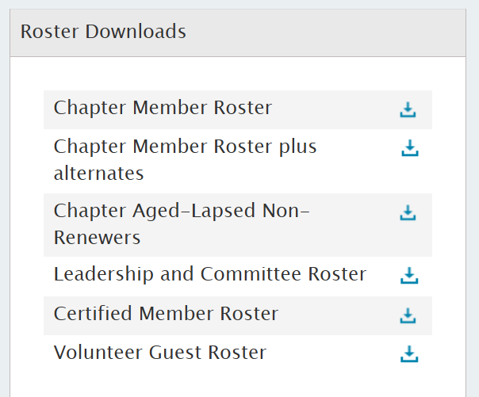
Chapter Portal
Access limited to certain roles
Officers
Committee chairs for Certification, Communication (incl Social Media), Member Engagement/Awards, Membership (incl Enterprise & Directory), Programs, Sponsorship
Membership Summary & Growth
Chapter Rosters
Membership
Certification
Notes:
Membership – Quick view of status of change in membership

Slide 12
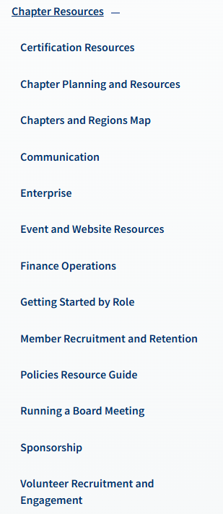
Chapter Resources Highlights
Communication
Chapter/Region logos
Chair Theme
Event display merchandise
Enterprise – Organizations within Chapters and contact information
Volunteer Recruitment and Engagement – Member/Volunteer Benefits Flyer
Versions for Member/Volunteer and Manager
Versions of each for chapter to fill in quote and contact information

Slide 13

What questions do you have?

