Slide 1

EMTALA
Emergency Medical Treatment
and Labor Act
Linda Corley
Compliance
Xtend Healthcare
706 577-2256
lcorley@xtendhealthcare.net

Slide 2
EMTALA
Medicare participating hospitals must adhere to the Emergency Medical Treatment and Labor Act (EMTALA) statute codified at §1867 of the Social Security Act, (the Act)
the accompanying regulations in 42 CFR §489.24 and
the related requirements at 42 CFR 489.20(l), (m), (q), and (r).
EMTALA requires hospitals with emergency departments to provide an appropriate medical screening examination (MSE) to any individual who comes to the emergency department and requests such an examination or treatment.

Slide 3
Intent of EMTALA
The EMTALA regulations were created to prevent
hospitals and providers from denying care to patients
on the basis of their ability to pay.
The law addresses the hospital’s legal obligation
when an individual presents to the hospital
campus or off-site urgent care or emergency
department and requests examination and
treatment for a possible emergency condition or
for labor.

Slide 4
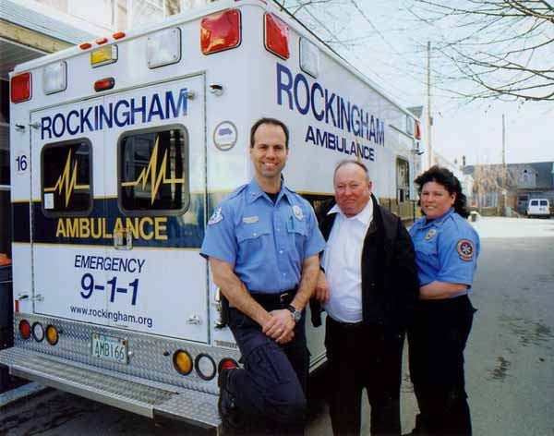
When Does EMTALA Apply?
EMTALA applies when a person seeking emergency
care arrives at the hospital or is on hospital property.
Define “seeking” = patient asking!
This includes:
Hospital owned ambulances on
route to facility.
Outpatient settings (where the
patient develops symptoms
and requests treatment).
Transfers of patients from facility
to another hospital for stabilization
of an emergency condition.

Slide 5

EMTALA applies to Emergency Medical Conditions (EMC)
An EMC is any medical condition manifesting:
  acute symptoms of severity, including pain, that, without immediate medical attention, could reasonably be expected to result in placing the health of the individual, including an unborn fetus, in:
    serious jeopardy;
    serious impairment to bodily functions;
    or serious dysfunction of any bodily organ or part.

Slide 6

EMTALA Components: Screening
Individuals presenting to the hospital requesting emergency services are entitled to a medical screening examination performed by qualified individuals, to determine if an emergency medical condition exists.
“Triage" is not medical screening.
Approved Med Staff document with required fields for EMC Screening.

Slide 7
A Little More About the Screening
If the Medical Screening Examination:
  Is refused:
    The physician / qualified provider should explain the risks to the patient of not having the exam.
    Document, document, document!
    A release should be signed by the patient!
Exams reveals no emergency medical condition:
    No further EMTALA obligations exist!
  Patient may be treated and released.
  Indicates an Emergency condition exists
    Treatment and stabilization should follow.
    Timing of services becomes important.

Slide 8
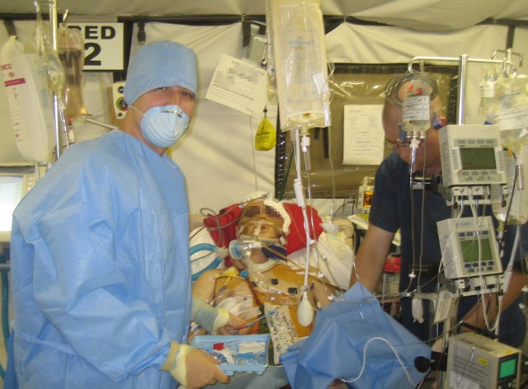
EMTALA
Components of Stabilization
If an Emergency Condition exists, the hospital is
required to provide stabilizing treatment within its capability and capacity.

Slide 9
EMTALA
Components of Stabilization
Must be within the hospital’s capability and capacity.
Is achieved when no further physical deterioration is apt to result from transfer or discharge.
Can be deferred to another facility if the hospital does not have the equipment / medical personnel to provide for stabilization.
If treatment refused ~ Patient must be asked to sign the LAMA / Refusal of Care form.

Slide 10

EMTALA Components:
Transfer
Patients can be transferred
to another hospital for
stabilization ~ however,
the transfer MUST be
performed within certain clinical and documentation guidelines in order to be considered appropriate.

Slide 11
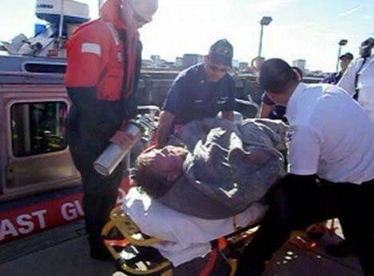
EMTALA Components:
Transfer
Authorization for transfer of care:
If stabilization is NOT complete:
  Patient or legal representative must request or consent to the transfer in writing after being informed of the benefits and risks of transfer
  Physician responsible for the patient must certify on the EMTALA form that the transfer is necessary for:
    stabilizing treatment
    further medical benefit

Slide 12

EMTALA Components:
Transfer
Physician responsible for patient documents:
Transferring physician (or designee)
  obtains consent for patient transfer
  makes arrangements with the receiving hospital
patient condition in medical record
risks and benefits with patient / guardian
The transferring physician is responsible for the patient until the patient arrives at the receiving facility
11

Slide 13

EMTALA Components:
Transfer
Medical record copies must be provided, including:
Signs / symptoms
Preliminary diagnosis
Treatment provided
Test results
Informed consent or transfer certification
Any information related to specialists contacted
Date and time of events
Durable power of attorney (if applicable)

Slide 14

EMTALA Components:
Transfer
Patient must be accompanied by personnel qualified to care for him / her during transport with supplies and equipment to assure safe transport
Requirements are guided by the Hawaii Administrative Rules and Guidelines:
State of Hawaii Code R. § 11-95-31
13

Slide 15

EMTALA: Implications for On-Call Physicians and Providers
A list of physicians who are “on-call” is required.
A 30-minute response time is required for all on call physicians.
Refusal to respond shall be reported for investigation and further action.

Slide 16

EMTALA: Implications for On-Call Physicians and Providers
On call responsibilities:
  Appropriate telephone orders given to ED physician.
  Primary care or direction of treatment of the patient.
  Care of the patient until the problem leading to Emergency presentation is resolved and the patient is discharged or transferred.

Slide 17

EMTALA: Central Log
A log must be maintained for including:
  each individual who comes to the Emergency Department seeking assistance,
  whether he or she refused treatment.
  whether he or she was transferred, admitted and treated, stabilized and transferred, or discharged.
The log is inclusive of patients presenting for labor and delivery.

Slide 18
EMTALA
All hospital staff members have responsibility through EMTALA.
If YOU discover a patient in need of medical attention ~
in ANY location, please assure they receive the care needed by taking the patient to the Emergency Department or calling 911.

Slide 19
EMTALA
New
The content of the MSE varies according to the individual’s presenting signs and symptoms and the capabilities of the hospital. It can be as simple or as complex, as needed, to determine if an EMC exists.
MSEs must be conducted by Qualified Medical Personnel (QMP), which may include physicians, nurse practitioners, physician’s assistants, or RNs trained to perform MSEs and acting within the scope of their State Practice Act.
Hospitals may use telehealth equipment to perform the MSE by the QMP if clinically appropriate. The QMP may be on-campus (e.g., using telehealth to self-contain) or offsite (e.g., due to staffing shortages).

Slide 20
EMTALA
New
Either way, the QMP must be performing within the scope of their state practice act and approved by the Hospital’s Governing Body to perform MSEs.
The use of telehealth equipment to provide evaluation of individuals who have not physically presented to the hospital for treatment does not create an EMTALA liability.
The hospital must provide stabilizing treatment (or appropriate transfer) to individuals found to have an EMC, including moving them as needed from the alternative site to another on-campus department.

Slide 21
EMTALA
New
Communities may set up screening/testing clinics at sites not under the control of a hospital (such as a mall or retail parking lot).
There is no EMTALA obligation at these sites even if hospital personnel perform the screening or testing.
Hospitals and community officials may encourage the public to go to these sites instead of the hospital for screening of viral respiratory illness. However, a hospital may not tell individuals who have already come to its ED to go to the off-site location for the MSE until they have been provided a MSE and determined not to have an EMC.

Slide 22
EMTALA
New
Communities are encouraged to staff the sites with medical personnel trained to evaluate individuals with viral respiratory illness.
There should be protocols or a process in place to safely transport patients who arrive in medical distress and need to be admitted to the hospital which may be as simple as calling 911.
In preparation for a pandemic of any viral illness, the community, its local hospitals and EMS are encouraged to plan for referral and transport of individuals needing additional medical attention on an emergent basis.

Slide 23
EMTALA
New
Drive through testing sites established for COVID-19 testing purposes-only do not have EMTALA implications

Slide 24
EMTALA
Filing Claims
Key to proving appropriate patient treatment under EMTALA is the provider’s documentation, of course!
Ensure physicians, nurse practitioners, and all Emergency Department team members are trained and re-trained on medical requirements and appropriate claim submission.
Charge capture is important – even if “packaged,” “bundled” or “non-covered,” ensure charge is placed on patient’s claim.

Slide 25
EMTALA
Filing Claims
Here are some keys to billing for Emergency Medical Treatment and Active Labor Act (EMTALA) services:
    Bill for all presenting symptoms as noted by the patient.
    Providers can bill for presenting symptoms or complaints in addition to the principal diagnosis.
    Use Form Locator 76 – Providers can use Form Locator 76 of the UB-04 claim form to bill for the ICD-10-CM code that represents the patient's reason for the visit.

Slide 26
EMTALA
Filing Claims
Here are some keys to billing for Emergency Medical Treatment and Active Labor Act (EMTALA) services:
    Although only one diagnosis code for the reason for the visit may be recorded in
    Form Locator 76, at the provider’s discretion additional diagnoses not inherent in the final diagnosis may be reported in Form Locators 68 through 75.
MLN Matters Number: MM3437
Related Change Request (CR) #: 3437

Slide 27
EMTALA
Questions / Discussion
Linda Corley
706 577-2256
lcorley@xtendhealthcare.net

