Slide 1
Denials Management and Prevention
HFMA Hawaii
November 20, 2024
Presented by:
Colleen Goethals, MS, RHIA, FAHIMA
VP, Mid-Revenue Cycle
Xtend Healthcare
A CorroHealth Company

Slide 2




Discussion Points
Impact of Denials
Strategies:
Data & Root Cause
Review Workflow
Accurate and Complete Documentation
Robust Appeals Process
Monitor, Track, Report
Education and Training
Continuous Process Improvement
© CorroHealth, Inc. 2024. All Rights Reserved.
2

Slide 3

Impact of Denials
89% of all hospitals have seen a significant increase in denied claims¹
Commercial insurers denials have increased on average of 20.2%²
Medicare Advantage claims denial up to 55.7%²
Providers spent $20B in 2022 pursuing delayed and denied claims from payors
Average of 3 rounds of reviews; 45-60 days each round
90% of denied claims are preventable³
35% of providers appeal denials even though 66% of denied claims are recoverable³
Report: The State of Claims 2022, Experian Health (www.experian.com/healthcare/resources-insights/thought-leadership/white-papersinsights/state-claims-report)
RCM Admin Tasks Driving Up Costs. Payer Tech to Blame, HealthLeaders, September 16, 2024
Success in Proactive Denials Management and Prevention, HFMA, May 1, 2021

Slide 4


Top causes of denials*
46%
Missing or inaccurate data
Followed by:
Authorizations: 36%
Patient information inaccurate/incomplete: 30%
Others:
Coding errors
Staff shortages
Poor training
Missing Coverage
Payer policies
Timely filing
*Experian Health survey 2024
4
Confidential and proprietary information © 2022 Xtend Healthcare. All rights reserved.
4

Slide 5

Impact of Denials
Survey says……
66% reported denials occur at higher rates than before the pandemic
65% state that submitting clean claims is more complex than ever before
84% said that reducing denials is a priority for the organization

Slide 6







Factors for the increase in denials
Payer policy changes occurring more frequently
Lack of denials resources
Staff attrition and training
Growing denials backlog
Pre-authorization tracking
Technology challenges
Presentations are tools that can be used as lectures, speeches, reports, and more It is mostly presented like
Solutions For Medical
Solutions For Medical
Next Page
6

Slide 7




Why the focus on denials?
67%
51%
43%
42%
Payor policy changes occurring more frequently
Reimbursement taking
longer
Increase in claim submission errors
Overall increase in denials
Report: The State of Claims 2022, Experian Health (www.experian.com/healthcare/resources-insights/thought-leadership/white-papersinsights/state-claims-report)
7

Slide 8

STRATEGIES

Slide 9

Data, Data, Data
Using denial data to identify root cause is critical
Document and trend the reasons for denials
Identify patterns and trends
9

Slide 10

Identify the Root Cause(s)
Create a multidisciplinary team
Coding
Patient Access
Utilization Management
Managed Care
Revenue Cycle
CDI
HIM/Coding
Legal
Compliance
Physician Liaison
Coding Denials: Effective Appeals HFMA March 1, 2021

Slide 11
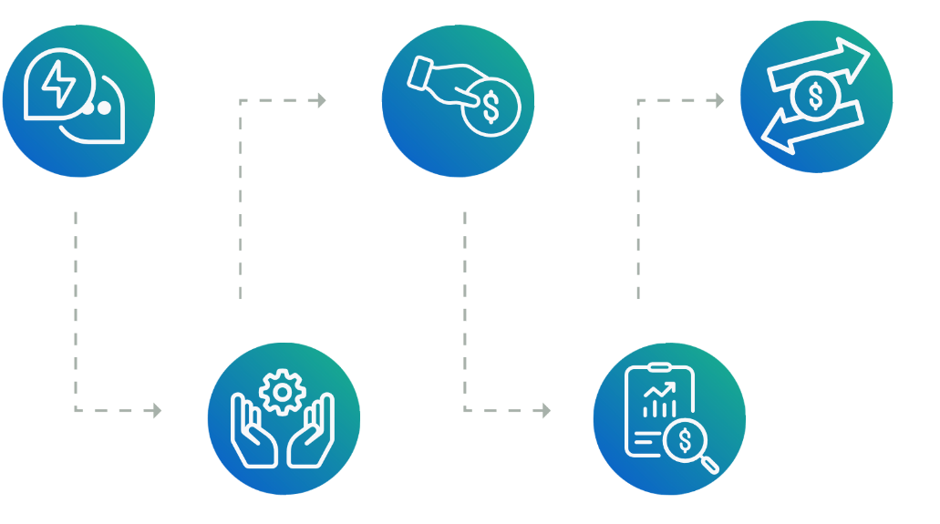

Review workflow
Patient Care
Physician documentation; CDI
Medical Necessity
Scheduling
Authorization
Medical Necessity
Billing / Patient Accounts
Bundling
Timely filing
Coordination of benefits
Patient Access
Authorization
Patient information accurate
Covered service
HIM/Charge Capture
Documentation
Coding

Slide 12

Accurate and Complete Documentation/Coding

Slide 13

Denials Prevention – Coding
Code to the highest level of specificity
Capture acuity by coding CCs and MCCs according to the updated coding clinics and coding guidelines
Look for missed documentation opportunities
Focus on DRGs with CC’s and MCC’s
Productivity is important, but quality is key
Develop a robust query process to prevent under-coding
Quality queries based on ACDIS query guidelines

Slide 14
Appealing Clinical Denials
© CorroHealth, Inc. 2024. All Rights Reserved.
14

Slide 15








Denials requiring appeal
Days, service level of care denied for no concurrent authorization
Claim denied for elective service without pre-authorization
Not a covered
service
Timely Filing
Charge/procedure as bundled

Slide 16

Appealing denials
Need a strong denials team to write the appeals letters
85 – 88% of denials is the recommended appeal rate

Slide 17





Tips to writing appeal letters
Appeal every case where there is documentation to support the original coding
Include Clinical and Coding Expertise to write the appeal
Include copies of the medical record where helpful
Include official coding guidelines
Include the credentials of those who have reviewed and are involved in the appeal
Keep the appeal letter concise to the reason for the denial
Include the pertinent record excerpts that support the appeal
17

Slide 18

Monitor, Track, Report

Slide 19





Monitor, Track and Report
Total denials
Total appeals
Cases not appealed and why
Total cases overturned and financial impact
Second-level denials
Failed appeals
Analyzing the trends allows you to educate and move from management of denials to prevention of denials

Slide 20
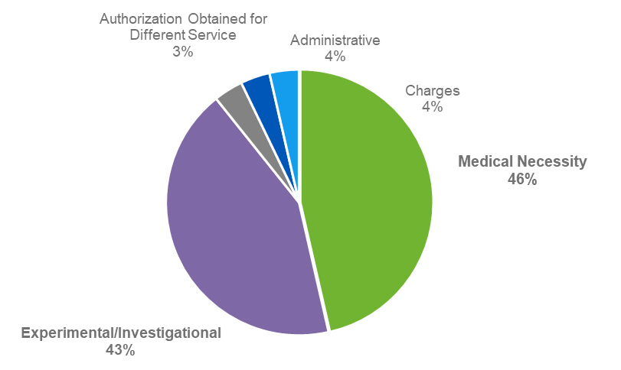
Monthly clinical denials
Denial Reason | Total # Accts | Acct Balance | % of Total Denials | % of Acct Balance
Medical Necessity | 13 | $58,512 | 53% | 46%
Experimental/ Investigational | 12 | $44,570 | 41% | 43%
Authorization Obtained for Different Service | 1 | $4,187 | 4% | 4%
Administrative | 1 | $1,287 | 1% | 4%
Charges | 1 | $1,113 | 1% | 4%
Grand Total | 28 | $109,668 | 100% | 100%

Slide 21

Education, Training, Continuous Process Improvement

Slide 22

Educate, Train, Report…..and Continuous Process Improvement
Regular coding audits
Review denials analysis data
Work together
Education – Physicians, Coders, Billers
Collaborate with Payors
Use the PEPPER report to proactively compare performance to other facilities
Engage in continuous process improvement

Slide 23


Next level - management to prevention
Transition to denial prevention for the 55% of denials that can’t be overturned
Departmental training
Engage clinical staff
HIM feedback
Build out front-end edits to stop denials before admission or service
23

Slide 24




In conclusion
Ongoing communication and collaboration
Consistent and timely review of denial data
Successful appeals letter writing

Slide 25



Thank you for your time.
Colleen Goethals, MS, RHIA, FAHIMA
cgoethals@xtendhealthcare.net

Slide 26
References
Success in Proactive Denials Management and Prevention, HFMA, May 1, 2021
Coding Denials: Effective Appeals HFMA March 1, 2021
Denials Management: Getting to the Root Cause, Denise Wilson & Tracey A. Tomak, November 2019
The State of Claims, 2024 Survey, Experian Health, June 2024
RCM Admin Tasks Driving Up Costs. Payer Tech to Blame, HealthLeaders, September 16, 2024
Mastering Denial Management Tactics for Maximizing Reimbursements, Medwave, March 14, 2024

Slide 27








About Xtend Healthcare
Senior management has an average of 30+ years experience in healthcare revenue cycle management
Heavy technology investment, ($120M annually), ensuring data security and compliance
Industry-leading, award-winning employee training
and education
Healthcare
is all we do.
Proven ability to
ramp up quickly
with new clients
Customer service approach that
enhances the patient experience
Blended
approach optimizes recovery and communication
Confidential and proprietary information © 2022 Xtend Healthcare. All rights reserved.
27

Slide 28

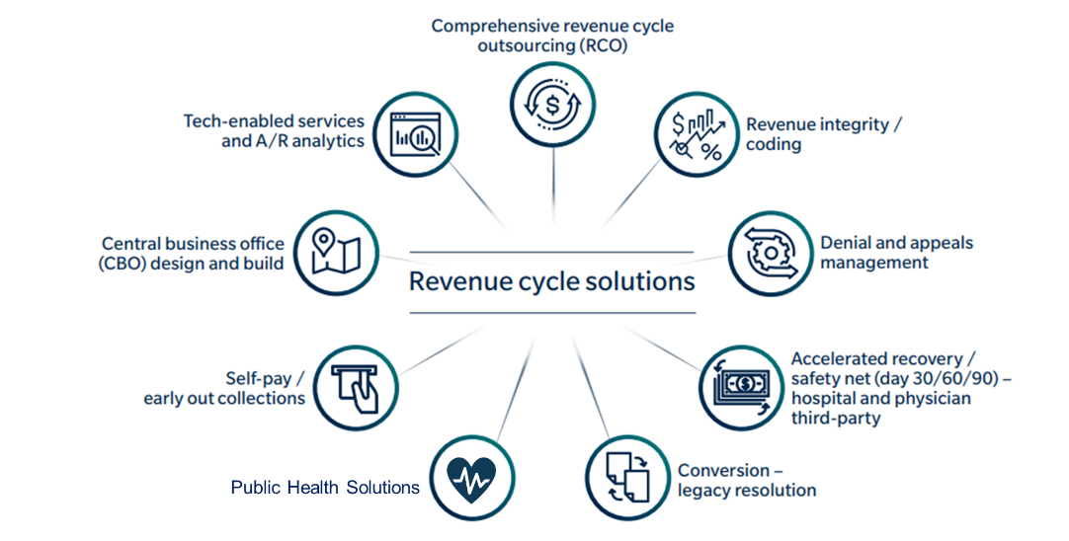

Xtend by the numbers
$12B+
net patient revenue
processed annually
3,200+
revenue cycle and public health professionals connected to our service centers as well as at our customer facilities
30+
years of revenue cycle experience
300+
contracts in 34 states
Solutions
5M+
inbound and outbound calls annually
3
US-based RCM service centers

