Slide 1
Building Your Bench
recruit
retain
develop
Bench Strength
Future proofing your team

Slide 2
Building Your Bench
What is bench depth?
“The quality and number of players available to substitute during a game.”
A lesson from professional sports:
Recruit talent
Focus on development
Foster winning attitude
Healthcare Translation:
Recruit, Retain, Develop
Succession planning
Healthcare is largest industry in the U.S.
One of the most challenging to recruit and retain

Slide 3
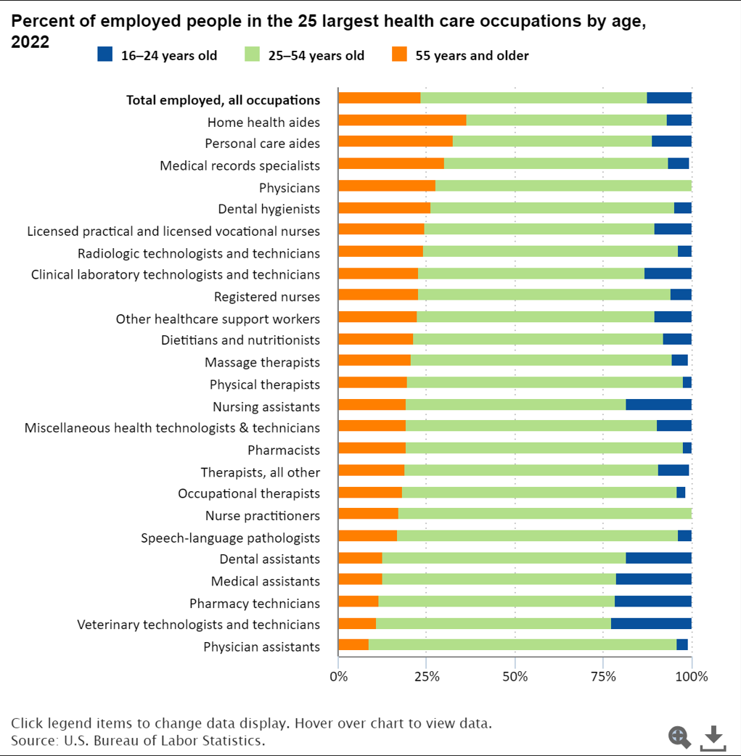
Aging statistics
23% of healthcare workers are >55
Skew older than national workforce: most between 35-54
6% of all healthcare workers are over 65
Average MD is 53.9
20% of MD workforce is 65 or older
22% are between 55 and 64
Projected shortage of 139,940 fulltime physicians by 2036
Median RN age is 46
>25% of RNs are planning to retire in the next 5 years

Slide 4
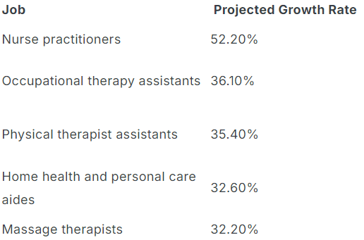
Nurse Migration
NPs expected to grow >52% over next decade

Slide 5
Culture and Values
Culture is key
Gallup: 70% of people will leave in the first year if they don’t know what their organization stands for and what makes it different
Values define culture and purpose
86% of millennials would consider taking a pay cut to work at a company that aligned with their values
Values define purpose
Purpose-oriented companies have 30% higher innovation
40% higher retention rates

Slide 6
Recruitment: Circle of Control
Out of our control:
Market
Geography
In our control:
Job descriptions: Wish lists vs necessities
Appropriate market analysis - are you competitive?
Creative benefits

Slide 7
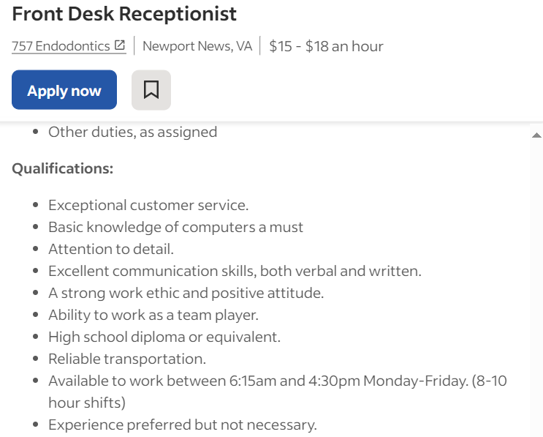
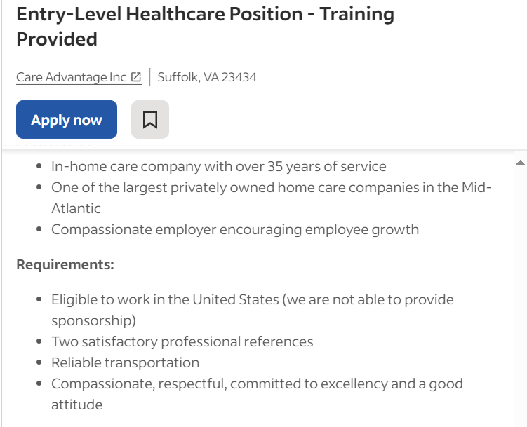
The Good

Slide 8
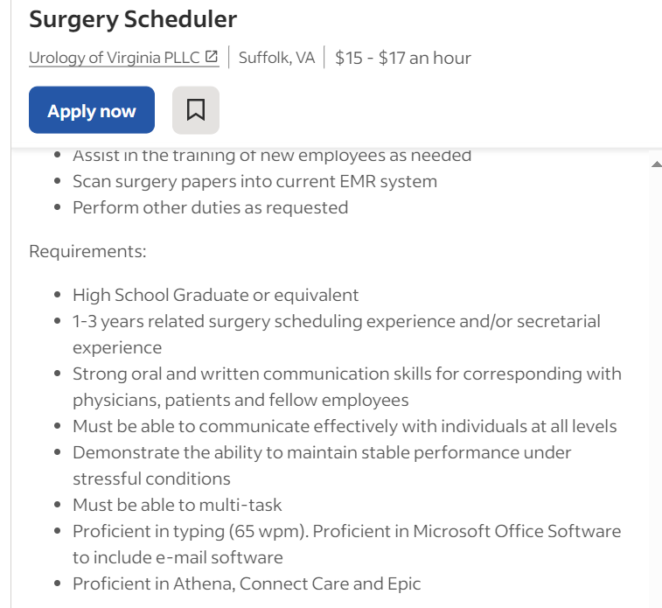
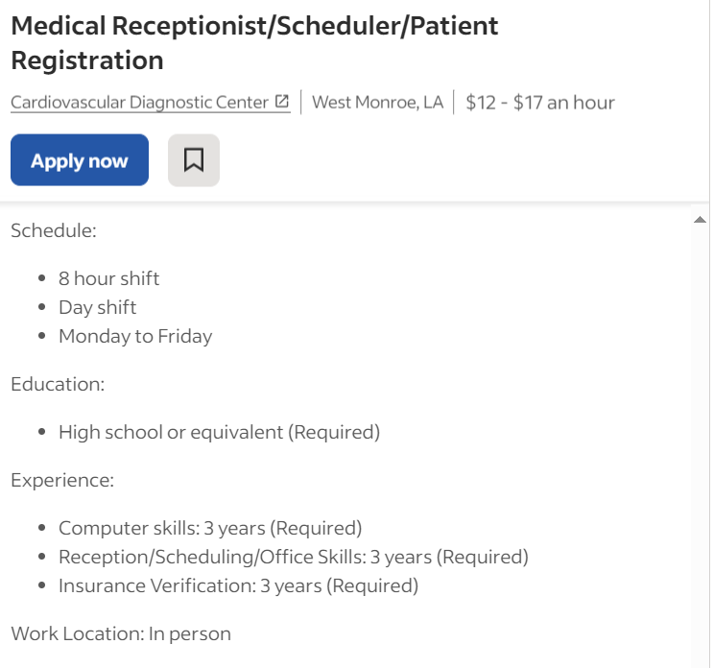
The Bad

Slide 9
Mentorship
Career Path
Career Ladder
Creative Benefits
Take a page from startups - what else can you offer?

Slide 10
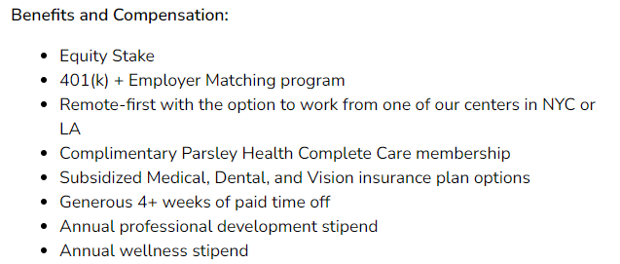
Parsley Health
Notes:
Holistic primary care startup

Slide 11
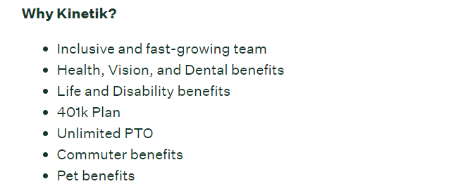
Kinetik
Notes:
non-emergency medical transportation start up

Slide 12
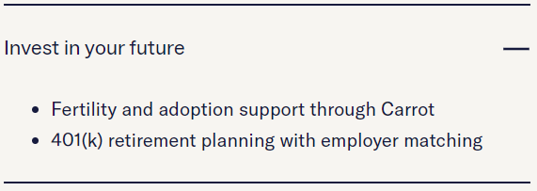
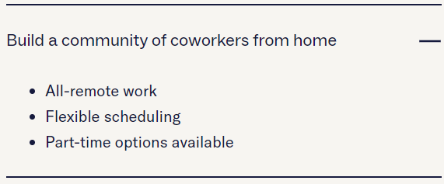
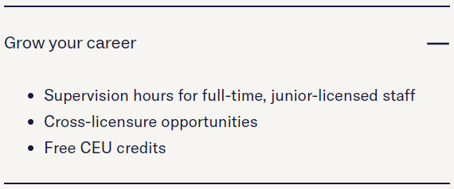
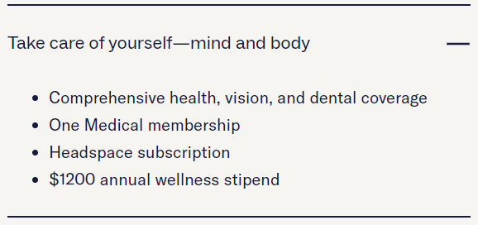
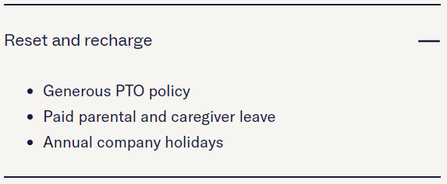
Charlie Health
Notes:
virtual mental health care specifically for teens and young adults

Slide 13
Connecting Metrics: Recruiting KPIs
Open position rate
Turnover of key positions
Time to fill
% of offer acceptance
Day 1 no show rate

Slide 14
Retention: Current State of the Industry
In the past 5 years:
Average hospital turned over 106.6% of its workforce
95.4% of all turn over is voluntary
Turnover rates:
20.7% for hospitals
National vacancy rate:
Turnover by tenure:
30.2% of all new hires left within a year – accounting for 40.4% of all healthcare turnover
62.2% of employees who left spent less than two years in their position
By region:
South-East U.S. has the highest regional turnover at 22.2%
North-Central U.S. has the lowest regional turnover at 19.0%
65% at-home care
94% nursing homes
U.S. average for all industries: 13.5%
20% of people, across all industries, leave in the first 90 days
RNs: 9.9%

Slide 15
Retention: Turnover Continued
Before COVID:
Over half of MDs and RNs reported burnout and exhaustion
During the pandemic:
93% of all healthcare workers reported high levels of stress
Average cost of turnover:
6-9 months' salary
Speciality turnover:
200% employee’s salary
Time to fill:
RN – average is 3 months
Med-surg RNs average 94 days

Slide 16
Retention methods
Build connections
30/60/90 check in and stay meetings
Identify those who are hungry
Career path - if you advertise it, fulfil it
Focus on development
Manage culture
Increase net promoter score
Current employees are best recruiters
Provide excellent Orientation
Formalize – checklist and timeline
Assigned preceptor

Slide 17
Connecting Metrics: Retention KPIs
Turnover rate
90 day turn over rates
1 year turn over rates
Employee engagement scores
How often do you survey?
Net promoter score
Average employee tenure
By company
By department

Slide 18
Development: Define Growth
Horizontal
New opportunities or departments at same leadership level
Vertical
Identify those hungry for upwards growth
Broaden
Expand current role
Depth
Increase expertise
Diagonal
Ex: change from staff to educator:

Slide 19

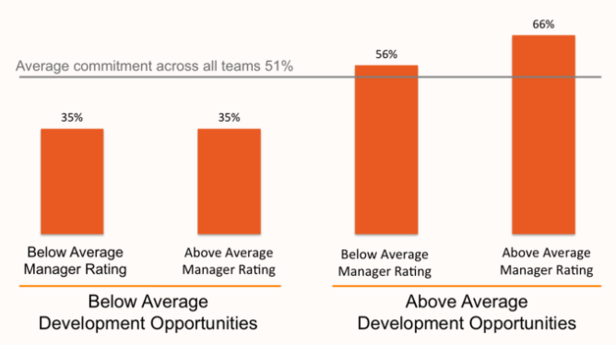
Why do people leave jobs?
Development
Bad manager – 12%
Bad pay – 11%
Poor leadership – 28%
Lack of development opportunities – 52%
In companies with fewer development opportunities – management made no difference!

Slide 20
Build Your Bench: Culture
Diversity
Humility
Does your culture encourage growth?
Only weeds grow in rocky crevices
Modelled at all levels
Cannot have a team of running backs
Relationships
Create connecting moments
Skill
Competence
Growth
Leadership
Continuity and clarity
Allow leaders to emerge and contribute at all levels
AND ensure leaders pour into them
Bring in people with capacity for growth

Slide 21
Build Your Bench: Culture Continued
Who is hungry?
Who raises their hand?
Stretch opportunities
Do people have opportunities to learn or try something new?
Integrate growth
Dedicated time to classes/courses or development activities
Promotion opportunities:
Not based on longevity
Training and coaching
Talent needs to be developed!
Who goes above and beyond?

Slide 22
Build Your Bench: Connecting Moments
Create connecting moments
Do people like each other?
Remember – it’s all about relationships
Are we siloed?
Do people have opportunity to get to know other departments
Are we hoarding talent?
Grow talent for your system, not your department
Want organization loyalty, not department loyalty

Slide 23
Take care of your people, and your people will take care of your outcomes
How are you taking care of your people?
Prioritize mental health
Work life balance
Address micromanaging

Slide 24




Build Your Bench: Mapping Your Team
Unhappy / Disengaged
Unhappy / Engaged
Toxic – coach them up or coach them out
Happy / Disengaged
Minimum productivity.
Rock Stars
Monitor morale and culture. Could be worker bees or pot stirrers.
Character: are they just a scrooge?
Promotion pool
Check for unmet needs: tech, comfort, shifts, balance.
Discover their motivation: surveys, check in and stay interviews
Happy / Engaged
Don’t neglect other quadrants to focus on them.

Slide 25
Great leaders equip others
Teach the ‘why’
Need greater meaning and purpose
Culture of coaching
Or do we give feedback annually?
Mentoring
Do current leaders know how to mentor
Reward those who excel
Requires culture of innovation
Release people to lead
Freshmen need to play, too

Slide 26
Succession Planning
Be Open
Transparency leads to trust
Don't make developing leaders a secret
Clearly communicate expectations
Ensure people know the development opportunities available to them

Slide 27
Connecting Metrics: Development KPIs
Rate of internal vs external hires in management positions and above
Indicates your bench depth, not to be used as a benchmarking tool
Don’t force a square peg in a round hole!
Pre and post promotion surveys
Self-rated readiness scores - should go up post promotion
Manager rated - should also go up
If these go down, start asking questions
Key drivers in engagement surveys
My manager treats me with respect
My manager cares about me

Slide 28
To Do List: Recruit, Retain, Develop
Adjust your job descriptions
Offer creative benefits
Prioritize culture: Be the place people want to work
Build development into the foundation of your organization
Develop the talent on your team

Slide 29
Thank you. Questions?
Connect with me on LinkedIn: Tabitha Hapeman
Upwards: 10 Essential Lessons is now available on Amazon

