Slide 1
COMPLIANCE ISSUES IN REVENUE CYCLE: TRENDING ISSUES
North Carolina HFMA Summer Meeting
August 23, 2024
Tracy M. Field

Slide 2
Agenda
Trending Issues:
  COVID 19 Audits
  Department of Justice Initiatives
  Artificial Intelligence
  … Supreme Court Rulings

Slide 3
COVID-19 Audits
Misspent Funds?
  Single Audit Findings
  OIG Report: Add on Payments for Covid Lab Tests
    “CMS Requirements related to supporting documentation for add-on payments were vague,…”
    CMS needs to perform audits/ oversight
  OIG Report: Overpayments in Phase 2 General Distribution
    Incorrectly calculated patient revenues
    Failure to account for previous payments for all subsidiaries

Slide 4
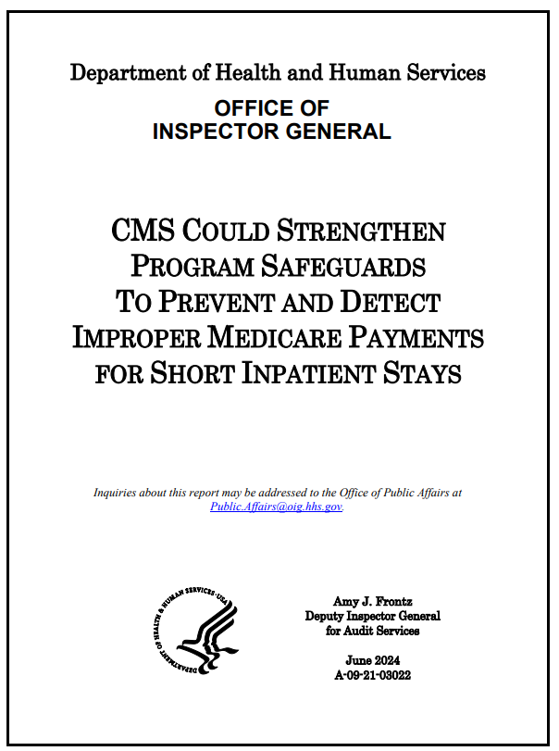
OIG Report: Short Stays
OIG recommended CMS “update policies and procedures for postpayment reviews to focus on claims for short inpatient stays identified as at risk for noncompliance with the two-midnight rule and to focus on overpayment recoveries”

Slide 5
Artificial Intelligence
Use in Coding and Auditing Functions?
  AI (with machine learning) to code/ create algorithm
  Reduction in manual reviews?
    Will this “catch” all CC’s and MCC’s?
    Unbundling codes
    Upcoding
    Check for NCCI edits
    Appending modifiers
  Testing for accuracy/ pilot first

Slide 6
Artificial Intelligence
Use in Denials Management?
  Root cause analysis
    CAVEAT: Recall the 60-day Rule
  Appeals generated automatically?
  Test for accuracy/ pilot first

Slide 7
Artificial Intelligence
Use by MAOs to deny claims
Litigation
  Estate of Gene B. Lokken et al. v. UnitedHealth Group, Inc. et al. (MN)
  Barrows et al. v. Humana, Inc. (KY)
    Complaints allege that these MAOs are using an AI tool, nH Predict, to make coverage determinations that are not based on individual patient needs
    Stay tuned…

Slide 8
Artificial Intelligence
Used to phish? Ransomware?
  Imitating voices?
  Imitating writing style
  Creating fake calls/attendees?

Slide 9
Stark Law Enforcement
More settlements in 2023
Payment to physicians in alleged violation of Stark Laws serve as basis for False Claims Act settlements
  Is compensation at or below 75%ile acceptable?
  Can use business judgment as part of valuation
  Can be “commercially reasonable” even if no profit to the entity

Slide 10
DOJ Initiative – August 1, 2024
New Pilot Program for Corporate Whistleblowers
  Gap filling in existing federal whistleblower programs
    For crimes involving financial institutions
    Foreign corruption involving private companies
    Domestic corruption
    Health care fraud schemes targeting private insurers that are not subject to qui tam recovery…..
    Caveat: Federal legislation may be required…..

Slide 11
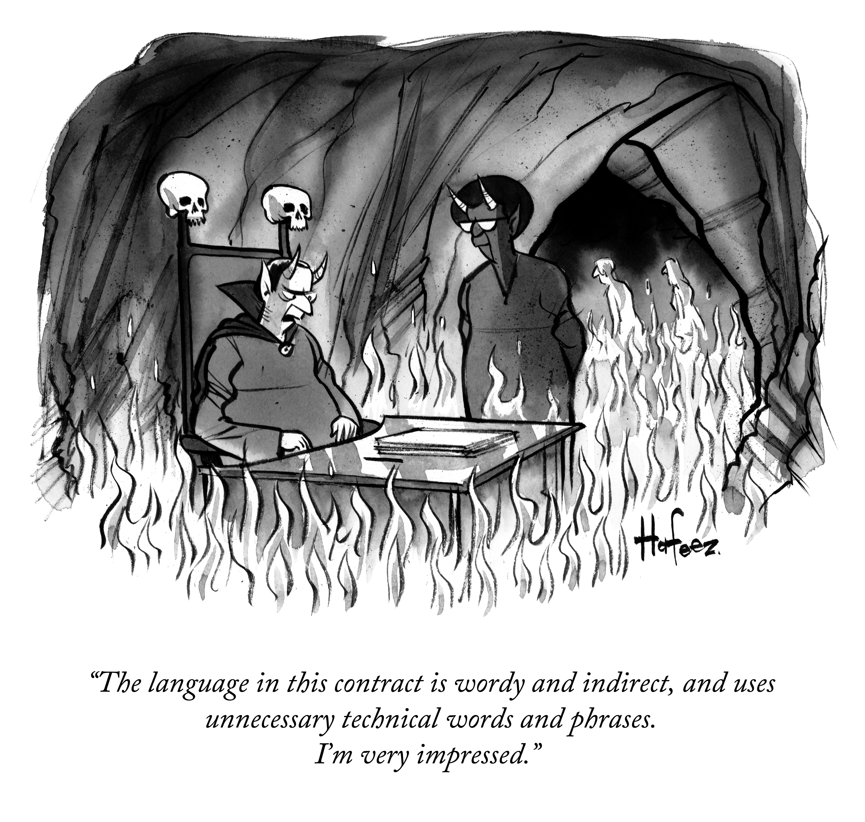

Slide 12
Recent Supreme Court Decisions
Loper Bright v. Rainondo 144 F.Ct. 2244 (603 U.S. ___) (2024)
Published June 28, 2024
The “Chevron Defense” used by the government is invalid …
Implications for Providers

Slide 13
Chevron: 1984 Decision
Deference to federal agencies to interpret statutes
Standard to overturn a regulation: Had to demonstrate that the Agency’s final regulation was
  Arbitrary or Capricious
  Now, the Court says NO DEFERENCE to Federal Agencies

Slide 14
Loper Bright Standard
Step 1: Whether Congress directly spoke to the precise question at issue
Step 2: If not, defer to agency if offered permissible construction
  The validity of regulatory action is a legal issue, for judges to decide
  Agencies “have no special competence in resolving statutory ambiguities. Courts do.”
Considerations:
CMS Program Manuals? Interpretive Guidance?

Slide 15
Compliance in Revenue Cycle
NO ONE KNOWS, but …

Slide 16


Slide 17
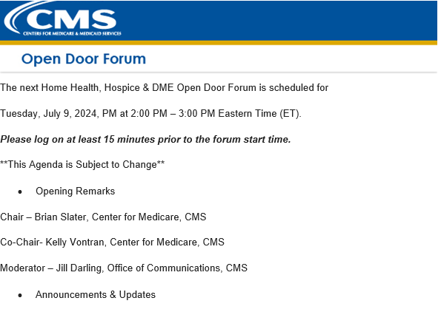
Compliance for Revenue Cycle

Slide 18
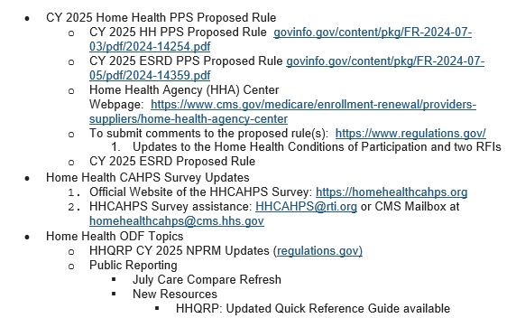
Compliance for Revenue Cycle

Slide 19
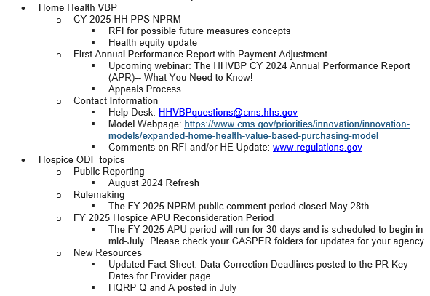
Compliance for Revenue Cycle

Slide 20
Compliance for Revenue Cycle
Litigation Favoring Providers: No Surprises Act
Texas Medical Association v. DHHS – vacated regulations regarding arbitration metrics to be used in Surprise Billing negotiations
Congress Listed factors to be considered, making clear QPA not determinative
Under Step 1 of Chevron- Judge Agreed that Congress made clear, did not delegate to federal agency to change

Slide 21
Compliance for Revenue Cycle
Medicare Advantage payments
Can you become a Critical Access Hospital
Nursing Home Staffing Regulation
FDA decisions on lab testing or devices and drugs?
340(b) payments
Home health reimbursement – payment for staff?
Quality metrics for reimbursement?
Telehealth?

Slide 22
Compliance for Revenue Cycle
Contrast: Medicare Fee Schedule
  New standards for Maternal Health in Fee Schedule
Congress must specifically defer to Agency expertise to continue as in past
  Else……

Slide 23
Compliance for Revenue Cycle
No Surprises Act
  Heavily litigated issues
  Reliance on Qualifying Payment Amount by IDR entities
  Failure to report QPAs timely (!)
  HHS audit to protect consumer… not a finding if the provider shorted (!)
  Delayed reviews …. however

Slide 24
Compliance for Revenue Cycle
No Surprises Act
HHS reports on outcome of NSA Independent Dispute Process
Reports issued for 6-month periods, including all of 2023
  First 6 months of year, 288k disputes filed – mostly by same parties/ entities
  In that period, IDR entity decided 83k cases…
  Delays caused by confusion over whether dispute eligible for IDR
  Most cases involved ED (68%) and radiology services (17%)
    Providers prevailed in 77% of cases!!

Slide 25
Compliance for Revenue Cycle
No Surprises Act
HHS reports on outcome of NSA Independent Dispute Process
Reports issued for 6-month periods, including all of 2023
  Last 6 months of year, 390k disputes filed – mostly by same parties/ entities
  In that period, IDR entity decided 83k cases….impacted by litigation changing the standards
  Delays caused by confusion over whether dispute eligible for IDR
  Most cases involved ED (60%) and radiology services (17%)
  Providers prevailed in 82% of cases!! (and higher than the QPA)
    Use OON rates to benchmark offers

Slide 26
Compliance for Revenue Cycle
2024 Medicare Advantage and Part D Final Rule (CMS-4201-F)
CMS clarified:
  Two midnight applies to MAOs
  MAOs must comply with NCDs, LCDs, and general coverage and benefit conditions set forth in traditional Medicare laws
    MAOs may create internal coverage criteria only when coverage criteria are “not fully established in applicable Medicare statutes, regulations, NCD or LCD” and must make such internal coverage criteria publicly accessible
      Rule should help in appeal of denials???

Slide 27
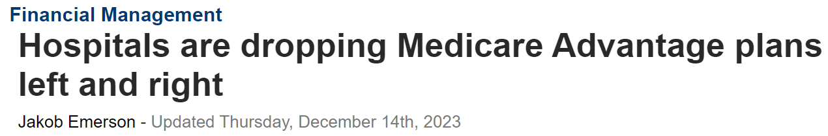
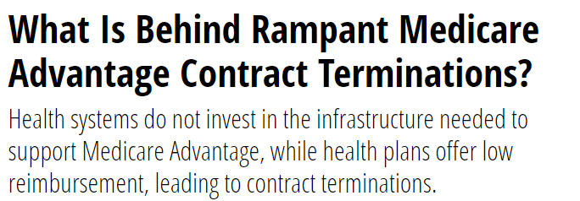
Compliance for Revenue Cycle
Continuing payment disputes between MAOs and providers
  Contract terminations

Slide 28
Overpayment Analysis – 60 Day Rule
Universal States ex rel. Schutte v. SuperValu Inc., 598 U.S. 739 (2023)
  What matters for an FCA is whether the defendant knew the claim was false
  In other words, subjective versus objective
    Challenge: Difference in Voluntary Repayment versus FCA investigation?

Slide 29
Overpayment Analysis – 60 Day Rule
Was LCD satisfied?
  What is the impact of an LCD in view of recent Supreme Court decisions?
  Voluntary repayment standard compared to knowingly filing a false claim…..

Slide 30
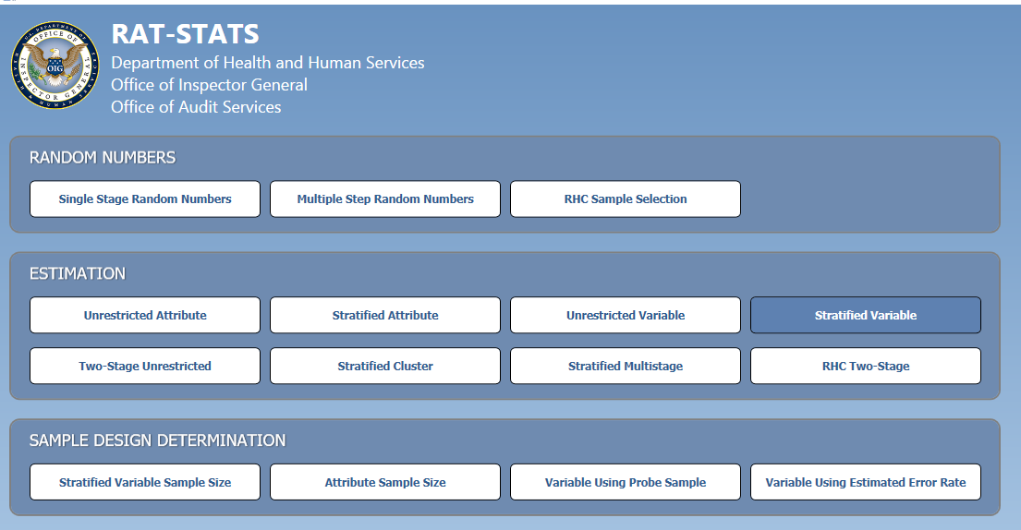
Understanding RAT-STATs
Considerations for Challenging Government Audsits – RAT STATS

Slide 31
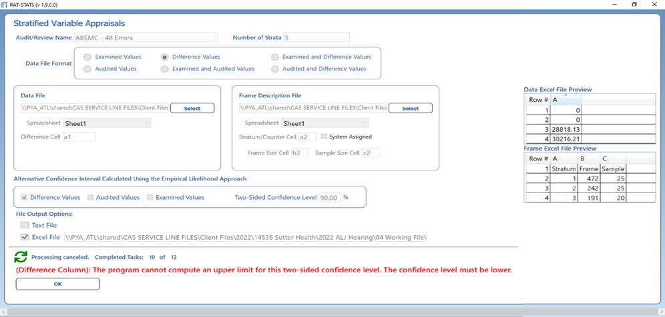
Understanding RAT-STATs
Considerations for Challenging Government Audsits – RAT STATS

Slide 32
Compliance for Revenue Cycle
Statistical Extrapolation and Due Process
  Goose Creek Physical Medicine v. Becerra (2024)
    Must have the UNIVERSE of claims to ensure administrative record complete
    FINALLY!

Slide 33
What is Error Rate Threshold?
Error Rate?
  See Merit Leasing Co., LLC v. Becerra, 2023 WL 8357441 (N.D. Ohio Dec. 1, 2023)
    Government extrapolated based on an error rate of 93%; at the ALJ level, error rate was reduced to just 21%
    After government still insisted on extrapolating, provider appealed in federal court. Government’s attempt to dismiss for failure to exhaust administrative remedies was denied because exhaustion would have been futile
Inter-rater reliability issues

Slide 34
Enrollment, Exclusion Challenges
CMS’ enrollment/ CHOW process – challenging
Recent activity in EXCLUSIONS
  Obligation to refund for excluded provider?
  Fact-basis for consideration
    Basis for Exclusion – OIG mandate or permissive?

Slide 35

Questions?
Tracy M. Field | Partner
tfield@phrd.com
D: (404) 420-1146 F: (404) 522-8409
303 Peachtree Street, N.E. | Suite 3600 | Atlanta, Georgia 30308

Slide 36
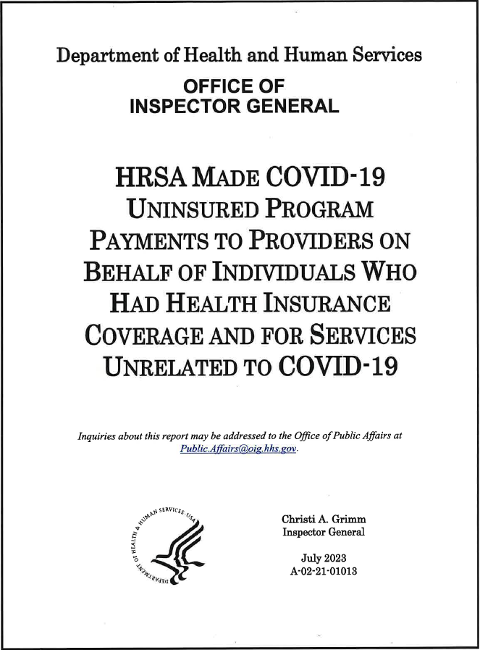
Insert Title

