Slide 1
Building An Exceptional Patient Financial Experience
NCHFMA – Summer Meeting
August 21, 2024

Slide 2

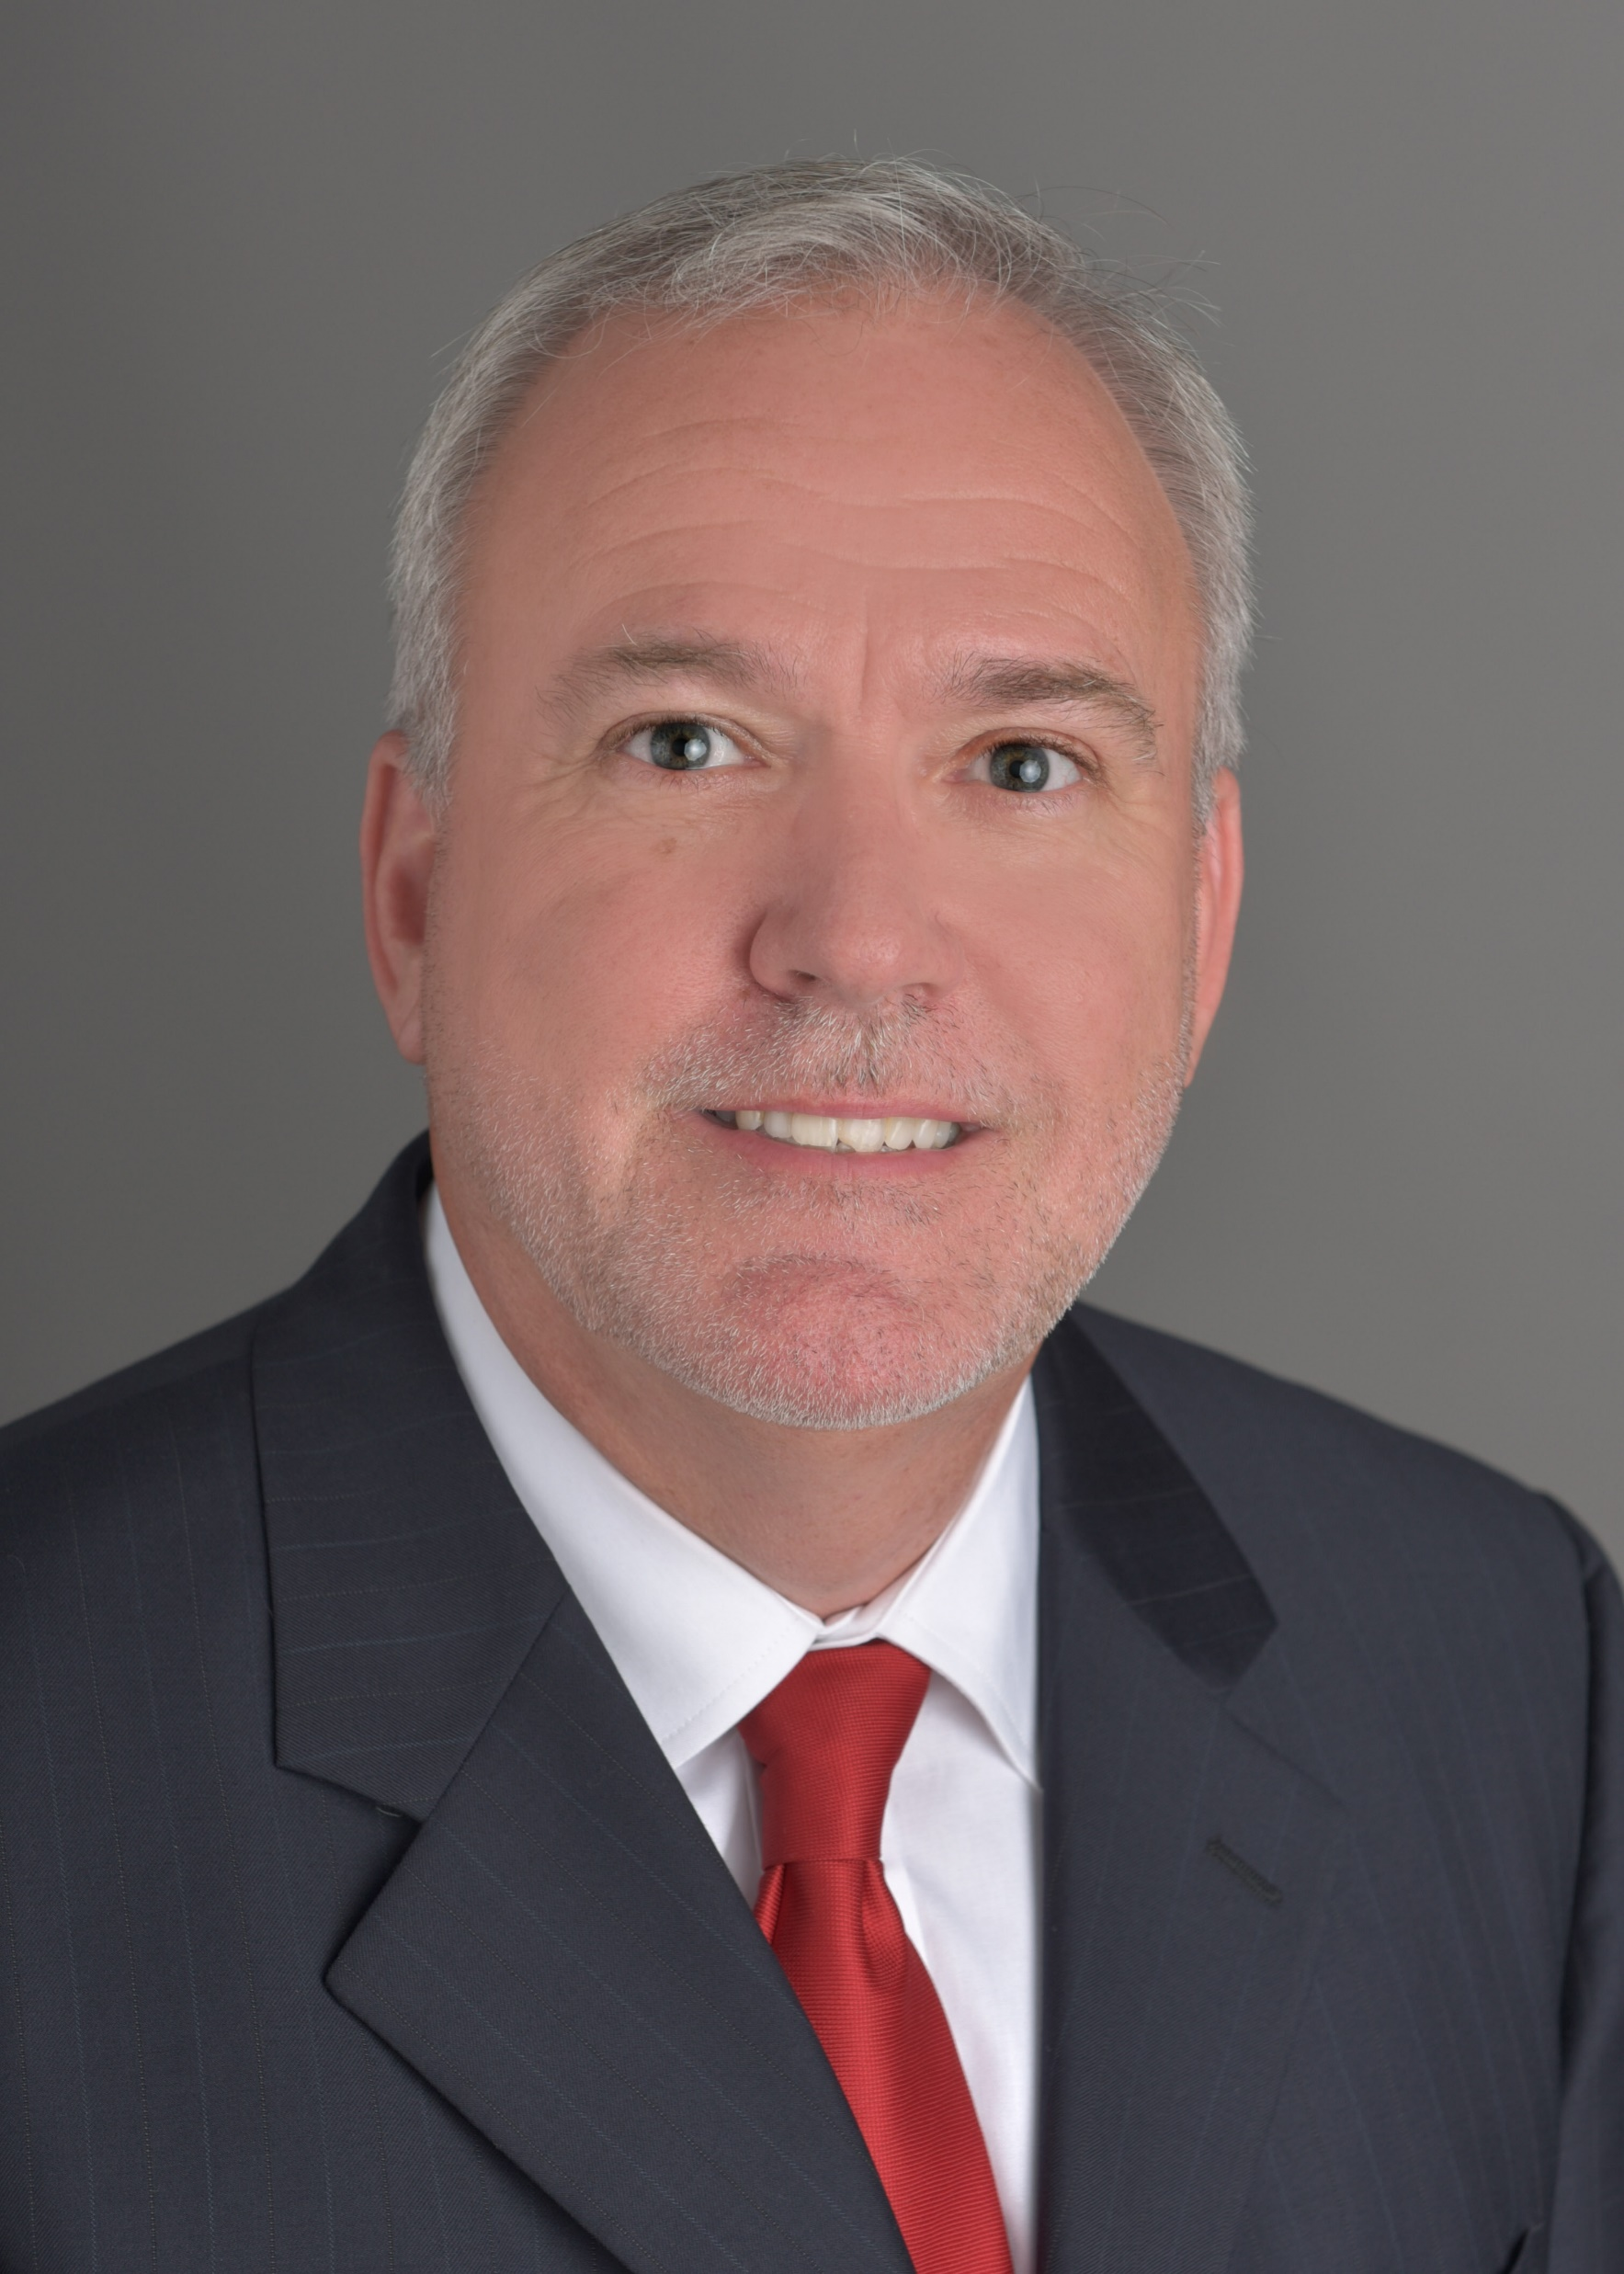
Meet The Speakers
Jonathan Johnson - currently serves as the leader of the Enterprise Pre-Arrival teams for Advocate Health. In this role he is responsbile for the pre-service functions for hospital-based encounters, revenue cycle scheduling, and policies and procedures for all of patient access. Jonathan is the operational leader responsible for the Epic estimator for all encounters.
Prior to his current role Jonathan was the patient access Director for the Western Division. In addition to his facility responsibilities, he led the patient access analytics teams and Epic optimization projects. Highlights of that work include implementing ED self-registration, e-check for hospital-based encounters, daily teammate scorecards, monthly facility scorecards, and mobile printing in the ED.
Chris Johnson - has been employed in the healthcare finance field for more than 30 years. During this time Chris has worked in multiple environments including sole community providers, an academic medical center and in integrated healthcare delivery system. He is employed by Advocate Health in Charlotte as Vice President Patient Accounts Services – Vendor Management. In his current role, Chris oversees Customer Service, Self-Pay AR and Vendor Management.
Chris is a Fellow in the Healthcare Financial Management Association and an active member of the North Carolina Chapter of HFMA where he has served in numerous leadership positions including Chapter President. Chris has also worked with National HFMA on the Board of Examiners, National Advisory Council, Regional Executive for Region IV, and the Chapter Advancement Team. In 2017 Chris was awarded the Fredrick C. Morgan Award, National HFMA’s highest member award for outstanding service and achievement. Chris received his Bachelor’s degree in Business Administration from Montreat College in Black Mountain, North Carolina, and is certified in Epic Resolute Hospital Billing and Single Billing Office Administration.
Notes:
Austin

Slide 3



A Combination of Four Legacy Institutions Who Joined Forces
to Chart a New Future Together
Established December 2, 2022

Slide 4
NC
SC
40 Hospitals
GA
AL
600 Sites of care
11K Doctors
20K Nurses

Slide 5


WI
18 Hospitals
11 Hospitals
230 Sites of care
235 Sites of care
IL
4,400 Doctors
7,400 Doctors
11K Nurses
11K Nurses

Slide 6

Greater Reach – Greater Impact
Milwaukee
Chicago
Winston-Salem
Charlotte
Atlanta
Birmingham
Charlotte, NC
Headquarters
Wake Forest University School of Medicine
Academic Core

Slide 7
Where Bigger Meets Better
Empowered to do more as an integrated system
5.4M
Unique Patients
$31.7B
Revenue
$6B+
Community Benefit
158K
Teammates
42K
Nurses
5.5K
Advanced Practice Providers/Clinicians
1K+
Sites of Care
69
Hospital Locations
23K
Active
Medical Staff

Slide 8
Disclaimer
Information shared in this session is for educational purposes only and is not intended to be an endorsement of any specific process, product or business partner. Views expressed by the presenters are their own and are derived from industry knowledge and years of experience.

Slide 9
Patient Financial Pressures
Patients are facing major financial challenges
Inflation is at levels not seen in forty years
85% of the US workforce has a deductible greater than $1K (2022 KFF Employer Health Benefits Survey)
Patient out of pocket healthcare expenditures exceeded $471.4 billion in 2022 (CMS)
Average US family spends 11% of it’s income on healthcare expenses (2020 KFF)
Half of adults say it is difficult to afford health care cost, including large shares of the uninsured, Black and Hispanic Adults, and those with lower incomes (2024 KFF)
1 In 4 adults report putting off health care because of cost (2024 KFF)
Notes:
JR

Slide 10
Provider Financial Pressures
Health Systems Continue to Fact Rising Cost, Economic Pressures
Economy-wide inflation grew by 12.4% between 2021 and 2023, more than double the 5.2% growth in Medicare reimbursement for hospital inpatient care.
Hospitals and health systems incurred significant underpayments for several essential and complex health care services in 2023
Hospitals and health systems face mounting administrative burden and cost due to certain commercial health insurer practices like prior authorization and denials.
Increasing drug prices and workforce challenges continue to cause hospitals financial stress:
In 2023, the median annual list price for a new drug was $300,000, an increase of 35% from the prior year.
2023 saw the most drug shortages in over a decade, there were an average of 301 drugs in shortage per quarter, an increase of 13% from the previous year.
Hospitals’ labor cost, which on average accounts for 60% of a hospital’s budget, increased by more than $42.5 billion between 2021 and 2023.
AHA Press Release – Washington, May 2, 2024
Notes:
JR

Slide 11
It’s time for providers to meet patients where they are, not where we want them to be!
Notes:
Austin

Slide 12
What Consumers Want Now: Clear Communication

Slide 13
How We Deliver-Pre-Arrival
Pre-registration at scheduling
Sets our teams up for a fast and accurate estimate
Redirects out of network patients at the point of scheduling
Did I mention we knock out the MSPQ while the patients on the phone?
Estimates sent to the patient
75% of the time in seconds via auto finalization
Within three days for all other estimates (not just self-pay)
90% of consumers say it is important to know how much they will owe before a provider visit *
* J.P. Morgan Healthcare Payments Fourteenth Annual Report

Slide 14
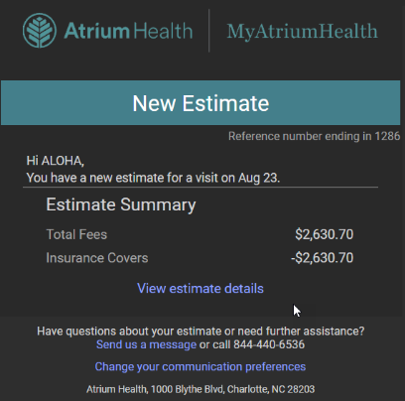
Estimate Automated Notifications
Patients are notified of their estimated amounts due within seconds of estimate finalization:
Alerts for all regardless of MyChart status
Alerts are triggered by both Epic estimate finalization and our third-party estimator
Alerts are sent to patients via text, push messages, and email
Notes:
Updated for week of 4/28

Slide 15
How We Deliver-Post Service
Single statement for hospital and professional billing where possible
Clarity on statements of what’s expected from them

Slide 16
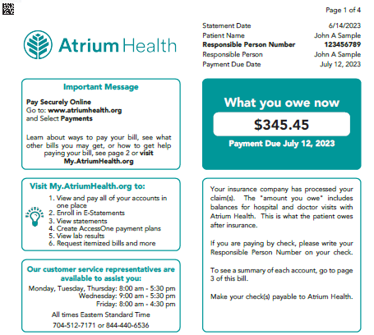
Statement Clarity
Notice Key Elements of First Page
Total balance due
Payment Due Date
Clarity that insurance has processed and paid their balance
Address to pay online (our preference)
Where to find additional information
Website
Customer Service

Slide 17
Billing Notification
Notifications are generated from Epic to advise a patient of changes in their billing process:
New balance – when an initial balance becomes guarantor responsibility
Balance Updates - when a guarantor’s balance increases or decreases
Statement
Hospital Account Detail Bill
Guarantor Account Detail Bill
Payment Processed
New Estimate

Slide 18
How Are They Generated?
Messages generate (via e-mail and text) at different times:
New balances – message sent the morning after an initial balance becomes guarantor responsibility.
Guarantors will only receive balance increased messages once every seven days.
Balance decreased messages will go out immediately.
Payment Processed – generates after the payment has posted. Occurs immediately.
New Detail Bill (HAR or Guarantor) – message sent immediately after the detail bill is generated.
New Billing Letter – message sent after the letter is generated.
New Estimate – generates immediately after estimate is finalized.

Slide 19
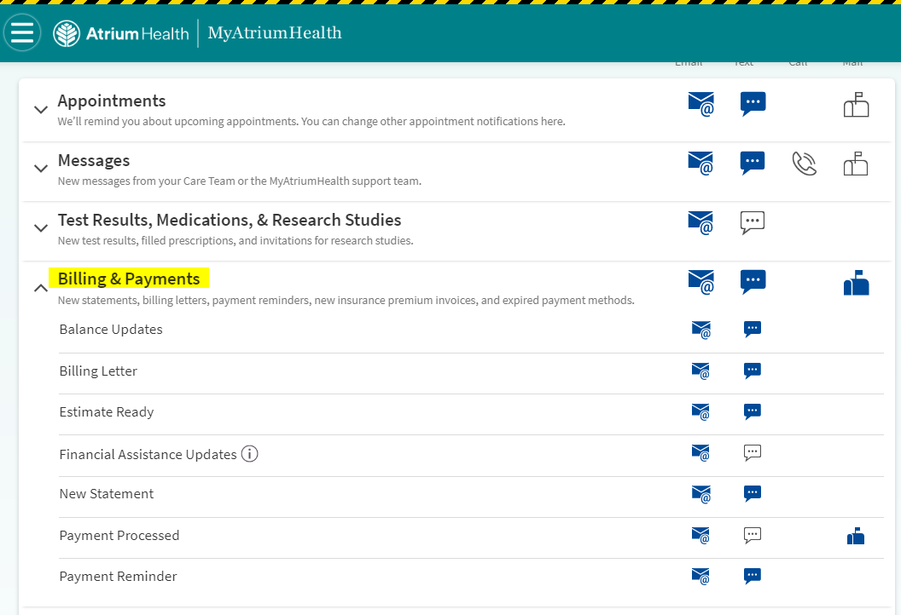
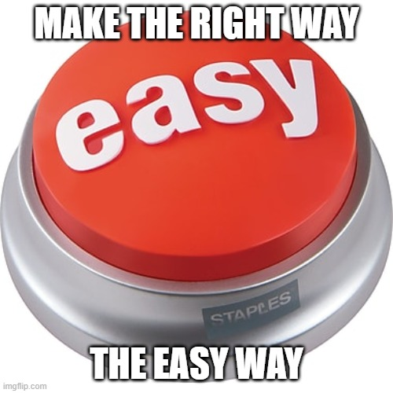
Consumer Control
Patients should be able to:
Determine which notifications they would like to receive,
Discontinue notices
Chose the communication method – text or email.

Slide 20
What Can We Learn From Others
Wells Fargo's ATMs Know You Better

Slide 21
What Consumers Want Now: Convenient ways to pay their outstanding balance

Slide 22
How We Deliver Pre-Arrival
Pre-Arrival
Pay in MyChart from the estimate notification
Pay our patient advance payment team when they call you
Pay via e-check in
Pay at check-in with our kiosk or friendly staff

Slide 23
Pre-Arrival Payments at a Glance
Advance patient payment team: 22 FTEs generating about $1.8 million a month in payments over the phone from outbound calls to patients
E-check In:
Offered to about 63% of our HB patients
About 40% complete E-check in
E-check in collects about 36% of the dollars requested from the patient
E-check in collects some portion of the balance due on 68% of accounts

Slide 24
How We Deliver Post Service
Post Service
Multi-channel options
Patient Portal
Text to pay
Visit auto pay
Google pay
Apple Pay
Customer Service Live Agent
IVR
Mail
Industry trend - 66% of providers are prioritizing the increase of online, automated and self-service payments *
* J.P. Morgan Healthcare Payments Fourteenth Annual Report

Slide 25
Technology Win-Win
Visit auto pay allows self-pay payments to be collected automatically
At check-in patients can provide a credit card/bank account and consent to be automatically charged up to a certain dollar amount for their visit
The self-pay amount is collected after insurance resolution, eliminating any burden on the provider and patient
Automatic emails and texts keep the patient informed of payment activity
Eliminates cost of billing patients after service is provided
Notes:
CJ

Slide 26
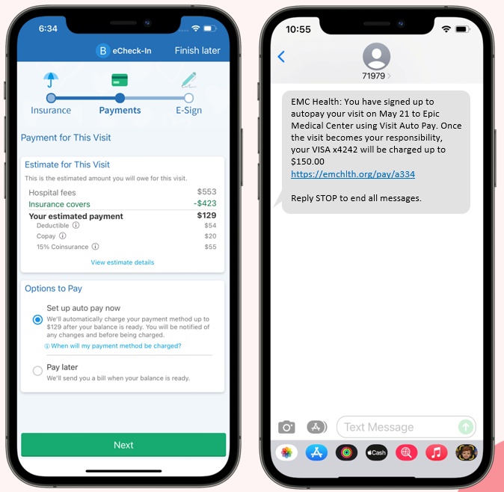
Visit Auto Pay
Card on file is charged once insurance resolves
Benefits:
Provides our patients another option to resolve balances
Reduces operational cost for the organization

Slide 27
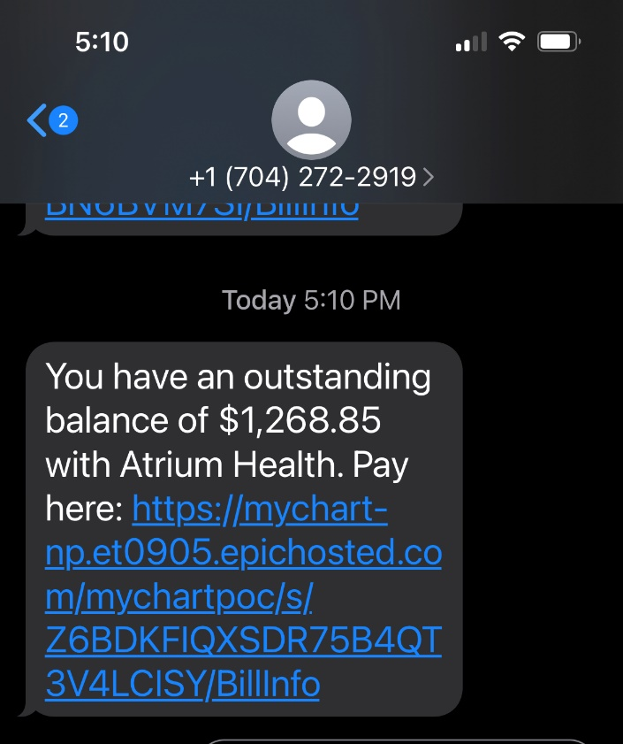
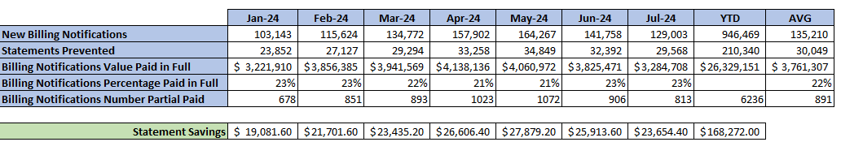
Text To Pay
Another technology win-win

Slide 28
What Consumers Want Now: Reasonable payment plans

Slide 29
How We Deliver Pre-Arrival/Arrival
Front end:
Information about available options is discussed as needed/requested
Brochures with information at front desk

Slide 30
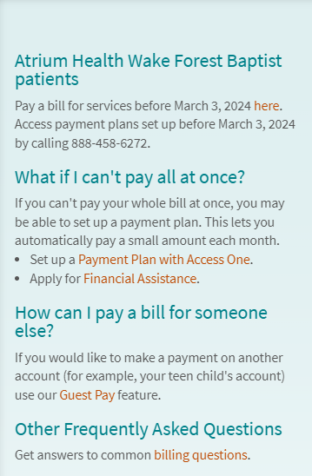
How We Deliver Post Service
Ability to self-serve to establish a payment plan
Access to Customer Service when assistance is required
Ability to have a single payment plan for hospital and professional services
Repayment time lines which increase as the outstanding balances increase
Payment plans available to all patients – no qualification process
Research indicates 62% of consumers pay recurring bills online when the amount is due *

Slide 31
What Consumers Want Now: Access

Slide 32
How We Deliver Pre-Arrival
Front end:
Patient facing estimator tool
Call center for scheduled patients and shoppers
Chat functionality from our estimation notification and our website home page to connect with our staff (goes live 8/22)

Slide 33
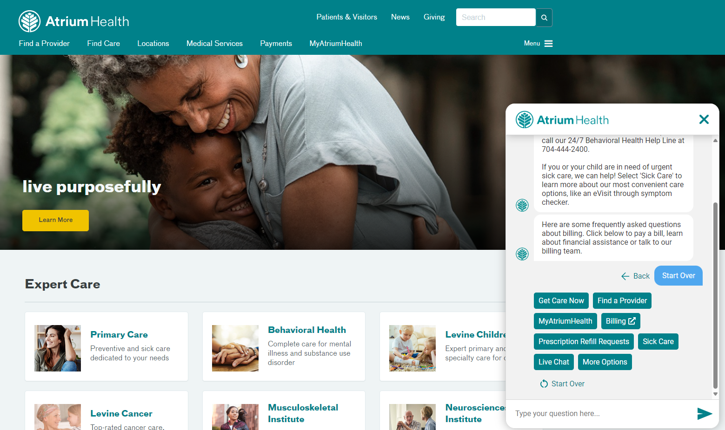
Future Chat Functionality (8/22)

Slide 34
How We Deliver Post Service
40% of providers are prioritizing patient education of collections and healthcare payments *
How we deliver:
Access to our customer service call center where patients can have questions related to their questions on hospital or professional balances answered
24-hour access to our phone system IVR
Real time chat capabilities (during call center hours)
* J.P. Morgan Healthcare Payments Fourteenth Annual Report

Slide 35
Tips for Engaging Patients Electronically

Slide 36
Paperless – Non-MyChart Users
Guarantors with valid email or mobile phone numbers:
Will get notification by email, mobile or both
Will not apply to customers who have already turned off this functionality
Can opt out by:
Calling Customer Service
Clicking on the link in email notification, validating identity and clicking on paperless
Why are we doing this?
Reduce carbon footprint of the organization
Reduce statement costs for the organization
Reduce lost mail
Reduce the time it takes for guarantor to receive statement
Provide guarantor safe/secure payment method

Slide 37
Paperless – Non-MyChart Users
What happens if they don’t pay?
Guarantors with a statement that contains any account with a Self-Pay Follow-Up level of 3 (past due) or 4 (final notice) will be sent on paper
Guarantors will still receive the notification with the link to pay
Note of Interest:
Moving MyChart users to opt out of paperless statements beginning November 2022 has saved $473,000 through august 21, 2024.

Slide 38
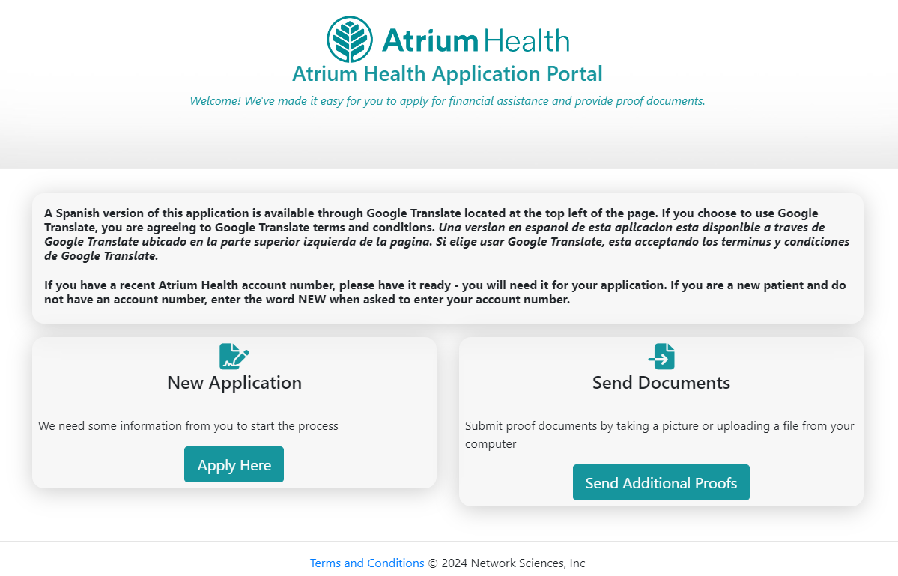
Technology – Win-Win
Online Financial Assistance Application launched August 2022
13,000 applications received to date
85% electronic approval rate
Aligns with manual submission rate
Eliminated approximately 1,083 worked hours

Slide 39

Utopia vs. Reality
Pre-Registration Complete
Insurance Verification Complete
Authorization, if Required, Complete
Patient Estimate Complete
Patient Out of Pocket Collected
If Only ……………………………….

Slide 40
When Reality and Utopia Diverge
In the end it all comes back to people. Having the people ready to guide the patients back to utopia requires:
Strong hiring practices
Exceptional training

Slide 41
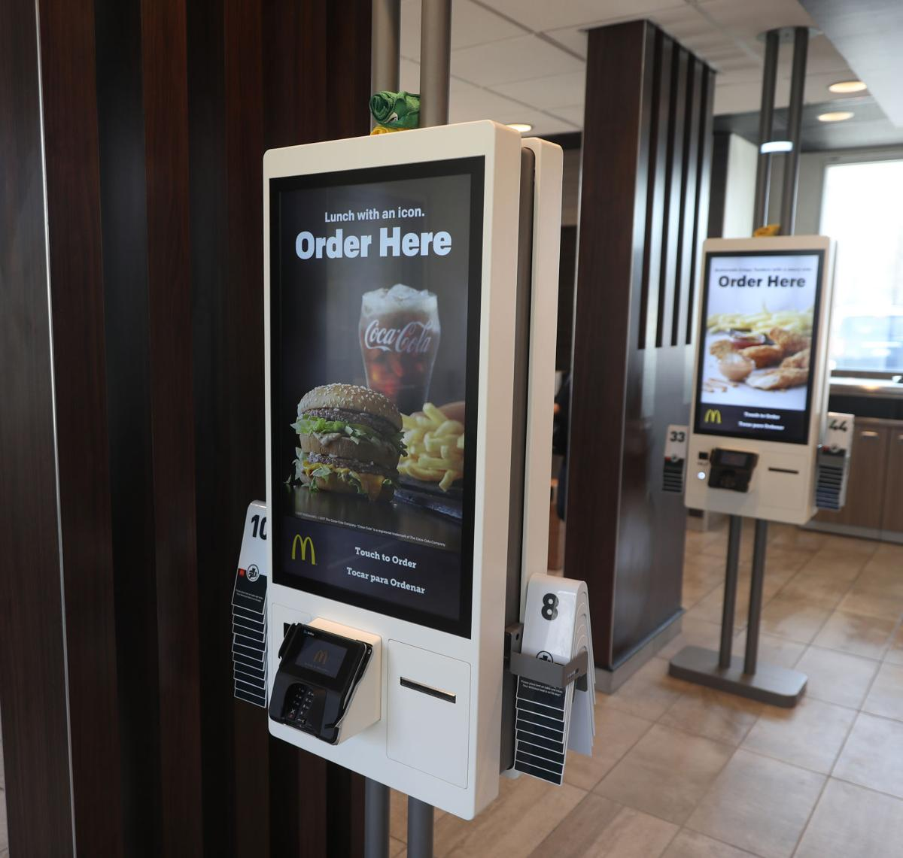

We Are In The People Business
Technology will only take us so far!

Slide 42
Hire The BEST People
Attitude, compassion, and empathy trump everything else!

Slide 43
Patient Access Training
Patient access new hires spend nearly two full weeks in training and patient access owns their own system training.
Classes
Welcome and intro to patient access
Feedback styles and MBTI
HIPAA, MPI, EMTALA, POS Collections & Cash Management
First and lasting impression with scenarios
Medicare!
RTE Boot Camp
You can't learn in all through a module:
Two days of simulation labs
Escape Rooms!
Other features:
Weekend training
Preceptor training
Notes:
Updated for week of 4/28

Slide 44
Customer Service Training
Customer Service new hires spend nearly four full weeks in training and patient accounting owns their own system training.
Classes:
Welcome and intro to patient accounting
Insurance
Coding
Denials
Call escalation
You can't learn it all through electronic trainings:
Two weeks of phone training
Role playing
Training continues:
Six weeks of side-by-side training
Notes:
Updated for week of 4/28

Slide 45
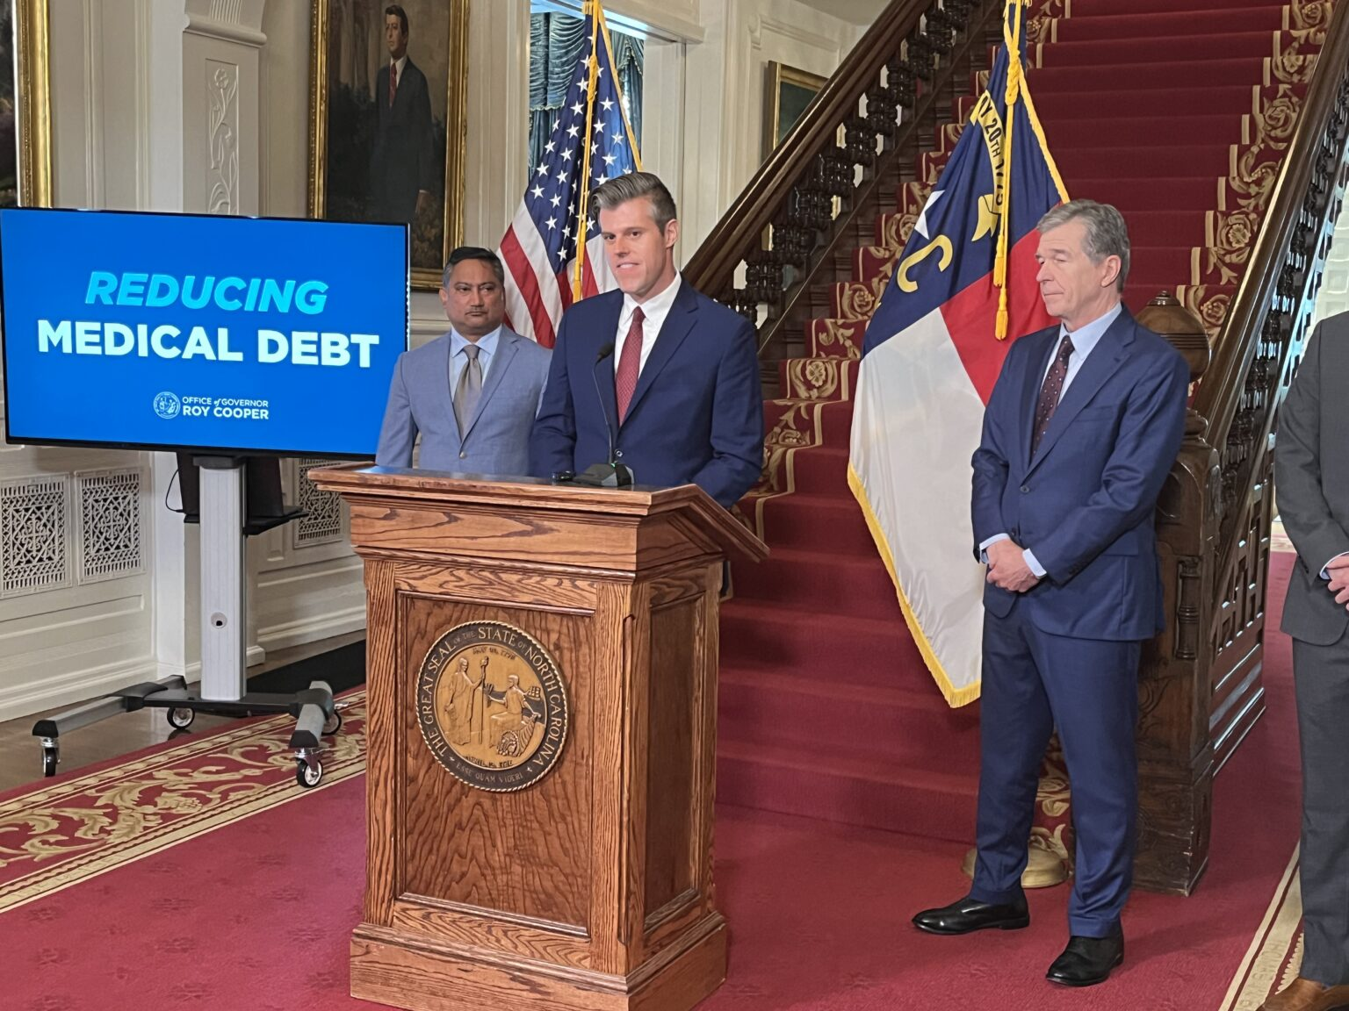
Breaking News
Federal government approves NC plan for medical debt relief

Slide 46
Q & A
chris.johnson@atriumhealth.org
jonathan.johnson@atriumhealth.org

