Slide 1


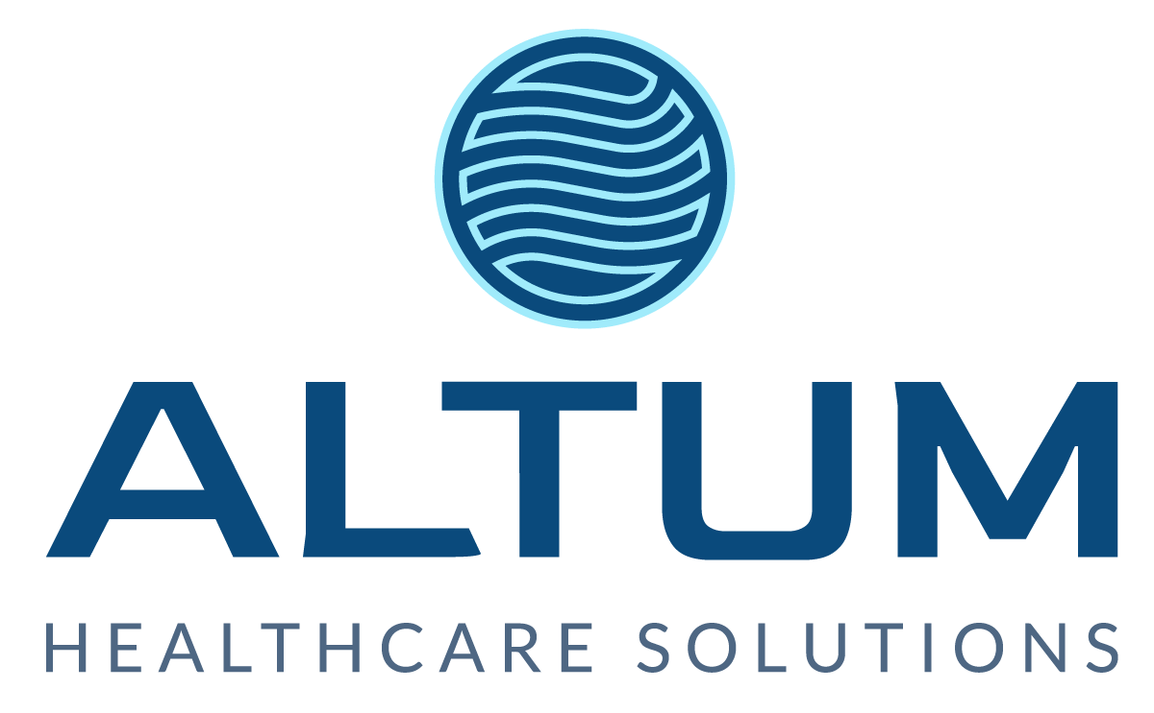
Better
reimbursement.
Better hospitals.
Better communities.
Better together.
AI and The Revenue Cycle: Proactive Approaches Revenue Cycle Executives Need to Prepare

Slide 2


The Altum Difference
“
Healthcare providers need to focus on patient care. But if they don't manage and control revenues and expenses properly, they won't survive. And that's where Altum comes in.
Altum Healthcare Solutions is an experienced team of professionals at the forefront of healthcare revenue cycle management (RCM).
Deep Dive
Approach
We focus on taking a strategic "deep dive" into our healthcare provider partners' revenue cycle needs.
Our client-focused approach, utilization of the latest technologies, and expert staff is our competitive advantage that translates to better operational performance and increased revenue for our partner clients.

Slide 3


Altum At-a-Glance
HQ
Atlanta, Georgia
20+ YRS
Avg Leadership Experience
We shape creative solutions with a
singular goal in mind:
Better reimbursement, better hospitals, better communities—better together.
2020
Founded
HEALTHCARE RCM
Niche Expertise
Good enough is not part of the language we speak.
EASTERN USA + EXPANDING
Hospitals + Physician Groups
We excel at servicing our partners and uncovering every single dollar available to give back to them.
We are driven to succeed for ourselves and our partners.

Slide 4
What is AI?
Artificial Intelligence- The ability of a Computer or Robot to perform tasks that historically required human intelligence, such as recognizing speech, making decisions, and identifying patterns.
Traditional AI- Makes decisions with date inputs and uses predictability. Ex. Siri, Alexa, Google
Generative AI- Creates something new with the inputs you give it. Ex. ChatGPT

Slide 5
History of AI
1950 Alan Turing (Father of Computer Science) writes a paper including the question “Can machines think?” From there he offers a test “Turing Test,” in which a human would try to distinguish between human and computer text responses
1956 John McCarthy coins the term “artificial intelligence”
1967 Frank Rosenblatt builds Mark I Perceptron, which was the first computer based on a neural network that “learned” through trial and error
1980s Neural Networks become widely used in AI applications
1995 Artificial Intelligence: A Modern Approach, is published becoming one of the leading textbooks in the study of AI

Slide 6
AI Transforming Revenue Cycle
Recent study from ENGINE insights reveals that 2/3 of responding hospitals (65%) use AI in RCM. With 98% reporting that their three-year plan includes AI
The most common applications are eligibility and benefits (72% of hospitals report using) and patient estimation tools (64%)
Prior Authorization is expected to be the area of the most growth over the next year
Perception of Value are very different with 86% of those in RCM roles seeing value, compared to 51% in IT and 44% of executives

Slide 7
AI Transforming Revenue Cycle
EPIC incorporated ChatGPT in some health records processing (Microsoft GPT-4 Collaboration) beginning in April 2023
Google Cloud now offers AI enabled prior auth processing
Doximity (telemedicine platform) rolled out a tool that can draft preauthorization and appeal letters
McKinsey and Company study shows that AI could cut $200-$360 Billion in administrative costs from the US Healthcare System

Slide 8
The Pros
Removing Administrative Waste
Relieving Staffing and Wage Challenges
Enhancing Decision Support
Optimizing Claims Life Cycle
Improving the Patient Experience
Faster Cash
Improving Job Force Satisfaction

Slide 9
The Cons
We want to supplement- not replace human thinking/decision making
Accuracy and Reliability
Increased denials
No transparency into what is occurring
Privacy and Security Concerns
Concern for too much reliance on technology
Implementation Challenges

Slide 10
The Litigation
The Estate of Lokken v. UnitedHealth Grp.
Plaintiffs sued UnitedHealthcare in a class action suit alleging that the defendants deployed AI in place of real medical professionals to wrongfully deny elderly patients care owed to them under Medicare Advantage Plan using nH Predict, a model United Healthcare knew had a 90% error rate (based on overturned appeals).
United Claims that the tool used real world experience to predict outcomes, not deny coverage.
Inpatient Rehab Claims have always been complicated and a target
Lawsuit also alleges employees who attempt to override the decisions are disciplined
“Defendants bank on the patients’ impaired conditions, lack of knowledge, and lack of resources to appeal the erroneous AI-powered decisions,” the complaint said.
Most of the Defendant’s families paid out of pocket for inpatient rehab and then they passed
Causes of Action: Breach of Contract, Breach of the Implied Covenant of Good Faith and Fair Dealing, Unjust Enrichment, Violation of Wisconsin Insurance Claim Settlement Statute, Insurance Bad Faith in Multiple States
Barrows V. Humana, Inc
Plaintiffs sue Humana in a class action suit against Humana based on nH predict for wrongfully denying elderly patients care owed to them under their Medicare Advantage Plan
Humana wrongfully delegates its obligation to evaluate and investigate claims to the nH Predict AI Model
Causes of Action: Breach of Contract, Breach of the Implied Covenant of Good Faith and Fair Dealing, Unjust Enrichment, Violation of state unfair claims settlement practices

Slide 11
The Litigation
“Upon information and belief, the nH Predict AI Model applies rigid criteria from which Humana’s employees are instructed not to deviate. The employees who deviate from the nH Predict AI Model prediction are disciplined and terminated, regardless of whether the additional care for a patient is justified.”
“Under Medicare Advantage Plans, patients who have a three-day hospital stay are typically entitled to up to 100 days in a nursing home. With the use of the nH Predict AI Model, Humana cuts off payment in a fraction of that time. Patients rarely stay in a nursing home more than 14 days before they start receiving payment denials.”
“Upon information and belief, the outcome reports generated by nH Predict are rarely, if ever, communicated with patients or their doctors. When patients and doctors request their nH Predict reports, Humana’s employees deny their requests and tell them that the information is proprietary.”

Slide 12
The Litigation
“Upon information and belief, over 90 percent of patient claim denials are reversed through either an internal appeal process or through federal Administrative Judge (ALJ) proceedings.”
“This demonstrates the blatant inaccuracy of the nH Predict AI Model, and the lack of human review involved in the coverage denial process. Humana fraudulently misled its insureds into believing that their health plans would individually assess their claims and pay for medically necessary care.”
“Had Plaintiffs and Class members known that Humana would evade the legally required process for reviewing patient claims and instead delegate that process to its nH Predict AI Model to review and deny claims, they would not have enrolled with Humana and/or would not have paid for their plan the amount they had to pay to be enrolled.”
“Humana’s use of the nH Predict AI Model to deny its insureds’ claims undermines the principles of fairness and meaningful claim evaluation, which insureds expect from their insurers.”

Slide 13
The Litigation
Kisting-Leung v. Cigna Corp
Plaintiffs are enrolled members with Cigna that were wrongfully denied coverage based off of Cigna’s personally developed PXDX algorithm
Allegation that Physicians were denying claims without even opening them
Plaintiffs were denied tests which eventually led to Cancer Diagnosis
Causes of Action: Breach of the Implied Covenant of Good Faith and Fair Dealing, Violation of Cali Unfair Competition Law, Intentional Interference with Contractual Relations, Unjust Enrichment
Snyder V. Cigna
Plaintiff members of Cigna brought this class action suit to challenge s Cigna’s practice of using a proprietary algorithm (PXDX or procedure to diagnosis) to review and reject claims
Causes of Action: Breach of Contract, Breach of Implied Covenant of Good Faith and Fair Dealing, Intentional Interference with Contractual Relations, Unjust Enrichment, Violation of VA Consumer Protection Act, Violation of Fiduciary Obligations, Improper Denial of Benefits, Equitable Relief and Declaratory Judgment

Slide 14
The Litigation
The PDX algorithm was designed for Cigna by Dr Alan Muney, a former pediatrician who also worked as an executive at Blackstone, a private equity firm, where he was in charge of reducing costs. He came up with the idea to cut the cost of the traditional system under which each claim is reviewed manually by a nurse and then by a medical director. Instead PDX matched each claim with a set of required conditions. All claims that failed to meet any of the conditions were then rejected by medical directors, who were not required to review the files.
Tracked down by reporters at ProPublica and The Capitol Report, Muney confirmed that PDX was designed to circumvent review by medical doctors. “The PXDX stuff is not reviewed by a doc or nurse or anything like that. It has undoubtedly saved billions of dollars.”
One of the individuals who appeared to have approved denials in bulk was Dr. Cheryl Dopke, who signed off on 60,000 claims in a single month in 2022, according to internal Cigna records. The reporters calculated that Cigna staff spent an average of 1.2 seconds on the 300,000 claims rejected during that period.

Slide 15
AI is Here to Stay
How does the Revenue Cycle Adapt to Protect itself?
Current regulatory concerns are focused on denial of care to the patient NOT denial of payment after the fact
Ethical Concerns, such as potential bias in algorithms
Is de-identification the solution?
Some argue that it is not HOW AI reaches its decision, but if the decision is accurate (think drug trials)

Slide 16
Responsible AI
Responsible AI is using AI in a way that is ethical, transparent, fair, and accountable, to ensure it is safe for society and consistent with human values
The Core Principles:
Fairness- AI must be unbiased and balanced
Transparency- AI must be explainable to the human audience
Empathy- AI adheres to social norms
Robustness- AI should be exposed to a variety of data, scenarios, inputs and conditions
Accountability- Everyone across an organization must test and hold the AI to high standards

Slide 17
Executive Order
In October 2023, President Biden issued an Presidential Executive Order on Safe, Secure, and Trustworthy AI
Require that developers of the most powerful AI systems share their safety test results and other critical information with the U.S. government.
Develop standards, tools, and tests to help ensure that AI systems are safe, secure, and trustworthy.
Protect against the risks of using AI to engineer dangerous biological materials
Protect Americans from AI-enabled fraud and deception by establishing standards and best practices for detecting AI-generated content and authenticating official content
Establish an advanced cybersecurity program to develop AI tools to find and fix vulnerabilities in critical software
Order the development of a National Security Memorandum that directs further actions on AI and security
Also includes provisions on protecting privacy, advancing equity, innovation and competition, leadership abroad, and responsible Government AI.

Slide 18
Practical Pointers for using AI
Understand what kind and where, you are currently using AI in your revenue cycle
Understand your organizations risk profile
If you choice to use Generative AI, make sure you understand what source documents are being used, as well as the level of conversation the AI is using (levels of literal).
Look for repetitive tasks that take little to no thinking
You can use the same AI analytics, as the payors, to assist you in preventing and fighting denials.
Monitor security concerns

Slide 19
Practical Pointers for fighting the use of payor AI
Contract Terms!!!!!!
Insurance Companies are not legally required to disclose the reasons behind denials, so you mut contractually obligate them to.
Ask the payor to define specifically where they are using AI, and to disclose the details regarding the source documents of that AI.
Watch for Pre-Authorization pitfalls (i.e. the AI returning the result that you don’t need a pre-auth)
Ask specifically, that every claim be reviewed by a human before denial, even technical cases.
Have very specific terms around Medical Necessity. This is where the payors are most heavily using AI right now.
Decide whether or not, your organization is going to engage in a de-identification strategy with the payor.
Alignment in what is the best interest of the patient

Slide 20



Better hospitals.
Better communities.
Better together.
Elizabeth Richards, Esq.
Chief Executive Officer | Altum Healthcare Solutions
erichards@altumhs.com
770.855.1715
1225 Johnson Ferry Rd.
Suite 831
Marietta, GA 30068
ALTUMHS.COM

