Slide 1
Module I - HFMA Business of Health Care
Course 4: Course 4: Strategic Financial Issues
Notes:
Last revised 3-31-2024

Slide 2
Learning Objectives
YOU will be able to
Describe how strategic planning influences budgeting,
Differentiate between various budgeting approaches,
Define the different types of budgets used in a healthcare business, and
Complete a simple budget variance analysis
Notes:
Next to national defense, the health care industry in the United States is one of the largest sectors of the economy. Currently making up almost 20 percent of the nation's gross domestic product, health care in the US will be a significant factor in the national economy for the foreseeable future. Upon completing this course, you should be able to:
Describe the general characteristics of the healthcare industry in the US;
Describe the impact of health reform on the industry;
Describe the payment system for healthcare services;
Define the role of financial management in health care organizations; and
Describe some of the new challenges facing healthcare finance in the US.

Slide 3
Starting Context
Planning
Budgeting
Notes:
The context for successful use of financial statement data comes from planning and budgeting

Slide 4
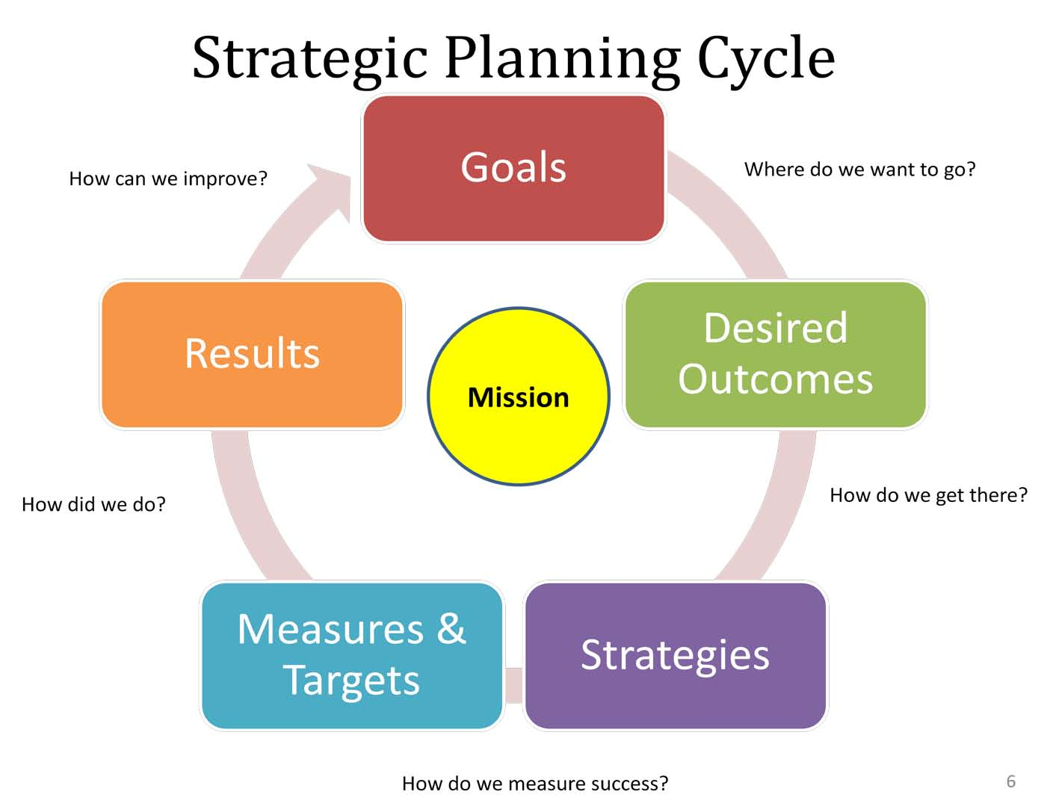
Basics of Strategic Planning
Notes:
Strategic planning is an essential part of managing any business and sets the general framework for what an organization is in business to accomplish and how it intends to accomplish what it has set out to do.

Slide 5

Mission Statement
Notes:
Strategic planning starts with a very fundamental premise – “What is it that the business intends to do?” or “What is the purpose of this business?” This is the essence of the mission statement – literally, what is the purpose of the business in terms of delivering a service or selling a product? A mission statement may be expressed in multiple parts, such as: “The mission of XYZ Hospital is to provide high quality care in a state-of-the-art facility that emphasizes the human element of health care.”

Slide 6

Vision Statement
Notes:
Closely linked to the mission statement is the vision statement, which is used by some organizations to concisely express the organization’s aspirations. An example of a vision statement for a community health center is: “to be the leading source of care to the medically vulnerable and underserved.”

Slide 7

Strategic Plan
Notes:
Once equipped with a sense of the mission and values of a business entity, managers can set out a broad plan to guide the organization toward fulfillment of its mission. This is usually carried out in a strategic plan, which looks at a long-term view of the future (at least a year and often ranging up to five years into the future).

Slide 8

Strategic Plan
Notes:
The strategic plan becomes the foundation for budgeting in a healthcare business. In many respects, an organization’s budget is an expression of its strategic plan in numeric terms. The budget defines the organization’s plans for earning revenues and using resources over a given time period.

Slide 9
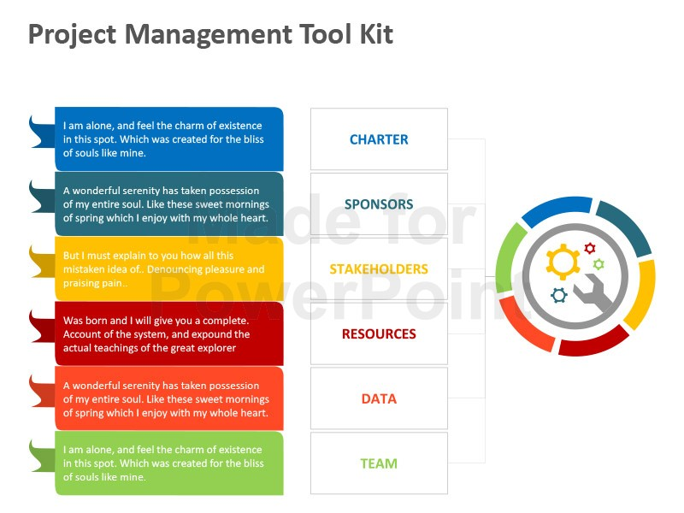
Basic Budget Concepts'
Budget
Notes:
A critical element of working with a budget is understanding that it is a management tool, not a financial tool. Budgets set targets and objectives based on a plan set out by management.
Budgets are useful in helping managers better control operations in their clinic, hospital, or health plan. Values in the budget can be used as a benchmark against which actual revenue and expense results can be compared.
Usually the budget for a healthcare entity is based on a forecast for the coming year. However, monitoring progress toward organizational goals on a year-by-year basis is generally ineffective, as unfavorable changes in financial performance could remain uncorrected until they have had a significant negative impact. Generally, an annual budget projection is broken down into quarterly or monthly segments, and those annual subdivisions are used for ongoing monitoring and control in a healthcare business.

Slide 10
Approaches to Budgeting
Incremental
Zero-based budgeting
Notes:
Incremental : This approach can be useful for a business that believes that past results are reasonably predictive of future activity and are consistent with the goals of the business. However, this approach can preserve operational inefficiencies (such as excessive staffing or supply usage) if projections are not critically assessed from time to time. The incremental approach is effective if managers assess each area of the budget for adjustment based on the needs of the business and known changes
Zero- based: The alternative approach to budget projection is the zero-based budget, where managers start each budget projection as if there were no past experience and each item in the budget must be justified as to its reasonableness each year.

Slide 11
Elements of the Budget for a Healthcare Business
Financial Planning Resources:
Operating and Statistical Budgets
Revenue Budget
Expense Budget
Capital Budget
Notes:
the financial planning process for a healthcare business will most likely include elements from each of these budget components.
The operating budget provides a benchmark for the normal, day-to-day operation of the business. Essentially the operating budget is a future projection of the income statement and includes estimates of services volume, revenues, and expenses
No matter the organization type, an understanding of the expected volume of services provided – expressed in a statistical budget – provides a necessary foundation for other elements in the operating budget by defining the volume and nature of units of service expected to be provided.
Once an understanding of service volumes is established, managers can apply expected collection rates or premium rates to estimated volumes to arrive at a revenue budget
While compiling the revenue budget, managers can make assumptions on the rate of collections for items on the statistical budget. he expense budget is built using results from the statistical budget. Managers can develop estimates of expenses by knowing operational relationships, such as the number of labor hours per patient served, the average time to address a patient billing question, the average amount of medication per patient discharge, or the salaries for executives and physicians employed in a hospital or clinic setting
Determining capital investments is an important next step in the budgeting and planning process, since capital investments can be a significant use of scarce resources for a healthcare business. These decisions are detailed in a capital budget

Slide 12
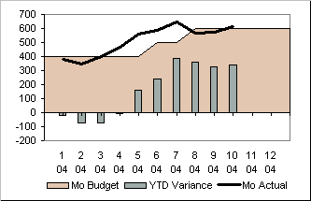
Budget Variance Analysis
Actual – Budget = Revenue variance
Budget – Actual = Expense variance
Notes:
Managers can use the budget in managing a healthcare business by comparing budgeted amounts with actual results achieved by the business. The calculated difference between the actual and budgeted amount is known as the variance.
When calculating variances in revenue, the budget amount is subtracted from the actual amount: Actual – Budget = Revenue variance. Conversely, an expense variance is calculated by subtracting the actual amount from the budget amount: Budget – Actual = Expense variance. Since most operating statistics relate to items that generate revenue, the same approach for calculating a revenue variance is used for statistical budget variances.

Slide 13

Budget Variance Analysis
Simple
Flexible Budget Variance Analysis
Notes:
There are two different types of budget variance analysis. The first is the simple budget variance analysis. The simple variance uses the budget as prepared before the beginning of the fiscal period and computes the variances between the budget projection and the actual results. As its name implies, this method is very simple, taking only the difference between the actual and budgeted result, but may be limited if actual volumes differ from the budget projection.
flexible budget variance analysis. In response to the fundamental weakness of the simple budget variance, this method requires the manager to adjust the budget for changes in volume by applying revenue and expense-per-unit standards to the actual volume. The analysis then determines the variance between actual results and a budget projection that has been “flexed” to the actual service volume experienced.

Slide 14

Other Guidance for
Strategic Financial Planning
Benchmarking
Notes:
Benchmarking is the comparison of key performance measures relative to the competition, other organizations, or groups of organizations compiled by an industry group like the American Hospital Association, America’s Health Insurance Plans, Healthcare Financial Management Association, or the Medical Group Management Association. Organizations such as these can provide valuable benchmarks on key ratios described elsewhere in this training module. A good example of this is the HFMA Key Hospital Financial Statistics and Ratio Medians published annually by HFMA for its members.

Slide 15
Strategic Finance Professionals
See the bigger picture of organizational strategy
  Business
  Clinical care delivery
Translate the strategy into measurable terms through the budget process
Assess problems with resource use to better manage resources
Notes:
Financial managers must see the bigger picture of the organization strategically from both a business and clinical care perspective, but they must also translate that strategic vision into measurable terms through the budgeting process.
Through the use of financial management tools such as budget and variance analysis, managers can assess problems with resource use in their businesses and better manage those resources in today’s challenging healthcare industry.

Slide 16


Slide 17
Thank You!

