Slide 1
Module I – HFMA Business of Health Care
Course 3: Cost Accounting Principles
Notes:
Last revised 3-31-2024

Slide 2
Learning Objectives
YOU will be able to
Define the term “cost” in health care from the multiple different perspectives represented in the industry;
Describe the varying types of costs in a health care business and the different ways that costs can change with the volume of services provided;
Notes:
Next to national defense, the health care industry in the United States is one of the largest sectors of the economy. Currently making up almost 20 percent of the nation's gross domestic product, health care in the US will be a significant factor in the national economy for the foreseeable future. Upon completing this course, you should be able to:
Describe the general characteristics of the healthcare industry in the US;
Describe the impact of health reform on the industry;
Describe the payment system for healthcare services;
Define the role of financial management in health care organizations; and
Describe some of the new challenges facing healthcare finance in the US.

Slide 3

What Comes to Mind…
Notes:
In health care this can sometimes appear as conflicting priorities. Managers in the healthcare industry certainly have a high degree of responsibility for taking care of patients. However at the same time, the expenses incurred to pay for patient care (such as salaries, supplies, medicines) are increasing. Regardless of one's position in the health care industry – physician office, hospital, or health insurer – cost is an important concern.

Slide 4
COST
Cost is the amount
Paid for a service provided
Notes:
The definition of “cost” in health care has different definitions that need to be considered. Depending on one's position in a health care transaction, cost may be the amount paid for a service such as the price paid by a health insurer or the patient to a physician or hospital. Conversely, cost may be defined as the amount paid for salaries to employees or the amount paid on an invoice to a supply or medicine vendor.

Slide 5
Types of Cost
Direct
Indirect
Variable
Fixed
Notes:
The key item with direct costs is that they are the costs directly associated with providing services or products (depending on what it is that the entity is operated for).
indirect costs are made up of those costs necessary to operate the business but are not incurred in the provision of services to patients, customers, or clients.
Variable costs as their name implies, vary directly with the volume of services provided
Fixed costs on the other hand remain constant within a range of operational volumes, regardless of the volume of services provided.
Total cost is the sum of variable and fixed costs in a health care organization
The cost relationships and behaviors illustrated here apply equally to health plans as they do to physician offices or hospitals.

Slide 6
Types of Cost
Semi-fixed
Step Variable
Short –term
Long-term
Notes:
Semi-fixed costs are those costs that show the behavior of a variable cost, increasing with volume, over a period over a range of service volumes.
A step variable cost is a cost that remains fixed over a finite level of volume and then increases incrementally at a higher level of volume.
A key assumption in the discussion of cost behavior is time frame. Most all discussions of cost behavior assume a short-term time frame, defined as less than one year. Long-term time frames extend beyond one year. The discussion in this unit will presume a short-term time horizon for consideration of cost and operational volumes

Slide 7

Cost Allocation
The challenge:
What actually is the cost of providing service to a patient?
Notes:
A common challenge among managers is to understand “what is the cost of providing a specific service to a patient or customer”? Determining the direct cost of a service can be fairly straightforward. A more difficult challenge is to understand how much benefit that department or subset gains from the support provided by indirect or overhead costs.
Cost allocation is a process by which indirect costs are assigned to a part of the organization that actually provides services to a patient or client. Since a solid understanding of the direct and indirect costs of a service is essential to setting a fair price for services, it is equally essential that managers understand all of the costs associated with providing a service. . At the same time, managers have a challenge of fairly allocating indirect costs among different parts of the entity that provide different services to patients.

Slide 8
Cost Allocation
Cost Pool
Costs Driver
Department | Cost Driver
Administration | Number of employees or total revenues
Accounting | Number of employees or total revenues
Housekeeping | Square footage cleaned
Maintenance | Square footage maintained or work orders completed
Information Systems | Number of users
Human Resources | Number of employees
Notes:
The amount of indirect or overhead cost to be allocated is called the cost pool. If that cost pool serves multiple different areas of the entity that provide different services, the cost pool is broken into multiple parts – one for each revenue producing area
cost driver. The cost driver is the basis upon which a cost pool is allocated among different revenue producing functions.
As pressures mount on health care entities to become more price competitive, a keen attention to all costs of providing services – direct and indirect – is essential.

Slide 9
Cost Allocation
Revenue Producing Departments
Non-revenue (or overhead) Departments
Notes:
It is important that at the end of a cost allocation exercise that all indirect costs have been allocated to all service providing areas of the entity. We often use the distinction of revenue producing departments to describe those direct service-providing areas of the entity that incur direct costs. The term non-revenue or overhead department is used to describe those areas that incur indirect costs.

Slide 10
Cost Allocation
Example of a Hospital Cost Allocation
Department | Square Feet | % of Square Feet | Allocated Cost
Adult Medicine | 1,500 | 30% | $7,500
Pediatrics | 1,500 | 30% | 7,500
Laboratory | 750 | 15% | 3,750
X-Ray | 1,250 | 25% | 6,250
Total | 5,000 | 100% | $25,000
Notes:
Notice here that not all of the 6,000 square feet of office space is included here, but only the 5,000 square feet occupied for revenue producing functions. Although there are costs associated with taking care of non-revenue producing areas, the total cost is allocated over only the revenue producing areas – so that the total housekeeping costs for the clinic can be considered when setting prices for each area. In so doing, the clinic can be better assured of generating revenues sufficient to pay not only direct costs, but indirect costs as well.
The allocation method illustrated here is known as the direct method – where the costs from overhead functions are directly allocated only to revenue producing areas

Slide 11
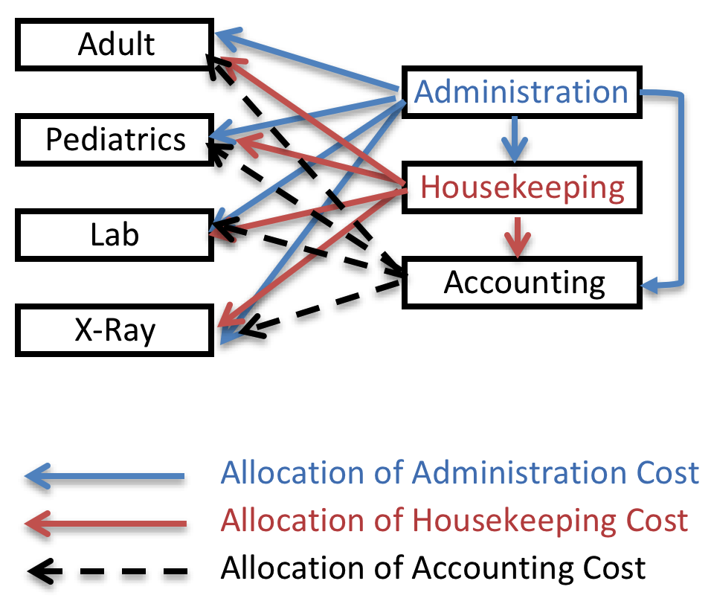
Cost Allocation
Example of the Step-down Approach
Notes:
The step-down approach is required to be used in preparation of the Medicare cost report by hospitals and nursing facilities.
The step-down approach starts with one overhead function that serves the most other departments (usually administration) and spreads its cost to other functions in the organization including other overhead functions. The overhead function having the next most service to other functions has its costs (plus the costs allocated by other overhead functions) to other areas of the organization. This cost allocation approach is illustrated in this diagram
The direct and step-down approaches are effective in estimating costs at a high level, such as within an entire clinic, hospital, or even a department within such an organization

Slide 12
Cost Allocatoi9n
Activity Based Costing (ABC
  Two steps:
    gathering total data and activity statistics
    then allocating the costs of activities to a service.
Notes:
a drawback with the direct and step-down approaches is that neither is particularly useful in estimating the costs of a specific service or activity such as a clinic or emergency room visit. This could be very important in a situation where a manager needs to determine the costs of a specific service to determine a price for that service for the purposes of negotiating a specific payment rate. This is known as activity based costing or “ABC
The process of completing an ABC analysis can be broken into two steps – gathering total data and activity statistics and then allocating the costs of activities to a service

Slide 13
Cost Allocation
Illustration of Cost Allocation in the Activity Based Costing method
Activity | Annual Costs | Cost Driver | Activity Totals |  |  | Allocation Rate
 |  |  | Medicine | Behavioral Health | Total
Registration & check-out | $25,000 | # Visits | 4,000 | 1,000 | 5,000 | $5.00/visit
Vital Signs | 50,000 | Minutes/ Visit | 10 | 5 | 50,000 | $1.00/minute
Diagnosis | 300,000 | Minutes/ Visit | 10 | 20 | 60,000 | $1.00/minute
Treatment | 500,000 | Minutes/ Visit | 15 | 20 | 80,000 | $1.00/minute
Medications | 75,000 | Medications/ visit | 1.0 | 1.0 | 5,000 | $15.00/ medication
Billing | 200,000 | # Visits | 4,000 | 1,000 | 5,000 | $5.00/visit
Total | $1,150,000

Slide 14

Setting Prices
Full Cost Pricing
Marginal Cost Pricing
Notes:
Entities that operate with little competition can use a full-cost pricing approach, where all direct and overhead costs and a desired level of profit (profit is considered to be an economic cost and must be considered in pricing services
Under a full-cost pricing approach, the price for services covers all costs of the service plus desired profits
. Buyers in this situation would have little leverage to entice a service provider to lower prices since they have few if any alternative sources for that service.
Hospitals or physician offices in competitive markets may find it necessary to set prices below full cost – the sum of desired profit, indirect, and direct cost – in order to offer a price low enough to attract customers. In such a situation, the seller of service – hospital, physician, or health plan – must offer a discounted price that does not cover full cost. In general, a seller will offer a lower price to a customer that buys more of a service – essentially trading a lower price for higher volumes of sale. In such a situation, the seller will set its prices using a marginal cost pricing approach. This requires a manager to make difficult decisions on how much cost can be included in the price charged to a particular customer based on a value judgment of how much customer volume will be gained for that lower price

Slide 15
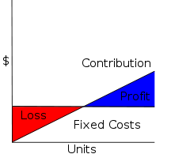
Contribution Maggie
Notes:
Since marginal cost pricing does not cover all costs, the approach must be used judiciously and only when there is the ability to garner enough volume of services to fully cover all indirect costs and in total generate a profit sufficient to sustain the operations of the business.
In no case should a hospital, health plan, or physician accept a price that is below the direct costs of providing a service. Each unit of service provided should fully cover the direct costs of service and generates at least a small amount above direct costs to defray indirect costs and generate a profit. This amount is known as contribution margin

Slide 16

Target Cost Pricing
Notes:
Health plans and health care providers may take on some degree of risk in its pricing when setting fixed fee prices such as capitation rates, per discharge prices, or insurance premiums. In such a case the entity will make an assumption that some customers will be profitable and others may not – but in the aggregate a price offered to a buyer will be profitable – and set prices based on a target cost.
The entity using this pricing strategy will set a cost level that they expect to arrive at in total for a given block of customer services and then set prices sufficiently above that total to generate a profit

Slide 17

Health Plans Target Cost Pricing
Community Rate Setting
Group Rate Setting
Notes:
Health plans have two different approaches to apply target cost pricing. In the early days of commercial insurance in the United States, health plans used a community rating approach to set prices based on the costs incurred to provide services to all members of a local market area
The group rating approach breaks a community down into smaller parts or groups and determines the prices they pay based on the risk of needing services for a specific group

Slide 18
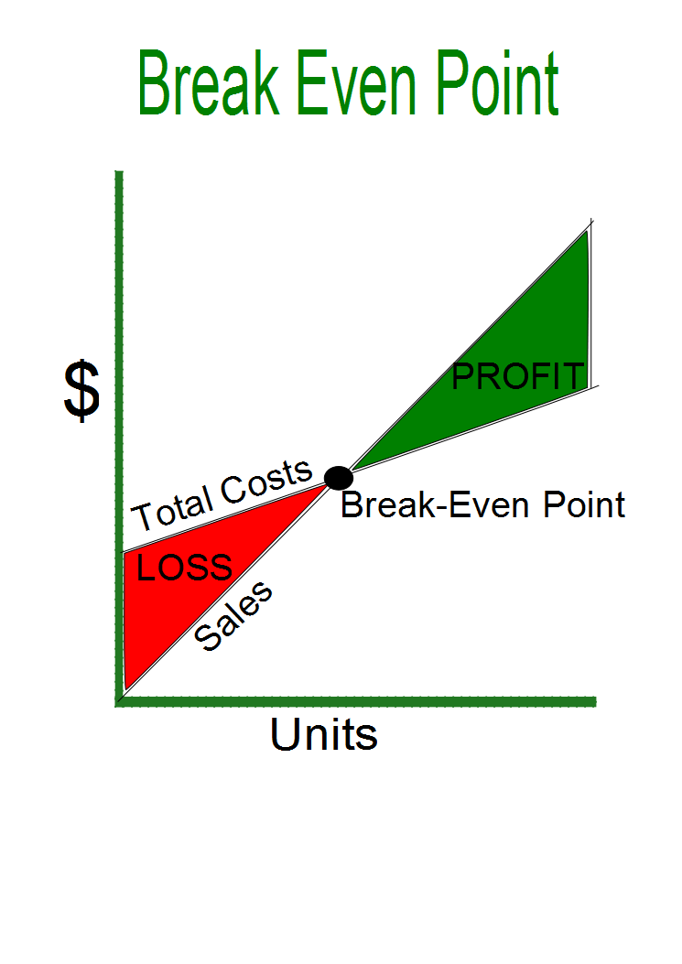
Break Even Analysis
Notes:
The analysis simply requires the manager to understand two basic elements of the cost structure for the entity - the contribution margin per unit of service provided and the total fixed or indirect costs (including profit) for the service.

Slide 19
Summary
Health care managers must be attentive to cost in order to remain competitive
AND
Managers must resist the temptation to maximize profits by cutting costs too far resulting in harm to patients or failure to meet the service needs of patients or customers

Slide 20


Slide 21
Thank You!

