Slide 1

Navigating the Patient Financial Experience The Revenue Cycle Impact
"It is not the strongest of the species that survive, nor the most intelligent, but the one most responsive to change."
-Charles Darwin
Basak Kaya, MBA, CHFP, FHFMA
Executive Director, Revenue Services

Slide 2
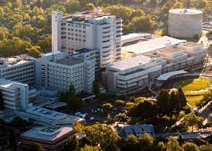

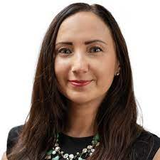
UC Davis Health at a Glance
Basak Kaya
Executive Director
Enterprise Revenue Services
UC Davis Health
Sacramento, California based integrated academic health system with approximately 17,000 employees, 1,000 students, 1,000 trainees, 1,300 faculty members and a large regional primary care network, providing more than 1.5 million outpatient visits every year with an annual budget of $4.3 billion.
Executive oversight of end-to-end hospital and professional revenue cycle operations with $3.5 billion in net revenue
Masters in Business Administration, specialization in Health Services Administration and Finance
Six Sigma Green Belt
Revenue Cycle Education Advisor to University of California San Diego
Fellow of the Healthcare Financial Management Association
Past President of the HFMA San Diego – Imperial Chapter
UC Davis Medical Center is a 648-bed Level 1 Trauma hospital consistently ranked among the nation's best by U.S. News & World Report, Newsweek, and Becker’s.
UC Davis Medical Center, in partnership with Shriners Children's, operates a top 50 children's hospital.
System incudes a National Cancer Institute-designated comprehensive cancer center, an international neurodevelopmental institute, a stem cell institute and a rehabilitation hospital.
517 Primary Care Network Providers, 1,956 School of Medicine Providers, 100+ Ambulatory Clinics; 30 different buildings, 70 different check-in areas.
UC Davis School of Medicine, ranked in the top 50 by U.S. News & World Report.
Betty Irene Moore School of Nursing, ranked in the top 50 by U.S. News & World Report.
Notes:
Advocates, trusted leaders

Slide 3
Navigating Patient
Financial Experience
The financial journey of a patient plays a pivotal role in their healthcare decisions, impacting their choice of provider, continuity of care, and the likelihood of pursuing necessary treatment. It’s the right thing to do. Healing is faster when we eliminate financial unclarity and insecurity.
Despite significant investment in enhancing the clinical experience for patients, the financial aspects of healthcare often remain overlooked.

Slide 4

Unpacking The Revenue Cycle Impact
Our mission at UC Davis Health is to place patients at the center of all we do. Our investment in optimizing the patient financial experience supports our mission, benefits our community, and strengthens our financial health.
This session will uncover how UC Davis Health:
Structured exceptional self-pay operations
Employed automation
Collaborated with industry-leading partners to slash bad debt write-off dollars by half
Earned the prestigious gold EPIC gold trophy, secured the silver EPIC Gold trophy for reducing self-pay aging and improving recovery rates.

Slide 5
Placing Patients At The Center
Our endeavors to enhance the patient financial experience aim to align healthcare management with consumer expectations, significantly reduce financial barriers to care, and directly contribute to the overall well-being and satisfaction of our community.
Today, we will:
Understand how to align the business of healthcare with consumer expectations for affordable care and easy experiences, in partnership with patient experience teams.
Learn how to efficiently structure teams, provide necessary training, engage effective partners, integrate outsource capabilities into innovative technology, and leverage automation.
Explore performance stats and metrics to ensure maximum team productivity and patient satisfaction.

Slide 6
Current Patient Financial Experience
The patient financial experience plays a critical role in determining not just whether patients seek care, but also where they receive care and the likelihood that they will stick with a healthcare provider ¹
The healthcare industry has spent decades and billions of dollars designing experiences that empower and activate patients across their unique clinical journeys. The same cannot be said for the financial side of healthcare ²
Default patient financial experience includes inaccurate estimates, surprise bills, jargon-laden explanations of benefits and limited payment options ²
More than 50% of Americans have medical debt of at least $1,000, more than two-thirds of consumers under 65 say they struggle to make these payments ²
¹ 2022 payments report
² Reimagining The Patient Financial Experience, Forbes May 24, 2022

Slide 7
FOCUS 1:
How do we align the business of healthcare with consumer expectations for affordable care and easy experiences, in partnership with patient experience teams?
Notes:
If I were the CFO of a hospital system, the alignment of healthcare business models with consumer expectations for affordable care and seamless experiences would be a strategic priority.
This alignment necessitates a collaborative approach, engaging directly with patient experience teams to design and implement solutions that not only address affordability but enhance the overall patient experience.

Slide 8
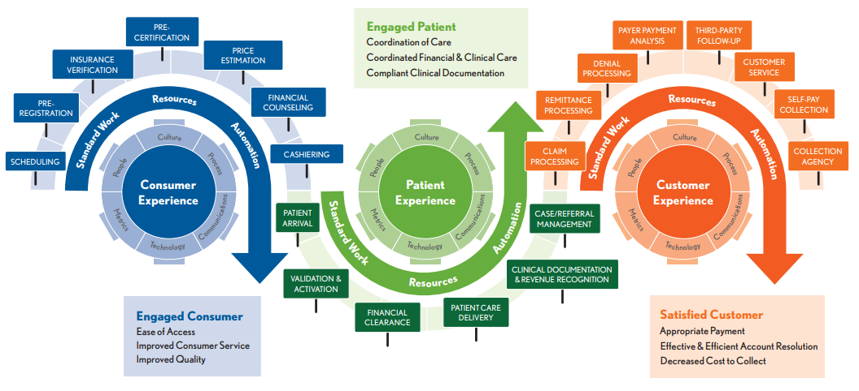
Revenue Cycle Touchpoints

Slide 9
Determine Focus Areas
  Headwind:
  Patient experience is a top priority, but we have no effective and accurate way of measuring our performance, results!
Revenue Services – Patient Experience team partnership!!!
Mapping and measuring our patient financial journey – implementing a patient survey, voice of the customer
Patient and staff education, creating awareness around resources
Observations at key patient access points – scheduling, registration, financial counseling, call center, self pay follow-up…
Patient estimates accuracy assessments, expanded automation initiatives
Relatable patient experience videos and write-ups for staff, created in a memorable story format
Sharing patient stories, relating our teams’ work to patient outcomes during all-hands meetings
  Build cadence and communicate importance of understanding the patient journey, throughout all functional system levels

Slide 10
Updated Self Pay Methodology
Standard discounts point of service and beyond
  In depth analysis of appropriate, affordable rates
  Moving to percent of charge self pay rates, automated to net in alignment with RTE functionality
Establishment of Rate Review Committee and Governance
  Consistent review and analysis of all new charges with all appropriate stakeholders
  Governance, formal approval process
Updated policy and procedures
  Revisit policies annually, align with latest laws, regulations AND consumer trends

Slide 11
FOCUS 2:
How do we effectively structure our team, provide necessary training, engage effective partners, integrate outsource capabilities into innovative tech, and leverage automation?
Notes:
In my role as CFO of a large healthcare system, effective structuring of our team is paramount to adapt to the evolving financial landscape in healthcare

Slide 12
Effective Revenue Cycle Team
Specialized teams/units: Revenue Cycle Organization Changes
  Single Billing Office, Patient Access alignment
  Modular approach enhances agility and focus, allowing us to address specific challenges with precision
  Billing, patient assistance, automation, and partner liaison.
    This modular approach enhances agility and focus, allowing us to address specific challenges with precision
Patient Access
Patient Financial Clearance
Single Billing Office (SBO)
Patient Customer Service
Patient Estimates Team
Patient Financial Counseling
Payment Plans, Coverage Discovery and Recovery, Feedback
Notes:
Creating specialized units within the financial team, each dedicated to distinct aspects like billing, patient assistance, automation, and partner liaison. This modular approach enhances agility and focus, allowing us to address specific challenges with precision.

Slide 13
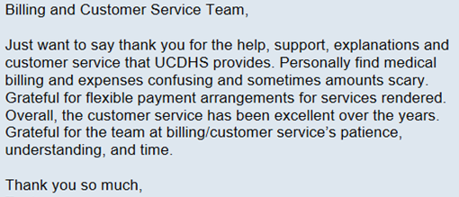
Fostering A Culture of Empathy & Understanding
Ensure every patient interaction is informed by a deep understanding of the patient’s unique circumstances and healthcare needs.
Adopting a patient-centered approach in financial services
Forge a stronger partnership between the business of healthcare and the mission of delivering outstanding patient experiences
Measure to ensure team is driving better health outcomes and is an integral part of overall patient satisfaction efforts.
A message from our patient
Notes:
Concurrently, fostering a culture of empathy and understanding within our teams ensures that every patient interaction is informed by a deep understanding of the patient’s unique circumstances and healthcare needs. By adopting a patient-centered approach in financial services, we forge a stronger partnership between the business of healthcare and the mission of delivering outstanding patient experiences, ultimately driving better health outcomes and patient satisfaction.

Slide 14
Effective Revenue Cycle Team
Training
  Champion a continuous learning environment, leveraging both in-house expertise and external resources.
  Keep our teams updated on the latest in healthcare finance management, technology, and customer service excellence.
  Partnering with leading providers and financial institutions would serve a dual purpose:
    One: bring in external expertise that complements our internal capabilities.
    Two: ensure that our team is proficient in the latest digital tools and platforms.

Slide 15
Effective Revenue Cycle Team
Leveraging Automation
  Opportunity to reduce manual errors, streamline processes, and free up our team to focus on areas requiring human touch, like patient counsel and support.
  Automation in billing, appointment scheduling, and routine inquiries can significantly enhance efficiency and patient satisfaction.
  A comprehensive strategy here would involve identifying repetitive processes that can be automated, ensuring that the automation tools we adopt integrate well with our existing systems, particularly MyChart, and continuously monitoring and refining these processes based on feedback and performance metrics.
    Increase Patient Estimate Automation & Volume
    Payment Plan EPIC Integration
    Extension of SBO
    HelloWorld

Slide 16
Effective Revenue Cycle Team
Effective Partner Selection
  Selection criteria would hinge on their ability to integrate seamlessly with our systems, particularly with EPIC and MyChart, which is pivotal for patient interaction.
    Integrating outsourcing capabilities into MyChart would be strategic, focusing on areas where direct expertise can enhance patient service without compromising data security or personal interaction quality.
  The partners we choose must not only offer innovative solutions but also align with our commitment to enhancing patient financial experiences.
    Should provide scalable options that can adapt to our diverse patient needs, from payment solutions to billing inquiries, with a special focus on user-friendly interfaces.
    Potential areas include after-hours support, specialized billing queries, and payment processing.
    The goal is to create a seamless transition for patients, where outsourced services feel as integral and reliable as our in-house offerings.
Notes:
Through these strategies, structured team organization, continuous training, strategic partnerships, effective integration of outsourced capabilities, and the judicious use of automation, we can significantly improve our healthcare system's financial dealings, making them more efficient, patient-friendly, and in line with our overarching goal of providing exemplary care.

Slide 17

Adoption of Innovative, User-Friendly Tools
Digital 24/7 Communication
Transparent pricing models
Flexible payment plans
Digital billing and payment solutions
—all make healthcare costs predictable and manageable for patients, reduce worry and administrative burden, support the healing process

Slide 18

Exceptional Program Performance
FINANCIAL IMPACT
Patient Loans Funded | $7,825,682
Guarantors Serviced | 3,259
Accounts Serviced | 17,330
Collection Rate | 89%
PATIENT ENGAGEMENT
Speed to Answer: 23 seconds
Call abandonment: < 1%
Complaint Rate: 0 complaints (10,325 patient contacts in 2023)
Maximizing Provider AR Value 2023
First Call Resolution | Rep was Professional | Rep was Knowledgeable | Recommend CB Program to Family & Friends
98% | 100% | 98% | 100%
 | UCD | ClearBalance | Change
Payment Plans | 1,700,017 | 1,888,908 | 188,891
Collection Rate | 65% | 89.0% | 37%
Net Payment Plan Collections | 1,105,011 | 1,683,317 | 578,306
Avg. Carrying Period (Months) | 22 | 0 | (22)
Service Cost of Payment Plans | 181,586 | 289,099 | 107,513
Carrying Cost | 88,672 | 0 | (88,672)
Net Value of AR | 834,753 | 1,394,218 | 559,465
Lift in Value |  |  | 36.3%
ROI |  |  | 4.39x
Notes:
I highly recommend partnering with ClearBalance Healthcare to enhance our healthcare system's financial operations. ClearBalance excels in providing innovative solutions that align with our commitment to improving patient financial experiences. By integrating their expertise in payment solutions and billing inquiries, we can further optimize patient interactions and financial services. This strategic partnership will help us offer scalable options tailored to diverse patient needs, ensuring a seamless and user-friendly experience. Let's leverage ClearBalance Healthcare's capabilities to elevate our financial dealings and deliver exceptional care.

Slide 19
FOCUS 3:
What performance stats and metrics should we be relying on to ensure maximum team productivity and patient satisfaction?

Slide 20
Right Measures for the Mission Driven Goal
Set, report out and hold teams accountable to outcomes driven patient experience KPIs
It’s not about the time spend on the phone, it’s the resolution of the reason for the call and avoidance of future phone calls
We measure:
  Timeliness and accuracy of patient cost estimates
  Financial counseling outcomes, patients qualifying for appropriate programs to support their care
  Reduced credit card fees, fully secured flexible payment option utilization rate
  Update UCDH Cashiering Webpage for ease of use, monitor utilization outcomes
  Reduce self-pay credit balances and refund turnarounds
  Paperless billing, text utilization rates

Slide 21
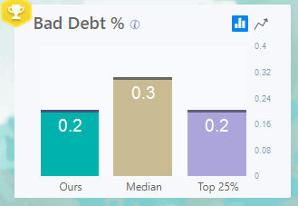
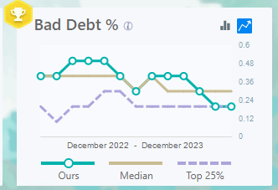
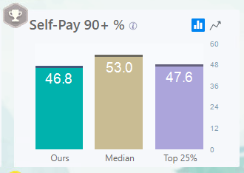
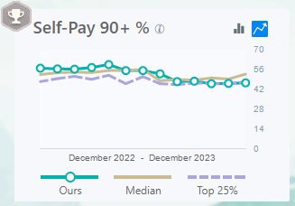
Total UCD Results

Slide 22
Questions?
Thank you.

