Slide 1
Leveraging a Global Workforce to Address
Provider Labor and Financial Challenges

Slide 2
Agenda
Market insights on financial and labor pressures in healthcare
Opportunities in tech-enabled revenue cycle solutions and clinical enablement
Examples and impact of global outsourcing delivery models

Slide 3
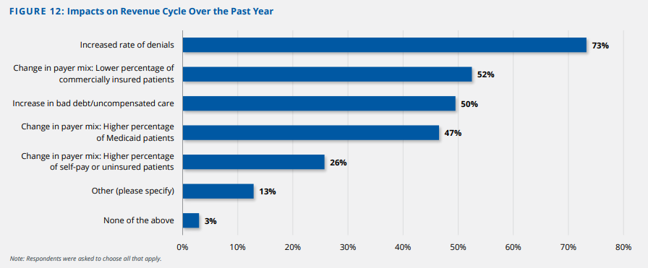
Providers Have Started to Stabilize in 2023, but Financial and Workforce Pressures Persist
73% of surveyed provider leaders cite increased denials impacting revenue in the last year
“We have a cost structure to support a revenue structure that doesn’t exist anymore.”
— Survey Respondent, Regional Health System
Source: 2023 State of Healthcare Performance Improvement: Signs of Stabilization Emerge, Kaufman Hall, Oct 2023.

Slide 4
Providers Have Started to Stabilize in 2023, but Financial and Workforce Pressures Persist
Kaufman Hall Report: 73% of surveyed provider leaders cite increased denials impacting revenue in the last year
“We have a cost structure to support a revenue structure that doesn’t exist anymore.”
— Survey Respondent, Regional Health System
Source: 2023 State of Healthcare Performance Improvement: Signs of Stabilization Emerge, Kaufman Hall, Oct 2023.

Slide 5
As Patient Demand Returns to Pre-Pandemic Levels, Providers are Struggling with Capacity
According to Kaufman Hall,
Nearly 50% survey respondents report that demand is above pre-pandemic levels at provider clinics
63% of respondents state their organization is struggling to meet demand for patient access to its physician enterprise
32% of respondents say that patient complaints about access are increasing
“The biggest risk to our future is the stability of our nursing staff.”
— Survey Respondent, Regional Health System
Source: 2023 State of Healthcare Performance Improvement: Signs of Stabilization Emerge, Kaufman Hall, Oct 2023.

Slide 6






Technology-enabled Solutions Reduce Administrative Burdens,
Empowering Providers and Staff to Focus on Work That Matters
Automate repetitive tasks
Increase accuracy
Reduce turnaround time
Financial pressures
Staff shortages
Tedious manual processes
Steep tech learning curve
Redeploy staff
Increase employee satisfaction
Focus on high value initiatives
Improve financial performance
Technology helps remove the mundane work
Natural Language Processing (NLP)
Robotic Process Automation (RPA)/Bots
Machine Learning (ML)
Artificial Intelligence (AI)
Notes:
Our technology-enabled solutions empower you to focus on work that matters
Today you’re juggling care delivery and administrative burdens: ongoing staff shortages, too many manual processes that can lead to errors, and even if you want to use tech, the learning curve is very steep
We help remove the administrative burden through technology-enabled solutions
Allows you to redeploy staff, increase employee satisfaction, and focus on high value work
Machine learning is a branch of artificial intelligence (AI) and computer science which focuses on the use of data and algorithms to imitate the way that humans learn, gradually improving its accuracy. (https://www.ibm.com/topics/machine-learning)
Artificial intelligence is a machine’s ability to perform the cognitive functions we usually associate with human minds. (https://www.mckinsey.com/featured-insights/mckinsey-explainers/what-is-ai)
Natural language processing (NLP) refers to the branch of computer science—and more specifically, the branch of artificial intelligence or AI—concerned with giving computers the ability to understand text and spoken words in much the same way human beings can. (https://www.ibm.com/topics/natural-language-processing)
Robotic process automation (RPA), also known as software robotics, uses intelligent automation technologies to perform repetitive office tasks of human workers (https://www.ibm.com/topics/rpa)
A bot -- short for robot and also called an internet bot -- is a computer program that operates as an agent for a user or other program or to simulate a human activity. Bots are normally used to automate certain tasks, meaning they can run without specific instructions from humans. (https://www.techtarget.com/whatis/definition/bot-robot#:~:text=What%20is%20a%20bot%3F,without%20specific%20instructions%20from%20humans)

Slide 7
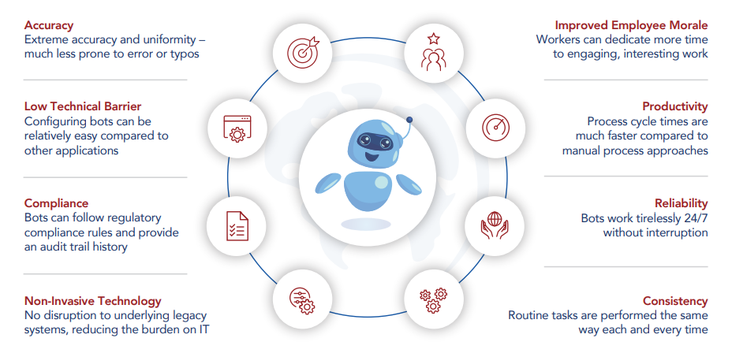
Benefits and Applications of Robotic Process Automation in the Revenue Cycle
Applications in RCM:
Open, read, write emails
Log into enterprise apps
Move files
Copy/paste
Fill in forms
Read/write to databases
Pull data from internet
Make calculations
Extract data from documents
Follow decision rules
Collect statistics
Obtain human input via emails/workflow
Sources: Revolutionizing Revenue Cycle Management: Unleashing the Power of Automation through RPA, Omega Healthcare, 2023; “Robotic Process Automation (RPA) Using UIPath,” Pier Paolo Ippolito, Towards Data Science, April 26, 2019

Slide 8
In Healthcare, Generative AI can Reduce Administrative Burdens and Enhance Efficiency
Sources: Bain Health Systems Survey (N=94); “Beyond Hype: Getting the Most Out of Generative AI in Healthcare Today”, August 2023.

Slide 9


Case Study: Academic Medical Center Improves Eligibility Verifications and Collections
About
One of the oldest and largest teaching hospitals in the United States in the northeast was experiencing challenges with front office staff experiencing
Challenge
Solution
Results - Urology
The Department was experiencing 11% eligibility denials and
1.5% authorization denials.
Front office staff were verifying eligibility, authorizations, checking-in patients, and point of service collections.
POS collections historically was below industry standard, and patient collections was post-encounter
The department experienced poor missed /delayed revenue
Omega Healthcare’s centralized patient access management solution, enabled by the Omega Digital Platform, helped manage patient eligibility verifications efficiently and prior to patient visits.
Eligibility and benefit verifications were completed 14 days prior to office visits and procedures.
Authorizations/referrals were obtained in advance to avoid cancellation of visits.
POS collections report was provided to front desk staff by each patient for upfront collection.
Prior patient balances from earlier visits were captured and provided to front office staff to collect at the time of service.
Patients were informed of their co-pay and balance from previous visits 3 days prior to visit, preparing them to pay the amount at the time of visit.
A competition was set up among offices to encourage front office staff to collect 100% of POS collections.
Eligibility denials reduced from 11% to 1.5%.
Authorization denials reduced from 1.5% to 0.6%.
  50%
POS collections doubled from $60K to $120K per month.
Patient visit cancellations reduced by 50%.
Notes:
Mount Sinai Dept of Urology

Slide 10
Case Study: Health System Reduces Physician Burnout with Clinical Communication Services
About
NYU Langone Health is one of the nation’s premier academic medical centers with six inpatient locations in the heart of Manhattan, with additional facilities throughout the New York City area.
Challenge
Solution
Results
Inbound messages created a backlog for this health system:
1000s of after-hours email messages from patients were overwhelming doctors and staff.
Clinicians were drowning in unexpected stream of work as patients adopt email via EMRs and patient portals
Health system wanted to maintain their brand and patient satisfaction amidst tens of thousands of messages across multiple practices.
Omega Healthcare implemented Clinical Communications services and became a partner:
Developed requirements for a dedicated and licensed team of “virtual nurses” to provide the flexibility and responsiveness the health system needed.
Defined the workflow for the team to evaluate and answer incoming patient calls and messages, working directly in the EHR.
Leveraged decision trees, databases, and workflows to understand patient needs, conditions, and potential treatments; then recommend the proper level of care.
Omega Healthcare’s Clinical Communications Services helped NYU Langone:
  Relieve the burden of the
  “unexpected stream of work
The clinics grew the volume of their practices without having to add more clinical support staff.
Give physicians more time to focus on face-to-face interactions
Notes:
Client: NYU – Clinical Comms

Slide 11
Case Study: Growth of Provider Engagement, E&M and RVUs
About
A Memphis, TN-based general and surgical facility partnered with a university health center in TN to lead the largest academic physician group in the mid-south. Their goal was to bring together physicians, leaders and innovators to create a healthier community.
Challenge
Solution
Results
Coders struggled to balance time between coding and physician education
Professional fee coders lacked resources for provider education
RevCDI provided customized feedback and education through the Omega Digital Platform to help providers on evaluation and management (“E&M”) levels and documentation improvement.
Provided education to both coders and providers
Providers received individual feedback on their patient charts and documentation
The practice improved physician engagement and education related to improving coding documentation:
71% of physicians responded to 330 documentation deficiencies in year one
3%
wRVU gain per E&M code compared to baseline
$1 million
estimated revenue improvements
Notes:
Client: Reventics ROH/UTROP
3% wRVU gain per E&M code
compared to baseline across
14 departments
• $1 Million in estimated
revenue improvements
$312,000 initial pilot with three departments annualized E&M value

Slide 12



How Outsourcing is Evolving with Hybrid Delivery Models
Finding the right strategic partner
Value of offshore resources paired with onshore oversight
Domain expertise with clinical and technology capabilities across the continuum
Commercial flexibility tied to accountability around outcomes
Workforce scale and ability to ramp up quickly
Recruitment, training, talent management of global workforce
Data security and operational rigor paired with quality standards
Industry certifications and validation
Continuous innovation to meet industry needs

Slide 13
Technology-Enabled RCM Solutions to Improve Outcomes
Increase revenue
Decrease costs
Accelerate cash flow
Reduce admin. burdens
Optimize workflow
Improve patient provider experience
E2E Revenue Cycle Solutions
Patient Access
Solutions
Scheduling & Registration
Insurance Eligibility & Benefits Verification
Prior Authorizations
Care Coordination
Mid-Revenue Cycle
Solutions
Medical Records Coding
Charge Capture
HCC Coding Review
Chart Audit and Education
Clinical Documentation Improvement
Business Office
Solutions
Claims Management & Billing
Payment Posting & Reconciliation
A/R Management & Collections
Denials & Appeals Management
Underpayment Analysis & Recovery
ODP-INSIGHT
Omega Digital Platform (ODP)
ODP-CONNECT
ODP-CODE
ODP-COLLECT

