Slide 1

Wheels Up! A Journey Through POS Collections
Presenters:
Pippa Tooley & Stacie Johnson

Slide 2

Departure
Notes:
Ladies & Gentleman, welcome to flight…., you have the pleasure of flying with me, Stacie johnson out of Naples, FL and co-crew, Pippa Tooley out of Charlotte, NC. If you’re on this flight, you should have your passport handy, because no journey is complete w/o your passport. During your flight today, you’ll be utilizing your passport to capture what we like to call ‘stamps of knowledge. So, when you hear us say ‘STAMP IT IN YOUR PASSPORT’ we mean write it down!

Slide 3

Reflection
By Debasish Mridha
To begin a new journey is never easy, but we have to start somewhere to reach a new destination.

Slide 4
Flight Entertainment
POS Challenges
The Pandemic
A.C.E “The Ask”
Notes:
A. C. E. It! “The Ask”: Overcoming, Preparing & Implementing In-Flight Activities

Slide 5

Point of Service (POS)
Notes:
Break into groups
Select a Scribe and Presenter
List your POS Collection challenges
Return from group breakouts
Presenter to share their group’s top two challenges

Slide 6

The Pandemic
We can’t talk about POS collections in most industries without talking about the Pandemic.
The pandemic has shaped our industries’ “new normal”, and impacted our approach to collections in some way.
¹ In the healthcare industry:
  Improve overall collection efforts:
    70% of healthcare providers have increased patient payment options
  Minimize the negative impact to customers:
    74% have adjusted bad-debt placement timing.
    61% have delayed credit reporting
  By understanding our “new normal”, we’re able to better adapt to the changing landscape in our industries.

Slide 7
A.C.E. “THE ASK”

Slide 8
A
Remove the AAA (Awkwardness, Anxiousness, and Apprehensiveness)
C
Develop the CCC (Competency, Confidence, and Consistency)
E
Explore the EEE (Excellence, Experience, and Expectations)

Slide 9


  Determine the starting point
  Map out the goals
  Break goals into manageable chunks
  Track and measure the goal
Opportunity Thinking!
Stamp that in your passport!
Plan Your Purpose

Slide 10
A
Remove the AAA (Awkwardness, Anxiousness, and Apprehensiveness)
C
Develop the CCC (Competency, Confidence, and Consistency)
E
Explore the EEE (Excellence, Experience, and Expectations)

Slide 11

Stamp that in your passport!
Work Your Plan

Slide 12
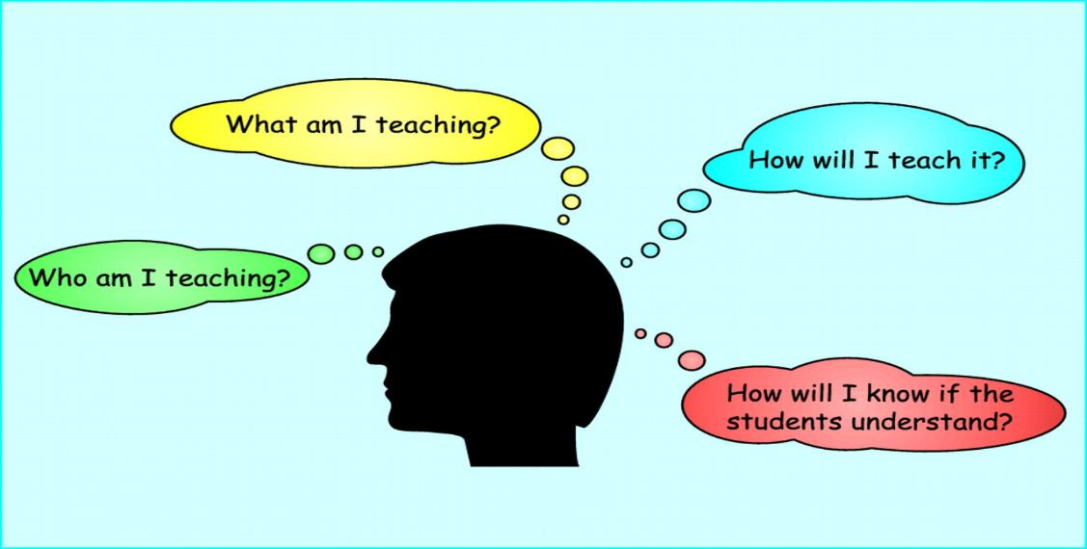








Do They Have What They Need?
Scripting
Role Play
Constructive Feedback
EDUCATION
TOOLS
Policies Procedures
Systems
Verifications
PRACTICE
Training, Elearnings, Job Aides & OJT
Continuing Education
This Photo by Unknown Author is licensed under CC BY
Notes:
How you ask
When you ask
Your Setting
The environment when asking
Are others around during that conversation
Do you know what to ask for? competence
Navigate difficult POS collection conversations with patients.
Not so black and white
You want your collectors to have some gray area to bring their personality, uniqueness and individuality
Adjust to any given situation
Add black and white circle with gray cross-section that’s where the personality, uniqueness and individuality lives

Slide 13

Confidently Show Up!
During the financial conversation, collectors should strive to:
    Actively listen
    Be empathetic
    Remain goal-oriented
    Always be kind and never critical
Leaders while working with your colleagues, you should strive to:
    Create an environment that encourages conversation around POS collections.
      Wins and Fails
    Allow collectors to ask questions and offer suggestions for improvements, i.e., cash box.
Notes:
Remember the Golden Rule: Treat others as you would like to be treated
Critical – don’t criticize - $50 might not seem like much to us but to someone struggling that could be the difference between food or a tank of gas.

Slide 14

Consistency is Key!
  Builds trust!
  Is vital to repeatable outcomes!
  Ensures that everyone understands that when an:
  Event A occurs, Event B will follow
For example:
  Event A: Patient Smith is seen in the Emergency Room (ER) and has BCBS insurance which has a verified copay due at the time of service of $150.
  Event B: The collector will ask Patient Smith for their ER copay due of $150 during their visit.
The confusion occurs when Event A happens, but Event B does not. If there is a valid reason why Event B cannot happen, i.e., system down, unable to verify information, card machine down, etc., it should be explained clearly and concisely to the patient.
Consistency can eliminate the confusion, increase opportunities for collection, and result in a more productive and less stressful financial conversation.
Notes:
As leaders you’re often looking at your kpi and determining where you are falling short so that you can correct the shortfall but often the KPI may not be where the focus should be on. Add an example. If you’re seeing your bad debt is growing, you might think it’s because people aren’t paying and focusing on increasing your POS on the front end when introspect it is that colleagues are not communicating other payment options such as your payment plans because maybe they don’t understand, know about them or aren’t comfortable discussing them with patients. We could miss an opportunity where a patient wasn’t able to pay the full amount and opted not to pay anything because we didn’t offer the payment plan option. This could be due to their lack of knowledge, or understating of the payment option resources.

Slide 15
A
Remove the AAA (Awkwardness, Anxiousness, and Apprehensiveness)
C
Develop the CCC (Competency, Confidence, and Consistency)
E
Explore the EEE (Excellence, Experience, and Expectations)

Slide 16
Stamp that in your passport!
Make the Connection

Slide 17
Focus On Excellence!
Excellent Customer Service:
  Is the foundation of successful organizations.
  Drives customers to continually return to a particular business.
  Will enhance the customer’s overall experience.
Your team can set the tone for an excellent experience throughout the entire customer’s visit, and ultimately the financial conversation.
At times, we can be so focused on getting the technical pieces right, that we forget about ensuring an excellent customer experience throughout the entire visit.
Notes:
One of the most important relationship you will have will be between you and your customer.
Customer service means doing ordinary things extraordinarily well!
Add value and integrity to every interaction. Your words have power and a far-reaching impact!

Slide 18

A.I.D.E.T.
What is ² A.I.D.E.T.? AIDET is an acronym that helps collectors navigate the financial conversation with their customers. It reminds them to begin and end with excellent customer service:
  A = Acknowledge
  I = Introduce
  D = Duration
  E = Explanation
  T = Thank You
Notes:
Who has heard of this term before?
Examples
Opportunities missed when you are not observing your surroundings.

Slide 19

“Take Two!”
We want you to “Take Two!”
  Take time
    It’s not about the clock!
    Engage with your customer.
    Look for opportunities to lighten the moment (when appropriate).
  Take action
    Be intentional about connecting with your customer.
    Find common ground such as weather, sports, kids, etc..
    NEVER discuss controversial topics such as politics or religion that can potentially offend your customer.
Notes:
Remember, any technique you choose to use should be appropriate for the situation.

Slide 20
Stamp that in your passport!
Frame “The Ask”

Slide 21


Just Say No!
  When it’s time to perform “The Ask”, it matters how we frame it!
  Stay away from closed-ended questions that can greatly reduce our chances of collecting the customer’s portion due at the time of service.
  Closed-ended questions such as:
      Can you?
      Will you?
      Do you want to?
  Closed-ended questions collectors from continuing the financial discussion!
Notes:
Use positive language.
Instead of saying, “I can’t tell you how long the wait time will be.”
Try saying, “I can assure you we’re making every effort to minimize your wait. I’ll be happy to make a phone call/check with the nurse for a status update.”
Focus on solutions, not problems.
Look for ways to meet service opportunities, not job requirements.

Slide 22
….But Don’t Take NO Too Easily
  Framing “the Ask” with open-ended questions, such as:
      How would you like to? I’ll be collecting. The amount due today is.
  We’re not asking IF they want to pay? We know they’re going to pay, we’re setting that expectation with how we frame “the Ask”.
  By not taking NO easily as the final answer and framing “the Ask” in an open-ended manner, it leaves room for the Follow-up Technique!
  This technique allows us to continue the financial conversation by:
    Actively listening
    Addressing the customer’s payment concerns
    Utilizing your payment alternatives (partial payments, multiple payments, flex spending, etc.) to further increase the opportunities for collections at the time of service.

Slide 23
Stop Talking!
  Collectors must learn to stand in the “Uncomfortable Silence” while the customer:
      Thinks through their options
      Determines what they can pay during that visit
  Refrain from jumping in during that awkward, uncomfortable silence to ease the tension or fill the silence.
    This uneasiness usually results in offering non-payment options such as bill me, payment plan, etc..
    Especially before the customer has thought through their options and told us what they can do during the visit!
  What do I do during the “Uncomfortable Silence”?
    Silently acknowledge the customer while they think through their options.
    Answer any questions asked, after, the customer has interrupted the uncomfortable silence with a question.
Notes:
“Wow, I didn’t know I owed anything today.” “$300” “I don’t remember being asked the last time I was here.”
Why didn’t y’all ask me for payment the last time I was here? I never have to pay at the other location, is this new? Why didn’t anyone explain this to me the last time I was here?
APOLOGY

Slide 24


And The Winner Is…..
Our tried-and-true script and IT WORKS! This script can level up “The Ask”, and increase your collectors’ chances for collection.
Hello Mr./Mrs. Customer, based on our verification, your portion due today is $__________.
You can use debit, credit, check or cash.
Stop talking!...and YES, it can get uncomfortable.

Slide 25

ACTION
“The Ask” (after)
1
“The Ask”
Notes:
Break into groups
Select a Scribe and Presenter
List your POS Collection opportunities
Return from group breakouts
Presenter to share their group’s top two opportunities

Slide 26
Did We A.C.E. “The Ask”?
Focus on Excellence!
AIDET
Take Two!
Uncomfortable Silence
Tried & True Script

Slide 27

A
Remove the AAA (Awkwardness, Anxiousness, and Apprehensiveness)
IT’S OUT OF HERE!!!
C
Develop the CCC (Competency, Confidence, and Consistency)
E
Explore the EEE (Excellence, Experience, and Expectations)

Slide 28

Stamp that in your passport!
Stacie Johnson’s email: Stacie.Johnson001@trinity-health.org
Pippa Tooley’s email: Pippa.Tooley@trinity-health.org

Slide 29
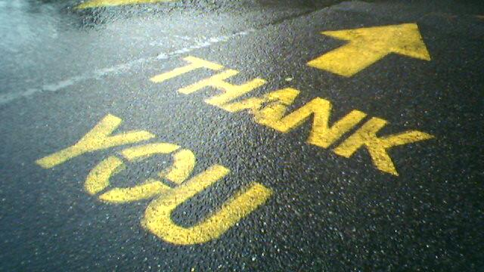

Slide 30
References
¹HFMA. “Survey: COVID-19 Profoundly Affecting Patient Collections and Financial Assistance Programs.” HFMA, 28 Oct. 2020, https://www.hfma.org/topics/hfm/2020/november/survey-covid-19-profoundly-affecting-patient-collections-and-financial-assistance-programs.html.
²Studer Group. “AIDET Patient Communication | Studer Group.” Healthcare - Huron, 1995, https://www.studergroup.com/aidet.

