Slide 1
The Changing No Surprises Act: Where it Stands and What Comes Next
Kathryn S. Beard, JD
September 21, 2023

Slide 2
Disclaimer
This presentation is for general educational purposes only, and is current as of September 18, 2023. Nothing in this presentation is intended to be used as, or constitute, legal or medical advice.

Slide 3
No Surprises Act Overview

Slide 4
Background
Healthcare Affordability
Costs increasing faster than inflation
Consumers paying more for their coverage
Financial insecurity for unexpected costs
Price transparency initiatives
Patients should understand what they’re paying for
Patients should be able to choose the most cost-effective medical services
Unexpected out-of-network bills
Insurance denies or underpays out-of-network services
Patient receives an unexpected bill for the unpaid balance

Slide 5
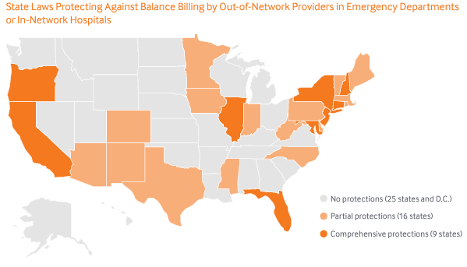
State Law Landscape, January 2019
Data Source: Center on Health Insurance Reforms, Georgetown University Health Policy Institute

Slide 6
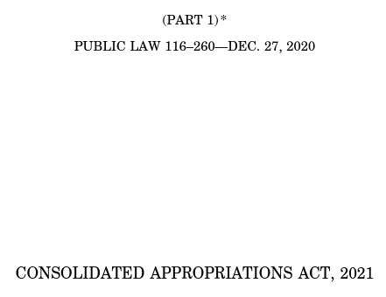
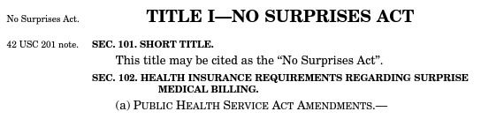
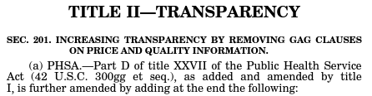
No Surprises Act Overview

Slide 7
Payer Reimbursement and Patient Responsibility for Unexpected Out-of-Network Services

Slide 8
Definitions & Language
If I say: | I mean:
The Departments | The U.S. Departments of Health & Human Services, Labor, & The Treasury – the federal agencies with responsibility for enforcing the No Surprises Act
Payer | A healthcare insurance plan, issuer, carrier, or other private payer of healthcare claims
Provider | A healthcare facility or healthcare provider, including hospitals, physicians, and nonphysician practitioners
IDR | Provider–Payer Independent Dispute Resolution Process – How the appropriate reimbursement rate is determined for unexpected out-of-network medical bills
IDRE | Certified Independent Dispute Resolution Entity – Organizations that applied to and were approved by the Departments to administer IDR
QPA | Qualifying Payment Amount – the median contracted rate for an item or service, calculated by the Payer

Slide 9
Payer Reimbursement for Unexpected Out-of-Network Services
Historically
No Surprises Act
Payers negotiate contracted reimbursement rates with Providers who are willing to join the Payer’s network
In-network Providers are reimbursed at the contracted rates
Services furnished by out-of-network Providers may be denied as noncovered
Out-of-network Providers are reimbursed at much lower rates than in-network Providers, or not reimbursed at all
Payers and plans that cover emergency or non-emergency services furnished by an in-network Provider must also cover those services if furnished by an out-of-network Provider
Payers have 30 days after receiving a claim to either send the out-of-network Provider an Initial Payment Amount or deny the claim
Providers may dispute the Initial Payment Amount and negotiate with Payers, including an arbitration process if the parties cannot agree to a resolution

Slide 10
Patient Responsibility for Unexpected Out-of-Network Services
Historically
No Surprises Act
Patient cost-sharing for covered out-of-network services is much higher than cost-sharing for covered in-network services
When a Payer denies reimbursement for out-of-network services or underpays the out-of-network Provider, the patient is billed for the unpaid balance of the claim
The patient may dispute or negotiate with the Payer’s denial or reimbursement amount, but is often responsible for the remaining balance in full
Patient cost-sharing for out-of-network emergency services and nonemergency out-of-network services provided at an in-network facility is the same as the patient’s in-network cost-sharing responsibility
Patient responsibility is determined by the Payer and is based on either state law or the Payer’s median in-network contracted rate for the services
Patients are not billed for any unpaid balance after Payer reimbursement and are removed from the dispute resolution process

Slide 11
Reimbursement for Unexpected Out-of-Network Services
Requirement | Summary | Policy Rationale
Balance Billing Prohibition | Patients only liable for in-network cost-sharing amount for emergency services and certain non-emergency services provided by out-of-network clinicians at in-network facilities | Patients are often unable to choose in-network providers and services during a medical emergency; many in-network facilities are staffed by out-of-network Providers without the patient’s knowledge
Prior Consent Required to Balance Bill | Protects patients from receiving unexpected medical bills resulting from gaps in coverage for certain services provided by out-of-network clinicians at in-network facilities; allows patients to choose to receive coverage from certain out-of-network Providers at in-network facilities | To avoid discouraging Providers from treating out-of-network patients altogether, there are certain circumstances where a Provider can balance bill if they’ve provided an estimate of costs and received the patient’s consent
IDR Process | Establishes forum for Providers to dispute reimbursement received from non-contracted Payers via IDR | Payers may not reimburse out-of-network Providers fairly

Slide 12
Emergency Services
Location | Items & Services | Provider and/or Facility Requirements | Notice & Consent Exception?
Emergency Department of a Hospital Independent Freestanding Emergency Department | Medical Screening Exam Ancillary services to evaluate emergency medical condition (EMC) EMC Stabilization | Nonparticipating Facility must not bill and must not hold liable the participant for amount that exceeds cost-sharing requirement for such services | No
 |  | Nonparticipating Provider must not bill and must not hold liable the participant for amount that exceeds cost-sharing requirement for such services
 | EMC Post-stabilization (observation, inpatient and outpatient services) | Nonparticipating Facility must not bill and must not hold liable the participant for amount that exceeds cost-sharing requirement for such services | The following must be met: 1. Attending Emergency Physician or treating provider determines that patient is able to travel using nonmedical transportation or nonemergency medical transportation to available participating provider or facility located within a reasonable travel distance; 2. Notice and consent provided; AND 3. Patient or Authorized Representative is able to exercise informed consent and medical judgment
 |  | Nonparticipating Provider must not bill and must not hold liable the participant for amount that exceeds cost-sharing requirement for such services
 | Unforeseen, urgent medical needs that arise at the time an item or service is furnished | Nonparticipating Facility must not bill and must not hold liable the participant for amount that exceeds cost sharing requirement for such services | No
 |  | Nonparticipating Provider must not bill and must not hold liable the participant for amount that exceeds cost-sharing requirement for such services
Notes:
July 2021 Compass

Slide 13
Nonemergency Facility/Hospital Services
Location | Items & Services | Provider and/or Facility Requirements | Notice & Consent Exception?
Hospital Hospital Outpatient Department Critical Access Hospital Ambulatory Surgical Center | Ancillary Services, including: Emergency Medicine Anesthesiology Pathology Radiology Neonatology Assistant Surgeons Hospitalists Intensivists Diagnostic (e.g., radiology and laboratory) | Nonparticipating Provider at a participating facility must not bill and must not hold liable the participant for amount that exceeds cost-sharing requirement for such services | No
 | Items and services provided by a nonparticipating provider if there is no participating provider who can furnish such item or service at such facility | Nonparticipating Provider at a participating facility must not bill and must not hold liable the participant for amount that exceeds cost-sharing requirement for such services | No
 | Urgent, unforeseen services | Nonparticipating Provider at a participating facility must not bill and must not hold liable the participant for amount that exceeds cost-sharing requirement for such services | No
Notes:
July 2021 Compass

Slide 14
Nonemergency Facility/Hospital Services
Location | Covered Items & Services | Provider and/or Facility Requirements | Notice & Consent Exception?
Hospital Hospital Outpatient Department Critical Access Hospital Ambulatory Surgical Center | All other hospital and surgical services | Nonparticipating Provider at a participating facility must not bill and must not hold liable the participant for amount that exceeds cost-sharing requirement for such services | The following must be met: Written notice using HHS’ standard “Surprise Billing Protection Form” in paper or electronic form Document is provided physically separate from other documents and not attached to or incorporated into any other document; and Is provided at least 72 hours prior; OR on the date the appointment where the appointment is scheduled within 72 hours. Where an individual is provided the notice on the same date that the items or services are to be furnished, providers and facilities are required to provide the notice no later than 3 hours prior. Patient consent must be: Provided voluntarily In the form and manner specified in, guidance issued by HHS; and Not revoked, in writing, prior to the receipt of items and services to which the consent applies. Patient must be provided a copy of the signed written notice and in-person or through mail or email.
Notes:
July 2021 Compass

Slide 15
Reimbursement for Out-of-Network Items and Services
Out-of-network rate = patient cost-sharing + insurer responsibility
Patient cost-sharing is calculated from the “recognized amount”:
State’s applicable All-Payer Model Agreement;
Specified state law; or
The lesser of:
the billed amount; or
QPA (calculated by Payer)
Insurer responsibility is determined by:
State’s applicable All-Payer Model Agreement;
Specified state law;
Parties’ agreement; or
The IDR process
Notes:
QPA Calculation

Slide 16
Qualifying Payment Amount
Calculated by the Payer
Items and services: median contract rate x combined % increase
Anesthesia: median contract rate x anesthesia conversion factor
Alternative calculation methods for new plans, new codes, insufficient information
Median contracted rate examples:
$475, $490, $510 = $490
$475, $490, $510, $515 = $500 ($490 + $510 / 2)
$475, $490, $510, $515, $515 = $510
Payer must include the QPA and additional information on the remittance advice
Notes:
QPA Calculation

Slide 17
Requirement vs. Reality: QPA & Disclosures
Requirement | Policy Goal | Reality
QPA Remittance Advice | Payers must disclose certain claim adjudication information, such as whether the QPA was “downcoded,” so Providers can determine whether to dispute a claim. | The Departments declined to require that Payers use Remittance Advice Remark Codes to indicate whether claims were even adjudicated pursuant to the No Surprises Act. It is unclear how some of the QPA data elements can or will be included in an 835 standard transaction.
Initial Payment Amount | The initial payment must be an amount Payer reasonably intends to constitute “payment in full” based on the relevant facts and circumstances. | There is no minimum initial payment amount requirement for payers, nor any penalties for abusive claims payment practices.
Timely Disclosures for Additional Information | Documentation included with the initial payment or notice of denial of payment must detail information about the QPA. Upon request, Payer must provide certain additional information in a “timely manner.” | Payer’s failure to provide required information pauses the IDR process until additional documentation is received. Payers have little incentive to expedite this process by disclosing the required information timely. No current guidance allows an IDRE to penalize a Payer for failing to meet its obligations.

Slide 18
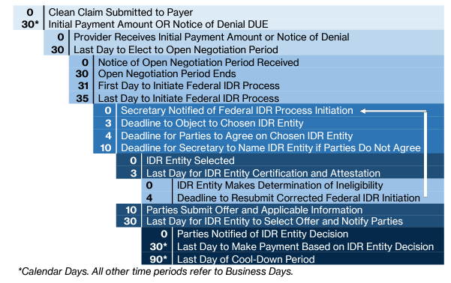
Payer–Provider Dispute Resolution Process

Slide 19
Requirement vs. Reality: Open Negotiation & IDR
Requirement | Policy Goal | Reality
Notice | Disputing providers are required to notify the payer of the intent to engage in open negotiation to encourage parties to settle disputes prior to IDR. | Payers often dispute receipt of the required notice. Copies of emails and letters are frequently required to be provided for each claim to demonstrate required notice has been provided. This process delays eligibility determinations by certified IDR entities and, ultimately, any payment determination.
30 Business Day Open Negotiation | Entities are encouraged to use this time to come to a mutually acceptable agreement prior to IDR. | Payers fail or refuse to negotiate prior to IDR forcing providers to file claims with the certified IDR entity.
Disputed Claim Batching | Grouping same or similar items or services allows for efficient resolution of disputed claims. | For Self-insured Group Health Plans, qualified IDR items or services can be batched only if payment is made by the same plan, even if the same third-party administrator (“TPA”) administers multiple self-insured plans. Often it is unknown whether claims from the same TPA are from the same or different plans, making it impossible for disputing parties to know whether it is appropriate to batch.

Slide 20

Policy vs. Reality: Federal & State Jurisdiction
Requirement | Policy Goal | Reality
Jurisdiction | The No Surprises Act’s statutory authority is limited in jurisdictions where an existing state dispute resolution process exists. | Disputing parties and certified IDR entities must interpret a complex decision matrix of federal preemption and state law for each claim where minute details, such as the presence of certain Common Procedural Terminology (“CPT”) codes, can drive whether state or federal dispute resolution applies.

Slide 21
State v. Federal Process
Federal IDR Process |  | Bifurcated Process*
Alabama Arizona Arkansas District of Columbia Hawaii Idaho Indiana Iowa Kansas Kentucky Louisiana Massachusetts Minnesota Mississippi Montana | North Carolina North Dakota Oklahoma Oregon Pennsylvania Rhode Island South Carolina South Dakota Tennessee Utah Vermont West Virginia Wisconsin Wyoming | California Colorado Connecticut Delaware Florida Georgia Illinois Maine Maryland Michigan Missouri Nebraska Nevada New Hampshire | New Jersey New Mexico New York Ohio Texas Virginia Washington
American Samoa Guam Northern Mariana Islands | Puerto Rico U. S. Virgin Islands | *Self-insured plans sponsored by private employers, private employee organizations, or public payers in these states that have not opted into the state process should use the Federal IDR process. Similarly, FEHB carriers that do not have contract terms with OPM to use a state process should also use the Federal IDR process.

Slide 22
Requirement vs. Reality: IDR Determinations, Costs, Payments
Requirement | Policy Goal | Reality
Administrative Fees | Parties should pay a nonrefundable fee to cover the costs of administering the IDR process | Administrative Fee for 2023 was announced to remain $50, then increased 7x to $350 on December 23, 2022. Providers with smaller amounts in dispute due to batching or other rules stopped filing IDRs and were forced to accept underpayments.
IDRE Determination | The IDRE has several data points to consider in determining the appropriate reimbursement amount, giving parties equal bargaining power and incentives to negotiate an agreed amount or enter into a network agreement | QPA given outsized role in IDRE determinations, disincentivizing negotiations and network agreements, leading some Payers to offer significantly worse contract terms or threaten termination to in-network providers.
Payment 30 Days After IDRE Decision | Losing party timely remits payment to the prevailing party based on the IDRE’s determination | There is no enforcement mechanism to ensure timely payment. Payers may delay or fail to remit payment or may issue a retroactive denial.

Slide 23

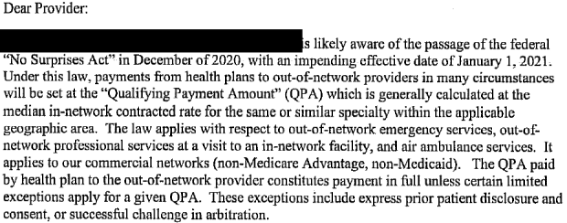
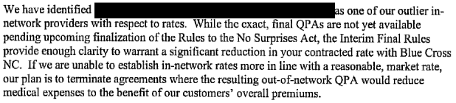
Managed Care Contracting
https://www.asahq.org/about-asa/newsroom/news-releases/2021/11/bcbs-abuses-no-surprises-act-regulations

Slide 24
Lawsuits Related to IDR Regulations
Texas Medical Association vs. HHS
I & II – IDRE Determination Factors
III – QPA Calculations
IV – Administrative Fee Hike & Batching
Haller vs. HHS
Constitutional Challenge
Others

Slide 25
Patient Cost Transparency for Scheduled Services

Slide 26
Definitions & Language
If I say: | I mean:
GFE | Good Faith Estimate – A notification of the expected charges for furnishing a medical item or service, including any item or service that is reasonably expected to be provided at the same time
Self-Pay | An individual without healthcare insurance (uninsured) or an individual who is not seeking to have a claim submitted to their plan for a medical item or service
PPDR | Patient–Provider Dispute Resolution Process – How the appropriate payment amount is determined when a Self-Pay patient receives a bill from a Provider that exceeds the GFE by at least $400
SDRE | Selected Dispute Resolution Entity – Organizations that applied to and were approved by the Departments to administer PPDR
AEOB | Advance Explanation of Benefits – A notification from a Payer to an insured individual including a GFE and the individual’s estimated cost-sharing and other financial requirements

Slide 27
Price Transparency for Scheduled Services
Requirement | Summary | Policy Rationale
GFE | The scheduling Provider must deliver a comprehensive estimate of all expected costs associated with a medical item or service to a Self-Pay patient upon request or at time of scheduling | Self-Pay patients should be able to “shop” scheduled services for the best price
PPDR | Self-Pay patients may dispute a final bill when the billed amount exceeds the GFE by at least $400 | Holds Providers accountable to accurate patient estimates
AEOB | The Payer must deliver a comprehensive estimate of all expected out-of-pocket costs associated with a medical item or service to an insured patient upon request or at the time of scheduling | Insured patients should be able to “shop” scheduled services for the best price

Slide 28
GFE Legislative & Regulatory Activity
Consolidated Appropriations Act of 2021
Created new obligations to provide GFEs to self-pay and AEOBs for insured
Uninsured / Self-Pay GFEs: Interim Final Rule, October 7, 2021
45 C.F.R. Subpart G, §149.610 et seq.
Defines terms, including Convening Provider, Co-Provider, Expected Charge, Primary Item or Service, and Uninsured (Or Self-Pay) Individual
Effective January 1, 2022
Insured GFEs: Request for Information, September 16, 2022
Issued for information and planning purposes prior to drafting regulations implementing Insured GFEs and AEOBs
Specific information requested includes data transfer recommendations, policy approaches, and economic impact

Slide 29
Price Transparency vs No Surprises GFEs
Hospitals Only
Insured and Self-Pay
Patient Self-Service
Shoppable Services Only
Delivered Online
Estimates in Real-time
Effective January 1, 2021
Hospitals & Professionals
Self-Pay (currently)
Upon Patient Request & Scheduling
All Services
Delivered Electronically & Paper
Estimates in 1-3 Business Days
Effective January 1, 2022
Price Transparency No Surprises Act
Single Expected Out-of-Pocket Amount
Displayed on Provider’s
Website
CMPs for
Non-compliance

Slide 30
Definition of GFE
A notification of expected charges for a scheduled or requested item or service, including items or services that are reasonably expected to be provided in conjunction with such scheduled or requested item or service, provided by a convening provider, convening facility, co-provider, or co-facility.
Expected charge means the cash pay rate or rate established by a provider or facility for an uninsured individual, reflecting any discounts for such individuals
Convening provider or convening facility means the provider or facility who receives the initial request for a good faith estimate from an uninsured individual and who is or, in the case of a request, would be responsible for scheduling the primary item or service
Co-provider or co-facility means a provider or facility other than a convening provider or a convening facility that furnishes items or services that are customarily provided in conjunction with a primary item or service
Notes:
IFR II

Slide 31
GFE Requirements for Providers/Facilities
Convening providers and facilities must determine if a patient is self-pay by:
Inquiring if an individual is enrolled in a plan;
Inquiring whether an individual who is enrolled in a plan is seeking to have a claim submitted to their plan; and
Informing all uninsured individuals of the availability of a GFE of expected charges upon scheduling or upon request
Information regarding the availability of GFEs must be:
Clear and understandable, prominently displayed on website and in the office where scheduling occurs
Orally provided when scheduling an item/service; and
Available in accessible formats and in languages spoken by the individuals considering or scheduling the item/service
The GFE is part of the medical record and must be maintained in the same manner
Notes:
IFR II

Slide 32
Content Requirements for GFEs
Required Information
Patient name and date of birth.
Description of the primary item or service in clear and understandable language (and if applicable, the date the primary item or service is scheduled).
Grouped by each provider or facility, the list of items or services reasonably expected to be furnished for the primary item or service, for that period of care including: Items or services reasonably expected to be furnished in conjunction with the primary item or service; Items or services reasonably expected to be furnished by the convening provider or convening facility for the period of care; and Items or services reasonably expected to be furnished by co-providers or co-facilities).
Diagnosis codes, service codes, and expected charges associated with each listed item or service.
Name, National Provider Identifier (“NPI”), and Tax Identification Number (“TIN”) of each provider or facility represented in the GFE, and the state(s) and office/facility location(s) where the items or services are expected to be furnished.
If the convening provider or facility anticipates the individual will require separate scheduling for items and services that are expected to occur before or following the expected period of care for the primary item or service, a list of those items and services.

Slide 33
Convening Providers vs Co-Providers
 | Convening Provider | Co-Provider | Convening Facility | Co-Facility
Scope | Physician or other health care provider | Physician or other health care provider | An institution (e.g., hospital, laboratory) | An institution (e.g., hospital, laboratory)
Definition | Responsible for providing the GFE to an uninsured (or self-pay) individual per the following: Requests Prior to Scheduling: When the Provider receives the initial request for a good faith estimate (GFE). Requests when Scheduling: When the Provider is responsible for scheduling the primary item or service. | Provider that furnishes items or services that are customarily provided in conjunction with primary items or services and: Requests Prior to Scheduling: Did not receive initial request from patient for GFE. Scheduled Services: Is not responsible for scheduling the primary item or service *If an individual separately schedules or requests a GFE from a co-provider, that provider is now a convening provider. | Responsible for providing the GFE to an uninsured (or self-pay) individual per the following: Requests Prior to Scheduling: When the Facility receives the initial request for a good faith estimate (GFE) Requests when Scheduling: When the Facility is responsible for scheduling the primary item or service. | Facility that furnishes items or services that are customarily provided in conjunction with primary items or services and: Requests Prior to Scheduling: Did not receive initial request from patient for GFE. Scheduled Services: Is not responsible for scheduling the primary item or service. *If an individual separately schedules or requests a GFE from a co-facility, that facility is now a convening facility.

Slide 34
Turnaround Time
 | Convening Provider | Co-Provider | Convening Facility | Co-Facility
Timeframe for Providing the GFE | GFE must be provided to the patient: Not later than 1 business day after the date of scheduling when a primary item or service is scheduled at least 3 business days in advance; OR Not later than 3 business days after the date of scheduling when a primary item or service is scheduled at least 10 business days in advance; OR Not later than 3 business days after the date of the request when a GFE is requested by an uninsured individual. | Must provide, and the convening provider or facility must receive, the GFE information no later than 1 business day after the co-provider or co-facility receives the request from the convening provider or facility. | GFE must be provided to the patient: Not later than 1 business day after the date of scheduling when a primary item or service is scheduled at least 3 business days in advance; OR Not later than 3 business days after the date of scheduling when a primary item or service is scheduled at least 10 business days in advance; OR Not later than 3 business days after the date of the request when a GFE is requested by an uninsured individual. | Must provide, and the convening provider or facility must receive, the GFE information no later than 1 business day after the co-provider or co-facility receives the request from the convening provider or facility.

Slide 35
Changes in Circumstances
 | Convening Provider | Co-Provider | Convening Facility | Co-Facility
Changes in Treatment (e.g., items and services) for Scheduled Services | üMust provide a new GFE if a convening provider, convening facility, co-provider, or co-facility anticipates or is notified of any changes to the scope of a GFE (e.g., expected charges, items, services, frequency, recurrences, duration, providers, or facilities). üA new GFE must be issued no later than 1 business day before the items or services are scheduled to be furnished. | If any changes in the expected co-providers or co-facilities represented in a GFE occur less than 1 business day before the item or service is scheduled to be furnished, the replacement co-provider or co-facility must accept as its GFE of expected charges the original GFE that was provided by the replaced provider or facility. | üMust provide a new GFE if a convening provider, convening facility, co-provider, or co-facility anticipates or is notified of any changes to the scope of a GFE (e.g., expected charges, items, services, frequency, recurrences, duration, providers, or facilities) üA new GFE must be issued no later than 1 business day before the items or services are scheduled to be furnished. | If any changes in the expected co-providers or co-facilities represented in a GFE occur less than 1 business day before the item or service is scheduled to be furnished, the replacement co-provider or co-facility must accept as its GFE of expected charges the original GFE that was provided by the replaced provider or facility.
Change in Providers and Facilities | If any changes in expected providers or facilities in a GFE occurs less than 1 business day before the item or service is scheduled to be furnished, the replacement provider or facility must accept as the expected charges in the original GFE . | If any changes in expected providers or facilities in a GFE occurs less than 1 business day before the item or service is scheduled to be furnished, the replacement provider or facility must accept as the expected charges in the original GFE. | If any changes in expected providers or facilities in a GFE occurs less than 1 business day before the item or service is scheduled to be furnished, the replacement provider or facility must accept as the expected charges in the original GFE. | If any changes in expected providers or facilities in a GFE occurs less than 1 business day before the item or service is scheduled to be furnished, the replacement provider or facility must accept as the expected charges in the original GFE

Slide 36
How should a Good Faith Estimate be provided?
Estimate must be delivered to patients in writing, which can be accomplished in several ways:
Delivered electronically (e.g., through e-mail, a patient portal, etc.)
Delivered via paper (e.g., through USPS, in person)
Note that because estimates must be delivered within 1–3 business days, may be difficult to meet requirements if mailing to patient
Best Practices
Scheduling departments and staff should confirm whether insurance will be utilized for every patient at time of scheduling services.
Treat all conversations regarding patient expected or anticipated financial responsibility as a request for a GFE

Slide 37
Patient–Provider Dispute Resolution Process
If the total billed charges are substantially in excess of—at least $400 greater than—the total expected charges for that specific provider or facility listed on the GFE:
Self-pay patient may initiate the PPDR process by notifying HHS within 120 calendar days after receiving the bill with charges in excess of the GFE
Resolved by an SDRE who reviews all documentation submitted by the patient and provider and:
Determines, for each unique item or service, whether the excess charge reflects the cost of a medically necessary item or service; and
Determines whether the difference between the billed charge and the GFE is based on unforeseen circumstances that could not have reasonably been anticipated when the GFE was provided
Notes:
IFR II

Slide 38

Prohibitions on Collections During PPDR Process
While the PPDR process is pending, the provider or facility must not move the bill for the disputed item or service into collection or threaten to do so.
If the bill has already moved into collection, the provider or facility should cease collection efforts.
The provider or facility must also suspend the accrual of any late fees on unpaid bill amounts until after the dispute resolution process has concluded.
Notes:
IFR II

Slide 39
Insured GFEs – What’s the Difference?
Requires payers to send an AEOB to an insured patient upon receiving a GFE from a provider.
Which plans are impacted?
Group health insurance plans;
Health insurers offering individual or group coverage;
Not federal healthcare programs (Medicare, Medicaid, etc.)
Departments deferred enforcing regulatory standards for insured GFEs in initial final rulemaking
No technical infrastructure existed to implement these provisions
For services scheduled at least 10 business days before a service is to be furnished:
Providers send the GFE to the Payer
Payers have 3 business days to produce the AEOB and send to the patient
For services scheduled within ten business days before a service is to be furnished:
Providers send the GFE to the Payer
Payers have 1 business day to produce the AEOB and send to the patient

Slide 40

Questions?

Slide 41
Thank you!

