Slide 1
It’s time
Dennis E. Dahlen, CPA, MBA, FHFMA
CFO, Mayo Clinic
2023-24 National Chair, HFMA
Notes:
Good morning.
I’m thrilled and honored to be here with you and to be your 2023-24 national chair.

Slide 2



39 years, 3 Chapters, Board Member since 2017
Notes:
I’ve been a member since 1984…that’s 39 years…and been a member of three chapters in my career:
North Dakota, where I went through the officer roles.
Arizona, where I was a member and supported others in my organization to go through the chair roles.
And now Minnesota, where I’ve sadly been less present than I would have liked.

Slide 3

Notes:
I grew up on my family’s dairy farm. Farming can be a wonderful vocation and lifestyle, but it also involves a significant amount of risk because on balance there are too many things out of your control. Fuel prices…feed availability…diseases…and pests.
But any guesses on what the biggest uncontrollable input into a farm operation is?

Slide 4
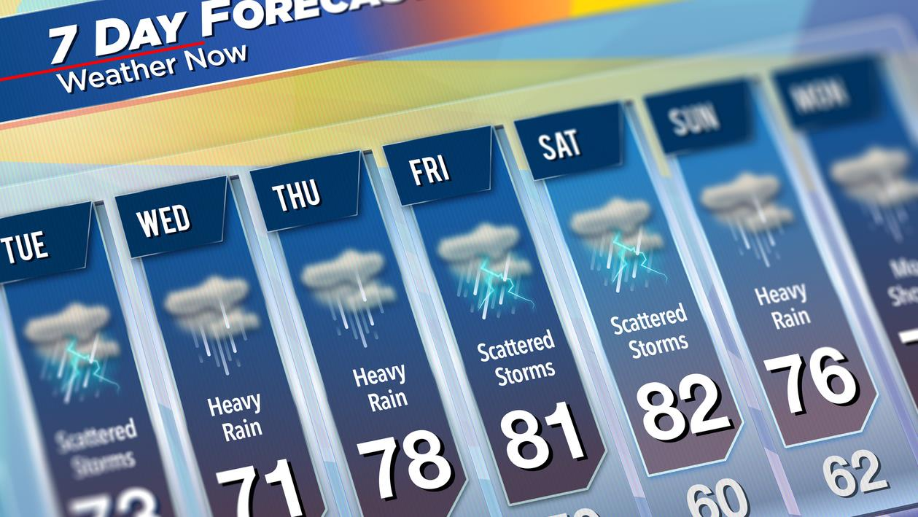
Notes:
That’s right…weather.
If, like me, your formative years included a farming experience, you’re always living with the sense that there are only so many days or hours that will be right for whatever it is that needs doing…and weather is the biggest variable.
It affects planting…harvesting…calving…tillage…equipment repairs…and essentially almost everything on a farm.
This behavior is reinforced when your life is on a farm, and that same feeling has been present for the past few years in my professional vocation…healthcare finance.

Slide 5
“If something cannot go on forever, it will stop.”
– Herbert Stein
Notes:
We’re at an unusual time in our history, one where we may have achieved that perfect storm for innovation when technology, policy and culture aligns.
The duress on the industry is unmistakable, and as the acclaimed economist, Herbert Stein, famously noted, “If something cannot go on forever, it will stop.”
Consider this……

Slide 6
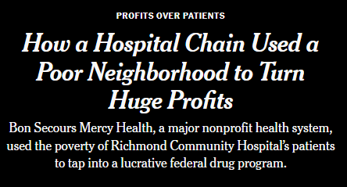
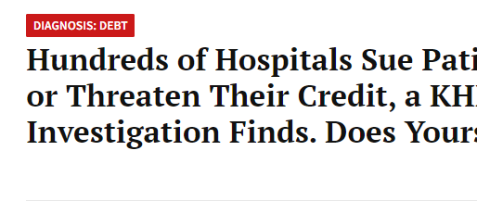
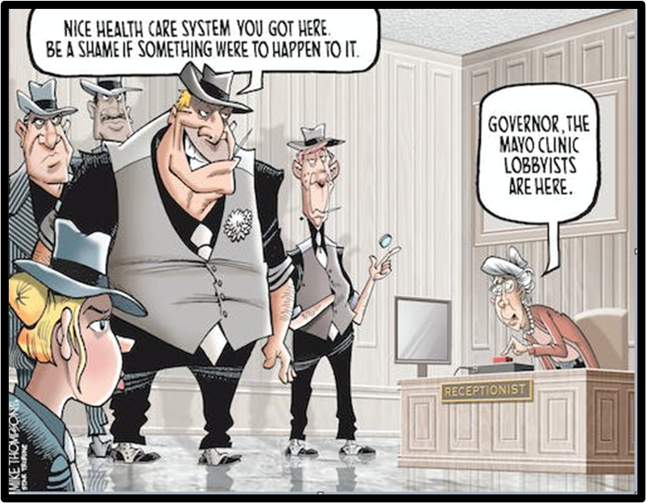
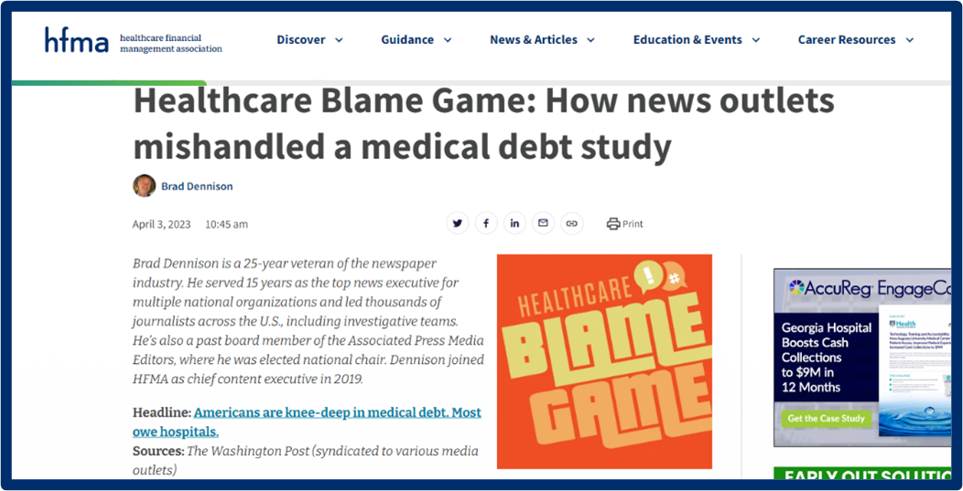

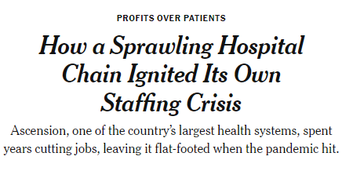
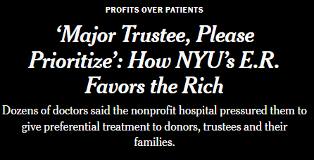
Losing the Battle for Hearts and Minds
Notes:
The nation that saluted healthcare providers during the COVID pandemic seems to have become more skeptical of us, taking us from heroes to zeroes. The headlines in the Wall Street Journal…the NY Times…and others point at NFP healthcare providers with allegations of using 340B discounts inappropriately…of creating our own staffing crisis…of intentionally serving wealthy and influential patients preferentially…and utilizing draconian collection techniques to collect debts.
[Click to bring up Mayo cartoon]
[CLICK to bring up “blame game graphic]
I would encourage you to read Brad Dennison’s new HFMA blog “Healthcare Blame Game,” in which Dennison and others point out the flawed reporting in some of these stories and thank HFMA for their help on this important front.
But the point remains we're at the very least under scrutiny... and at most not meeting minimum standards of service…performance…and mission impact.

Slide 7
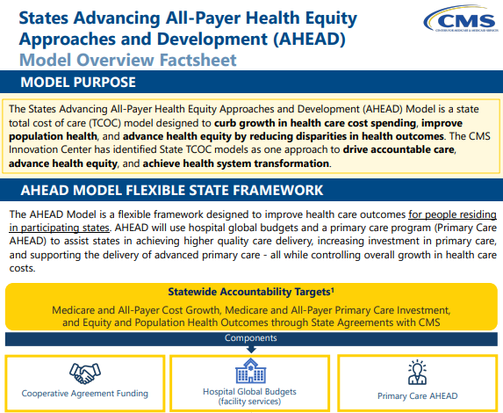
Rise of State-level Healthcare Affordability Efforts
Massachusetts (2012)
Delaware (2018)
Rhode Island (2019)
Connecticut (2020)
Oregon (2021)
Washington (2021)
New Jersey (2021)
Nevada (2021)
California (2021)
Indiana (2023)
Minnesota (2023)
Notes:
The momentum building at the state level for affordability boards and global budgeting approaches to controlling healthcare costs also bears watching. You can see from the dates for each state the number of recent additions to the list, including what is by most measures the business-friendly, politically red state of Indiana. It opens another consequential front in the interface between policymakers and providers in the work to improve the performance of the healthcare system.
Perhaps surprisingly, these efforts are being supported by the recently-announced AHEAD model promoted by CMS. States can apply for the AHEAD model which includes hospital global budgets – HGB’s – for acute care hospitals, critical access hospitals, and rural emergency hospitals as well as enhanced primary care payments to be focused on behavioral health integration, care management and specialty coordination, and health-related social needs.
Clearly, a step toward global budgets has both pros and cons but if followed to its conclusion, leads us to a very different future than what other value-based models would have led to.

Slide 8
Significant Operating Pressure Faced by Healthcare Providers Nationwide --- Change in Operating EBITDA Margin for the Twelve-Month Period Ended December 31, 2021 and 2022 for Health Systems with more than $3 Billion in Revenue
Collapsing Health System Margins….
Change in Operating EBITDA Margin for the Twelve-Month Period Ended December 31, 2021 and 2022 for Health Systems with more than $3 Billion in Revenue
Change in Op. EBITDA Margin
Total Op. Revenue ($B)
Total operating revenues increased an average of 4.0% Y-o-Y from the 12 month period ended December 2021 to December 2022
On average, large health systems EBIDA margins declined by 3.4% for the comparative 12 month periods ended December 2021 and December 2022
This decline in operating performance was observed across the board
 | Total Operating Revenue
 | Change in Operating EBITDA Margin for NFP “A” Category
 | Change in Operating EBITDA Margin for NFP “AA” Category
 | Change in Operating EBITDA Margin for For Profit Systems
1
____________________
Source: EMMA – Audited and Interim Financials as of and for the 12-month ended December 31, 2021 and 2022; based on national and large regional healthcare providers with more than $3 billion in revenues with December 31, 2022 financials; BofA Securities database
Notes:
Considerate this...unprecedented financial trauma among even the bedrock organizations of healthcare…large health systems. The most recent calendar year has been marked with unprecedented losses and performance declines. Even the best positioned hospitals…the market essential ones…are suffering losses. This graph portrays the year-over-year performance changes…EBIDTA margins…for most of the largest and most successful U.S. healthcare systems for 2022.
And if the year-over-year change wasn’t significant enough, the number of these very large organizations that have the advantages of scale…market essentiality…and access to the best talent are generating operating losses.

Slide 9
Labor Cost Pressure… --- Change in Labor Cost as % of Revenue for the Twelve-Month Periods Ended December 31, 2021 and 2022
….and Labor Cost Pressure
Change in Labor Cost as % of Revenue for the Twelve-Month Periods Ended December 31, 2021 and 2022
Change in Labor Cost as % of Revenue
3
____________________
Source: EMMA – Audited and Interim Financials as of and for the 12-month ended December 31, 2021 and 2022; based on national and large regional healthcare providers with more than $3 billion in revenues with December 31, 2022 financials; BofA Securities database
Notes:
I suspect there is no one in the room that isn’t aware of healthcare’s labor challenges…shown here as the year-over-year increase in labor costs stated as a percent of revenue.

Slide 10
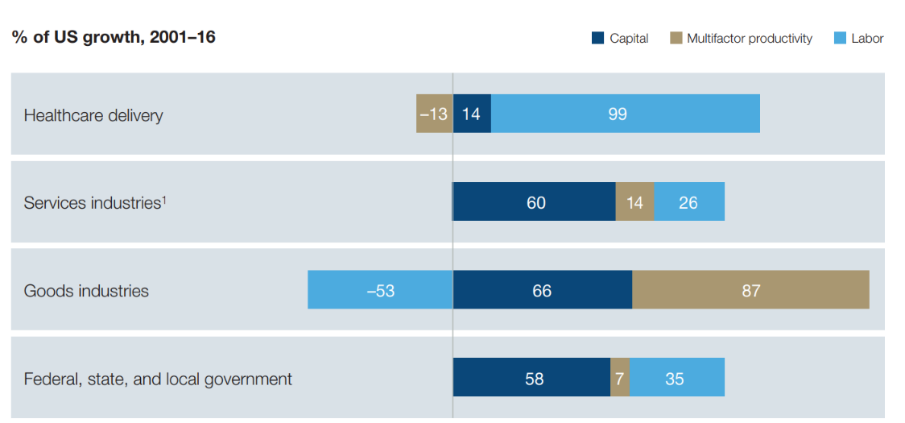
Healthcare’s Negative Productivity
Growth Attributed to Labor
Healthcare 99%
vs.
Overall U.S. Economy 25%
Sources: Bureau of Economic Analysis, Bureau of Labor Statistics and McKinsey analysis
Notes:
We’ve worried workforce issues for years have finally come home to roost and we’ve shown no ability as an industry to be able to grow any other way than by scaling human labor. This slide references a McKinsey study showing healthcare growth over a recent 15 year period vs the US economy. The graphs on the right highlight the fact that healthcare growth was made possible almost entirely – 99% - through human effort and scaling labor; the US economy used technology and productivity gains to a much greater degree – about 75 %. A thought: this growth, while creating massive demands on federal debt/deficits, and is a constant irritant to the business community, is not ALL bad. We have created millions of well paying jobs, benefiting our society. So how do we balance the cost/benefit of healthcare industry growth. The point that might make sense to raise is the line between positive growth and impact and uncontrolled negative growth is really hard to decipher. In essence, without diluting your point, it may throw a bone to the industry attendees. Again, just a thought.

Slide 11
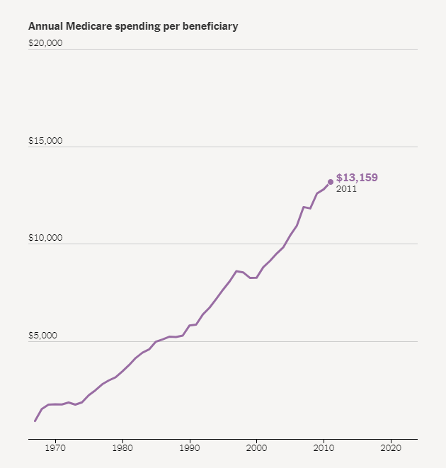
Labor Cost Pressure… --- Change in Labor Cost as % of Revenue for the Twelve-Month Periods Ended December 31, 2021 and 2022
There is Hope…..
Progression in Medicare per Beneficiary Spending, 1968 - 2011
6.7% annual growth rate
____________________
Source: New York Times Article – A Huge Threat to the U.S. Budget Has Receded. And No One Is Sure Why By Margot Sanger-Katz, Alicia Parlapiano and Josh Katz, Sept. 4, 2023

Slide 12
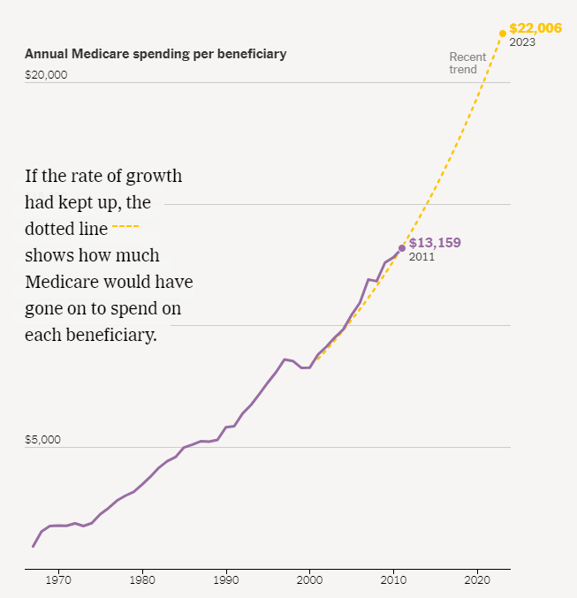
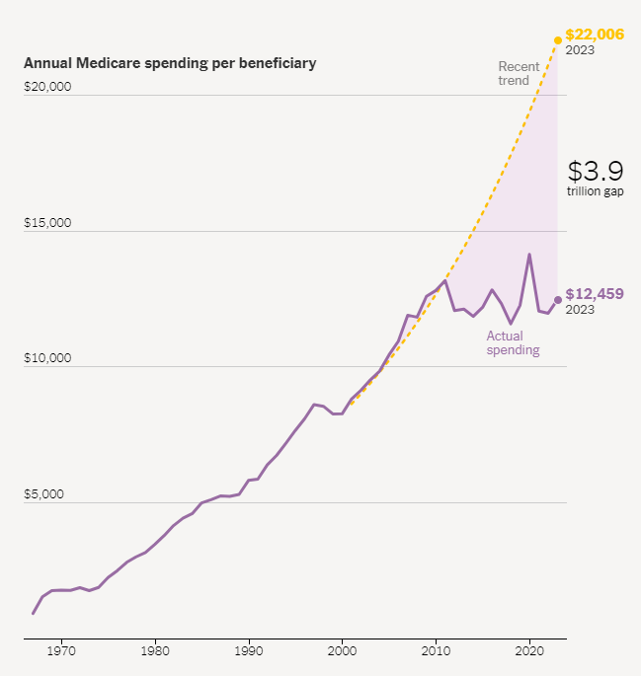
Labor Cost Pressure… --- Change in Labor Cost as % of Revenue for the Twelve-Month Periods Ended December 31, 2021 and 2022
……in Medicare Spending
Progression in Medicare per Beneficiary Spending, 1968 - 2023
____________________
Source: New York Times Article – A Huge Threat to the U.S. Budget Has Receded. And No One Is Sure Why By Margot Sanger-Katz, Alicia Parlapiano and Josh Katz, Sept. 4, 2023

Slide 13

Hope from medical science
mRNA Vaccinology for cancer and viruses
Delaying Type 1 Diabetes: monoclonal antibody Teplizumab
Human Genome Mapping Completed
Cellular Senescence: cure for aging and age-related diseases like cancer, diabetes, cardiovascular disease
Extracellular Vesicles: new delivery vehicle for biologics
Breakthrough diagnostics
Notes:
So, significant trauma and reason for concern, but it’s also a time of discovery, innovation and promise. As I mentioned earlier, we may be in one of those sweet spots where culture, policy and technology align to create an opportunity for forward movement.
Consider for a moment the significant advances in science, treatments and cures. Touching on just a few here:
The application of many years of work on mRNA vaccine development during COVID is paying off in expanding ways to treat other disease, partially replacing the much slower processes used to create vaccines over the past century.
The monoclonal antibody Teplizumab was recently approved to delay the onset of clinical stages of diabetes, one of the most costly chronic conditions in terms of both treatment and lifestyle.
The mapping of the human genome was completed. For those of you who like me thought that had already been completed, approximately 8% was unmappable until recently, and it has now been completed.
A little farther down the path... something Mayo Clinic is working on ... is the study of cellular senescence. Senescent cells are cells that have aged and accumulated more than their share of toxins and…if they aren’t removed from the body naturally…invite inflammation and disease. As we age, our ability to remove them declines. But if we can remove them therapeutically, the chances for extended health…think no cancer…diabetes…cardiovascular disease…into old age increases.
We're also introducing new tools in imaging and labs to increase the signal-to-noise ratio, leading to quicker and better diagnostics.
As a recent New York Times article article headlined: "Suddenly, it looks like we're in a Golden Age for Medicine."

Slide 14

Hope from data science
Healthcare sector generates 30% of global data and is growing
Truveta: clinical data sets for trials
Nference: utility to transform decades of unstructured EMR data to power diagnostics and treatments
Culmination: an Intermountain Health company that provides omics-level data
ChatGPT: the age of Human-Machine collaboration?
Notes:
In addition to science, treatments, and cures, the proliferation and mass assemblage of clinical…demographic…and genomic data to power research and diagnostics promises to accelerate medical research…and also create artificial intelligence that just might allow us to use technology to improve on and/or replace humans as the caregivers.
I’ll mention just four:
1. Truveta: a firm that collects and provides large clinical data sets to researchers to assist in accelerating clinical trials.
2. Nference: a firm partnering with health systems to transform decades of rich and predominantly unstructured data captured in electronic medical records into powerful software solutions that enable scientists to discover and develop the next generation of personalized diagnostics and treatments for patients worldwide.
3. Culmination: an Intermountain Health company that provides or produces omics-level data to create an insights engine for medical research, health data, and healthcare services.
4. ChatGPT: is the age of AI and human-machine collaboration finally here?

Slide 15











Hope from innovation and disruption
www.goforward.com
www.onemedical.com
Notes:
There is Forward…a healthcare startup founded by ex-Googler Adrian Aoun…which has opened two locations on the east coast and with plans to become the de facto healthcare program of the future. Forward is a doctor's office that works like a gym membership and focuses on preventative healthcare…and promises to use advanced AI to help patients manage their health.
We’ve all heard about Amazon and One Medical. One Medical’s primary care model utilizes remote presence and multi-modal connections between patients and care providers with very convenient access to basic diagnostics and prescriptions. When acquired by Amazon, One Medical had 800,000 members in 26 markets, but Amazon and One Medical say their recent combination will transform the primary care experience for consumers.
Can they grow quickly to scale a better model nationally?
To quote Amazon CEO Andy Jassy: “If you fast forward 10 years from now, people are not going to believe how primary care was administered. Customers want and deserve better, and that’s what One Medical has been working and innovating on for more than a decade. Together, we believe we can make the healthcare experience easier, faster, more personal and more convenient for everyone.”
Coupled with Amazon’s e-Pharmacy business, I like their chances and hope they’re successful. And they certainly have the capital to do it!

Slide 16
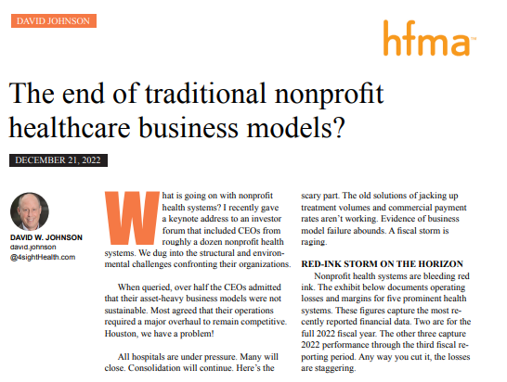
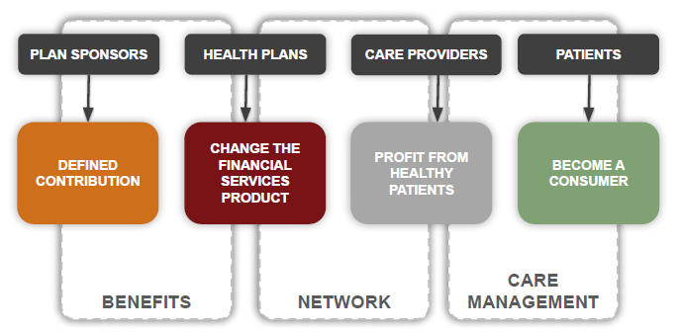
Voices of innovation: New models needed?
Notes:
Voices of innovation are challenging long held approaches and business models:
Our own Dave Johnson has asked whether the time has come for the end of the nonprofit business model for healthcare. (Joe: Maybe so as not to paint him (a board member) as negative against the industry we serve (and many of our members) I wonder if it is worth a 30 second pro/con of his argument simply to suggest it is not a simple binary question. That makes his point a debatable topic, and not just him railing against many of our members. I wonder if this softens it a bit. It also sets up the next point of duress and opportunity, debate and decision, solving a wicked problem. By the way, the term wicked problem is the best description of the complexity in which we operate, isnt it?)
There are successful PE firms investigating the use of tax incentives and features of the ACA to supplant the current annual enrollment approach to employer-sponsored healthcare with a defined contribution approach to better align incentives and eliminate the artificial boundaries and barriers in the current system.

Slide 17
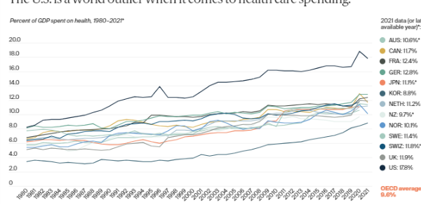
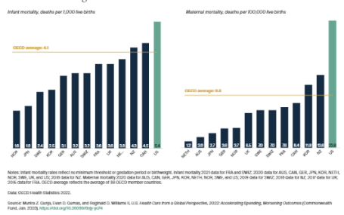

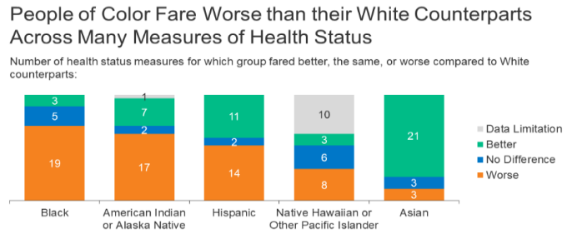
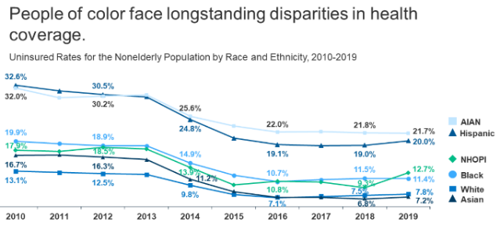
So much room for improvement
Source: KFF.org
Source: KFF.org
Notes:
At the same time, no one who is paying attention believes that what we all do together is optimal OR sustainable.
30-50% of our spending is waste, including the 15%-30% we spend on administration and which Health Affairs suggests is half waste.
U.S. health care spending grew 2.7 percent in 2021, reaching $4.3 trillion or $12,914 per person. As a share of the nation's Gross Domestic Product, health spending accounted for 18.3 %.
We rank off the charts in the wrong direction on spending and mortality – Commonwealth Fund keeps us honest on that front with their annual rankings.
Health disparities persist and demand our attention.

Slide 18
“It’s not necessary to change. Survival isn’t mandatory.”
– W. Edwards Deming
Notes:
As a professional association, we are well tuned to provide training, certification, and networking to help us all be more effective with all those pursuits but……..with 100,000 of us now, shouldn’t we be doing more to advance on the larger problem, the state of US healthcare, the excessive cost, the health disparities, and the underperformance on the health of our nation?
The inspiration for including this Deming quote – which is of course naturally true – came from our final interviews with Ann Jordan, HFMA’s new CEO, as we were discussing the imperative on cost effective health. Innovate or die!
The Call to Action
“It is not necessary to change. Survival isn’t mandatory.” – Deming

Slide 19


Our mission:
“To lead the financial management of healthcare.”
Notes:
Does everyone here know HFMA’s mission?
[Click to bring up text}
It is “To lead the financial management of healthcare.”
No one assigned us that mission. We chose it. We chose “lead” as the verb in that statement, and it confers some responsibility on us all individually…and explicit responsibility on the association to do something other than perpetuate waste and underperformance.
Lead is an interesting word and comment. It is easier from a distance than close up. Close up, leading can be hard and messy.
We could perhaps be forgiven for abrogating this responsibility if the future were hopeless…but nothing could be further from the case. The tools have never been more plentiful if we’re able to leverage the duress we’re under and embrace them.

Slide 20
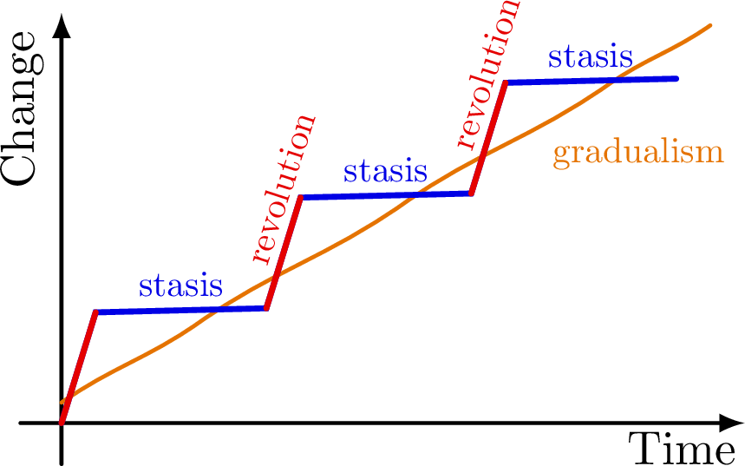
Punctuated equilibrium
Evolutionary development in systems is marked by isolated episodes of rapid speciation between long periods of little or no change.
Notes:
Is anyone here familiar with the concept of “punctuated equilibrium”? It is the hypothesis…based on observed behavior…that evolutionary development in systems is marked by isolated episodes of rapid speciation between long periods of little or no change. The periods of accelerated change are generally created by external factors.
The notion is simple. For most of history, we see stasis…or incremental change…until a significant event occurs causing rapid change in short time.
I think this hypothesis describes healthcare…long periods of stasis punctuated with periods of significant change and advancement. We have been in a period of relative stasis, waiting for conditions ripe for change.
Does the convergence of science, technology, and policy create an environment for punctuated equilibrium?
Can we be the punctuation in the sad equilibrium we’re in?

Slide 21

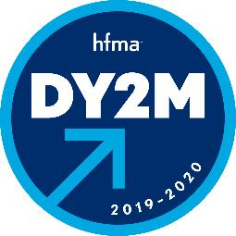


Notes:
I believe we can be, and that question was large on my mind as I chose "It's time" as the theme for my year as Chair. I also reflected on the fact that…in addition to being right for me personally…the theme ultimately needed to be right for the Association…for the members…for the industry… and for the moment in time.
Our recent chair themes have hinted at movement and action. For example…Kevin Brennan’s “Imagine Tomorrow”…Mike Allen’s “Dare You to Move”…Tammy Jackson’s “Bolder, Brighter, Better”…and Aaron Crane’s “Ignite the Spark.” Clearly, the past four chairs have all felt the same thing I’m feeling…that we’re not moving fast enough or making enough of a difference.”
I was…and am…fascinated by the duality of duress on the industry and opportunities in discovery and innovation…and reminded of the wisdom of not letting a good crisis go to waste.

Slide 22
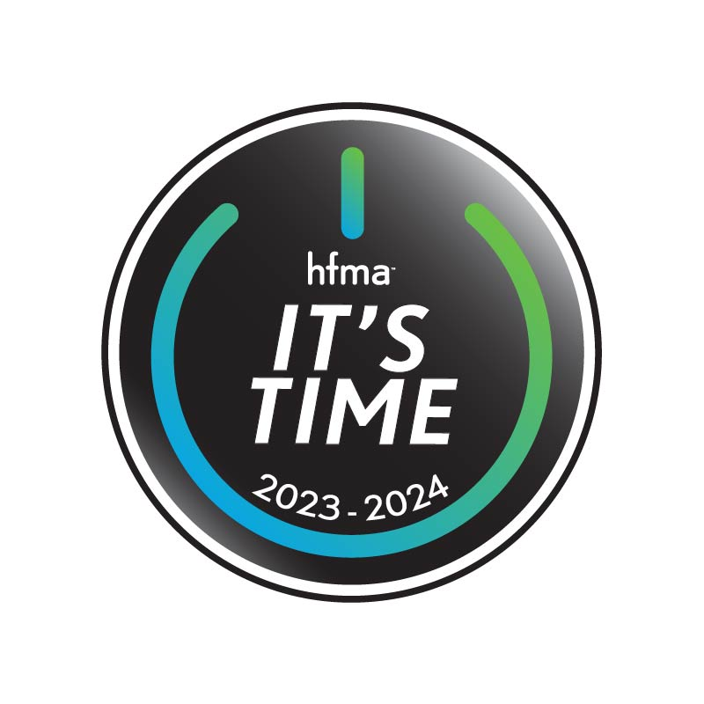
It’s Time…..
To REFLECT
To CELEBRATE
To ONBOARD
To ACT
Notes:
So...it’s time.
Time to:
Reflect on a 75-year history of service to the industry and our members…being the trusted authority on healthcare finance and providing our signature publications, thought leadership content and certification programs.
Celebrate the many accomplishments of the past 10 years, including the Polaris initiative…Chapters 2.0…pandemic operations…CEoH… Boomtown, etc.
Onboard a new CEO, enable new ideas and new business opportunities.
Start and Act…truly stepping into our CEoH goals and exploring new offerings in service to the industry and our members.

Slide 23
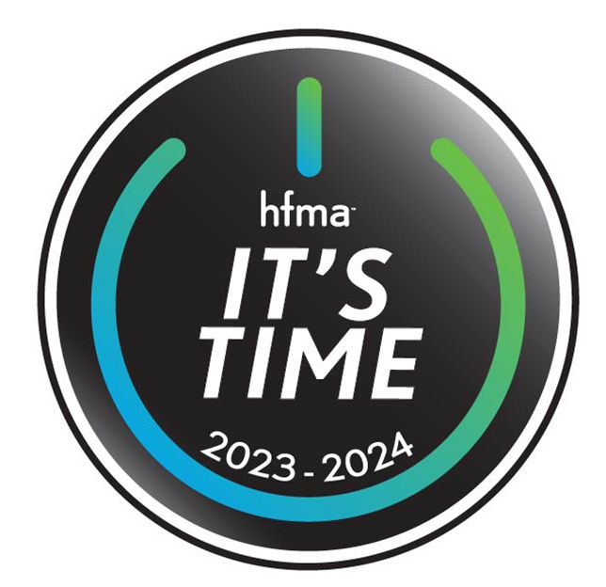
It’s Time…to ACT as a national organization
Collaborations and partnerships
Thought leadership and advocacy
Benchmarking and metrics
Research
Tools and resources
Education and training
Notes:
So, what are my hopes and dreams for the coming year? My hope is that we’ll exit the year firmly engaged as an association in the bigger picture of improving the industry that we all work in…reducing costs…increasing convenience and access…and improving health.
I’m confident HFMA will be leaning in at the national level with specific initiatives such as:
Collaborations and partnerships
Thought Leadership and advocacy
Benchmarking and metrics
Research
Increased tools for data and insights
Providing education and training opportunities to help healthcare finance professionals thrive in a rapidly evolving industry
In fact, HFMA is already making strides in several of these areas, and I’d like to spend the next few minutes sharing some of what we’ve been up to.

Slide 24
Collaboration and partnerships
Physician/clinical areas
American Organization for Nursing Leadership
National Academy of Medicine (formerly the IOM)
Institute for Healthcare Improvement
American Association for Physician Leadership
Health insurance plans
America’s Health Insurance Plans (AHIP)
Alliance for Community Health Plans
National Association of Insurance Commissioners
Society of Actuaries
Purchaser/employer/consumer perspective
Catalyst for Payment Reform
Community Catalyst
Leapfrog Group
National Alliance of Healthcare Purchaser Coalitions
Hospital and health systems
American Hospital Association
Association of American Medical Colleges
Catholic Health Association of the U.S.
Federation of American Health Systems
National Rural Health Association
Standard-setting bodies
Financial Accounting Standards Board
Governmental Accounting Standards Board
Regulatory agencies
Centers for Medicare & Medicaid Services
Department of Health and Human Services
Internal Revenue Service
Department of Treasury
Notes:
HFMA has a rich tradition of collaborating and partnering with other organizations and associations here in the US
These are some of the many groups with whom HFMA collaborates. Please note, however, that it is by no means an exhaustive list.

Slide 25


Collaboration and Partnerships: Academic
Boise State University: Master Degree Program
Carnegie Mellon University: Health finance in Master of Medical Management for Physicians, plus multiple undergrad courses in health finance.
Case Western: Senior Nurse Executive Fellowship program
University of Iowa: Healthcare Business Leadership for Pharmacy and Dental Fellows
Notes:
This slide depicts some of the universities and academic institutions with which HFMA is collaborating on healthcare finance education opportunities.
We’re especially excited about the partnership with Boise State University to co-create and deliver a master degree program…the Master in Population and Health Systems Management Degree:
The program consists of 30 Hours…5 semesters, spread over 2 years.
Total Degree Cost (Tuition, Fees, Books): $26,000
Remote instruction, coursework available 24/7, proceed at your own pace.
Includes the ability to earn 4 HFMA certifications, co-taught by BSU and HFMA.

Slide 26

Notes:
Another example of collaboration is HFMA signing on to the Smart Check-In initiative that seeks to standardize the way insurance plan information is shared between patients, providers and health plans. There are currently over 1,000 difference health plans in the U.S., each with their own format and approach.
As the primary membership organization for healthcare revenue cycle leaders, HFMA’s endorsement and engagement with the initiative leaders will be very helpful in perfecting this advancement and promoting wide adoption of an improvement to a routine and repeated step in the patient care process. I want to specifically thank our revenue cycle leadership group for their efforts.

Slide 27

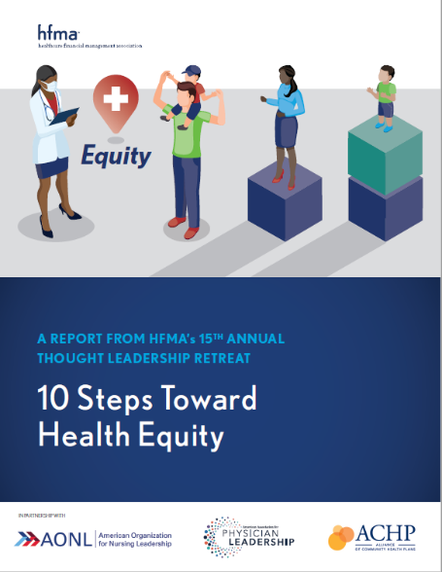
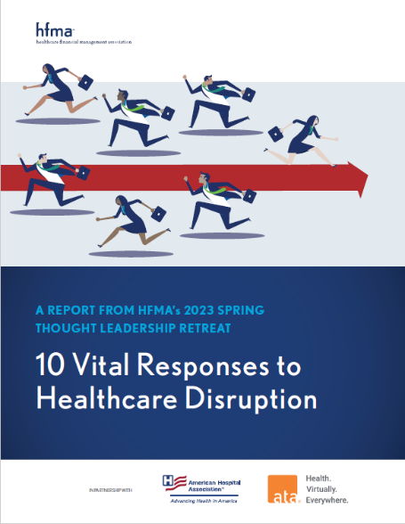
Thought Leadership Retreat
www. hfma.org/guidance/
Notes:
Another of HFMA’s thought leadership activities is the annual Thought Leadership Retreat, which brings together senior clinical, financial and health plan executives to collaboratively discuss and develop strategies to address emerging trends.
Based on these discussions, HFMA publishes a summary report and shares findings with the community. You can access these reports on the HFMA website.
The reports from the three most recent retreats are featured on this slide:
2021: Cost-effective health
2022: Health equity
Spring 2023: Healthcare disruption
You can access these…and all the Thought Leadership report on the HFMA website.
The next Thought Leadership Retreat will take place in late September 2023, when attendees will consider the timely topic of restoring trust in healthcare.

Slide 28

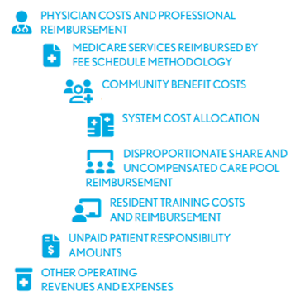
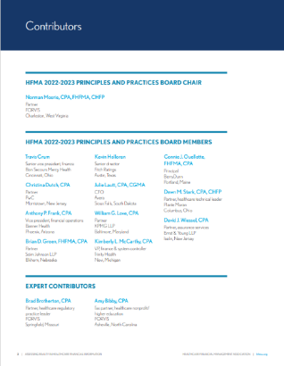



Significant Operating Pressure Faced by Healthcare Providers Nationwide --- Change in Operating EBITDA Margin for the Twelve-Month Period Ended December 31, 2021 and 2022 for Health Systems with more than $3 Billion in Revenue
HFMA’s Principles and Practices Board:
The Industry’s Source of Truth
“Financial statements, tax/information returns, and Medicare cost reports are key information sources for the healthcare industry, but many times they convey seemingly contradictory information, which creates confusion for both management and external stakeholders.”
www. hfma.org/guidance
Notes:
HFMA’s Principles & Practices Board…aka the P&P Board…reevaluates…clarifies…and establishes accounting principles and financial reporting practices of health service organizations.
Their work is issued in the form of position statements, issue analyses and white papers.
The most recent white paper…”Assessing reality in healthcare financial information”…was issued in late-April 2023.
It addresses the issue of financial statements…tax/information returns…and Medicare cost reports. These are key information sources for the healthcare industry…but many times…convey seemingly contradictory information, creating confusion for both management and external stakeholders.
Thus, the goal of this latest P&P white paper is to help readers understand the purpose and use of distinct information sources is essential to assessing reality in healthcare information.
You can access this white paper…and all P&P Board guidance…on the HFMA website at www. Hfma.org/guidance

Slide 29
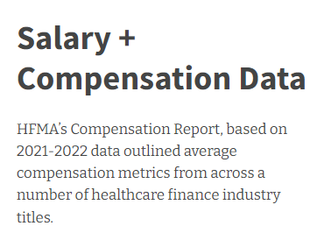
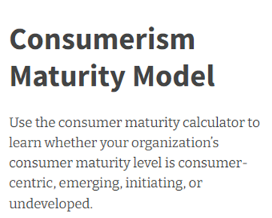
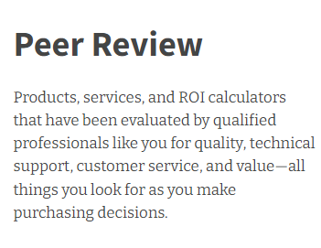
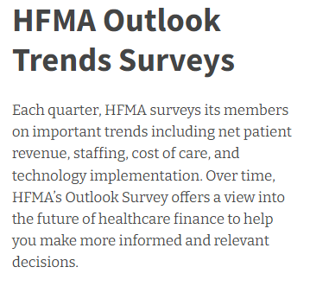


Data + Insights
HFMA Member Value Tools and Services:
https://www.hfma.org/data-and-insights/
Notes:
In today’s increasingly data-driven healthcare world, HFMA’s Data + Insights is a combination of HFMA-driven research…industry-developed key performance indicators…and tools designed to improve results.
HFMA also has developed a process that validates third-party resources from companies interested in providing additional HFMA member value through complimentary access to datasets. These companies…and tools…go through financial, legal and member review before data is offered to HFMA Members as part of their HFMA Membership.
This slide features some of these resources that are designed to help you discover emerging strategies to advance your healthcare data analytics and solve your clinical and business challenges.
You can access all of these tools and resources on the HFMA website.

Slide 30
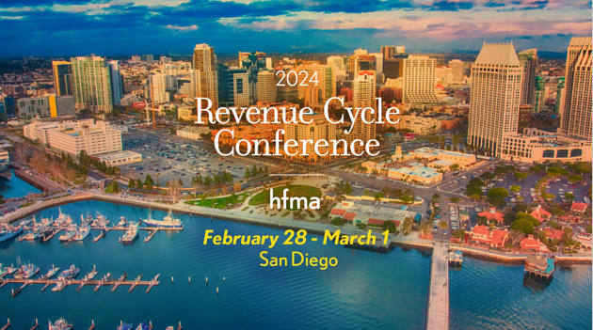
Notes:
Some of HFMA’s most popular offerings are our “live” conferences where attendees enjoy top-notch educational and networking opportunities.
That includes the annual Revenue Cycle Conference. The next one will take place Feb 28-March 1 in San Diego. The 2023 event sold out, so watch for registration to open later this fall if you’re wanting to attend.

Slide 31
Notes:
We also hope you’re planning to join us next year when we gather in Las Vegas for HFMA’s 2024 Annual Conference. The event will take place June 24 through June 27 at the Mandalay Bay Resort and Casino.
Ask anyone who’s been to an HFMA Annual Conference in Vegas, and they’ll tell you it’s always a good time.

Slide 32
It’s Time…to ACT as individuals
BOLO for innovations or results in service to CEoH
Join the conversations to advance the cause
Share your thoughts on coming attractions and new initiatives
Notes:
As individuals and leaders, it is imperative that we all lean in as well. Let’s be on the lookout for innovative solutions that can make a difference on the big picture of cost, convenience and results.
Please listen and watch for new initiatives from your association as we leverage all 100,000 of us in this infinite game of improving health for ourselves…our neighbors…and the next generation.
And finally, please let us know what you think would be most effective for the national organization to focus on to advance this cause.

Slide 33

Leadership Lesson: Run to the Sound of the Guns
Admiral William H. McRaven
(US Navy Retired)
Commander, U.S. Special Ops Command
Responsible for planning Bin Laden operation
Navy Seal – the “Bullfrog”
Chancellor, Univ. of Texas at Austin
“Make Your Bed”
Notes:
I want to close with a leadership lesson in support of action. How many of you have heard of Admiral William McRaven? He’s one of those individuals whose accomplishments and personae make everything I’ve done seem very ordinary.
Admiral McRaven had a 37-year career in the armed services…beginning as a Navy Seal…and ending as an Admiral and commander of US Special Ops Command. He’s been a special ops guy nearly his entire career and participated in every major military operation our nation was involved in between 1977 and 2014…from Iraq to Afghanistan to the Bin Laden raid. In fact, fact he had operational control for that particular raid.
In his last active-duty years, he was also the “Bullfrog”…or the Navy Seal with the most years of active service. The name Bullfrog comes from the fact that Navy Seals are first, and foremost, frogmen.
Admiral McRaven retired in 2014 and moved on to become the Chancellor at UT-Austin. He may be most famous for his “Make the Bed” commencement address to that university’s 2014 graduating class.
Admiral McRaven has just published a new book entitled “The Wisdom of the Bullfrog, Leadership Lessons Made Simple (but not easy).” In it, he describes 18 leadership lessons, including ...“you can’t surge trust”…"the only easy day was yesterday"...“when in command, command”…but the one that resonated with me when I read it was “run to the sound of the guns.”
To a military leader, the sound of guns means where trouble is. So that particular lesson was that leaders need to go where the trouble is rather than in the other direction…or instead of not moving at all.
Military history…and in fact history in general…is filled with examples of success when leaders moved and moved quickly to the sound of the gun…areas where leadership was needed and their attention made a difference.
The converse is also usually true...failure to run leads to ineffective leadership at best…and failure at worst.
So I hope you agree that it is indeed time to reflect…celebrate…onboard… but most importantly…it’s time to act.
If we all run to the sound of the guns, we will be going where the nation needs us and where HFMA can be most effective in leading the financial management of healthcare.
It’s Time!

Slide 34
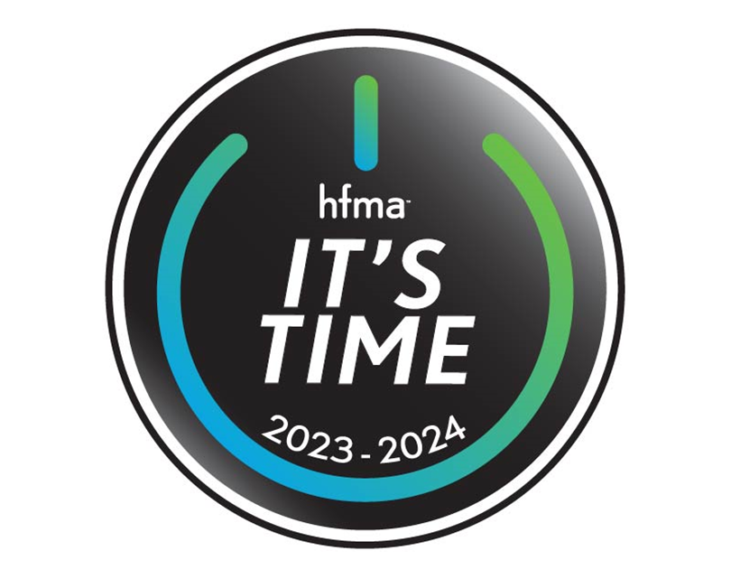
Notes:
Thank you for your time and attention.
[Pause for applause]

