Slide 1
Compassionate
Leadership
Wade W. Mitzel
Chief Operating Officer
University of Louisville Physicians

Slide 2
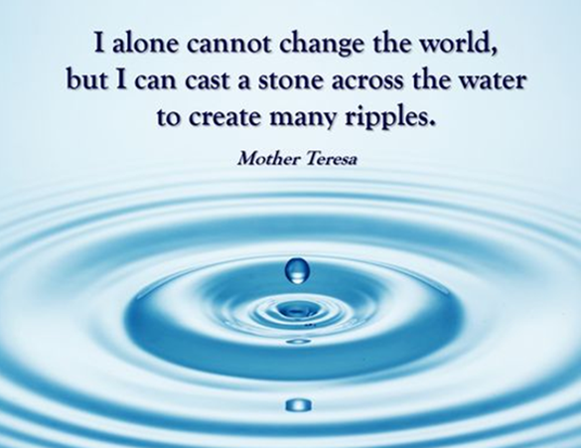

Slide 3

Meet Johnny

Slide 4

To become a better leader….

Slide 5
Why We Need Compassionate Leadership
The Gallup Organization has surveyed tens of thousands of employees across a variety of industries in the U.S. When asked to name key words that best describe a leader that contributed to their daily lives, they said words like trust, compassion, stability, and hope.

Slide 6

UofL Health Mission

Slide 7
Definitions
Kindness:
The quality of being friendly, generous, and considerate.
Empathy:
The ability to understand and share the feelings of another.
Compassion:
Compassion literally means “to suffer together.” Among emotion researchers, it is defined as the feeling that arises when you are confronted with another's suffering and feel motivated to relieve that suffering.
Empathy + Intention to help = Compassion
“While empathy can lead to fatigue, compassion can increase our resilience and approach stressful situations with more positive effect.” ¹
¹ Hoffman, A. (2013). When empathy hurts, compassion can heal. https://greatergood.berkeley.edu/article/item/when_empathy_hurts_compassion_can_heal

Slide 8
Compassionate Leadership Defined
Compassion
Leadership
Empathy combined with intention to help.
Seeing the strength in others.
A belief that we are equal as human beings.
Having a vision and creating energy.
Lead people and manage resources and funds.
Being a coach, facilitator, change agent, manager, and a strategist
Compassionate Leadership is the ability to take yourself, teams and organizations to a higher level of performance and well-being in a human way.
Compassionate leadership is not a dichotomy to performance but a force multiplier!

Slide 9
The Science
Leader resilience² :
People who practice compassion produce 23% less cortisol, which is the hormone associated with stress.³
People who feel compassion demonstrate less depression, reduced moodiness, and less mental illness.⁴
Cultivating compassion leads to more calm and less emotional distress in the face of suffering.⁵
Cultivating self-compassion results in greater ability to empathize with others, greater ability to own up to one’s own mistakes and learn from them, and greater ability to bounce back from negative events . ⁶

Slide 10
The Science Continued
Team dynamics:
People who feel compassion demonstrate higher levels of helping behavior, moral reasoning, connectedness, and stronger interpersonal relationships. ⁷
Researchers found high levels of compassion inspired higher levels of trust between team members, who were then more likely to share important information with peers both on and off their team. ⁷
In a survey of over 1,000 business leaders across more than 800 organizations, leaders who exhibited (or were perceived by the team to exhibit) high levels of compassion had teams who scored higher on critical performance dynamics within their organizations. ⁷

Slide 11
The Science Continued
Organizational performance and retention:
Teams led by compassionate leaders exhibited better intra-team collaboration, stronger commitment to the company, and far lower turnover rates than those led by less-compassionate leaders. ⁷
Studies show that workers who feel compassion from their employers are likely to work harder, to the tune of 30% longer on difficult tasks. ⁸
Research on employee tenure and loyalty shows that when leaders are perceived to have high levels of compassion, their teams are 15 percent more likely to stay with the company. For a 50-employee company, a 15 percent improvement in employee retention can translate to nearly $400,000 in additional profit per year. ⁷

Slide 12

The Science Continued
In the book, Compassionomics, by Dr. Trzeciak and Dr. Mazzarelli quote studies that compassion:
  Lowers blood pressure
  Promotes healing from trauma
  Improves the quality of life in palliative care
  Reduces perception of pain
  Helps build stronger immunities
  Improves endocrine function

Slide 13
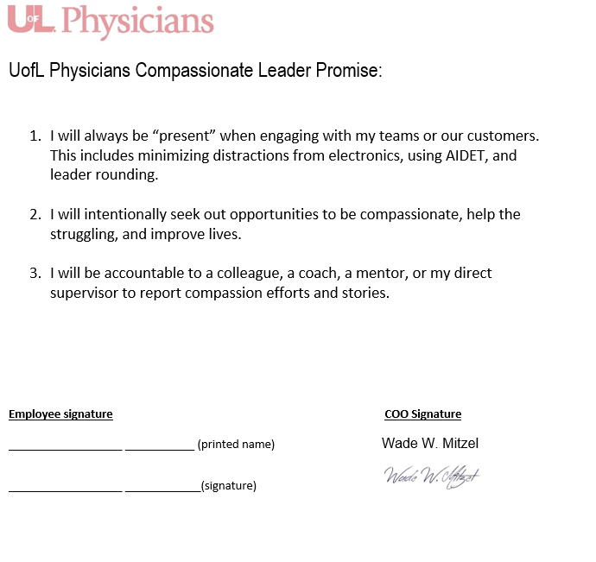
Compassionate Leader Promise

Slide 14

The rest of the story…..

Slide 15

Call To Action

Slide 16
Thank you!
Wade Mitzel
Wade.Mitzel@uoflhealth.org

Slide 17
Reference Page
¹ Hoffman, A. (2013). When empathy hurts,compassion can heal. https://greatergood.berkeley.edu/article/item/when_empathy_hurts_compassion_can_heal
² Leading Through Compassion. (n.d.) Why Compassion https://www.leadingthroughconnection.org/why-compassion
³ Venturo,K. (2014, October 15). Why compassion matters. https://www.linkedin.com/pulse/20141016021525-26656909-why-compassion-matters/
⁴ Schwantes, M. (2018, February 23). New research says you will need this 1 rare management skill to be successful. Inc. https://www.inc.com/marcel-schwantes/with-a-single-tweet-linkedins-ceo-taught-a-major-lesson-in-managing-people-successfully.html
⁵ Weng, H. Lapate, R. Stodola, D. Rogers, G., Davidson ,R. (2018). Visual attention to suffer after compassion training is associated with decreased amygdala responses. Frontier Psychology. https://doi.org/10.3389/fpsyg.2018.00771
⁶ Wong, K. (2017, December 28). Why self compassion beats self confidence. https://www.nytimes.com/2017/12/28/smarter-living/why-self-compassion-beats-self-confidence.
⁷Robinson, A. (2018, May 29). According to Harvard, this 1 leadership trait separates exceptional leaders from the rest. Inc. https://www.inc.com/adam-robinson/according-to-harvard-this-1-leadership-trait-separates-exceptional-leaders-from-rest.html
⁸ Comaford, C. (2018, July 29). The key trait that will make you an exceptional leader.Forbes. https://www.forbes.com/sites/christinecomaford/2018/07/29/this-one-key-trait-will-make-you-an-exceptional-leader/?sh=3dfc10e4ffb3

Slide 18
