Slide 1

Charge Reconciliation / Attestation
VCU Health

Slide 2


Hi, we’re excited to meet you.
Carrie Meeker
VP, Client Delivery
Jennifer Trescot
Director, Revenue Integrity
Carrie has over 30 years’ experience in healthcare administration and leadership. She’s held leadership positions in revenue cycle management, clinical operations and research administration.
Jennifer is the Director of the Revenue Integrity physician and acute program at VCUH. She brings years of progressive experience in mid-revenue cycle.

Slide 3
Agenda
Purpose
Introduce Ensemble’s online charge reconciliation form and review the charge reconciliation process
01
02
03
Charge Reconciliation
Charge Reconciliation Process
Quantitative + Qualitative Impact

Slide 4
Charge Reconciliation
01

Slide 5

Intro to Charge Reconciliation
Services Provided
Charges Generated
Charge reconciliation, or the act of comparing charges generated to services provided, is an important component of accurate and comprehensive charge capture and revenue generation.
Completing charge reconciliation daily preserves revenue streams and promotes early identification of root cause issues affecting financial stability.
Financial Stability
Revenue Preservation
Charge Capture Process
Charge Capture Technology
Charge Capture Personnel

Slide 6







Why Reconciliation is Important
Improves patient satisfaction through transparency + reduces billing errors
Ensures all departments understand their revenue
Helps identify missing + incorrect revenue
Provides real-time feedback + training to staff on charges processes
Allows the organization to maintain adequate resources
Establishes a long-term policy + process for revenue management
Improves financial performance

Slide 7
Charge Reconciliation Process
02

Slide 8
Reconciliation Procedure
Pull charges from your Hospital Billing (HB) Posted Charges Summary report for the previous day
The HB Posted Charges Summary report is used to find detailed information about charges posted to a hospital billing account over a specific period
The report can be grouped using up to four levels of information such as Cost Center + Account Class
Compare the HB Posted Charges Summary report to your patient list
Patient lists vary based on your department:
Operating Room (OR) – Unposted OR Log Report
Nursing Floor – Midnight Census
Emergency Department (ED)
Department Appointment Report – any department with scheduled visits
Complete the Charge Reconciliation Attestation Form daily

Slide 9
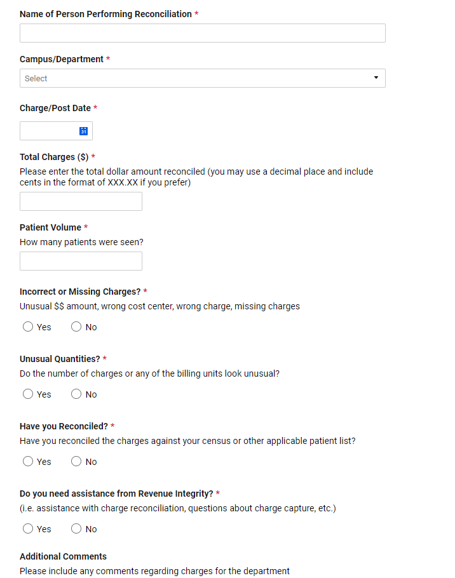
Online Attestation Form
This form is an attestation to sign-off on completing daily charge reconciliation.
It helps ensure all departments are reconciling charges, allowing for escalation + fast resolution of any charge-related issues.
A simple 2-step process that eliminates the need to send emails and/or update spreadsheets regarding charge issues
Each client has their own specific attestation form
Revenue Integrity (RI) is responsible for replying to questions flagged for help needed on the attestation

Slide 10
Causes for Missing Charges
Charging Process
Incomplete or inaccurate system mappings
Outdated CDM
Unclear charging processes
Staff
Lack of department visibility into revenue impact
Lack of root cause analysis to correct systemic issues
Competing priorities
Information Systems
Incorrect clinical module to CDM linkage

Slide 11
Responsible Parties
Expectations for the charge reconciliation policy applies to all employees
Division Administrators / Directors
Department Managers
Ensemble Revenue Cycle
Ownership of reconciling department charges can be delegated or assigned to anyone within the department that would have knowledge of what should be present on accounts

Slide 12
Revenue Integrity Responsibilities
Expectations for Revenue Integrity:
Timely response to help needed requests from clinical areas
Respond to revenue owner questions regarding compliance rates
Round with departments with low- or zero-compliance rates
Train new or existing revenue owners on charge reconciliation + attestation, as needed

Slide 13
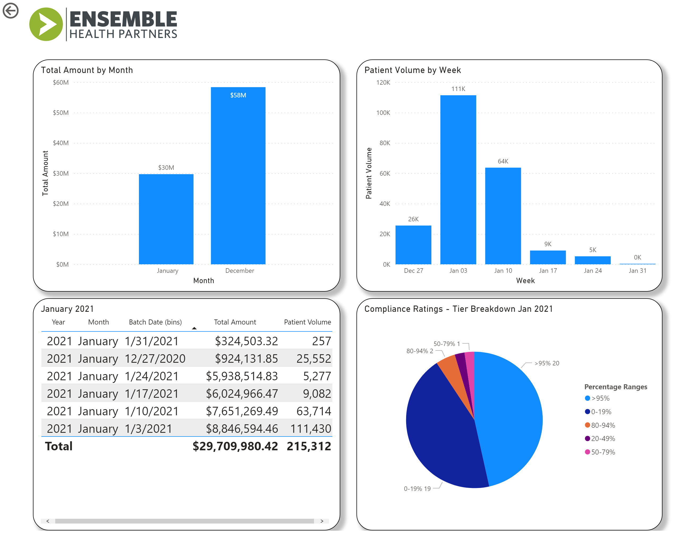
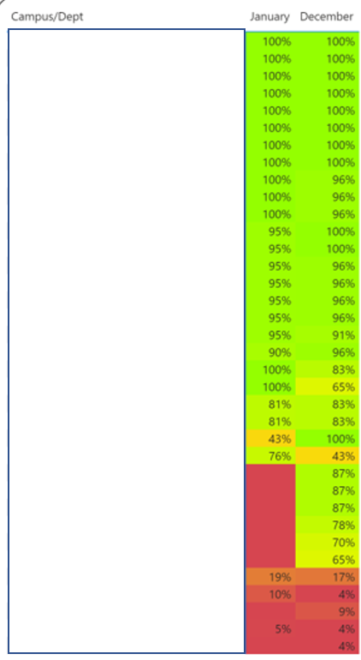
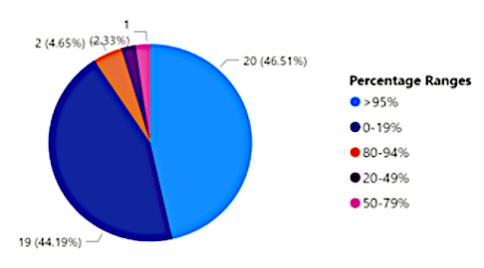


Dashboards + Tracking

Slide 14
Quantitative + Qualitative Impact
03

Slide 15




Quantitative Impact
Helps ensure timely capture of all charges
Creates financial stability
Decreases missing charges
Protects revenue streams

Slide 16
Case Study:
Impact on Missing Charges
Charge reconciliation attestation process implemented in September 2020
The clinical departments were highly engaged + diligent in attesting daily
After one month of attestation, the client realized a 75% decrease in missing charges previously being added post-discharge by Ensemble

Slide 17
Case Study:
Impact on Missing Charges
Attestation Form Implemented
Late charges have reduced 27% within 90 days following implementation of the attestation workflow

Slide 18




Quantitative Impact
Promotes early identification of root cause issues
Supports administration of quality patient care
Enhances communication between revenue cycle + clinical departments
Accurate charging = patient satisfaction
Assigns responsibility

Slide 19
HFMA
Healthcare Financial Management Association (HFMA) recently surveyed 125 hospital senior executives to learn about the next generation of revenue cycle management. They discovered three key improvement opportunities:
1
2
3
Optimize revenue cycle technology
Enhance revenue integrity + charge capture efforts
Better engage patients around financial obligations

Slide 20
Thank you!

