Slide 1




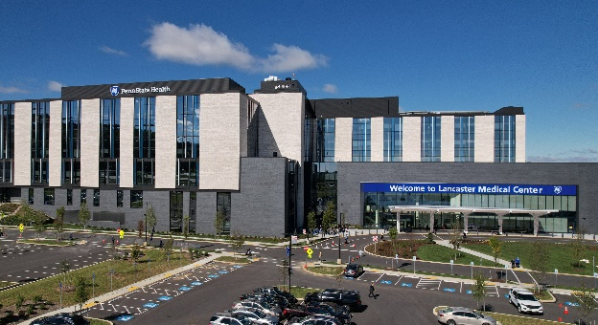
Central PA Healthcare Financial Management Association
Diversity, Equity, Inclusion Initiatives Inside Penn State Health
Lynette Chappell Williams, JD (she/her)
Vice President & Chief Diversity Officer
Penn State Health
May 17, 2023
Notes:
Use reg Kiss logo

Slide 2


Slide 3

Diversity, Equity & Inclusion Defined

Slide 4
Business Case for Diversity, Equity and Inclusion (DEI)
Nationally and locally, we are becoming more racially and ethnically diverse. Currently, 25% of children under age 5 are Hispanic; by 2050, that percentage will be almost 40 percent. By 2050, there will be no one racial majority, but instead a “collective majority” of the populations currently defined as racial/ethnic minority populations. *
Globally, there are more than 4,200 religions, and in the US there are 9 major groups, including those who do not practice a religion. **
According to a GLAAD study, 12% of Millennials identify as transgender or gender non-conforming, meaning they do not identify with the sex they were assigned at birth, or their gender expression is different from conventional expectations of masculinity and femininity. They are also the most diverse population, with 44.2% identifying as belonging to a racial/ethnic minority population and prioritize DEI when seeking employment. ***
Research studies indicate that diversity in leadership and a respectful, inclusive work environment increases productivity, innovation, and positive financial outcomes. ****
* Minorities expected to be majority in 2050 - CNN.com
** How Many Recognized Religions Are There In The United States? - CLJ (communityliteracy.org)
*** New GLAAD study reveals twenty percent of millennials identify as LGBTQ | GLAAD
**** The Importance Of Diversity And Inclusion For Today’s Companies (forbes.com)

Slide 5

Penn State Health
Putting the
Pieces Together
Notes:
Check For Understanding

Slide 6
Building the Foundation for Penn State Health’s Diversity, Equity and Inclusion Efforts:
Addressing Bias in the Workplace
Overt Bias / Discrimination
  Bias is an overt or known prejudice in favor of or against one thing, person, or group compared with another, usually in a way that can have negative or positive consequences.
  Penn State Health modified its HR policy to provide zero tolerance for known overt bias/discrimination.
Implicit / Unconscious Bias
  Unconscious biases are social stereotypes about certain groups of people that individuals form outside their own conscious awareness that are more prevalent when we are stressed or tired.
  In 2021, all employees completed an online introductory course on unconscious bias and this year, all managers/leaders were expected to complete an online course and have a dialogue with their staff.

Slide 7

Building the Foundation for Penn State Health’s Diversity, Equity and Inclusion Efforts: Addressing Patient Bias
Penn State Health policy PSH ADM 120, that is included in the Patient Rights and Responsibilities, provides that patients, their family members, and their visitors cannot discriminate against those who care for them based on their aspect(s) of diversity.
The policy also provides that Penn State Health will not honor requests from patients, and their family members or visitors, for a change in the person providing their medical care based on diversity-related bias. Special consideration is provided for requests based on gender.

Slide 8

Building the Foundation for an Inclusive Penn State Health: Preparing Employees to be Upstanders
  When you recognize when something is wrong, act to make it right.
  As a leader, go against the tide and protect someone experiencing bias including microaggressions.
  It is not enough to be a bystander, who is someone who recognizes when something is wrong but does nothing to help when someone is being mistreated.

Slide 9

Establishing Penn State Health’s Plans to Advance Diversity, (Workforce and Health) Equity, and Inclusion

Slide 10

Penn State Health “Playbook” for Diversity, Equity and Inclusion Priorities

Slide 11
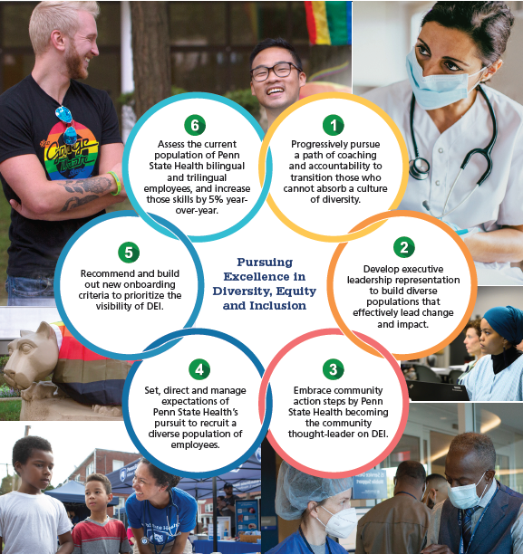
Penn State Health “Playbook” for Diversity, Equity and Inclusion “Breakthrough Strategies”

Slide 12







Penn State Health - Diversity, Equity and Inclusion Priority Pillars, Pillar Leads and Stakeholders
Workforce Representation
Authentic Dialogue on DEI
DEI Communications
Diverse Patient Care Competencies
Best in Class Work Environment
Organizational Accountability for DEI
Collaborators
Advancing Health Equity
Facets for Each Pillar
Compliance with Regulatory Requirements
Unapologetic Leadership Support
Employee Skills Development
Revised/Developed systems, procedures and policies to align with DEI
Budgetary Allocation
Notes:
Chappell Williams, Lynette 5/13/2023
add column for Advancing Health Equity

Slide 13
Key Initiatives to Advance Penn State Health Diversity Playbook Priorities and Strategies
Workplace representation:
  Encourage and track usage of policy HR09 to increase diversity of leadership and workforce
Authentic dialogue:
  Incorporate “dialogue” on diversity and inclusion into Health System and entity town hall meetings
DEI Communications:
  Regular cadence of communication regarding diversity, equity and inclusion efforts, including those of entities included in Diversity Council
Diverse Patient Care Competencies
  Increase workforce skills to care for increasingly diverse patients through Inclusion Academy offerings
  Increase bilingual language skills of employees
Best in Class Work Environment
  Incorporate DEI into employee core competencies to establish accountability
  Continue leadership education on and accountability for addressing unconscious bias and microaggressions
Organizational Accountability
  Revise and bolster employee resource groups and establish inclusion champions
  Improve business diversity progress

Slide 14
Regulatory Requirements for Penn State Health Equity Program
Joint Commission
CMS
EP1: Health equity strategy lead
EP2: Patients' health/social needs assessment
EP3: Quality and safety data stratified by sociodemographic characteristics
EP4: Written health equity strategy plan
EP5: Health equity action plan goal(s) review
EP6: Annual organizational progress update
Domain 1: Equity is a Strategic Priority​
  Identified goals, action steps, engagement strategy and resources​
Domain 2: Data Collection​
  Patient self-reported information and EHR data​
Domain 3: Data Analysis​
  KPIs stratified by patient demographic variables ​
Domain 4: Quality Improvement​
  Participation in local, regional and national efforts to reduce health disparities​
Domain 5: Leadership Engagement​
  Boards, chief executives, and senior leaders annually review the health equity action plan and the KPIs

Slide 15
Penn State Health Goal for Health Equity
Penn State Health Goal for Health Equity
The opportunity for every person to attain their highest level of health regardless of social or demographic factors.
Penn State Health Aspiration for Health Equity
An organization where all employees are successful in collectively eliminating health care disparities by a demonstrated commitment to our mission, equitable processes and achievement of performance measures.
Penn State Health’s Approach to Advancing Health Equity
Matrixed team from throughout the health system advancing interconnected strategies.

Slide 16
Penn State Health System-wide Objectives for Health Equity
Effective Community Outreach: Partnerships and visibility in diverse communities resulting in increased understanding and support of unique needs of all communities, including diverse communities
Advancing Health Equity Research: Growing the institutional infrastructure to optimize and guide scholarly research and quality improvement relevant to health equity and increase diversity in clinical trials
Data Driven Outcomes: Using quantitative and qualitative patient data to develop, inform, and measure health care improvement strategies.
Culturally Responsive Patient Care: Delivering compassionate, quality and safe health care in inpatient and outpatient settings resulting in consistent equitable health outcomes and patient experience across all patient populations
Diverse Workforce: Increasingly diverse leadership team workforce who are thriving in a respectful, inclusive work environment
Organizational accountability: Effectively using organizational influencers to sustain DEI and health equity progress and advancing commitment to business diversity

Slide 17




Penn State Health - Health Equity Pillars and Teams
Community Engagement
Team:
Ashley Visco
Jessica Deer
Health Equity Research
Team:
Sarah Bronson
Monali Vasekar
Adrian Zurca
Eugene Lengerich
Amanda Taylor Gehman
Data Infrastructure
Collection and Access
Team:
Rebecca Monaghan
Carol Houlihan
Kendle Sims
Larry Sinoway
Culturally Appropriate Patient Care
Inpatient & Outpatient
Team:
Michelle George
Allison Polinski
Cheryl Crozier
Ann Monk
Courtney Miller
Corby Myers
Leadership and Workforce Diversification and Workplace Climate
Team:
Jess Daud
Hector Ortiz
Hillary Miller
Governance and Organizational Accountability
Team:
Lynette Chappell Williams
Rachel Yost
Ashleigh Aviles
Facets for Each Pillar
Information Technology and Required Data
Regulatory Requirements: Community, Outpatient, Inpatient
Communication: Workforce Governance, External Community
Education
Funding, Resources and Strategic Planning

Slide 18

Next Step: Identifying Your Current DEI Priority (or Priorities)
Options:
Diversity/Inclusion Statement
Workplace Bias
Patient Bias
Diversity Recruitment
Diversity Retention/Engagement
Diversity/Inclusion Web Page Presence
Diverse Community Reputation
Compliance with Health Equity Regulations
Addressing Nonbinary Patient/Employee Needs

Slide 19
Advancing Your DEI Priority
Research comparable organizational units to identify what they see as their priorities and identify 3 - 5 to focus on
Get input from internal (and external) stakeholders to determine top priorities
Get support from senior leaders, including coming to agreement on defining success
Share plans with workforce and share expectations for supporting priority
Establish periodic cadence for identifying stage in progress of addressing priority and communicate this to workforce
Share outcome of priority as end of year report and determine whether to continue the priority, modify priority and continue, or establish new priority based on progress of original priority

Slide 20

Penn State Health
Office for Diversity, Equity & Inclusion
Lynette Chappell-Williams, JD (she/her/hers)
Vice President and Chief Diversity Officer for Penn State Health
lchappellwilliams@pennstatehealth.psu.edu
717-531-1012
Dr. Adrian Zurca (he/him/his)​
Chief Diversity Clinical Officer​
azurca@pennstatehealth.psu.edu
Hector Ortiz (he, him, his)
Program Manager Diversity and Inclusion hortiz1@pennstatehealth.psu.edu
Caanen Churukha (he/him/his)
Program Manager Disability and Inclusion cchurukha@pennstatehealth.psu.edu
Ashleigh Aviles (she/her/hers)
Project Specialist Diversity and Inclusion
aaviles@pennstatehealth.psu.edu
Christine Howard (she/her/hers)
Executive Administrative Associate choward2@pennstatehealth.psu.edu

