Slide 1

Healthcare Accounting and Auditing Update
May 17, 2023

Slide 2


Presenters
Ryan Miller, CPA
Manager
Withum’s Healthcare Services
Rmiller@withum.com
(267) 332 5837
Sienna Richert, CPA
Staff II Accountant
Withum’s Healthcare Services
Srichert@withum.com
(732) 759 6873

Slide 3
Learning Objectives
After completing the course, the attendee should be able to:
Recognize recently issued ASUs (Accounting Standard Updates) applicable to the healthcare industry.
Define upcoming AICPA (American Institute of Certified Public Accountants) and FASB (Financial Accounting Standards Board) updates.
Identify best practices for implementing new ASUs including ASC (Accounting Standards Codification) 842 Leases.

Slide 4
Agenda
ASC 842: A Final Look
ASU No. 2020-07: Not-for-Profit Reporting of Gifts-in-Kind
ASU No. 2021-08: Business Combinations – Accounting for Contract Assets and Liabilities from Contracts with Customers
ASU No. 2016-13: Financial Instruments – Credit Losses
ASU No. 2021-10: Government Assistance Disclosures
ASU No. 2021-01 and No. 2020-04: Reference Rate Reform
ASU No. 2021-03: Goodwill – Accounting Alternative for Evaluating Triggering Events
Accounting for Cryptocurrency
Upcoming FASB Research Projects
Internal Controls and Fraud Risk Management

Slide 5
ASC 842: A Final Look
Notes:
SR - We all have heard lots about 842 and its implementation over the past couple of years but we wanted to take one final look at the implementation dates and some lease exceptions

Slide 6
Reminder of Effective Dates
Fiscal years beginning after December 15, 2021 (calendar year 2022) for nonpublic companies
Interim periods beginning after December 15, 2022 (calendar year 2023) for nonpublic companies
Notes:
Implementation of 842 is effective for fiscal years beginning after December 15, 2021 for nonpublic companies, so this means it must be implemented for December 31, 2022 year ends. For June 30 year ends it must be implemented by June 30, 2023.

Slide 7
Definition of a Lease
ASC 842 defines a lease as a contract, or part of a contract, that conveys the right to control the use of identified property, plant, or equipment (an identified asset) for a period of time in exchange for consideration
Controlling the Asset
Control over the use of the identified asset means that the customer has both
The right to obtain substantially all of the economic benefits from the use of the asset and
The right to direct the use of the asset
Notes:
842 Defines a lease as a contract, or part of a contract, that conveys the right to control the use of identified property, plant, or equipment (an identified asset) for a period of time in exchange for consideration
The key component there is the right to control the asset which means the customer has both the right to obtain substantially all of the economic benefits from the use of the asset and the right to direct the use of the asset

Slide 8
ASC 840 to 842 - Comparison
Differences | Similarities
Reflects nearly all leases on the balance sheet Capital leases are now called finance leases Lease commencement date Initial direct costs | Capital and finance lease calculations Renewal criteria: Reasonably Assured = Reasonably Certain Lease expense recognition
Notes:
Differences
Here is a quick comparison between ASC 840 and ASC 842. Starting with some differences under 842 both operating and finance leases go on the balance sheet.
Pursuant to ASC 840, assessments of lease classification are performed at the lease inception date (the date the arrangement was agreed or committed). Under the new guidance in ASC 842, lease classification assessments will be performed at the lease commencement date (the date an asset is made available to the lessee for use).
Under ASC 842, initial direct costs are defined as incremental costs of a lease that would not have been incurred if the lease had not been obtained. Under ASC 840, incremental direct costs can include internal costs as well as external costs such as legal fees, even if incurred before the lease was obtained. Therefore, certain incremental costs previously eligible for capitalization will be expensed under ASC 842.
Going into a couple of similarities
The capital or finance lease criteria remain similar, but they have removed the bright line measurements, previously the test included the following 2 points:
whether the lease term represents 75% or more of the economic life of the leased asset, and 2) Whether the present value of future minimum lease payments represents 90% or more of the fair value of the leased asset. These percentages have been removed and replaced with “major part” of the asset life and “substantially all” of the fair value of the leased asset. However, the standard does suggest these percentages are still good measurement to use.
Next – the expense is still recognized on a straight-line basis for an operating lease. This is accomplished by increasing the amortization of the right-of-use asset as the imputed interest on the liability declines over the lease term. Recognition of expense for a finance lease will be similar to capital leases in ASC 840.
Lastly In evaluating renewal criteria reasonably assured and reasonably certain are equivalent. Reasonably certain is discussed later.

Slide 9
Exceptions
Short-Term Leases
A lease that, at the commencement date, has a lease term of 12 months or less and does not include an option to purchase the underlying asset that the lessee is reasonably certain to exercise
Lease Term
The noncancelable period for which a lessee has the right to use an underlying asset,
Takeaway
Even if a short-term lease is excluded from the liability and right-to-use calculation, an entity is still required to disclose the total expense incurred for short-term leases in the aggregate.
Notes:
We wanted to cover some exceptions that exclude leases from ASC 842
First is short term leases that have a lease term less than 12 months
Next covers the lease term if there is noncancellable period for which a lessee has the right to use an underlying asset, together with all of the following:
Periods covered by an option to extend the lease if the lessee is reasonably certain to exercise that options
Periods covered by an option to terminate the lease if the lessee is reasonably certain not to exercise that option
Periods covered by an option to extend (or not to terminate) the lease in which exercise of the option is controlled by the lessor

Slide 10
Exceptions
What is “reasonably certain?”
Changed from “reasonably assured” to conform to International Financial Reporting Standards (“IFRS”)
Meant to be a higher bar, believed to be 75%-80%
Takeaway
The likelihood of including renewal options is not that high. Remember, it is management’s conclusion to make, and there is a required disclosure for why or why not an option was included in the calculation.
Notes:
Next we want to cover what is reasonably certain. Reasonably certain is in regard to the likelihood of lease renewals. Under 842 this terminology changed from reasonably assured to reasonably certain. If the likelihood of the lease renewal is not high then it should not be included. This is managements conclusion to make, and there is a required disclosure for why or why not an option was included in the calculation

Slide 11
Exceptions
Low-Value Leases
IFRS establishes a bright-line $5,000 threshold for exempting a lease from treatment under IFRS 16
ASC 842 has no such threshold, but the FASB admits that materiality still exists
Takeaway
In applying materiality, you should consider the overall effect on the financial statements in the aggregate.
Notes:
Also an exception are low-value leases. IFRS establishes a threshold of $5,000 for exempting a lease from treatment under IFRS 16
ASC 842 has no such threshold, but the FASB has admitted that materiality still exists
In applying materiality you should consider the overall effect on the financials statements in the aggregate

Slide 12
Exceptions – Due to other ASC Topics Being Applicable
Leases of intangible assets
Leases to explore for or use materials, oil and natural gas, and similar nongenerative resources
Leases of biological assets, including timber
Leases of inventory
Leases of assets under construction
Notes:
These exceptions here may not apply to many healthcare organizations but they are still important to note

Slide 13
ASU No. 2020-07: Not-for-Profit Reporting of Contributed Nonfinancial Assets (Gifts-in-Kind)
Notes:
ASU 2020-07 Provides the rules for the presentation and disclosure by not-for-profit entities for contributed nonfinancial assets. The standard was issued with the intendent to make reporting of contributed nonfinancial assets more transparent in a not-for-profit entity's financials statements through increased disclosures especially for nonfinancial assets the entity uses in operations. This ASU did not change any of the accounting for nonfinancial assets, it only changed the presentation and disclosure.

Slide 14
ASU No. 2020-07 - Not-for-Profit Reporting of Contributed Nonfinancial Assets (Gifts-in-Kind)
Not-for-profits (“NFPs”), including healthcare organizations, receive many forms of donations to support their mission; these contributions are received as financial contributions but also as nonfinancial contributions, such as fixed assets, supplies, and services)
Nonfinancial contributions are often referred to as gifts-in-kind
FASB believes more information related to gifts-in-kind is needed by financial statement users
Notes:
This ASU is important as NFPs…..
We will be using the term nonfinancial contributed assets and gifts-in-kind interchangeably as many people refer to contributions of nonfinancial assets as gifts in kind
Increased disclosure is needed as:
Gifts-in-kind are subjectively valued compared to financial contributions
Many NFPs rely heavily on contributions, and this should be apparent in reporting
Significant reliance on gifts-in-kind and how they are utilized has direct effects on NFP’s operations

Slide 15
ASU No. 2020-07 Not-for-Profit Reporting of Gifts-in-Kind
This new ASU does not change current recognition or measurement requirements for gifts-in-kind
New guidance changes the presentation and disclosure for gifts-in-kind
NFPs will present gifts-in-kind received in a separate line item in the statement of activities apart from contributions of cash or other financial assets
New disclosures will require NFPs to breakout the dollar amount of gifts-in-kind received by category in the disclosures
Notes:
As noted before the ASU does not change current recognition or measurement requirements, it only changes the presentation and disclosure.
NFPs will present gifts-in-kind received in a separate line item in the statement of activities apart from contributions of cash or other financial assets
New disclosures will require NFPs to breakout the dollar amount of gifts-in-kind received by category in the disclosures. It is noted that a NPF might only have one category of contributed nonfinancial assets.

Slide 16
ASU No. 2020-07 Not-for-Profit Reporting of Gifts-in-Kind Disclosures
Under the new disclosure guidance, for each category of gifts-in-kind received:
The NFP will provide a description of any associated donor restrictions
The NFP will provide a description of the valuation techniques and inputs utilized to arrive at a fair value measurement at initial recognition
The principal market used to arrive at a fair value measurement
Notes:
For the new disclosure guidance, for each category of gifts-in-kind received:
The NFP will provide a description of any associated donor restrictions, a description of the valuation techniques and inputs utilized to arrive at fair value measurement at initial recognition and the principal market used to arrive at a fair value measurement

Slide 17
ASU No. 2020-07 Not-for-Profit Reporting of Gifts-in-Kind Disclosures
Under the new disclosure guidance, for each category of gifts-in-kind:
The NFP will disclose qualitative information about whether the gifts-in-kind were either monetized or utilized during the reporting period
If utilized, then a description of the specific programs or other activities in which those assets were used will be included
The policy (only if the NFP has a monetization policy) for monetizing rather than utilizing gifts-in-kind must also be disclosed
Notes:
For each category of gifts in kind the not for profit must disclose qualitative information about whether the gifts in kind were either monetized or utilized during the reporting period.
The policy for monetizing rather than utilizing gifts in kind must also be disclosed. Please not that you do not have to disclose if there is no monetization policy.

Slide 18
ASU No. 2020-07 Not-for-Profit Reporting of Gifts-in-Kind Measuring Nonfinancial Assets
ASC 958-605-30-2 – “Contributions received shall be measured at their fair values. Topic 820 establishes a framework for measuring fair value.”
Definition of fair value under ASC 820:
“The price that would be received to sell an asset or paid to transfer a liability in an orderly transaction between market participants at the measurement date.”
Notes:
The measurement of gifts in kind if covered under the framework in Topic 820 for measuring fair value
Topic 820 defines fair value as “The price that would be received to sell an asset or paid to transfer a liability in an orderly transaction between market participants at the measurement date.”

Slide 19
ASU No. 2020-07 Not-for-Profit Reporting of Gifts-in-Kind Measuring Nonfinancial Assets
Principal Market Definition:
The market with the greatest volume and level of activity for the asset or liability
In a Principal Market:
The reporting entity must have the ability to access the market but doesn’t need to have the ability to sell the asset in that market
Concessions in a Principal Market:
If there is a principal market, you must use the principal market, even if there is a more advantageous market to use
If no principal market exists, then use the most advantageous market
Notes:
Under ASU 2020-07 the principal market is used to arrive at a fair value measurement if it is a market in which the recipient NFP is prohibited by donor restrictions from selling or using the contributed nonfinancial asset
The principal market is defined as the market with the greatest volume and activity for the asset or liability
The reporting entity must have the ability to access the market but doesn’t need to have the ability to sell the asset in that market.
If there is a principal market, you must use the principal market, even if there is a more advantageous market to use.
If no principal market exists, then use the most advantageous market.

Slide 20
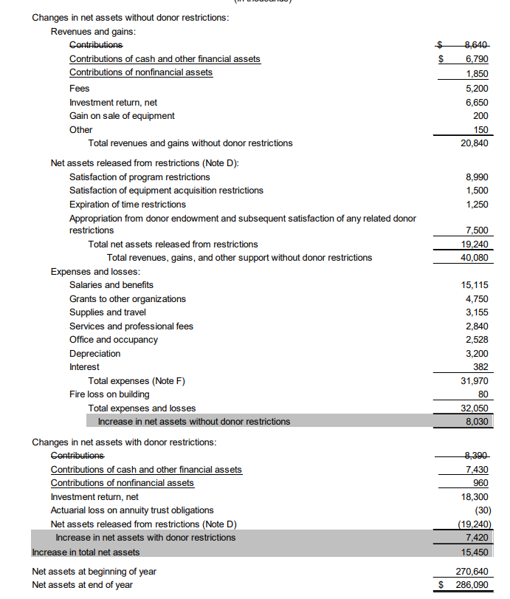
Example #1 from page 13 of ASU No. 2020-07
Notes:
This example came from the ASU
Items crossed out are from prior guidance and is superseded by ASU 2020-07
Items underlined are items that are new under this ASU
I know this is small and hard to read so the page number from the ASU is referenced
You can see here that there are now two lines for contributions, one for contributions of financial assets and one for contributions of gifts and kind. There is still a breakout between without donor restrictions and donor restricted contributions.

Slide 21
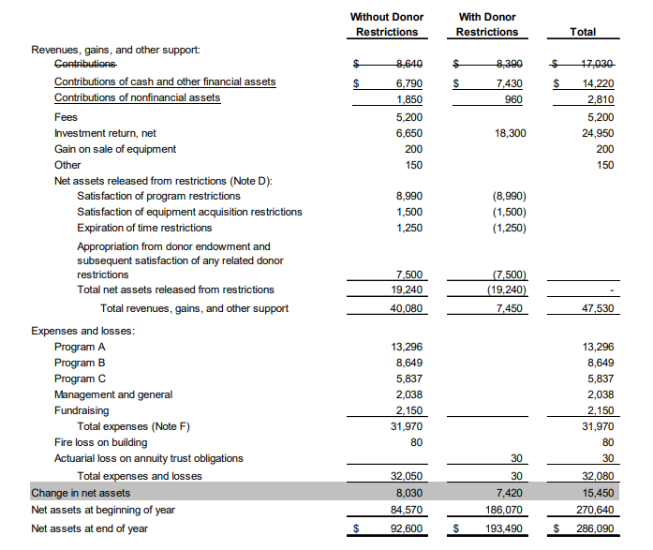
Example #2 from page 14 of ASU No. 2020-07
Notes:
ASU 2020-07 This is a different presentation of the same information from the previous example. Please note you do not have to use this exact wording

Slide 22
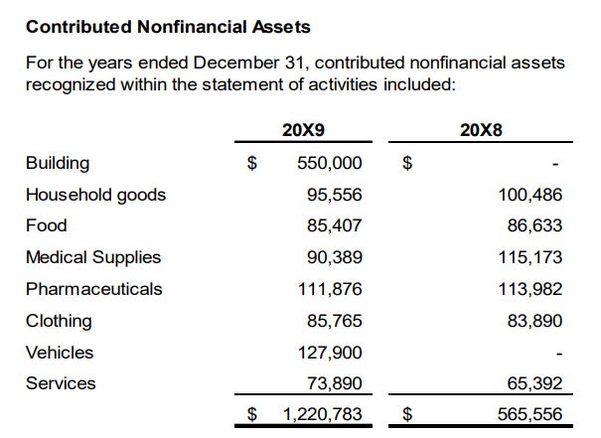
ASU No. 2020-07 Not-for-Profit Reporting of Gifts-in-Kind Disclosures Examples
Notes:
This is an example of a quantitative disclosure in a tabular format which is followed by a qualitative narrative, the next 3 slides will show the qualitative disclosures that are required.
As you can see here there are 8 categories of contributed nonfinancial assets the entity received.

Slide 23
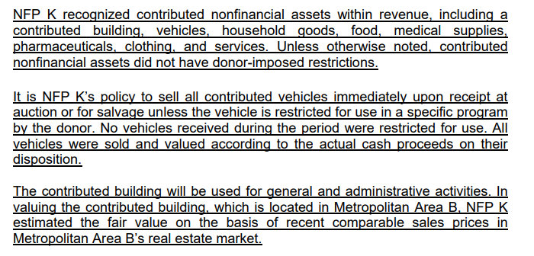
ASU No. 2020-07 Not-for-Profit Reporting of Gifts-in-Kind Disclosures Examples
Qualitative Disclosures
Notes:
Some of the 8 categories of gifts in kind were combined into one paragraph for the narrative disclosures. The first paragraph lists all the categories and tells the reader that if there's no donor- restriction noted for a category then there is none.
The second paragraph discusses the entities policy for monetizing donated vehicles.
The third paragraph describes how the gifted building is being utilized and the technique used to determine its fair value

Slide 24
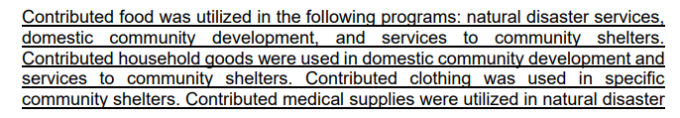

ASU No. 2020-07 Not-for-Profit Reporting of Gifts-in-Kind Disclosures Examples
Qualitative Disclosures
Notes:
This paragraph discusses donated food in the entities various programs.
And provides a listing of programs that the donated goods were used in.
This paragraph also discusses the methods used to value donated goods

Slide 25
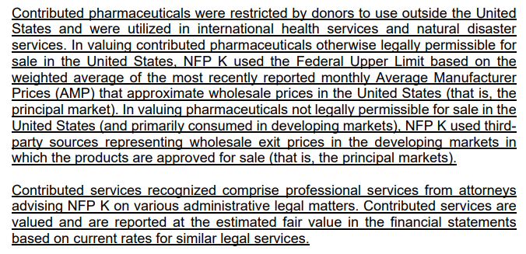
ASU No. 2020-07 Not-for-Profit Reporting of Gifts-in-Kind Disclosures Examples
Qualitative Disclosures
Notes:
The first paragraph here discusses all the qualitative disclosures required for phamaceuticals. This includes the donor restrictions, discusses the programs that they were used in, and the technique used to value the pharmaceuticals. It also notes the principal market used for fair value.
Second paragraph discusses contributed services and how they were valued.

Slide 26
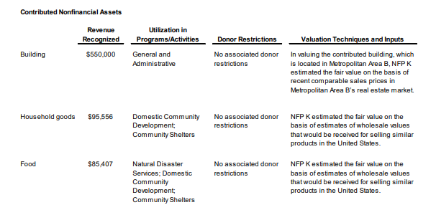
ASU No. 2020-07 Not-for-Profit Reporting of Gifts-in-Kind Disclosures Examples
Notes:
This is a second format which has qualitative and quantitative disclosures combined. This has the same first two columns from the tabular format from the first example and then adds columns to discuss donor restrictions and valuation. This are the same disclosures from the first example, all that changed is the presentation.

Slide 27
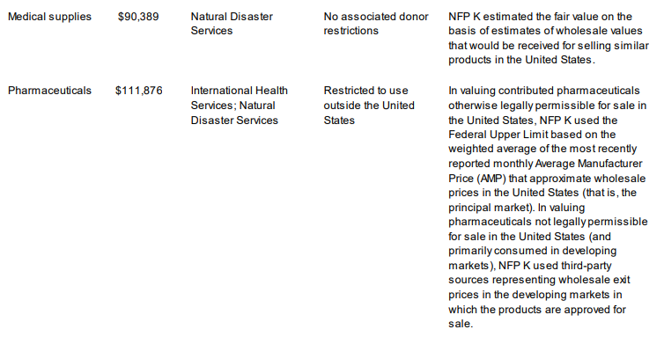
ASU No. 2020-07 Not-for-Profit Reporting of Gifts-in-Kind Disclosures Examples
Notes:
Continuation of the example from the previous slide.

Slide 28
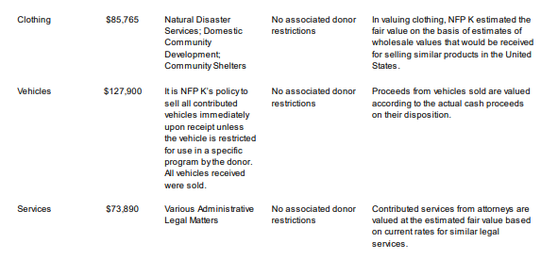

ASU No. 2020-07 Not-for-Profit Reporting of Gifts-in-Kind Disclosures Examples
Notes:
Continuation of the example from the previous slide. Which will conclude our review of example disclosures.

Slide 29
ASU No. 2020-07 Not-for-Profit Reporting of Gifts-in-Kind Effective Date
New presentation and disclosure requirements are effective for NFPs for annual reporting periods beginning after June 15, 2021, and interim periods within financial years beginning after June 15, 2022, with early adoption permitted
Retrospective application is required
Notes:
For this ASU retrospective adoption of the standard is required because the FASB believes it is important to have trending information to be comparative
If the financial statements are comparative and the prior period does not have the contributed nonfinancial assets broken out this must be updated and reclassified, and a note must be added to the financial statements which would say the prior financials have been updated to be in conformity for current year presentation

Slide 30
ASU No. 2020-07 Not-for-Profit Reporting of Gifts-in-Kind – Key Takeaways
Many healthcare organizations are NFPs that receive substantial contributions including gifts-in-kind.
During the COVID-19 pandemic, many healthcare organizations received donated PPE that would have had to be presented separately .
ASU No. 2020-07 requires additional line(s) item on the statement of activities/
ASU No. 2020-07 requires disclosures that provide a breakout of each category of gift-in-kind with details regarding utilization or monetization, fair value measurement, and donor restrictions for the contributions.
Notes:
Here are some key take aways for ASU 2020-07
This is especially relevant as many healthcare organizations are NFPs that receive substantial contributions including gifts-in-kind
If this was applicable during COVID all donations of PPE would have been disclosed separately
Please remember that this ASU now requires an additional line item on the statement of activities and it requires disclosures for each category of gifts in kind received with details regarding utilization or monetization, fair value measurement, and donor restrictions for the contributions

Slide 31
ASU No. 2021-08: Business Combinations - Accounting for Contract Assets and Liabilities from Contracts with Customers
Notes:
RM

Slide 32
ASU No. 2021-08 Business Combinations - Accounting for Contract Assets and Liabilities from Contracts with Customers
FASB issued ASU No. 2021-08 on October 28, 2021, which changes the accounting for contract assets and liabilities acquired in a business combination.
Under current US GAAP, an acquirer recognizes assets and liabilities assumed in a business combination, including contract assets and contract liabilities arising from revenue contracts with customers in accordance with FASB ASC 606 on the acquisition date.
Initial fair value measurement for acquired revenue contracts in a business combination can be complex and require significant judgement
To address this, ASU No. 2021-08 requires an acquirer to account for the related revenue contracts in accordance with FASB ASC 606 as if it had originated the contracts

Slide 33
ASU No. 2021-08 Business Combinations - Accounting for Contract Assets and Liabilities from Contracts with Customers
To address concerns, ASU 2021-08 requires an acquirer to account for the related revenue contracts in accordance with FASB ASC 606 as if it had originated the contracts.
There are exceptions in FASB ASC 805, Business Combinations, surrounding the principle of fair value measurement of assets and liabilities acquired in business combinations, including assets and liabilities arising from contingencies, income taxes, employee benefits, indemnification assets, and leases. ASU No. 2021-08 adds contract liabilities to the list of exceptions.
Effective dates:
Public companies – fiscal years beginning after December 15, 2022
All other entities, the effective date is fiscal years beginning after December 15, 2023
Early adoption is permitted

Slide 34
ASU No. 2016-13: Financial Instruments – Credit Losses

Slide 35
ASU No. 2016-13 Financial Instruments – Credit Losses
Purpose of the standard is to increase accuracy and timeliness of reporting expected credit losses
Affects most financial instruments not valued at fair value such as:
Receivables (exchange-type revenues) – tuition/fees, membership dues, special event income, and merchandise sales
Notes receivable
Held-to-maturity and programmatic investments
Does not apply to promises to give receivables

Slide 36
ASU No. 2016-13 Financial Instruments – Credit Losses
The main transition is from losses “incurred” to losses “expected”
Incurred loss model
Delayed recognition until loss was “probable”
Impairment recognized at time when deemed probable that a loss event had occurred; uses historical data and loss rates
Expected loss model
Impairment recognized based on past (historical), present (current), and future (forecasted) data to estimate losses
Allowance (contra-asset) used to present financial assets at net amount expected to be collected

Slide 37
ASU No. 2016-13 Financial Instruments – Credit Losses Effective Date and Transition Method
Effective for periods beginning after December 15, 2022
Early adoption is permitted
Modified retrospective application is required

Slide 38
ASU No. 2021-10: Government Assistance Disclosures
Notes:
RM

Slide 39
ASU No. 2021-10 Government Assistance Disclosures
Required disclosures about government transactions
Nature of transaction and accounting policy used is a required disclosure
Balance sheet and statement of income line items affected by the transactions and the amounts applicable to each line item
Significant terms and conditions of the transactions, including commitments and contingencies
Disclosures apply to business entity accounting for the transaction (ASC 958 IAS 20)
Effective dates:
Public companies – fiscal years beginning after December 15, 2022
All other entities, the effective date is one year later
Early adoption is permitted

Slide 40
ASU No. 2021-01 and No. 2020-04: Reference Rate Reform

Slide 41
ASU No. 2021-01 Reference Rate Reporting for LIBOR and LIBOR Elimination - Background
LIBOR is the world’s most widely used short-term interest rate benchmark
LIBOR was scheduled to be retired by regulators sometime during 2022
LIBOR will be replaced by SOFR (Secured Overnight Funding Rate)
Notes:
RM To

Slide 42
LIBOR vs. SOFR – Why the Change?
LIBOR is calculated by an adjusted average of panel banks based on their reported funding rate to the Intercontinental Exchange Benchmark Administration at 11:45 a.m. London time each business day
The number of panel banks has shrunk since 2008, thereby limiting the sample for calculating LIBOR
As a result, LIBOR has relied more and more on expert judgement
SOFR was established in 2018 and is based on the US Treasury Repo Market
Other countries are introducing alternative reference rates, but SOFR is expected to be the dominant global benchmark rate

Slide 43
ASU No. 2020-04 Reference Rate Reform
Impacts entities that have contracts, hedging relationships, and other transactions that reference LIBOR or another referenced rate that is expected to be discontinued
Provides optional expedients and application exceptions for US GAAP to contracts, hedging relationships, and other transactions if certain criteria are met
Expedients:
Contract modifications handled prospectively as a rate adjustments
Lease modifications are a continuation of the existing contracts
Critical terms change in a hedging relationships; does not trigger ineffectiveness of the hedge and other hedge expedients
Modification does not trigger reassessment regarding whether or not this is an embedded derivative

Slide 44
ASU No. 2021-01 and No. 2020-04 Effective Dates
ASU No. 2021-01 – Effective immediately for all entities, with full retrospective basis
ASU No. 2020-04 – Effective for all entities through December 31, 2022
Expedients and exceptions do not apply to contract modifications made and hedging relationships entered into or evaluated after December 31, 2022, except for hedging relationships existing as of December 31, 2022, where expedients were elected

Slide 45
ASU No. 2021-03: Goodwill - Accounting Alternative for Evaluating Triggering Events

Slide 46
ASU No. 2021-03 Goodwill
Applies only to private companies and NFPs (private companies becoming public need to reverse effects of adoption)
Eligible entities may elect to perform a goodwill impairment triggering event evaluation as of the end of each reporting period (whether the reporting period is an interim or annual period)
Effective on a prospective basis for fiscal years beginning after December 15, 2019, with early adoption permitted

Slide 47
Internal Controls

Slide 48
Internal Controls
Maintaining effective internal controls at healthcare organizations is of paramount importance due to the following reasons:
Patient Safety
Regulatory Compliance
Financial Integrity
Operational Efficiency
Risk Management

Slide 49
Fraud Risk Management

Slide 50
Fraud Risk Management
Proactive fraud risk management is crucial for healthcare entities due to the following reasons:
Financial Loss Prevention
Patient Safety and Quality of Care
Regulatory Compliance
Cost Savings
Legal and Ethical Obligations

Slide 51
Accounting for Cryptocurrency
Notes:
SR Cryptocurrency is a popular topic in the news so we are going to cover how to account for it

Slide 52
Accounting for Cryptocurrency
What is cryptocurrency?
A digital asset, which is an alternative form of payment created using encryption algorithms
It is a medium of exchange built on distributed ledger technology
It has no contractual rights or obligations
It is not issued by a jurisdictional authority
It is not considered a security under US securities law
Notes:
SR

Slide 53
Accounting for Cryptocurrency
How do I present cryptocurrency?
Not accounted for as cash as it cannot be considered an equivalent to cash because it cannot be readily exchanged for any good or service
Not accounted for as a cash equivalent as it is subject to significant price volatility
Not accounted for as a financial asset at fair value because it does not represent cash, an equity interest in an entity, or a contract establishing a right or obligation; additionally, it is not a debt security nor an equity security
Cryptocurrency does meet the definition of an intangible asset as it is an identifiable nonmonetary asset without physical substance
Notes:
The question leads into how do I present cryptocurrency

Slide 54
Accounting for Cryptocurrency Measurement
The FASB has reached the decision that cryptocurrency should be measured at fair value, with fair value changes recorded in current period earnings
An alternative measurement is not required or permitted, such as historical cost less impairment, for crypto assets not traded in an active market
Commissions, transaction fees, and other charges incurred to acquire crypto assets should be expensed as incurred
Notes:
https://frv.kpmg.us/reference-library/2022/fasb-takes-on-accounting-for-digital-assets.html

Slide 55
Accounting for Cryptocurrency – Presentation
Presentation
Should be reported on the balance sheet separate from other intangible assets
Gains and losses on cryptocurrency assets should be recorded , separately from other impairments or other changes to carrying amounts of other intangible assets in net income each period
Cash flows received from the sale, immediately or almost immediately after acquisition, of cryptocurrencies received as noncash consideration should be classified in cash flows from operations

Slide 56
Accounting for Cryptocurrency – Disclosure
Disclosure
The entity’s crypto asset holdings at each reporting date presented should be broken out by each significant holding of cryptocurrency. For each significant holding, the number of units held, cost basis (how that was determined), and fair value should be disclosed.
A roll-forward of the entity’s crypto asset holdings, showing additions, disposals (by sale or otherwise), gains and losses, along with disclosure about the nature of the additions and/or disposals, should be presented.
Cumulative realized gains and losses need to be disaggregated so that realized gains and losses are presented on a gross, rather than net, basis.
The fair value of any crypto assets subject to restriction, the nature and remaining duration of the restriction(s), and what conditions must be met to remove the restriction(s) are to be disclosed

Slide 57
Upcoming FASB Research Projects

Slide 58
FASB’s Current Research Agenda
Accounting for and Disclosure of Intangibles
Accounting for Exchange-Traded Commodities
Accounting for Financial Instruments with Environmental, Social, and Governance (ESG)- Linked Features
Accounting for Government Grants
Consolidation of Business Entities
Financial Key Performance Indicators for Business Entities
Notes:
Here is the FASBS current research agenda and items to look out for on the horizon

Slide 59
Thank you! Questions?
Ryan Miller, CPA
Manager
Withum’s Healthcare Services
Rmiller@withum.com
(267) 332 5837
Sienna Richert, CPA
Staff II Accountant
Withum’s Healthcare Services
Srichert@withum.com
(732) 759 6873
Notes:
Thank you so much for your time, if anyone has any questions we are happy to answer them!

