Slide 1



The Benefits of Conducting an Operational Assessment
Dan Marano, CHFP
Notes:
Thank you everyone for joining us. My name is Dan Marano and today I am going to walk through the benefits of conducting an operational assessment.

Slide 2


Biography
Manager of Healthcare Management Consulting division at Lighthouse Healthcare Advisors (LHA)
Certified Healthcare Financial Professional (CHFP)
Member of Healthcare Financial Management Association (HFMA)
Experienced in the following aspects of Practice Management:
  Performance Improvement Studies
  Revenue Cycle KPIs
  Billing and Documentation Compliance
  Managed Care Contracting Negotiations
  Due Diligence Assessments
Dan Marano
Consulting Manager
(410) 252-0804
dmarano@lighthouseha.com
All Rights Reserved
Notes:
So a little about me and my background:
I’m the Manager of the Healthcare Management Consulting team at LHA
I’m a Certified Healthcare Financial Professional and
I’m experienced in Performance Improvement, Revenue Cycle, Billing and Documentation Compliance, Managed Care Contracting, and Due Diligence Assessments

Slide 3
Learning Objectives
1
Learn how to evaluate your current workflows/staffing
2
Learn how to measure back-end billing
3
Learn best practices for maintaining processes
All Rights Reserved
Notes:
So what are our learning objectives today?
First, to learn how to evaluate your current workflows
Second, to evaluate your back-end billing and productivity
And third, best practices maintaining robust operations

Slide 4

How do I evaluate my current operations?
A brief rundown of how to assess current workflows and potential waste
Notes:
So this leads us to our first question of the day:
How do I evaluate my current workflows?

Slide 5


Step 1: Define Your Workflows
Goal 1: Breakup operation into a few distinct workflows to better evaluate practice
  Define your processes
  Breakout full patient encounter into several distinct workflows
  Create checklists to fully capture process for observations
  Include the following for each process:
    Number of Staff by position
    Infrastructure (i.e. EMR, check-in software)
    Required Deliverables (i.e. completed patient forms, verifying insurance, obtaining prior authorization, completed patient visit etc.)
Patient Scheduling
Pre-Visit Work
Patient Check-In
Patient Medical Encounter
Patient Check-Out
Back-End Billing
All Rights Reserved
Notes:
The first goal of any provider who wants to evaluate their practice or facility is to breakup your operation into a few distinct processes:
Breaking up your operation and defining distinct start and end points for each process will allow you to take a more focused approach to discovering sources of error
In the example to the right, I have displayed the processes we would breakout in an ambulatory practice starting with Patient Scheduling through Back-End Billing
Finally, create a checklist for each process that captures the current staffing, infrastructure (such as an EMR or billing software), and required deliverables (such as a prior authorization or patient form).
The goal of this checklist is to serve as a guide during observations and to assist you when it comes time to document your processes

Slide 6
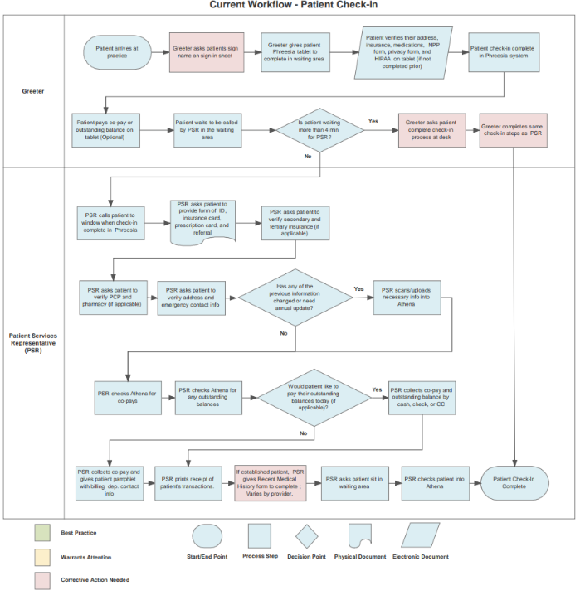
Step 2: Observations & Interviews
Goal 2: Understand each step of processes
  Observe each process
  Conduct observations at different time periods
  Complete checklists
  Conduct Interviews with key staff from each department
  Utilize feedback for potential solutions
  Document Steps on Process Map
  Outline key stakeholders
  Highlight decision points
  Focus on deliverables
All Rights Reserved
Notes:
So from the creation of that checklist, this takes us to our second goal which is to understand each step of your processes.
This will require conducting observations, preferably at multiple periods throughout the day or week. From these observations, you should be able to complete your checklists for any outstanding information
Next, conduct interviews with key staff members
While many of you are leaders within your organization, it important when you are evaluating your operations that you meet in-person with the individuals who maintain business on a daily basis
When our team at LHA conducts an assessment, we meet with many Call Center Representatives, Front Desk Staff, Patient Coordinators, Medical Assistants, Providers, Billing Representatives, you name it
We find that these individuals may be able to share steps of the process you were unaware of, potential sources error, as well as solutions.
Finally, document each process on a process map.
I apologize for the size of this image but in this example, we are outlining the key stakeholders for this process, each decision point, and the key deliverables throughout.
If you wanted to take this a step further, you can make a second process map that documents what the optimal state would be and use that as a comparison.

Slide 7
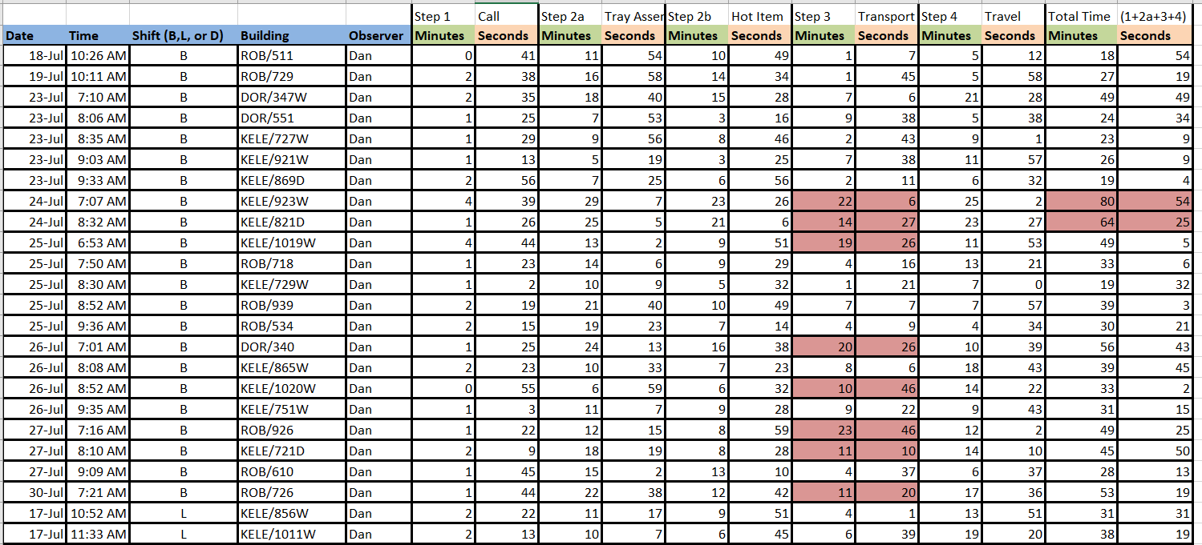
Step 2: Observations & Interviews (Cont.)
Goal 3: Identify source of potential delays/waste
  Conduct Time Studies for each process
  Determine average time to complete each step
  Compare to internal time goals (i.e. patient wait time not to exceed 15 min.)
  Evaluate whether each step is a value-added activity
All Rights Reserved
Notes:
Our next goal would be to identify potential sources of delay and waste.
To do this, we recommend organizations conduct time studies and document the time each step of the process took
This is one of my favorite analyses to do as the results can be eye opening.
Below is an example of a time study I conducted for a Food and Nutrition Department within a hospital to determine how long it took for patient’s meals to be delivered once ordered
The cells highlighted in red represent steps that took longer than what the leadership stated was the max time for that step
Next, be sure to evaluate whether each step is a value-added activity or not.
This will help you understand what is essential to a deliverable and what is waste.
As a disclaimer, this can be difficult as members of your team may have differing views on what is a value-added activity
So this is where it may be helpful to see if any professional organizations have best practices or recommendations for a certain process

Slide 8
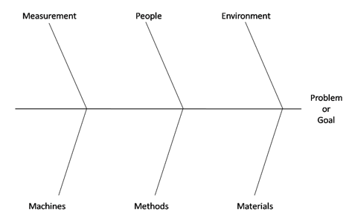
Step 2: Observations & Interviews (Cont.)
Goal 4: Address sources of error or waste
  Attribute errors/delays to specific categories
  Utilize Fishbone Diagram
  Target interventions that address specific sources of error
All Rights Reserved
Notes:
Our next goal would be to address sources of error or waste.
To do so we utilize the fishbone diagram to attribute errors or waste to specific sources:
Such as Measurements, machines, people, methods, environment, or materials
This will allow to better understand what type of intervention is needed to address a source or error or waste

Slide 9
Step 3: Analysis of Process Metrics
Goal 5: Analyze current performance of operational KPIs
  Conduct Analysis into Operational KPIs
  Examples:
    Staffing Ratios
    Wait Times
    Cancellations
    Auth Denials
  Compare to industry benchmarks, if available
Average Hospital Stay
No Shows
Equipment Utilization
Error Rate
All Rights Reserved
Notes:
Taking this a step further, evaluate performance or operational data to industry benchmarks, if available
Ensure you are tracking operational KPIs; some examples include:
Staffing ratios which you can see in the example below. In this example we compared the ratio of ancillary, clinical, and front office staff to the number of providers in the practice to determine if they were over or understaffed
Other KPIs can include average hospitals stay, wait times, no show rate, cancellations, equipment utilization, authorization denials, and error rates
Then check to see what professional organizations are putting out there as optimal benchmarks, while this example highlights an MGMA benchmark, the HFMA has many resources that our firm uses to evaluate practices against

Slide 10
Step 3: Analysis of Process Metrics (Cont.)
Goal 6: Conduct analysis for reason for subpar KPIs
  Conduct analysis to track reason for errors/delays
Provider | Provider Cancelled Total | Provider Cancelled % | No Show Total | No Show % | Scheduling Error Total | Scheduling Error % | Other Reason Total | Other Reason % | Total Cancellations | % of Total Cancellations
Provider 1 | 138 | 8.35% | 0 | 0.00% | 0 | 0.00% | 87 | 5.26% | 225 | 13.61%
Provider 2 | 13 | 0.79% | 74 | 4.48% | 5 | 0.30% | 128 | 7.74% | 220 | 13.31%
Provider 3 | 30 | 1.81% | 25 | 1.51% | 3 | 0.18% | 146 | 8.83% | 204 | 12.34%
Provider 4 | 30 | 1.81% | 14 | 0.85% | 0 | 0.00% | 124 | 7.50% | 168 | 10.16%
Provider 5 | 40 | 2.42% | 13 | 0.79% | 3 | 0.18% | 65 | 3.93% | 121 | 7.32%
Provider 6 | 17 | 1.03% | 16 | 0.97% | 6 | 0.36% | 72 | 4.36% | 111 | 6.72%
Provider 7 | 33 | 2.00% | 17 | 1.03% | 4 | 0.24% | 50 | 3.02% | 104 | 6.29%
Provider 8 | 13 | 0.79% | 16 | 0.97% | 2 | 0.12% | 66 | 3.99% | 97 | 5.87%
Provider 9 | 5 | 0.30% | 12 | 0.73% | 0 | 0.00% | 76 | 4.60% | 93 | 5.63%
Provider 10 | 40 | 2.42% | 0 | 0.00% | 0 | 0.00% | 49 | 2.96% | 89 | 5.38%
Provider 11 | 3 | 0.18% | 16 | 0.97% | 5 | 0.30% | 60 | 3.63% | 84 | 5.08%
Provider 12 | 44 | 2.66% | 7 | 0.42% | 9 | 0.54% | 19 | 1.15% | 79 | 4.78%
Provider 13 | 26 | 1.57% | 14 | 0.85% | 0 | 0.00% | 16 | 0.97% | 56 | 3.39%
Provider 14 | 0 | 0.00% | 0 | 0.00% | 0 | 0.00% | 2 | 0.12% | 2 | 0.12%
TOTAL | 432 | 26.13% | 224 | 13.55% | 37 | 2.24% | 960 | 58.08% | 1653 | 100.00%
All Rights Reserved
Notes:
Once you have your operational KPIs you can then drill down by analyzing reason for error, delay, or waste.
In this example, we found a practice with a high cancellation rate, and we decided to drill down by provider and reason.
For Provider 1 you will see that they have a high % of cancellations where they initiated the cancellation. We found out that due to procedure issues in the call center, this provider was constantly being scheduled to do several office visits and hospital-based procedures on the same date of service. This provider was fairly new and thought other providers had the same issue and did not speak to it.
We also found that for “Other Reason” most cancellations were due to the call center not having access to PTO calendars for the providers
While these may seem like issues that should be easily identified, we find that in the healthcare industry and all the tasks grabbing your attention, it can be difficult to quantity an issue, determine the source, and build an intervention. And that is our goal at LHA.

Slide 11
How do I measure back-end billing and productivity?
A detailed listing of billing KPIs for providers to track to ensure a robust revenue cycle
Notes:
So this takes us to our second question: How do I measure back-end billing and productivity?

Slide 12




Step 4: Analysis of Billing Metrics
Why does billing matter for an operational assessment?
Robust billing reflects sound operations
All Rights Reserved
Notes:
Now you may be thinking what does billing have to do with operations.
Robust billing is reflective of sound operations
If you have staff working in silos or in direct conflict with each other, I guarantee that will be illustrated in the billing

Slide 13
Step 4: Analysis of Billing Metrics
Goal 7: Analyze current performance of billing KPIs
  Conduct Analysis into Billing KPIs
  Compare to industry benchmarks, if available
  Check availability of automated metrics via EMR or billing software
  Examples:
    Gross Collection Rate, Net Collection Rate, Denial Rate, Days in AR, % AR > 90 Days, First Pass Resolution Rate, Charge Lag, Denial Appeal/Recovery Rate
Metric | Actual | Optimal Benchmark | Variance
Gross Collection Rate | 39.91% | 45% | -5.09%
Net Collection Rate | 83.80% | 96% | -12.2%
Denial Rate | 20.78% | 3% | 17.78%
Days in AR | 90.70 | < 30 Days | 60.7 Days
CY22 Total Charges: | $4,499,740.56
CY22 Total Payments: | $1,795,855.41
All Rights Reserved
Notes:
So what do we recommend?
Providers should start by analyzing their billing KPIs
Some examples of billing KPIs we like to look at include gross collection rate, net collection rate, denial rate, days in AR, % of AR greater than 90 days old, first pass resolution rate, charge lag, and denial appeal or recovery rate.
These are just some examples of metrics that will help you evaluate the health of your revenue cycle
Now, its important to check whether your EMR, billing software, or billing company pulls these metrics automatically, as it can save a lot of time from pulling reports
In this example below, we are able to quantify how poor their collection, denial, and AR metrics are when compared with industry best practices.
As you may be able to tell, our team at LHA strongly believes there is value not just in identifying issues but quantifying their severity before designing interventions.

Slide 14
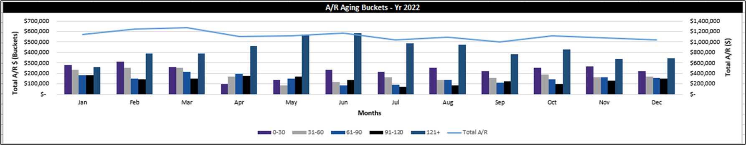
Step 4: Analysis of Billing Metrics (Cont.)
Goal 7: Analyze current performance of billing KPIs (Cont.)
  Calculate Billing Trends
  Analyze for potential shifts in KPIs
  Assess interventions/impacts that cause shift
  Check availability of automated metrics via EMR or billing software
All Rights Reserved
Notes:
Taking this a step further, once you have your billing KPIs, you can then track trends over time.
Tracking these metrics over time can highlight either 1.) the issue has been persistent, and the issue is baked into the operation or 2.) there was a specific time period when an issue arose
This information can help you design an intervention that targets specific issues or errors
As you can see in our example here, this is exactly what you do not want to see in your AR aging buckets, with a majority of AR falling into the category greater than120 days old.
However, you can see the problem begins to alleviate in the second half of the year which represents when specific policies for AR follow up and write offs were implemented

Slide 15
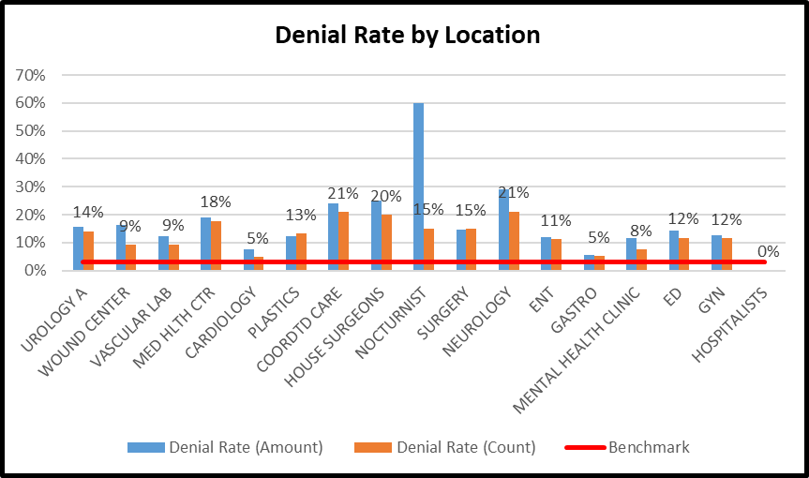
Step 4: Analysis of Billing Metrics (Cont.)
Goal 7: Analyze current performance of billing KPIs (cont.)
  Calculate KPIs by location
  Allows providers to focus attention on specific areas
  Assess interventions/impacts that cause discrepancies across sites
  Check availability of automated metrics via EMR or billing software
All Rights Reserved
Notes:
You can also break out your billing KPIs by location.
This will allow you to target problem areas and prioritize interventions by location
You will see we did this by denial issues by specific areas of a health system

Slide 16
Once I have addressed sources of error, how do I maintain operations?
A checklist of action items to maintain strong operations
Notes:
So once you have located the source or sources of error or waste and you design interventions to address those, how do you maintain optimal operations?

Slide 17
Step 5: Set Policies and Procedures
Goal 8: Develop Policies and Procedures to Maintain Strong Operations
  Develop new policies that outline organizational standards
  Conduct training session around new procedures
  Designate “owners” for each process and standard
  Optimize organizational structure to have a few individuals oversee processes
  Owners will be responsible for tracking and maintaining optimal benchmarks
  Incentivize staff to attain high standards during transition
  Audit operations annually, at a minimum
All Rights Reserved
Notes:
Ultimately it will require time by you and your colleagues.
First, you need to implement policies and procedures on how you want to structure your processes
This will require training of your staff and will take time for individuals to learn best practices
You should also allow for time to workshop any new policies to ensure you have the appropriate intervention
Next, designate owners for your processes. This cannot be led by one person and requires oversight from your team members
This can also be a way to improve engagement as you delegate more responsibility
You can also incentive staff to attain high standards during the transition
This can be difficult to set up, but we have seen gift cards, vacation days, meals or even bonuses as incentives
Finally, audit your interventions. At minimum we recommend annual audits but ideally quarterly or semiannually audits should be conducted
This is the work needed to ensure you can maintain any operations. It does come with an investment of time and resources, but it is required to create change.

Slide 18

Summary
8. Develop new policies
1. Define the process
2. Understand each step of process
7. Analyze billing KPIs
Operational Assessment Benefits
3. Identify sources of error
6. Compare to industry benchmarks
5. Calculate operation KPIs
4. Address sources of error
All Rights Reserved
Notes:
So in summation here are the benefits of an operational assessment:
Defining your processes
Understanding each step of your processes
Identifying sources of error
Addresses sources of error
Calculating operational KPIs
Comparing KPIs to industry benchmarks
Analyzing billing KPIs
And developing new policies

Slide 19

Questions? Please contact:
Dan Marano
Consulting Manager
(410) 252-0804
dmarano@lighthouseha.com
Notes:
That concludes my presentation today, my contact information is listed on the screen and I would like to open it up for any questions.
Thank you, again, for having me today.

