Slide 1

Combatting Emerging Trends in Denials
May 17, 2023

Slide 2
Agenda
1
Denials Increasing Across the Country
2
Issue Identification
3
Rules and Rationales
4
Analysis and Application
5
Conclusion

Slide 3

Today’s Clinical Denials Landscape Clinical denials have increased, particularly complex denials.
15-20%
AVERAGE INCREASE
IN CLINICAL DENIALS
Over the last 5 years, Aspirion has seen a 15%-20% average increase in clinical denials including:
Authorization,
Medical Necessity,
Inpatient to Outpatient Downgrades,
ED Acuity Level Downgrades, etc.

Slide 4
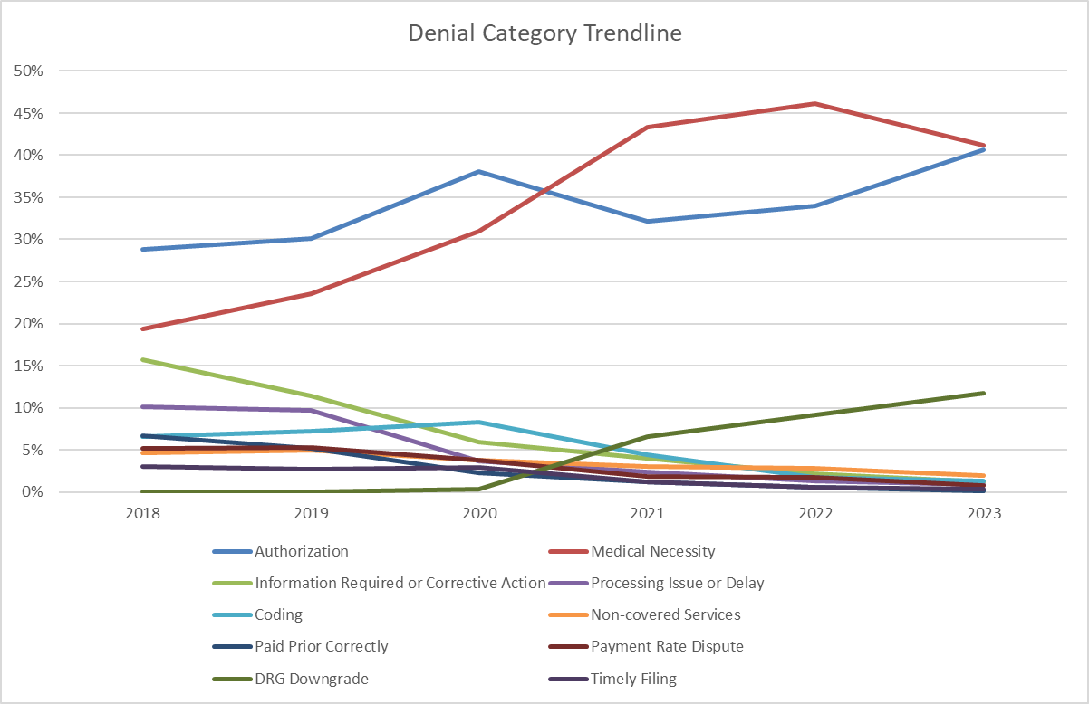

Aspirion Denial Category Trends
Rising Denial Categories
No Authorization
Medical Necessity
DRG Validation

Slide 5

Access Documentation
Timing of Inpatient Order
The patient can be treated at a lesser level of care.
Health Plan
Inpatient authorization denied at time of request
Physician Rationale
Peer-to-Peer Review
Clinical Guidelines Utilized
Documentation Quality
Communication/Process Issue
Notes:
We began analyzing different pieces of information that our clinical team were noting as they were appealing inpatient level of care denials. At first it was looking at a lot of text claim by claim, appeal by appeal, to start identifying the pieces of information that we wanted to track. It took a few months of analysis of a lot of information in order to identify seven main categories of information that we would classify as objective data elements in the subjective decision-making process. ​
​
I will talk us through three of the categories where we have seen significant impact on the root cause and will provide some examples of the insight we have captured and reported back to our clients.​
​

Slide 6
Access Documentation
Physician Rationale
Was physician rationale for inpatient admit clearly documented?
Timing of Inpatient Order
Physician Rationale
Peer-to-Peer Review
Clinical Guidelines Utilized
Documentation Quality
Communication/Process Issue
Notes:
And of course, we have to look at the rationale for inpatient admission as documented by the physician. ​
​
Does the physician rationale match what is documented in the MR? For example, the physician notes severe pain as the reason for IP admission or continued hospitalization, yet the MR documentation shows the patient received no pain medication or only pain medications by mouth. ​
Is the rationale only noted in the Utilization Management section of the record or is it documented in the physician progress notes? It is very important that physicians document their thought process and rationale for hospital admission and continued stay in the medical record and not just in the UM section. As payers typically do not have access to the UM notes, so the payer does not get the full picture and concerns of the physician. ​
​
Physician rationale and judgement is a very important component to justify medical necessity and must be taken into consideration by the payers. ​
​
We also should address the copy & pasting of notes for physician progress notes. I am sure all of you have seen physician progress notes that are copied and pasted for subsequent daily progress notes. Sometimes, there may be an additional statement of a change, but it is often overlooked as the note mirrors the prior day note and payers are not reviewing for a one line variation. It is easy to understand why this cut & paste is done by physicians given the volume of records they are completing, but this lack of critical, patient-specific information leads to denials and often makes overturning the denial very challenging. ​
​
Here are some observations we have noted. ​
​
First example involved 13 accounts reviewed. The clinical criteria was noted as not being met for IP on them and of those 13 accounts, 9 accounts did not have physician rationale noted for conversion to IP and the MR documentation did not meet criteria for IP. So having the physician rationale documented would have been key to understanding the reason for the conversion to IP. ​
​
Another example involved a patient initially admitted OBS and then converted to IP. The physician documented, appropriately, that the patient was admitted to Observation status. However, the patient was converted to IP on Day 3 yet the physician progress notes continued to state “admitted to OBS status” on subsequent daily progress notes until patient was discharged on Day 5. This cut & paste documentation for Observation status made it very difficult to justify IP LOC.​

Slide 7
Access Documentation
Clinical Guidelines Utilized
Payer used IQ for General Trauma
Patient had no injury within 24 hours of admit
Payer used chronic renal failure criteria
Patient was admitted with heart failure
Payer used IQ for Adult General Medicine
Patient met under IQ for Diabetic Ketoacidosis
Timing of Inpatient Order
Physician Rationale
Peer-to-Peer Review
Clinical Guidelines Utilized
Documentation Quality
Communication/Process Issue
Notes:
As I discussed earlier, there are two main criteria sets, InterQual and MCG guidelines, to assist in level of care determinations. Payers and hospitals may use different criteria sets to make their decisions. Again, these criteria sets are only guidelines and other factors must be considered to determine appropriate level of care including risk factors, comorbidities and physician judgement. ​
​
Is the criteria used correct? Does the MR support the criteria chosen? ​
In one scenario, we noticed the payer was incorrectly denying claims based on MCG criteria but the criteria was met based on the MR documentation. It was also noted that the physician reviewer did not have the specialty background or experience to conduct the reviews. It is important to understand that physicians conducting these reviews must have the proper experience and training in the same field or specialty to conduct reviews for authorizations. ​
​
In addition, as this slide shows, there were other examples in which the payer used the incorrect guideline to render their decision or often only use one guideline to approve or deny an admission for IP level of care. However, as we all know, many patients are not just admitted with one condition but multiple conditions being treated concurrently. So although criteria may not be met under one guideline, it may be met under another guideline. For example, a patient is admitted with both Pneumonia and COPD exacerbation. Although MN may not be met for Pneumonia, criteria for IP may be net under the COPD guideline. It is important for both hospital UM nurses and the payers to review other appropriate guidelines before making a final determination for admission status. When these discrepancies are noted in which the payer is denying claims incorrectly based on the guidelines they used, this information should be brought to the attention of the payer for training opportunities.​
​
We also provide feedback to the hospital when the hospital UR nurses use or interpret guidelines incorrectly – again for training opportunities. We have seen opportunities in which UM nurses cited criteria noting criteria was met but the MR documentation did not support the criteria selected. In one case, the criteria chosen was due to the patient having surgery but then the surgery was cancelled and not performed. However, there was no re-review of this admission following this change in the treatment plan in order to ensure correct admission status. ​
-​

Slide 8
Agenda
1
Denials Increasing Across the Country
2
Issue Identification
3
Rules and Rationales
4
Analysis and Application
5
Crafting an Effective Appeal

Slide 9
Principles of Appeal Drafting: Issue Identification
Overlying Goal: To submit a well-drafted, tailored appeal that will yield favorable resolution.
Steps to Take for Issue Identification:
Carefully review the history of the account and payor correspondence(s).
Contact the Payor for additional information or clarification.
Ask specific and pointed questions – narrowly tailor the reasons why.
Ensure that you are speaking with the correct department/entity.
Remember to contact the authorization department, too. Do not assume that the claims department is giving you the correct and/or complete information.
Request a copy of the denial letter.
Additional Research, if required per the denial type
Experimental, non-covered services, vague denials, coding issues
Notes:
- May need to speak with the specific auth department

Slide 10
Principles of Appeal Drafting: Issue Identification
Appeals must be narrowly tailored to the claim’s specific denial type.
Denial Example: “Claim was denied due to lack of authorization”
Broad denial reason – what is the argument? Are we sure it’s the right argument?
Non-Compliance/Procedural/Technical Authorization Denials
No Authorization was Requested.
Authorization was requested, but the authorization request was late.
Authorization was requested, but for a substantially similar procedure.
Medical Necessity/Clinical Authorization Denials
Authorization was requested, but the level of care and/or service was deemed not medically necessary (level of care denial).
Authorization was requested, and partially approved, but the claim’s date of service exceeds the approved units of authorization (length of stay denial).
Notes:
While a med nec argument must also be included for subsection (A), most payors will not overturn an authorization denial due to non compliance if there is not an argument explaining the extenuating circumstances surrounding the facility’s failure to request authorization appropriately.

Slide 11
Principles of Appeal Drafting: Issue Identification
Depending on whether the root of the denial is due to (A) or (B), the argument stated in the appeal changes
A. Non- Compliance Authorization Denial
The crux of this denial is the facility’s failure to request authorization as required by the payor’s authorization guidelines.
The first argument must address the non-compliance/procedural/ technical denial explaining why authorization wasn’t requested.
The second argument must address the clinical rationale.
B. Medical Necessity Authorization Denials
The crux of this denial is payor’s failure to agree with the level of care/service that the facility provided to the patient
The central argument for this denial type is a Medical Necessity Argument for the level of care/service provided

Slide 12
Case Study – Issue Identification
Newborn baby claim with dates of service 6/1/2022-9/1/2022.
Baby immediately placed in the NICU for respiratory distress and suspected esophageal fistula.
Total charges of $1,500,000 and an Expected Reimbursement of $900,000.
Primary insurance is Highmark BCBS and secondary is AmeriHealth Medicaid.
The claim initially denied as out of network. There are approved authorizations for the complete services by both Highmark and AmeriHealth.
What is/are the issue(s)?
No out of network coverage?
Authorization? Invalid or denied?
Medical Necessity Issues?
Initial Appeal submitted and denied

Slide 13
Agenda
1
Denials Increasing Across the Country
2
Issue Identification
3
Rules and Rationales
4
Analysis and Application
5
Crafting an Effective Appeal

Slide 14
Rules and Rationales
Medical reviewers must only consider the medical evidence that was available to the physician at the time he or she made the admission decision (i.e., what is “known & knowable”).
Medicare Advantage Plans may not restrict a patient’s benefits beyond the limitations imposed by Traditional Medicare.
Section 10.2 Medicare Managed Care Manual
Reviewers are instructed NOT to take into account other information, such as test results, that was not available to admitting physician unless it would support the admission decision.
Benefits Policy Manual (CMS Pub. 100-02), Ch. 1, § 10

Slide 15
Rules and Rationales
Regulatory Arguments – Use of Incorrect Clinical Criteria
Health Plans often use Milliman Care Guidelines (“MCG”) or InterQual criteria to deny inpatient Medicare Advantage Plan claims.
Inpatient admissions for Medicare Advantage beneficiaries must be reviewed under the two-midnight rule with deference to the physician’s complex medical judgement.
According to CMS, criteria such as “InterQual and MCG are just tools, not Medicare policy.”
What does your contract say?

Slide 16
Clinical Denials: Common Payer Trends
As a rule of thumb, authorization denials will have an underlying medical necessity issue.
I.e. Payers will deny the level of care rendered or will deny the length of stay.
Payers may target accounts with certain symptom or diagnosis codes (i.e., chest pain, shortness of breath, syncope) for denial review
Payers may use wrong criteria to assess the medical necessity of the admission
Commercial: InterQual & Milliman Care Guidelines (“MCG”)
Medicare: Two Midnight Rule
Payers may limit review to one condition when the patient has multiple conditions that could be evaluated against the criteria

Slide 17

The Unique Patient
Courts have stated the term “medical necessity” must refer to what is medically necessary for a particular patient.
Where an insurer presents sufficient evidence to show that a treatment is not medically necessary in the usual case, the burden shifts to the patient/provider to show that this individual patient is different from the usual in ways that make the treatment medically necessary for him or her.
Notes:
​InterQual and MCG are commercial products widely accepted, including by Courts, as an acceptable method to establish what is or isn't medically necessary care in the usual case. The denials you are receiving for inpatient level of care are because the information provided did not support that level of care in the usual case. Not all patients fall into the usual case. ​ We are going to circle back to this in just a moment.
​

Slide 18
Case Study – Rules and Rationales
No out of network coverage and Authorizations
Was authorization provided and what does that even mean?
If there was a network issue it should have been identified and addressed during the authorization process
Provider Contract – Is there a network agreement between provider of service and the payor?
Were the services provided emergent in a nature or otherwise medically supported?
External Supporting Information – Federal and State Statutory support
Are the Federal or State Statutes which support the coverage determination?
Are the Federal or State Statutes which support the medical necessity of the services?

Slide 19
Agenda
1
Denials Increasing Across the Country
2
Issue Identification
3
Rules and Rationales
4
Analysis and Application
5
Crafting an Effective Appeal

Slide 20
Medical Necessity Argument
Medical Records Do’s and Don’ts
Do:
Refer to how long the symptoms have been going on for and what other treatments have been tried
Include abnormal testing results that impact why the patient needed the care
Use the right portions of the record for the denial you have
Proper timeframe reference
Don’t:
Regurgitate the medical records
Include testing results that don’t impact the patient’s treatment
Include information that could hurt your argument

Slide 21
Medical Necessity Argument: Commercial
Argue the admission met inpatient criteria based on the information “known and knowable” to the physician at the time the decision was made.
“We disagree that UHC can override and ignore the assessment and plan of the healthcare providers who were directly involved in caring for this patient and devise a new plan for her at its discretion; solely based on paper documentation, without physical examination and direct involvement with the patient.”
“The decision to admit was made by a licensed provider, and required complex medical judgment based on comprehensive knowledge and understanding of the bedside care essential for this patient to have a successful outcome. Great deference must be given to the treating physician and the information available at the time of the decision to admit; a retrospective review is not permissible.”
Notes:
Cannot “replace” a doctor’s physical and visual assessment of a patient

Slide 22
Contractual Medical Necessity Argument
Example: Health Net Contractual Definition of Medical Necessity
“Medically Necessary or Medical Necessity: Those Covered Services which, under the provisions of this Agreement, are determined to be:
Appropriate and necessary for the symptoms, diagnosis or treatment of a condition, illness or injury; and
Provided for the diagnosis or the direct care and treatment of a medical condition, illness or injury; and
Within the standards of good medical practice within the organized medical community; and
Not primarily for the convenience of the member, or the Member’s physician or other provider; and
The most appropriate supply or level of service, including levels of acute care such as ICU services or regular acute medical and surgical services as determined by the clinical status of the Member, which can safely be provided to the member. For hospitalization, this means that the Member requires acute care as an inpatient due to the nature of the services the Member is receiving, or the severity of the Member’s condition, and that safe and adequate care cannot be received as an outpatient or at a less intensified medical setting such as a sub-acute unit or Skilled Nursing Facility.”

Slide 23
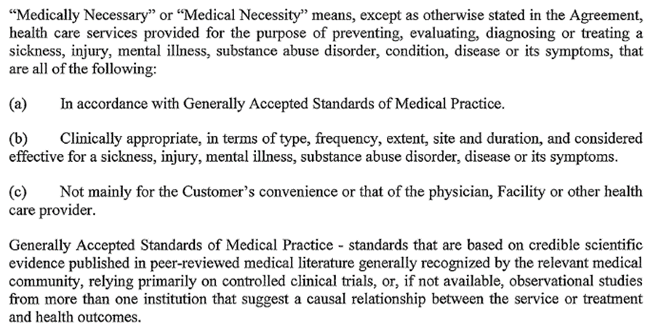
Contractual Medical Necessity Argument
Example: UHC Contractual Definition of Medical Necessity

Slide 24
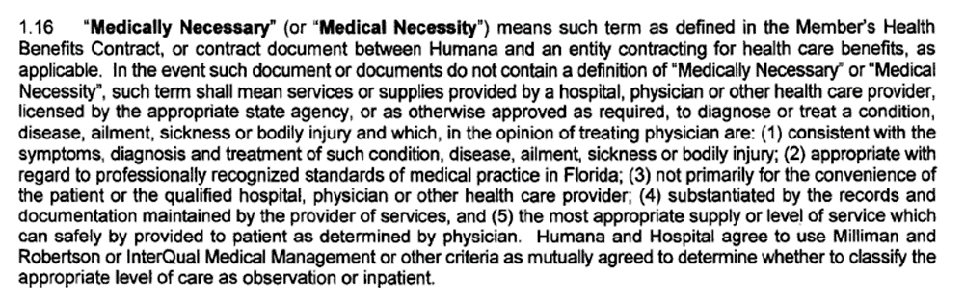
Contractual Medical Necessity Argument
Example: Humana Contractual Definition of Medical Necessity

Slide 25
Medical Necessity Argument: Medicare
Medicare criteria for medical necessity is based on
Medicare Policy Manuals
Local Coverage Determinations (“LCD”)
National Coverage Determinations (“NCD”)
Medicare Level of Care Determinations – Two Criteria:
The Two Midnight Rule
Admission was Medically Necessary and Reasonable
Notes:
Cannot “replace” a doctor’s physical and visual assessment of a patient

Slide 26
Medical Necessity Argument: Commercial Inpatient Only Procedures
Apply similar argument for non-Medicare claims
“The country’s largest payer of healthcare services (i.e., the Federal Government) deemed these procedures so serious that the surgeries must be performed at a hospital on an inpatient basis.”
“Payer must cover services provided in accordance with the generally accepted standards of medical practice. However, Payer’s determination that this surgery should have been performed on an outpatient basis is in direct conflict with generally accepted standards of medical practice as evidenced by CMS’s designation of this surgery as in “inpatient” procedure.”
*Note, some Commercial payers may have a provision in their contract stating that the payor must pay per the IP list. As such, a good reminder to check through the contract! ☺

Slide 27
Case Study – Analysis and Application
No out of network coverage and Authorizations
Both Highmark BCBS and AmeriHealth Medicaid provided approved authorizations
If there was a network issue it should have been identified and addressed during the authorization process
Provider Contract – Policy documents state all emergency care and services out of network with authorizations would be reimbursed, and provider is in-network
Estoppel and Detrimental Reliance – the legal principles which excludes the assertion of a contrary position to the position that is implied by prior action – they authorized the claim, the facility relied on that authorization in providing services, and should be compensated appropriately.
External Supporting Information – Federal and State Statutory support
Newborn and Mother’s Health Protection Act (NMHPA 1) – group health can’t restrict benefits for childbirth to less than 96 hours for cesarean
Affordable Care Act (ACA) – Maternity care is covered as an essential health benefit
PA Sate Act: 1975 Act 81 § 1-3 – Insurers required to provide coverage for treatment of medically diagnosed congenital defects, birth abnormalities, prematurity, and routine nursery care

Slide 28
Agenda
1
Denials Increasing Across the Country
2
Issue Identification
3
Rules and Rationales
4
Analysis and Application
5
Crafting an Effective Appeal

Slide 29
Appeal Components
Header
Background
Procedural Arguments
Contractual Arguments
Medical Necessity
Closing Summary & Plea for Payment

Slide 30
Appeals Approach:
Procedural Arguments
Denied requests may involve issues in addition to “lack of medical necessity” that must be overcome prior to addressing medical necessity
Procedural Issue Example: Invalid Authorization
Often, there is a valid reason for failure obtain valid authorization:
The patient presented to the emergency department unconscious and could not communicate coverage information;
The patient did not have an insurance identification card upon presentation to the emergency department;
The patient indicated coverage under traditional Medicare.
The hospital attempted to obtain authorization, however, when the hospital called the carrier, the carrier advised that authorization was not required

Slide 31
Appeals Approach: Contract Argument
The Hospital’s managed care contract may contain language which supports your procedural argument
For example: UHC contract provision which excuses untimely authorization requests or untimely submission of a claim if the facility can show that at the time the notification or submission was required, the facility was unaware and unable to reasonably determine that the patient was a UHC member.

Slide 32
Appeals Approach: Contract Argument
Example: Health Net Contractual Definition of Medical Necessity
“Medically Necessary or Medical Necessity: Those Covered Services which, under the provisions of this Agreement, are determined to be:
Appropriate and necessary for the symptoms, diagnosis or treatment of a condition, illness or injury; and
Provided for the diagnosis or the direct care and treatment of a medical condition, illness or injury; and
Within the standards of good medical practice within the organized medical community; and
Not primarily for the convenience of the member, or the Member’s physician or other provider; and
The most appropriate supply or level of service, including levels of acute care such as ICU services or regular acute medical and surgical services as determined by the clinical status of the Member, which can safely be provided to the member. For hospitalization, this means that the Member requires acute care as an inpatient due to the nature of the services the Member is receiving, or the severity of the Member’s condition, and that safe and adequate care cannot be received as an outpatient or at a less intensified medical setting such as a sub-acute unit or Skilled Nursing Facility.”

Slide 33
Appeals Approach:
Medical Necessity Arguments
Once the procedural issue is addressed, the appeal must then establish the medical necessity of the treatment
Argue the admission meets inpatient criteria based on the information “known and knowable” to the physician at the time the decision was made
Address situations in which the payer utilized the incorrect MCG/InterQual Criteria

Slide 34

Effective Level of Care Appeals
Get the denial letter!
Provides the clinical rationale used to deny the claim
Dispute their findings directly with the medical record documentation
Cite specific medical necessity criteria
InterQual or Milliman Care Guidelines
Add risk stratification to your argument
Example: Comorbid conditions being treated concurrently that increased the risk of the patient for possible complications or deterioration of patient’s condition

Slide 35
Case Study – Crafting an Effective Appeal
Authorization For Services Was Obtained
These services are for a newborn born on 06/01/2022 at HOSPITAL. Highmark was notified of the baby’s delivery and authorization was requested. Highmark provided authorization # Case-111111, see enclosed case management notes. HOSPITAL and Highmark corresponded every couple of days to extend the authorization throughout the entire date of service. The patient was also authorized for transfer on 8/21/2022 to Second Hospital. During this time, Highmark never mentioned the patient was out-of-network or requested the patient be transferred instead of receiving care.

Slide 36
Case Study – Crafting an Effective Appeal
Services are Protected Federally and by the State of Pennsylvania
As noted above, these services were for a newborn and are therefore protected federally and statutorily in the State of Pennsylvania. Notably, per NMHPA, “group health plans and health insurance issuers may NOT restrict benefits for a hospital stay in connection with childbirth to less than 48 hours following a vaginal delivery or 96 hours following a delivery by cesarean section. Moreover, per ACA, emergency and maternity care is covered as an essential health benefit. The patient required additional NICU care and could not be safely discharged or transferred until stable.
Under Pennsylvania law health insurers are required to provide coverage with respect to a newborn child. The coverage “shall consist of coverage of injury or sickness including the necessary care and treatment of medically diagnosed congenital defects, birth abnormalities, prematurity and routine nursery care, but need not include routine well-baby care, immunizations and medical examinations or tests not necessary for the treatment of a covered injury, illness, defect, deformity or disease except to the extent that such coverages are provided the insured or for dependent children under the same class of coverage”.
These services are required to be rendered and covered by health insurers under the above statutes. Therefore, HOSPITAL demands processing of this claim for payment.

Slide 37
Case Study – Crafting an Effective Appeal
HOSPITAL is a Contracted Provider with Highmark
Per the eligibility checks run during the patient’s stay, Highmark was a valid policy. Per HIPAA, as long as a newborn is enrolled on the mother’s plan within 30 days of birth, coverage is effective as of the birth date. This patient was added to the policy and the policy remained in effect through the end of the year.
HOSPITAL has an active contract with Highmark and is in network. Even if Highmark determined this particular plan was not in network, the policy documents state all emergency care and services out of network with authorization would be reimbursed. As noted above, services were fully authorized. Lastly, per the Highmark Sapphire Digital site, HOSPITAL is in-network.

Slide 38
Case Study – Crafting an Effective Appeal
Services Were Medically Necessary
The patient is a newborn, born at 39 weeks by C-section, with a weight of 3271 grams. The patient was immediately placed in the NICU for respiratory distress and suspected esophageal fistula. The patient required care for sepsis, respiratory distress, hypoxemia, tachypnea and TEF. The patient underwent repair of the esophageal atresia and tracheoesophageal fistula on 06/24/2022. She required intubation and mechanical ventilation. She was unable to extubated until 08/10/2022 and 08/12/2022, she was noted to have severe tracheomalacia and a type III laryngeal cleft. The patient had persistent reflux and emesis, leading to G-tube placement. Moreover, the patient was treated for MSSA infections and pneumonia during the stay. Eventually, the patient was transferred via LifeFlight to Second Hospital. There is no question these services were medically necessary, and they were fully authorized by Highmark. Nonetheless, the medical records are included for review.

Slide 39
Case Study – Crafting an Effective Appeal
Conclusion
Highmark should reimburse these services under the legal theory of detrimental reliance. HOSPITAL notified Highmark, received authorization, continued to verify eligibility, and provided medically necessary services. HOSPITAL was never informed of any issues regarding the patient’s services. HOSPITAL relied on Highmark to their detriment. Highmark is in the best position to know whether services require authorization or are out of network. HOSPITAL attempted to comply with Highmark by obtaining authorization. HOSPITAL should be compensated for the services provided to the Highmark member.
It is clear that the services performed were medically necessary and protected by state and federal legislation. Therefore, HOSPITAL requests review and reimbursement of the above claim.

Slide 40
Case Study – RESULTS!
What if none of that works? – Multiple appeals denied!
What’s in your toolbox?
Escalate, escalate, escalate
Provider reps
JOC Meetings
General Counsel
This account needed escalation through all of the above
Ultimately resolved through several emails/phone calls with Highmark’s GC
$900,000 recovered!

Slide 41
Appeal Writing Tips
Place the most compelling argument and information at the beginning of the appeal
Don’t just state “the services were medically necessary.” Use facts from the medical records, not just generalities
Avoid including information that is inconsistent with your argument
Keep the reviewer focused on the “right” information – make it easy for them to approve

Slide 42
Questions?

Slide 43

Thank you
Dave Jewell, JD MBA Managing Attorney & Executive Director, Client Success Direct: (540) 664-6150 dave.jewell@aspirion.com

