Slide 1
Recent Accounting Pronouncement Updates and Risk Assessment for your Organization
February 16, 2023

Slide 2
ASU 2016-02, Leases (Topic 842)
Effective Date for NFPs: Fiscal years beginning after December 15, 2021
Standard applies to leases of Property, Plant, and Equipment
Lessees will be required to recognize a Right of Use (ROU) asset for all leases that qualify. The lease liability will be equal to the present value of lease payments and represents the financial obligation over the lease term. The ROU asset represents the lessee’s right to use the underlying asset and will be based on the liability, subject to adjustment for things such as initial direct costs, prepaid rent, and lease incentives
Leases will be required to be classified as either operating or finance leases
The criteria for determining if a lease is a finance lease is similar to ASC 840 capital lease criteria. However, ASU 2016-02 removes the 75% and 90% bright line test
Operating leases will result in a straight-line expense over the lease term. This straight line expense will include both amortization and interest expense

Slide 3
ASU 2016-02, Leases (continued)
Finance leases will result in a “front-loaded” expense pattern, meaning the related expense would generally decrease over the lease term (similar to previous guidance for capital leases)
Separation of lease and nonlease components
Leases under 12 months that do not come with a purchase option are excluded from standard adoption
Lease term will include non-cancelable lease term plus period for which it is reasonably certain that renewal and termination options will or will not, respectively, be exercised
Lessees should use the rate implicit in the lease as the discount rate if it is readily determinable. If the rate is not readily available, the incremental borrowing rate should be used

Slide 4
Determining Application Dates
ASU 2016-02 requires the use of the modified retrospective approach, meaning that the determination of lease balances is based on remaining lease payments and discount rates as of the date of initial application
Two options for determining the application date:
Comparative date option – apply at the beginning of the earliest comparative period presented on the face of the financial statements (for example, a December 31, 2022 year end would use January 1, 2021)
Effective date option – apply at the effective date of the standard (for example, a December 31, 2022 year end would use January 1, 2022)
If the effective date option is selected, comparative period is still presented in line with ASC 840
The effective date option simplifies transition requirements

Slide 5
Practical Expedients at Transition
Practical Expedient Package. If elected, entity does not have to reassess:
Whether any expired or existing contracts is, or contains, a lease
The lease classification of any expired or existing leases
Initial direct costs for any existing leases
Entity that elects the above package must apply it to all leases; lease-by-lease basis is not allowed
Hindsight practical expedient
Land easement practical expedient

Slide 6
Accounting Policy Elections
Short term lease exemption
Applies to leases with lease terms of 12 months or less at commencement date and do not include a purchase option that the lessee is reasonably certain to exercise. Will continue to be treated as they were under ASC 840
If there are renewal options and the entity is reasonably certain to exercise the renewal, the lease would not qualify for the short-term lease exemption
Combining lease and nonlease components
Lease components includes the right to use the identified asset while nonlease components are the costs related to the payment of a service (i.e. maintenance costs)
Entities are permitted, as a policy election, by asset class, to combine these components as a single component for classification, recognition, and measurement purposes

Slide 7
Accounting Policy Elections
While this election will save time, more cost will be capitalized on the balance sheet
If not elected, entities will be required to allocate consideration in the lease contract to lease and nonlease components
Discount rates
Under ASC 842, lessees are required to use the discount rate implicit in the lease contract. However, can use the incremental borrowing rate since the discount rates are typically not available
There is a practical expedient that allows entity to use a risk free rate instead of the IBR when determining the present value of the lease payments.

Slide 8
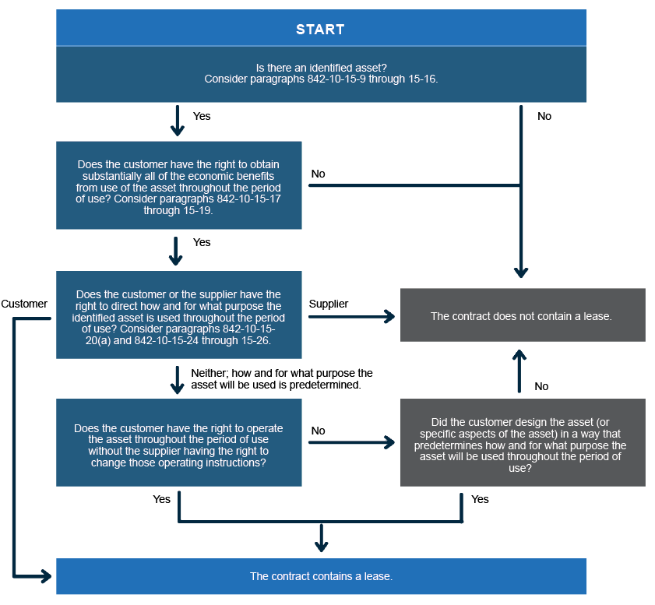
Do you have a lease?

Slide 9
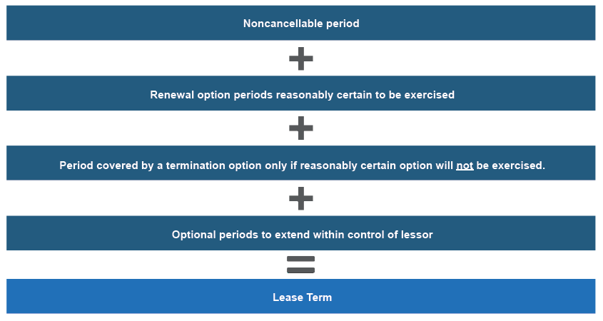
What is the lease term?

Slide 10
Finance Lease vs. Operating Lease
Criteria for classification as a finance lease
Transfers ownership to lessee
Purchase option contained in contract is reasonably certain to be exercised
Lease term for major portion of asset’s remaining economic life
Present value of lease payments and residual value exceeds substantially all of the fair value of the underlying asset
Specialized nature of the underlying asset results in no expectation of alternative use after lease term

Slide 11
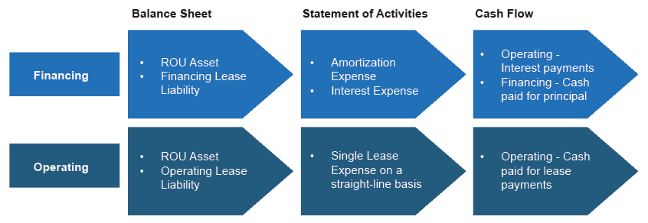
Accounting for finance lease vs operating lease

Slide 12
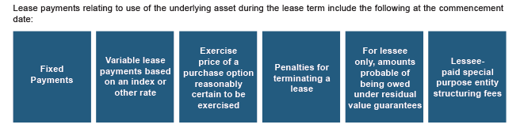
Lease Payments
Items that are excluded from lease payments: variable lease payments not based on an index or rate, lessees guarantee of lessors debt, amounts allocated to nonlease components if practical expedient is not elected (examples: real estate taxes, building insurance)

Slide 13
Lease Accounting Example
Lessee enters into a five-year contract with a supplier for the right to use specified equipment over the lease term. The contract meets the definition of a lease and includes only a single lease component. As a result, the lessee needs to determine the lease liability and the ROU asset resulting from the lease at the lease commencement.
The facts relevant to the lease are as follows:
Fixed payments of $10,000 per year, increasing by 3% each year
No renewal options
No transfer of ownership
Incremental borrowing rate of 7%
Initial direct costs of $700
Cash incentive received of $2,000
Qualifies as an operating lease

Slide 14
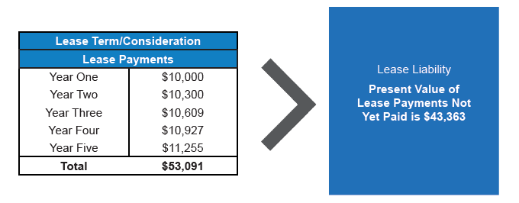
Lease Accounting Example (continued)
Lease liability calculation is calculated as the present value of the lease payments not yet paid by using the lease term and discount rate at the lease commencement

Slide 15
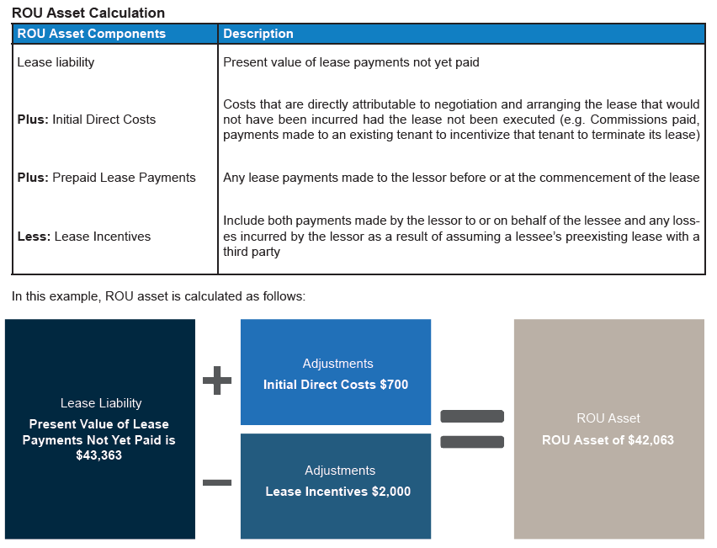
Lease Accounting Example (continued)

Slide 16
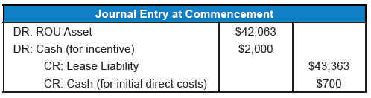
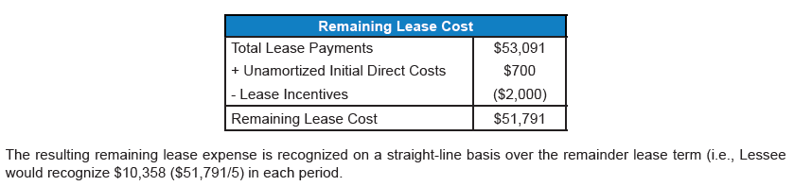
Lease Accounting Example (continued)
Initial journal entry at lease commencement
The total remaining lease expense on the commencement date would be $51,791, calculated as follows:

Slide 17
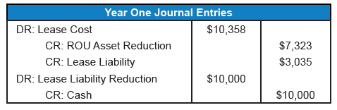
Lease Accounting Example (continued)
Year one journal entries:

Slide 18
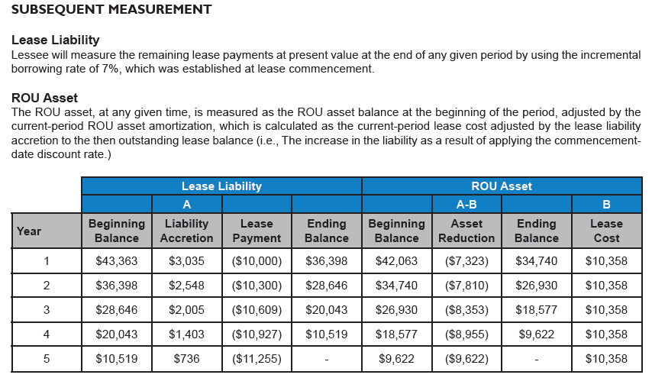
Lease Accounting Example (continued)

Slide 19
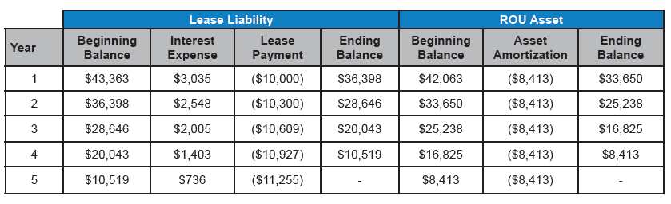
Lease Accounting Example (continued)
Using the same facts as the previous example, assume the lease qualified as a finance lease
Initial entries/impact would mirror the operating lease example

Slide 20
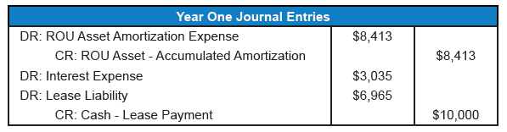
Lease Accounting Example (continued)
Year one journal entries

Slide 21
Financial Statement Presentation
Balance Sheet
ROU assets on finance leases must be presented separately from operating lease ROU assets
Finance lease liabilities must be presented separately from operating lease liabilities
Such assets and liabilities must be presented as current vs non-current
Income Statement
For finance leases, interest expense and amortization of the ROU asset must be presented as interest expense/depreciation or amortization expense, respectively
For operating leases, a single amount of lease expense should be included in operating expenses
Statement of Cash Flows
Repayment of the principal portion of finance leases must be presented as a financing activity
Interest expense on lease liabilities resulting from finance leases must be presented as an operating activity
Payments from operating leases must be presented as an operating activity

Slide 22
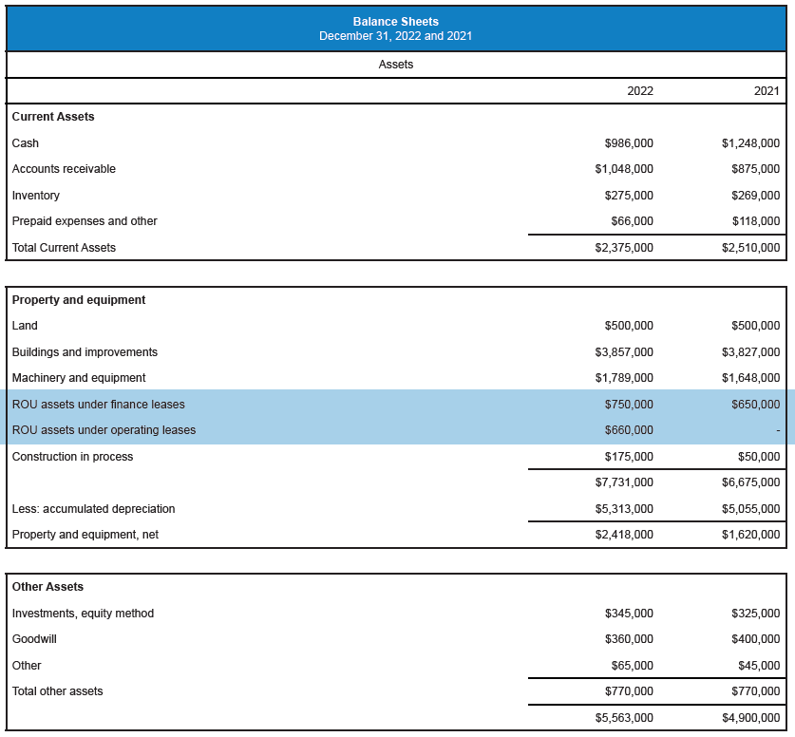
Financial Statement Presentation (continued)

Slide 23
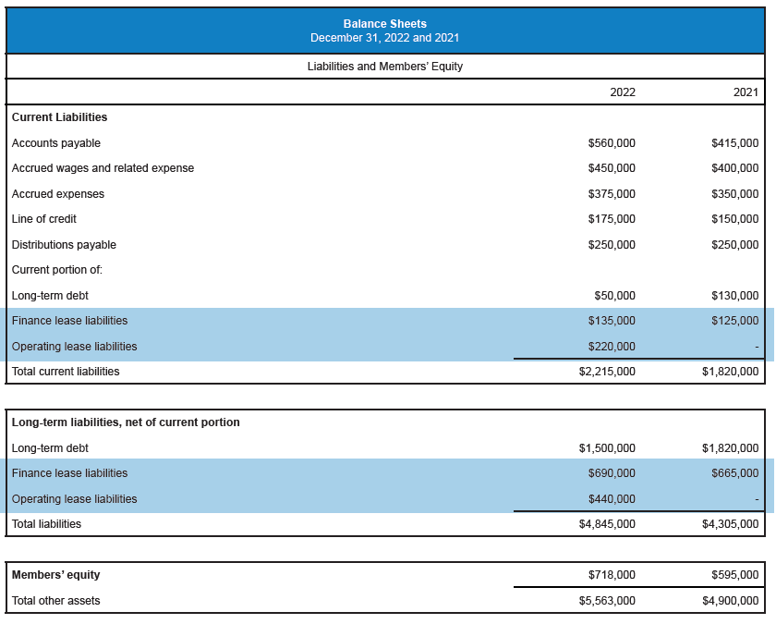
Financial Statement Presentation (continued)

Slide 24
Disclosure Requirements
A general description of the leases. (ASC 842-20-50-3(a)(1))
The basis, terms, and conditions on which variable lease payments are
determined. (ASC 842-20-50-3(a)(2))
The existence and terms and conditions of options to extend or terminate
the lease, which should include narrative disclosure concerning options that
(1) are recognized as part of ROU assets and lease liabilities, and (2) those
that are not included as part of ROU assets and lease liabilities. (ASC 842-
20-50-3(a)(3))
The existence and terms and conditions of residual value guarantees the
lessee has provided (ASC 842-20-50-3(a)(4))
Any restrictions or covenants imposed by leases (e.g., Those relating to
dividends or incurring additional financial obligations.) (ASC 842-20-50-3(a)
(5))
For each item 1-5 above, the information related to subleases (as applicable)
(ASC 842-20-50-3(a))

Slide 25
GASB Statement No. 87 - Leases

Slide 26
GASB 87 - Leases
Goal of this new standard is to more accurately represent lease obligations and to increase the usefulness of governmental financial statements
Under GASB 87, a lease is defined as “a contract that conveys control of the right to use another entity’s nonfinancial assets as specified in the contract for a period of time in an exchange or exchange-like transaction”
Requires all leases that have a maximum possible term greater than 12 months to be recorded in the statement of net position

Slide 27
GASB 87 vs ASC 842 – Key Differences
Capitalization Model
GASB 87 – all leases are considered to be finance leases
ASC 842 – leases can be classified as either operating or finance
Short term leases
GASB 87 – short term leases are not capitalized. Short term assessment should consider maximum possible lease term. Extension/renewal periods are included regardless of probability the lease will be extended.
ASC 842 – have the option of capitalizing short term leases. Renewal and termination options are only included in the lease term if reasonably certain they will be exercised.
Effective date
GASB 87 – for fiscal years beginning after June 15, 2021
ASC 842 – for fiscal years beginning after December 15, 2021

Slide 28
GASB 87 vs ASC 842 – Key Differences
Transition reporting
GASB 87 – requires full retrospective presentation
ASC 842 – modified retrospective presentation
Required disclosures
GASB 87 – report the first 5 years of maturities, then in 5 year increments thereafter
ASC 842 – report the first 5 years of maturities, then “thereafter” as a single amount

Slide 29
Other Accounting Pronouncement Updates

Slide 30
ASU No. 2020-07
Not-for-Profit Entities (Topic 958): Presentation and Disclosures by Not-for-Profit Entities for Contributed Nonfinancial Assets
Will require a more prominent presentation of contributed nonfinancial assets and enhance disclosures around the valuation of those contributions
Examples of contributed nonfinancial assets: fixed assets, contributed use of long-lived assets, materials and supplies, intangibles, contributed services
Contributed nonfinancial assets will be presented as a separate line item in the statement of activities
Effective date: fiscal years beginning after June 15, 2021

Slide 31


RISK ASSESSMENT

Slide 32
Risk Assessment
What are the primary risks that your entity faces from a financial reporting perspective, and how do you respond to those risks?
What are the key areas of risk within your accounting processes?
What internal controls have been implemented?
Are they properly designed and operating effectively?

Slide 33
Internal Controls surrounding Federal Funding
Best practices related to internal controls
Have you implemented and documented internal control policies that are specific to each federal program?
Is balanced billing being practiced for out-of-network patients being seen?
Is there an adequate segregation of duties (authorization, custody, and recordkeeping)?
What key controls been developed in your financial reporting processes that ensures adequate review and supervision?
Have those documented policies been approved by appropriate levels of management and/or those charged with governance?

Slide 34
PROVIDER RELIEF FUNDS

Slide 35
COVID-19 Relief Funding Programs: Rural Healthcare
Assistance Listing #93.498 - Provider Relief Fund and American Rescue Plan (ARP) Rural Distribution
Distributed to eligible health care providers between April 2020 and December 2021.
Assistance Listing #93.461 - COVID-19 Claims Reimbursement to Health Care Providers and Facilities for Testing, Treatment, and Vaccine Administration for the Uninsured
Claims reimbursement to health care providers generally at Medicare rates for testing uninsured individuals for COVID-19, treating uninsured individuals with a COVID-19 diagnosis, and administering COVID-19 vaccines to uninsured individuals on or after February 4, 2020.
Assistance Listing #93.697 – COVID-19 Testing and Mitigation for Rural Health Clinics (RHCs)
Rural Health Clinic COVID-19 Testing (RHCCT) Program: $49,461 distributed to each eligible RHC in May 2020 (or December 2020 for those not funded in May).
Rural Health Clinic COVID-19 Testing and Mitigation (RHCCTM) Program: $100,000 distributed to each eligible RHC in June 2021 (or August-September 2021 for those ineligible in June).

Slide 36
COVID-19 Relief Funding Programs: Rural Healthcare (cont’d)
Assistance Listing #93.912 – Rural Health Care Services Outreach, Rural Health Network Development and Small Health Care Provider Quality Improvement
Rural Health Clinic Vaccine Confidence (RHCVC) Program: $49,529 distributed through the HRSA Payment Management System to each eligible RHC applicant in July 2021.
Other COVID-19 Nonfinancial Assistance Programs for RHCs
Rural Health Clinic Vaccine Confidence (RHCVD) Program: Direct shipments of the COVID-19 Vaccine.
Rural Health Clinic COVID-19 Testing Supply Program: Direct shipments of at-home COVID-19 tests, and Point-of-Care Testing Supplies.
Rural Health Clinic COVID-19 Therapeutic Treatment Program: Direct access to COVID-19 therapeutics Paxlovid and Lagevrio (monulpiravir).

Slide 37

Provider Relief Fund (PRF) and American Rescue Plan (ARP) Rural Distribution – General Overview
PRF General Distributions
All providers that received Medicare fee-for-service (FFS) reimbursements in 2019 were eligible to receive at least one Phase 1 General Distribution PRF payment in April 2020. Most providers received two payments.
General Distribution PRF payments for Phases 2-4 and ARP Rural Distributions were distributed to providers that applied and met eligibility criteria.
PRF Targeted Distributions
PRF Targeted Distributions were distributed to skilled nursing facilities, tribal healthcare providers, safety net hospitals, children’s hospitals, providers in COVID-19 high impact areas, and providers in rural areas throughout 2020 based on designated eligibility criteria.
Use of Funds
Funds are required to be used to prevent, prepare for, and respond to coronavirus, and for unreimbursed healthcare-related expenses or lost revenues attributable to coronavirus. Unreimbursed expenses are applied first, followed by lost revenues.

Slide 38
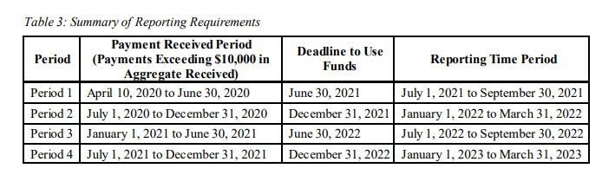
Reporting Requirements
Deadline to use funds and timetable for reporting on PRF payments in the HRSA PRF Reporting Portal based on the period in which funds were received.
Only providers that received payments exceeding $10,000 for the Payment Received Period are required to submit reports to the PRF Reporting Portal.
PRF Reporting Portal: https://prfreporting.hrsa.gov/s/

Slide 39
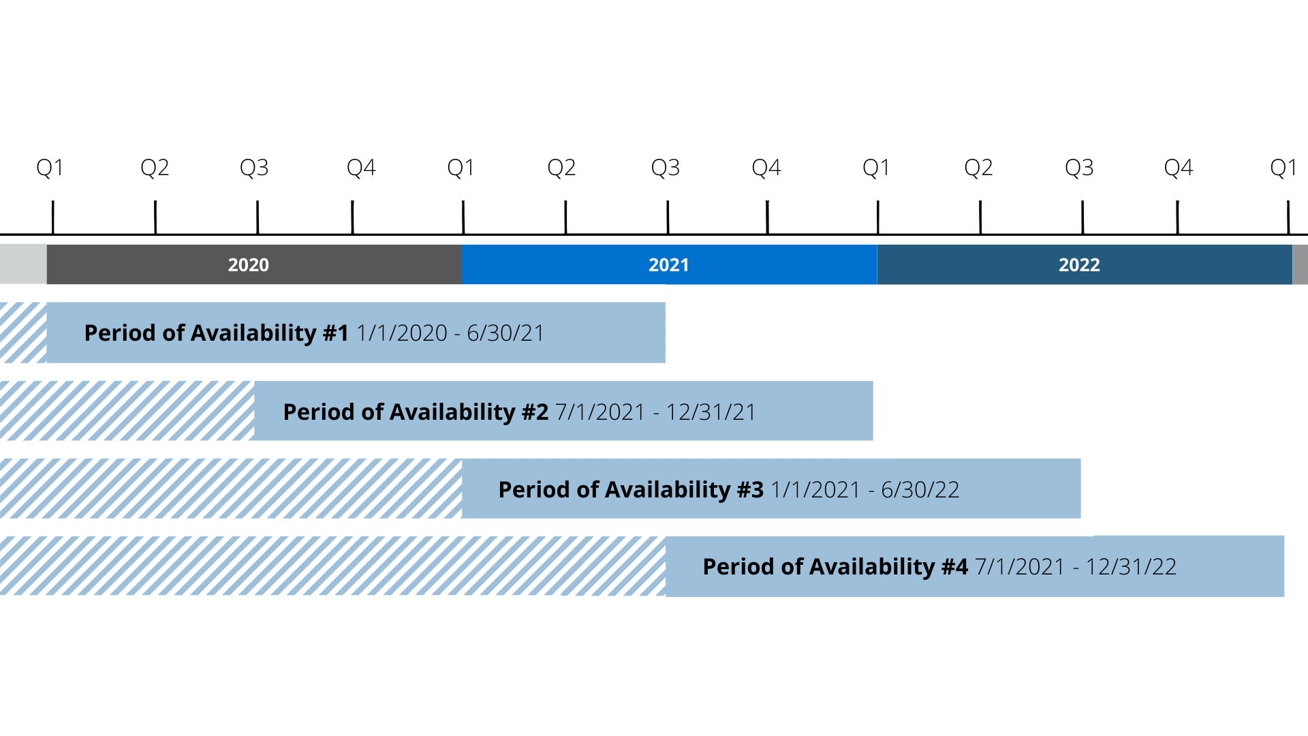
Reporting Periods
Reporting by Quarters and Periods of Availability

Slide 40
Summary of Key Items/Steps – PRF Portal Reporting
Interest Earned on PRF Payments – Must report amount of interest earned from date of receipt through end of period of availability on SNF Infection Control and Quality Incentive payments and/or amount of interest earned on all other PRF payments. Any interest earned that was not expended in the form of unreimbursed expenses or lost revenues attributable to coronavirus must be returned.
Other Assistance Received – Other assistance received is reported by quarter for informational purposes. Includes all non-PRF COVID relief funding.
Nursing Home Infection Control Expenses (if applicable) – SNF Infection Control and QIP payments may only be used to reimburse nursing facility Infection Control Expenses, which are reported separately. May not be used to reimburse lost revenues. Portal only permits reporting of expenses in this step up to amount of Infection Control and QIP payments received during the payment period.
Other Provider Relief Fund Expenses – Unreimbursed expenses attributable to coronavirus for all other General and Targeted Distribution payments received during payment period. Portal only permits reporting of expenses in this step up to amount of Other PRF payments received during the payment period.
Unreimbursed Expenses Attributable to Coronavirus – Expenses attributable to coronavirus through the end of the period of availability that remain unreimbursed after consideration of all COVID-related assistance, including the PRF (excess expenses over PRF payments reported on in payment period).
Actual Patient Care Revenue or Lost Revenues – If expenses attributable to coronavirus in step 10 equal or exceed PRF payments for the payment period, portal will prompt to enter actual patient care revenues for the relevant period(s). If not, one of three lost revenue calculation methods will be selected.

Slide 41
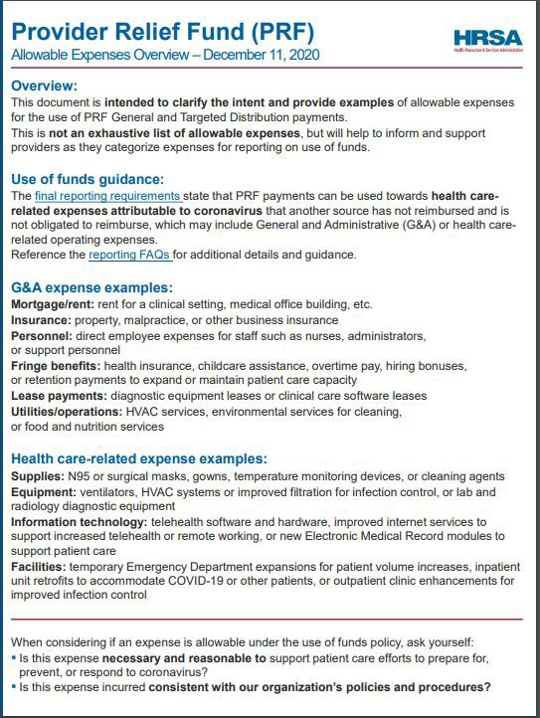
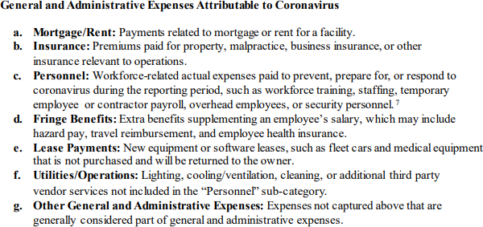
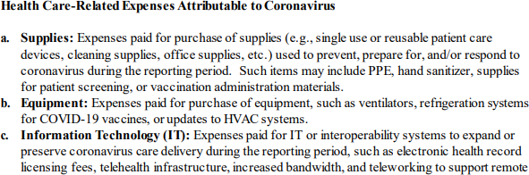
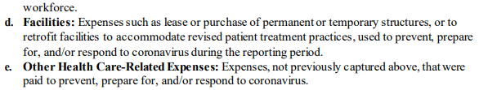
COVID-19 EXPENSES
Notes:
Must report expenses by quarter for each category above if $500,000 or more was received in a Payment Received Period. If less than $500,000 was received, provider is only required to total General & Administrative and Healthcare-Related expenses by quarter.

Slide 42
Provider Relief Funds
As part of the process of receiving your single audit of Provider Relief Funding, and other federal funding included as part of the CARES Act, consider the following as a best practice:
Ensure that there is adequate recordkeeping related to the underlying records that tie to your portal submissions with HRSA
Detailed listings of direct expenses incurred and applied towards funding, including dates, descriptions, and amounts that are supportable with third-party documentation
For estimates used to apply costs towards funding received, ensure that documented descriptions of the methodologies used, and support of any underlying financial data used in these estimates, are readily available
Ensure that an estimate of any potential reimbursement for costs through insurance claims submitted to payors, have been considered as a potential reduction of claimed costs
For lost revenue calculations, ensure there is adequate recordkeeping that supports quarterly breakdowns of patient service revenues for purposes of determining potential lost revenues to apply towards funding received

Slide 43
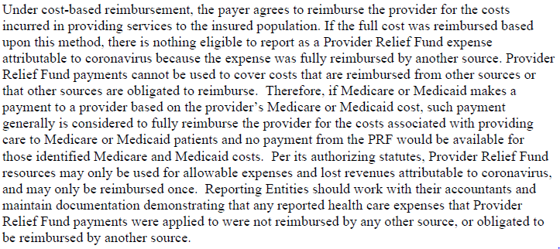
Provider Relief Funds (continued)
Reimbursement of costs incurred, per HHS:

Slide 44
QUESTIONS?

Slide 45


THANK YOU
FOR ATTENDING!
If you have any additional questions please contact today’s presenter or your local advisor.
Gage Beavers, CPA
Senior Accountant gbeavers@blueandco.com
502-992-3483

