Slide 1
2023 Federal Policy Update:
Latest Guidance on the No Surprises Act
Healthcare Financial Management Association
Andrew Donahue, MHA, CPA
Director, Healthcare Finance Policy

Slide 2

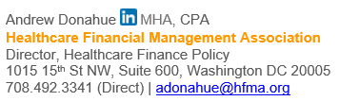
Contact Information

Slide 3
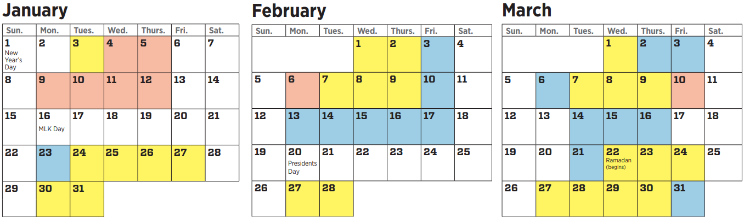
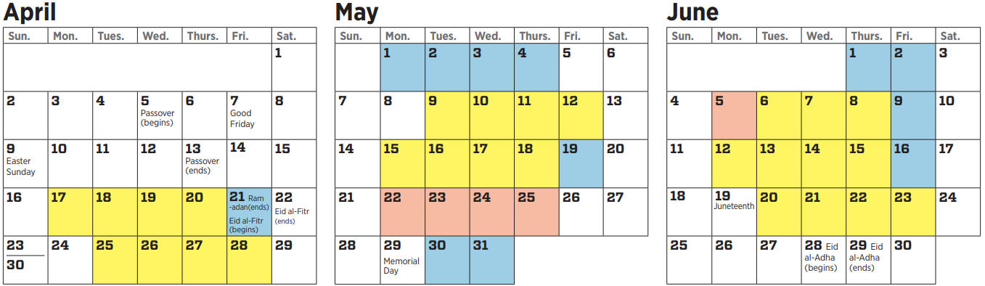
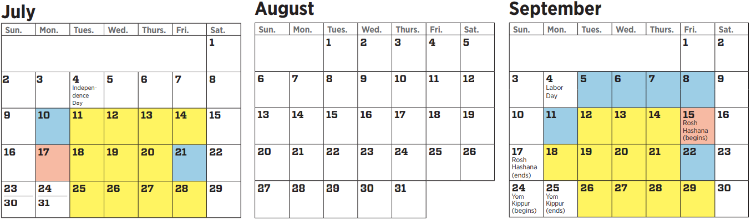
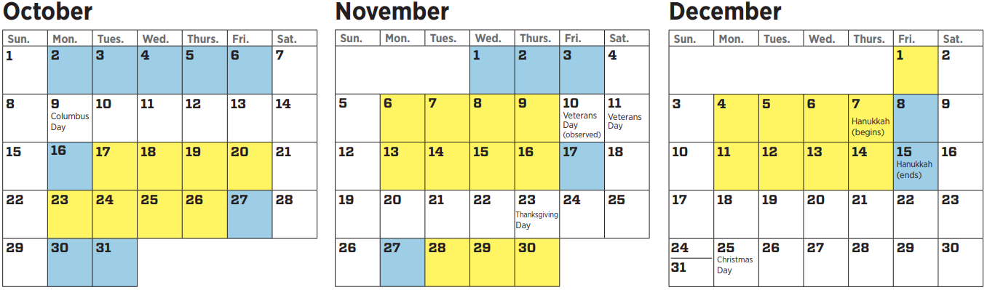
Calendar Year 2023
Limited time, bandwidth and political capital
Move-in
SOTU
Biden’s budget
GOP budget
Debt ceiling?
NSA
IDR Guidance
Medicaid contin. coverage
340B fix
PHE unwind
Recess-ion?
Govt. funding
Holiday season
Primary season
Price trans-parency
No Surprises Act
DSH cuts

Slide 4
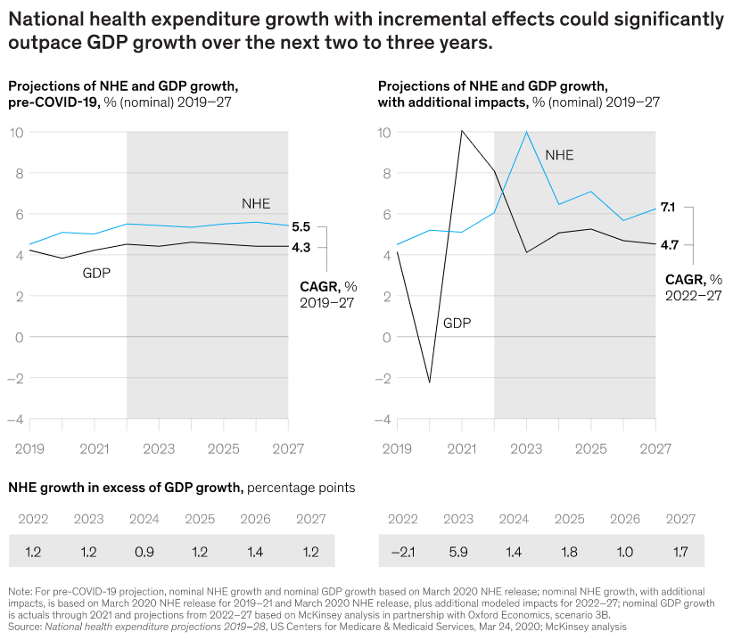
Mounting Pressure
Source: McKinsey & Company

Slide 5
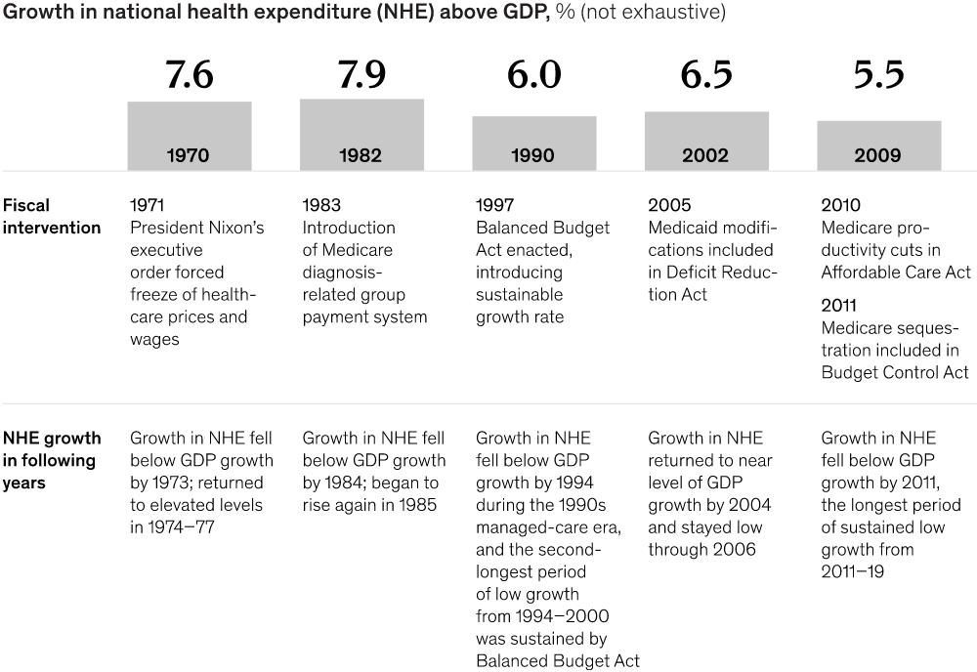
Mounting Pressure
Source: McKinsey & Company

Slide 6
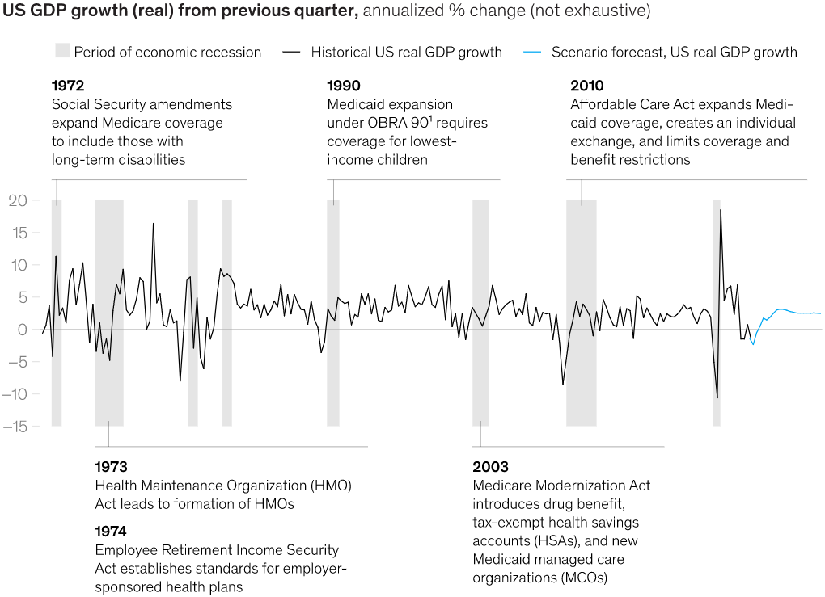
Mounting Pressure
Source: McKinsey & Company

Slide 7
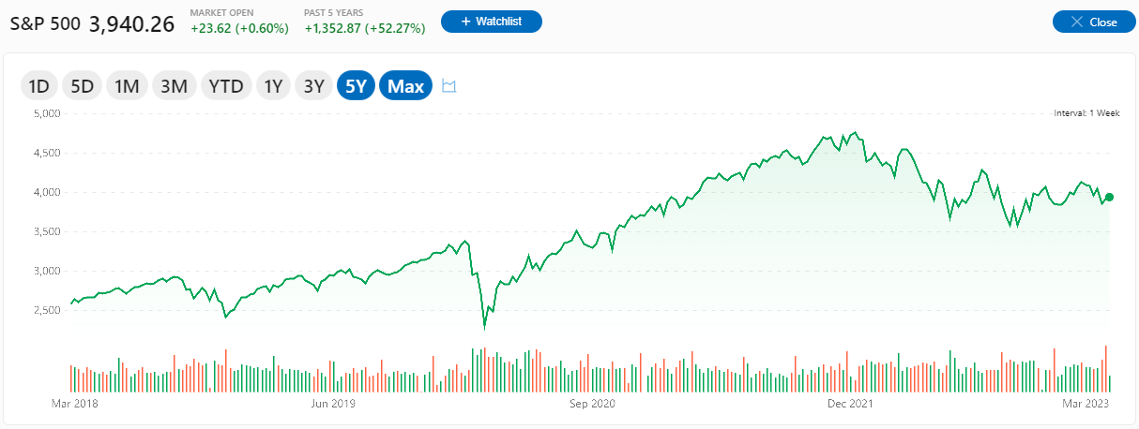
Mounting Pressure
Source: MSN Money.
Crisis
Stabilization
Normalization?

Slide 8
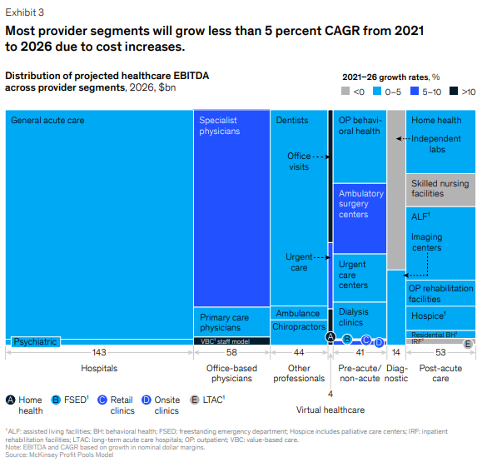
Mounting Pressure
Source: McKinsey & Company

Slide 9

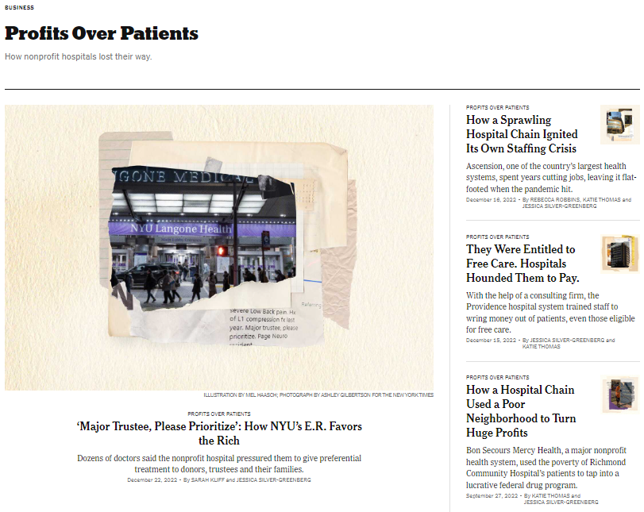
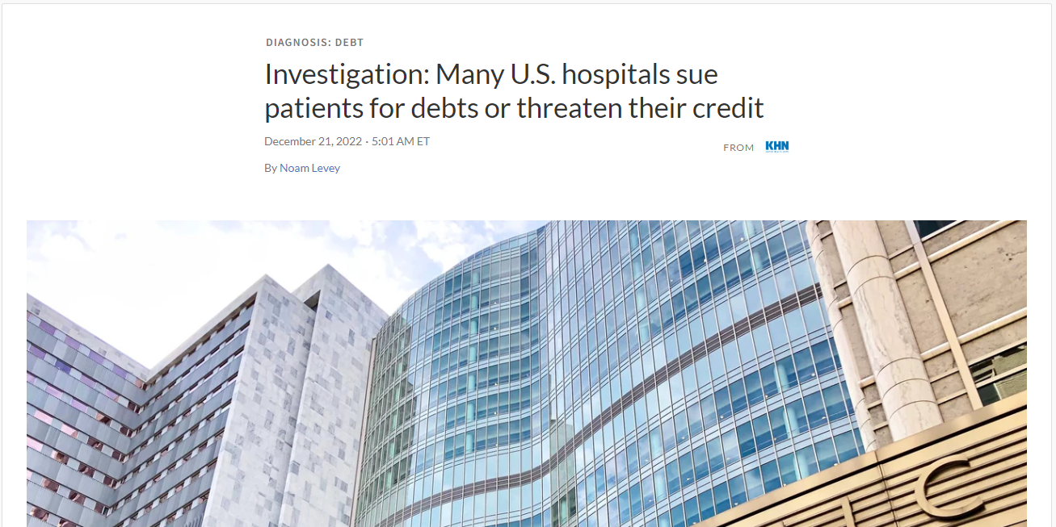
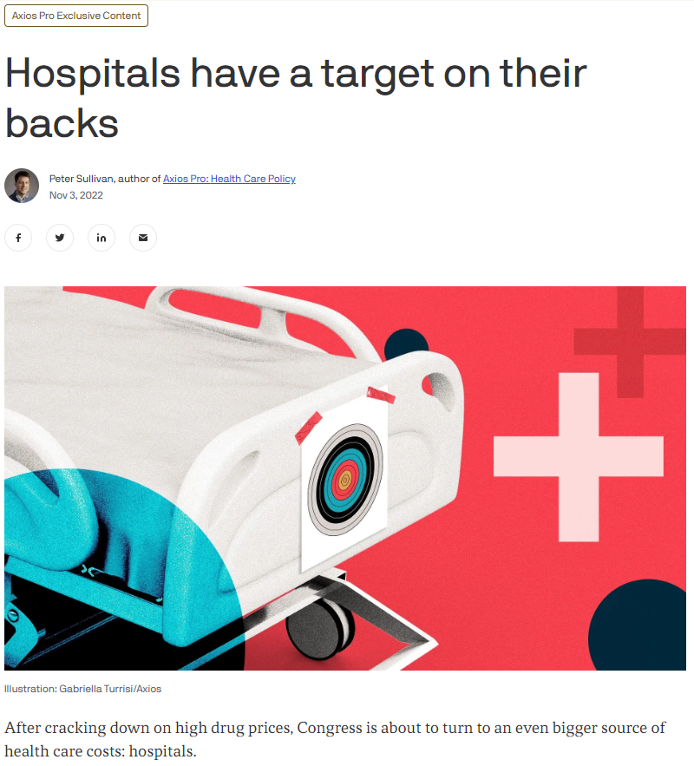
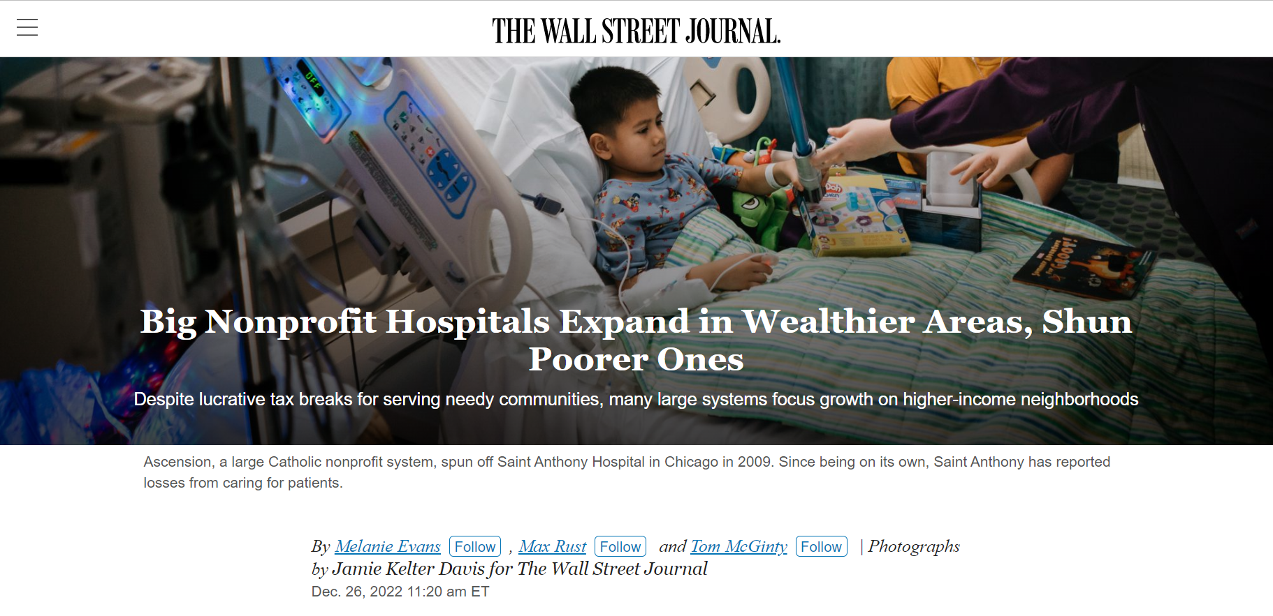
Anti-Hospital Sentiment Rising
Source: New York Times; Axios Pro; National Public Radio; Wall Street Journal.

Slide 10
Calendar Year 2023
Limited time, bandwidth and political capital
Move-in
SOTU
Biden’s budget
GOP budget
Debt ceiling?
NSA
IDR Guidance
Medicaid contin. coverage
340B fix
PHE unwind
Recess-ion?
Govt. funding
Holiday season
Primary season
Price trans-parency
No Surprises Act
DSH cuts

Slide 11
No Surprises Act
Other state law-suits
PHI Health
Dr. Daniel Haller
Limited time, bandwidth and political capital
Move-in
SOTU
Biden’s budget
QPA: AMS suit
GOP budget
Debt ceiling?
IDR: After
10/25/22
Med-Trans Corp.
NSA
IDR Guidance
Medicaid contin. coverage
340B fix
PHE unwind
Senate HELP Comm.
GFEs:
~Delay
QPA:
TMA III Lifenet
Fee hikes: TMA IV
IDR: Before
10/25/22
Recess-ion?
Govt. funding
Holiday season
Primary season
Price trans-parency
No Surprises Act
DSH cuts
AEOB & GFE RFI

Slide 12
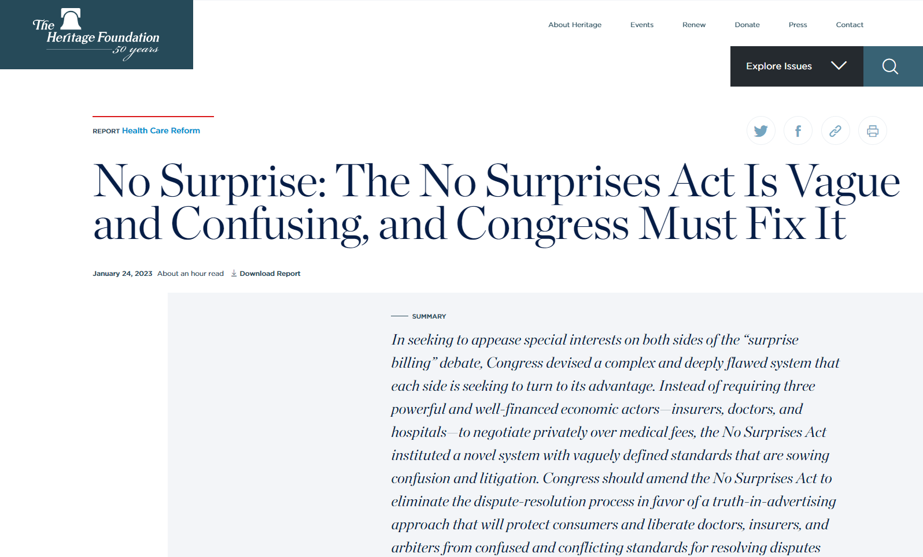
No Surprises Act
Other state law-suits
PHI Health
Dr. Daniel Haller
Limited time, bandwidth and political capital
Move-in
SOTU
Biden’s budget
QPA: AMS suit
GOP budget
Debt ceiling?
IDR: After
10/25/22
Med-Trans Corp.
NSA
IDR Guidance
Medicaid contin. coverage
340B fix
PHE unwind
Senate HELP Comm.
GFEs:
~Delay
QPA:
TMA III Lifenet
Fee hikes: TMA IV
IDR: Before
10/25/22
Recess-ion?
Govt. funding
Holiday season
Primary season
Price trans-parency
No Surprises Act
DSH cuts
AEOB & GFE RFI

Slide 13
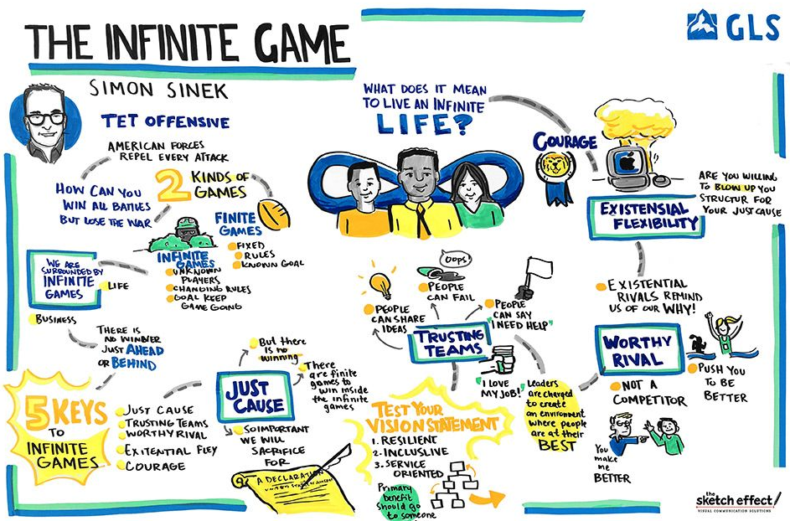

Infinite Players
Source: Simon Sinek, “The Infinite Game”; thesketcheffect.com.

