Slide 1
Healthcare Financial Management Association
January 2023

Slide 2
SFY 2023 Medicaid Reimbursement Changes

Slide 3
MO HealthNet Division Rationale
Officials viewed payment models as inflexible and outdated.
Add-on payments did not promote transparency or accountability.
Payments were not tied to utilization.
CMS opposed payments made outside the capitated rate.
MHD views its changes as an interim step to DRG-based payments. Director Richardson estimates it will take 24 – 30 months for the transition.

Slide 4
MO HealthNet Assumptions and Goals
MHD wanted:
  to repurpose existing funds while accounting for the $20 million impact associated with the simplified outpatient fee schedule
  to limit the hospital-specific impact to the extent possible
  to reduce negotiation obstacles between hospitals and MCOs by ensuring that hospitals above the maximum per diem rate receive no more than the maximum; hospitals below the minimum will be brought to the minimum
  to be compliant with CMS

Slide 5
SFY 2023 Fee-For-Service
Inpatient Reimbursement Changes

Slide 6
Ownership Groupings
To ensure compliance with the federal UPL requirements, hospitals have been categorized into one of the three ownership groups based on the federal definitions:
  Privately Owned
  Non-State Government Owned
  State-Owned

Slide 7
Fee-For-Service Inpatient Reimbursement Changes
Previous Methodology
New Methodology
Per Diem payments based on 1995 cost report trended to 2001
Direct Medicaid Add-On payments (including Medicaid share of assessment)
Out-of-State Add-On payments
Rebased Per Diem payments based on 2020 cost report trended to 2023 (plus the Medicaid inpatient share of assessment)
Acuity-Based Supplemental payments
Stop-Loss Supplemental payments

Slide 8
SFY 2023 Rebased Per Diem Payments

Slide 9
SFY 2023 Rebased Per Diem Calculation
Because the rebased per diem now equals the total cost per day, there no longer is a need for a direct Medicaid add-on payment.
The 2020 cost report has been used for all hospitals (except for new hospitals that do not have a 2020 cost report).
DSH Tier I, DSH Tier II, and Safety Net hospitals no longer have the benefit of using the “better of” cost report.
MHD no longer includes a Utilization Adjustment for Safety Net and Children’s Hospitals.

Slide 10
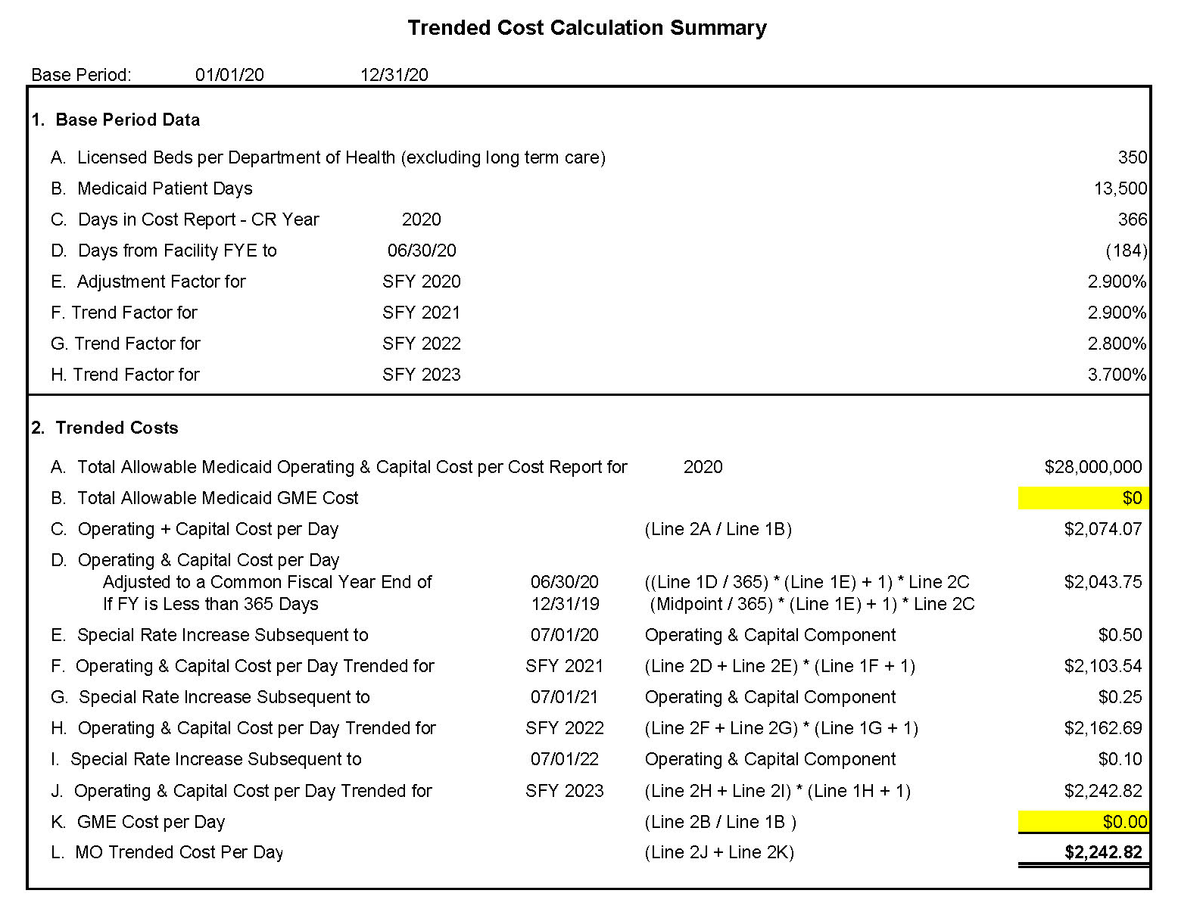
SFY 2023 Trended Cost Per Day Example
MHD will apply these trends.
MHD no longer includes the Medicaid GME cost in this calculation.
*
*Hospitals continue to be limited to the lower of the trended cost per day or the charge per day, except federally deemed critical access hospitals.

Slide 11
SFY 2023 Rebased Per Diem Calculation
Rebased Per Diem Calculation
 | 2020 Trended Cost Per Day
+ | SFY 2023 Inpatient Medicaid Assessment Per Day
= | SFY 2023 Rebased Per Diem Rate

Slide 12
Rebased Per Diem Calculation
Per diems will be rebased every year from now on using the third prior-year cost reports.
The 2021 cost reports will be used to determine the SFY 2024 per diem rates.
In the absence of adequate cost data, a new hospital’s Medicaid rate shall be 100% of the weighted average statewide per diem rate for the similar type of hospitals (i.e., acute care hospitals, free-standing psychiatric, etc.)

Slide 13
Fee-For-Service Acuity-Based
Supplemental Payment

Slide 14
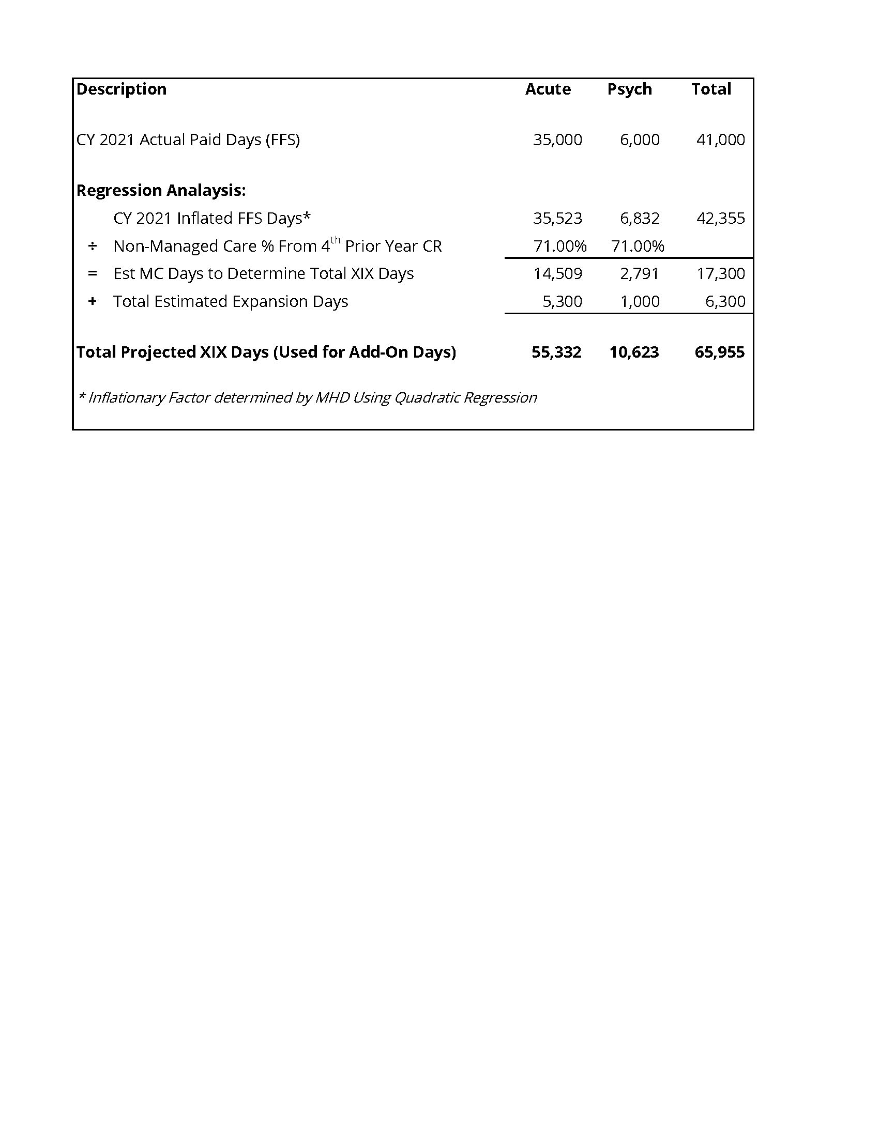
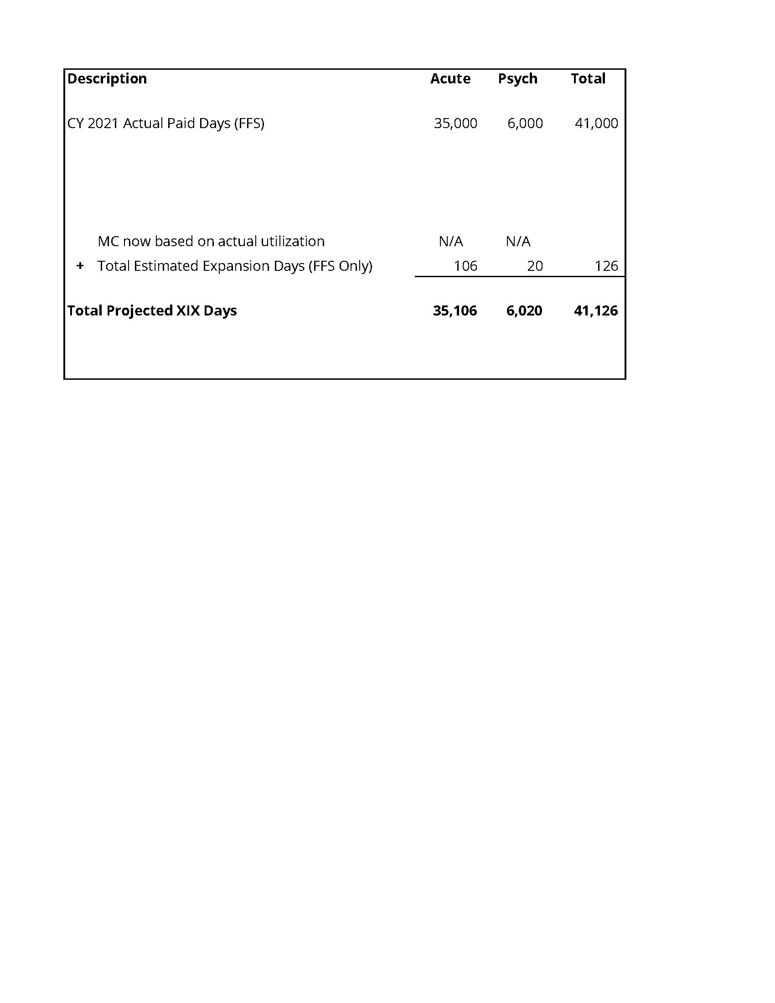
MO HealthNet Estimated Days
Previous Methodology
New Methodology
MHD no longer will apply regression analysis
(FFS & MC)**
**
**Total estimated expansion days = 40% of the uninsured days from the 2018 DSH survey. Two percent are estimated to be fee-for-service.
Note: State-owned hospitals (including University of Missouri Health Care) will not have acuity and stop-loss payments, but instead will receive an upper payment limit payment.

Slide 15
Previous Medicaid Payment Calculation Used for SFY 2023
MHD used the previous Medicaid payments for each hospital in determining the acuity and stop-loss payments.
MHD confirmed these payments will be updated annually.
Previous Medicaid Payment Calculation Used for SFY 2023
 | Inpatient claims payments paid during calendar year 2021
+ | SFY 2022 inpatient direct Medicaid add-on payments (including expansion)
+ | SFY 2022 out-of-state add-on payments (inpatient and outpatient)
= | Previous Medicaid payments for purposes of applying limits

Slide 16
Acuity-Based Payment Calculation
MHD calculated the case-mix index for each hospital. MHD used 2019 and 2020 data for SFY 2023; 2020 and 2021 data will be used for SFY 2024.
Acute care hospitals whose CMI is greater than the CMI threshold for its ownership group is eligible for an acuity-based payment.
A stop-gain provision was applied that will limit the amount of increase in payments a hospital can receive.
Established thresholds and limits for FFS supplemental payment purposes were applied separately for each ownership group.

Slide 17
CMI Threshold and Stop-Gain Limit for SFY 2023
Ownership Group | CMI Threshold | Stop-Gain Limit
Privately Owned | 1.15 | 4%
Non-State Government Owned | 0.85 | 4%
State-Owned* | N/A | N/A
*State-owned hospitals (including University of Missouri Health Care) will not have acuity and stop-loss payments, but instead will receive an upper payment limit payment.
MHD has prepared a two-page document describing the case mix methodology in more detail which is available on the MHA website.
A number of hospitals that have psychiatric units have asked MHD to consider an acuity adjustment.

Slide 18
Fee-For-Service Stop-Loss
Supplemental Payment

Slide 19
FFS Stop-Loss Supplement Payment Calculation
MHD implemented a stop-loss payment to help minimize the financial impact on hospitals.
Freestanding psychiatric hospitals do not qualify for an acuity-based payment. As a result, if their estimated rebased claims payments were less than the previous year’s Medicaid payments, they received a stop-loss payment equal to the difference between the estimated SFY 2023 rebased payments and the previous Medicaid payments.
The total stop-loss payments available within each ownership group were proportionally distributed to the qualifying hospitals within the group.

Slide 20
Timing of Fee-For-Service Payments
Actual claims payments will be processed as claims are submitted.
MHD is processing the acuity-based and stop-loss payments over the 24 Medicaid payroll cycles.

Slide 21
Graduate Medical Education
Reimbursement Changes

Slide 22
Graduate Medical Education Reimbursement Changes
Previous Methodology
New Methodology
Quarterly GME payment based on cost
Enhanced GME payment based on cost
GME payment based on a Medicaid cost per resident multiplied by the uncapped FTE count
GME stop-loss payment

Slide 23
GME Payment Methodology
MHD is using the lower of the calculated Medicaid GME cost per resident for each hospital based on the 2020 cost report trended to 2023 or the maximum per resident amount of $45,000.
The uncapped FTE counts from the 2020 cost report are being used for SFY 2023.
Graduate Medical Education Calculation
 | Lower of the hospital’s Medicaid GME cost per resident or $45,000 cost per resident
x | Hospital’s uncapped FTE count from Worksheet S-3
= | Graduate medical education payment

Slide 24
GME Payment Methodology
If a hospital’s GME payment was less than the previous year’s GME payment, it was eligible for a GME stop-loss payment.
The total GME stop-loss payments available were proportionally distributed to the qualifying hospitals regardless of ownership group.
In the future, MHD likely will establish different per resident amounts for general resident and specialty practices. This would allow MHD to provide additional reimbursement for defined specialty practices.

Slide 25
Timing of GME Payments
MHD intends to transition all GME payments to be processed on a quarterly basis as indicated on the chart below (subject to available funding).
SFY 2023
Sept 2022 | 1st Quarter of Total SFY 2023 GME Payments
Dec 2022 | 2nd Quarter of Total SFY 2023 GME Payments
Mar 2023 | 3rd Quarter of Total SFY 2023 GME Payments
July 2023 | 4th Quarter Delayed Until July (SFY 2024)

Slide 26
Managed Care Directed Payments

Slide 27
Hospital Directed Payments Approach
On July 15, CMS notified MHD that the directed payments methodology for reimbursing inpatient and outpatient hospital services through the managed care plans was approved, effective July 1.
CMS also verified that it would not require the changes to be retroactive to SFY 2022.
The directed payment approach established a minimum and maximum level of reimbursement.

Slide 28
Hospital Directed Payments Approach
The starting point for negotiations was based on the following FFS rates, effective July 1, 2022:
  Inpatient rebased per diem: trended cost per day + IP Medicaid share of assessment
  Outpatient: outpatient FFS simplified fee schedule + OP Medicaid managed care share of assessment
Negotiated reimbursement had to be:
  Within the established ranges for a particular hospital class
  Inclusive of amounts previously identified as full Medicaid pricing payments and tied to hospital utilization

Slide 29
Hospital Directed Payments Approach
The classification of hospitals is based on a hierarchy approach, meaning once a hospital is determined to be in a class, it no longer is considered for the tiers below it.
Changes in a hospital’s classification that occur by January 15 will be recognized at the beginning of the next state fiscal year.

Slide 30
Inpatient Hospital Directed Payment
Hospital Class |  | SFY 2023 Minimum % of FFS Rebased Per Diem Rate | SFY 2023 Maximum % of FFS Rebased Per Diem Rate
Tier 1 | Children’s Hospitals | 100% | 142%
Tier 2 | Federal Critical Access Hospitals | 100% | 102%
Tier 3 | Specialty Hospitals | 100% | 130%
Tier 4 | Teaching Hospitals | 100% | 146%
Tier 5 | 1-100 Licensed Beds | 100% | 118%
Tier 6 | More Than 100 Licensed Beds | 100% | 118%

Slide 31
Outpatient Hospital Directed Payment
Hospital Class |  | SFY 2023 Minimum % of Outpatient Simplified Fee Schedule | SFY 2023 Maximum % of Outpatient Simplified Fee Schedule
Tier 1 | Children’s Hospitals | 100% | 305%
Tier 2 | Federal Critical Access Hospitals | 100% | 110%
Tier 3 | Specialty Hospitals | 100% | 215%
Tier 4 | Teaching Hospitals | 100% | 170%
Tier 5 | 1-100 Licensed Beds | 100% | 165%
Tier 6 | More Than 100 Licensed Beds | 100% | 180%

Slide 32
Hospital Directed Payments Approach
Hospitals that do not participate in a health plan’s managed care network will be paid 90% of the FFS payment rate if they deliver a service to a managed care enrollee. MHD may be open to a discussion of this provision.
New hospitals participating in managed care will be held to the same minimum and maximum range for their provider class.
Hospitals outside of Missouri are not impacted by the directed payments methodology.

Slide 33
Hospital Directed Payments Approach
The directed payment methodology allows for flexibility in negotiating different reimbursement arrangements such as diagnosis related groups (DRGs) or global capitations.
  Required to inform MHD of such arrangements
  Still must fall within minimum and maximum ranges of directed payments
  Must provide supporting evidence of equivalence, if requested
MHD distributed Inpatient/Outpatient Directed Payment Reimbursement Guidance on how hospitals can compare current managed care reimbursement to the directed payment methodology.

Slide 34
Impact of New Payment Methodologies on
SFY 2023 Interim Disproportionate Share Hospital Payment

Slide 35
SFY 2023 Interim DSH Payment
MHD adjusted the interim DSH payment methodology to account for the following changes:
  Removing costs and payments for dual eligible individuals for the full year
  Estimated inpatient rebased per diem payments (including expansion)
  FFS acuity-based payments
  FFS stop-loss payments
  FFS UPL payments in state-owned group
  Revised GME payments
  Managed care directed payments

Slide 36
SFY 2023 Interim DSH Payment
MHD did not adjust for outpatient expansion or the $20 million reduction from the outpatient simplified fee schedule.
Hospitals are receiving 100% of their uncompensated care cost for SFY 2023.

Slide 37
SFY 2018 DSH Recoupments and Redistributions
MHD recouped SFY 2018 DSH liabilities in December 2022.
MHD made SFY 2018 redistribution payments on the December 18, 2022, payroll. The pooling adjustments were processed on the same payroll.
Estimates of the SFY 2018 unspent DSH allotment payments have been included at the bottom of the Revised Schedule A forms for SFY 2018. Payments totaling nearly $72 million are expected in June 2023.

Slide 38
SFY 2019 DSH Audit
The preliminary SFY 2019 audit results were submitted to CMS on December 31, 2022.
A total of 32 hospitals have liabilities totaling $57.3 million. One of these facilities now is closed and two are in bankruptcy.
According to MHD’s recent proposed amendment, SFY 2019 liabilities must be paid to the state by October 31, 2023.
Redistribution payments likely will be processed in December 2023.
Approximately $59.8 million is available in unspent DSH allotment payments to 63 hospitals for SFY 2019. The payments likely will be made in June 2024.

Slide 39
Impact of New Payment Methodologies on MSC Pooling Arrangement and Schedule A Form

Slide 40
Reduction in Add-On Payments
Statewide Comparison
Because MHD rebased per diem rates, add-on payments were reduced by approximately $1 billion and are now being paid as claims payments.
Payment Description | SFY 2022 | SFY 2023 | Decrease
Uninsured (DSH) Payment | $405,232,846 | $477,577,932
Direct Medicaid Add-On Payments | $782,058,148 | $40,402,916
Out-of-State Payments | $215,201,219
Full Medicaid Pricing Payments | $531,962,031
Acuity-Based, Stop-Loss & UPL |  | $403,985,293
Total Add-On Payments | $1,934,454,244 | $921,966,141 | ($1,012,488,103)

Slide 41
Impact on MSC Pooling Arrangement
It was determined that holding the payments to a SFY 2022 level would help maintain stability in the MSC pooling arrangements.
To accomplish this, claims payments now will supplant the add-on payments previously considered in the pooling formula.
Because claims payments are subject to change based on actual utilization, the amounts included for pooling and reflected on the Schedule A form are estimates.

Slide 42
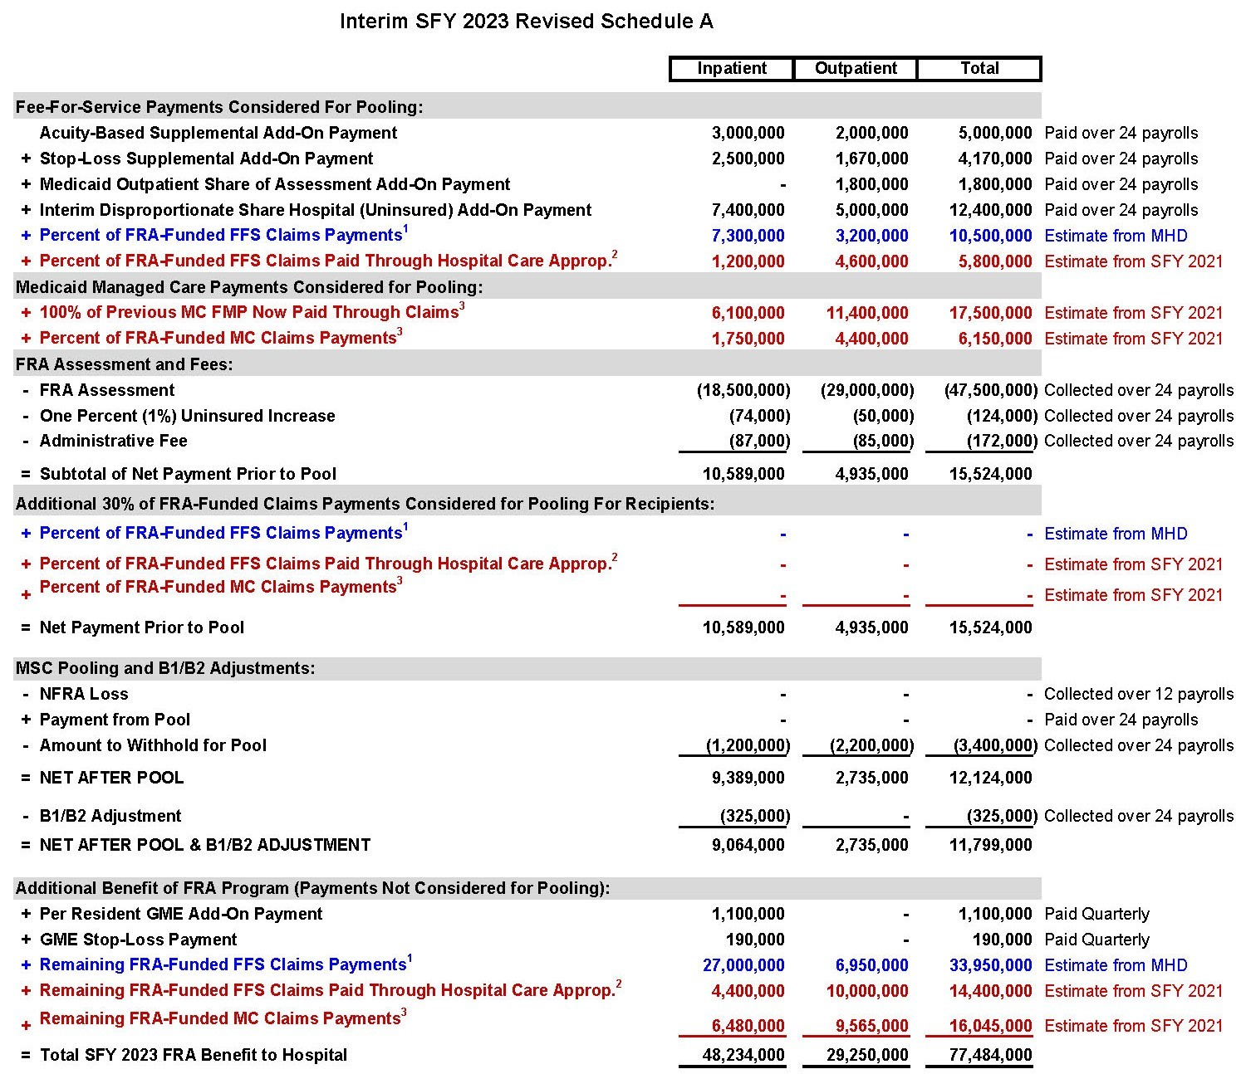
Not-for-profit pool participants must consider 27% of inpatient claims payments and 46% of outpatient claims payments for pooling purposes.
Hybrid pool participants must consider 37% of inpatient claims payments and 31% of outpatient claims payments for pooling purposes.

Slide 43
Access to the FRA Website
You can access your hospital-specific forms, the MHA Management Services Corporation pooling policies and procedures, and the FRA Tutorial by visiting the following website:
https://www.mhanet.com/docshare
  Enter Username and Password
  Click on Download
  Click on FRA for Hospital-Specific Forms
  Click on Info for Pooling Policies and Procedures, Managed Care Directed Payment Methodology Guidance, Case Mix Index Methodology and the FRA Tutorial
  For assistance contact klafarge@mhanet.com

Slide 44
Other Topics

Slide 45
Other Topics
Outpatient Surgeries in SFY 2024– Outpatient Simplified Fee Schedule
Value-Based Reimbursement
Inquiry by WPS Government Health Administrators Regarding FRA Accounting

Slide 46
Medicaid Caseload

Slide 47
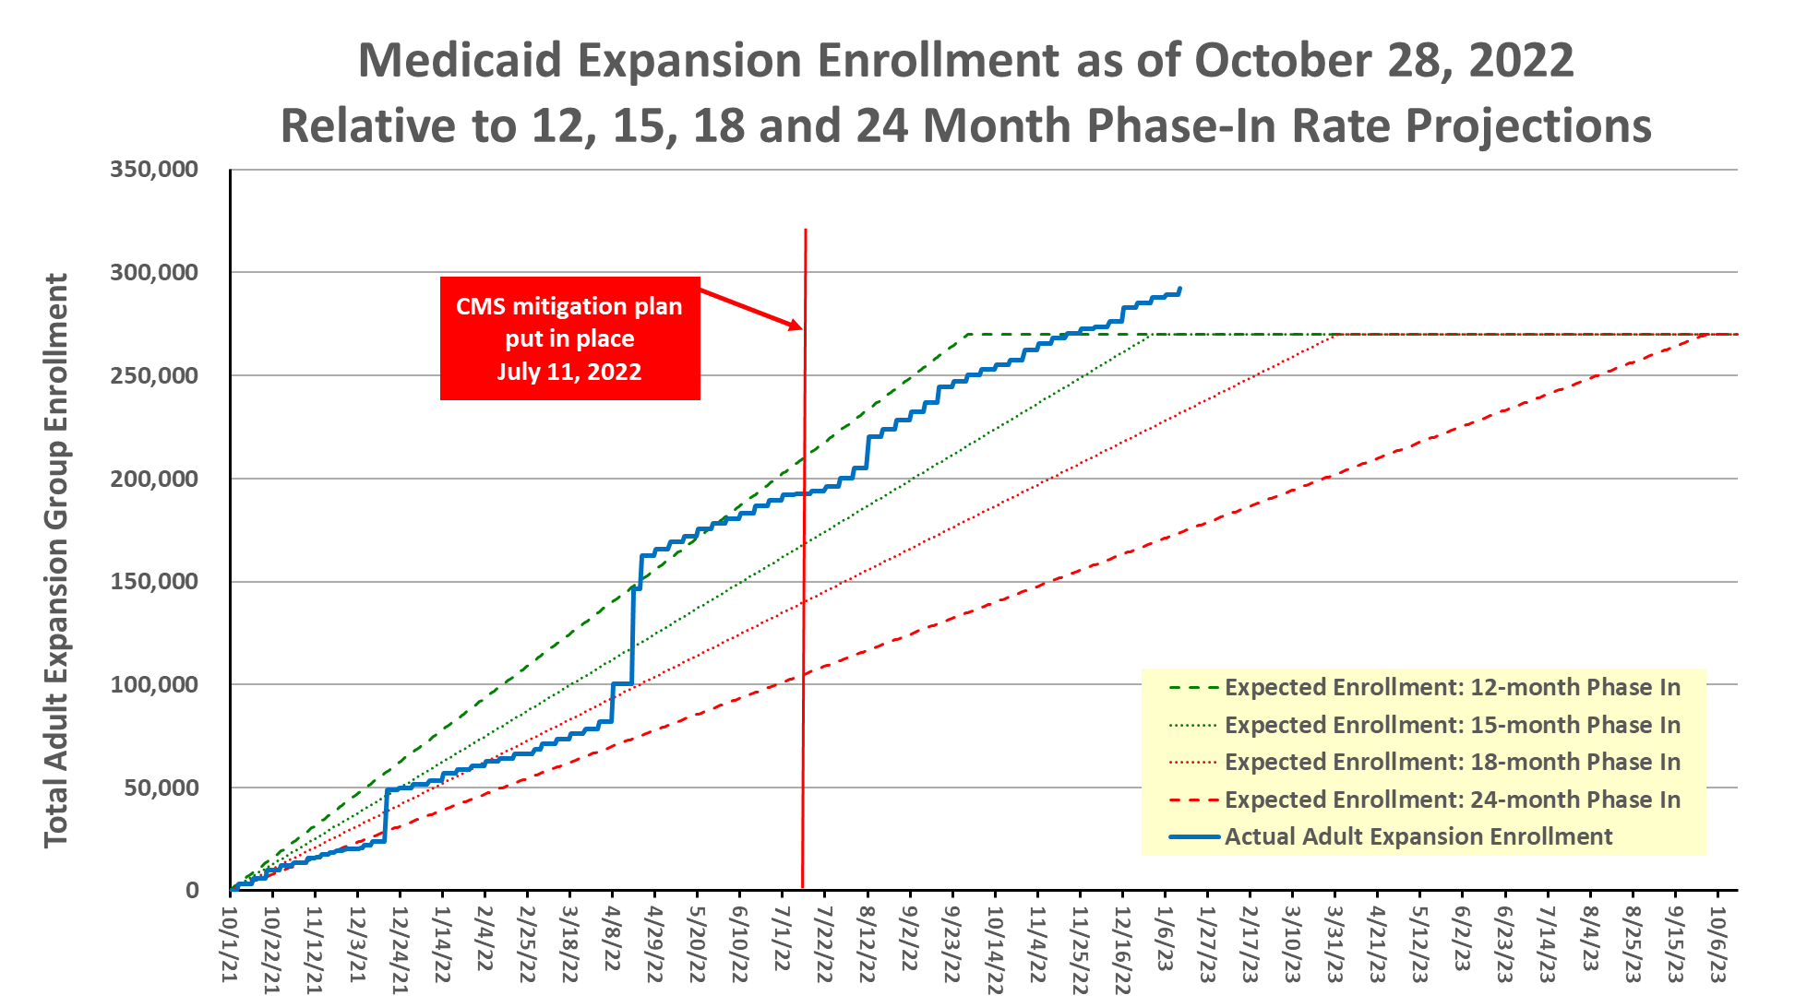

Slide 48
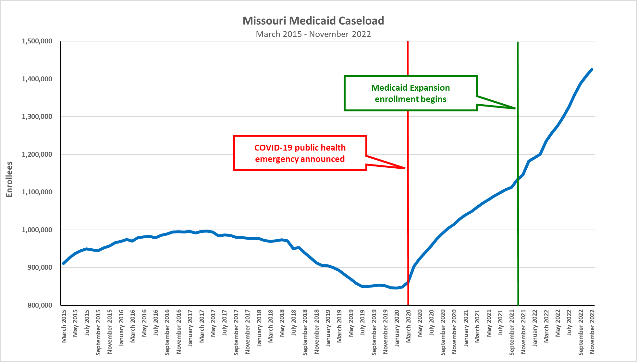

Slide 49
Consolidated Appropriations Act, 2023

Slide 50
Consolidated Appropriations Act, 2023
Medicaid
  Continuous eligibility for children to be provided with 12 months of coverage effective January 1, 2024
  Requires up-to-date searchable provider directories effective July 1, 2025
    Fee-for-Service and Managed Care
  Makes 12-month postpartum coverage state plan option permanent
  CHIP reauthorized through 2029

Slide 51
Consolidated Appropriations Act, 2023
Medicaid
  Ends continuous eligibility under the COVID-19 public health emergency on Friday, March 31
  Requires states to begin reverifying eligibility of all Medicaid participants beginning April 1 over a 12-month period
  Steps down enhanced FMAP as follows:
    Quarter ending March 31, 6.2%
    April — June, 5%
    July — September, 2.5%
    October — December, 1.5%

