Slide 1
Outdated Contracts
Are They Costing Your Organization?

Slide 2
Seminar Description
Are your existing Managed Care Contracts hurting you? What was acceptable ten – or even five – years ago may no longer be acceptable, and may, in fact, be dragging your organization down, financially.
A contract audit will help you identify the “leaks”.

Slide 3
Seminar Objectives
GOAL: Discover lost revenues and opportunities for revenues in your existing contracts with a contract audit.
What can you find during a Contract Audit?
What should the contract audit focus on?
Things to remember during renegotiations.

Slide 4

“Life is like a ten-speed bike; We all have gears we never use.” -
Charles Schulz

Slide 5

Why the audit?
Why?

Slide 6
What’s the Point?
Hospital | Results of Contract Audit and/or Subsequent Negotiations
76 Med/Surg Beds | Renegotiated Marketplace Plan contract with a regional plan that increased facility gross revenues >$200K over 3 years
89 Med/Surg Beds | Renegotiated leased network contract that represented 2 major payers. Increased IP/OP gross revenues >$300K first year.
98 Med/Surg Beds | Renegotiated Marketplace plan. Increased gross revenues by approximately $225K the first year.
24 Med/Surg Beds | Contract audit uncovered that hospital had an 18-year old commercial contract with one of the state’s largest payers with a contracted commercial inpatient per diem rate that was well below Medicaid.
76 Med/Surg Beds | Contract audit revealed a contract with the hospital’s largest payer that included an old commercial inpatient mental health per diem that was barely half of the state’s current Medicaid rate.

Slide 7


text

Slide 8
Rates
When was the last rate increase?
Comparable to the market? For this product?
Rate methodologies, such as MSR.
Fee Schedules
Proprietary fee schedule? Copy?
Benchmark? Tied to specific year? Medicare or Medicaid?

Slide 9
Effects of Language
“CMS/Medicaid rate” vs. “CMS/Medicaid rate applicable to Provider”
“CMS/Medicaid rate” vs. “based on the CMS/Medicaid rate”
“Current rate” vs. “rate in effect on the date of service”
DRG add-ons (included?)
Annual Chargemaster Maximum (0%?)
Inflators? Did you receive?

Slide 10
More Language to Watch
Prior Authorization Denials
Payer’s ability to send contractual notifications through unreliable means:
Cable, telegram, telex
Email, fax, “other means”
US Mail without Return Receipt Requested
Website

Slide 11
Housekeeping
Amendments – Require mutual written consent?
Are notification addresses current?
Are all ancillary providers covered?
Are you regularly reviewing the online Provider Manual?

Slide 12

Contract Negotiations: Time Management

Slide 13
Contract Negotiations
Things to Know Beforehand to Speed the Process:
Understand what the payer can / cannot administer.
Understand how / what you are being paid.
Does the payer have an automated contract generation system?
Manage timelines and expectations.
Have all of your questions / concerns ready, if possible, up-front.

Slide 14
Contract Negotiations
During the Negotiations:
Pick your battles.
Understand statutes / regulations. Don’t waste time on things you have no control over.
Be creative.
Definitions – READ, but worry only about how they are USED, not how they are written.

Slide 15

Questions?

Slide 16
Michael R. Montgomery, HIA - Bio
There are few network management professionals in the Ohio-Kentucky-Indiana tri-state area with the depth of experience that Michael Montgomery, HIA brings to the table. A 37-year veteran of the health insurance industry, Michael has crafted, negotiated, and implemented managed care contracts for all types of providers throughout Ohio, Kentucky, Indiana, West Virginia, Tennessee, and Arkansas, while working at companies such as Anthem BCBS, Aetna, Wellpoint, Magellan Behavioral Health, Coventry, and CareSource. During that time, he has led and trained multiple Network Management teams. Prior to his work in Network Management, Michael was the Senior (corporate) Underwriter for BCBS of KY, and he was also a professional radio broadcaster in the late 1970s/early 1980s.
Michael came to Blue & Co., LLC in November of 2021, where he advises hospitals and large group providers as they negotiate managed care contracts. An award-winning public speaker, Michael has been a frequent presenter over the years, speaking to provider groups such as the Ohio Hospital Association, HFMA, and the Kentucky Medical Equipment Suppliers Association on topics including Contract Negotiations, Contract Audits, Managed Care Medicaid, Subacute Care, and Public Speaking.
Michael is a member of the Honorable Order of Kentucky Colonels and a 2019 inductee into the Oldham County HS Hall of Fame. His hobbies include coaching youth baseball and broadcasting high school basketball / football games. Michael has been married to his wife, Rhonda, for 34 years and has two adult sons, Kevin (age 29) and Shaun (24).

Slide 17
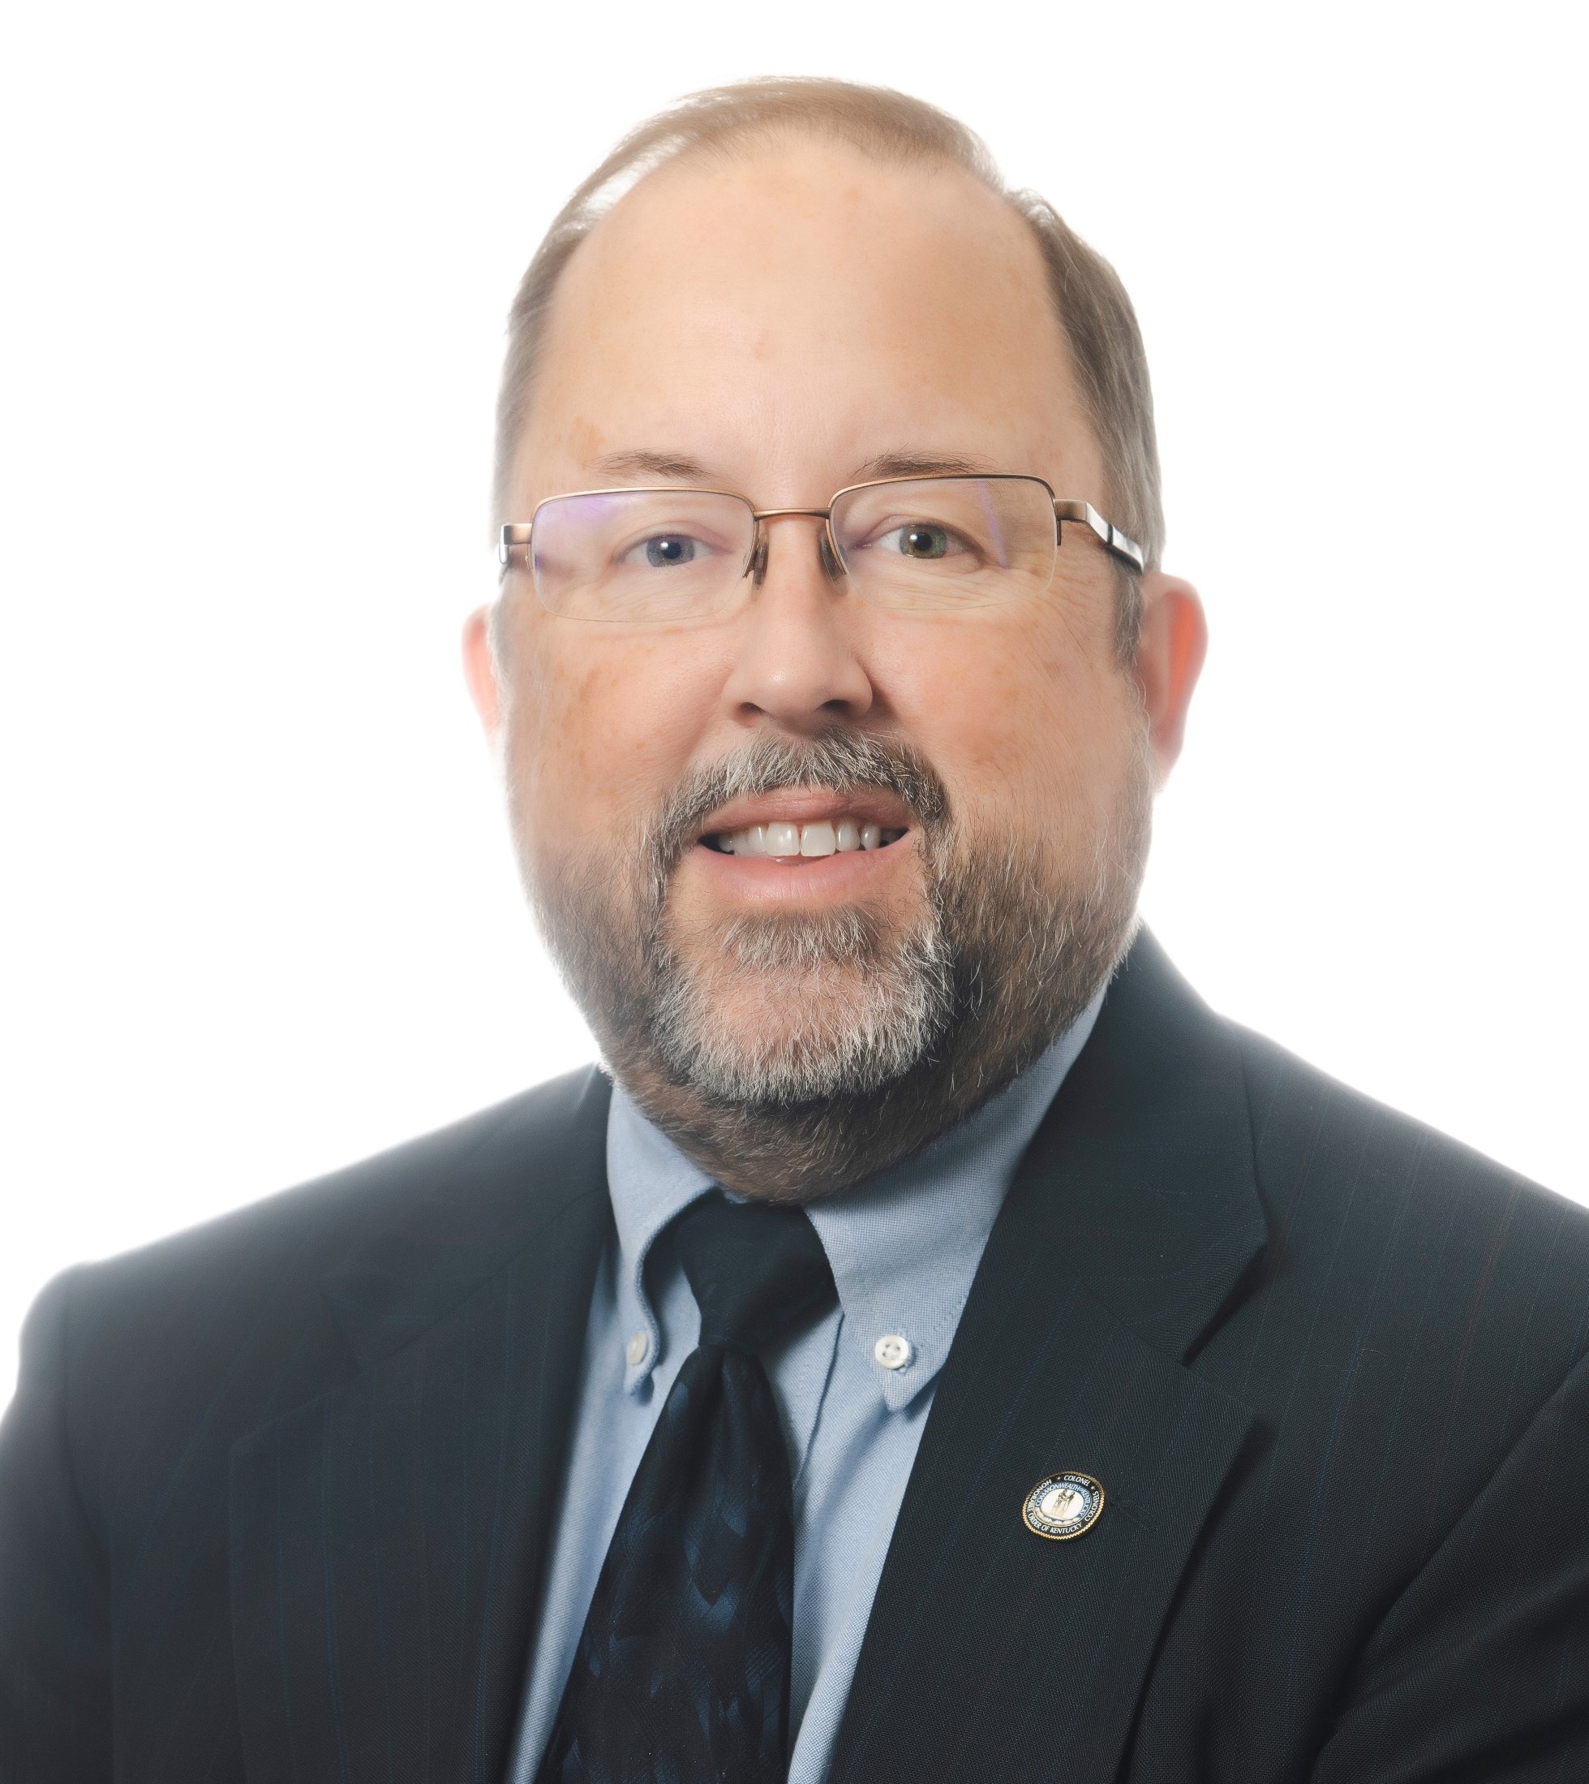
Michael R. Montgomery, HIA
Manager, Reimbursement
2650 Eastpoint Parkway, Suite 300
Louisville, KY 40223
mmontgomery@blueandco.com
502-992-3481

