Slide 1
Kansas Hospitals Overview
Presented by Kansas Hospital Association
January 23, 2023

Slide 2
Today’s Topics
Realities of Today’s Issues
State Policy Issues
Financial Overview
Workforce Realities
Medicaid Redetermination and RFP
Payer Denials and Prior Authorizations
Federal Policy Issues
No Surprise Act 2023

Slide 3


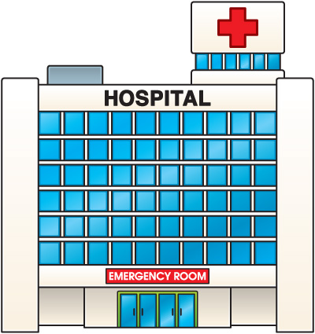


Kansas hospitals at a glance
10,517 Staffed Hospital Beds
7,573,907 Outpatient Visits
292,285 Admissions
38,049 Births
1,215,322 Emergency Room Visits
Notes:
Jaron please update numbers

Slide 4
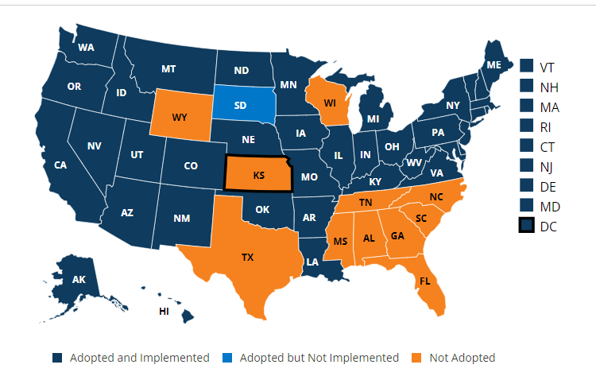
Kansas realities
In 1991 Kansas ranked eighth healthiest state in the nation. In 2022 Kansas ranks between 24th and 29th in five health categories.
In September 2022 the US Census Bureau data showed more Kansans are uninsured than the United States average. Kansas uninsured is 9.2% while the US Average is 8.6% –Kansas Health Institute Data.
Currently 11 states have not yet adopted Medicaid Expansion.

Slide 5


Our contribution to the Kansas economy
Kansas Hospitals:
Employ nearly 100,000 people
  5.0 percent of all job holders
Support an additional 94,035 jobs in other business and industry
  For every hospital job another 0.95 job supported
Total employment impact of more than 192,500 jobs
Generate approximately $7.5 billion in direct labor income
Impact on income throughout all business and industry of $12.3 billion
For every $1 another $0.63 is generated
Generate nearly $4 billion in local retail sales
Notes:
Check Numbers.

Slide 6
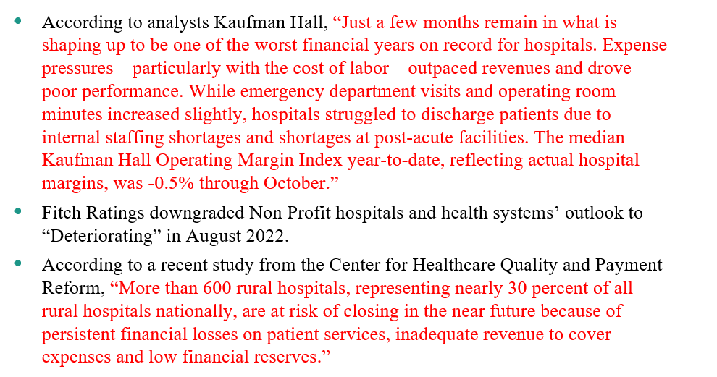
A FEW BIG FACTS

Slide 7
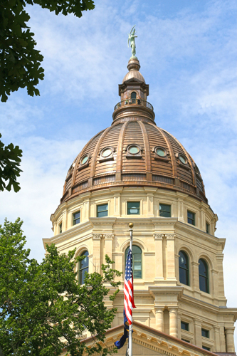
WORKING TOGETHER IN 2023
Notes:
Chad turn over to Tara

Slide 8
What Issues Are Driving the Conversation?
Workforce
Patient Service
Financial Viability
Legislative Priorities Live Here
Notes:
So what are the major issues driving the conversation right now around healthcare: This is how we frame the legislative priorities based on what are the current conversation drivers.

Slide 9
2023 Top STATE Policy Issues
Workforce Issues
  Streamlining
    Licensing and Credentialing
    Prior Authorization
    Apprenticeship
  Protections
  Housing and Childcare
  Investing in early interest programs
  Retaining health educators
Patient Care
  Ensuring Telehealth usage remains an option for patients
  Mental Health Capacity and Reimbursement
  Ensuring transfer facilities and EMS Services remain intact to support patient care along the full care continuum
Notes:
Tara highlight Prior Authorization, Worker Protections, Telehealth, Mental Health Capacity and Reimbursement and ensuring patient care.

Slide 10
2023 Top STATE Policy Issues
Financial Viability
  Medicaid Reform
    Expanding coverage
    Addressing lagging rates
  Staffing Agency Reform
  Inflation Costs
  Overall Rural Sustainability

Slide 11

Hospital finances
Notes:
Tara Introduce Shannan: Shannan introduce yourself give 10 seconds of background

Slide 12
Hospital Finances
What makes Hospitals different?
Negotiating Price - can’t just increase price to offset losses
Choosing the customer - can’t deny services to those that cannot pay (EMTALA)
Very limited negotiation parameters –where else in the US do prices get dictated to a firm?
Flow of funds – seldom paid by the customer but through an intermediary
Standardizing the product – every person is chemically, structurally, and emotionally unique. What works for one person may not work for another
Establishing referral relationships – can’t market services to those who control our patient flow – Stark anti-kickback regulations
How are Hospitals the same as private industry?
Need books to balance
Need to make payroll
Notes:
Shannan:

Slide 13
Hospital finances - REVENUE
Public Payers
  Medicare: Paid by Federal Government for those over 65 and some specific disabilities. 500,000 people covered in Kansas. Rates not negotiable
  Medicaid: Paid by Federal and State Government for eligible low-income individuals and families and people with certain chronic conditions and disabilities. About 360,000 people in Kansas. Rates not negotiable.
Private Payers
  Private health insurance groups, self-payments, and health insurance marketplaces. Periodically rates are negotiated between hospitals and payers.
Notes:
Shannan:

Slide 14
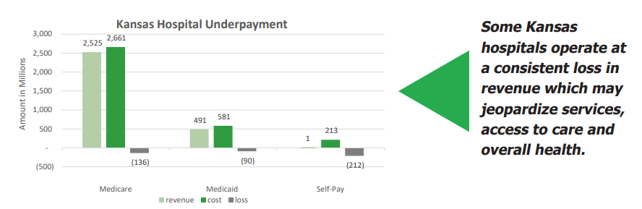
Hospital finances – Revenue
Non-negotiable payment rates of Medicare and Medicaid typically do not cover the actual costs of patient treatment. The shortfall is called underpayment.
In 2019, Medicare payments to Kansas Hospitals covered only 94 percent of total cost of care to Medicare beneficiaries.
In 2019, Medicaid payments covered just 84 percent of the total cost of treating Medicaid patients at Kansas hospitals.
Notes:
Shannan:

Slide 15
Hospital finances - cost
Cost Structure
Salaries, wages and benefits represent about 50% of Kansas hospitals’ cost
Supplies are the second largest hospital cost category. This category includes medical supplies, drugs, and other supplies such as food and linens. Supplies accounted for 20% of costs
Capital Expenditures round out the top 3 cost categories. 10% of the hospitals cost.
2019 Average cost for each day that a patient spent in a Kansas hospital
$2,191
Notes:
Shannan: Staffing agency, supply costs

Slide 16
Hospital Finances: Solutions
Financial Viability
  Medicaid Reform
    Expanding coverage
    Addressing lagging rates
  Staffing Agency Reform
    Transparency
    Non-competes
    Direct Patient Care
  Payer Accountability
    Prior Authorization and Denial Safeguards
Notes:
Tara re-highlight these possible solutions

Slide 17

workforce
Notes:
Tara introduce Jaron

Slide 18
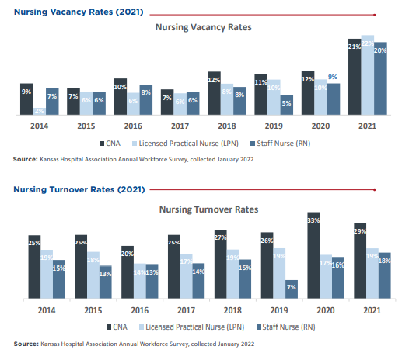
workforce

Slide 19
workforce
The positions below are in high demand across Kansas
Source: Kansas Hospital Association Annual Workforce Survey, collected January 2022

Slide 20
workforce
Costs of Turnover
Average cost of turnover for bedside RN is $40,038.
Each percentage change in nursing turnover can save a hospital $270,800 a year.
NSI 2021
NSI 2021
Notes:
End of Slide: Jaron turn back to Tara

Slide 21
Workforce – Solutions for healthcare
Immediate Options:
Protecting our Healthcare Workers
Kansas Nursing Initiative
Health Educators Pay
Establish New Scholarship for higher levels of Nursing
Pipeline Options:
Invest in early interest programs such as Health Occupation Students of America (HOSA)
Develop Apprenticeship Pathway for those looking at entry level healthcare fields
Notes:
Tara highlight

Slide 22
Kansas Medicaid
KS Medicaid Unwinding
  February 2020 Medicaid Enrollment – 422,182
  June 2022 Medicaid Enrollment – 520,159
  Estimated that as many as 125,000 enrollees may lose coverage
  How can hospitals help?
KanCare 3.0
  New Timeline – contracts extended to December 31, 2024
  Expected to maintain 3 MCO’s
  Up to six insurance payers interested in the RFP
HCAIP Program
  New program implemented on 7/1/22
  Increase the tax assessment to 3% of IP & OP net revenue
  Increase Medicaid funds available to $384 million to be used to increase hospital and physician payments
  Quarterly Enhancement payments – 2 rounds of payments now completed.
Notes:
Tara highlight

Slide 23
Payer Denials and Prior Authorizations
Kansas Prompt Pay Act – In general, an insurer has 30 days to pay a clean claim or to send a notice to the provider stating why the payment has been delayed or denied. Failure of this compliance results in a 1% interest penalty per month.
  Once the additional information is received, the insurer has 15 days to pay or deny the claim
Prior Authorization Timelines
Medicare Advantage – 14 calendar days to respond to a PA
KS Medicaid – 14 calendar days
Proposed Medicare Advantage Rule
7 calendar days for standard prior authorization requests and 24 hours for expedited
Proposed Medicaid Rule
14 days for standard and 24 hours for expedited and no more 2 hours after admission
Notes:
Tara highlight

Slide 24
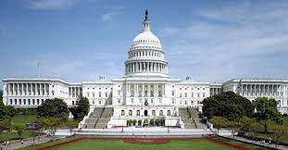
federal
Notes:
Tara turn over to Audrey

Slide 25
Federal POLICY PRIORITIES
Insurer Accountability
Sequestration
PHE
REH
FEDERAL APPROPROPRIATIONS
Congress appropriated $1.7 trillion to fund the government through Sept. 30, 2023. The bill contains many provisions favorable to hospitals.
  Extended the Medicare Dependent Hospital and Medicare Low-Volume Hospital programs through September 30, 2024
  Extended the Hospital at Home program and add-on payments for ambulance services through December 31, 2024
  Extended the Children’s Health Insurance Program through September 30, 2029
  Increases Medicare Physician Fee Schedule by 2.5%
  Mental Health Enhancements
  Telehealth Flexibilities through December 31, 2024

Slide 26
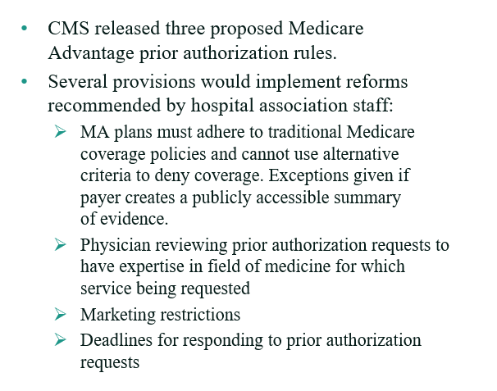
MEDICARE ADVANTAGE PROPOSED RULES

Slide 27
No Surprise Act 2023
HHS extends enforcement discretion for co-provider Good Faith Estimates
Revision to Model Disclosure Notice – January 1, 2023
Downcoding – additional information if a claim is downcoded
Payment Determination Standards under the IDR Process – Department made changes to the payment determination standards under the IDR process. Rules require the certified IDR entity to consider the QPA for the applicable year for the same service but takes away the language that the IDR should favor the QPA in the process

Slide 28
WORKING TOGETHER IN 2023
Notes:
Tara or Chad Close

Slide 29

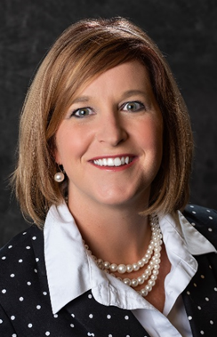



Contacts
Chad Austin
President and CEO
caustin@kha-net.org
(785) 276-3127 (office)
Tara Mays
Vice-President State Legislative Relations
tmays@kha-net.org
(785) 969-9270 (cell)
(785) 276-3124 (office)
Audrey Dunkel
Vice-President Government Relations
adunkel@kha-net.org
(785) 221-8789 (cell)
(785) 276-3116 (office)
Shannan Flach
Vice-President Finance and Reimbursement
sflach@kha-net.org
(785) 276-3132 (office)
Jaron Caffrey
Project Manager Workforce Strategies
jcaffrey@kha-net.org
(785) 276-3111

