Slide 1

Medicaid HAF/HIP Update
HFMA February 16, 2023

Slide 2
Medicaid Return to “Normal”
HFMA February 16, 2023

Slide 3
End of Public Health Emergency
During the COVID-19 federal public health emergency (PHE), due to federal requirements, Indiana Medicaid members have been able to keep their coverage without interruption.
The most recent federal spending bill removed Medicaid coverage protections from the federal PHE, which means Indiana Medicaid will begin to return to normal operations.
Eligibility redetermination actions will begin in April 2023, with a 12-month plan to return to normal operations.
Any extension of the federal PHE will not impact the returning to normal operations timeline for Medicaid eligibility.
In addition to eligibility changes, the increased federal match rate will be phased out.

Slide 4
HAF Impact of Phase out of Federal Match
During the pandemic, the federal match was increased 6.2%, decreasing the state share and HAF fees.
Indiana hospitals pay the State’s share of the enhanced reimbursement via HAF fees.
The increased federal match will begin phasing out April 1, 2023:
  Reduced to 5% April 1, 2023 through June 30, 2023
  Reduced to 2.5% July 1, 2023 through September 30, 2023
  Reduced to 1.5% October 1, 2023 through December 31, 2023
IHA currently undergoing overall analysis of HAF program

Slide 5
Medicaid Enrollment Growth

Slide 6
Redeterminations
Redeterminations were halted during the PHE, therefore, 100% of enrollees will need to renew their coverage.
  This includes traditional Medicaid, Hoosier Healthwise, HIP, and Hoosier Care Connect.
FSSA estimates approximately 25% of current enrollees have remained eligible solely due to the PHE requirements. This is approximately 500,000 members.
FSSA will process roughly 1/12 of this group each month
Indiana began mailing postcards to enrollees in late December
First possible disenrollments will begin 4/30/23
All redetermination efforts will be complete 5/01/24

Slide 7
Resources
Watch for updates
  To receive updates about updated communications that are available, or to ask questions, send an email to: PHEstakeholders@fssa.in.gov (Please note: This is not a contact for member issues)
Print or request posters and postcards from FSSA website to display or hand out (https://www.in.gov/medicaid/members/member-resources/How-a-return-to-normal-will-impact-some-Indiana-Medicaid-members/health-coverage-toolkit )
More information and another toolkit can be found various locations including Covering Kids and Families website at Covering Kids & Families of Indiana health insurance help (ckfindiana.org)

Slide 8
HIP Provider Equalization
HFMA February 16, 2023

Slide 9
HIP Provider Equalization
Hospitals pay for hospital and non-hospital providers to be paid at 100% of Medicare for the expansion population (HIP)
  Payment at Medicare levels was a key component of the philosophy behind HIP
Hospitals pay to increase non-hospital provider payments to 75% of Medicare for the remaining Medicaid population (HHW, HCC, FFS)
  This was required in HIP negotiations with State to close the gap between provider rates in the existing Medicaid population and HIP Medicare levels
Federal match on traditional, non-expansion Medicaid population is approximately 65%, but federal match on HIP population is 90%
Paying providers more for HIP costs the federal government more due to higher match, and CMS also had expressed concerns around different rates leading to discrimination in access

Slide 10
HIP Provider Equalization
CMS will no longer approve capitation rates based upon different provider payment levels for expansion and non-expansion populations
  Beginning CY 2024
FSSA is modeling a revision to provider payments to bring the non-expansion population payments and the HIP payments to the same level in a “revenue neutral” manner
  Likely will bring HIP down and non-expansion Medicaid payments up
  Will impact non-hospital provider payments; will not impact hospital payments
Unclear how this will impact HIP fees
  Parity at 80% could cost $50 to $100 M in state dollars
Requires a State Plan Amendment and a change in state statute, which could open door for other changes

Slide 11
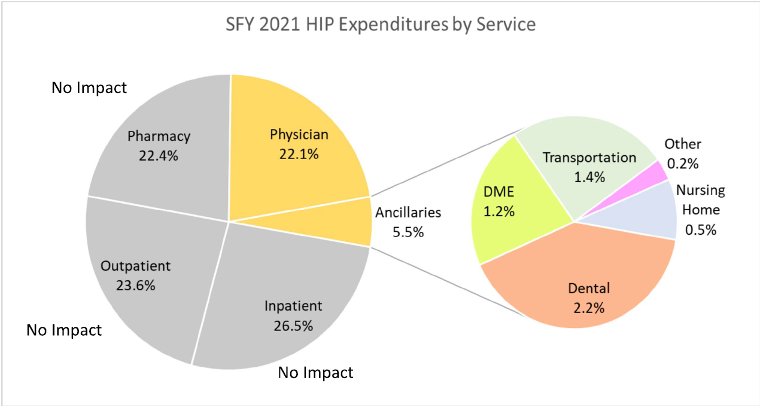
Provider Types Impacted by Equalization

Slide 12
HIP Provider Equalization
Depending on the type of patients served, some classes of providers could see rates decrease while others increase
  Current “Medicare” based on 2014 Medicare fee schedules
  Different impact between groups of providers—for example, pediatricians don’t treat HIP patients and could see Medicaid rate increases, but specialists that largely treat HIP patients could see cuts
  There could be impacts within classes of providers—for example, dentists who treat children versus adults
Public comment period ended late 2022
New rates will be published in October 2023 and effective January 2024

Slide 13
General HAF/HIP Update
HFMA February 16, 2023

Slide 14
HAF vs HIP Fees: What They Pay For
HAF Fees Fund…
Hospital Reimbursement Enhancement (difference between Medicaid fee schedule and “Medicare” for traditional & managed care population)
HIP Fees Fund…
Capitation Payments for All Medical Costs of Expansion Population at Medicare Rates (this includes hospitals but also physician, drugs, etc.)
State Administrative Costs for HIP (with limits)
Increases in Physician and Other Provider Rates to 75% of 2014 “Medicare” for Non-Expansion Medicaid
Leveraging Indiana’s Medicaid DSH Allotment
28.5% Share of the Total Goes to FSSA for the General Medicaid Budget
Hospital Presumptive Eligibility

Slide 15
Historical HAF/HIP Fees

Slide 16
Gross HAF Benefit

Slide 17
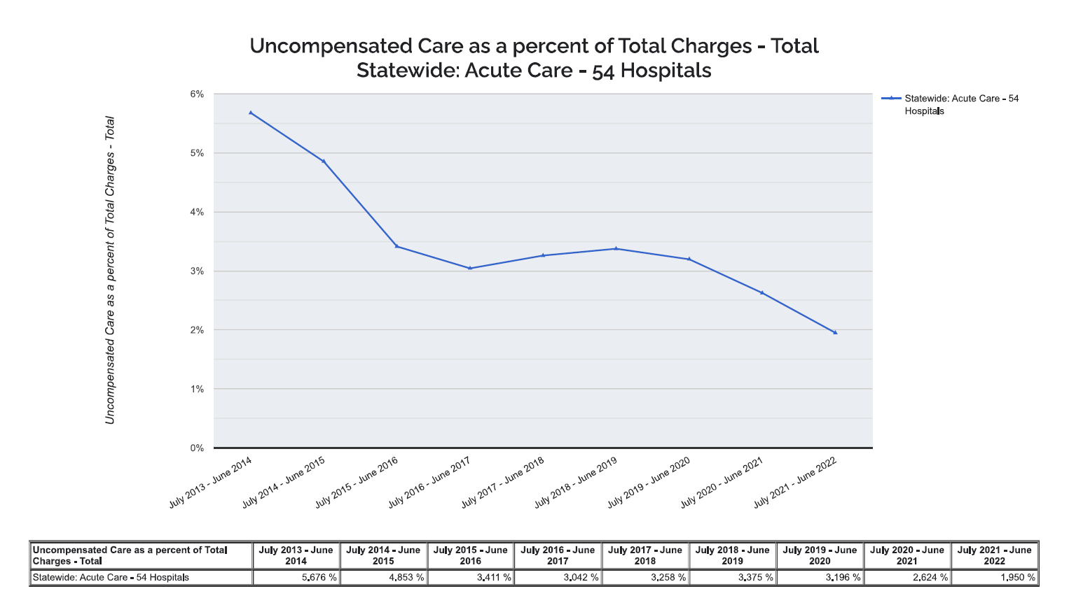
HIP Impact on Uncompensated Care

Slide 18
Recent HAF Years
SFY 2020: Recently reconciled by State. $10M credit to Hospitals with corrected letters sent in January 2023
SFY 2021: Reconciliation started but questions with FSSA. Initial review shows potential $18M decrease in fees
SFY 2022: Reconciliation starting March 2023
SFY 2023: Corrected letters sent December 2023. Reconciliation starts in 1 year

Slide 19
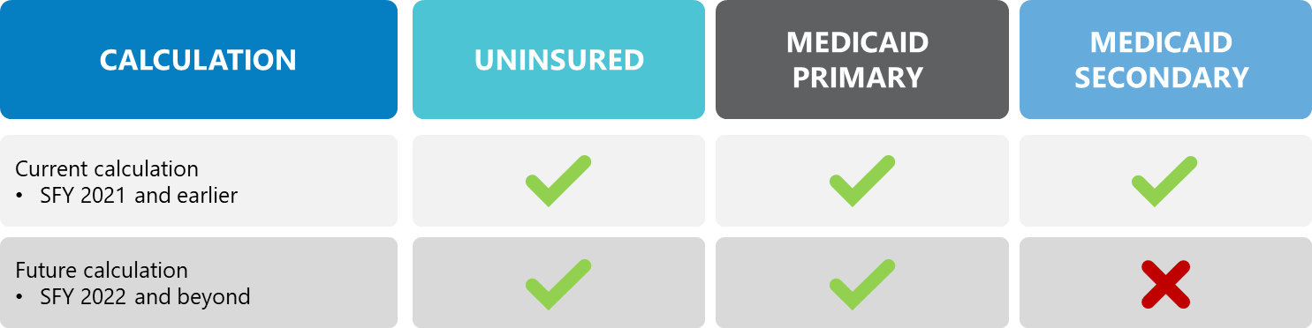
Federal Medicaid DSH Calculation Changes
Section 203 law passed in December 2020 that changes how DSH Hospital Specific Limits (HSL) are calculated:

Slide 20
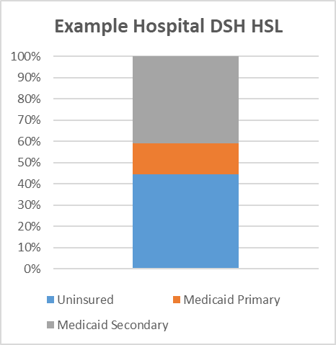
Federal Medicaid DSH Calculation Changes
Dual eligible claims currently make up a large portion of Indiana DSH payments
Cost of Medicare/Medicaid beneficiaries is greater than payments
No CMS rules to date, but appears effective date is for patients after 10/1/22 unless federal legislation is passed

Slide 21
FSSA Calendar Year 2023
SFY 2022/2023 DSH eligibility letters sent in February 2023
July 2023 – Notification of SFY 2024 HAF factors
August 2023 – SFY 2024 HAF fees begin
Summer/Fall – SFY 2020 DSH Examinations to begin
Late Fall – SFY 2022 DSH AUP’s to begin

