Slide 1
Bridges, Bacon & Being Yourself
A Mary Havens Production

Slide 2
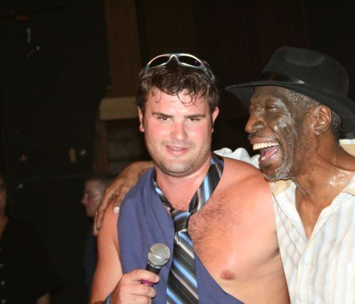
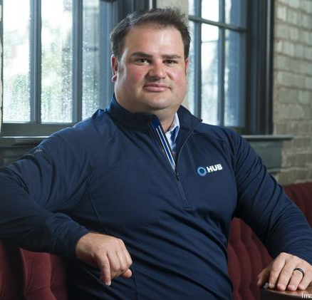
Bull, Hawk & Wheel – Best 5 Years of my Life
Mistakes & Lesson’s Learned
Under promise & over deliver
Fail quickly & often
Taking care of yourself
Different Networks

Slide 3
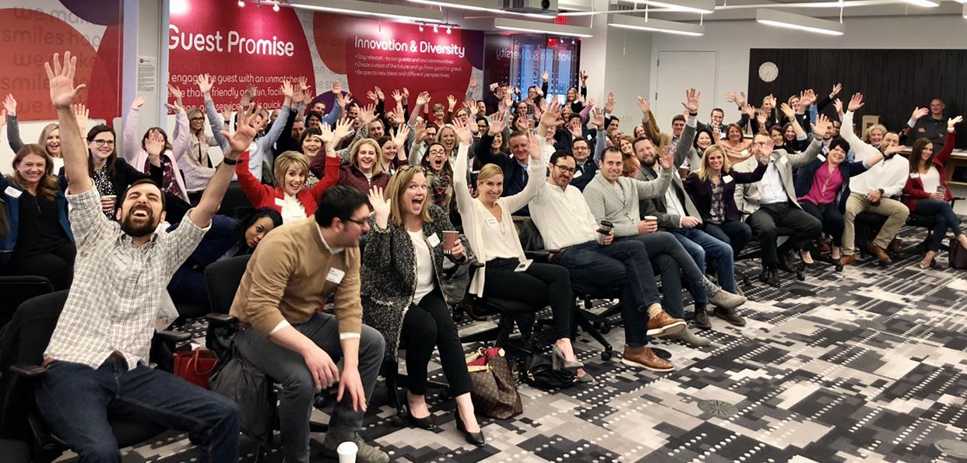
The Grind
If you are paid what you are worth then how does everyone else, make money?
What is your game?
Is there gas in the tank?
7 Year rule of saying YES
3 Groups always
1 Weekly Coffee
Infinite Mentors
Response Time

Slide 4
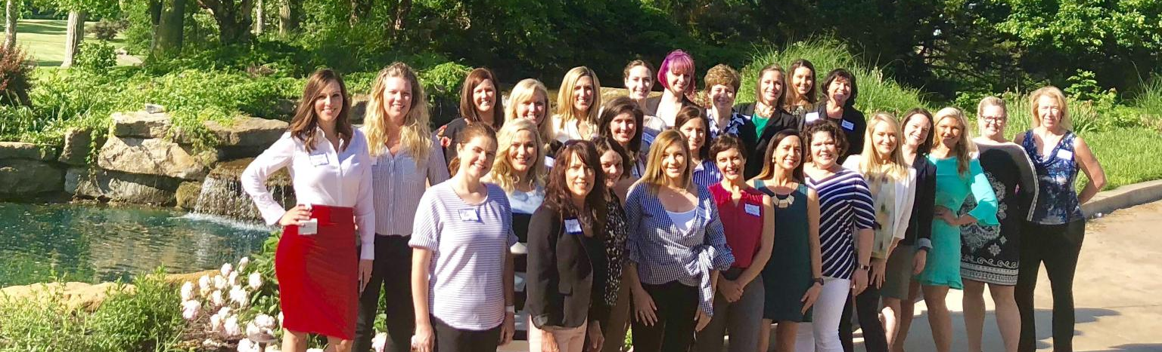
Ripping Up The Play Book & Making Your Own - Be Different!!!
Scott Havens - LinkedIn

Slide 5
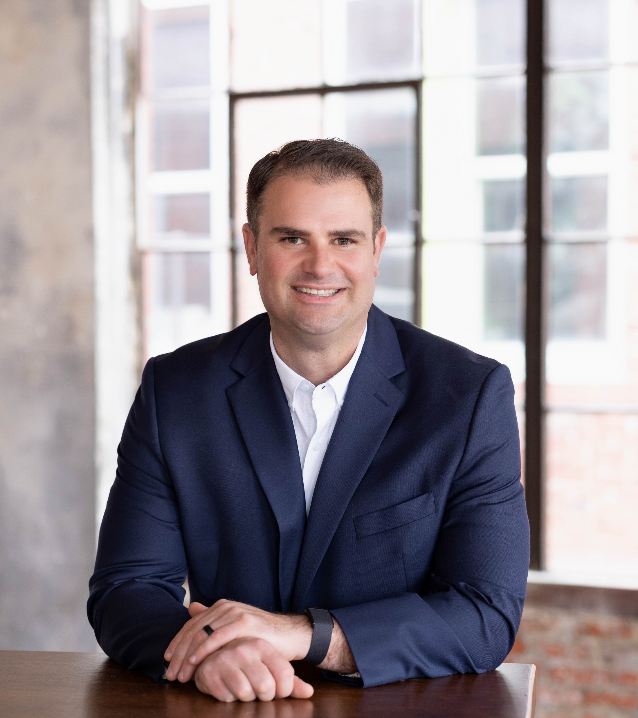
Bridges
Every person I meet is in some way my superior; and in that I can learn of them.
The best business in a gold rush is the pick & shovel business.
Richest are in the niches.

