Slide 1
HFMA Virtual Winter Meeting
Tonya Yale
1/19/2023

Slide 2
United Healthcare Community Plan Updates
Care Provider Manual has been updated for 2023 Care Provider Manual for Nebraska Heritage Health - UnitedHealthcare Community Plan of Nebraska (uhcprovider.com)
Continuous Glucose Monitoring (CGM) has been added as a covered benefit beginning 1/1/23 (page 33 under member benefits)
PT/OT/ST Changes beginning 11/1/22
Monthly Education Webinars
Known Issues UnitedHealthcare Community Plan of Nebraska Homepage | UHCprovider.com
United Healthcare Community Plan of Nebraska has begun implementation of the Heritage Health program beginning 1/1/24
Incorporating dental services

Slide 3
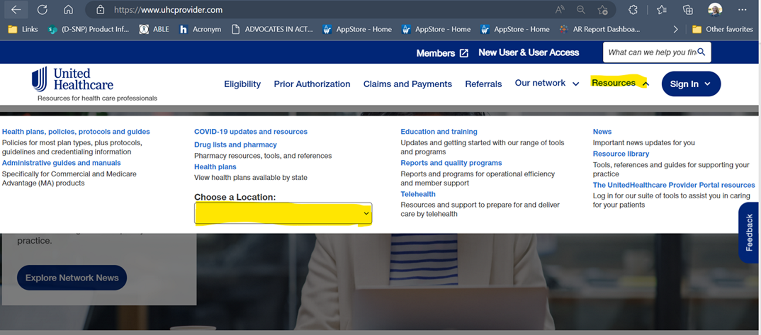
2023 Reminders
See the plans and products UHC offers www.uhcprovider.com – Resources - Choose a Location
To confirm participation, confirm if a plan needs a referral, submit a referral online, and most importantly verify eligibility of the member, please utilize our Provider Portal - Get training!
Policies and Protocols for Providers | UHCprovider.com
Healthcare Provider Administrative Guides and Manuals | UHCprovider.com
Network News | UHCprovider.com

Slide 4

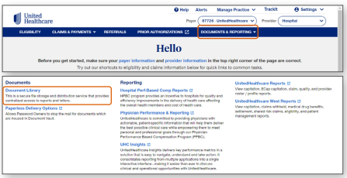
Let’s go digital!
Digital and paperless initiatives | UHCprovider.com
Reconsideration and appeal submissions going digital | UHCprovider.com
Document Library | UHCprovider.com

Slide 5
Misc Updates
Provider Advocate Updates – From the UHC Community home page, under contact us is an contact sheet of all provider advocate information.

Slide 6

Thank you!
© 2023 United HealthCare Services, Inc. All Rights Reserved.

