Slide 1

Legislative Agenda
2023
HFMA

Slide 2
New Governor & Senators
New Governor – Jim Pillen
16 new senators
15 senators will be term limited in 2024
63% will have no more than two years of legislative experience in 2025

Slide 3
NEW COMMITTEES
Appropriations
Sen. Robert Clements, Chairperson
Sen. Christy Armendariz
Sen. Myron Dorn
Sen. Robert Dover
Sen. Steve Erdman
Sen. Loren Lippincott
Sen. Mike McDonnell
Sen. Tony Vargas
Sen. Anna Wishart

Slide 4
NEW COMMITTEES
Health and Human Services
Sen. Ben Hansen, Chairperson
Sen. Beau Ballard
Sen. Machaela Cavanaugh
Sen. Jen Day
Sen. Brian Hardin
Sen. Merv Riepe
Sen. Lynne Walz

Slide 5
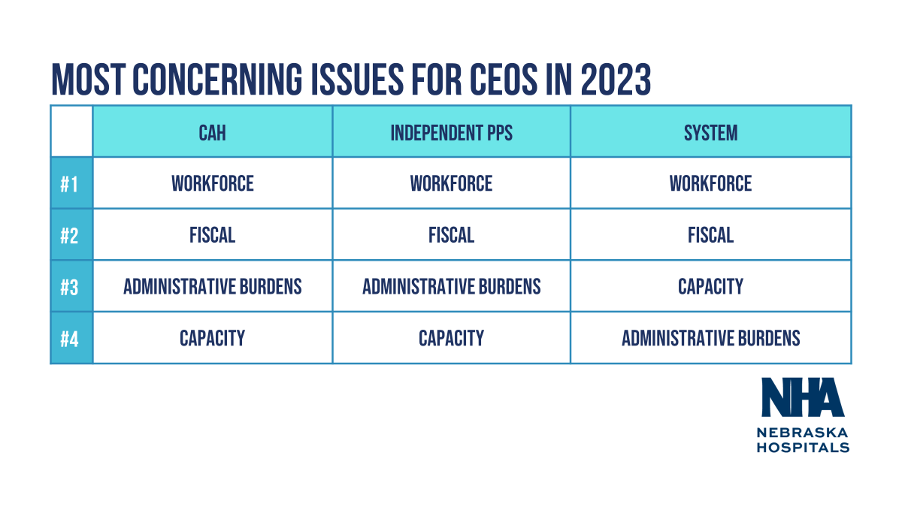

Slide 6
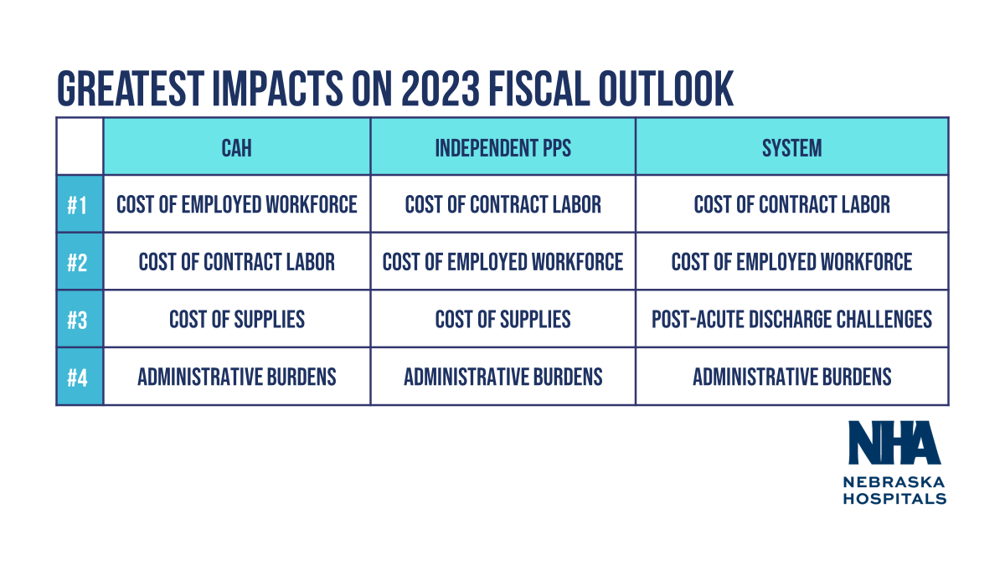

Slide 7
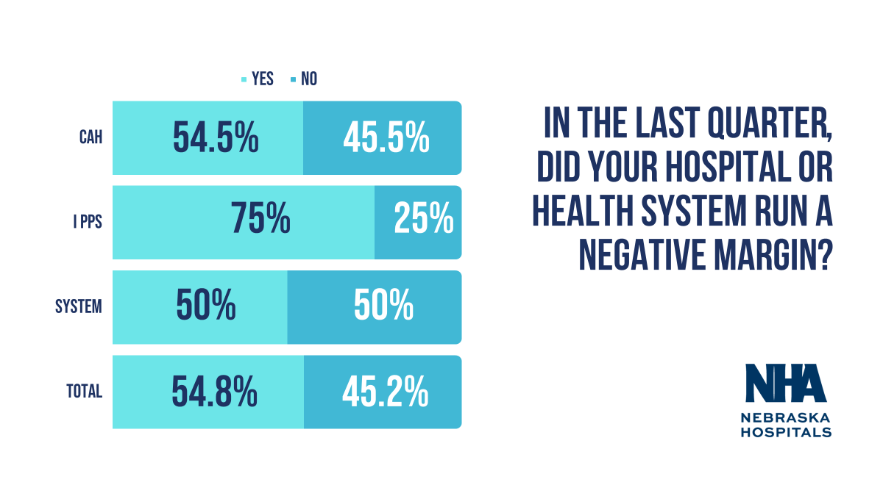

Slide 8
Nebraska hospitals are hurting.
Workforce Crisis.
Historic Inflation.
Post-Acute Placement Bottlenecks.
Aggressive Commercial Insurance Practices.
We need public officials to help hospitals heal.

Slide 9
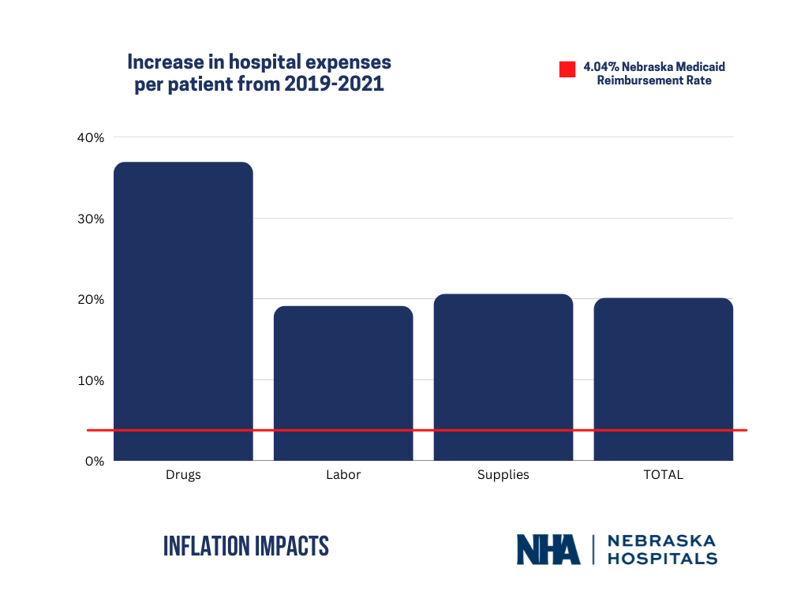

Increase in hospital expenses per patient in 2020 and 2021

Slide 10
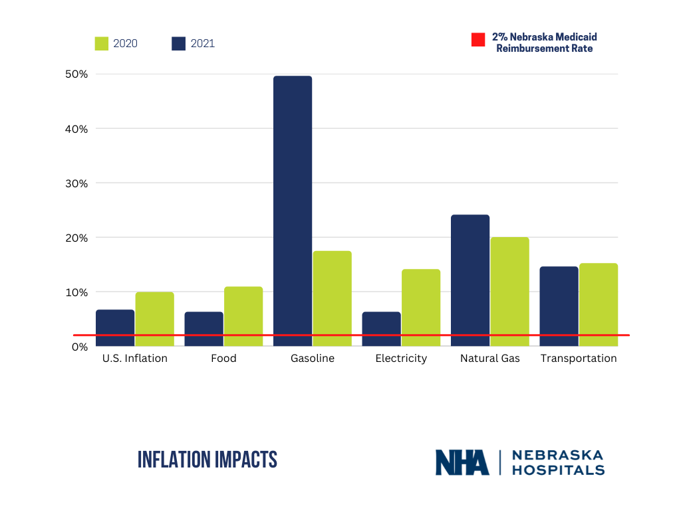

Slide 11
Hospital Costs Have Skyrocketed
 | FY 2021 & FY 2022
Labor | 19.1%
Medical Supplies | 20.6%
Drugs | 36.9%
Total Increase | 20.1%
 | Budgeted FY 2023 | Projected FY 2024
Salaries | 6.5% | 3.8%
Benefits | 7.0% | 4.7%
Contract Labor | 11.8% | 0.9%
Medical Supplies | 4.0% | 3.6%
Drugs | 4.1% | 7.4%
Food | 5.8% | 1.9%
Insurance P&C | 27.3% | 0.5%
Cyber Insurance | 68.9% | 20.3%
Utilities | 5.9% | 3.5%
 | 6.1% | 4.2%
FY 2021-2024 Compounded Cost Increase
32.8%

Slide 12
Hospitals Need Provider Rates to Keep Pace with Costs
 | FY 2024 Request | FY 2025 Request
Current Cost Increase for Next Biennium | 6.1% | 4.2%
Adjustment for Previous Biennium | 3.5% | 3.5%
Total Request for Next Biennium | 9.6% | 7.7%
FY 2022-2025 Compounded Rate Increase
22.8%

Slide 13
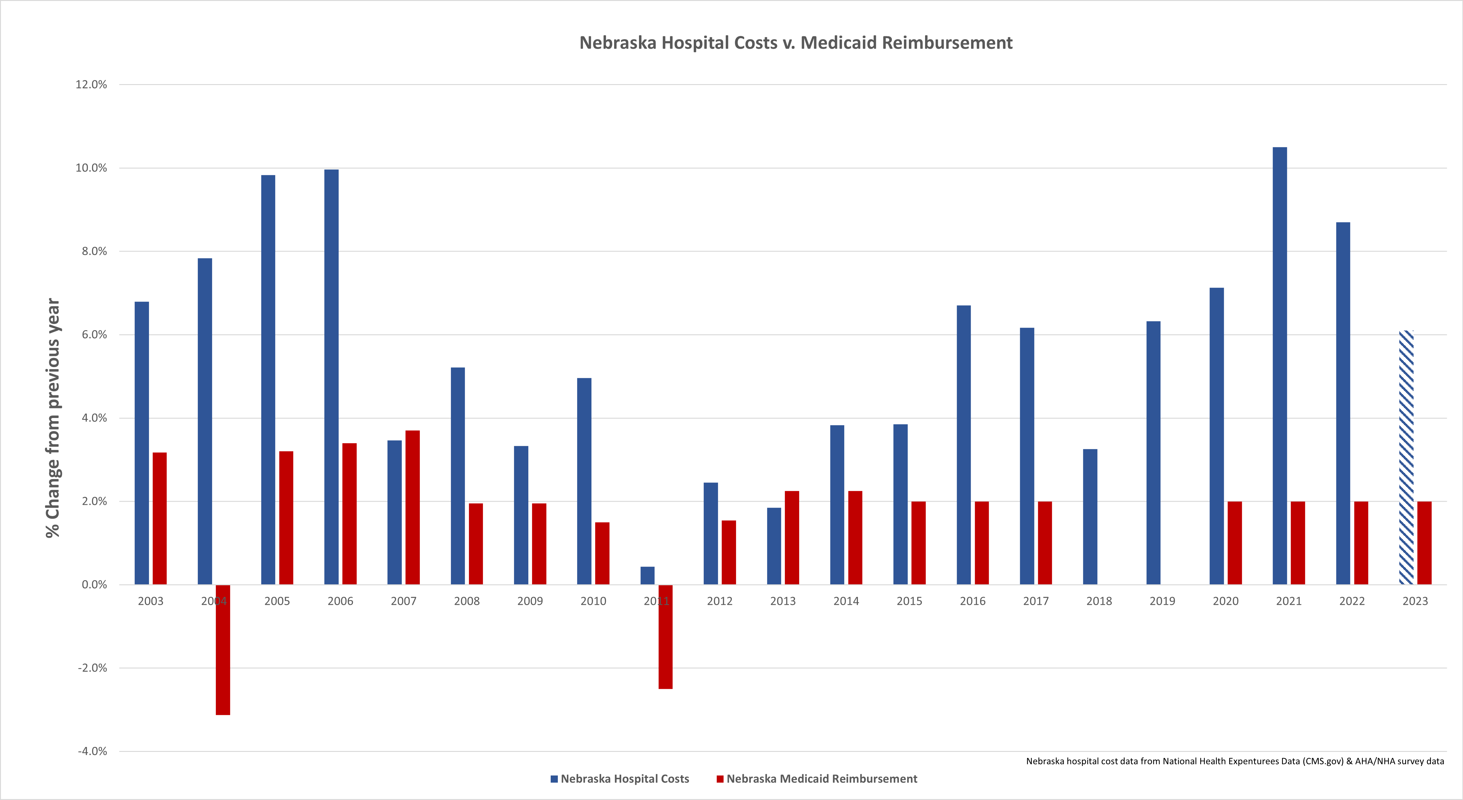
LB128 – Provider Rates

Slide 14
Rural Hospitals Need Increased
Per Diem Rates
Critical Access Hospitals (CAHs) are cost-based reimbursed.
Costs are $3,300-4,500 per day.
CAHs get paid a per diem rate shortly after providing care.
$1,800-2,600 per patient day.
Only covers about 50-60% of costs.
Have to wait 18-24 for full payment. CAHs carrying $150,000-500,000 in accounts receivable from Medicaid.
Rates need to be set annually based on the most recent cost report or rebased.
No new state money. LB219 – CAH Rebasing

Slide 15
Nebraska Needs to Rebase Inpatient Behavioral Health Rates
Rates have not been rebased since 1993 and have fallen significantly.
Hospitals cannot sustain inpatient behavioral health services with current rates.
Example from one system (2022 numbers):
$6,846 cost per case ($3,919 variable cost per case)
$3,066 payment per case from Medicaid
$3,780 loss per Medicaid case in 2022
  $3,106 loss per Medicaid case in 2021
  $1,844 loss per Medicaid case in 2018
Closing this gap is essential for sufficient inpatient behavioral health capacity in Nebraska. LB149 – BH Inpatient Rebasing

Slide 16

In the last quarter, has it been challenging to transfer patients to other hospitals in Nebraska?
94.9% - YES
5.1% - NO

Slide 17
CAH
iPPS
In the last
quarter, how challenging has it
been for your hospital to find placement for patients in need of
post-acute care?
26.1%
33.3%
66.7%
65.2%
31.2%
Very Challenging
67.5%
system
Somewhat challenging

Slide 18
Hospitals Need Help
Discharging Patients
237 patient in NE have been waiting for discharge for more than 7 days.
66 are Medicaid patients
103 patients have been awaiting discharge for more than 30 days
35,500 avoidable days last year among largest hospital systems.
Driven by lack of skilled nursing capacity, especially for specialized care, and behavioral health capacity.
DHHS working with hospitals and nursing homes on better coordination and process improvement.

Slide 19
Hospitals Need Help
Discharging Patients
NHA will be advocating for the following this session:
New or updated payment models for post-acute facilities to operate more specialized units, especially for behavioral health and bariatrics patients.
Capital grants to assist with specialized units.
Improved guardianship capacity in Nebraska to remove administrative barriers.
Hospital reimbursement for avoidable days.
Medicaid reimbursement for Long-Term Care Hospital services.
LB227 – Hoteling LB434 – LTAC Medicaid Payments

Slide 20
Nebraska is Facing a
Healthcare Workforce Crisis
Nebraska will experience a workforce shortage of 5,435 nurses by 2025.
2,600 fewer nurses compared to 2019
Estimated 1,400 RNs are very likely to leave their current employment in the next 12 months.
19 percent of physicians and 17 percent of nurses are over the age of 60.

Slide 21
less than 10%
more than 10%
what % of your hospital or health system is currently understaffed?
CAH
56.5%
43.5%
PPS
25%
75%
System
43.7%
56.3%
0
25
50
75

Slide 22
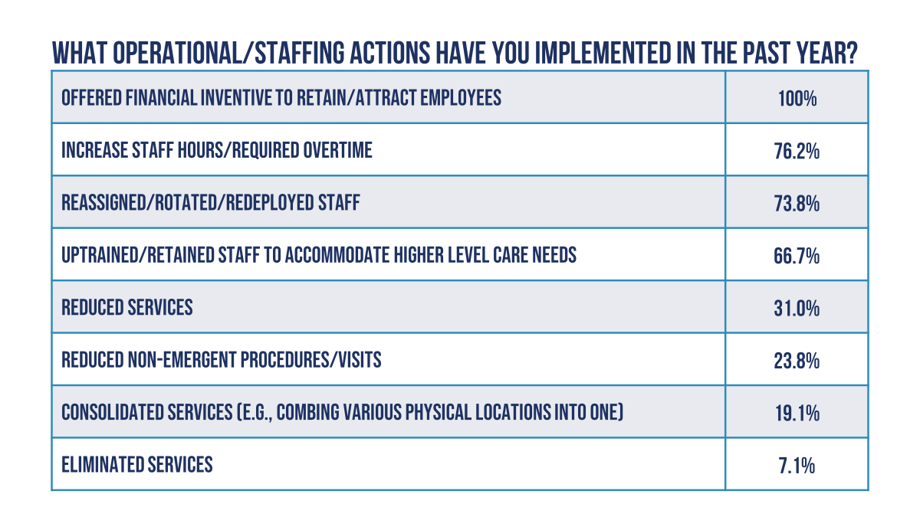

Slide 23
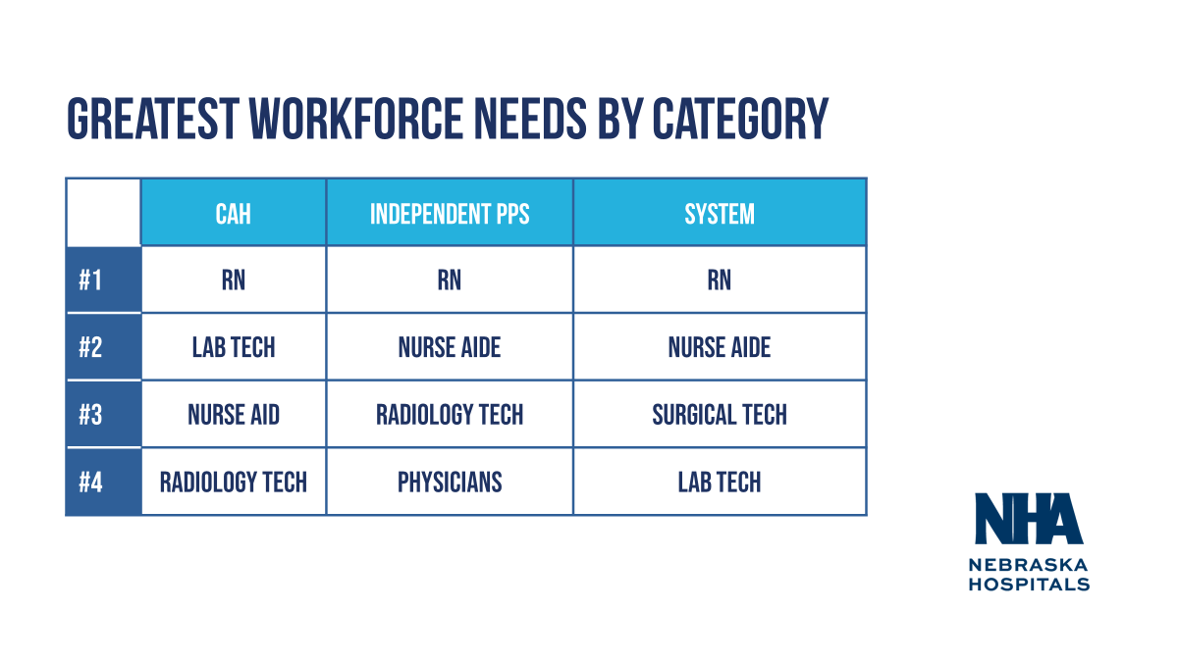

Slide 24
Rebuilding the Healthcare Workforce Pipeline
NHA will be advocating for the following this session:
Funding for Career Technical Education (CTE)
Grants for rural nursing clinical site and facility support.
LB586 – Center for Nursing Grants LB610 – CTE/CTSO Funding

Slide 25
Addressing Commercial Insurance Abuses
NHA will be advocating for the following this session:
Telehealth Payment Parity. LB256 – Telehealth Pay Parity
Restrictions on White Bagging. LB448 – White Bagging

Slide 26
92 member hospitals
Nearly 50,000 hospital employees
$7.5B in total expenditures
$3.5B in salary and benefits
$15B in total economic impact

