Slide 1
NC HFMA Medicare Workshop
January 26, 2023

Slide 2
Welcome

Slide 3


Utilization management
NC HFMA Medicare Workshop

Slide 5
Agenda
What is Utilization Management?
Data
Days in A/R (Accounts Receivable)
Pre-Claim Denial Management
Utilization Review
Questions

Slide 6
Healthcare Utilization Management
According to the Healthcare Financial Management Association (HFMA), healthcare utilization management is the “integration of utilization review, risk management, and quality assurance into management in order to ensure the judicious use of the facility's resources and high-quality care.”

Slide 7
Utilization Management Programs
Essential part of a provider organization’s revenue cycle, helping to prevent unnecessary costs and claim denials
Key to preventing denials and lodging successful requests for appeals
Can prevent hospitals from receiving retrospective claim denials and being forced to relinquish money already received
Hospital Utilization Management Can Reduce Denials, Improve Care (revcycleintelligence.com)

Slide 8
Utilization Management
Revenue Cycle Management + Utilization Review

Slide 9
What Is Revenue Cycle Management?
Healthcare revenue cycle management is the process by which health systems bill for services and generate revenue — from a patient’s first appointment all the way through to the payor’s acceptance of final payment.

Slide 10
NC Part A Disbursement
Bill Type | Provider Disbursement 2022H1 | Provider Disbursement 2021H2 | Provider Disbursement 2021H1 | Provider Count 2022H1 | Provider Disbursement. per Provider 2022H1 | Bene Count 2022H1 | Provider Disbursement. per Bene 2022H1 | ProProvider Disbursement per Bene 2021H2 | Provider Disbursement per Bene 2021H1 | Covered Charge 2022H1 | Claim Count 2022H1
011X Hospital Inpatient (Part A) | 1,683,459,626 | 1,682,813,511 | 2,572,013,959 | 139 | 12,111,220 | 166,533 | 10,109 | 10,564 | 12,628 | 13,361,824,692 | 219,413
012X Hospital Inpatient (Part B) | 10,176,080 | 13,724,963 | 11,792,096 | 118 | 86,238 | 5,744 | 1,772 | 1,877 | 2,052 | 85,075,384 | 6,437
013X Hospital Outpatient | 1,041,149,443 | 1,157,177,576 | 998,915,419 | 94 | 11,076,058 | 530,540 | 1,962 | 2,025 | 1,572 | 7,403,305,458 | 1,740,700
014X Hospital Other (Part B) | 16,511,032 | 19,054,683 | 18,880,951 | 81 | 203,840 | 199,677 | 83 | 86 | 90 | 119,263,673 | 334,891
018X Hospital Swing Bed | 9,137,636 | 7,462,756 | 10,206,541 | 17 | 537,508 | 460 | 19,864 | 18,026 | 20,211 | 16,785,164 | 496
021X SNF Inpatient (Part A) | 290,225,895 | 227,846,821 | 245,170,792 | 298 | 973,912 | 25,388 | 11,432 | 10,647 | 10,794 | 429,042,530 | 49,351
022X SNF Inpatient (Part B) | 25,445,396 | 34,792,981 | 30,458,884 | 292 | 87,142 | 10,216 | 2,491 | 2,798 | 2,872 | 51,289,277 | 28,607
023X SNF Outpatient | 3,592,676 | 4,611,955 | 4,135,009 | 108 | 33,266 | 2,323 | 1,547 | 1,729 | 1,766 | 7,233,667 | 5,803
032X Home Health Inpatient (Part B) | 193,124,430 | 201,912,022 | 218,680,766 | 158 | 1,222,307 | 50,640 | 3,814 | 3,765 | 3,780 | 199,458,514 | 113,674
033X Home Health Outpatient | 3,637 | . | 2,352 | 1 | 3,637 | 1 | 3,637 | . | 2,352 | 3,520 | 1
034X Home Health (Part B Only) | 463,966 | 4,625 | 578 | 5 | 92,793 | 291 | 1,594 | 132 | 48 | 1,412,204 | 1,694
071X Clinic RHC Rural Health | 7,095,496 | 7,015,858 | 5,134,273 | 41 | 173,061 | 21,022 | 338 | 330 | 257 | 10,059,974 | 44,073
072X Clinic ESRD Renal Dialysis | 104,789,664 | 115,233,754 | 122,680,798 | 198 | 529,241 | 9,288 | 11,282 | 10,817 | 10,512 | 1,269,835,409 | 43,212
074X Clinic ORF Other Rehab | 17,447,031 | 20,138,228 | 20,777,113 | 48 | 363,480 | 11,463 | 1,522 | 1,704 | 1,956 | 40,962,084 | 39,126
075X Clinic CORF Comprehensive Outpatient Rehab | 113,423 | 114,447 | 145,450 | 2 | 56,712 | 153 | 741 | 954 | 944 | 286,688 | 274
077X Clinic FQHC Federal Qualified Health Center | 6,912,991 | 7,601,523 | 7,771,860 | 126 | 54,865 | 21,785 | 317 | 337 | 320 | 18,174,346 | 55,097
081X Hospice Nonhospital-based | 335,425,366 | 336,683,815 | 313,825,660 | 64 | 5,241,021 | 31,490 | 10,652 | 9,989 | 10,055 | 545,483,015 | 83,445
082X Hospice Hospital-based | 25,032,530 | 22,648,719 | 27,869,376 | 10 | 2,503,253 | 3,405 | 7,352 | 6,816 | 7,619 | 41,117,277 | 6,607
085X CAH Critical Access Hospital | 28,477,879 | 32,484,032 | 31,333,982 | 19 | 1,498,836 | 42,685 | 667 | 655 | 630 | 252,694,399 | 96,243
IRF Inpat Rehab Facility | 81,556,375 | 84,117,613 | 131,917,578 | 22 | 3,707,108 | 4,544 | 17,948 | 18,227 | 20,088 | 255,041,653 | 4,776

Slide 11
JM Disbursement by DRG
Overview Rank | Overview Category | Overview Category Description | Dollars Current | Dollars Per Claim Current | Number of Claims Current | Number of Beneficiaries Current | Number of Providers Current
1 | 872 | Septicemia Or Severe Sepsis W/O Mv >96 Hours W/O MCC | 669,653,495 | 7,932 | 84,426 | 75,298 | 267
2 | 470 | Major Hip And Knee Joint Replacement Or Reattachment Of Lower Extremity W/O MCC | 375,770,722 | 9,293 | 40,437 | 39,454 | 216
3 | 293 | Heart Failure & Shock W/O CC/MCC | 341,377,749 | 5,679 | 60,109 | 46,743 | 265
4 | 855 | Infectious & Parasitic Diseases W O.R. Procedure W/O CC/MCC | 272,895,435 | 20,759 | 13,146 | 12,639 | 223
5 | 004 | Trach W MV >96 hrs OR PDX exc face, mouth & neck W/O MAJ O.R. | 233,706,211 | 80,700 | 2,896 | 2,855 | 145

Slide 12
NC Part A Disbursement by DRG
Rank | DRG Code | Covered Charge Apr-Jun 22 | Provider Disbursement Apr-Jun 22 | Number of Claims | Number of Benes
1 | 871 | 367,207,978 | 48,086,205 | 7,034 | 6,714
2 | 291 | 197,133,931 | 26,847,926 | 6,035 | 5,485
3 | 853 | 158,625,647 | 20,216,892 | 1,132 | 1,122
4 | 177 | 124,014,922 | 19,056,037 | 2,518 | 2,465
5 | 003 | 99,932,710 | 15,443,946 | 167 | 167
6 | 470 | 95,324,595 | 11,754,169 | 1,493 | 1,491
7 | 454 | 91,632,075 | 11,433,512 | 435 | 435
8 | 247 | 84,001,685 | 6,380,670 | 994 | 990
9 | 267 | 81,437,088 | 11,456,702 | 482 | 482
10 | 246 | 79,818,953 | 8,024,275 | 710 | 707

Slide 13
NC Claim Denials
Rank | Denial Code | Count of Claims with Denial Code | Percent of Denied Claims to Total Claims with any Denial Code by State | Percent of Denied Claims to Total Claims by State Excluding T Status Claims
1 | W7112 | 17,511 | 28.6 | 4.1
2 | 31324 | 15,963 | 26.1 | 3.8
3 | 31241 | 5,059 | 8.3 | 1.2
4 | 31947 | 2,976 | 4.9 | 0.7
5 | U5233 | 2,572 | 4.2 | 0.6
6 | 38200 | 1,394 | 2.3 | 0.3
7 | C7010 | 1,085 | 1.8 | 0.3
8 | 31711 | 1,063 | 1.7 | 0.3
9 | 54NCD | 1,042 | 1.7 | 0.2
10 | 39929 | 825 | 1.3 | 0.2

Slide 14
Days in A/R
Days in accounts receivable (A/R) is a critical performance indicator that measures the average time taken for a claim to be paid based on average daily charge volume
Number of days in A/R is a measure of the overall revenue cycle efficiency
Less number of days in A/R represents greater efficiency and faster payment

Slide 15
Calculating Days in A/R
Divide your total accounts receivable by your average daily gross charges i.e., total gross charges for the past calendar year divided by 365 days (or whatever time you choose)
Example:
Total outstanding AR is $350,000
Average daily charge is $6200
Days in AR is $350000/$6200 = 56 days, meaning it is taking an average of 56 days to get a claim/service paid

Slide 16
Calculating Days in A/R
Days in A/R is calculated by taking the total A/R and dividing by the calculated average charges per day over the selected period of time. It is advisable to use calendar rather than business days. Make sure you are comparing like amounts (gross A/R to gross charges or net A/R to net charges).
Calculate your average charges per day by:
Adding all the charges posted for a given period (e.g., 3 months, 6 months, 12 months).
Divide the total charges by the total number of days in the selected period (e.g., 30 days, 90 days, 120 days, etc.).

Slide 17
Calculation Days in A/R — 3 Month Example
 | Month 1 | Month 2 | Month 3 | Total
Days in month | 30 | 31 | 31 | 92
Charges | $991,668 | $802,426 | $842,401 | $2,636,495
 | Average Daily Charges |  |  | 28,657.55

Slide 18
Calculation Days in A/R
Next, calculate the days in A/R by dividing the total receivables by the average daily charges.
Total Accounts Receivable | $951,578
Average Daily Charges | $28,657.55
Days in A/R | 33.2
Ask Caryl: Calculating and Understanding Days in A/R — Serbin Medical Billing: Personalized ASC Revenue Cycle Services

Slide 19
Common Factors Leading to Increased Days in A/R
Claim filing delays
Ineffective determination of eligibility
Increased claim rejections
Increased denials and inefficient appeals process
Incorrect coding
Data entry errors
Incorrect posting process

Slide 20
Perform AR Follow-Up
Sort your payer follow up list, based on priority
Oldest (30-60-90-120+)
Biggest $$
Different payors
Trends
Develop well defined follow up actions with built in next follow up date. Make sure these are standard across the board

Slide 21
Claim Status and Location
Status/Location | Description
P B9996 | Payment floor
P B9997 | Processed or paid claim
D B9997 | Denied claim
R B9997 | Rejected claim
T B9997 | Claim needing correction
S B6001 | Claim selected for an additional documentation request (ADR)

Slide 22
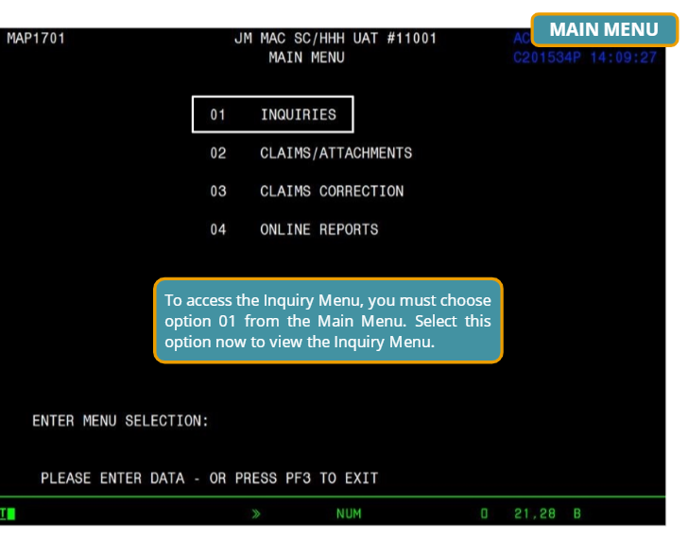
Claim Status and Location

Slide 23
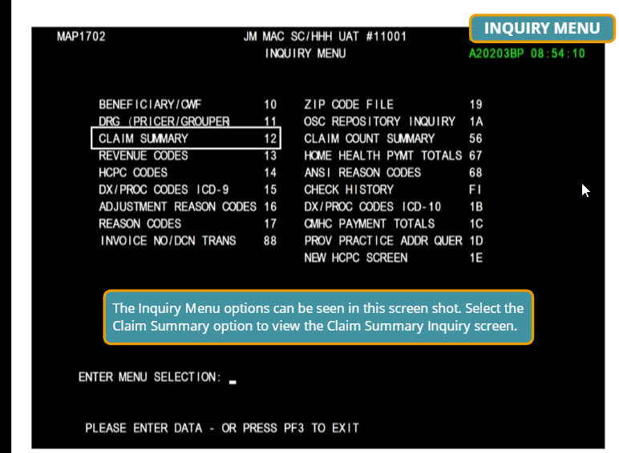
Claim Status and Location
Select option “12” from the Inquiry Menu to access the Claims Summary Inquiry screen (MAP1741)
The Claims Summary Inquiry screen displays specific claim history information for all pending (RTP claims, MSP claims, Medical Review claims) and processed (paid, rejected, denied) claims
The claim status information is available on-line for viewing immediately after the claim is updated/entered on DDE
The entire claim (six pages) can be viewed on-line through the claim inquiry function, but it cannot be updated from this screen

Slide 24
Claim Status and Location Example
S/LOC | CLAIM COUNT | TOTAL CHARGES | TOTAL PAYMENT
 | 2723 | 46,956,782.77 | 2,400,650.07
P B9996 | 747 | 10,715,214.74 | 2,400,650.07
S B6001 | 15 | 1,121,910.23 | 00.00
S MMSP2 | 1 | 2,016.00 | 00.00
T B9997 | 312 | 9,467,816.46 | 00.00

Slide 25
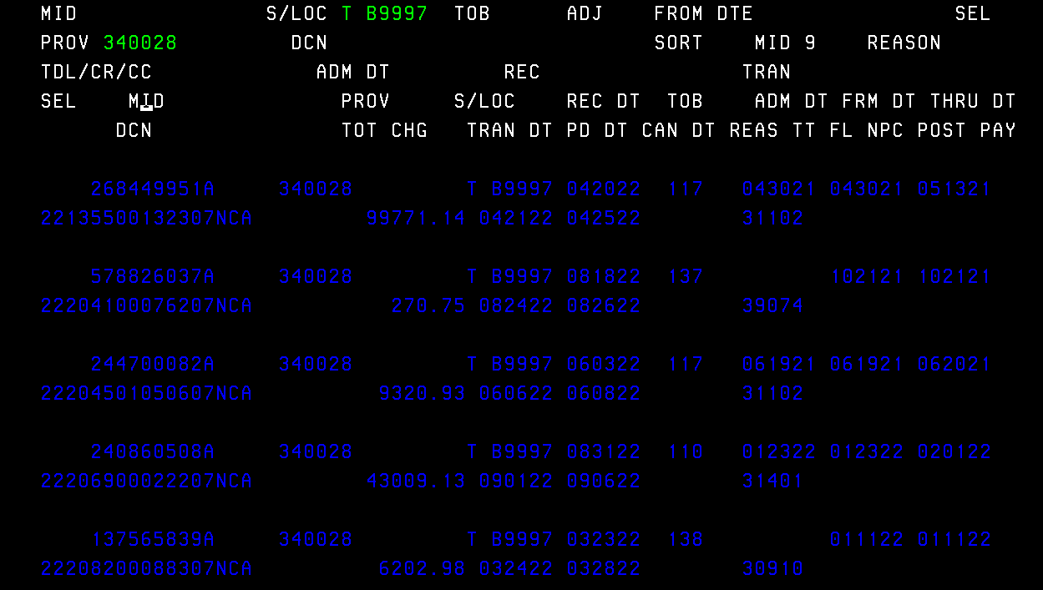
Claim Status and Location
……………..
……………………
……………………..
…………
……………………
……..
…………
………………………
……………………..
…………
………………………
……………………..
………………………
……………………..
…………
………………………
……………………..
…………

Slide 26
Steps in the Revenue Cycle Management Process
Claims: Turning in and submitting medical billing fee claims to insurance companies
Coding: Assigning the proper medical coding to procedures
Charge Capture: Turning medical services into billable charges
Collections: Collecting patient payments for outstanding balances

Slide 27
Pre-Claim Denial Management
Identify
Manage
Monitor
Prevent
WF109376_Denial_Mgmt_Add_Logo.indd (optum.com)

Slide 28
Identify
The first step in a successful claims resolution approach is to identify not only that a claim has been denied, but also the reason for the denial
When adjudicated claims are returned unpaid, the insurer will indicate the reason on the accompanying explanation of payment. These indicators, known as claims adjustment reason codes (CARC), are applied at the line item — CPT® code — level. Each CARC may be further explained in an accompanying remittance advice remark code (RARC)
Jurisdiction M Part B - Denial Resolution (palmettogba.com)
External Code Lists | X12
WP_Denial_Management.pdf (optum.com)

Slide 29
Manage
Use a checklist
Don’t delay
Avoid automatic rebilling
WP_Denial_Management.pdf (optum.com)

Slide 30
Monitor
Maintain a log of denials
Date received
Type of denial
Date appealed
Disposition

Slide 31
Activity

Slide 32
Prevent
Sort denials by category to determine the potential opportunities to revise processes, adjust workflows or re-train employees, physicians and providers
Developing a cross-functional approach prevents the common problem of one team “fixing” an issue, while another team “corrects” it — teams working in parallel on the same problem may end up working at cross-purposes, duplicating others’ work or failing to root out the problem altogether

Slide 33
Front-End Driven Revenue Cycle Process
Verifying insurance eligibility
Primary payor
Secondary payor
Coverage
Non-Medicare coverage polices
Medicare Coverage polices
Local Coverage Determination
National Coverage Determination
Requesting prior-authorization, if necessary

Slide 34
Manage Your Denials Effectively
Create a well-defined list of CARC (claim adjustment reason code) and group them by similarity of further follow up actions
What action is appropriate?
Appeal
Correct
Reopen
Rebill
Jurisdiction M Part A - Reason Code Help Tool (palmettogba.com)
Jurisdiction M Part A - Reopenings (palmettogba.com)
Jurisdiction M Part A - Appeals Overview for Providers Module (palmettogba.com)

Slide 35
Determine Why the Claim Was Denied
The first step in working a denied claim is to understand why the claim has been denied
Insurance carriers will use different denial codes on the remittance advice
Denial codes may also be referred to as adjustment codes
This code communicates why a claim might be paid different than billed

Slide 36
Missing or Invalid Patient Demographic and Insurance Information
Always confirm the spelling of the patient’s name, date of birth, responsible party, and vision and medical plan numbers
Even one required field will trigger a denial/return to provider

Slide 37
The Claim Is Missing a Code, Modifier or the Modifier Is Invalid
Payers will reject your claim if even one of the procedure codes is inconsistent with the modifier used, or a required modifier is missing for the date of service being billed.

Slide 38
Utilization Review
Process to review treatment to determine if it is medically necessary
Help figure out whether the treatment is eligible for reimbursement from the insurance plan

Slide 39
Utilization Review
Avoid claim denials
Provide appropriate care
Minimize costs
Confirm insurance coverage
Notes:
The UR process serves to improve hospital services, determine medical necessity and manage the cost of care. Below is a list of primary reasons the UR process takes place:
Avoid claim denials: The utilization review ensures insurance companies will approve patient care according to the patient's insurance plan and the provider's criteria. The discussion of methods of care, medical history and the patient's present and future needs allow room for alternative solutions so the patient receives the necessary care.
Provide appropriate care: The review process strives for an efficient approach to healthcare so patients receive the best possible and appropriate methods of care. Insurance companies want to ensure patients show improvement and work to move patients through stages of care with consideration and forethought. The review aims to provide efficient care in the environment that best serves the patient.
Minimize costs: In response to rising healthcare costs, utilization reviews work to identify unnecessary costs or provide economical alternatives. For example, reviewers often evaluate whether a patient needs intensive care, or if they can move to a trauma unit instead. Reviews may determine that attending physical therapy three times a week has the same expectation for improvement as attending five days a week.
Confirm insurance commitment: If a patient is facing extensive procedures or expects a lengthy recovery, it's important to know whether or not insurance will cover the costs in part or in whole. Patients can prepare for their own care when they are aware of their responsibilities and assured the insurance company will honor their claims.

Slide 40
Utilization Review Tips
If the patient needs to be in the hospital, emphasize why in the chart
If the patient’s status is “observation” or “24-hour stay” rather than “admission,” make that clear
If the patient is unstable, specify how
Document the patient’s acute needs
Hospital Utilization Management Can Reduce Denials, Improve Care (revcycleintelligence.com)

Slide 41
Utilization Review Tips
Clinical documentation should be able to answer a series of basic questions:
Are the patient’s vital signs stable?
Has the provider made a diagnosis?
Has a treatment plan been started and modified, if appropriate?
What acute needs are present? Can lower care levels address these needs?
Has the provider considered alternatives to hospitalization? Why are alternative care settings not appropriate?
Hospital Utilization Management Can Reduce Denials, Improve Care (revcycleintelligence.com)

Slide 42
Utilization Review Stages
Utilization reviews take place over the course of patient treatment, including the quest for approval before scheduling a procedure. Reviews happen in these three stages:
Prospective
Concurrent
Retrospective

Slide 43
Purpose of Documentation
Historical account
Professional responsibility
Legal requirement
Communication tool for other disciplines and/or providers

Slide 44
Purpose of Documentation
Measurement of patient outcomes
Need for services
Justification for plan of treatment
Basis for the quality of care
Reimbursement for services

Slide 45
Medical Necessity
Title XVIII of the Social Security Act Section 183(E) prohibits Medicare payment for any claim which lacks the necessary information to process the claim
Section 1862(a)(1)(A) of the Act allows coverage and payment for only those services that are considered to be medically reasonable and necessary

Slide 46
Prospective Review
Seeks approval in preparation for care
Validated prerequisites for a procedure are met
For example, a patient schedules elective surgery and the UR process determines:
Course of treatment including medical history
Pre-surgical requirements
Prior authorization
LCD/NCD requirements

Slide 47
Concurrent Review
Concurrent review occurs while treatment is in progress and usually starts within 24-72 hours of admission to a hospital
The main focuses of the review are to track utilization of resources and the patient's progress, and to reduce denials of coverage after the treatment is complete
Utilization Management in Healthcare | Smartsheet

Slide 48
Concurrent Review
Care Coordination: Syncing the delivery of a patient’s health care when it comes from multiple providers or specialists
Discharge Planning: Determining what needs or milestones need to be met for a patient to leave the hospital
Care Transition: When a patient moves from one level of care to another (for example, from ICU to standard care)
Utilization Management in Healthcare | Smartsheet

Slide 49
Concurrent Review
During a concurrent review, a service or treatment that’s already underway may be stopped, or reviewers may look for alternatives to ongoing inpatient care or try to begin the discharge planning process
Concurrent review can also be referred to as a continued stay review or an admission review
Utilization Management in Healthcare | Smartsheet

Slide 50
Example of Utilization Review
Rob is hospitalized overnight with a really severe case of the flu. The UR nurse visits him in the morning to review the medical record and take stock of the treatment Rob has received so far. Rob was admitted as inpatient care, a designation that means the patient requires more technical, skilled care. However, after reviewing his symptoms, the UR nurse decides that observation status is a more appropriate designation since Rob is too sick to be treated at his regular doctor’s office, but not sick enough to require full inpatient admission.
Utilization Review: What It Is and How to Get Involved (allheart.com)

Slide 51
Condition Code 44
Inpatient admission changed to outpatient
For use on outpatient claims only, when the physician ordered inpatient services, but upon internal review performed before the claim was initially submitted, the hospital determined the services did not meet its inpatient criteria

Slide 52
Condition Code 44
The change in patient status from inpatient to outpatient is made prior to discharge or release, while the beneficiary is still a patient of the hospital
The hospital has not submitted a claim to Medicare for the inpatient admission
A physician concurs with the utilization review committee’s decision
The physician’s concurrence with the utilization review committee’s decision is documented in the patient’s medical record

Slide 53
Retrospective Review
This review evaluates after-care plans including outpatient therapies
It also serves to review rendered care to determine historic medical necessity

Slide 54
Query
Questions asked to physicians to obtain additional, clarifying documentation to improve the specificity and completeness of the data used to assign diagnosis and procedure codes.

Slide 55
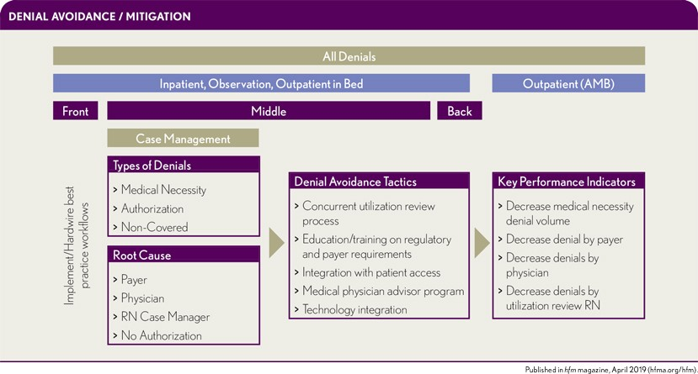
Utilization Review: 5 Reasons Hospitals Lose Revenue (hfma.org)

Slide 58
Medicare Part A Updates
NC HFMA Medicare Workshop

Slide 60
Agenda
UPDATES
Medicare Deductible, Coinsurance & Premium Rates: Calendar Year 2023 Update
Coverage for Colorectal Cancer Screening Updates
Inpatient and Long-Term Care Hospital Prospective Payment System: FY 2023 Changes
Rural Emergency Hospitals (REH)
HOT TOPIC
Medicare Secondary Payer Billing

Slide 61
Medicare Deductible, Coinsurance & Premium Rates: Calendar Year 2023 Update

Slide 62
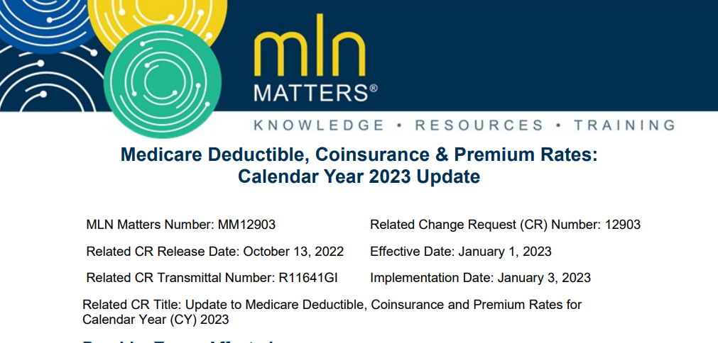
Notes:
Patients using covered Part A and Part B services may be subject to deductible and coinsurance requirements. Medicare subtracts an inpatient hospital deductible amount from the amount payable to the hospital for inpatient hospital services it provides in a spell of illness. When a patient gets such services for more than 60 days during a spell of illness, they’re responsible for a coinsurance amount equal to one-fourth of the inpatient hospital deductible for each day of days 61-90 spent in the hospital. A patient has 60 lifetime reserve days of coverage, which they may use after day 90 in a spell of illness. The coinsurance amount for these days is equal to one-half of the inpatient hospital deductible. A patient is responsible for a coinsurance amount equal to one-eighth of the inpatient hospital deductible per day for days 21-100 of skilled nursing facility (SNF) services provided during a spell of illness

Slide 63
2023 Part A – Hospital Insurance (HI)
Part A Deductible — $1,600.00
Part A Coinsurance
$400.00 a day for days 61–90
$800.00 a day for days 91–150 (lifetime reserve days)
$200.00 a day for days 21–100 (SNF coinsurance)
Part A Base Premium (BP) — $506.00 a month
Part A BP with 10% surcharge — $556.60 a month
Part A BP with 45% reduction — $278.00 a month (for those who have 30-39 quarters of coverage)
Part A BP with 45% reduction and 10% surcharge — $305.80 a month

Slide 64
Coverage for Colorectal Cancer Screening Updates
Notes:
Based on the Final Rule for FY 2023 there have been multiple updates for the coverage of Colorectal Cancer Screenings

Slide 65
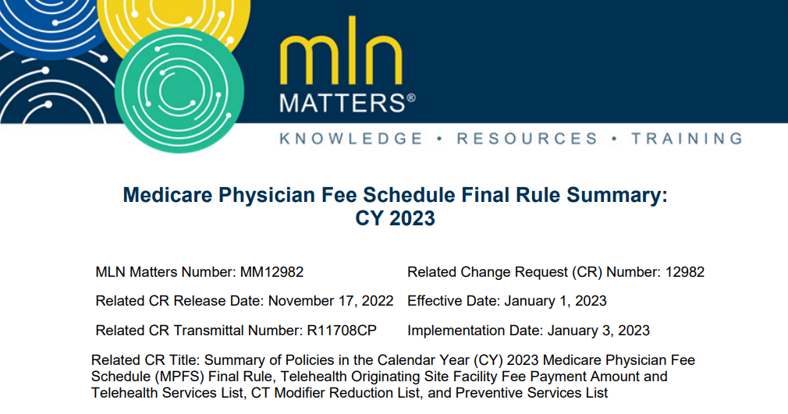
Notes:
Expansion of Coverage for Colorectal Cancer Screening and Reducing Barriers
Lower the age from 50 years old to 45

Slide 66
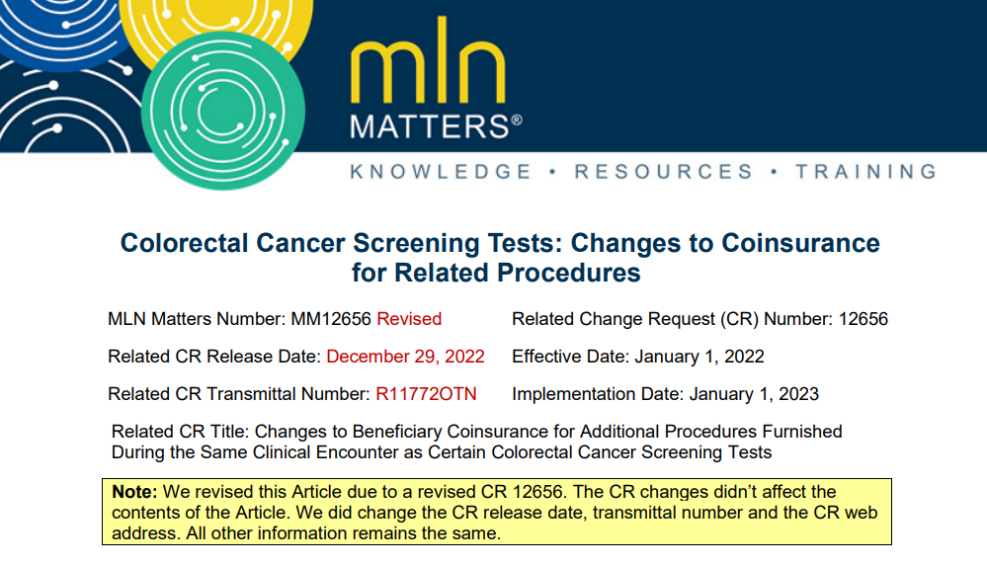
Notes:
Change in the Coinsurance for CRC

Slide 67
Expansion of Coverage for Colorectal Cancer Screening and Reducing Barrier
CMS modified policies to expand coverage of colorectal cancer (CRC) screening in 2 ways:
Age limit reduced to 45 years of age or older from the prior limit of 50 years of age or older
Blood-based Biomarker Tests
The Cologuard™ — Multi-target Stool DNA (sDNA) Test
Immunoassay based Fecal Occult Blood Test (iFOBT)
Guaiac-based Fecal Occult Blood Test (gFOBT),
Barium Enema Test
Flexible Sigmoidoscopy Test
Notes:
Screening Colonoscopy will continue with no minimum age limitation.
No modification toexisting maximum age limitations. • Second, we’re expanding the regulatory definition of CRC screening tests to include a follow-on screening colonoscopy after a Medicare covered non-invasive stool-based CRC screening test returns a positive result. We added the regulatory definition to 42 CFR 410.37.

Slide 68
Expansion of Coverage for Colorectal Cancer Screening and Reducing Barrier
2. Expanded the regulatory definition of CRC screening tests to include a follow-up screening colonoscopy after a Medicare covered non-invasive stool-based CRC screening test (FOBT or MT-sDNA test) returns a positive result.
Follow-up screening covered as a screening test
No patient responsibility if the provider accepts assignments
Notes:
Second, we’re expanding the regulatory definition of CRC screening tests to include a follow-on screening colonoscopy after a Medicare covered non-invasive stool-based CRC screening test returns a positive result. We added the regulatory definition to 42 CFR 410.37.

Slide 69
Colorectal Cancer Screening Tests: Changes to Coinsurance for Related Procedures
Previously, planned colorectal cancer screening tests were free unless a procedure was added in the same encounter as a result of the screening.
CMS implemented on January 1,2023 the gradual reduction of coinsurance for procedures performed:
In connection with a colorectal cancer
As a result of a screening test
In the same clinical encounter as the screening test
Notes:
tarting January 1, 2023, CMS will gradually reduce coinsurance for procedures performed: • In connection with a colorectal cancer screening test MLN Matters: MM12656 Related CR 12656 Page 2 of 2 • As a result of a screening test • In the same clinical encounter as the screening tes

Slide 70
Colorectal Cancer Screening Tests: Changes to Coinsurance for Related Procedures
The reduced coinsurance applies regardless of the code you bill.
For dates of service in CYs:
2023–2026, coinsurance is 15%
2027–2029, coinsurance is 10%
Starting 2030, no coinsurance

Slide 71
Colorectal Cancer Screening Tests: Changes to Coinsurance for Related Procedures
When a screening colorectal cancer procedure, G0104, G0105 or G0121 has the PT modifier submitted on the claim line item with HCPCS codes 10000–69999, G0500, 00811 or CPT® code 99153 for diagnostic colonoscopy, or diagnostic flexible sigmoidoscopy, or other procedure to indicate that a screening colorectal cancer procedure has become a diagnostic or therapeutic service, coinsurance is reduced or waived.

Slide 72
IPPS & LTCH PPS: FY 2023 Changes
Notes:
Each year CMS updates the rates and factors for the IPPS and the LTCH PPS to account for changes in the prices of goods and services used by hospital in treating Medicare patients along with other factors. .
The outline of the updates for FY 2023 can be found under CR 12814 or MLN Matters Number MM12814.

Slide 73
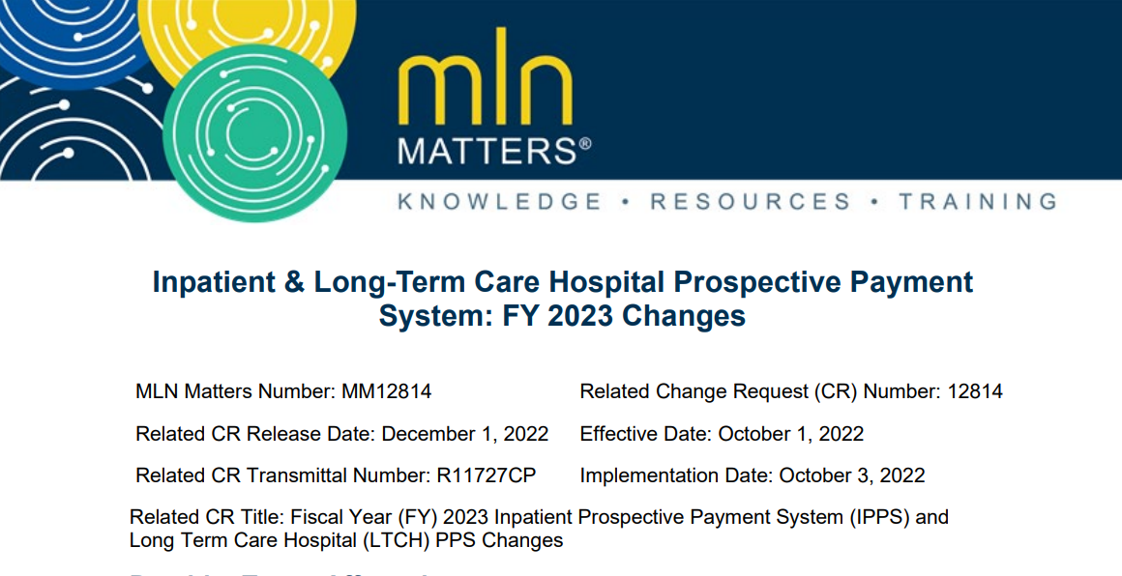
Notes:
The changes addressed in the article went on display on August 1, 2022, and appeared in the Federal Register on August 10, 2022.
All items covered in the Article are effective for hospital discharges occurring on or after October 1, 2022 and remains effective through September 30, 2023, unless otherwise noted.

Slide 74
FY 2023 IPPS Rates and Factors
Operating Rates/Standardized Amounts and the Federal Capital Rate
Tables 1A-C and Table 1D of the FY 2023 IPPS/LTCH PPS Final Rule
4.3% rate
General acute hospitals with successful participation in the Hospital IQR Program
Other IPPS factors
Applicable percentage increase, budget neutrality factors, High-Cost Outlier (HCO) threshold, and Cost-of-Living Adjustment (COLA) factors
MAC Implementation File 1 of the FY 2023 MAC Implementation Files website
Notes:
One of the first changes listed in this CR is The increase in operating payment rates for general acute care hospitals paid under the IPPS, that successfully participate in the Hospital IQR Program and are meaningful electronic health record (EHR) users, is 4.3%. This reflects a FY 2023 hospital market basket update of 4.1% reduced by a 0.3 percentage point productivity adjustment and increased by a 0.5 percentage point adjustment required by statute.
There are no changes to the COLA factors for FY 2023. We use the same COLA factors under the IPPS and LTCH PPS for FY 2023.

Slide 75
Changes to Payment Rates Under IPPS
Hospitals may be subject to other payment adjustments under the IPPS, including:
Payment reductions for excess readmissions under the Hospital Readmission Reduction Program (HRRP)
Payment reduction for the worst-performing quartile under the HAC Reduction Program
Upward and downward adjustments under the Hospital VBP Program
HRRP payment adjustment factors for FY 2023 in Table 15 of the FY 2023 IPPS/LTCH PPS final rule.
Notes:
HRRP payment adjustment factors for FY 2023 in Table 15 of the FY 2023 IPPS/LTCH PPS final rule
Those Hospitals that aren’t subject to a reduction under the HRRP in FY 2023 (such as Maryland hospitals), have an HRRP payment adjustment factor of 1.0000.
For FY 2023, hospitals should only have an HRRP payment adjustment factor between 1.0000 and 0.9700.

Slide 76
Hospital Readmission Reduction Program (HRRP)
Payment adjustments located in table 15 of the IPPS/LTCH PPS final rule
FY 2023, hospitals should only have an HRRP payment adjustment factor between 1.0000 and 0.9700
Hospitals that aren’t subject to a reduction under the HRRP in FY 2023
HRRP payment adjustment factor of 1.0000.
Notes:
HRRP payment adjustment factors for FY 2023 in Table 15 of the FY 2023 IPPS/LTCH PPS final rule
Those Hospitals that aren’t subject to a reduction under the HRRP in FY 2023 (such as Maryland hospitals), have an HRRP payment adjustment factor of 1.0000.
For FY 2023, hospitals should only have an HRRP payment adjustment factor between 1.0000 and 0.9700.

Slide 77
Hospital-Acquired Condition (HAC) Reduction Program
No payment adjustments under the program for FY 2023
Indicators on the provider specific file have been changed to “N” for all providers
HAC Reduction Indicator
Worst-Performing Quartile
Notes:
CMS decided not to adjust payments for any hospital in the HAC Reduction Program for FY 2023. Palmetto GBA has updated the HAC Reduction Indicator and Worst-Performing Quartile fields to hold a value of ‘N’ for every hospital indicating there is not a subject to reduction under the program

Slide 78
Hospital-Acquired Condition (HAC) Reduction Program
No payment adjustments under the program for FY 2023
Indicators on the provider specific file have been changed to “N” for all hospitals
VBP Program participant indicator (VBP Participant)
VBP Program adjustment field (VBP Adjustment)
Tables 16A and 16B will not be issued for FY 2023 with the FY 2023 IPPS/LTCH PPS Final Rule.
Notes:
CMS will not adjust payments for any hospital in the HAC Reduction Program for FY 2023. Palmetto GBA has updated the HAC Reduction Indicator and Worst-Performing Quartile fields to hold a value of ‘N’ for every hospital indicating there is not a subject to reduction under the program

Slide 79
New Technology Add-On Payment Policy
MAC Implementation File 8 - FY 2023 New Technology Add-on Payment (NTAP) - Technologies Continuing to Receive NTAP
Technology | Maximum Add-on Payment | ICD-10-CM/PCS Coding Used to Identify Cases Eligible for NTAP | Alternative Pathways Status
aScope™ duodeno | $1,296.75 | XFJB8A7 or XFJD8A7 | Breakthrough Device
aprevo® | $40,950.00 | XRGA0R7, XRGA3R7, XRGA4R7, XRGB0R7, XRGB3R7, XRGB4R7, XRGC0R7, XRGC3R7, XRGC4R7, XRGD0R7, XRGD3R7, or XRGD4R7 | Breakthrough Device
Caption Guidance | $1,868.10 | X2JAX47 | Breakthrough Device
Fetroja® (cefiderocol) (HABP/VABP) | $8,579.84 | XW033A6 or XW043A6 in combination with Y95 and one of the following: J14, J15.0, J15.1, J15.5, J15.6, J15.8 OR XW033A6 or XW043A6 in combination with J95.851 and one of the following: B96.1, B96.20, B96.21, B96.22, B96.23, B96.29, B96.3, B96.5, B96.89 | QIDP
HARMONY™ TPV | $26,975.00 | 02RH38M | Breakthrough Device
Intercept® Fibrinogen Complex (PRCFC) | $2,535.00 | 30233D1 or 30243D1 in combination with one of the following: D62, D65, D68.2, D68.4, or D68.9 | Breakthrough Device
RECARBRIO™ (HABP/VABP) | $9,576.51 | XW033U5 or XW043U5 in combination with Y95 and one of the following: J14, J15.0, J15.1, J15.5, J15.6, or J15.8 OR XW033U5 or XW043U5 in combination with J95.851 and one of the following: B96.1, B96.20, B96.21, B96.22, B96.23, B96.29, B96.3, B96.5, B96.89 | QIDP
Shockwave Coronary IVL | $3,666.00 | 02F03ZZ or 02F13ZZ or 02F23ZZ or 02F33ZZ | Breakthrough Device
Rybrevant® (amivantamab) | $6,405.89 | XW033B7 or XW043B7
Abecma® (idecabtagene vicleucel) | $289,532.75 | XW033K7 or XW043K7
StrataGraft® | $44,200.00 | XHRPXF7
Tecartus® (brexucabtagene autoleucel) | $259,350.00 | XW033M7 or XW043M7
Cosela™(trilaciclib) | $5,612.10 | XW03377 or XW04377
Veklury® (remdesivir) | $2,028.00 | XW033E5 or XW043E5
Zepzelca® (lurbinectedin) | $9,145.50 | XW03387 or XW04387
Notes:
For FY 2023, 15 technologies continue to be eligible for new technology add-on payments

Slide 80
New Technology Add-On Payment Policy
FY 2023 New Technology Add-on Payment (NTAP) - Technologies Beginning to Receive NTAP
Technology | Maximum Add-on Payment | ICD-10-CM/PCS Codes Used to Identify Cases Eligible for NTAP | Alternative Pathways Status
DefenCath™ | $4,387.50 | XY0YX28 | QIDP
Carvykti™ (ciltacabtagene autoleucel) | $289,532.75 | XW033A7 or XW043A7
DARZALEX FASPRO® | $5,159.41 | XW01318 in combination with E85.81
Livtencity™ (maribavir) | $32,500.00 | XW0DX38 or XW0G738 or XW0H738
Hemolung Respiratory Assist System (RAS) | $6,500.00 | 5A0920Z
Cerament® G | $4,918.55 | XW0V0P7 | Breakthrough Device
GORE® TAG® Thoracic Branch Endoprosthesis | $27,807.00 | 02VW3DZ in combination with 02VX3EZ | Breakthrough Device
iFuse Bedrock Granite Implant System | $9,828.00 | XNH6058, XNH6358, XNH7058, XNH7358, XRGE058, XRGE358, XRGF058, or XRGF358 | Breakthrough Device
Thoraflex™ Hybrid Device | $22,750.00 | X2RX0N7 in combination with X2VW0N7 | Breakthrough Device
ViviStim® Paired VNS System | $23,400.00 | X0HQ3R8 | Breakthrough Device
Notes:
9 technologies are newly eligible for new technology add-on payments. CMS granted 1 technology conditional approval pending FDA marketing authorization. We’ll issue additional instructions if FDA marketing authorization is granted in time for FY 2023 payments under the conditional approval policy.
For more information on FY 2023 new technology add-on payments, specifically about the technologies either continuing to get payments or starting to get payments, see MAC Implementation File 8. Starting FY 2023, MAC Implementation File 8 also includes information about technologies no longer eligible to get new technology add-on payments (About 25 discontinued

Slide 81
Outlier Payments — IPPS Statewide Average Cost to Charge Ratios (CCRs)
For FY 2023, statewide average Cost to Charge Ratios (CCRs) are used in the following instances:
New hospitals that haven’t yet submitted their first Medicare cost report. (For this purpose, a new hospital is defined as an entity that hasn’t accepted assignment of an existing hospital’s provider agreement.)
Hospitals with operating or capital CCR exceeding three standard deviations above the corresponding national geometric mean. CMS recalculates this mean annually and publish it in the annual notice of prospective payment rates issued per 42 CFR 412.8(b). For FY 2023 operating CCR and capital CCR trim values, refer to MAC Implementation File 1.
Hospitals for whom accurate data to calculate an operating or capital CCR (or both) aren’t available
IPPS Statewide Average Cost to Charge Ratios (CCRs) Tables 8A and 8B contain the FY 2023 statewide average operating and capital CCRs for urban and rural hospitals.
Notes:
Note: Hospitals and MACs can request an alternative CCR to the statewide average CCR per instructions found in Chapter 3, section 20.1.2.1 of the Medicare Claims Processing Manual. Also, for all hospitals, use of an operating and/or capital CCR of 0.0 or any other alternative CCR requires approval from the CMS Central Office
IPPS Statewide Average Cost to Charge Ratios (CCRs) Tables 8A and 8B contain the FY 2023 statewide average operating and capital CCRs for urban and rural hospitals. These tables are available on the FY 2023 Final Rule
Tables website.

Slide 82
FY 2023 LTCH PPS Rates and Factors
FY 2023 LTCH PPS Standard Federal Rates
Table 1E on the FY 2023 Final Rule
Other FY 2023 LTCH PPS Factors
MAC Implementation File 2
LTCH PPS Pricer has been updated
Version 40 MS-LTC-DRG table, weights and factors
effective for discharges occurring on or after October 1, 2022 – September 30, 2023

Slide 83
LTCH Quality Reporting (LTCHQR) Program
The annual update to a standard federal rate will continue to be reduced by 2% if an LTCH doesn’t submit quality-reporting data per the LTCHQR Program for that year.
Notes:
Requires the submission of data pertaining to quality measures, resource use, and other domains. In addition, the IMPACT Act requires assessment data to be standardized and interoperable to allow for the exchange of data among post-acute providers and other providers. The IMPACT Act intends for standardized post-acute care data to improve Medicare beneficiary outcomes through shared decision-making, care coordination, and enhanced discharge planning.

Slide 84
LTCH Statewide Average CCRs
Statewide average CCRs are used in the following instances:
New hospitals that haven’t yet submitted their first Medicare cost report
LTCHs with a total CCR above the applicable maximum CCR threshold (the LTCH total CCR ceiling, which is calculated as 3 standard deviations from the national geometric average CCR). For the FY 2023 LTCH total CCR ceiling, see MAC Implementation File 2.
Any hospital for which data to calculate a CCR isn’t available
Table 8C contains the FY 2023 statewide average LTCH total CCRs for urban and rural LTCHs. Table 8C is available on the FY 2023 Final Rule Tables website.
Notes:
1For this purpose, a new hospital is defined as an entity that hasn’t accepted assignment of an existing hospital’s provider agreement.
Note: Hospitals and MACs can request an alternative CCR to the statewide average CCR per instructions found in Chapter 3, section 150.24 of the Medicare Claims Processing Manual. For all LTCHs, use of a total CCR of 0.0 or any other alternative CCR requires approval from the CMS Central Office.

Slide 85
A/B Rebilling

Slide 86

Purpose of the A/B Rebilling Process
Rebilling is necessary when a hospital inpatient payment, cannot be made under Medicare Part A. It gives the hospital a second opportunity, to receive payment.
It is important that providers understand that websites from palmettogba.com or cms.gov are here to educate you and your staff. A/B Rebilling is one of the many processes that can assist with reimbursement on Medicare claims.
Notes:
Many of you have been billing Medicare for over 20 years. You understand that Medicare changes and advances frequently. This statement, can help you remember to code your claims correctly. Any CMS final rule, quarterly update, etc. can affect the reimbursement of your claim. A CPT or HCPCS code could be valid during the first quarter and invalid during the third quarter, for example. The purpose of the A/B rebilling process is to help you, the provider, get paid.

Slide 87
Approved Providers for A/B Rebilling
All Hospitals Billing Part A Services are Eligible to Bill the Part B Inpatient Services
Short Term Acute Care Hospitals paid under the Inpatient Prospective Payment System or (IPPS)
Hospitals paid under the Outpatient Prospective Payment System or (OPPS)
Long Term Care Hospitals (LTCHS)
Inpatient Psychiatric Facilities (IPFS) and IPF Hospital Units
Inpatient Rehabilitation Facilities (IRFS) and IRF Hospital Units
Critical Access Hospitals (CAHS)
Children’s Hospitals
Cancer Hospitals
Notes:
This is a list of facilities, approved for A/B rebilling. Let’s review!

Slide 88
Exceptions
Outpatient Visits
Emergency Department Visits
Observation Services
Notes:
There are exceptions to A/B Rebilling:
Outpatient Visits
Emergency Department Visits
Observation Services
These services require an outpatient status. These services are provided to Hospital Outpatient claims only.

Slide 89
Step 1: Self-Audit Claim Criteria
Notes:
We will now shift gears and learn how to successfully A/B rebill Medicare claims.

Slide 90
Inpatient-Only Services
Medicare does not consider a beneficiary as inpatient until after a physician issues an order for inpatient admission and the written order proceeds an inpatient-only procedure.
There are two exceptions to this rule:
Admit the beneficiary for inpatient care
Admit the beneficiary after the procedure and before transferring the beneficiary to a higher level of care
Notes:
If A is selected, hospitals can include the inpatient-only procedure as part of the inpatient admission and expect reimbursement according to the specific Medicare Severity (MS) Diagnosis-Related Group (DRG).
If B is selected, the facility that provided the inpatient-only procedure and stabilized the beneficiary will receive a transfer/per diem DRG payment.

Slide 91
Step 1: Self-Audit Claim Criteria
Type of Bill (TOB) 110
Non-covered days
The services from admission through discharge listed
The appropriate patient status
Occurrence Span Code “M1” and dates of service
Non-covered charges for all services rendered
All diagnosis codes
All procedures codes
The 110 TOB must COMPLETELY finalize into a R B9997 location, before the 12x TOB can be submitted
Notes:
Palmetto GBA understands that billing can get complicated. The following slides are simplified to assist your staff with the billing process. You are saving lives and we appreciate your service.

Slide 92
Correction Process of a Previously Submitted 111 TOB
Cancel the original with a 118 TOB
Wait for the cancellation to process
Once complete, submit a 110 TOB provider liable claim
The document control number(DCN) must be appended to the 121 TOB
Do not append the original DCN or the 118 TOB DCN
Tip: Appending the original DCN will cause the claim to return to the provider(RTP) for corrections. An RTP’d claim is not accepted into the Fiscal Intermediary System (FISS) and will not be considered a timely submission.
Notes:
If a mistake occurs and the claim was submitted incorrectly, please troubleshoot using the following steps.

Slide 93
Tips to Remember
Medicare requires that the 110 Type of Bill (TOB) be submitted which indicates that the provider is liable for the cost of the Part A services
Do not add condition code 21 to the 110 TOB. It indicates that the beneficiary is liable for the cost of services
The occurrence span code (OSC) M1 and the inpatient admission dates of service, must be on the claim
The claims’ system converts the original 11x claim to a 110 TOB on behalf of the hospital
Notes:
Just a reminder…to perform a self-audit claim, it must have the following information on the claim.

Slide 94
Step 2: Part B Inpatient Ancillary Claim Criteria
Notes:
At this point, there should be a clear understanding of the Self-Audit claim or type of bill 110. Now let’s move forward to step 2 of the A/B Rebilling process. We will discuss the Part B Inpatient Ancillary Claim Criteria.

Slide 95
Step 2: Part B Inpatient Ancillary Claim Criteria
For Part A Inpatient admissions denied as not reasonable and necessary, providers shall submit a qualifying Part B inpatient claim (TOB 12x) with:
1. A treatment authorization code of A/B Rebilling submitted by a provider;
2. A condition code "W2" attesting that this is a rebilling, and no appeal is in process; and
3. The original, denied inpatient claim (CCN/DCN/ICN) number is indicated in the remarks section of the claim, for example:
ABREBILL12345678901234
The claim must COMPLETELY finalize into a P B9997 location before the 13x TOB can be submitted.
Notes:
After the inpatient claim has processed and a Remittance Advice (RA) has been issued, a Part B inpatient claim (TOB 12X) can be submitted.

Slide 96
Step 3: The Hospital Outpatient Claim
Notes:
Now that step 1 and 2 are complete, we can move forward with...

Slide 97
Step 3: The Hospital Outpatient Claim
The 13x TOB is the hospital outpatient claim. It must be before the admit date of the 110 TOB
This claim is billed as a regular outpatient claim and does not need any significant A/B Rebilling coding
This is the last claim to be billed. Current Procedural Terminology (CPT®) modifier 91 must be appended to any duplicate laboratory test, provided on the same Line-Item Date of Service (LIDOS). The modifier is required even if the repeat test is reported on the 121 TOB for the same LIDOS.
Tip: If the patient dies, the use of the CA modifier is allowed with a patient status code of 20.
Notes:
There are 3 things to remember during this step:

Slide 98
Sequential Billing
A/B rebilling MUST BE IN sequential ORDER
A/B
Rebilling
Process
Step 1:
110 TOB
Step 2:
121 TOB
Step 3:
131 TOB
PAID CLAIM
If the claims are not submitted in the proper order the claims will return to provider (RTP) or reject incorrectly
The only way to correct this issue is to cancel the claim that is out of sequence:
Wait for each claim to finalize
Submit the correct TOB with the correct coding for accurate processing
Notes:
The diagram is an illustration of this process. If followed correctly, it could increase the chance of the facility receiving reimbursement on a claim.

Slide 99
2023 Part A Kickoff Teams
Alabama, Georgia & Tennessee
Consultant: Sandra Booker
Representative: Jamela Hillary-Harris
North Carolina & South Carolina
Consultant: April Gause
Representative: Areka Freeman
Virginia & West Virginia
Consultant: Teresa Brown
Representative: Tyrekia Barden
Notes:
We are the Part A Team lead by our Supervisor Wendy Weary, Manager Belinda Marin and our Director Terrance Proudy. We are traveling and are ready to work for our provider communities. Please submit your Speaker Requests. The form is available on our Palmetto GBA website!

Slide 100

Medicare Part A Events

Slide 101
Meet With Your MAC
Sessions Every Thursday
Hot Topic Tuesday
Brunch and Billing Series
Spring Tour 2023
April – June
MACtoberfest
Savannah, Ga.

Slide 102
Reminders
Self-service tools
Contact Us
Interactive Voice Message (IVR)
eServices
Website Tools Available
Website Education Available
Departmental information is available on our website “Contact Us” link
Customer Experience Survey
Speaker Request Form
Meet with Your MAC Sessions
Education Request Form
Provider Contact Center (PCC)
JJ Call 877–567–7271 (Toll Free)
JM Call 855–696–0705 (Toll Free)

Slide 104
Part B Hot Topics
NC HFMA Medicare Workshop

Slide 106
Agenda
Comprehensive Error Rate Testing
Evaluation and Management 2023 Changes
Telehealth

Slide 107
Medicare Part B Physician National Data — CY 2021 Expenditures And Services by Specialty
Specialty | Allowed Services | Allowed Charges | Payment Amt
Total | 5,417,819,832 | 149,512,633,508 | 118,191,557,198
General Practice | 8,953,366 | 414,445,837 | 318,133,349
General Surgery | 12,043,576 | 1,786,971,532 | 1,404,115,031
Cardiology | 62,338,637 | 5,180,526,855 | 3,953,867,649
Family Practice | 137,128,300 | 6,689,809,190 | 5,048,342,226
Internal Medicine | 183,975,707 | 10,151,916,126 | 7,834,353,592
Pathology | 31,649,008 | 1,346,142,879 | 1,080,821,597
cy-2021-expenditures-and-services-specialty.pdf (cms.gov)

Slide 108
NC Family Practice E/M Billing Jan–June 2022
Procedure Code | Carrier Services | NC Specialty % of Use | National Specialty % of Use
99202 | 1,020 | 5.9 | 7.1
99203 | 6,470 | 37.1 | 40.4
99204 | 8,724 | 50.1 | 47.0
99205 | 1,216 | 7.0 | 5.5
 | 17,430
99212 | 6,702 | 1.4 | 2.2
99213 | 123,390 | 26.6 | 33.6
99214 | 309,646 | 66.8 | 59.9
99215 | 24,057 | 5.2 | 4.3
 | 463,795

Slide 109
General Practice E/M Billing Jan-June 2022
Procedure Code | Carrier Services | NC Specialty % of Use | National Specialty % of Use
99202 | 12 | 2.8 | 8.2
99203 | 184 | 42.2 | 43.9
99204 | 228 | 52.3 | 40.8
99205 | 12 | 2.8 | 7.1
 | 436
99212 | 102 | 1.5 | 5.2
99213 | 2,551 | 38.0 | 45.2
99214 | 3,999 | 59.5 | 45.1
99215 | 68 | 1.0 | 4.5
 | 6,720
Notes:
Specialty Code: Provider specialty as it appears in the Part B National Summary Data file
Specialty Description: Description of the specialty code
Procedure Code: A code used to describe a service rendered to the beneficiary
Carrier Services: Carrier allowed services as indicated in the Part B National Summary Data file
SC, NC, VA, and WV
Specialty % of Use: Total allowed services for the specified procedure code and specialty for carrier (i.e. SC, NC, VA, and WV) divided by the total allowed services for the E&M code family and specialty for carrier expressed as a percentage. Computation is based on allowed services for the carrier.
National Specialty % of Use: Allowed services for the specified procedure code and specialty nationally divided by the total allowed services for the E&M code family (and any associated modifiers) and specialty nationally expressed as a percentage. Computation is based on allowed services for the nation

Slide 110
Comprehensive Error Rate Testing (CERT)

Slide 111
Five Major CERT Error Categories
Comprehensive Error Rate Testing Contractor’s 2022National Improper Payment Rate
Errors Defined by Category
Notes:
The national Medicare Fee-for-Service (FFS) improper payment rate was reported on Monday, November 15th in the 2021 Department of Health and Human Services’ Agency Financial Report (AFR). This information is posted at: http://www.hhs.gov/afr. The Medicare FFS information can be found in the “Other Information p211” portion of the AFR under the Payment Integrity Report section. The 2021 national Medicare FFS improper payment rate is 6.26% or $25.03 billion in improper payments.
The most recent CERT calculations shown here on this slide indicate that the top Five CERT major error categories identified in this years 2021 National Improper Payment report Insufficient documentation accounted for 64% of errors the most common causes of improper payments, followed by 13% being related to medical necessity, 11% being noted as incorrect coding, 7% being emphasized as other, and 5% being due to no documentation.

Slide 112
Improper Payment Rates and Projected Improper Payments by Claim Type (Dollars in Billions)
Claim Type | Claims Sampled | Claims Reviewed | Total Payments | Projected Improper Payments | Improper Payment Rate | Percent of Overall Improper Payments
Part A (Total) | 28,676 | 18,528 | $306.6 | $20.5 | 6.7% | 65.2%
Part A (Excluding Hospital IPPS) | 8,001 | 7,088 | $193.4 | $17.1 | 8.9% | 54.5%
Part A (Hospital IPPS) | 20,675 | 11,440 | $113.3 | $3.4 | 3.0% | 10.8%
Part B | 14,420 | 14,072 | $106.6 | $8.8 | 8.2% | 27.8%
DMEPOS | 9,605 | 9,398 | $8.7 | $2.2 | 25.2% | 7.0%
Total | 52,701 | 41,998 | $421.9 | $31.5 | 7.5% | 100.0%

Slide 113
Top Root Causes for Office Visits — Established
Root Cause Description | Error Category | Sample Claim Count
Documentation supports lower level of E/M service than what was billed | Incorrect Coding | 114
Documentation supports higher level of E/M service than what was billed | Incorrect Coding | 17
Documentation to support the services were provided or other documentation required for payment of the code — Inadequate | Insufficient Documentation | 11
Separately identifiable E/M service documentation — Inadequate | Insufficient Documentation | 11
Documentation for the billed date of service — Inadequate | Insufficient Documentation | 9
Documentation for the billed date of service — Missing | Insufficient Documentation | 8
Signature log to support a clear identity of an illegible signature — Missing | Insufficient Documentation | 5
A separate and identifiable service is not supported as billed (i.e., removal of a modifier as a coding error) | Incorrect Coding | 4
Attestation for unsigned documentation — Missing | Insufficient Documentation | 4
Provider/supplier indicates they are unable to locate medical records for this patient/beneficiary or the provider/supplier indicates not their patient/beneficiary | No Documentation | 4

Slide 114
Top Root Causes for Specialist
Root Cause Description | Error Category | Sample Claim Count
Annual Wellness Visit (AWV) or Subsequent AWV — Inadequate | Insufficient Documentation | 88
Chronic Care Management: Care Plan provided to the beneficiary/family — Missing | Insufficient Documentation | 60
Provider’s intent to order (for certain services) — Missing | Insufficient Documentation | 54
Order — Missing | Insufficient Documentation | 51
Documentation to support medical necessity — Missing | Insufficient Documentation | 29
Plan of care — Missing | Insufficient Documentation | 18
Chronic Care Management (CCM): Informed consent for services (verbal or written) — Missing | Insufficient Documentation | 17
Attestation for unsigned documentation — Missing | Insufficient Documentation | 13
Chronic Care Management (CCM): Documentation of time — Missing | Insufficient Documentation | 13
Documentation to support the services were provided or other documentation required for payment of the code — Inadequate | Insufficient Documentation | 12

Slide 115
Projected Improper Payments by State (Dollars in Millions)
State | Claims Reviewed | Projected Improper Payments | Improper Payment Rate | Percent of Overall Improper Payments
N.C. | 1,379 | $915.5 | 7.4% | 2.8%

Slide 116
Improper Payment Rates by Service Type
Part B Services (BETOS Codes) | Claims Reviewed | Projected Improper Payments | Improper Payment Rate | Percent of Overall Improper Payments
Lab tests — other (non-Medicare fee schedule) | 1,911 | $1,185,426,655 | 26.4% | 3.7%
Office visits — established | 1,105 | $755,705,932 | 5.2% | 2.3%
Specialist — other | 1,186 | $623,559,793 | 24.5% | 1.9%
Minor procedures — other (Medicare fee schedule) | 1,694 | $580,266,233 | 13.1% | 1.8%
Hospital visit — initial | 644 | $517,687,780 | 20.9% | 1.6%
Hospital visit — subsequent | 806 | $513,271,531 | 10.3% | 1.6%
All Codes With Less Than 30 Claims | 1,228 | $464,234,943 | 2.6% | 1.4%
Ambulance | 315 | $356,181,558 | 8.8% | 1.1%
Office visits — new | 518 | $269,421,546 | 9.8% | 0.8%
Nursing home visit | 535 | $251,050,202 | 13.0% | 0.8%

Slide 117
Improper Payment Rates for Lab Tests — Other by Referring Provider
Lab tests — other (non-Medicare fee Schedule Part B Services (BETOS Codes) | Claims Reviewed | Projected Improper Payments | Improper Payment Rate | Percent of Overall Improper Payments
Internal Medicine | 657 | $373,490,095 | 22.7% | 31.5%
Family Practice | 308 | $249,809,624 | 29.5% | 21.1%
Nurse Practitioner | 263 | $184,939,488 | 34.7% | 15.6%
Physician Assistant | 83 | $38,972,541 | 19.0% | 3.3%
No Referring Provider Type | 98 | $38,604,323 | 19.0% | 3.3%
Anesthesiology | 83 | $20,148,230 | 32.7% | 1.7%
Physical Medicine and Rehabilitation | 51 | $17,223,611 | 36.1% | 1.5%
Cardiology | 42 | $12,376,710 | 16.7% | 1.0%
General Surgery | 68 | $12,057,159 | 9.7% | 1.0%
Interventional Pain Management | 51 | $4,128,381 | 11.3% | 0.3%
All Referring Providers | 1,911 | $1,185,426,655 | 26.4% | 100.0%

Slide 118
Improper Payment Rates for Office Visits — Established by Provider Type
Lab tests — other (non-Medicare fee Schedule Part B Services (BETOS Codes) | Claims Reviewed | Projected Improper Payments | Improper Payment Rate | Percent of Overall Improper Payments
Internal Medicine | 180 | $139,121,238 | 6.5% | 18.4%
Family Practice | 174 | $130,785,704 | 5.3% | 17.3%
Nurse Practitioner | 120 | $93,038,652 | 7.3% | 12.3%
All Provider Types With Less Than 30 Claims | 76 | $80,080,686 | 8.2% | 10.6%
Cardiology | 63 | $46,317,071 | 4.3% | 6.1%
Neurology | 31 | $21,984,033 | 4.7% | 2.9%
Physician Assistant | 41 | $17,574,550 | 3.3% | 2.3%
Ophthalmology | 45 | $13,962,350 | 3.3% | 1.8%
Dermatology | 33 | $13,314,190 | 2.3% | 1.8%
All Provider Types | 1,105 | $755,705,932 | 5.2% | 100.0%

Slide 119
AMA 2023 E/M Updates
Notes:
The purpose of the change when the 2021 EM guidelines went into effect was to:
Decrease the administration burden of documentation and coding, and align CPT to CMS when possible (to include having multiple sets of guidelines)
To decrease the need for audits
To decrease unnecessary documentation in the medial record that is not needed for patient care
To ensure that payment for EM is resource-based and that there is no direct goal for payment redistribution between specialties (what do I need to document to obtain a level 5?)
For 2023 we will see this purpose and goals carryover.

Slide 120
E/M Guidelines Overview
Continue to have category or subcategory specific instructions
What is New
New Guideline Sections
New vs. Established Patients: specialty and subspecialty
Initial vs. Subsequent Services
Services Reported Separately: ordering and actual performance and/or interpretation of diagnostic test/studies during a patient encounter
History and Examination

Slide 121
New Definitions
Acute, uncomplicated illness or injury requiring hospital inpatient or observation level of care
A recent or new short-term problem with low risk of morbidity or which treatment is required. There is little to no risk of mortality with treatment, and full recovery without functional impairment is expected. The treatment required is delivered in a hospital impatient or observation level setting.
Acute, Stable Illness
A problem that is new or recent for which treatment has been initiated. The patient is improved and, while resolution may not be complete, is stable with respect to this condition.
99211 and 99281 face-to-face may be performed by clinical staff

Slide 122
Updated Definitions
Independent Historian
Added: “It does not include translation services.”
Independent Interpretation
Added: “This does not apply when the physician or other qualified health care professional who reports the E/M service is reporting or has previously reported the test.”
Risk
Added: “For example, a low probability of death may be high risk, whereas a high chance of a minor, self-limited adverse effect of treatment may be low risk.”
Drug therapy requiring intensive monitoring for toxicity
Added: “Long-term intensive monitoring is not performed less than quarterly. The monitoring may be performed with a laboratory test, a physiologic test, or imaging.”

Slide 123
Selecting Level of Service Based on Time
Physician or other qualified health care professional time includes the following activities, when performed:
Preparing to see the patient(e.g., review of tests)
Obtaining and/or reviewing separately obtained history
Performing a medically appropriate examination and/or evaluation
Counseling and educating the patient/family/caregiver
Ordering medications, tests, or procedures
Referring and communicating with other health care professionals (when not separately reported)
Documenting clinical information in the electronic or other health record
Independently interpreting results (not separately reported) and communicating results to the patient/family/caregiver
Care coordination (not separately reported)

Slide 124
Time You Cannot Count
Do not count time spent on the following:
The performance of other services that are reported separately
Travel
Teaching that is general and not limited to discussion that is required for the management of a specific patient

Slide 125
Inpatient and Observation Overview
Combining Inpatient and Observation sections
Deletion of Observation EM codes (99217–99220, 99224–99226) and merge to Inpatient EM codes
Revisions to code descriptors, structure, total time on date of encounter or MDM for LOS
Maintain Observation or Impatient Care Services (Including Admission and Discharge Services) (99234–99236)
Revision of Guidelines
Awaiting CMS guidance on this section

Slide 126
Inpatient and Observation Guidelines
An initial service may be reported when the patient has not received any professional
services from the physician or other QHP or another physician or other QHP of the exact same specialty and subspecialty who belongs to the same group practice during the stay. When advanced practice nurses and physician assistants are working with physicians, they are considered as working in the exact same specialty and subspecialty as the physician.
Consistent for all inpatient services and new section in E/M introductory guidelines
Similar to “new” and “established” patient definitions except related to the stay vs. last 3 years
Awaiting CMS guidance on NPP services in relation to MD services

Slide 127
Admission and Discharge Guidelines
Codes 99234, 99235, 99236 require two or more encounters on the same date of which one of these encounters is an initial admission encounter and another encounter being a discharge encounter.
*CMS Proposes to accept the term “calendar date” to be the same as “per day.” CMS also intends to maintain the special rules for this code set
If less than 8-hours stay only use 99221–99223, not 99234–99236
If 8 or more hours, but less than 24 hours, even if on two different dates, use only 99234–99236
Notes:
This code set is used to report hospital impatient or observation care series provided to patients admitted and discharged on the same date of service.

Slide 128
Discharge Guidelines
The hospital inpatient or observation discharge day management codes are to be used to report the total duration of time on the date of the encounter spent by a physician or other qualified health care professional for final hospital or observation discharge of a patient, even if the time spent by the physician or other qualified health care professional on that date is not continuous.
99238: Hospital inpatient or observation discharge day management; 30 minutes or less on the date of the encounter
99239: more than 30 minutes on the date of encounter
Codes 99238, 99239 are to be used by the physician or other QHP who is responsible for the discharge services. Services by other physician or other QHP that may include instructions to the patient and/or family/caregiver and coordination of post-discharge services may be reported with 99231–99233.

Slide 129
Inpatient and Observation Codes
Initial hospital inpatient or observation care, per day, for the evaluation and management of a patient, which requires a medically appropriate history and/or examination and XXX level medical decision-making.
Subsequent hospital inpatient or observation care, per day, for the evaluation and management of a patient, which requires a medically appropriate history and/or examination and XXX level of medical decision-making.
Hospital inpatient or observation care, for the evaluation and management of a patient including admission and discharge on the same date, which requires a medically appropriate history and/or examination and XXX level of medical decision-making.
Initial Visits | Total Time | Subsequent Visits | Total Time | Same Day Admit/Discharge | Total Time | Discharge Services | Total Time
99221 SF/Low | 40 | 99231 SF/Low | 25 | 99234 SF/Low | 45 | 99238 | ≤ 30 minutes
99222 Moderate | 55 | 99232 Moderate | 35 | 99235 Moderate | 70 | 99239 | ≥ 31 minutes
99233 High | 75 | 99233 High | 50 | 99236 High | 85
Prolong (993X0)* | ≥ 90 minutes | Prolonged (993X0)* | ≥ 65 minutes | Prolonged (993X0)* | ≥ 100 minutes
*CMS proposes G-code for prolonged services

Slide 130
G-Code for Prolonged Services
Finalizing Medicare-specific coding for prolonged Other E/M services and creating 3 new G codes (one per E/M family). These are:
G0316 for reporting prolonged hospital inpatient or observation services
G0317 for prolonged nursing facility services
G0318 for prolonged home or residence services
Report prolonged cognitive impairment assessment services using G2212, the Medicare specific code for prolonged office/ outpatient services. Don’t use CPT® codes to report these services.

Slide 131
Reporting G2212
Total Duration of New Patient Office or Other Outpatient Services (Use with 99205) | Code(s) | Total Duration of Established Patient Office or Other Outpatient Services (Use with 99215) | Code(s)
Less than 89 minutes | Do not report Prolonged Services | Less than 69 minutes | Do not report Prolonged Services
89-103 minutes | 99205 x 1 and G2212 x1 | 69-83 minutes | 99215 x 1 and G2212 x1
104-118 minutes | 99205 x 1 and G2212 x2 | 84-98 minutes | 99215 x 1 and G2212 x2
119 or more | 99205 x 1 and G2212 x3 or more for each additional 15 minutes | 99 or more | 99215 x 1 and G2212 x3 or more for each additional 15 minutes
Total Duration of Office or Other Outpatient Services- Consultations (Use with 99245) | Code(s)
Less than 84 minutes | Do not report Prolonged Services
84-103 minutes | 99245 x 1 and 99417 x1
104-118 minutes | 99245 x 1 and 99417 x2
119 minutes or more | 99245 x 1 and 99417 x3 or more for each additional 15 minutes

Slide 132
ED Services Overview
Maintained the existing principle that time will not be used as a key criterion for code level selection
Modified MDM levels to align with office visits and maintain unique MDM levels for each visit
Articulated current practice that was not explicit in CPT® code set
May be used by physicians and NPPs other than ED staff only
Critical care may be reported in addition to ED services for clinical change
Notes:
Time is NOT a factor in the Emergency Department setting
• Time is not a descriptive component for the emergency department levels of E/M services because emergency department services are typically provided on a variable intensity basis, often involving multiple encounters by the same physician or NPP with several patients over an extended period of time.

Slide 133
ED Services Guidelines
For critical care services provided in the emergency department, see Critical Care guidelines and 99291, 99292. Critical care and emergency department services may both be reported on the same day when after completion of the emergency department service, the condition of the patient changes and critical care services are provided.
If a patient is seen in the emergency department for the convenience of a physician or other qualified health care professional, use office or other outpatient services codes (99202–99215).
Notes:
Time is NOT a factor in the Emergency Department setting
• Time is not a descriptive component for the emergency department levels of E/M services because emergency department services are typically provided on a variable intensity basis, often involving multiple encounters by the same physician or NPP with several patients over an extended period of time.

Slide 134
ED Code Descriptions
Modified to conform with office visits (i.e., linear progression of MDM and “99211-like” staff supervision code)
99281: Emergency department visit for the evaluation and management of a patient that may not require the presence of a physician or other qualified health care professional
99282-99285: Emergency department visit for the evaluation and management of a patient, which requires a medically appropriate history and/or examination and XXX medical decision-making
99288: Physician or other qualified health care professional direction of emergency medical systems (EMS) emergency care, advanced life support
ED Services | MDM
99281 | Does not require the present of MD or NPP
99282 | Straightforward
99283 | Low
99284 | Moderate
99285 | High
Notes:
Time is NOT a factor in the Emergency Department setting
• Time is not a descriptive component for the emergency department levels of E/M services because emergency department services are typically provided on a variable intensity basis, often involving multiple encounters by the same physician or NPP with several patients over an extended period of time.

Slide 135
Nursing Facility Services Overview
Revisions to the code descriptors to reflect the new standard E/M code structure
Deletion of code 99318. This existing service will be reported through the subsequent nursing facility care services 99307-99310 or Medicare G codes.
Not all “initial care” codes are the mandated comprehensive “admission assessment” and may be used by consultants
Use subsequent visit when the principal physician’s team member performs care before the required comprehensive assessment
Notes:
Revisions to the code descriptors to reflect the new standard E/M code structure.
Revision of guidelines with new “problem addressed” definition of “multiple morbidities requiring intensive management,” to be considered at the high level of initial nursing facility care.
Intentionally did not add to the MDM Table, first column, in the E/M guidelines
Deletion of code 99318. This existing service will be reported through the subsequent nursing facility care services 99307-99310 or Medicare G codes
Not all “initial care” codes are the mandated comprehensive “admission assessment” and may be used by consultants
Use subsequent visit when the principal physician’s team member performs care before the required comprehensive assessment.

Slide 136
Nursing Facility Guidelines
The principal physician is sometimes referred to as the admitting physician and is the physician who oversees the patient’s care as opposed to other physicians or other qualified health care professionals who may be furnishing specialty care.
There services are also performed by physicians or other qualified health care professionals in the role of a specialist performing a consultation or concurrent care. Modifiers may be required to identify the role of the individual performing the service.

Slide 137
Nursing Facility Guidelines
An initial service may be reported when the patient has not received any face-to-face professional serviced from the physician or other QHP or another physician or other QHP of the exact same specialty and subspecialty who belongs to the same group
When the patient is admitted to the nursing facility in the course of an encounter in another site of services (e.g. hospital emergency department, office). The services in the initial site may be separately reported. Modifier 25 may be added to other evaluation and management service to indicate a significant, separately identifiable service by the same physician or other QHP was performed on the same date.
For reporting initial nursing facility care, transitions between skilled nursing facility level of care and nursing facility level of care do not constitute a new stay
Notes:
Additional AMA guideline revision:
When advanced practice nurses or physician assistants are working with physician, they are considered as working in the exact same specialty and subspecialty as the physician.
As mentioned previously CMS currently does not follow this guideline and has stated they are not proposing any clarification at this time.
Second bullet
There may be a potential conflict with CMS
Third bullet

Slide 138
Nursing Facility Guidelines
When selecting a level of medical decision-making for nursing facility services, the number and complexity of problems addressed at the encounter is considered. For this determination, a high-level MDM-type specific to initial nursing facility care by the principal physician or other QHP is recognized
Multiple morbidities requiring intensive management: A set of conditions, syndromes, or functional impairments that are likely to require frequent medication changes or other treatment changes and/or re-evaluations. The patient is at significant risk of worsening medical (including behavioral) status and risk for (re)admission to a hospital.
AMA intentionally did not add to the MDM Table, first column, in the E/M guidelines as it only applies to CPT® code 99306
Notes:
Revision of guidelines with new “problem addressed” definition of “multiple morbidities requiring intensive management,” to be considered at the high level of initial nursing facility care.
AMA intentionally did not add to the MDM Table, first column, in the E/M guidelines as it only applies to CPT code 99306

Slide 139
Nursing Facility Discharge Revisions
The nursing facility discharge management codes are to be used to report the total duration of time spent by a physician or other QHP for the final nursing facility discharge of a patient.
The codes include, as appropriate, time spend in final examination of the patient, discussion of the nursing facility stay, and instructions are given for continuing care to all relevant caregivers, preparation of discharge records, prescriptions, and referral forms. Time for this service includes the total time spent on that date even if it is not continuous.
These services require a face-to-face encounter with the patient an/or family caregiver that may be performed on a date prior to the date the patient leaves the facility
Code selection is based on the total time on the date of the discharge management face-to-face encounter.

Slide 140
Nursing Facility Service Codes
Initial nursing facility care, per day, for the evaluation and management of a patient, which requires a medically appropriate history and/or examination and XXX level medical decision-making.
Subsequent nursing facility care, per day, for the evaluation and management of a patient, which requires a medically appropriate history and/or examination and XXX level of medical decision-making.
Nursing facility discharge management, codes are to be used to report the total duration of time spent by a physician or other QHP for the final nursing facility discharge of a patient.
Initial Visits | Total Time | Subsequent Visits | Total Time | Discharge Services | Total Time
99304 SF/Low | 25 | 992307 Straightforward | 10 | 99315 | ≤ 30 minutes
99305 Moderate | 35 | 99308 Low | 15 | 99316 | ≥ 31 minutes
99306 High | 45 | 99309 Moderate | 30
 |  | 99310 High | 45
Prolong (993X0)* | ≥ 60 minutes | Prolonged (993X0)* | ≥ 60 minutes
*CMS proposes G-code for prolonged services

Slide 141
Home and Residence Services Overview
Deletion of domiciliary or rest home codes 99334–99340. These have been merged with the existing home visit codes 99341–99350.
Elimination of duplicate MDM level new patient code (99343)
Notes:
Revisions to the code descriptors to reflect the new standard E/M code structure.
Revision of guidelines with new “problem addressed” definition of “multiple morbidities requiring intensive management,” to be considered at the high level of initial nursing facility care.
Intentionally did not add to the MDM Table, first column, in the E/M guidelines
Deletion of code 99318. This existing service will be reported through the subsequent nursing facility care services 99307-99310 or Medicare G codes
Not all “initial care” codes are the mandated comprehensive “admission assessment” and may be used by consultants
Use subsequent visit when the principal physician’s team member performs care before the required comprehensive assessment.

Slide 142
Home and Residence Guidelines
These codes are also used when the residence is an assisted living facility, group home (that is not licensed as an intermediate care facility for individuals with intellectual disabilities), custodial care facility or residential substance abuse treatment facility
Existing CMS place of service rules, but now codified in the CPT® code set
When selecting code level using time, do not count any travel time
Updated in 2021 Technical Correction
Notes:
The definition of home has not changed. However, the guideline for this code set has been revised or expanded to include assisted living facility and group home.

Slide 143
Home and Residence Service Codes
New Home or residence visit, for the evaluation and management of a new patient, which requires a medically appropriate history and/or examination and XXX level medical decision-making.
Established Home or residence visit, for the evaluation and management of a patient, which requires a medically appropriate history and/or examination and XXX level of medical decision-making.
New Visits | Total Time | Established Visits | Total Time
99304 Straightforward | 15 | 992347 Straightforward | 20
99342 Low | 30 | 99348 Low | 30
99305 Moderate | 60 | 99349 Moderate | 40
99306 High | 75 | 99350 High | 60
Prolong 99317/G2212 | ≥ 90 minutes | Prolonged 99317/G2212 | ≥ 75 minutes

Slide 144
Split (or Shared) Visits
CMS is delaying for another year our CY 2022 final policy defining the substantive portion of a split (or shared) visit as more than half of the total practitioner time. For CY 2023, as in CY 2022, the substantive portion can be 1 of the following:
History
Physical exam
Medical decision-making
More than half of the total practitioner time

Slide 145
Critical Care
We issued a technical correction clarifying that the reporting threshold time for the add-on code for critical care services is the same for split (or shared) critical care as for critical care that isn’t split (or shared)
Use CPT® code 99292 to report additional, complete 30-minute time increments provided to the same patient, therefore it isn’t reported until at least 104 minutes are spent (74 + 30 = 104 minutes)

Slide 146
Elements of Medical Decision-Making
Level of MDM (Based on 2 out of 3 Elements of MDM) | Number and Complexity of Problems Addressed at the Encounter | Amount and/or Complexity of Data to Be Reviewed and Analyzed *Each unique test, order, or document contributes to the combination of 2 or combination of 3 in Category 1 below | Risk of Complications and/or Morbidity or Mortality of Patient Management
Straightforward | Minimal 1 self-limited or minor problem | Minimal or none | Minimal risk of morbidity from additional diagnostic testing or treatment

Slide 147
Level of MDM (Based on 2 out of 3 Elements of MDM) | Number and Complexity of Problems Addressed at the Encounter | Amount and/or Complexity of Data to Be Reviewed and Analyzed *Each unique test, order, or document contributes to the combination of 2 or combination of 3 in Category 1 below | Risk of Complications and/or Morbidity or Mortality of Patient Management
Low | Low 2 or more self- limited or minor problems or 1 stable, chronic illness or 1 acute, uncomplicated illness or injury; or 1 stable, acute illness; or 1 acute, uncomplicated illness or injury requiring hospital inpatient or observation level of care | Limited (Must meet the requirements of at least 1 out of 2 categories) Category 1: Tests and documents Any combination of 2 from the following: - Review of prior external note(s) from each unique source* - Review of the result(s) of each unique test* - Ordering of each unique test* or Category 2: Assessment requiring an independent historian(s) (For the categories of independent interpretation of tests and discussion of management or test interpretation, see moderate or high) | Low risk of morbidity from additional

Slide 148
Level of MDM (Based on 2 out of 3 Elements of MDM) | Number and Complexity of Problems Addressed at the Encounter | Amount and/or Complexity of Data to Be Reviewed and Analyzed *Each unique test, order, or document contributes to the combination of 2 or combination of 3 in Category 1 below. | Risk of Complications and/or Morbidity or Mortality of Patient Management
Moderate | Moderate 1 or more chronic illnesses with exacerbation, progression, or side effects of treatment or 2 or more stable, chronic illnesses or 1 undiagnosed new problem with uncertain prognosis or 1 acute illness with systemic symptoms or 1 acute, complicated injury | Moderate Category 1: Tests, documents, or independent historian(s) Any combination of 3 from the following: - Review of prior external note(s) from each unique source*; - Review of the result(s) of each unique test*; - Ordering of each unique test*; - Assessment requiring an independent historian(s) or Category 2: Independent interpretation of tests performed by another physician/other qualified health care professional (not separately reported); or Category 3: Discussion of management or test interpretation - Discussion of management or test interpretation with external physician/other qualified health care professional/appropriate source (not separately reported) | Moderate risk of morbidity from additional diagnostic testing or treatment additional diagnostic testing or treatment Examples only: - Prescription drug management - Decision regarding minor surgery with identified patient or procedure risk factors - Decision regarding elective major surgery without identified patient or procedure risk factors - Diagnosis or treatment significantly limited by Social determinants of health

Slide 149
Level of MDM (Based on 2 out of 3 Elements of MDM) | Number and Complexity of Problems Addressed at the Encounter | Amount and/or Complexity of Data to Be Reviewed and Analyzed *Each unique test, order, or document contributes to the combination of 2 or combination of 3 in Category 1 below. | Risk of Complications and/or Morbidity or Mortality of Patient Management
High | High 1 or more chronic illnesses with severe exacerbation, progression, or side effects of treatment or 1 acute or chronic illness or injury that poses a threat to life or bodily function | Extensive (Must meet the requirements of at least 2 out of 3 categories) Category 1: Tests, documents or independent historian(s) Any combination of 3 from the following: - Review of prior external note(s) from each unique source* - Review of the result(s) of each unique test* - Ordering of each unique test* - Assessment requiring an independent historian(s) | High risk of morbidity from additional diagnostic testing or treatment Examples only: - Drug therapy requiring intensive monitoring for toxicity - Decision regarding elective major surgery with identified patient or procedure risk factors - Decision regarding emergency major surgery - Decision regarding hospitalization or escalation of hospital- level care - Decision not to resuscitate or to de- escalate care because of poor prognosis - Parenteral controlled substances

Slide 150
References
American Medical Association. 2022. CPT® Evaluation and Management (E/M) coding and Guideline Changes. Ama-assn.org. https://www.ama-assn.org/system/files/2023-e-m-descriptors-guidelines.pdf
American Medical Association. 2022. CPT ®Evaluation and Management. Ama-assn.org. https://www.ama-assn.org/print/pdf/node/33386
Centers for Medicare & Medicaid Services (CMS), Health and Human Services (HHS). 2022. CY 2023 Payment Policies Under the Physician Fee Schedule and Other Changes to Part B Payment Policies. https://www.federalregister.gov/documents/2022/07/29/2022-14562/medicare-and-medicaid-programs-cy-2023-payment-policies-under-the-physician-fee-schedule-and-other

Slide 151
MLN 12982
Telehealth Services
Notes:
First on our agenda for today is an update on our most recent Medicare Learning Network or MLN articles, but before we get started with that you may be wondering how you can find these on your own as they contain very important Medicare updates from CMS.

Slide 152
Telehealth Categories
Category 1: Services that are similar to professional consultations, office visits, and office psychiatry services that are currently on the list of telehealth services
Category 2: Services that are not similar to the current list of telehealth services
Category 3: Services that likely have a clinical benefit when furnished via telehealth, but lack sufficient evidence to justify permanent coverage

Slide 153
Telehealth
Adding new HCPCS codes to the list of Medicare telehealth services on a Category 1 basis:
HCPCS codes
G0316 — Prolonged services for inpatient and observation care services
G0317 — Prolonged services for nursing facility services
G0318 — Prolonged services for home/residence services
G3002 — Chronic pain management and treatment, monthly bundle
G3003 — “Each additional 15 minutes of chronic pain management and treatment by a physician or other qualified health care professional”
Notes:
Category 1: Services that are similar to professional consultations, office visits, and office psychiatry services that are currently on the list of telehealth services. In reviewing these requests, we look for similarities between the requested and existing telehealth services for the roles of, and interactions among, the beneficiary, the physician (or other practitioner) at the distant site and, if necessary, the telepresenter. We also look for similarities in the telecommunications system used to deliver the proposed service, for example, the use of interactive audio and video equipment.
Category 2: Services that are not similar to the current list of telehealth services. Our review of these requests will include an assessment of whether the service is accurately described by the corresponding code when delivered via telehealth and whether the use of a telecommunications system to deliver the service produces demonstrated clinical benefit to the patient. Requestors should submit evidence indicating that the use of a telecommunications system in delivering the candidate telehealth service produces clinical benefit to the patient. The evidence submitted should include both a description of relevant clinical studies that demonstrate the service furnished by telehealth to a Medicare beneficiary improves the diagnosis or treatment of an illness or injury or improves the functioning of a malformed body part, including dates and findings and a list and copies of published peer reviewed articles relevant to the service when furnished via telehealth. Our evidentiary standard of clinical benefit will not include minor or incidental benefits. Some examples of clinical benefit include the following:
Ability to diagnose a medical condition in a patient population without access to clinically appropriate in person diagnostic services.
Treatment option for a patient population without access to clinically appropriate in person treatment options.
Reduced rate of complications.
Decreased rate of subsequent diagnostic or therapeutic interventions (for example, due to reduced rate of recurrence of the disease process).
Decreased number of future hospitalizations or physician visits.
More rapid beneficial resolution of the disease process treatment.
Decreased pain, bleeding, or other quantifiable symptom.
Reduced recovery time.
Related Links

Slide 154
Telehealth
Keeping many services that are temporarily available as telehealth services for the duration of the COVID-19 Public Health Emergency (PHE) on a Category 3 basis through CY 2023; including: CPT® codes 90875, 90901, 92012, 92014, 92550, 92552, 92553, 92555-92557, 92563, 92567, 92568, 92570, 92587, 92588, 92601, 92625-92627, 94005, 95970, 95983, 95984, 96105, 96110, 96112, 96113, 96127, 96170, 96171, 97129, 97130, 97150-97158, 97530, 97537, 97542, 97763, 98960-98962, 99473, 0362T and 0373T.
Notes:
CMS' Category 3 list contains services that likely have a clinical benefit when furnished via telehealth, but lack sufficient evidence to justify permanent coverage. CMS proposed adding 54 codes to that Category 3 list.

Slide 155
Telehealth
The status of these codes on the Medicare Telehealth Services List changed to: “Available up Through December 31, 2023”
Extending the time services are temporarily included on the Medicare Telehealth Services List during the PHE, but aren’t included on a Category I, II, or III basis for a period of 151 days following the end of the PHE, in alignment with the Consolidated Appropriations Act, 2022 (CAA, 2022)

Slide 156
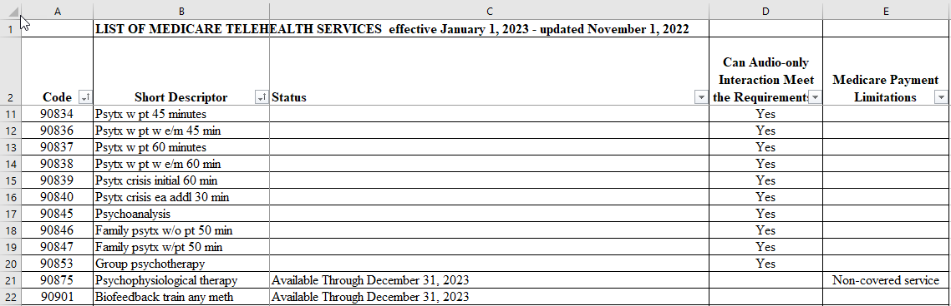
List of Telehealth Services
https://www.cms.gov/Medicare/Medicare-General-Information/Telehealth/Telehealth-Codes

Slide 157
Telehealth
Implementing the 151-day extensions of Medicare telehealth flexibilities in the CAA, 2022, including allowing telehealth services to be provided in any geographic area and in any originating site setting, including the patient’s home
Allowing certain services to be provided via audio-only telehealth, and allowing physical therapists, occupational therapists, speech language pathologists, and audiologists to provide telehealth services.

Slide 158
Telehealth
The CAA, 2022 also delays the in-person visit requirements for mental health services you provide via telehealth until 152 days after the end of the PHE.
For 2023, you should continue billing telehealth claims with the place of service indicator you would bill for an in-person visit and you must use modifier 95 to identify them as telehealth services through the end of CY 2023 or the end of the year in which the PHE ends.

Slide 159
Consolidated Appropriations Act of 2022
The legislation includes provisions to extend and expand telehealth flexibilities for 151 days after the end of the COVID-19 public health emergency. These include:
Expanding originating site to include any site at which the patient is located, including the patient’s home
Expanding eligible practitioners to furnish telehealth services to include occupational therapist, physical therapist, speech-language pathologist and audiologist
Extending the ability for federally qualified health centers (FQHCs) and rural health clinics (RHCs) to furnish telehealth services
Delaying the 6-month in-person requirement for mental health services furnished through telehealth until 152 days after the emergency, including the in-person requirements for FQHCs and RHCs
Extending coverage and payment for audio-only telehealth services
Extending the ability to use telehealth services to meet the face-to-face recertification requirement for hospice care
Requiring the Medicare Payment Advisory Commission to conduct a study on the expansion of telehealth services and to require the Department of Health and Human Services (HHS) Secretary to publicly post data with respect to telemedicine utilization
Senate Passes Omnibus Spending Package with Health Provisions | AHA

Slide 160
Summary Chart
Issue | Change made by budget bill | Difference from current waiver
Patient Location — Geographic | Extension of waiver on the geographic location of patient requirement to continue an additional 151 days after the Public Health Emergency (PHE) is declared over. | No difference from current COVID-19 temporary waiver
Patient Location — Site | Extension of waiver on the site location of patient requirement to continue an additional 151 days after the PHE is declared over. | No difference from current COVID-19 temporary waiver.
Eligible Providers | Allow FQHCs, RHCs, PTs, OTs, Speech-Language Pathologists and Audiologists to continue to be reimbursed for services delivered via telehealth an additional 151 days after the PHE is declared over | Under the current COVID-19 waivers, the category of providers is all eligible Medicare providers.
Audio-Only | Extension of waiver on the use of audio-only as a modality to continue an additional 151 days after the PHE is declared over | No difference from current COVID-19 temporary waiver
Recertification of eligibility for hospice care | Extension of waiver on the use of telehealth to continue to be used an additional 151 days after the PHE is declared over | No difference from current COVID-19 temporary waiver

Slide 162
Medical Review Program and Targeted Probe and Educate
NC HFMA Medicare Workshop

Slide 163
Agenda
Goal of the Medical Review (MR) Program
Comprehensive Error Rate Testing (CERT)
Improper Payment Reduction Strategy (IPRS)/Strategy Analysis Report (SAR) Development
Defining Risks/Analysis
Target Probe and Educate (TPE) Overview
Validation/Analyze/Improve
Questions

Slide 164
Medical Review Program
Designed to reduce/prevent improper payments by preventing payment of claims that do not comply with Medicare’s coverage, coding, payment and billing policies.

Slide 165
Comprehensive Error Rate Testing (CERT)
The Centers for Medicare & Medicaid Services (CMS) calculates the Medicare Fee-for-Service (FFS) improper payment rate through the Comprehensive Error Rate Testing (CERT) program.
Each year, CERT evaluates a statistically valid stratified random sample of claims to determine if they were paid properly under Medicare coverage, coding, and billing rules.

Slide 166
Comprehensive Error Rate Testing (CERT)
Ten highest projected improper payment amount FY 21.
State | Projected Error Rate | Projected Improper Payments
N.C. | 4.5% | $527,311,135
Texas | 13.1% | $435,723,453
Va. | 5.1% | $391,145,629
Okla. | 37.9% | $339,621,149
S.C. | 4.3% | $232,899,360
Fla. | 3.9% | $168,277,409
Ohio | 11.4% | $156,439,551
La. | 17.9% | $150,107,414
Ill. | 5.0% | $73,394,216
Miss. | 9.5% | $53,879,190
The reporting period for this improper payment rate is July 2019 - June 2020.
*North Carolina accounted for the highest projected improper payments (over $527 million), comprising 19.1% of the overall improper payment amount; however, the state also had one of the lowest error rates.

Slide 167
Comprehensive Error Rate Testing (CERT)
Top 10 Type of Service (Part A)
(Sorted by Projected Improper Payment)
Type of Service | Projected Error Rate | Projected Improper Payment
Home Health | 12.5% | $1,042,246,341
Nonhospital based hospice | 5.1% | $496,375,084
Hospital based hospice | 26.1% | $139,768,083
Critical Access Hospital | 27.1% | $134,265,946
Hospital Outpatient | 1.7% | $104,510,974
SNF Inpatient | 5.6% | $71,995,244
Hospital Inpatient (Part A) | 9.3% | $33,310,830
Clinic ESRD | 0.1% | $782,708

Slide 168
Comprehensive Error Rate Testing (CERT)
Top 10 Type of Service DRG (Part A)
(Sorted by Projected Improper Payment)
Part A (Inpatient Hospital PPS) MS-DRG | Projected Error Rate | Projected Improper Payment
Psychoses (885) | 7.2% | $9,158,823
Percutaneous Intracardiac Procedures W/O Mcc (274) | 8.4% | $5,174,164
Degenerative Nervous System Disorders W/O Mcc (057) | 10.1% | $2,665,949
Endovascular Cardiac Valve Replacement & Supplement Procedures W Mcc (266) | 2.3% | $1,624,946
Aicd Generator Procedures (245) | 4.8% | $198,310
Other Skin, Subcut Tiss & Breast Proc W/O Cc/Mcc (581) | 1.8% | $70,120
Simple Pneumonia & Pleurisy W Mcc (193) | 0.1% | $56,332

Slide 169
Comprehensive Error Rate Testing (CERT)
Top 10 Type of Service (Part B)
(Sorted by Projected Improper Payment)
Type of Service | Projected Error Rate | Projected Improper Payment
Lab tests — other (non-Medicare fee schedule) | 19.4% | $63,674,800
Minor procedures — other (Medicare fee schedule) | 11.2% | $47,040,631
Office visits — established | 3.1% | $43,356,694
Ambulatory procedures — skin | 21.2% | $40,248,409
Other drugs | 3.9% | $38,553,008
Minor procedures — musculoskeletal | 23.1% | $33,534,792
Emergency room visit | 17.5% | $31,078,243
Specialist — other | 23.9% | $29,124,060
Eye procedure — cataract removal/lens insertion | 14.5% | $27,762,221
Nursing home visit | 13.8% | $20,870,771

Slide 170
Comprehensive Error Rate Testing (CERT)
Top 10 HCPCS Code (Part B)
(Sorted by Projected Improper Payment)
HCPCS | Projected Error Rate | Projected Improper Payment
Xcapsl ctrc rmvl w/o ecp (66984) | 14.5% | $27,762,221
Emergency dept visit (99285) | 14.4% | $19,761,499
Eye exam&tx estab pt 1/>vst (92014) | 30.7% | $19,532,196
Therapeutic exercises (97110) | 21.3% | $17,130,033
Office o/p est sf 10-19 min (99212) | 25.7% | $15,693,913
Subsequent hospital care (99233) | 14.8% | $14,690,405
Initial hospital care (99223) | 12.6% | $14,195,074
Office o/p est low 20-29 min (99213) | 3.3% | $12,738,839
Drug test def 22+ classes (G0483) | 29.9% | $10,746,180
Therapeutic activities (97530) | 14.9% | $10,359,784

Slide 171
Required by CMS
Problem focused, outcome based operational plan that identifies risks and describes the planned interventions
Prioritized problem list is developed by service type after data analysis has been completed
Once prioritized list has been identified, interventions are implemented to reduce/prevent improper payments
Improper Payment Reduction Strategy (IPRS)

Slide 172
Required by CMS
Midway through the year, assess progress towards achieving the improvement goals outlined in the IPRS
Based on evaluated results can modify or continue with the IPRS plan
Strategy Analysis Report (SAR)

Slide 173
Analysis of data:
Provider, service, & beneficiary specific
Historical claims data
National, Regional, State
Utilization trending/patterns
High volume/cost
Change in frequency
Outliers
Region, State
Defining Risks/Analysis

Slide 174
Evaluation of Other Information:
Reports from CMS & other Government Agencies
Office of Inspector General (OIG)
Government Accountability Office (GAO)
Reports from other Contractors
Comprehensive Error Rate Testing (CERT)
Recovery Auditor
Jurisdiction Specific Prioritization Reports
Defining Risks/Analysis

Slide 175

Targeted Probe and Educate Overview

Slide 176
Previous Medical Review Process
Service specific and provider specific edits
Probe with progression to Targeted Medical Review with percent of claims sampled
Quarterly results reviewed for continuation of edit
Limited interaction with clinical review staff

Slide 177
TPE Purpose
The purpose of TPE is to:
Reduce appeals
Decrease provider burden
Improve the medical review & education process

Slide 178
TPE Background
Targeted Probe and Educate (TPE) began as a pilot program in June of 2016
Paused April 2020
Restarted September 2021
Developed from the Inpatient as well as HH Probe and Educate models
Prior models included participation of all providers with smaller review samples
Current TPE model providers are selected based on data analysis and probe reviews are conducted for 20-40 claims
Previous success was demonstrated by:
Decreased appeals
Increased acceptance of provider education

Slide 179
Targeted Probe and Educate Process
Providers identified by data analysis when developing IPRS described earlier
Up to 3 rounds of probe review
Each round consist of a 20-40 claims for review
One on one education intervention with clinical staff
Allow 45-56 days between education intervention and next round
After each TPE round providers will be reassessed and if compliant will be released and not moved to the subsequent round
Monitor for one year via data analysis with follow-up review if needed

Slide 180
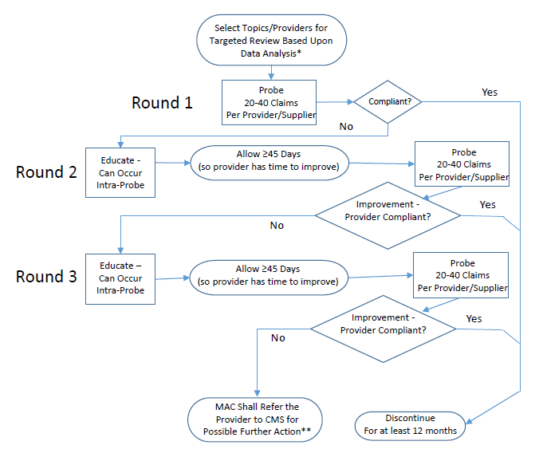
Targeted Probe and Educate Process

Slide 181
Provider Notification
Please ensure the process for routing this information to the person(s) who should receive the notification is timely and effective
If selected for TPE, the provider will receive a notification letter outlining reason for review
Notice of Review – Targeted Probe and Education
Letter will be addressed to the Medicare Provider or Compliance Officer

Slide 182
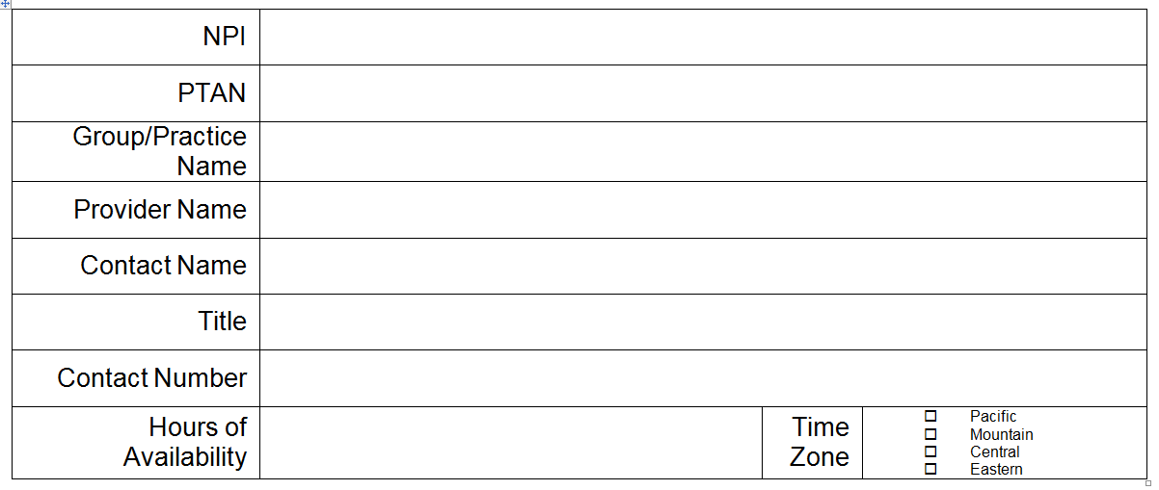
Provider Notification
The interaction between the reviewer and the provider is a key component of the TPE model.
The notification letter will contain a form for providers to designate a point of contact (POC) for the reviewer to contact by phone for any education calls.
This form should be returned with the ADR response

Slide 183
Results and Education
During the probe review, the reviewer may contact the designated POC for any missing information or to provide education on a specific claim or issue identified. If you have submitted a complete documentation package or no education requirement was identified during the probe, the reviewer will not contact you during the probe.
Examples of missing documentation most frequently requiring contact for edits being highlighted today may include (but is not limited to) items listed below.
Outpatient Therapy
Missing certification
Missing progress notes
Missing initial evaluation
Missing plan of care
Missing total therapy minutes
Ambulance (emergent)
Missing signature from beneficiary and receiving facility
Ambulance (non-emergent)
Missing clinical documentation
Missing physician certification statement (PCS)
Missing signature from beneficiary and receiving facility

Slide 184
Results and Education
Upon completion of the 20-40 claim sample, Medical Review will provide you written notification to include your results.
This letter will include the number of claims reviewed, the number of claims allowed in full, the number of claims denied in full or in part and education on the results.
After the written notification has been issued, the Reviewer or Clinical Educator will contact you to schedule a 1:1 educational session via teleconference regarding any errors noted during the claim review.

Slide 185
Validation/Analyze/Improve
Measure
Once risks are identified medical review of claims may be initiated
Validate issues
Targeted Probe and Educate (TPE)
Review of 20-40 claims
Establish benchmarks
Analyze
Review edit effectiveness reports for reviewed claims once universe of claims in the selected sample are completed
Improve/Control
One-on-One provider specific education
Providers with moderate and high error rates will continue to a second round, followed by additional education
Based on results, a provider may be advanced to a third round

Slide 186
Statistics & Error Reporting For Implemented Edits
Navigate
Navigate to Palmetto GBA website
www.Palmetto GBA.com
Select
Select the jurisdiction and line of business
Access
Access the Medical Review Topics list
Populate
Articles will populate on the landing page

Slide 187
Common TPE Questions and Answers
Examples of data analysis that may trigger selection for TPE?
Data is analyzed to identify services that have a high payment error probability and/or present the greatest risk
These services may be identified via previous review activity conducted by the MAC, the CERT contractor, the OIG and other CMS contractors
Once the services are identified, additional data analysis includes (but is not limited to) establishing a baseline to identify unusual trends such as provider’s rank against peers and changes in utilization over time

Slide 188
Common TPE Questions and Answers
When were the first TPE notification letters mailed?
Initial TPE notification letters were mailed back in September 2021 (TPE Restart)
As new providers and topics are identified, additional notifications are mailed
TPE probes and rounds are specific to a provider and each provider is treated independently

Slide 189
Common TPE Questions and Answers
Who conducts the TPE reviews?
Registered Nurses
Certified Coders
Physical Therapists

Slide 190
Common TPE Questions and Answers
Is there a documented threshold to determine if the provider should move to the next round?
Each MAC evaluates the TPE probe claim denial or charge denial rate against an established threshold at the conclusion of each probe round.
Providers with error rates that exceed the established threshold may be progressed to the next round
Notes:
If a claim denial rate or charge denial rate — either one is greater than 20 percent you may progress to the next round.

Slide 191
Common TPE Questions and Answers
Who should participate in the 1:1 education?
There are no requirements for who should participate
Anyone the organization chooses to participate in the call is welcome
Recommend including participant(s) that can benefit from the education and can facilitate implementation of any necessary changes

Slide 192
Common TPE Questions and Answers
What is the process to appeal a TPE denial?
The appeal’s process has not changed due to TPE
If you have a review determination during TPE that results in a claim denial, we encourage you to review the medical records you submitted, and if you disagree with that determination — you should follow the established appeal’s process.

Slide 193


Slide 194
Resources
CMS IOM : https://www.cms.gov/Regulations-and-Guidance/Guidance/Manuals/Internet-Only-Manuals-IOMs.html
100-02 Medicare Benefit Policy Manual
Chapter 10
Chapter 15
100-08 Medicare Program Integrity Manual
Chapter 3
Chapter 7
CR 10249: https://www.cms.gov/Regulations-and-Guidance/Guidance/Transmittals/2017Downloads/R1919OTN.pdf
TPE Flowchart: https://www.cms.gov/Research-Statistics-Data-and-Systems/Monitoring-Programs/Medicare-FFS-Compliance-Programs/Medical-Review/Downloads/TPE-Pilot-Flow-chart06-20-17v9-final.pdf
CMS TPE Strategy Article: https://www.cms.gov/Research-Statistics-Data-and-Systems/Monitoring-Programs/Medicare-FFS-Compliance-Programs/Medical-Review/Targeted-Probe-and-EducateTPE.html
CERT Reports: https://www.cms.gov/Research-Statistics-Data-and-Systems/Monitoring-Programs/Medicare-FFS-Compliance-Programs/CERT/CERT-Reports.html

Slide 195
Submitting Claims Electronically

Slide 196
Agenda
EDI Acronyms
EDI Enrollment Options
How to Enroll
EDI Self Service Tools
System Security
How to Contact EDI

Slide 197
EDI Acronyms
EDI — Electronic Data Interchange — sending and receiving data files electronically: claims, remittances, reports
Submitter/Receiver ID — Unique id used by providers and clearinghouses to submit and receive data files directly from us
GPNet — Palmetto GBA’s front end system for sending and receiving data files
837 file — claims batched together into one file and submitted
277CA Report — Claim Acknowledgement Report generated through GPNet that provides claim rejections or acceptance
835/ERA — Electronic Remittance Advice: electronic file of remittances
DDE ID — Direct Data Entry ID – unique id assigned to an individual to access the standard processing system to key and correct Part A claims
eServices — Palmetto GBA’s provider portal
PCC — Provider Contact Center or Customer Service

Slide 198
EDI Enrollment Options and Enrolling
Submit claims electronically directly or through a clearinghouse
Receive 277CA Reports showing acceptance or rejections
Receive remittances electronically
Part A providers may key and correct claims directly into the processing system using DDE IDs
Part B providers(only) may submit claims through eServices
Claim Status and Eligibility may be checked using the eServices portal among many other eServices options

Slide 199
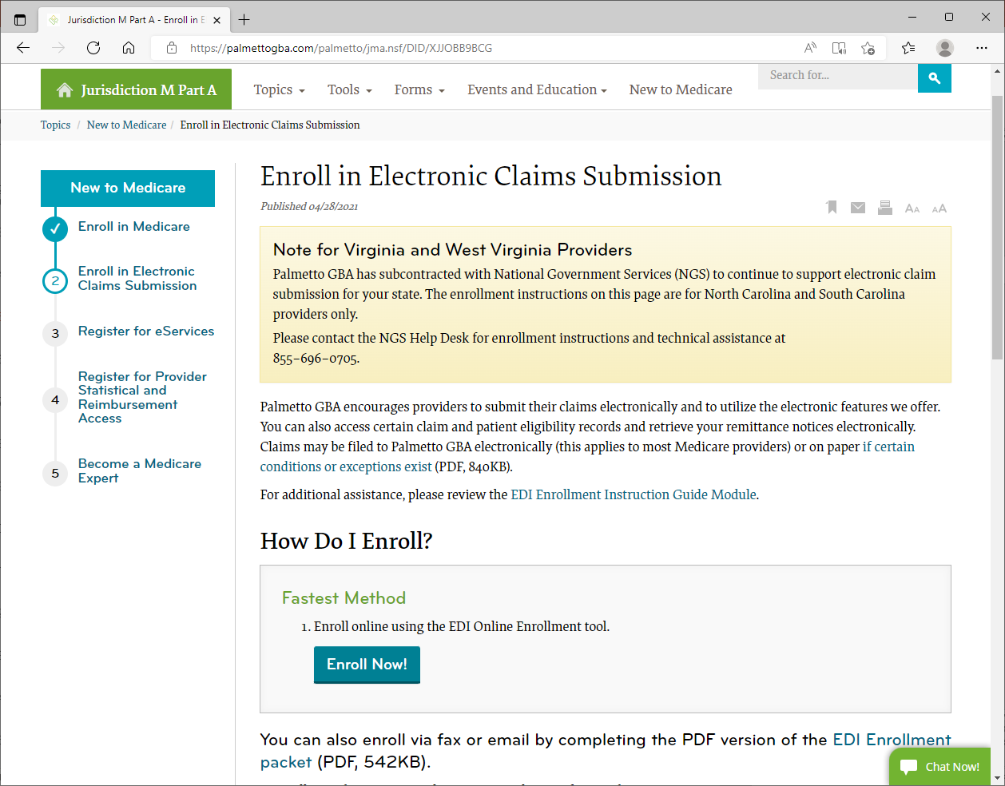
New Providers
Follow the instructions on our website to enroll in EDI to submit claims, receive remittances, and check claim status

Slide 200
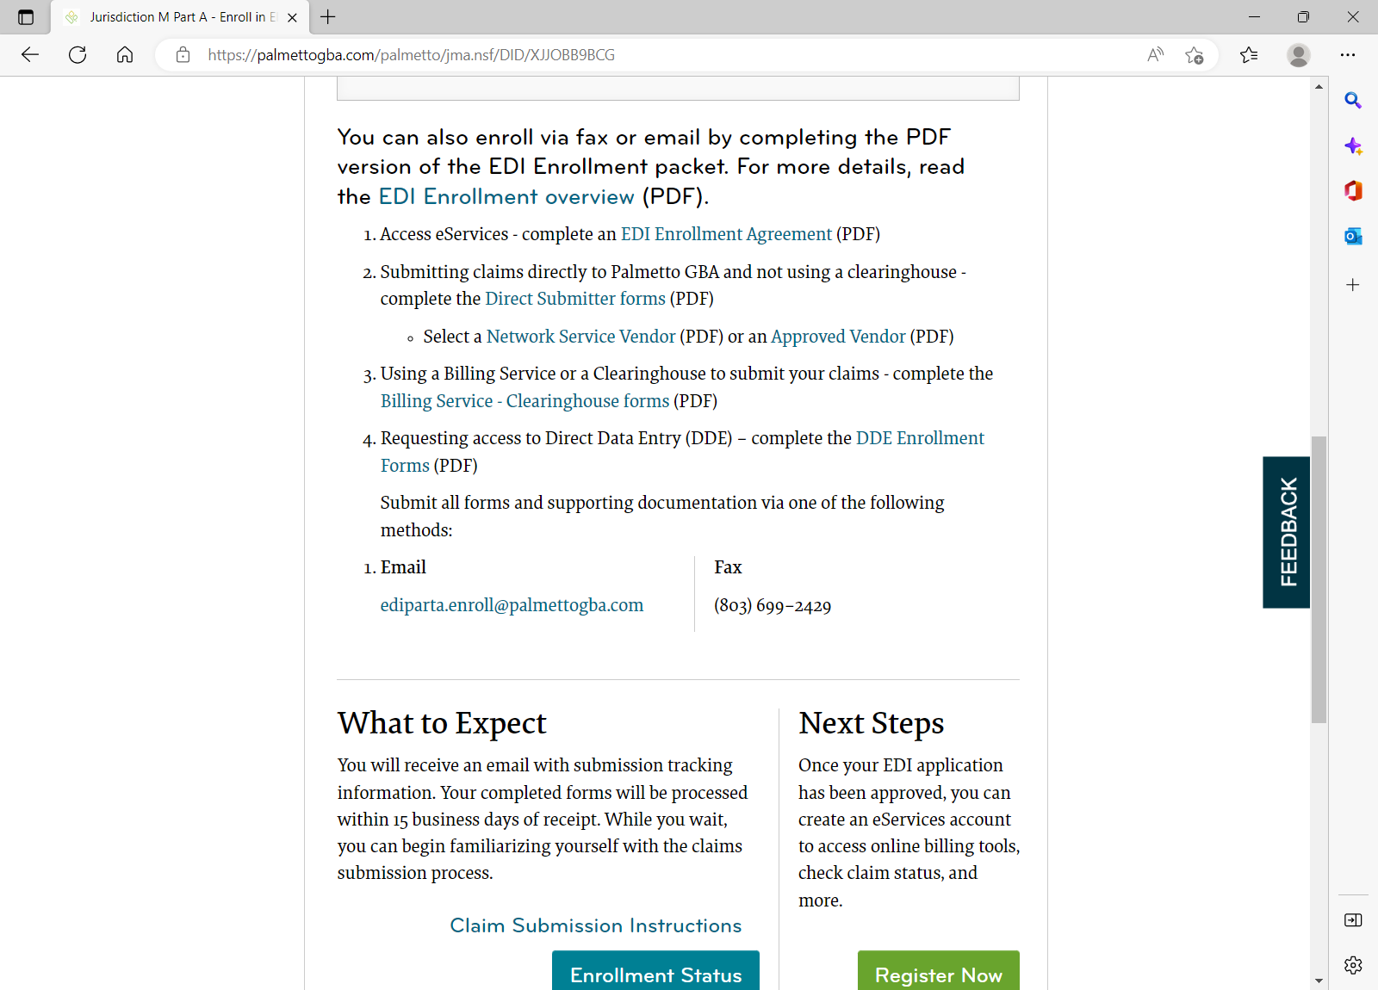
EDI Enrollment
Providers may complete the online forms or fill out the PDF forms and fax or email them in
Providers will receive email notification upon completion

Slide 201
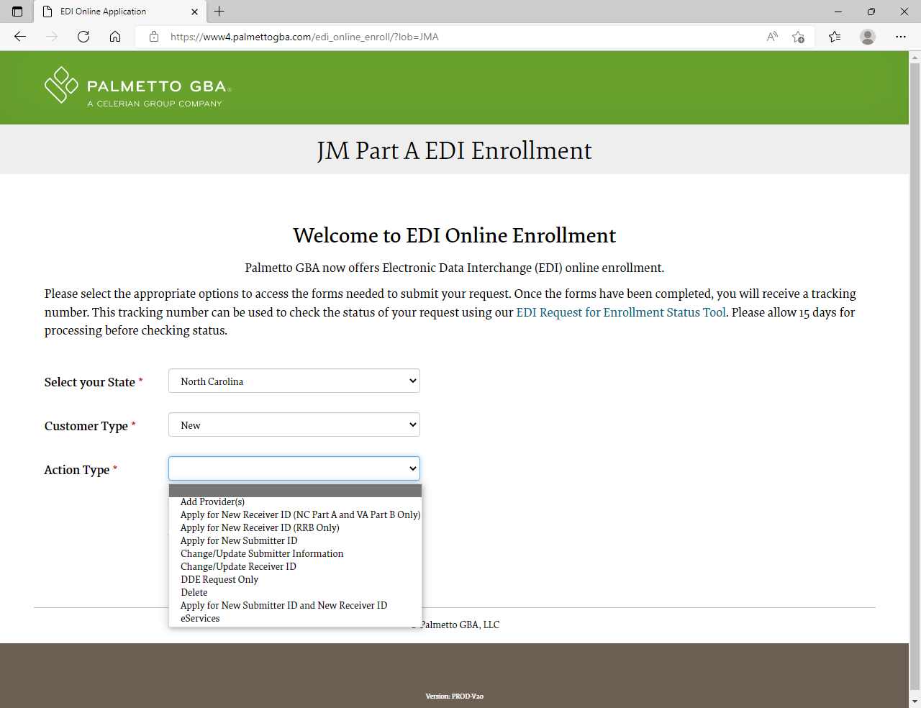
Online Enrollment Forms
Available for JJ and JM Part A and Part B Providers
Drop-down menus provide options on each screen
Screens will guide you through the process
Performs PTAN and NPI validation based on contract
Tracking numbers are provided upon submission to track the processing status

Slide 202
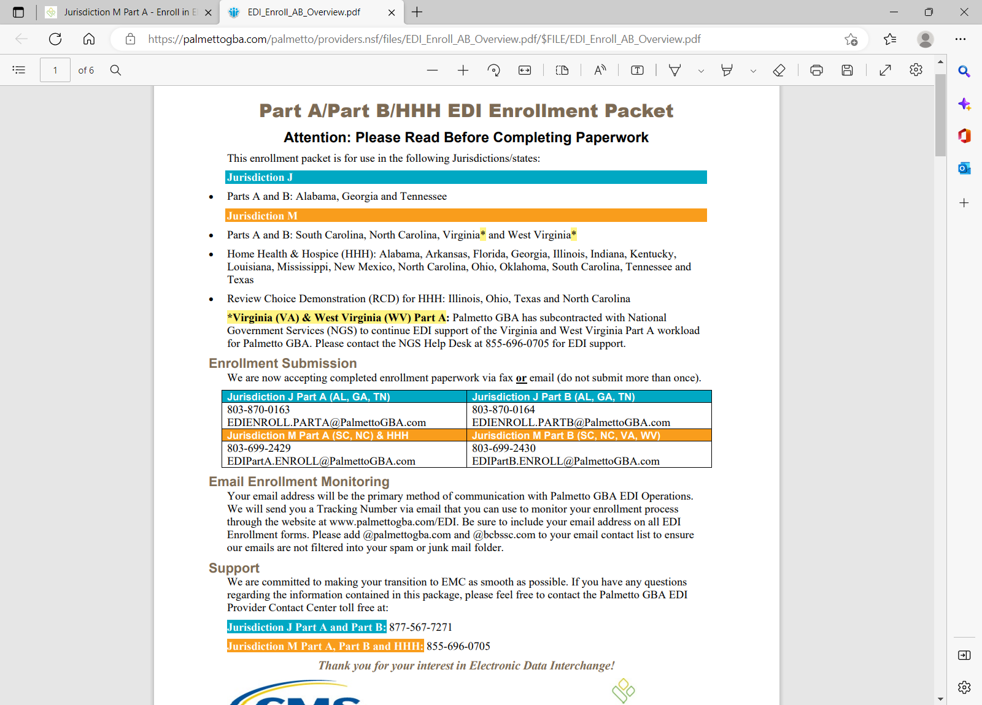
Enrollment Forms PDF version
The PDF version is interactive and can be completed and faxed or emailed in
Instruction guide is attached to the packet to assist with completing the individual forms

Slide 203
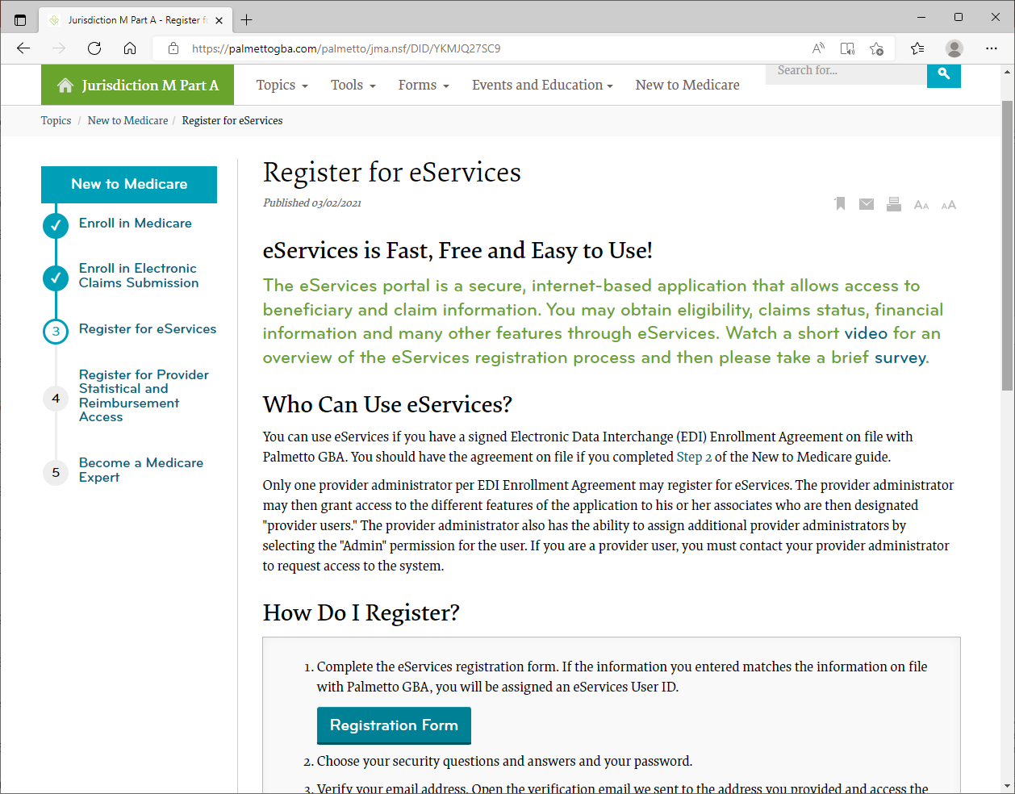
eServices Registration
Requires provider to have an EDI Enrollment Agreement on file.

Slide 204
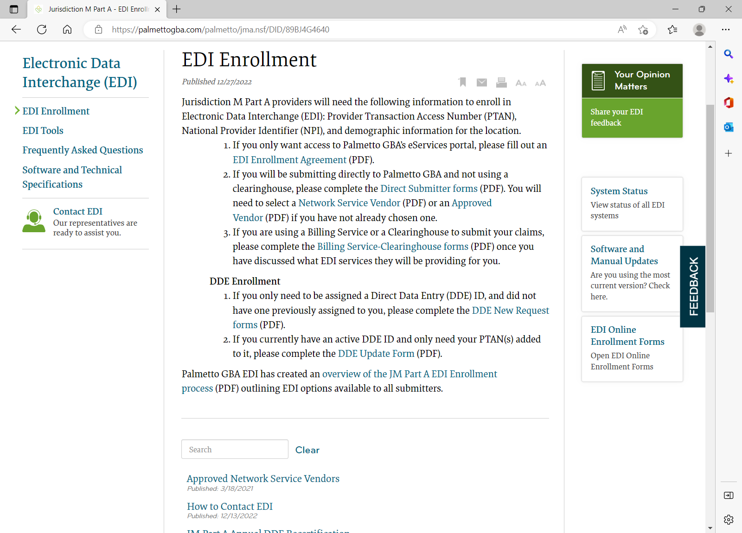
EDI Enrollment for Existing Providers
The EDI Enrollment section of the website has been updated to reflect more streamlined instructions for making EDI changes.

Slide 205
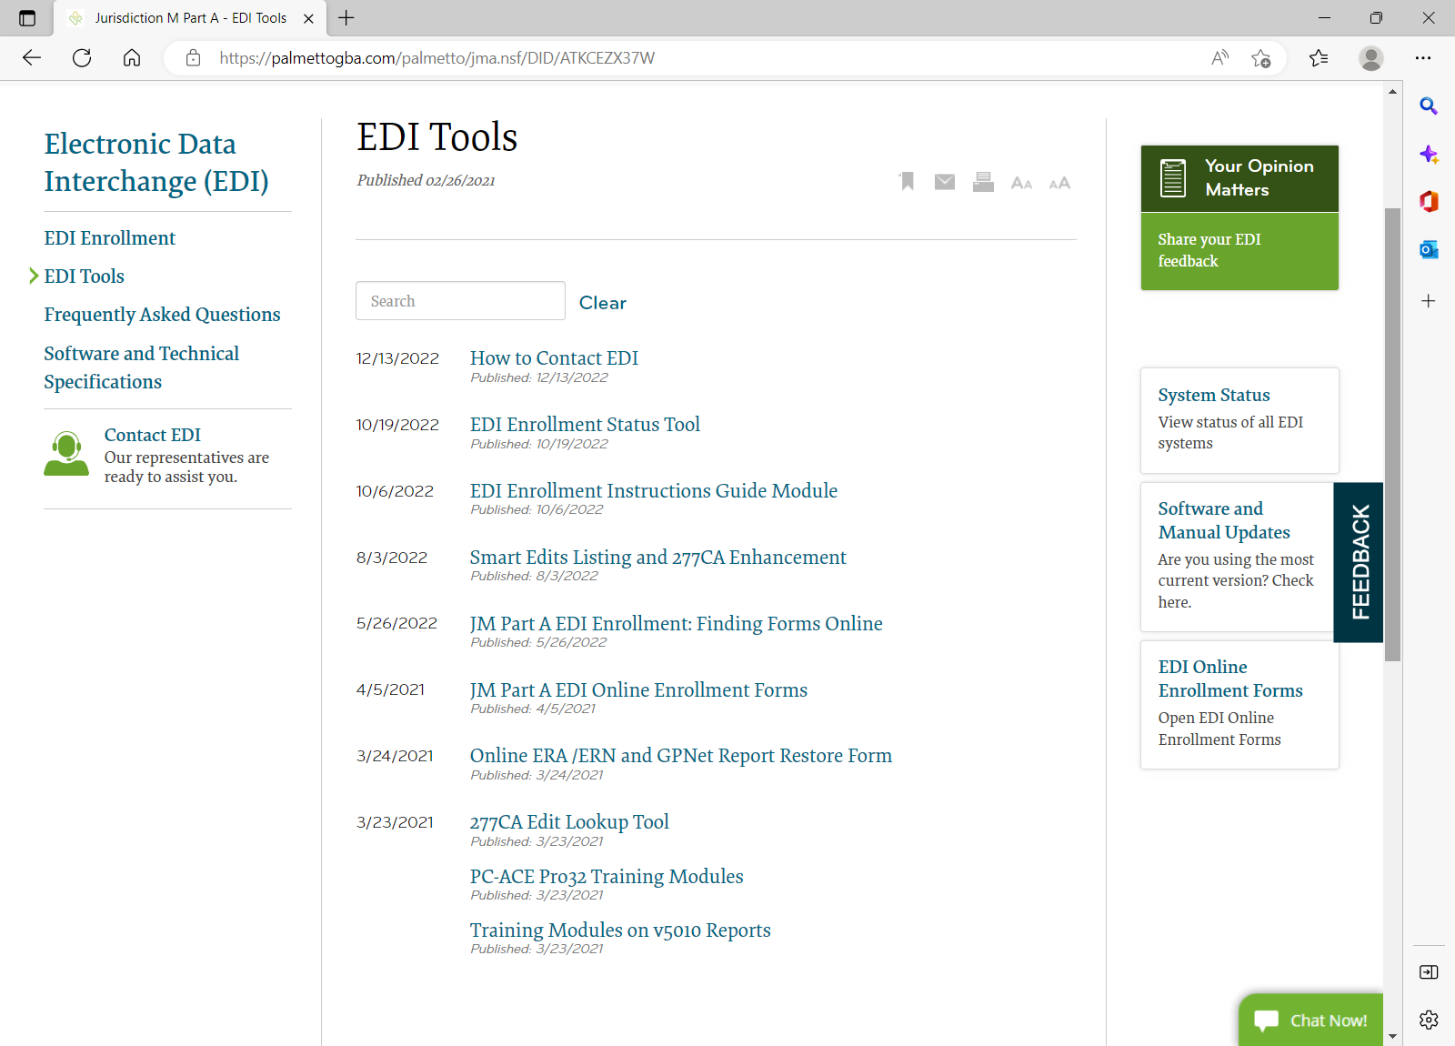
Self Service Tools
Various EDI Self Service Tools are available on the website including GPNet System Status, Smart Edit and GPNet Front End Error Lookups, understanding how to read a 277CA Report, tracking EDI Enrollment.

Slide 206
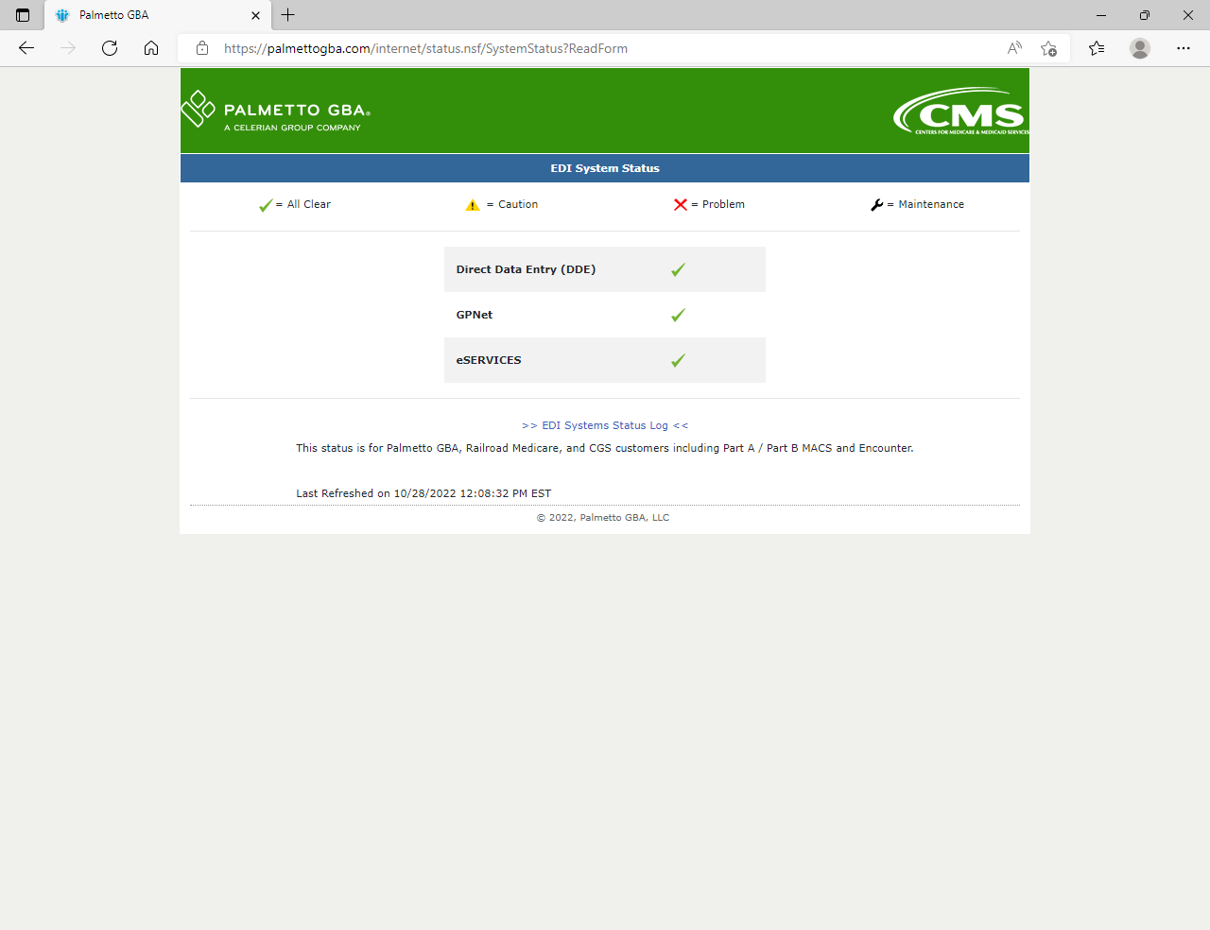
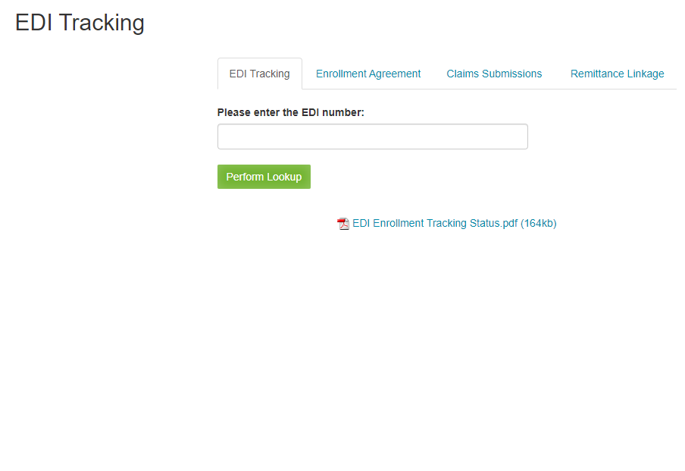
Tools Examples
EDI System Status
EDI Enrollment Status Tool

Slide 207
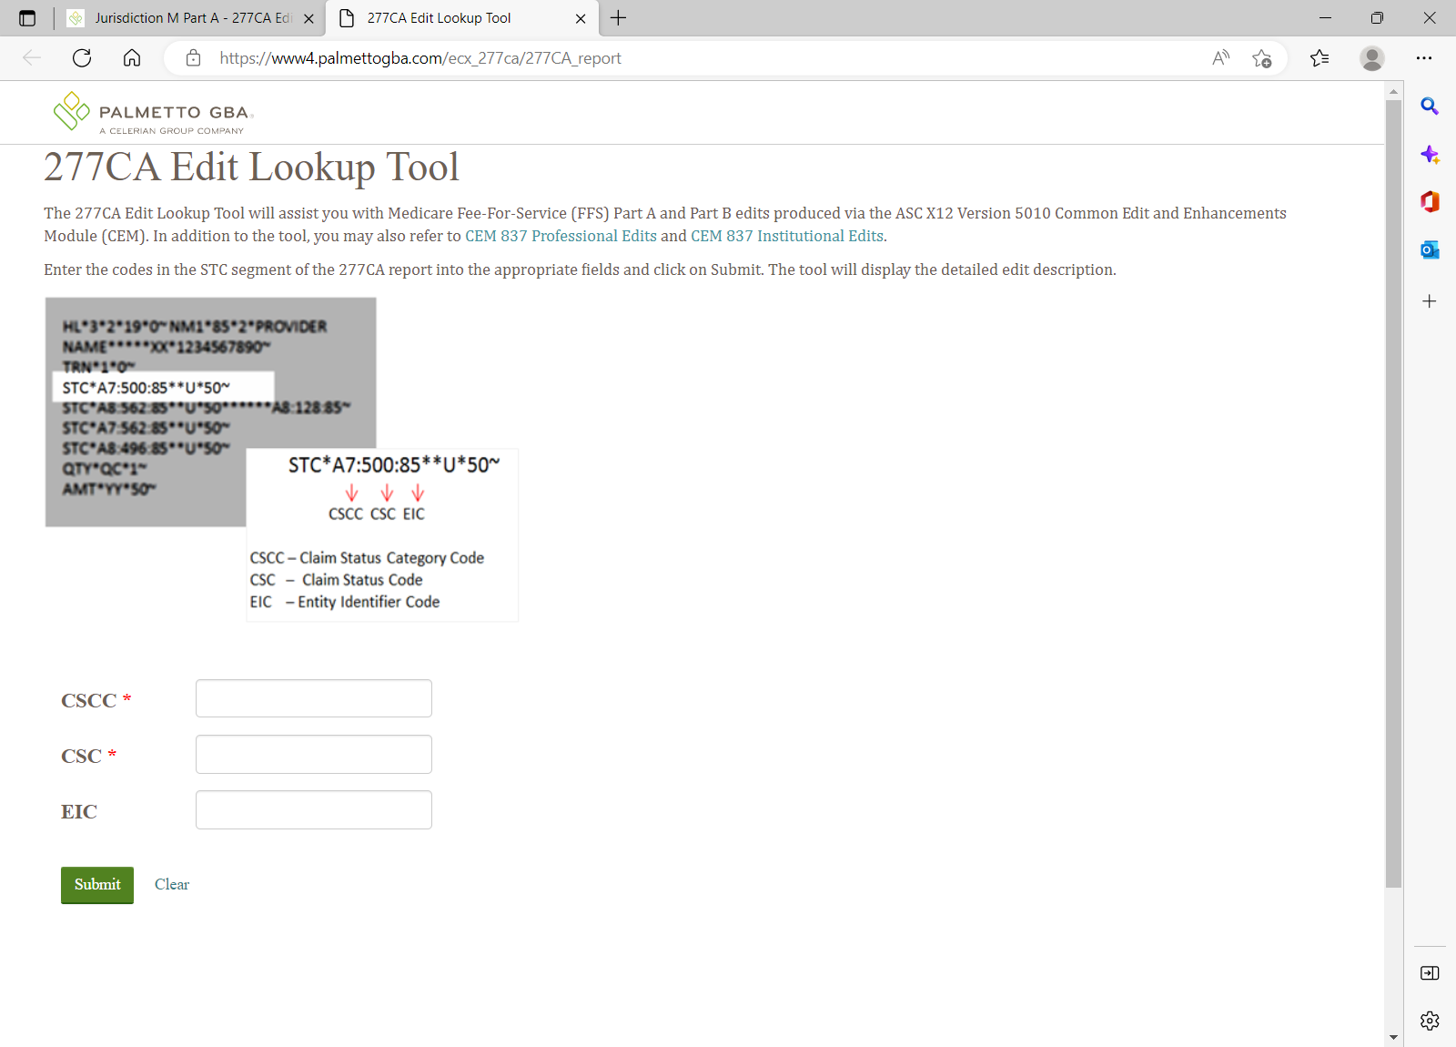
277CA Edit Lookup Tool
Allows you to key in rejection codes from the 277CA Report and displays detailed information about the edit.

Slide 208
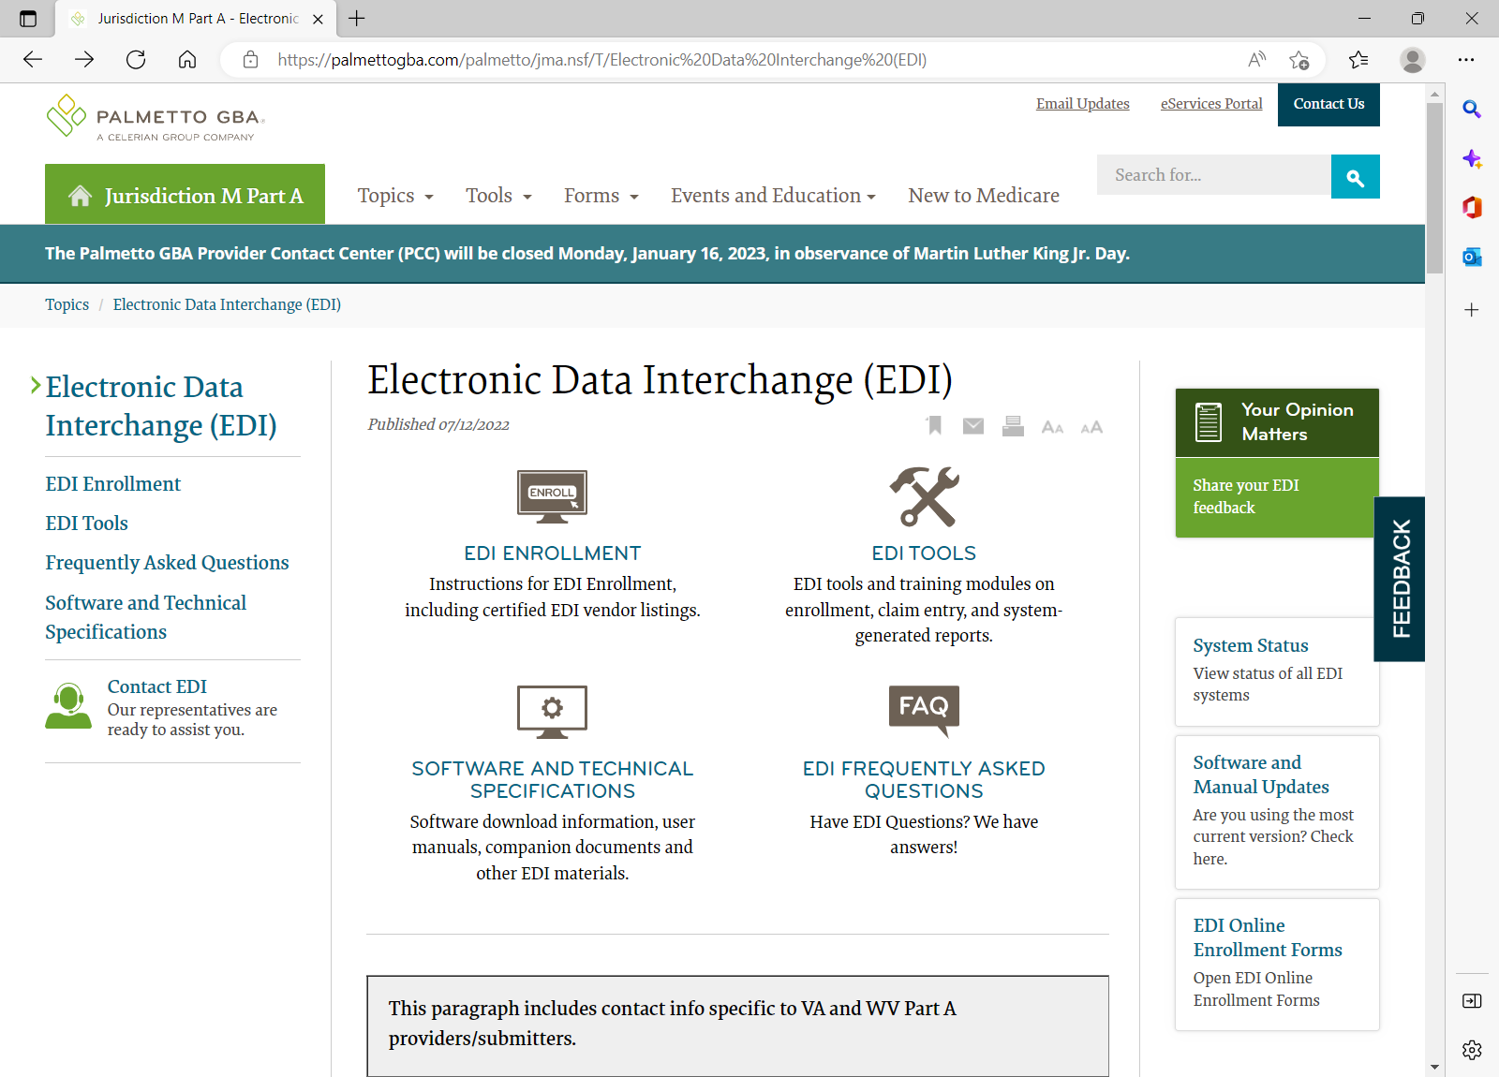
EDI Can Assist
When Providers Need to:
Change Clearinghouses
Update your DDE ID
Update the EDI Contact
Check the status of an EDI Application
Get assistance with understanding GPNet errors
Look up a GPNet error message
Look up a Smart Edit error message
Get a missing 277CA Report restored
Get an 835 remit file restored
Know if all systems are available and running on time – GPNet, eServices, DDE

Slide 209
System Security
All DDE and eServices IDs are assigned to individuals and cannot be shared with other people
If an ID is shared it will be deleted
All IDs are required to be certified and if they are not, they will be deleted
Individuals must respond to emails from the Palmetto GBA security team to avoid their id being deleted

Slide 210
EDI Contact Information
Notify EDI if the following has changed:
New EDI contact
Phone number
Email account
Address
DDE ID no longer employed or needed

Slide 211
Contact EDI
Call our EDI Helpdesk :
JJ 877-567-7271
JM 855-696-0705
Please listen carefully to the menu prompts
Retain all EDI ticket numbers from calls to the EDI Helpdesk
Email general EDI questions or report an issue:
Medicare.edi@Palmettogba.com
eChat any EDI questions to EDI staff

Slide 212
EDI Survey
Please provide your contact information so we can follow up on your EDI concerns or suggestions
Can be found on any EDI page

Slide 213
Part A/B Audit and Reimbursement
NC HFMA Medicare Workshop

Slide 214
Agenda
Agenda
S-10 Audits
Cost Report Reopenings
General Updates

Slide 215
The content in this presentation is intended for JM providers and is current as of January 10, 2020. Any changes or new information superseding this information is provided in articles with publication dates after January 10, 2020, at: www.Palmettogba.com.
Disclaimer
CPT® only copyright © 2019 American Medical Association. All rights reserved.
215

Slide 216
S-10 Audits
216

Slide 217
S-10 Audits
Section 3133 of the Affordable Care Act amends the Medicare DSH adjustment provision under section 1886(d) (5) (F) of the Act and establishes 1886(r) which provides for an additional payment for a hospital’s uncompensated care
Effective for discharges occurring on or after FY 2014, hospitals will receive 25 percent of the amount they previously would have received under the current statutory formula for Medicare DSH. The remaining 75 percent will become available for an uncompensated care (UCC) payment.

Slide 218
S-10 Audits
In the Fiscal Year (FY) 2018 Inpatient Prospective Payment System (IPPS) Final Rule, CMS finalized that uncompensated care data from the Medicare Cost Report Worksheet S-10 would be incorporated into Factor 3 of the Disproportionate Share Hospital Uncompensated Care Payment (DSH UCP)
In 2018, MACs began conducting audits of Worksheet S-10 on a CMS selection of FY 2015 cost reports. The CMS selection of S-10 Audits continued in 2019 for FY 2017 cost reports.
In 2020, CMS instructed MACs to proceed with conducting S-10 Audits for all hospitals eligible for DSH on an annual basis. The audits of the full eligible population began for FY 2018 cost reports.

Slide 219
S-10 Audits
Common Issues & Adjustments
Duplicates in the charity and bad debt listings
Incomplete or unclear supporting documentation for sample selections
Documentation insufficient to support write-offs
Misclassification of insured vs uninsured

Slide 220
S-10 Audits – Charity Care Charges and Uninsured Discounts (Line 20)
For cost reporting periods beginning on or after October 1, 2016, and for subsection (d) Puerto Rico hospitals under §1886(n)(6)(B) beginning on or after October 1, 2020, through cost reporting periods beginning prior to October 1, 2022, enter the actual charge amounts for the entire facility for patients, including uninsured patients who were given full or partial discounts that were determined in accordance with the hospital’s charity care criteria/policy or Financial Assistance Policy, and written off during this cost reporting period, regardless of when the services were provided.
Effective for cost reporting periods beginning on or after October 1, 2018, a cost report is rejected when submitted without listings supporting the charity care amounts claimed on line 20 (42 CFR 413.24(f)(5))
For cost reporting periods beginning on or after October 1, 2022, see Exhibit 3B (Charity Care Listing Instructions and Form) of PRM 15-2, Chapter 40

Slide 221
S-10 Audits – Charity Care Charges and Uninsured Discounts (Line 20)
Column 1 – Uninsured Patients
Total charges, or the portion of the total charges for uninsured patients
Total charges, or the portion of total charges for patients with coverage from an entity/insurer that does not have a contractual relationship with the provider
Total charges, or the portion of total charges for insured patients that were determined uninsured for the entire hospital stay
Charges for non-covered services provided to patients eligible for Medicaid or other indigent care programs, if such inclusion is specified in the hospital’s charity care policy or FAP and the patient meets the hospital's policy criteria.
The total charges or the portion of total charges is the amount the patient is not responsible for paying.

Slide 222
S-10 Audits – Charity Care Charges and Uninsured Discounts (Line 20)
Column 2 – Insured Patients
Enter the sum of amounts written off to charity care
Deductible and coinsurance required by the payer for insured patients covered by a public program or private insurer with which the provider has a contractual relationship
Non-covered charges for days exceeding a length-of-stay limit for patients covered by Medicaid or other indigent care programs, if such inclusion is specified in the hospital’s charity care policy or FAP and the patient meets the hospital's policy criteria (such amounts must also be included on line 25)

Slide 223
S-10 Audits – Charity Care Charges and Uninsured Discounts (Line 20)
Do not include in columns 1 or 2:
Amounts that do not meet the hospital’s charity care policy of FAP
Medicaid shortfalls, contractual allowances, or amounts for patients given courtesy allowances
Deductible and coinsurance amounts claimed as Medicare bad debts
Charges for physician and other professional services
Charges reported in a previous cost reporting period

Slide 224
S-10 Audits – Bad Debt Amount (Line 26)
For cost reporting periods beginning prior to October 1, 2022, enter the amount of bad debts (Medicare bad debts and non-Medicare bad debts), net of recoveries, written off during this cost reporting period on balances owed by patients for the entire facility regardless of the date of service. Do not include:
Bad debts for physician and other professional services
Amounts from line 20
Amounts for privately insured patients that were the obligation of an insurer rather than the patient

Slide 225
S-10 Audits – Bad Debt Amount (Line 26)
For cost reporting periods beginning on or after October 1, 2022, enter the amount of Medicare and non-Medicare bad debts/implicit price concessions (pursuant to the Accounting Standards Update, Topic 606) written off during this cost reporting period, net of recoveries, that relate to balances owed by patients, regardless of the date of service, for the entire facility. Submit Exhibit 3C (Listing of Total Bad Debts Instructions and Form) of PRM 15-2, Chapter 40 to support the bad debt amount claimed. Do not include:
Bad debts for physician and other professional services
Amounts from line 20
Amounts for privately insured patients that were the obligation of an insurer rather than the patient

Slide 226
S-10 Audits – Bad Debt Amount (Line 26)
Do not include in columns 1 or 2:
Amounts that do not meet the hospital’s charity care policy of FAP
Medicaid shortfalls, contractual allowances, or amounts for patients given courtesy allowances
Deductible and coinsurance amounts claimed as Medicare bad debts
Charges for physician and other professional services
Charges reported in a previous cost reporting period

Slide 227
Cost Report Reopenings
227

Slide 228
Cost Report Reopenings
Cost Report Reopening Request
Once a cost report is finalized you may not amend the report but can reopen.
Request must be received within 3 years of the original NPR
Must be greater than $10,000 unless related to a payment error by the MAC
Supporting documentation should be sent with the reopening request, this includes logs of additional days or bad debts.
The financial impact of the request and all individual issues should be stated in the request letter.
If a consultant or outside party is filing a reopening request on the provider’s behalf, Palmetto GBA requires a letter authorizing communication with that entity.
Reopening requests and supporting information should be sent to JMaudit.reopening@palmettogba.com

Slide 229
Cost Report Reopenings
A common mistake is to include an issue in the summary or calculation supporting workpapers and exclude from the reopening letter. Please ensure all issues are clearly stated in the reopening request letter.
The palmetto website has information under the audit location at Jurisdiction M Part A — Audit (palmettogba.com)
If you have questions, you may reach our reopening supervisors at Rick.McLain@palmettogba.com or Deborah.Scott@palmettogba.com

Slide 230
General Updates
230

Slide 231
General Updates
Medicare Cost Report e-Filing
MCReF has been in operation since May 2018 with cost report submission
It is both a CMS and MAC goal to expand the use of the MCReF system. Efforts have been made to improve e-filing functionality and to increase transparency to provider through cost report tracking.
In April 2020 MCReF functionality was enhanced to allow Part A providers to track their cost reports through the settlement process. The MCReF Home page has been updated to provide a summary of cost report activity.
Future Enhancements include having access to retrieve A&R correspondence, rate reviews, tentative settlements and NPRs.

Slide 232
General Updates
Palmetto GBA is pleased to offer eServices, our free Internet-based, provider self-service portal. The eServices application provides the opportunity to upload documentation to Palmetto GBA A&R.
Only one provider administrator per PTAN/NPI combination performs the registration process. The provider administrator grants permissions to additional users and administrators related to that PTAN/NPI combination.

Slide 233
General Updates
Palmetto GBA is looking for ways to improve the provider’s audit and reimbursement experience. Provider surveys are linked in the notification letters for NPRs, Rate Reviews, and RNPRs.
Survey results are reviewed weekly to identify strengths and opportunities.

Slide 234
Contact Information
PalmettoGBA.com
Provider Contact Center: 855–696–0705
Cost Report Review: JMCostReport@palmettogba.com
S-10 Audit Review: JMS10@palmettogba.com
Wage Index: CostReport.WageIndex@palmettogba.com
Rate Reviews, Tentative Settlements, CCR: JMReimbursement@palmettogba.com
Cost Report Receipt, Acceptance: STAR@palmettogba.com
Cost Report Reopening: JMAudit.Reopening@palmettogba.com
Cost Report Appeals: JMAudit.Appeal@palmettogba.com

Slide 235
Management Contact
Arteya Robinson, Director of Audit arteya.robinson@palmettogba.com
(803) 382–6166
Francee Sams, Audit Manager francee.sams@palmettogba.com
Chrissy Sturm, S-10 Audit Manager
christina.sturmmatthews@palmettogba.com
Tammy Holmes, Reopening/Appeals Manager tammy.holmes@palmettogba.com

Slide 236
Management Contact
Donna Salais, Director of Reimbursement donna.salais@palmettogba.com
(803) 763–6603
Melissa Carpenter, Reimbursement Manager melissa.carpenter@palmettogba.com
Sherry Robertson, Reimbursement Manager sherry.robertson@palmettogba.com

Slide 238
Managing Medicare Overpayments
NC HFMA Medicare Workshop

Slide 239
Agenda
Voluntary Refunds
Credit Balance Reports
Utilizing Online Overpayment Recovery Tools
Overpayment lookup
Green mail demand letters
eCheck
eOffset

Slide 240

Voluntary Refunds
Medicare Overpayments — Submitting a Voluntary Refund

Slide 241
Voluntary Refunds
When would I need to submit a voluntary refund?
A voluntary refund should be made to Medicare any time an overpayment has been identified by a provider. Overpayments are Medicare funds that a provider, physician, supplier or beneficiary has received in excess of amounts due and payable by Medicare.
How do I submit a voluntary refund?
Providers are strongly encouraged to submit voluntary refunds electronically using the eCheck feature within the Financial Tools section of Palmetto GBA’s eServices. The eCheck function allows payments to be sent electronically to Palmetto GBA. Voluntary refunds can be submitted by using the eCheck option and selecting the option within the eCheck form indicating the payment is not associated with a demand letter. A copy of the voluntary refund form and any other relevant documents must be uploaded and attached to the eCheck to assist in processing. Once submitted, you will receive a confirmation from Palmetto GBA indicating that the payment has been received. For more information, please review the Financial Tools section in the eServices user manual (PDF, 8.25 MB). **eCheck review to follow in this presentation
Providers may also mail a check payable to Palmetto GBA or Medicare, the completed applicable voluntary refund form, and any relevant documentation to the address listed at the bottom of the applicable voluntary refund form. Please visit our website at Palmettogba.com to locate the forms.
What happens when I submit a voluntary refund?
If all information is provided the claim(s) reported will be adjusted and your voluntary refund check will be applied to the overpayment created from the claim adjustment

Slide 242
Voluntary Refunds
Additional Information
If you are refunding an overpayment for multiple claims, you may attach a listing of the individual claim details so that you do not have to complete a new form for each claim. Remember to include all of the data elements listed on the voluntary refund form in the claim listing.
Part A and Part B voluntary refunds should be submitted separately with the corresponding voluntary refund form to ensure proper processing
Voluntary refunds for Medicare Secondary Payer (MSP) situations must include a copy of the primary insurers Explanation of Benefits (EOB) to ensure proper processing
Separate voluntary refund forms are available for MSP and non-MSP situations to ensure sufficient information is received to process the voluntary refund
All claims adjusted as a result of the voluntary refund request will be reflected on the Medicare Remittance Advice
Voluntary refunds cannot be collected via an immediate offset request. Payment must be submitted with a voluntary refund.
To ensure accurate and timely processing, please avoid handwritten information when completing the form
Links to Refund Forms
Non-MSP Voluntary Refund Form (PDF, 772 KB)
MSP Voluntary Refund Form (PDF, 708 KB)
CMS Regulation References
Publication 100-05
Publication 100-06, Chapter 5, Section 410 (PDF, 5.72 MB)

Slide 243

Credit Balance Reports

Slide 244
Credit Balance Reports
Overview
The quarterly Credit Balance Reports (CMS-838) are due within 30 days of the end of each calendar quarter. The credit balance report is used to disclose Medicare credit balance amounts due from the provider to Medicare as of the last day of each quarter. Generally, when a provider receives an improper or excess payment for a claim, it is reflected in their accounting records (patient accounts receivable) as a "credit." Credit balances should only be reported at the end of the quarter if the provider has not repaid the amount to Medicare through a voluntary refund, has not received a remittance advice indicating that the adjustment associated with the credit has been adjudicated, or has not received a demand letter for the credit balance amount.
The CMS guidelines governing these processes can be found on the CMS website under Publication 100-06 – Medicare Financial Management Manual, Chapter 12 (PDF, 201 KB).
Palmetto GBA is committed to helping providers understand the credit balance process. For more information and the options available to you, please refer to the Palmetto GBA website, Topics, Credit Balance Reporting (CMS-838).

Slide 245
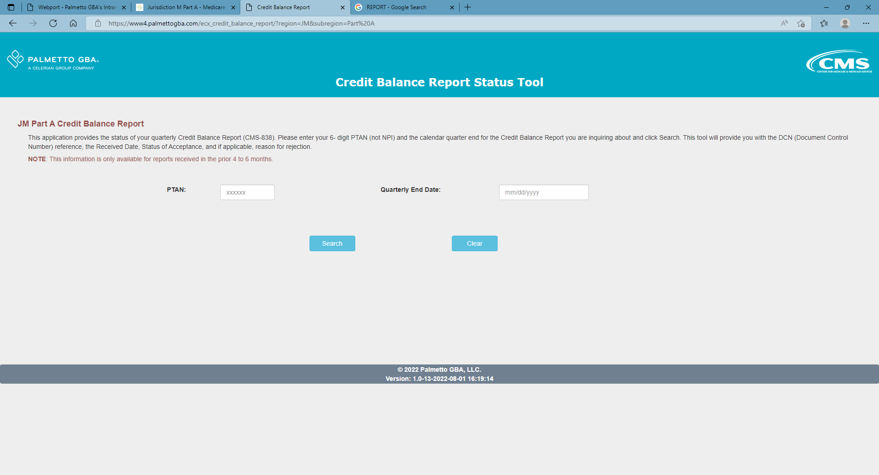
Credit Balance Reports
Can the quarterly Credit Balance report be submitted via eServices?
Yes! Palmetto GBA is pleased to offer providers the capability to submit their quarterly Credit Balance Reports in eServices. You may access the form in the Financial Forms section located under the Financial Tools tab in eServices. Choose the "CMS-838 Credit Balance" option from the Select a Form dropdown menu.
Complete the form and attach the actual Credit Balance Report that you would typically fax or mail.
Once the form is submitted, you will receive a message in your message inbox that the form was submitted successfully. The message will be updated with the DCN when the form is received by Palmetto GBA and has begun to be processed. If a form is submitted over the weekend or on a holiday, the DCN may not be assigned until the next business day
Under Tools, select Credit Balance Report Status Tool. Simply enter in your PTAN and the quarter-end date to retrieve a response.

Slide 246

eServices
Utilizing Overpayment Online Portal
Overpayment Lookup
Greenmail for Demand Letters
eCheck
eOffset
It’s all right there!

Slide 247
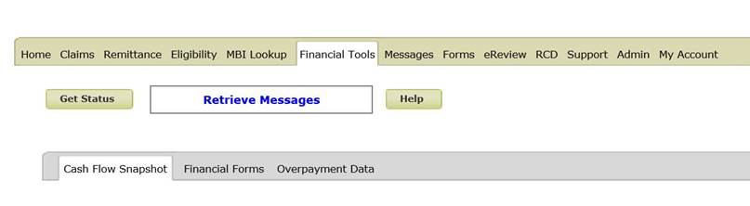
Overpayment Lookup
Log in to eServices https://www.onlineproviderservices.com/ecx_improvev2/
Once on the Financial Tools menu, click on Overpayment Data tab

Slide 248
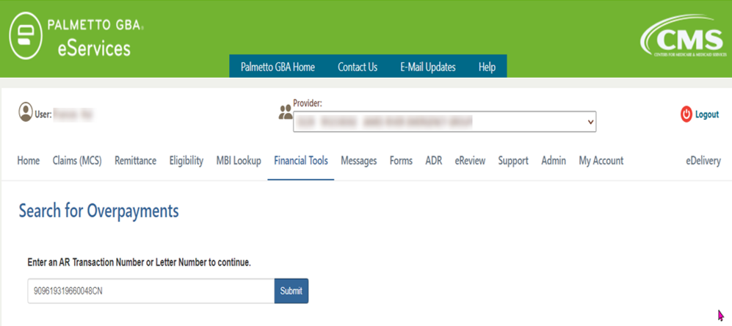
Overpayment Lookup (continued)

Slide 249
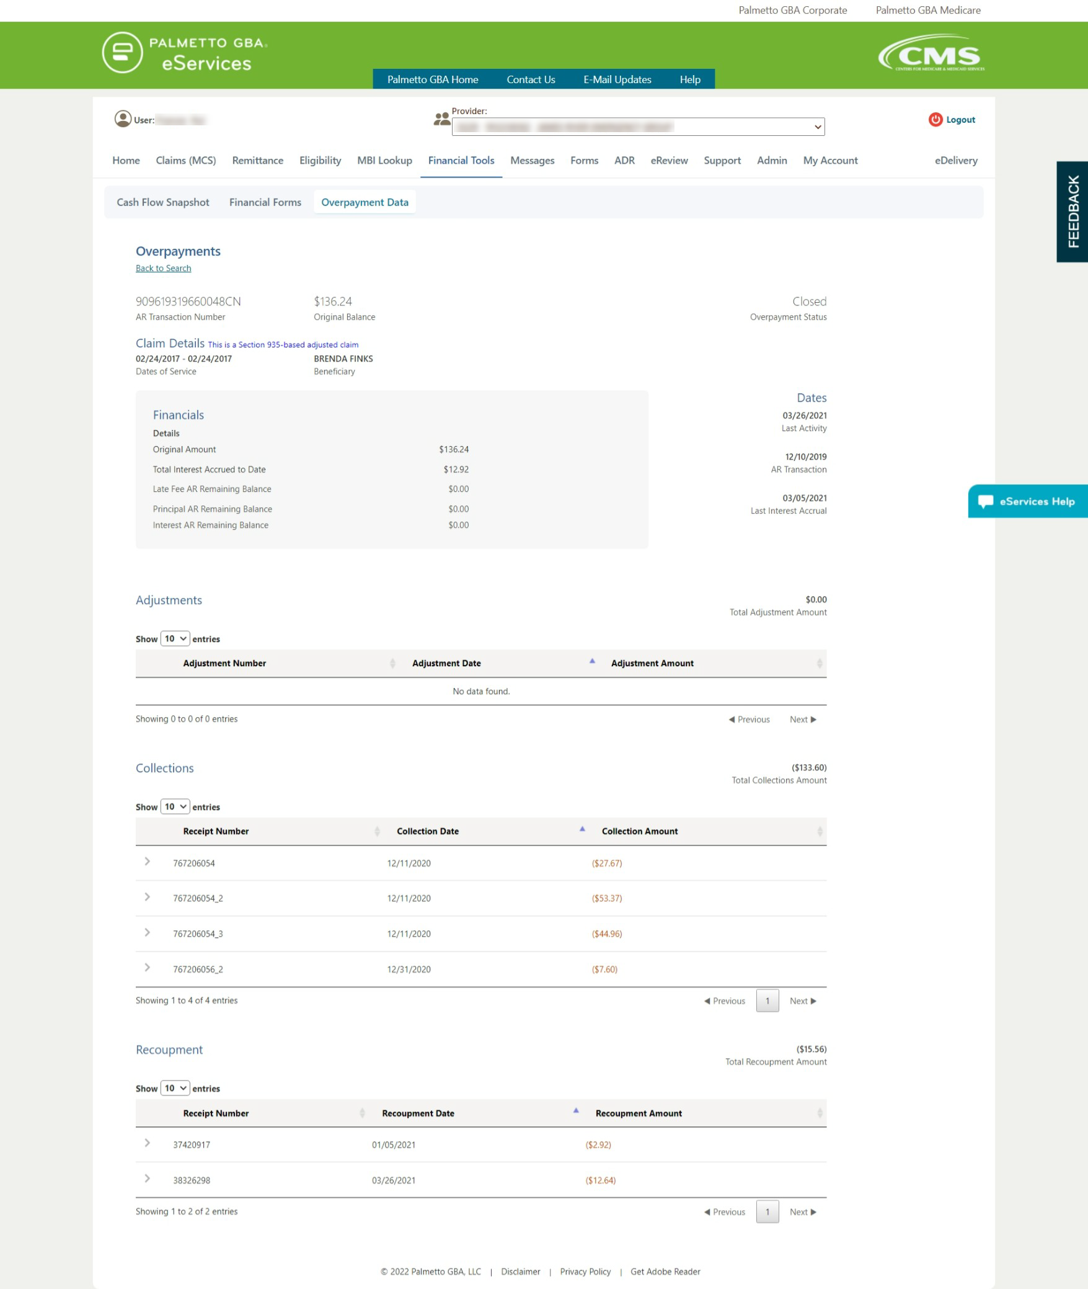
Overpayment Lookup (continued)

Slide 250
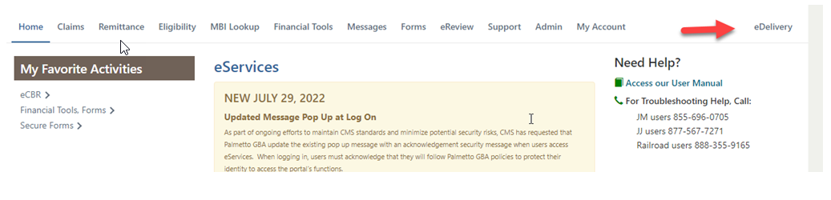
Greenmail for Demand Letters
Receive Overpayment Demand Letters Via eDelivery

Slide 251
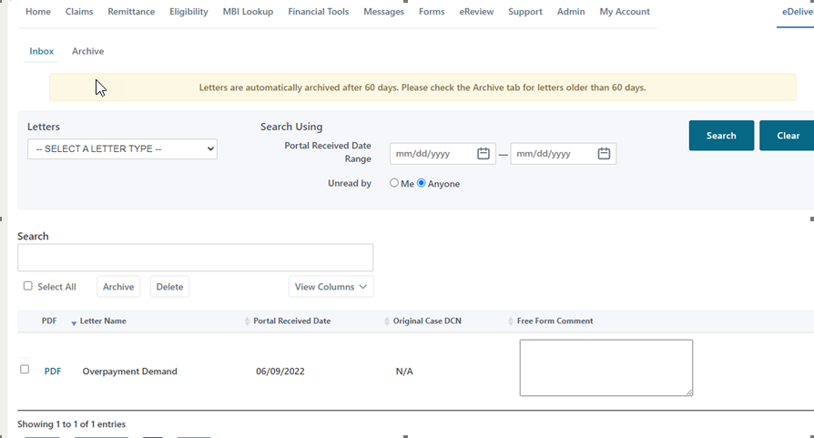
Greenmail for Demand Letters
Viewing Letters

Slide 252
Using eCheck
Use eCheck to submit electronic payments for voluntary refunds or in response to overpayment demand letter
Voluntary refund: include a copy of the voluntary refund form as an attachment to the eCheck payment
Use an Excel file if multiple claims are associated with the refund
Include the same claim specific information requested on the voluntary refund form for each claim included in the Excel file
Confirm you are in the correct contract when submitting e-Check payments
Form prepopulates the Contract/Region, PTAN and NPI fields with the data associated with the user ID that is logged in
eService User Manual Section 7.3: What is eCheck?
https://www.palmettogba.com/eServicesuserguide
NEED HELP?

Slide 253
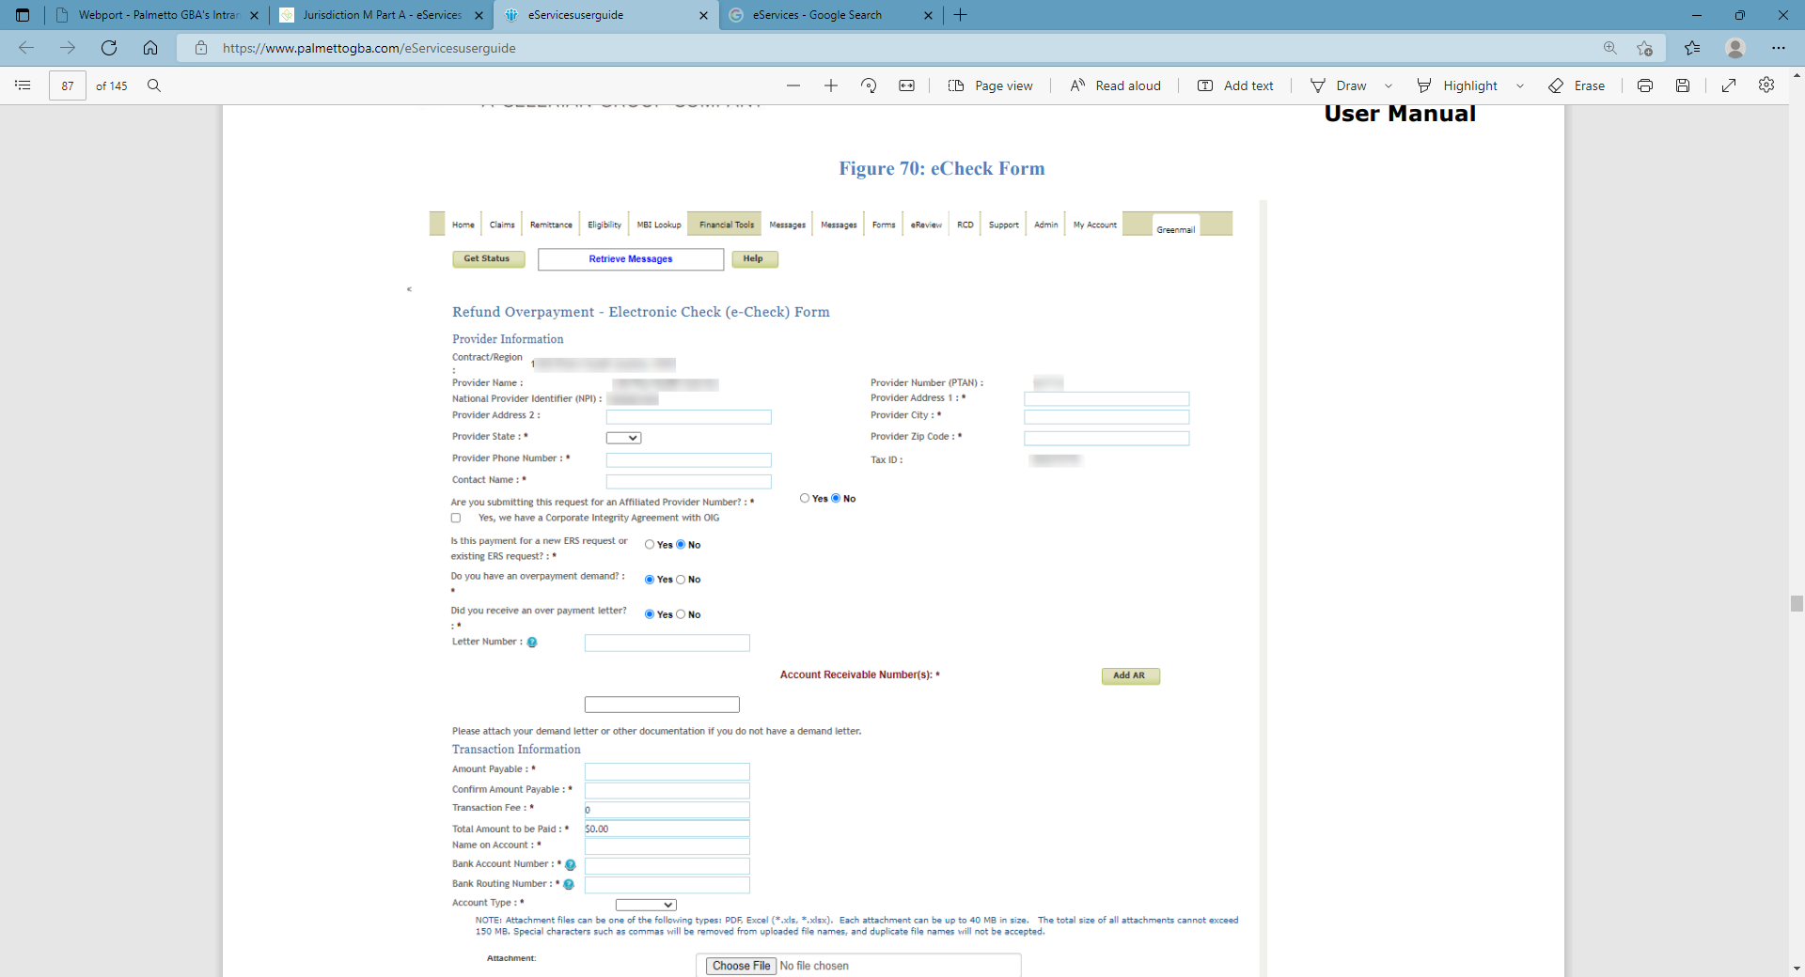
Using eCheck

Slide 254
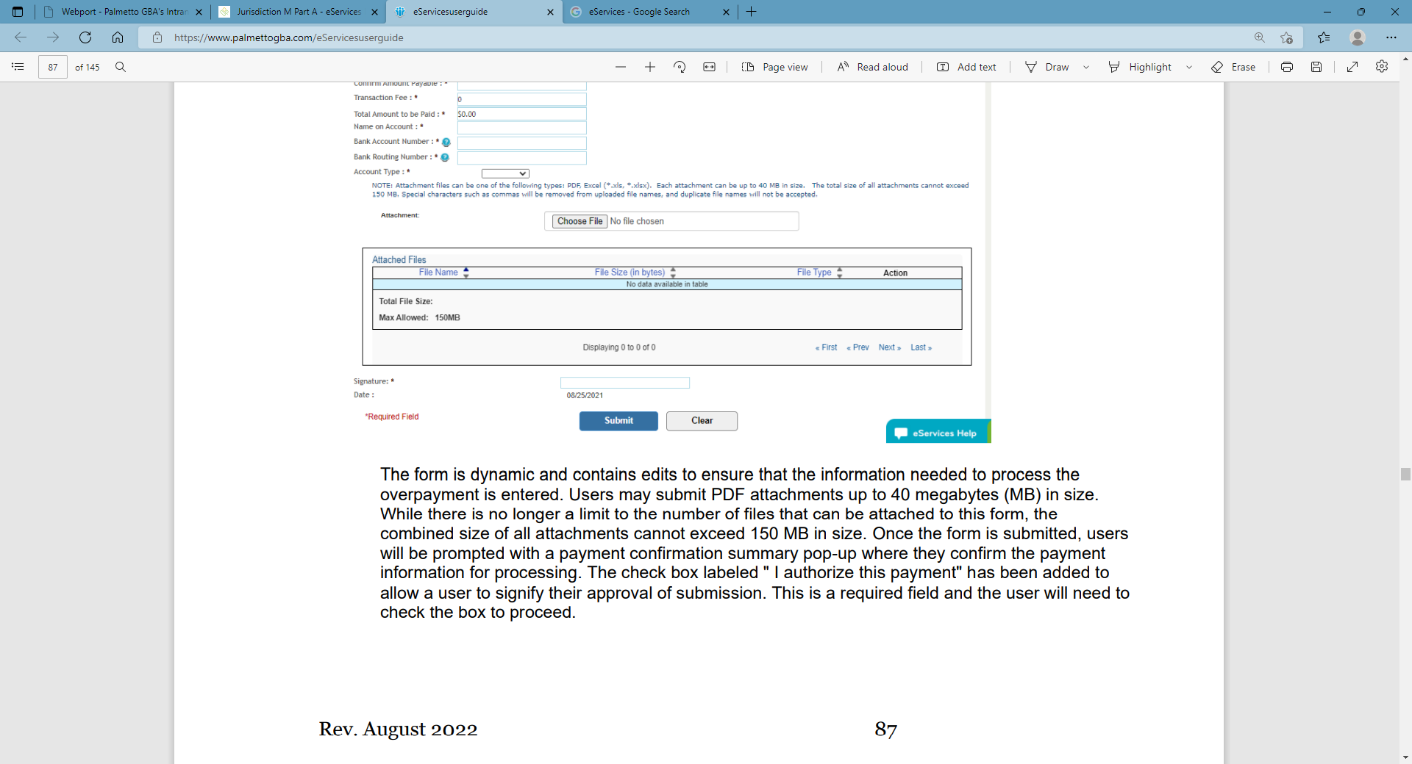
Using eCheck (continued)

Slide 255
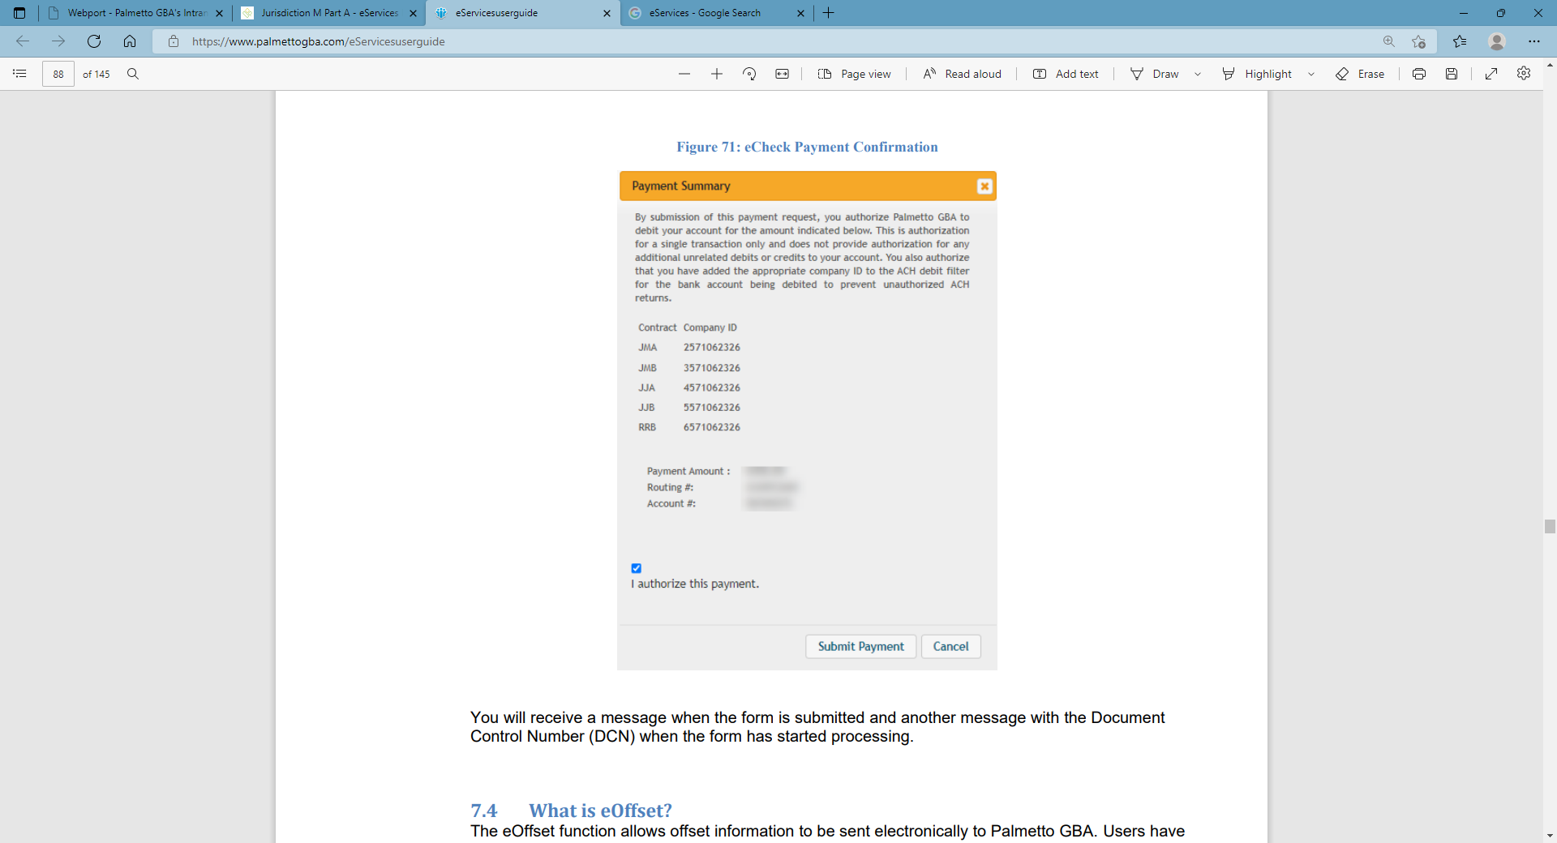
Using eCheck (continued)

Slide 256
More eCheck Tips
Press submit only once and wait for a response
Confirm bank account doesn’t have a debit block before submitting an eCheck
To have a successful transaction, company ID (indicated by line of business and shown on your screen) must be added to the account’s debit filter (your bank can assist on this) prior to resubmitting an eCheck or payment on the portal
If for any reason the transaction is not successful, we will send an email to the submitter of the form as notification
Contract Company ID
JMA | 2571062326
JMB | 3571062326
All Palmetto GBA Contract Company IDs are located on page 88 of the eServices manual on our website

Slide 257
eOffset
What is eOffset?
The eOffset function allows offset information to be sent electronically to Palmetto GBA. Users have the option to request an immediate offset when they receive a demanded overpayment or make a permanent request for all future demanded overpayments. More information regarding this is located on the form page.
The eOffset function can be accessed from the Financial Forms subtab located under the Financial Tools tab. Once on the financial forms landing page, select the option for eOffset from the Payment Type dropdown menu. Then select the eOffset form link.
The form will prepopulate the Contract/Region, Provider Number (PTAN) and National Provider Identifier (NPI) fields with the data associated with the user ID that is logged in.

Slide 258
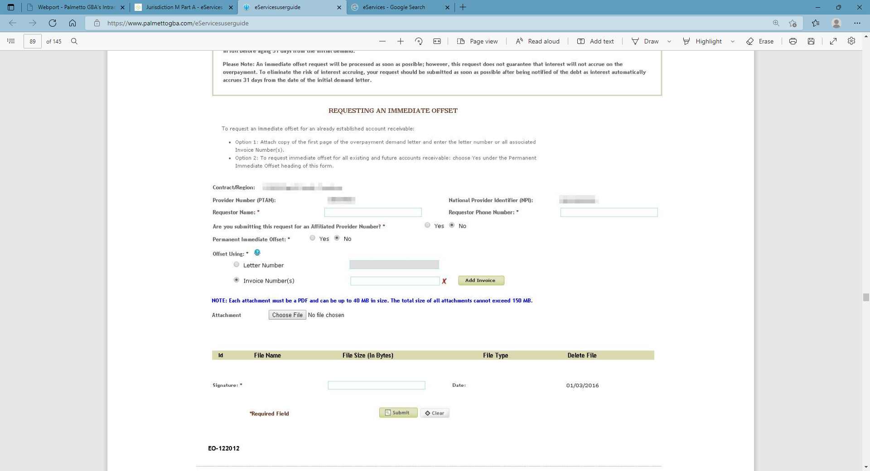
eOffset
Users are only able to submit an eOffset form for the PTAN/NPI combo logged in with
eOffset signature confirmation – you will receive message when form is submitted

Slide 259
Resources & References
Palmetto GBA Website — Palmetto GBA
eServices Portal — Welcome to Palmetto GBA eServices (onlineproviderservices.com)
Voluntary Refund Topic — Jurisdiction M Part A — Medicare Overpayments: Submit a Voluntary Refund (palmettogba.com)
CMS Regulation References for Voluntary Refunds — Publication 100-05 & Publication 100-06, Chapter 5, Section 410 (PDF, 5.72 MB)
Forms (Finance/Overpayments) — Forms (palmettogba.com)
eServices Portal Overview & User Manual — Jurisdiction M Part A - eServices Portal (palmettogba.com)
Credit Balance Reporting (CMS-838) information (Part A Providers only) — Jurisdiction M Part A — Credit Balance Reporting (CMS-838) (palmettogba.com)
CMS Website — Home — Centers for Medicare & Medicaid Services | CMS

Slide 261
Food For Thought
NC HFMA Medicare Workshop

Slide 262
Agenda
Single and dual chamber pacemaker coverage
Implantable Automatic Defibrillator coverage
Outpatient Infusion Services
Shared Decision-Making
Home Oxygen Therapy coverage

Slide 263
A54831 Billing and Coding Article
Single and Dual Chamber Pacemakers
NCD 20.8.3 — Effective in August 2013
CMS instructed MACs to implement the NCD at the local level
CMS determined evidence was sufficient to conclude that implanted permanent cardiac pacemakers (single or dual chamber) are reasonable and necessary for the treatment of:
Documented non-reversible symptomatic bradycardia due to sinus node dysfunction,
Documented non-reversible symptomatic bradycardia due to second and/or third-degree atrioventricular block

Slide 264
Non-Reversible Symptomatic Bradycardia
Etiology for SSS: Fibrosis, infiltrative disease, familial (cardiac sodium channel mutations), atherosclerosis to sinoatrial nodal artery (inferior MI), prescription medications (β blockers, CCB, digoxin, antiarrhythmics, acetylcholinesterase inhibitors), miscellaneous (hypothyroidism, hypothermia, hypoxia)
“Non-reversible” needs to be documented and supported
Symptoms directly attributable to a heart rate < 50-60 bpm
Example: syncope/presyncope, seizures, heart failure, lightheadedness, or confusion; fatigue

Slide 265
A54831 Nationally Non-Covered Indications
Reversible causes of bradycardia such as electrolyte abnormalities, medications or drugs, and hypothermia
Asymptomatic first-degree AV block
Asymptomatic sinus bradycardia
Asymptomatic sino-atrial block or asymptomatic sinus arrest
Ineffective atrial contractions without symptomatic bradycardia
Asymptomatic second-degree AV block of Mobitz Type 1 unless the QRS complexes are prolonged or EP study demonstrates the block is at or below the His bundle

Slide 266
A54831 Nationally Non-Covered Indications
Syncope of undetermined cause
Bradycardia during sleep
RBBB with left axis deviation (and other forms of fascicular or bundle branch block) without syncope or other symptoms
Asymptomatic bradycardia in post-MI patients starting β-blocker therapy
Frequent or persistent SVT, except when the pacemaker is specifically for control of the tachycardia, and
A clinical condition in which pacing only needed intermittently or briefly

Slide 267
Covered Conditions and Diagnosis Codes-Group 1
Conditions: Documented non-reversible symptomatic bradycardia due to sinus node dysfunction and documented non-reversible bradycardia due to second and/or third-degree AV block
Attest with Modifier KX
Atrioventricular (AV) block (I44.2)
Mobitz Type II AV block (I44.1)
Other second-degree AV block (I44.1)
Sinoatrial (SA) node dysfunction/Sick Sinus Syndrome (I49.5)
Congenital heart block (Q24.6)

Slide 268
NCD 20.8.3
Single-Chamber and Dual-Chamber Permanent Cardiac Pacemakers
Does not address biventricular pacemakers (CRT), pacemakers that stimulate more than two heart chambers, devices to treat tachyarrhythmias and cardiac dyssynchrony, cardiac pacemaker evaluation services, or self-contained pacemaker monitors
Only applies to CPT® codes for the initial insertion of cardiac pacemakers (33206, 33207, 33208)
Does not address replacement of pacemaker generators

Slide 269
A54831 Palmetto GBA Additional Dx Codes
Group II (also attested with modifier KX)
AV block, unspecified (symptomatic) (I44.30)
First degree AV block (symptomatic with PR interval > 300 ms) (I44.0)
LBBB, other or unspecified (I44.7)
RBBB, unspecified or other (I45.10 or I45.19)
Bundle branch block, unspecified (I44.30 or I45.19)
RBBB and LPFB (I45.2)
RBBB and LAFB (I45.2)
Other bilateral bundle branch block (Bifascicular I45.2, Trifascicular I45.3)
Supraventricular tachycardia (reproducibly terminated by pacing when ablation and/or drugs have failed or have intolerable side effects (I47.1 or I47.9)

Slide 270
A54831 Palmetto GBA Additional Dx Codes
Group II continued:
Atrial fib with symptomatic bradycardia due to necessary medical therapy (I48.11 or I48.91)
Atrial flutter with symptomatic bradycardia due to necessary medical therapy (I48.3, I48.4, I48.92)
Hypersensitive carotid sinus syndrome and neurocardiogenic syncope (Syncope without clear, provocative events and with a hypersensitive cardioinhibitory response of > 3 seconds or for significantly symptomatic neurocardiogenic syncope associated with bradycardia occurring spontaneously or with tilt table testing) (G90.01)

Slide 271
Conditions Not Addressed by NCD or Palmetto
Group III which include but are not limited to:
Cardiac resynchronization therapy
Obstructive hypertrophic cardiomyopathy
Pacing in children, adolescents and patients with congenital heart disease
Pacemaker or generator replacements
Sustained pause-dependent ventricular tachycardia with or without QT prolongation
Attest with Modifier SC

Slide 272
KX modifier
Attestation by the practitioner and/or provider of the service that documentation is on file verifying the patient has a symptomatic arrhythmia or a high potential for progression of the rhythm disturbance requiring a permanent pacemaker for Groups I and II
Bradycardia that is the consequence of essential long-term drug therapy of a type and dose for which there is no acceptable alternative DOES NOT exclude the use of modifier KX

Slide 273
KX modifier
Can also be used in for patients without symptoms in Groups I and II in the following situations:
Awake, symptom-free patients in sinus rhythm, with documented periods of asystole > 3 seconds or any escape rate < 40 bpm or with an escape rhythm that is below the AV node
Awake, symptom –free patients with Afib and bradycardia with > 1 pause(s) of at least 5 seconds or longer
Catheter ablation of the AV junction
Post op AV block that is not expected to resolve after cardiac surgery
Patients with various neuromuscular disease with advanced 2nd or 3rd degree AV block

Slide 274
KX modifier, continued
Asymptomatic persistent 3rd degree AV block at any site with average awake ventricular rates of 40 bpm or faster if cardiomegaly or LV dysfunction present or if site of block below the AV node
2nd or 3rd degree AV block during exercise in absence of myocardial ischemia
Persistent 3rd degree AV block with an escape rate > 40 bpm in asymptomatic adults without cardiomegaly
Asymptomatic 2nd degree AV block within or below the His bundle noted at EP study
1st or 2nd degree AV block with symptoms like pacemaker syndrome or with hemodynamic compromise
Asymptomatic Type II second-degree AV block with a narrow QRS or 2nd degree AV block with a wide QRS including RBBB

Slide 275
Other Modifiers
Modifier SC (Medically necessary service or supply)
Group III: For medically necessary pacemakers in conditions not addressed by NCD 20.8.3 or A54831
Modifier GA (waiver of liability statement issues as required by payer policy, individual case)
Medicare denial anticipated as not reasonable and necessary and a signed ABN is on file
May also be used when beneficiary refuses to sign the ABN and proper witness is present. (For Part A claims, need occurrence code 32 and date of the ABN)
Modifier GZ when Medicare denial expected as not reasonable and necessary and beneficiary not asked to sign ABN
If criteria for KX or SC modifiers not met, a GA or GZ modifier should be appended and the claim will deny

Slide 276
A56343 Billing and Coding Article
Implantable Automatic Defibrillators
NCD 20.4
Nationally covered indications:
Personal history of sustained ventricular tachyarrhythmia (VT) or cardiac arrest due to ventricular fibrillation (VF);
Prior MI and a measured left ventricular ejection fraction (LVEF) < 30%;
Severe, ischemic dilated cardiomyopathy w/o hx of VT or Vfib arrest, w/ NYHA II or III HF, LVEF < 35%
Severe, nonischemic dilated cardiomyopathy w/o hx of VT or Vfib arrest, w/ NYHA II or III HF, LVEF < 35%, and on optimal medical therapy at least 3 months
Documented familial or genetic disorders with high risk of life-threatening tachyarrhythmia
Existing ICD who need a replacement due to battery life or device/lead malfunction

Slide 277
Shared Decision-Making
A formal shared decision-making encounter must occur between the patient and physician or a qualified nonphysician practitioner (NPP) using an evidence-based decision tool on ICDs prior to initial ICD implantation
Questions begged…
NPP can be a PA, NP or clinical nurse specialist
The shared decision-making encounter may occur at a separate visit
*SDM only required for the primary indications for an ICD

Slide 278
Personal history of Sustained VT or cardiac arrest due to Vfib Secondary
Must have demonstrated an episode of:
Sustained VT, either spontaneous or induced by an electrophysiologic (EP) study, not associated with an acute MI and not due to a transient or reversible cause; or
Cardiac arrest due to VF, not due to a transient or reversible cause
I46.2, I46.9, I47.2, I49.01, I49.02, I49.3, I49.9, Z45.02 or Z86.74

Slide 279
Prior MI and Reduced EF Indication (Primary)*
Patients with a prior MI and a measured LVEF < 30%, but not having:
NYHA class IV heart failure or
A CABG or percutaneous coronary intervention (PCI) with angioplasty and/or stenting, within the preceding three months or
An MI within the preceding 40 days or
Clinical symptoms and findings that would make them a candidate for coronary revascularization
I25.2 must be billed with one of these codes:
I50.21, I50.22, I50.23, I50.41, I50.42 or I50.43

Slide 280
Severe Ischemic Cardiomyopathy (Primary)*
Patients with a severe, ischemic, dilated cardiomyopathy but no personal history of sustained VT or cardiac arrest due to VF, and have NYHA Class II or III heart failure with an LVEF of < 35%
Patients must not have had:
A CABG or PCI with angioplasty and/or stenting within the preceding three months or
An MI within the preceding 40 days or
Clinical symptoms and findings that would make them a candidate for coronary revascularization
I25.5 billed with one of the following: I50.21, I50.22, I50.23, I50.41, I50.42, or I50.43

Slide 281
Severe Non-ischemic Dilated Cardiomyopathy (Primary)*
Patients with severe, non-ischemic, dilated cardiomyopathy but no personal history of sustained VT or cardiac arrest due to Vfib , and have NYHA Class II or III heart failure, LVEF ≤ 35%, and on optimal medical therapy for at least three months. Must not have had:
A CABG or PCI with angioplasty and/or stenting within past three months; or
An MI within the past forty days; or
Clinical symptoms and findings that would make them a candidate for coronary revascularization
I42.0, I42.6, I42.7 or I42.8 must be billed with one of these: I50.21, I50.22, I50.23, I50.41, I50.42 or I50.43

Slide 282
High Risk Familial/Genetic Disorders (Primary)*
Patients with documented familial or genetic disorders with a high risk of life-threatening tachyarrhythmias (sustained VT or Vfib), to include, but not limited to, long QT syndrome or hypertrophic cardiomyopathy
ICD-10-CM codes: I42.1, I42.2, I45.6, I45.81 or I45.89

Slide 283
ICD Replacement
Patients with an existing ICD may receive an ICD replacement if it is required due to end of battery life, Elective Replacement Indicator (ERI), or device/lead malfunction
T82.110A, T82.111A, T82.118A, T82.119A, T82.120A, T82.121A, T82.128A, T82.129A, T82.190A, T82.191A, T82.198A, T82.199A, T82.7XXA or Z45.02

Slide 284
Other Circumstances
Heart transplant candidates on the United Network for Organ Sharing (UNOS) list considered for bridging to transplant utilizing ICDs or cardiac resynchronization therapy
MAC discretion
Z76.82 with I50.84
Recommend strong documentation regarding reasonable and necessary basis for what is planned

Slide 285
All Other Indications for ICD
Not currently covered by this NCD may be covered under Category B IDE trials (42 CFR 405.201)
Z00.6 code

Slide 286
Questions Begged
Sustained VT? Per the ACC, > 30 bpm or terminated by a shock
Rhythm strip or EKG or clear physician documentation regarding the presence of V fib or VT This also frequently lacks documentation
What are transient or reversible issues?
Acute ischemia, electrolyte disorders or drug toxicities
EF measurement?
ECHO, nuclear medicine imaging, cardiac MRI or catheterization angiography
Any MI in past 40 days? That’s the way it reads.
For all indications, patients must be clinically stable (e.g., not in shock, from any etiology), not have significant irreversible brain damage, and have no other disease with a less than 1 year survival or any SVT such as atrial fibrillation with poorly controlled ventricular rate)

Slide 287
Exceptions to Waiting Periods
These are the CABG/PCIs within prior 3 months and MIs within prior 40 days
IF the patient needs a pacemaker AND otherwise qualifies for an ICD, then the combined devices may be placed at the same time when the pacemaker is clinically indicated

Slide 288
Challenges
Code with specificity
Operationalize SDM process
Cardiologists splitting hairs or being insistent-what’s your process?
MACs are not allowed to provide preauthorization

Slide 289
Outpatient Infusion Services
Variety of settings: OP infusion department, provider-based infusion clinic, emergency department, urgent care department, L&D, observation, independent infusion centers
Clinical excellence is one thing; financial excellence is also important
Challenges: Much of demand countered with space availability, an increase in uncompensated care, staff shortages, and a growing and aging patient population
As always, documentation and coding accuracy are key

Slide 290
Costly Drugs
Some with established J codes and some that don’t yet have a J code
What if your medical record is requested?
FDA label indications
Office notes that detail a specific diagnosis with laterality if relevant, what has already been tried and failed, an exam that matches the condition of the patient, an explanation of why the drug being ordered is the best choice, and narrative on how the patient is doing with repeated treatments.
Medication Administration record that is clear
A procedural note if relevant
Precise, specific ICD-10 and CPT® coding that matches the record
Cloning, templated inserts can be a real problem

Slide 291
An Example
Saphnelo™ (Anifrolumab)
Indicated for the treatment of adult patients with moderate to severe systemic lupus erythematosus (SLE) who are receiving standard therapy.
Dose and frequency must follow FDA prescribing information
It is not uncommon to receive records that:
Never mention the dx at all or note the dx without any indication of its severity
An office note details no current symptoms and a normal templated exam or a repetitively cloned one from months prior that doesn’t correlate with the stated condition of the patient
Current other therapy is not clear
Disease severity based on what? Perhaps use a standardized tool?

Slide 292
Other Scenarios
What if a drug dosage is FDA labeled as progressive week to week or month to month?
Is the record identifying that chronology?
Are OP office records needed? Do you have a process to get those pre-infusion and into the hospital record system?
The same is true for diagnoses, disease severity, medical necessity

Slide 293
Vabysmo™ (Faricimab-svoa)
Vascular endothelial growth factor and angiopoietin-2 inhibitor intravitreal injection indicated for wet AMD and DME
Many patients are affected bilaterally by these conditions
So what shot is going into which eye and when?
For wet AMD, the dose starts at 6mg Q 4 weeks x 4 and then, based on evaluations, can stretch out by 20 weeks or more
Does the most recent exam confirm ongoing problems or at least stabilization?

Slide 294
New and Emerging Technology
The same previously stated principles apply
The submitted record should contain a well-described diagnosis and all the test results that support that diagnosis
A device should be used consistent with its FDA indication; otherwise, it should be part of a trial
If not, there is a risk of denial for off-label use
The procedure note on its own may not tell the story regarding a reasonable and necessary premise. OP office notes may be key.

Slide 295
Shared Decision-Making
CMS believes SDM engages patients to allow for discussion of treatment options, potential benefits/harms, and to incorporate personal views and beliefs. It is patients and providers working together.
Evidence-based decision tools provide a foundation of current clinical evidence and recommendations
Several procedures mandate SDM-the two most prominent are ICDs and left atrial appendage closures (LAACs). Also required with hypoglossal nerve stimulators (L38276), low dose CT scans for lung cancer screening (NCD 210.14), etc.

Slide 296
SDM Descriptions Differ
ICD NCD 20.4-a formal shared decision-making encounter must occur between the patient and a physician or qualified nonphysician practitioner using an evidence-based decision tool on ICDs prior to initial ICD implantation.
LAAC NCD 20.34-independent non-interventional physician other than the implanter (such as a primary care physician, non-interventional cardiologist or neurologist)

Slide 297
SDM
The Shared Decision-Making encounter must be documented in the medical record prior to implanting an ICD or LAAC.
Palmetto GBA
SDM prior to implantation of these devices
Documentation of benefits and harms discussed with the patient
Any necessary calculations related to risk scoring (We won’t calculate for you)
Document (by name) the evidence-based decision-making tool used
Document the result of the tool
With LAACs, document the reason why long-term anticoagulation is not an option

Slide 298
Questions Often Asked
Is SDM the same as informed consent? No.
Can I just say “SDM done on xxx date”? No.
A progress note documenting the content and details and participants must be present for the shared decision-making encounter.
What are some tools frequently utilized?
(Colorado Program for Patient Centered Decisions, ACC CardioSmart, SPARC-Stroke Prevention in AF Risk Tool)

Slide 299
Home Use of Oxygen (NCD 240.2)
Effective 9/27/21
Oxygen therapy and oxygen equipment is covered in the home for acute or chronic conditions, short- or long-term, when the patient exhibits hypoxemia
Need must be based on clinical test results ordered and evaluated by the treating practitioner
ABG or oximetry must be done at the time of need (for a hospitalized patient, within 2 days of discharge)

Slide 300
Hypoxemia Defined
Arterial pO2 < 55 or an O2 sat < 88% at rest on RA; or
Arterial pO2 < 55 or an O2 sat < 88% during sleep in a patient with pO2 of 56 or O2 sat > 89% while awake (or a drop in oxygen level while asleep > 10 mm Hg or > 5% by sat) with associated signs/symptoms (covers nocturnal oxygen); or
Arterial pO2 < 55 or O2 sat < 88% during exercise for a patient with pO2 > 56 or O2 sat > 89% during the day at rest. (Qualifies for exercise oxygen); or
Arterial pO2 56-59 or O2 sat 89% with dependent edema suggesting HF, pulmonary HTN or erythrocythemia =HCT > 56%.
120-day limit
Certificates of medical necessity are no longer required (1-1-23)

Slide 301
Non-Coverage of Home Oxygen
Angina without hypoxemia
SOB without cor pulmonale or evidence of hypoxemia
Severe peripheral vascular disease with desaturation in one or more extremities
Terminal illnesses unless they affect the ability to breathe
MACs determine coverage for oxygen therapy and equipment patients who are not described or precluded in this policy

Slide 302
Are the DME Suppliers Cooperating?
Version 1 of this NCD referenced a “diagnosis of disease requiring home use of oxygen”
Severe lung disease such as COPD, diffuse interstitial lung disease, cystic fibrosis, bronchiectasis, widespread lung cancer; or
Hypoxia-related symptoms or findings that might be expected to improve with oxygen therapy (Examples-pulmonary HTN, recurring HF due to chronic cor pulmonale, erythrocytosis, cognitive impairment, nocturnal restlessness, morning headache)
The new version expands coverage and negates the need for circulating lists of qualifying diagnoses and may alter any templated medical record entries already in place

