Slide 1
Denials Management: Understanding Current Trends and Strategies for Reducing Denials.
Nebraska HFMA Winter Meeting
January 19, 2023
Colleen Goethals, MS, RHIA, FAHIMA
VP, Mid-Revenue Cycle
Xtend Healthcare

Slide 2



Welcome / introductions
Colleen has more than 30 years of healthcare experience, vast knowledge of HIM operations and revenue cycle management, and is a subject matter expert on privacy. Her experience includes HIM/Revenue Cycle Regional Director; HIM Consultant; Privacy Officer; adjunct college instructor; speaker; and author on revenue cycle topics.
Colleen is a past AHIMA Board member, past-President of the Illinois Health Information Management Association (ILHIMA), ILHIMA Distinguished Member, an AHIMA fellow, and is NARA Certified in Federal Records Management. She also is the recipient of AHIMA’s Triumph Award for Advocacy and Policy.
Colleen Goethals
Vice President
Mid Revenue Cycle

Slide 3



Agenda
Impact of denials
Know your denial rates
Get to the root cause
Trends
Collaboration
Workflow assessment
Writing successful appeal letters
Measure your success
Sample reports
Confidential and proprietary information © 2022 Xtend Healthcare. All rights reserved.
3

Slide 4
Impact of denials
89% of health systems saw an increase in denied claims over the past 3 years
11% of hospital claims are initially denied
90% of denied claims are preventable
Only 35% of providers appeal denials even though 66% of denied claims are recoverable
The average denial rate for payers is 6-13%. For Medicare and Medicaid, it’s closer to 10%
31% of healthcare providers use a manual process for managing denials

Slide 5





Top causes of denials
Registration/Eligibility errors make up almost 27% of denials.
Followed by:
Missing or Invalid Claim Data
Authorization / Pre-Certification
Service Not Covered
Medical Documentation Requested
Medical Necessity
Untimely Filing
Medical Coding
Provider Eligibility
Confidential and proprietary information © 2022 Xtend Healthcare. All rights reserved.
5

Slide 6







Factors for the increase in denials
Lack of denials resources
Staff attrition and training
Growing denials backlog
Technology challenges
Presentations are tools that can be used as lectures, speeches, reports, and more It is mostly presented like
  Solutions For Medical
  Solutions For Medical
Next Page
Confidential and proprietary information © 2022 Xtend Healthcare. All rights reserved.
6

Slide 7




Denials statistics
Know your denial rates
Calculate your claims and dollars rate
Know your rate
of appeals
Calculate your denial rate
Number of zero paid claims denied by total claims remitted.
Strive for <5%; Best practice is 2% or lower
  Total dollars remitted – total dollars paid/by total dollars remitted
  Best practice: 85 – 88% of denials should be appealed

Slide 8


We found denials…now what?
What type?
  Technical denials - (group by payer)
    Start tracking “top 10” reasons
    Authorization
    Out of network
    Missing/wrong codes or modifiers
  Appeal technical denials with letters
  Clinical denials
    Medical necessity
    Designate clinical resources
    Robust appeals letter writing team
Technical denials
Rejected for non-medical reasons
Clinical denials
Medical necessity
Length of stay
Level of care determination
Coding
Consider an outsource partner
Confidential and proprietary information © 2022 Xtend Healthcare. All rights reserved.
8

Slide 9








Denials requiring appeal
Days, service level of care denied for no concurrent authorization
Claim denied for elective service without pre-authorization
Not a covered
service
Timely Filing
Charge/procedure as bundled

Slide 10

Denials requiring additional information
Pending receipt of medical records
Pending receipt of itemize bill
Missing or inaccurate information
Charge or coding issues
Confidential and proprietary information © 2022 Xtend Healthcare. All rights reserved.
10

Slide 11

Data and Analytics
Using denial data to identify root cause is critical
Document and trend the reasons for denials
Identify patterns and trends
Confidential and proprietary information © 2022 Xtend Healthcare. All rights reserved.
11

Slide 12


Identify the Root Cause(s)
Create a multidisciplinary team
    Coding
    Patient Access
    Utilization Management
    Managed Care
    Revenue Cycle
    CDI
    HIM
    Legal
    Compliance
    Physician Liaison
Confidential and proprietary information © 2022 Xtend Healthcare. All rights reserved.

Slide 13
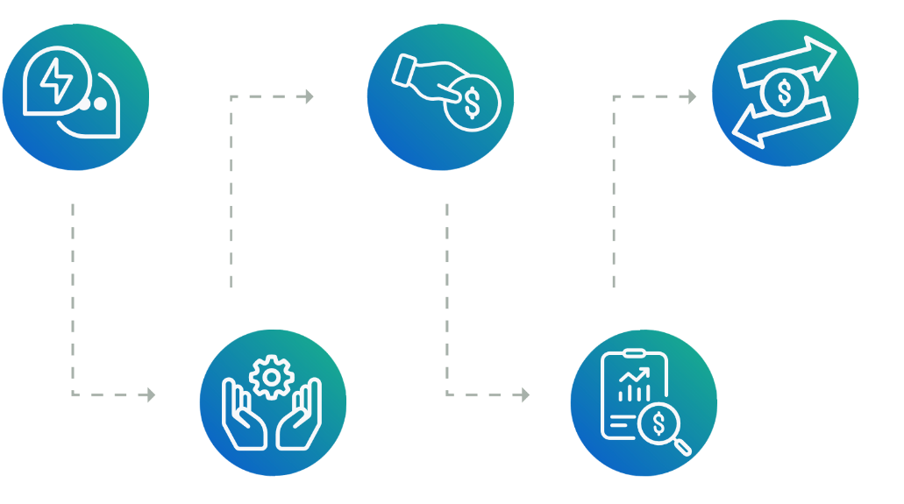

Review workflow
Patient Care
Physician documentation; CDI
Medical Necessity
Scheduling
Authorization
Medical Necessity
Billing / Patient Accounts
Bundling
Timely filing
Coordination of benefits
Patient Access
Authorization
Patient information accurate
Covered service
HIM/Charge Capture
Documentation
Coding

Slide 14

Scheduling Potential Denials
Pre–certification / authorization not obtained
Non–covered services
Invalid insurance information
Patient Identification
Confidential and proprietary information © 2022 Xtend Healthcare. All rights reserved.

Slide 15

Patient access potential denials
Pre–cert / authorization not obtained
Patient information incorrect or incomplete
Non–covered services
Confidential and proprietary information © 2022 Xtend Healthcare. All rights reserved.

Slide 16

Patient care areas of potential denials
Ancillary and patient care units
  Medically necessary services
  Authorizations
Case Management / CDI
  Clinical documentation does not support level of care; not provided in a timely manner
Confidential and proprietary information © 2022 Xtend Healthcare. All rights reserved.

Slide 17

HIM/Coding potential denials
Coding issues
Incomplete and inaccurate documentation
Timely filing
Confidential and proprietary information © 2022 Xtend Healthcare. All rights reserved.

Slide 18

Additional departments to include
Information Technology
Ensure systems are updated timely
Review interface issues
Compliance
Audits performed
Confidential and proprietary information © 2022 Xtend Healthcare. All rights reserved.
18

Slide 19
Appealing Clinical Denials
Confidential and proprietary information © 2022 Xtend Healthcare. All rights reserved.
19

Slide 20

Appealing denials
Need a strong denials team to write the appeals letters
85 – 88% of denials is the recommended appeal rate

Slide 21





Tips to writing appeal letters
Appeal every case where there is documentation to support the original coding.
Include Clinical and Coding Expertise to write the appeal
Include copies of the medical record where helpful
Include official coding guidelines
Include the credentials of those who have reviewed and are involved in the appeal
Keep the appeal letter concise to the reason for the denial
Include the pertinent record excerpts that support the appeal.
Confidential and proprietary information © 2022 Xtend Healthcare. All rights reserved.
21

Slide 22




Measure your success!
Track and Report
  Total denials
  Total appeals
  Cases not appealed and why
  Total cases overturned and financial impact
  Second-level denials
  Failed appeals
Analyzing the trends allows you to educate and move from management of denials to prevention of denials

Slide 23


Next level - management to prevention
Transition to denial prevention for the 55% of denials that can’t be overturned
  Departmental training
  Engage clinical staff
  HIM feedback
  Build out front-end edits to stop denials before admission or service
Collapse appeal time
  Billing scrubbers are introducing real-time denial adjudication
  Clean up payer-friendly contracts
Continuous improvement
Collaborate with payors
Communicate with colleagues
Educate: Front, Middle, Back including Physicians
Confidential and proprietary information © 2022 Xtend Healthcare. All rights reserved.
23

Slide 24


In conclusion
Consistent and timely review of denial data
Successful appeals letter writing
Ongoing communication and collaboration
Measure your success

Slide 25
Sample Reports
Confidential and proprietary information © 2022 Xtend Healthcare. All rights reserved.
25

Slide 26
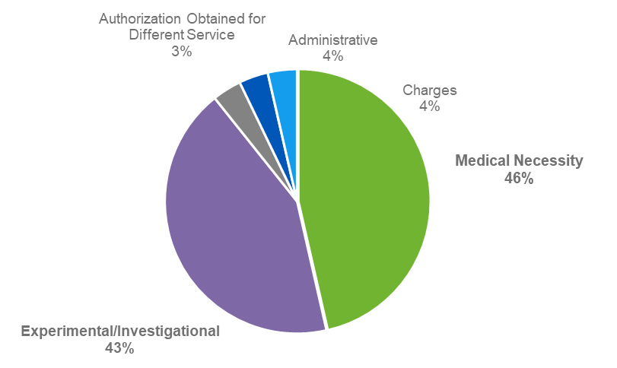
Monthly clinical denials
Denial Reason | Total # Accts | Acct Balance | % of Total Denials | % of Acct Balance
Medical Necessity | 13 | $58,512 | 53% | 46%
Experimental/ Investigational | 12 | $44,570 | 41% | 43%
Authorization Obtained for Different Service | 1 | $4,187 | 4% | 4%
Administrative | 1 | $1,287 | 1% | 4%
Charges | 1 | $1,113 | 1% | 4%
Grand Total | 28 | $109,668 | 100% | 100%

Slide 27
Clinical denials by payor
Payor | Total # Accts | % of Total Denials | Acct Balance
Aetna | 11 | 39% | $42,509
BCBS | 8 | 33% | $36,428
UHC | 5 | 21% | $23,112
Cigna | 3 | 3% | $3,432
Humana | 1 | 4% | $4,187
Grand Total | 28 | 100% | $109,668

Slide 28
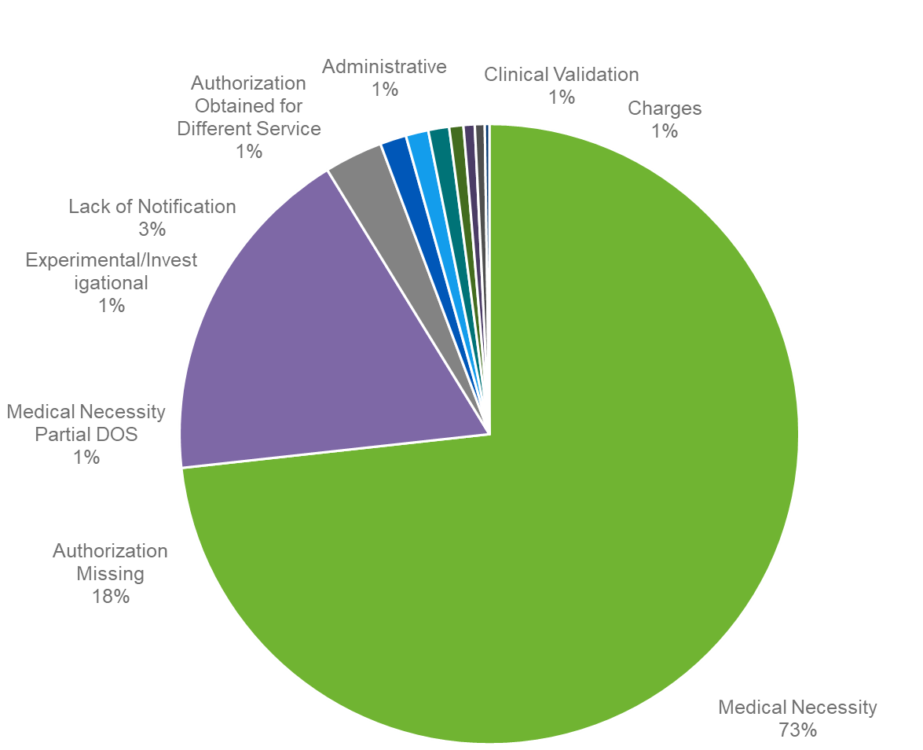
Monthly clinical denials
Denial Reasons | Account Balance | Total | % Account Balance
Medical Necessity | $ 2,318,195.91 | 110 | 73
Authorization Missing | $ 568,682.97 | 17 | 18
Lack of Notification | $ 96,358.67 | 6 | 3
Medical Necessity Partial DOS | $ 43,427.06 | 4 | 1
Experimental/Investigational | $ 37,344.30 | 1 | 1
Administrative | $ 34,414.31 | 3 | 1
Charges | $ 23,361.12 | 1 | 1
Authorization Obtained for Different Service | $ 18,551.66 | 2 | 1
Clinical Validation | $ 16,362.24 | 1 | 1
Grand Total | $ 3,164,314 | 147 | 100

Slide 29
Monthly clinical denials by payor
Denial Reasons | Account Balance | Total
Aetna | $ 541,431 | 10
Medical Necessity | $ 457,802 | 5
Authorization Missing | $ 57,425 | 2
Administrative | $ 12,537 | 1
Authorization Obtained for Different Service | $ 11,235 | 1
Medical Necessity Partial DOS | $ 2,432 | 1
Amerigroup | $ 554,863 | 22
Medical Necessity | $ 478,339 | 17
Lack of Notification | $ 64,664 | 3
Authorization Missing | $ 11,860 | 2
BCBS | $ 813,716 | 30
Medical Necessity | $ 556,279 | 20
Authorization Missing | $ 195,869 | 5
Administrative | $ 21,877 | 2
Medical Necessity Partial DOS | $ 18,338 | 1
Clinical Validation | $ 16,362 | 1
ED Visit Nonemergent | $ 4,990 | 1
Cigna | $ 162,148 | 13
Humana | $ 278,741 | 15
Medicaid | $ 18,989 | 1
Medicare | $ 8,404 | 1
UHC | $ 726,479 | 50
Medical Necessity | $ 537,236 | 41
Authorization Missing | $ 154,896 | 6
Charges | $ 23,361 | 1
Authorization Obtained for Different Service | $ 7,317 | 1
Medical Necessity Partial DOS | $ 3,668 | 1
WellCare | $ 59,543 | 5
Lack of Notification | $ 31,695 | 3
Medical Necessity | $ 27,848 | 2
Grand Total | $ 3,164,314 | 147

Slide 30
Monthly nurse determination
Denial Reasons | Account Balance | Total
Appealed | $ 2,750,651 | 119
Medical Necessity | $ 1,967,953.61 | 85
Authorization Missing | $ 541,160.93 | 16
Lack of Notification | $ 96,358.67 | 6
Medical Necessity Partial DOS | $ 43,427.06 | 4
Experimental/Investigational | $ 37,344.30 | 1
Administrative | $ 21,877.28 | 2
Authorization Obtained for Different Service | $ 18,551.66 | 2
Clinical Validation | $ 16,362.24 | 1
ED Visit Nonemergent | $ 7,615.31 | 2
No Appeal | $ 413,662 | 28
Medical Necessity | $ 350,242.30 | 25
Authorization Missing | $ 27,522.04 | 1
Charges | $ 23,361.12 | 1
Administrative | $ 12,537.03 | 1
Grand Total | $ 3,164,314 | 147

Slide 31


Thank you for your time.
Contact Information:
Colleen Goethals, MS, RHIA, FAHIMA
cgoethals@xtendhealthcare.net
xtendhealthcare.net

Slide 32
References
7 Crazy Stats About Healthcare Claims Denial, Sift, Bethany Grabher, 2019
Success in Proactive Denials Management and Prevention, HFMA, 5/1/2021
Medical Claim Denial Rates Rising, Highest in Initial COVID-19 Hotspots, M. Gavidia, January 21, 2021
Coding Denials: Effective Appeals HFMA 3/1/2020
Denials Management: Getting to the Root Cause, Denise Wilson & Tracey A. Tomak, Nov. 2019
Top Ten Tips for Denials Management, Kathryn DeVault, AHIMA Journal, April 1, 2020

Slide 33







About Xtend Healthcare
Senior management has an average of 30+ years experience in healthcare revenue cycle management
Heavy technology investment, ($120M annually), ensuring data security and compliance
Industry-leading, award-winning employee training
and education
Healthcare
is all we do.
Proven ability to
ramp up quickly
with new clients
Customer service approach that
enhances the patient experience
Blended
approach optimizes recovery and communication
Confidential and proprietary information © 2022 Xtend Healthcare. All rights reserved.
33

Slide 34

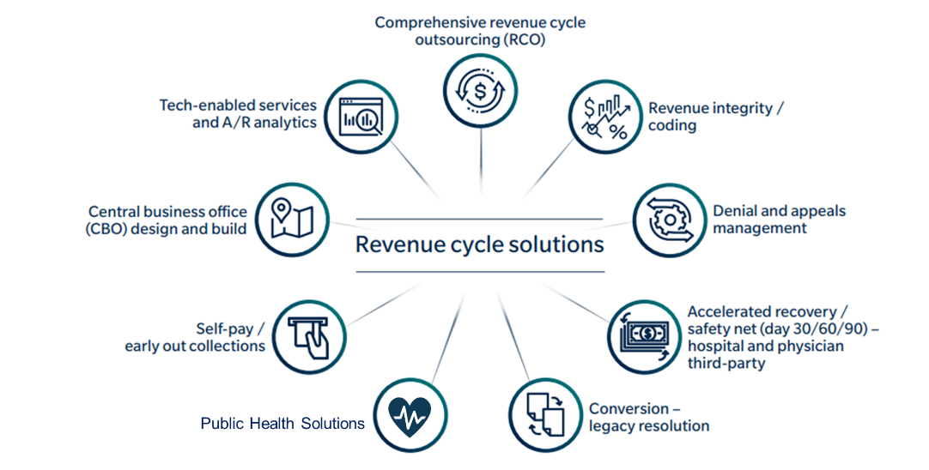

Xtend by the numbers
$12B+
net patient revenue
processed annually
3,200+
revenue cycle and public health professionals connected to our service centers as well as at our customer facilities
30+
years of revenue cycle experience
300+
contracts in 34 states
Solutions
5M+
inbound and outbound calls annually
3
US-based RCM service centers

