Slide 1
BCBSNE HFMA Presentation
1/19/2023

Slide 2




World-class customer service from right here in Nebraska
 | Customer Service Nebraskablue.com Provider service phone number Claims processing questions Benefits questions Eligibility questions Pre-authorization guidance
100+
 | Provider Support Specialist Providerexecs@nebraskablue.com Timely filing override requests Fee schedule assistance Reimbursement reviews Escalated claim assistance Electronic rejects Provider data/set up
10+
 | Provider Relationship Executive Direct call Scheduled sessions Scheduled meetings Training/education sessions On site visits Escalated situations
6

Slide 3
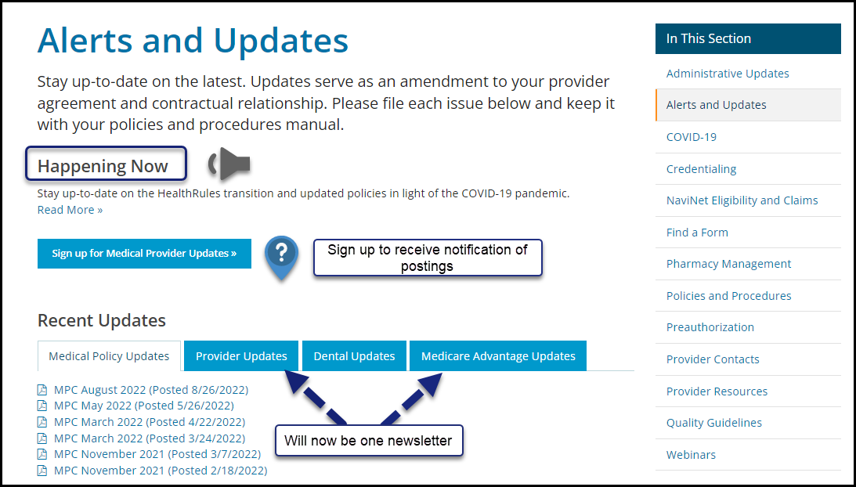
Nebraska Blue – Provider Page
Searching for updates
Alerts & Updates for Providers | BCBSNE (nebraskablue.com) Keeping current on BCBSNE alerts
Happening Now: Information for Providers | BCBSNE (nebraskablue.com)
3

Slide 4
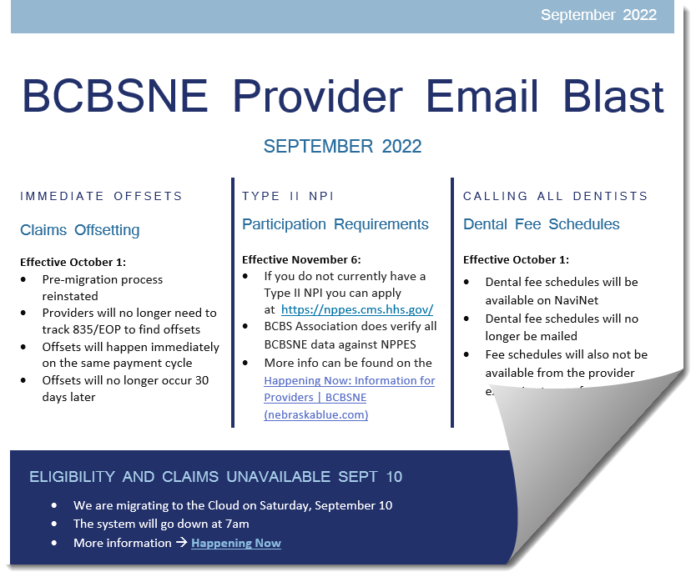
Provider Email Blast

Slide 5
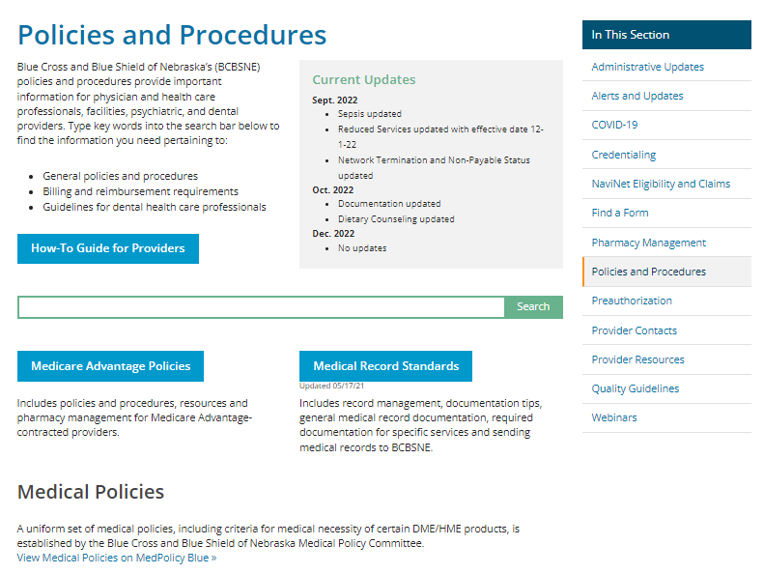
Policy and Procedures Manual
NEW P&P FORMAT IS LIVE
Streamlined Provider P&P
Providers can now access new, searchable webpages
No more PDFs, searching for processes or procedures
Policies & Procedures for Providers | BCBSNE (nebraskablue.com)

Slide 6
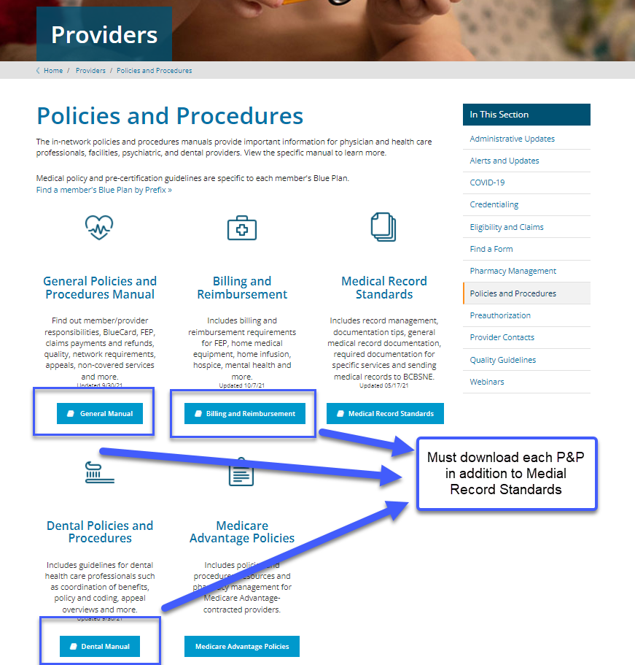
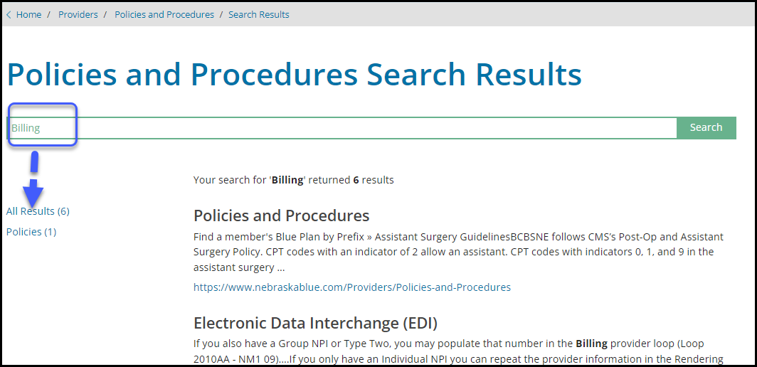
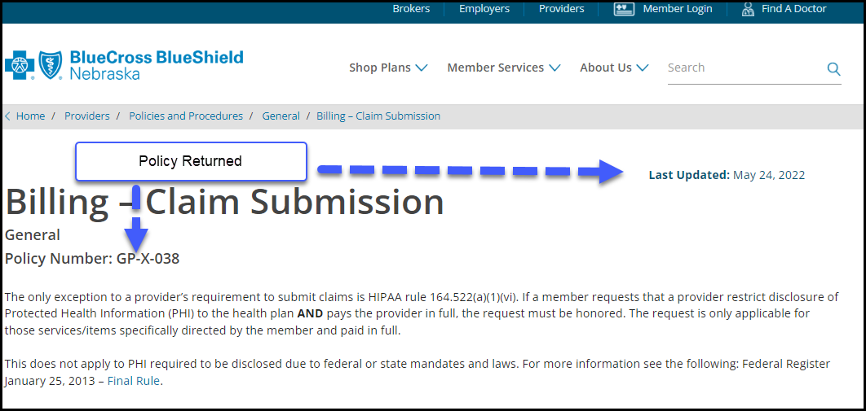
Prior Search
New search
Requires downloading the PDF
Use “control F” feature to search
Knowledge of which manual to use
No PDF
No downloading
All P&P content (General, Reimbursement, and Dental) searched in one location

Slide 7
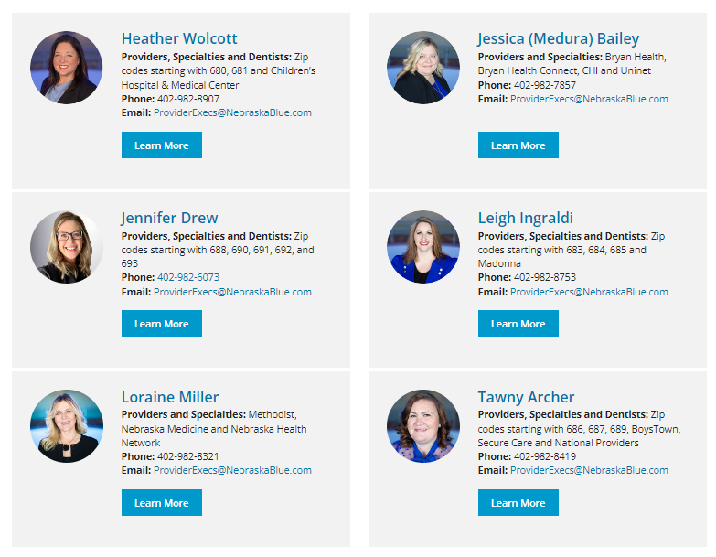
Provider Executive Relationship Team

Slide 8
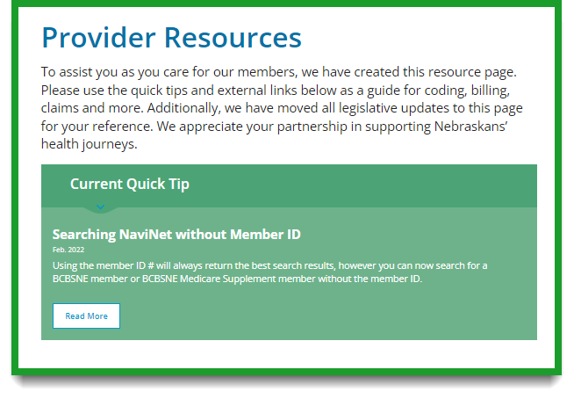
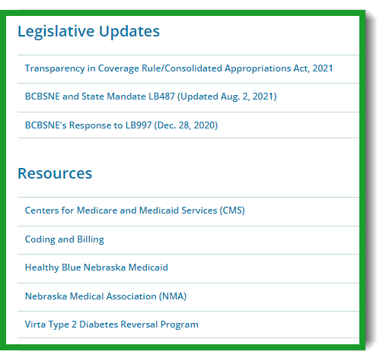
Provider Resources
NebraskaBlue.com/Providers/Provider-Resources
8

Slide 9
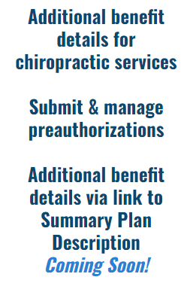
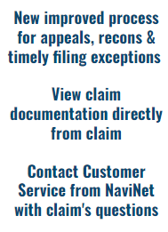
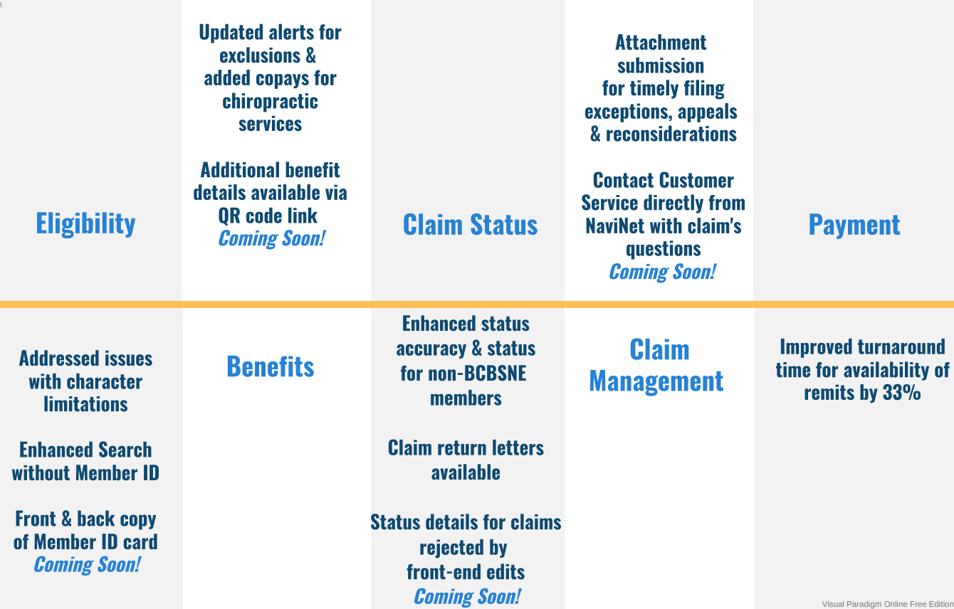



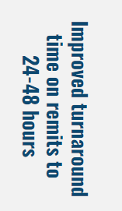



NaviNet enhancements for BCBSNE members
Coming soon!

Slide 10
Listening and making it easier
Q1 2022
Q3 2022
Q1 2023
Out of network claims paid directly to the provider
Search in NaviNet without ID (for BCBSNE members)
Enhanced Provider Resources page on NEBlue
Changes to 835s for recoupment offsets & educational guide
Online medical policy updates
Line-item denials for invalid NDC, missing cost invoice & invalid new patient procedure code vs. returning claim
Specific CLIA waived PLA tests allowed
Transitioned to immediate offsetting
835 enhancements for adjusted claims
Enhancement allowing DX Z23 in any position with COVID Vaccine on Institutional claims
Dental fee schedules in NaviNet 10/1
Additional upfront claim rejections
Claim documentation linked to Claim Status in NaviNet
New NaviNet process for claim’s questions
EAPG info on 835s
New NaviNet webform process for timely filing exceptions, appeals and recons
Provider workshops
Q2 2022
Q4 2022
Return letters & attachments in NaviNet
Implemented Customer Service Provider Support Team
New line-item denials & upfront claim rejections
Re-designed Policies & Procedures & newsletters
Front & back of ID card in NaviNet
Additional benefit details in NaviNet (including dental)
Additional claim status details in NaviNet & the IVR
Provider directory information in NaviNet
Adjusting end of year split claims
Updated NaviNet user guide on NebraskaBlue

Slide 11
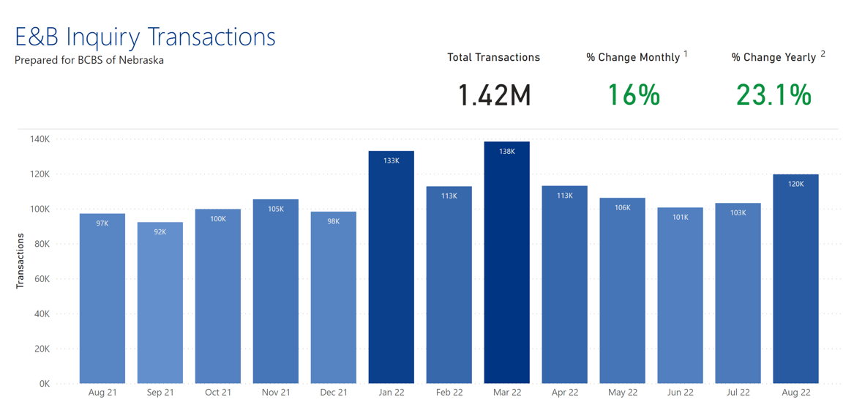
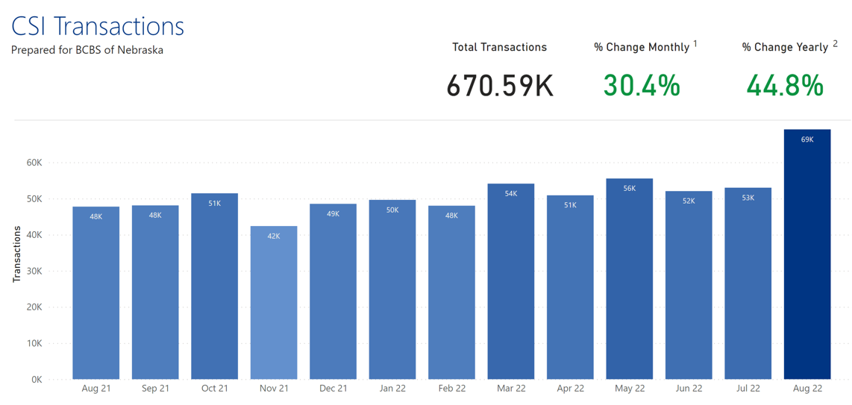
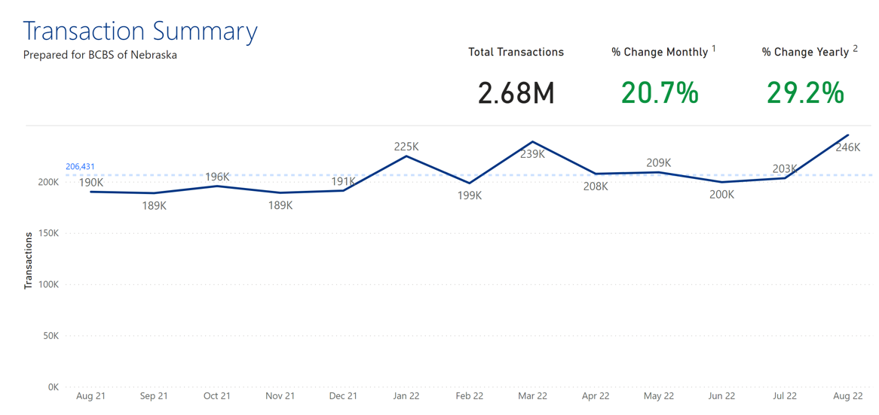
Par Provider Enrollment Summary
NaviNet utilization is up! You can register at https://connect.NaviNet.net/enroll
Eligibility & Benefits
Claim Status
Transactions

Slide 12

Thank you for your time!

