Slide 1
Case Study:
Finance ERP Upgrade Project
HFMA Central Pennsylvania Chapter
January 18th, 2023
Tracy Moyer
Penn State Health
Vice President, Financial Services
Michael Andre
Penn State Health
Director, ERP Governance

Slide 2
Penn State Health - Executing on Strategic Initiatives
2014
Formation of new 501(c)(3), PSH, to serve as parent organization for healthcare activities
July 2015
PSH becomes sole corporate member of PSH St. Joseph (Berks County)
April 2017
Strategic partnership with Physicians Alliance, Ltd. (“PAL”), largest independent physician practice in Lancaster. Partnership increased number of employed physicians and advanced practitioners by 98 (closed in October 2017)
Oct. 2017
Establishment of Hampden Medical Center, LLC, whose purpose was to acquire property in Cumberland County for future site of acute care facility
Dec. 2017
Highmark Health acquires minority interest in PSH pursuant to Affiliation Agreement, thus forming integrated model to facilitate creation of value-based community care network in Central PA.
March 2018
Establishment of LPADC, Inc., whose purpose was to acquire property in Lancaster County for future site of acute care facility
2018
PSH acquired assets of and employed physicians that in total provided over $80 million in revenue and increased providers by 54
March 2019
PSH commences construction of PSH Hampden Medical Center in Harrisburg (Cumberland County). Total costs ~$330M. Once constructed will be 300K SF, 108 bed, 3 story acute care facility
July 2019
PSH announced plans to construct PSH Lancaster Medical Center (~$400M project costs), which is expected to be acute care hospital located on 30 acres in Lancaster County
Sept. 2019
PSH became network provider for Geisinger Health Plan
Oct. 2019
Issuance of $422M in tax-exempt and taxable bonds
.
2014
2015
2016
2017
2018
2019
March 2020
COVID declared state of emergency in U.S
Nov/Dec 2020
Completion of acquisition of Holy Spirit Health System that includes 306-bed hospital in Cumberland County; Creation of Penn State Health Life Lion, LLC, integrating WSALS as part of the Holy Spirit acquisition
Feb 2021
Moody’s and S&P revise rating outlook from Stable to Negative but maintain A1/A+ rating
April 2021 System closed a new $230 million line of credit with PNC
October 2021
Opening of Hampden Medical Center
November 2021
Issuance of debt to fund construction of Lancaster Medical Center ($63M+ of $400M in costs funded with operating cash)
2021-2022
Repayment of $160M of Medicare advance payments (commencing on 1-year anniversary of receipt recouped at 25% for 11 months, 50% for 6 months and full amount due after 17 months (29 months after initial receipt))
June 2022
PSH completes and opens the Lancaster Pediatric Center, a 47k SF pediatric outpatient center in Lancaster, branded under PSH Children’s Hospital
October 2022
Final stages of conversions of all Holy Spirit IT platforms and solutions into PSH infrastructure (conversions off TSAs with Geisinger)
Late 2022
Opening of Lancaster Medical Center
2023-2024
Ambulatory EMR & Billing platform conversions for PSH Community Medical Group practice sites (throughout 2023-24 calendar year)
Upcoming Key Events
2
2020
2021
2022
2023
Hospital M&A / Construction
Debt Issuances / Credit News
Other Significant Milestones

Slide 3
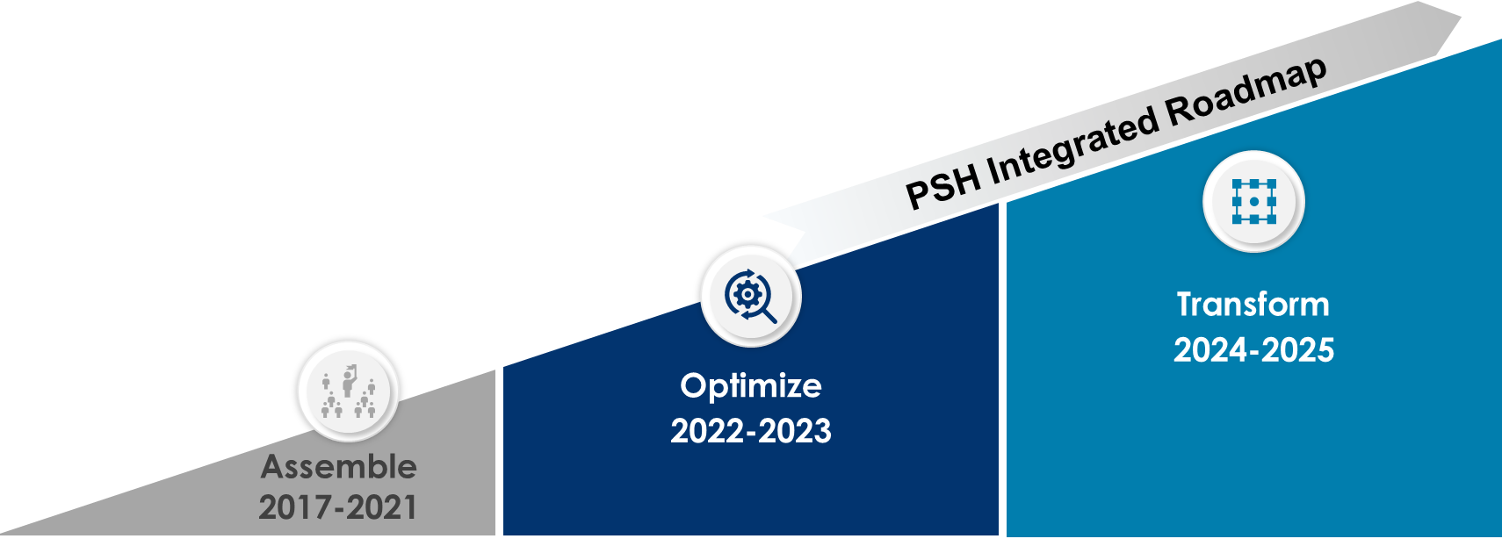
Penn State Health Strategic Journey
An overview of the PSH journey – past, present, future
2017 Penn State Health/Highmark Health Affiliation
Unify all electronic medical records systems
Deliver differentiated experience for patients, providers, staff
Acquisitions of PAL, Holy Spirit, Andrews & Patel, etc.
Enhance patient access and experience
Enhance affordability
Development of new ambulatory sites
Strengthen provider referral management
Advance digital experience
Opening of Hampden Medical Center
Site of care strategy: Right care, right place, right cost
Development of Lancaster Medical Center
Transform IT infrastructure
Implement alternative payment models
Establishment of Community Practice Division
Streamline processes and functions
Launch Choice Blue product
Expand virtual health strategy
Re-Launch of Penn State Health Clinically Integrated Network
Grow population health capabilities

Slide 4









Cloud ERP Implementation Vision and Objectives
Penn State Health’s vision was to transform its services and capabilities in order to behave and operate as one leading, integrated health system through the implementation of Infor Cloudsuite.
Improve & Streamline Operations
Sustain Growth
Streamlined interactions and increased collaboration across
Human Resources, Finance and Supply Management
Minimized disruption when ingesting M&A by leveraging new, standard definitions as opposed to unique cost centers
Standardization
Shared Services
Leverage Leading
Processes
Remain Competitive
and Agile
Backoffice Automation
More efficient, automated processes that eliminate the need for paper based forms
Ability to communicate additional budgeting and forecasting details (e.g. EoY projections) to executive leadership and the Board

Slide 5









Technology Landscape
With an “Infor first” approach, PSH worked towards a simplified systems landscape.
Past
(Illustrative)
Post implementation (Illustrative)
HPM
Docfinity
Equifax
Qlik
Smart Square
FCM
Cash Rec
Infor XM
Email
Cerner
EAM
SCM
ServiceNow
Lawson Financials
Paper Forms
AllScripts
Infor GHR
BANG
S3
Kronos
Crystal
Excel
Birst
HCM
Avantas
McKesson
Access
LeaseX
Many systems including redundant systems
Complex and customized
Many manual and inefficient processes
Large number of workarounds
Data and core activities outside of a system
System simplification and standardization
Transformational thinking
Using out of the box functionality
Efficient processes
Manual processes virtually eliminated
All employees and departments are working together as one team toward a common goal

Slide 6














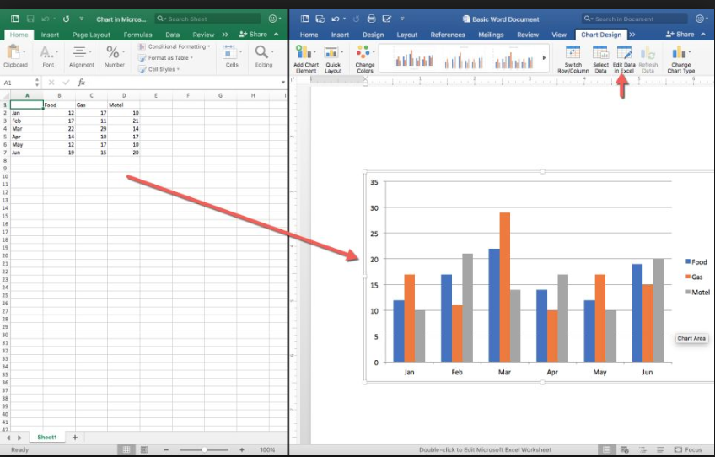
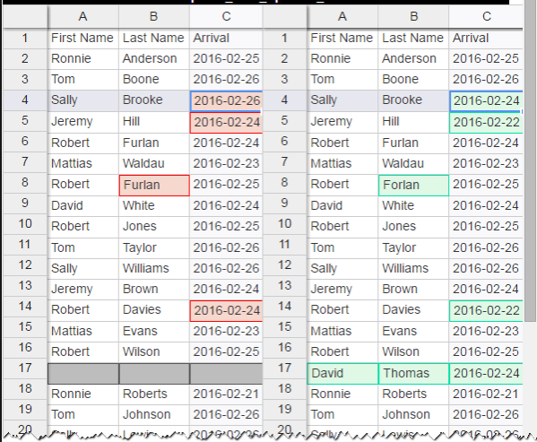

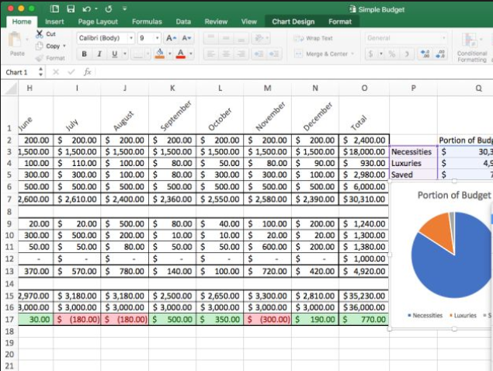
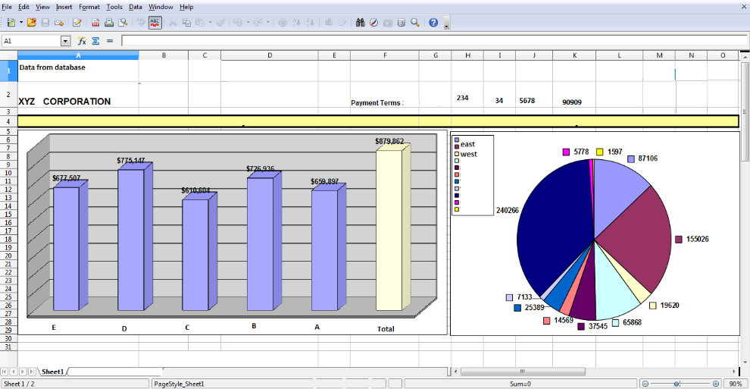



New Ways of Working
Enabling technology and end-to-end process execution have activated new ways of working and behavior change.
Past (Illustrative)
Desired Post Implementation (Illustrative)
Finance
HR
IT
SCM
One Health System
Finance
HR
IT
SCM
End-to-End Processes
Infor CloudSuite
Siloed operations and ad hoc communication
Limited access to data and poor flow of information
Lack of governance and accountability
Complex and customized
Many manual and inefficient processes
Large number of workarounds
Process simplification and standardization
Transformational behaviors that understand upstream and downstream
End-to-end process orientation
Efficient processes and automated processes
All employees and departments are working together as one team toward business objectives with common procedures and data

Slide 7
Implementation Timeline
High level ERP Cloud Implementation Timeline
October 2018 – May 2019
June 2019 – September 2020
September 2020 – May 2021
May 2021 – July 2021
July 2021 –
October 2021
Plan
Design and Build
Test / Validate
Train / Final Prep and Deploy
Support
Communication Development and Delivery
Timeline listed above is actual timeline from Planning through Support.
Initial phase lengths were extended due to various circumstances in agreement with all parties.

Slide 8
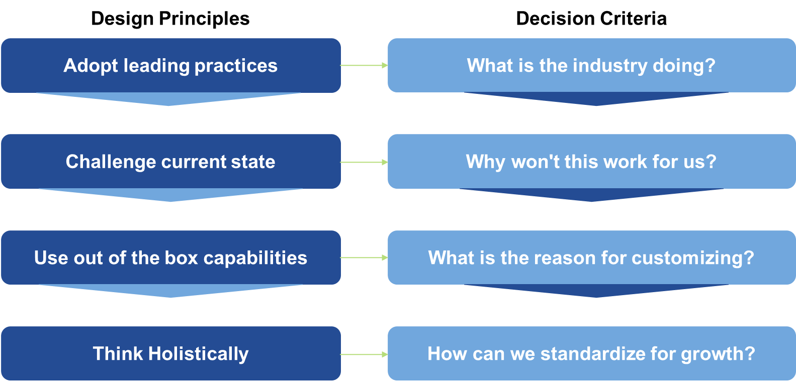




Design Principles and Decision Criteria
Solutions were focused on what's core to its vision and the goals of the health system at large.

Slide 9
Implementation by the numbers
Through the implementation of Infor Cloudsuite, PSH achieved the following:
Design / Testing Statistics
Training Statistics
Other Statistics
Design workshops held | 120
Processes validated | 65
Conference Room Pilots | 6
Engaged unique stakeholders | 500+
Testing cycles (system integrated testing and user acceptance testing) | 3
Instructor lead trainings | 46
e-learnings created | 43
Job Aids available (Access: 2 , Finance: 174, Human Resources: 57, Supply Chain: 100, Workforce Management: 34) | 367
Live presentations / comms (i.e. design summit, Management councils, leadership meetings, Executive briefings, etc.) | 150+
# of employees impacted | 18,462
# of help desk tickets remediated as of 11/22/21 | 7,279

Slide 10



Challenges and Lessons Learned through Implementation
Like almost all projects, PSH experienced challenges and has many lessons learned.
Challenges
Lessons Learned
Organizational Readiness
Overall readiness for large scale change across the enterprise
Organizational Change Management
Frequent communication & key stakeholder involvement is necessary– resistance to change can be high
Global Pandemic: COVID-19
Supply Chain shortage, travel restrictions, work environment changes
Cultural Shift to Adopt Design
Adherence to updated policies, cloud technology environment
Resource Availability / Complexity
Multi-year project, operational responsibilities, knowledge gaps
Dedicated Project Resources
Internal and external resources dedicated to the project are imperative
Technology Changes / Offerings
Changing landscape of available features
Scope Management and Change Control
Technology continuously evolves, scope must be managed via proper change controls to decrease scope creep
Health System Acquisitions & Growth
Growth across the enterprise
Monitoring as a Top Priority
Operational and End User reports/dashboards/controls should be considered a top priority for go-live, inclusive of data validation

