Slide 1


Denials Management
Leveraging Analytics to
Improve Denials Performance
January 2023

Slide 2

Healthcare Providers Are Facing a Perfect Storm
Massive shift to Fee-for-Value with inadequate tools and information
Commercial payers and CMS both committing to significant FFV targets over the next 3 years; providers tracking upwards of 100 quality measures, primarily via spreadsheets; accurate coding/HCC capture is essential
Administrative requirements are reaching a breaking point
Greater usage of pre-authorizations, referrals, etc. to control utilization of services
Increased need of data concerning predictive analytics in a learn based care environment
REGULATION
ADMINISTRATIVE REQUIREMENTS
Costs shifting to the consumer
Approaching $650 billion in annual patient responsibility and increased bad debt expense; providers must increase yields just to maintain current revenue
Massive productivity & staffing challenges
Projected to result in 40% productivity loss in coding operations; significant impact to cost-to-collect metrics and denial rates
PATIENT
PAY
STAFFING
Consumerism is changing the game and the necessary tools to play
Patient experience, mobile transparency tools, patient payment options... all critical to maintain patient volume
Pressure to consolidate for providers
Limited options to achieve necessary scale, manage risk and make necessary technology purchases
CONSUMERISM
CONSOLIDATION

Slide 3
The Healthcare Revenue Cycle is Complex
Yield & Cost Optimization Opportunities Across the Front, Middle and Back Ends of the Revenue Cycle Offer Significant Opportunities for Performance Improvement
PRE-CERTIFICATION
PAYER PAYMENT ANALYSIS
THIRD-PARTY FOLLOW-UP
INSURANCE VERIFICATION
PRICE ESTIMATION
Coordination of Care
DENIAL PROCESSING
CUSTOMER SERVICE
Coordinated Financial & Clinical Care
PRE-REGISTRATION
FINANCIAL COUNSELING
Compliant Clinical Documentation
REMITANCE PROCESSING
SELF-PAY COLLECTION
ENGAGED PATIENT
RESOURCES
RESOURCES
SCHEDULING
CASHIERING
CLAIM PROCESSING
Standard Work
Culture
COLLECTION AGENCY
Standard Work
Culture
Culture
People
CUSTOMER
EXPERIENCE
Process
AUTOMATION
People
CONSUMER
EXPERIENCE
Process
AUTOMATION
PATIENT
EXPERIENCE
People
Process
PATIENT ARRIVAL
CASE/REFERRAL MANAGEMENT
Metrics
Communication
Metrics
Communication
Metrics
Communication
AUTOMATION
Technology
Technology
STANDARD WORK
Technology
SATISFIED CUSTOMER
ENGAGED CONSUMER
VALIDATION AND ACTIVATION
RESOURCES
CLINICAL DOCUMENTATION &
REVENUE RECOGNITION
Ease of Access
Appropriate Payment
Improved Consumer Service
Effective and Efficient Account Resolution
Improved Quality
FINANCIAL CLEARANCE
PATIENT CARE DELIVERY
Decreased Cost to Collect
Source: HFMA

Slide 4

Without a Data Driven approach revenue cycle teams are managing Denials blind
Lower Yield
Missed Cash Opportunities
Increased AR Days
Wasted Labor and Processing Costs
Poor Patient Financial Experience
Reputational Harm

Slide 5


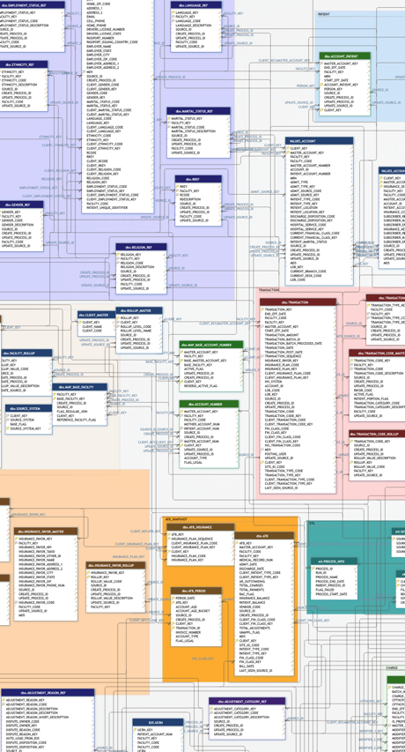
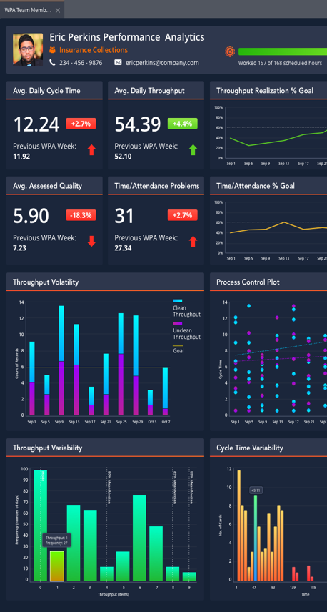
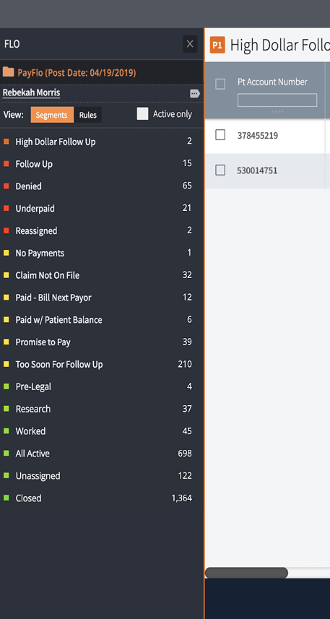
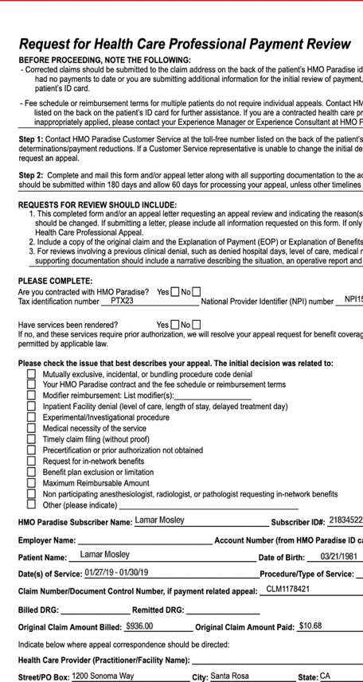

The Analytics Backbone for improved Denials Performance Management
RCM DATA LAKE
AGGREGATION
ANALYSIS
ACTION
AUTOMATION
Smart Data Curation
Advanced Analytics
Intelligent Workflow
Cognitive Automation

Slide 6
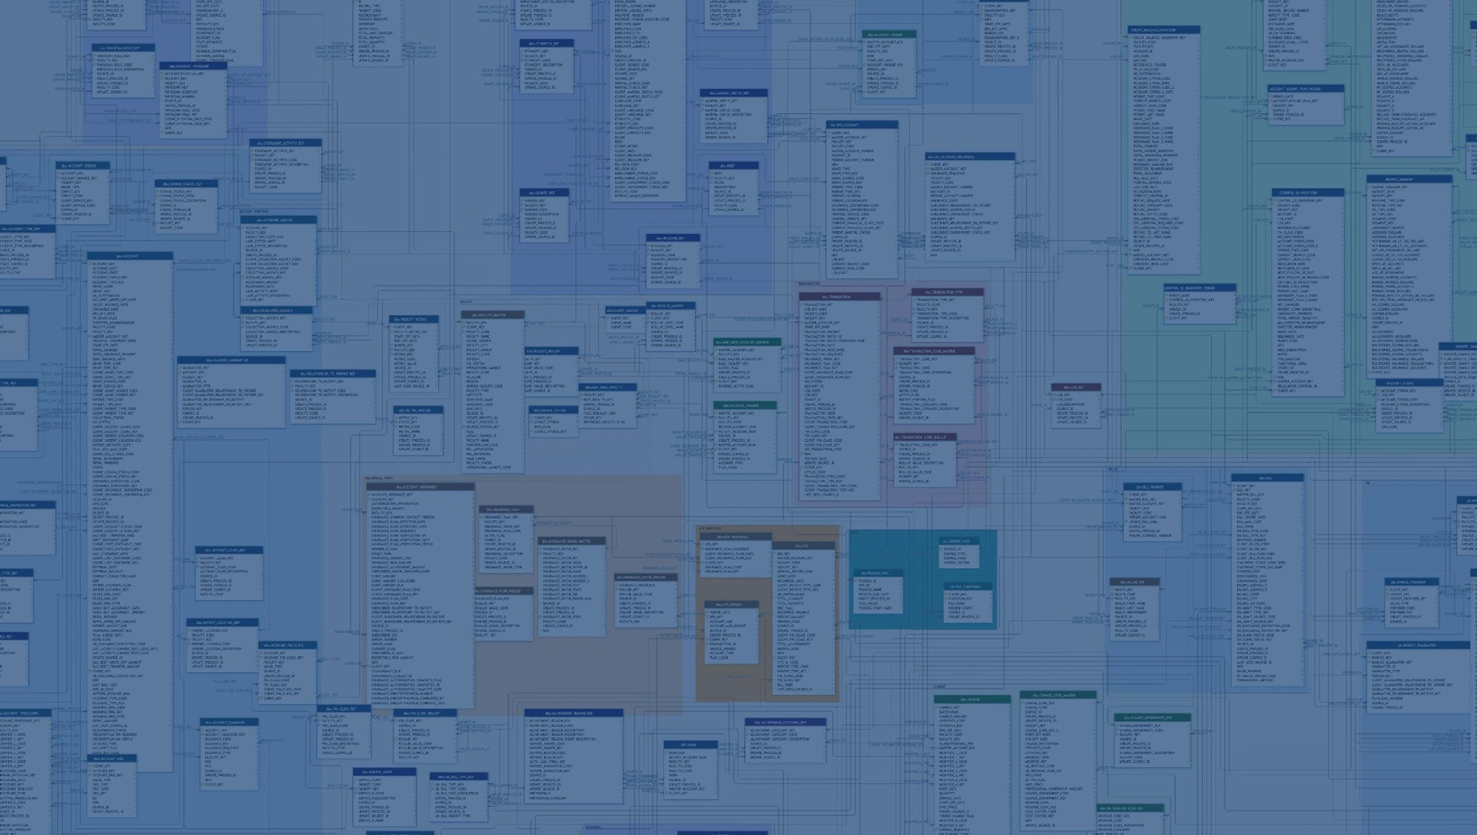
The Longitudinal Patient Financial Record
AGGREGATION
Smart Data Curation

Slide 7
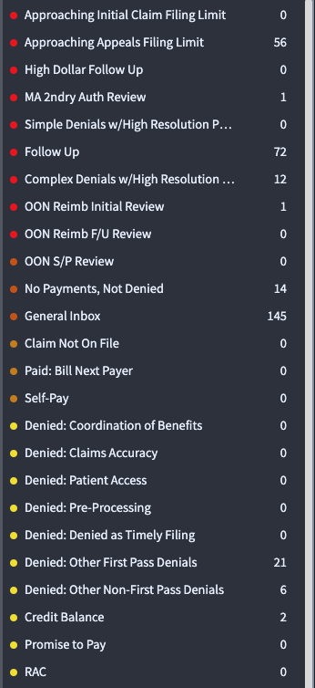

The Analytics Backbone // Curation, Aggregation, & Imbedded Intelligence
DATA SOURCES
IMBEDDED INTELLIGENCE
ATB
Txns
Charges
Clearing House
Root Cause
Compliance Timers
Complexity
837/835
Owner
Payer Mapping
Opportunity %
Claim Status
Category
FOCUSED
Segmentation

Slide 8
The Analytics Backbone // Analyze & Visualize
Exploratory analyses facilitate identification
Conduct an exploratory analysis of your data to identify the right data points and establish parameters that qualify the problem.
The right data points are mission critical
Enrich with Advanced analytics, imbedded intelligence to drive informed decision making
Imbedded Intelligence: Root Cause, Owner, Overturn Rank, Actionability, Complexity, Type, Disposition, First, Most Recent, Payer Order
ANALYSIS
Advanced Analytics

Slide 9
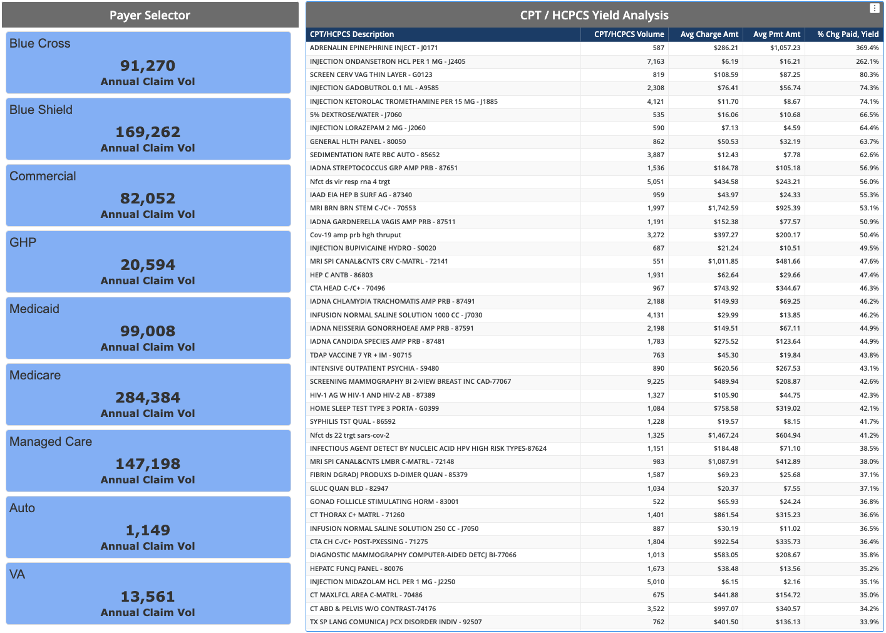
CPT/HCPCS Yield Analysis
– Aggregate, Segment, & Analyze –

Slide 10
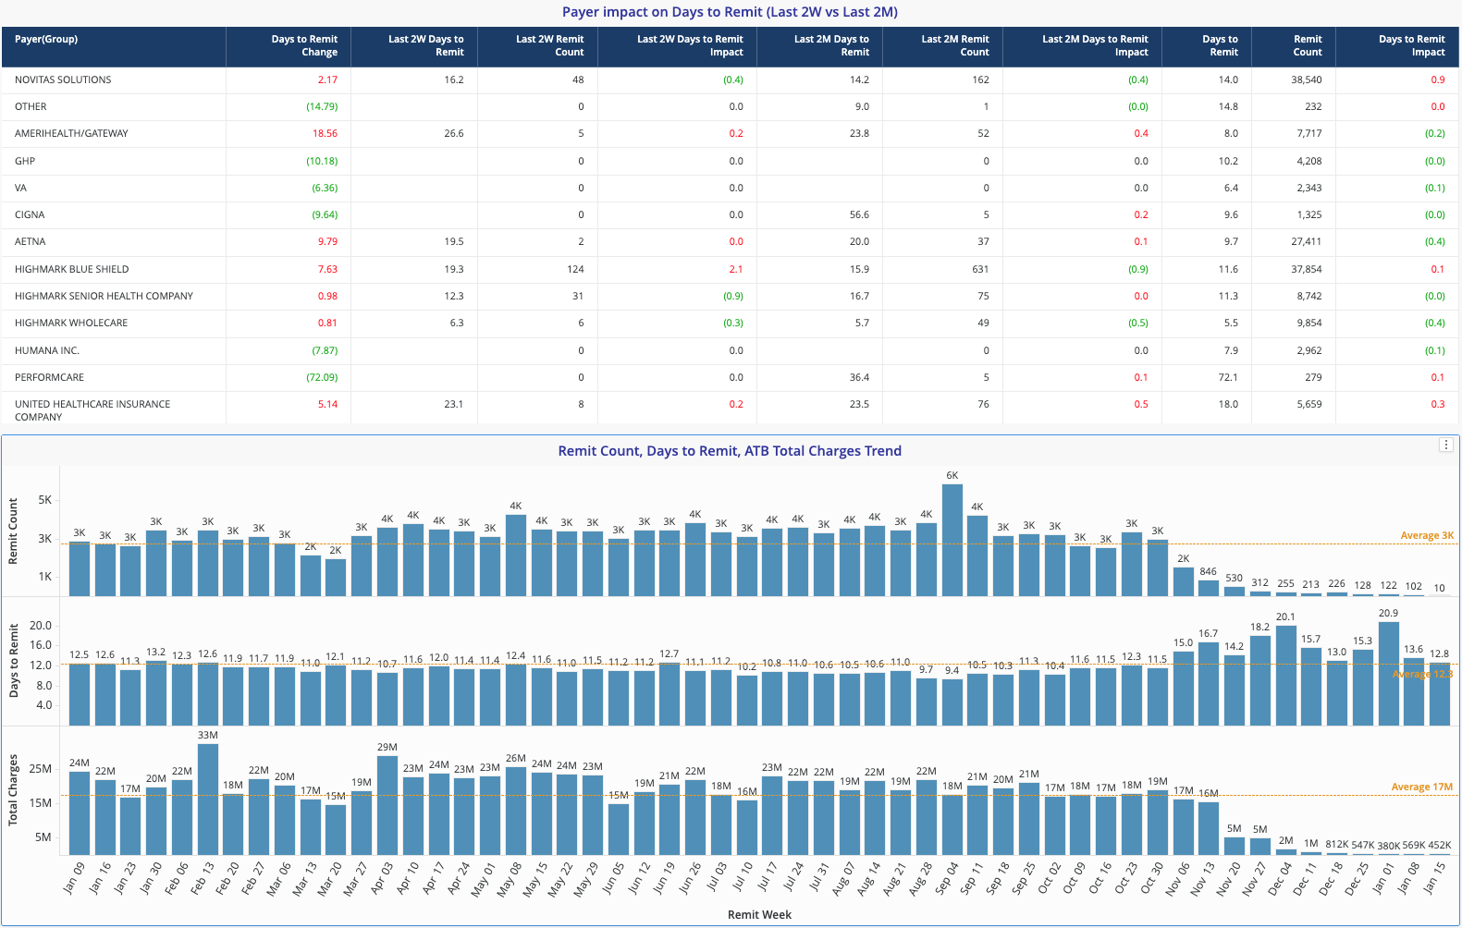
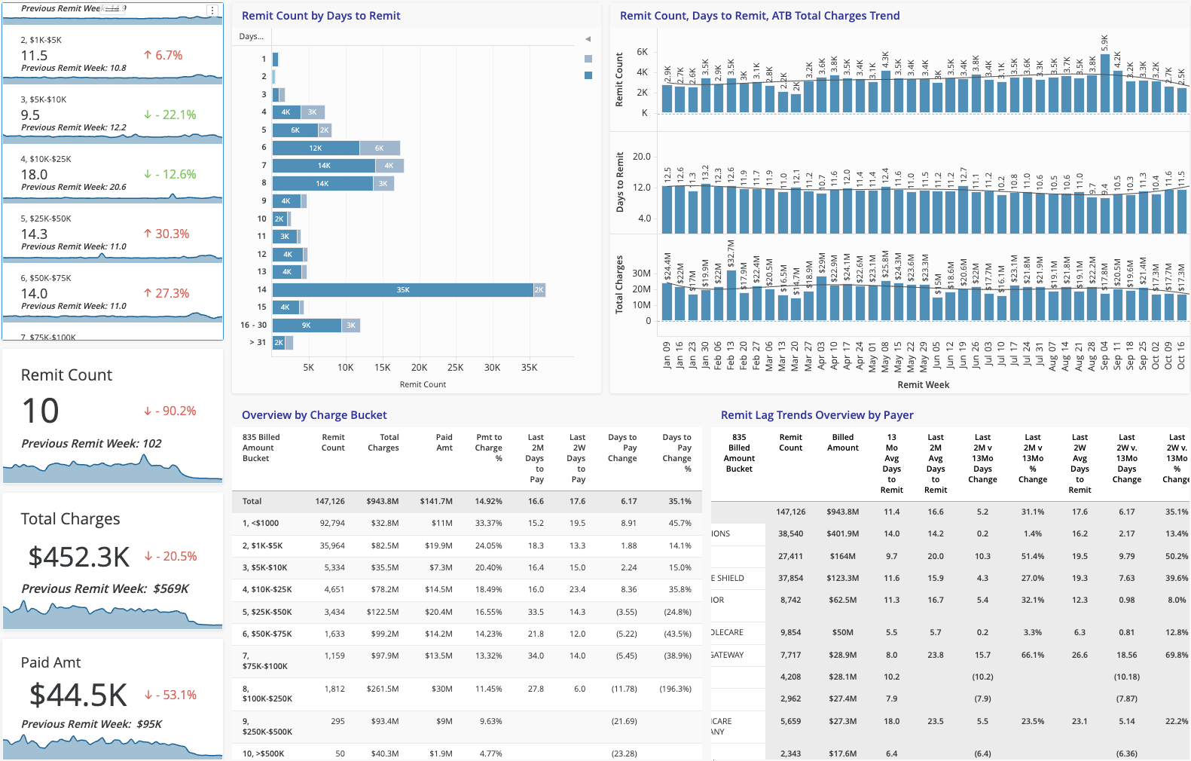
Payer Response & Payer Lag Insights
– Analyze: Summary, Trend, & Directional Analyses –
Directional
Analyses
Summary & Trend
Analyses

Slide 11
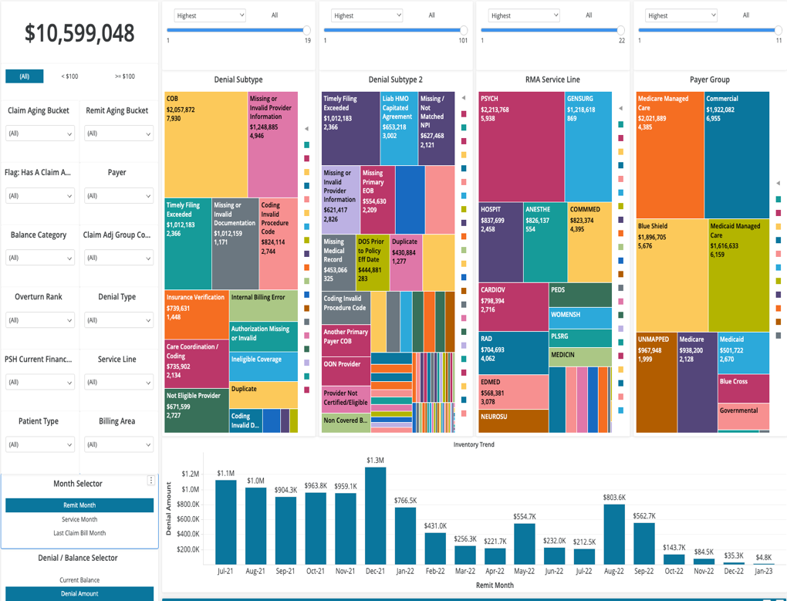
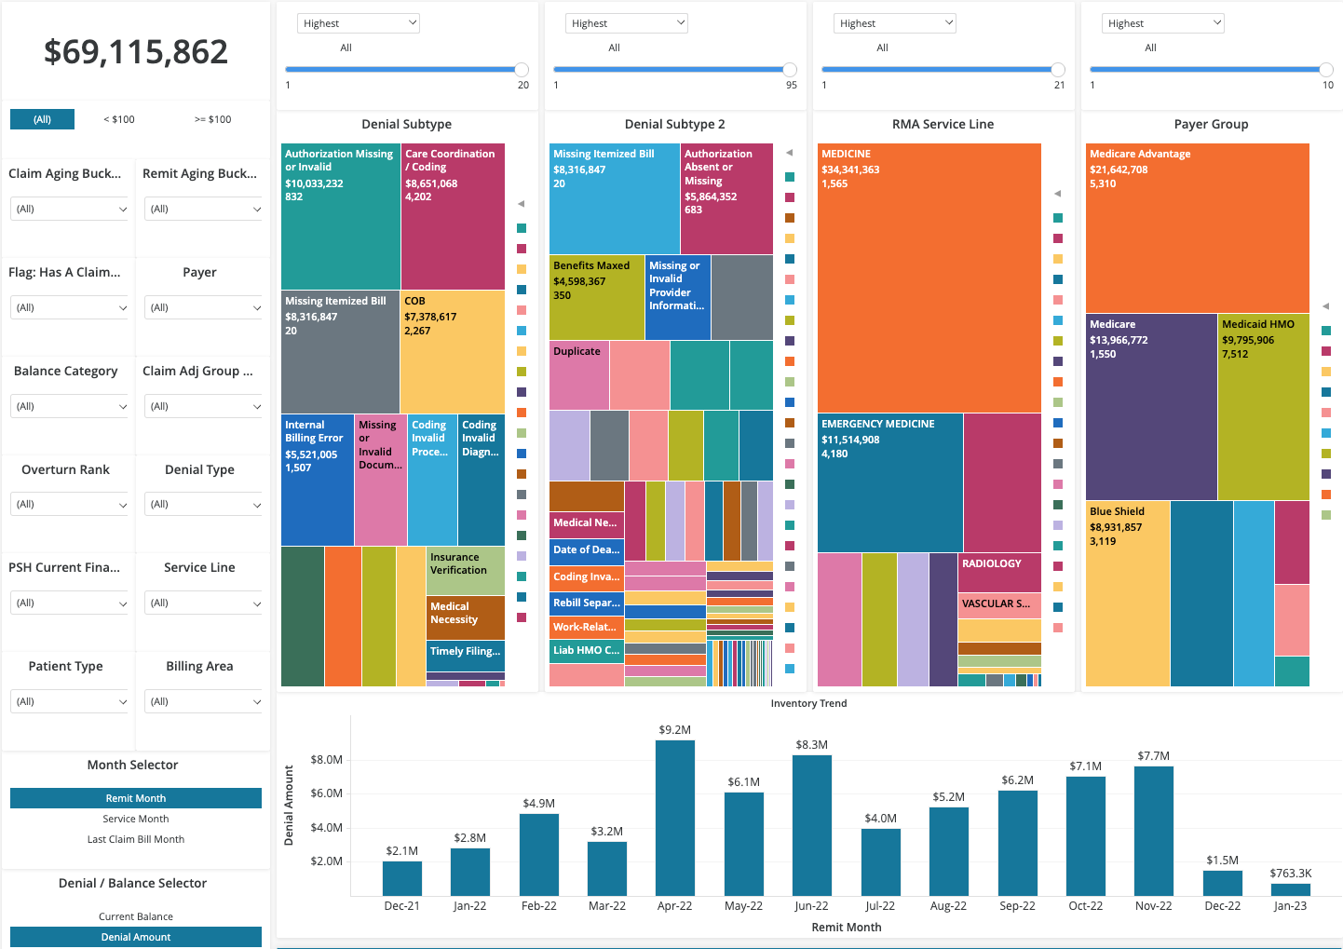
Robust Denials Insights for Improved Operational Performance
– Insights Drives Action –

Slide 12
The Analytics Backbone // Automation
Leverage Automation to Streamline Denials Management
Data analytics tools are also key to automating denial management strategies
Implementing more automated denials management processes can also help providers navigate a plethora of different payer rules and codes.
Automation Starting Points
Coordination of Benefits
Itemized Bill Submission at time of Claim Drop
Medical Records Denials (Missing Documentation)
Eligibility and Auth
AUTOMATION
Cognitive Automation

Slide 13
Summary
For organizations, leaders and teams to effectively manage denials and ultimately improve performance they must
The Foundation: Deploy a robust and scalable analytics solution that aggregates, curates, and imbeds intelligence into the digital longitudinal patient record
Reduce Noise: Establish a clear picture of your denial baselines and position, and overall organizational impact
Take Action: Operationalize the curated intelligence by injecting up stream and down stream for end-to-end process improvements
Automate: Layer RPA/IPA into high volume, high friction processes
Measure & Repeat: Measure the outcomes and adjust as needed

Slide 14
THANK YOU
Please reach out directly with questions or inquiries!
VisiQuate
Dom Foliano, Vice President Client Development
Dominic.Foliano@VisiQuate.com
M: 717.884.4077 // W: VisiQuate.com
111 N. Front St // Harrisburg, PA 17101

