Slide 1


Michigan Great Lakes HFMA
CHFP Exam Prep Session #1
January 5, 2023
Nick McLaughlin
Founder & CEO
Breez Health

Slide 2

Certified Healthcare Financial Professional
Module 1 Overview

Slide 3
Polling Question # 1
How did you learn about this CHFP training series?
a) HFMA email blast
b) Social Media
c) HFMA website
d) Other
Notes:
Answer is A

Slide 4

Module I: The Business of Health Care
Notes:
HFMA’s The Business of Health Care presents the comprehensive analysis of today’s healthcare environment and provides a broad overview of the shift in healthcare service delivery and evolving payment models. The course offers participants the unique opportunity to expand their breadth of industry understanding and sharpen their ability to engage in healthcare business issues.

Slide 5
Purpose of this Chapter Learning Program
Highlight key knowledge for strong job performance
Provide an overview of important concepts. The in-depth presentation is in the online course.

Slide 6
What’s In It For Me?
Big-Picture
Multi-disciplinary perspective
Business savvy
4
Notes:
What’s In it for me? After completing The Business of Health Care you will be better prepared to:
Objectives:
Gain a “big picture” perspective enabling you to articulate the current healthcare business environment
Realize an integrated, multi-disciplinary business perspective with deep awareness of the business issues for providers, payers and physicians
Build professional practice knowledge and skills integrating:
- Financial accounting and management
- Cost Accounting
- Strategic Financial Management
Recognize payment trends and opportunities for providing value in healthcare service delivery
Establish strong multi-disciplinary and collaborative business skills
Gain the knowledge to work in contemporary healthcare business environment

Slide 7
The Approach
The Business of Health Care, six courses:
Healthcare Finance: The Big Picture
Financial Accounting Concepts
Cost Analysis Principles
Strategic Financial Issues
Managing Financial Resources
Looking to the Future
End of course assessment:
90-minute assessment, 75 questions
5
Notes:
The Business of Health Care consists of six courses:
Healthcare Finance: The Big Picture
Financial Accounting Concepts
Cost Analysis Principles
Strategic Financial Issues
Managing Financial Resources
Looking to the Future

Slide 8
Tips for Learning
Concept Guide
Identifies key concepts, terms and applications that you must know for the end-of-module examination
USE IT
Notes:
The Business of Healthcare is designed as an online learning experience. Each course is designed to assist you in learning at your own pace. There are brief knowledge demonstration exercises through each course as well as a quiz to conclude each course. Additionally, once you have completed all courses, there is a comprehensive examination to validate your knowledge.
In addition, there is a Concept Guide that can be used as a study guide as you review each course.
The Concept Guide is available in the elearning course materials as part of the purchase price.

Slide 9
Learner’s Guide
Coaching Course Learning Exercises
Take notes
Notes:
For the learner:
The Learner's Guide provides an opportunity to candidates to understand, integrate and apply the concepts covered. As we go through the course presentations, we will reference items that you may follow along with using the Learner’s Guide provided as a handout.
Please take notes using the blank sheets as needed.
For the facilitator:
There are a variety of exercises that the candidates may complete together or undertake as homework.
The Learner's Guide may also be used as a sample guide for chapters to design exercises as well. The guide may be used as a brief assessment to determine if candidates understanding of the concepts covered.
Chapter leaders are encouraged to be creative in using the Learner's Guide

Slide 10
Certified Healthcare Financial Professional
Module I - The Business of Health Care
Course 1: The Big Picture

Slide 11
Learning Objectives
You will be able to:
Describe the structure of the US healthcare industry
Understand the impact of healthcare reform on the industry
Explain the payments systems
Explain the role of financial management in healthcare
Notes:
Next to national defense, the health care industry in the United States is one of the largest sectors of the economy. Currently making up almost 20 percent of the nation's gross domestic product, health care in the US will be a significant factor in the national economy for the foreseeable future. Upon completing this course, you should be able to:
Describe the general characteristics of the healthcare industry in the US;
Describe the impact of health reform on the industry;
Describe the payment system for healthcare services;
Define the role of financial management in health care organizations; and
Describe some of the new challenges facing healthcare finance in the US.

Slide 12
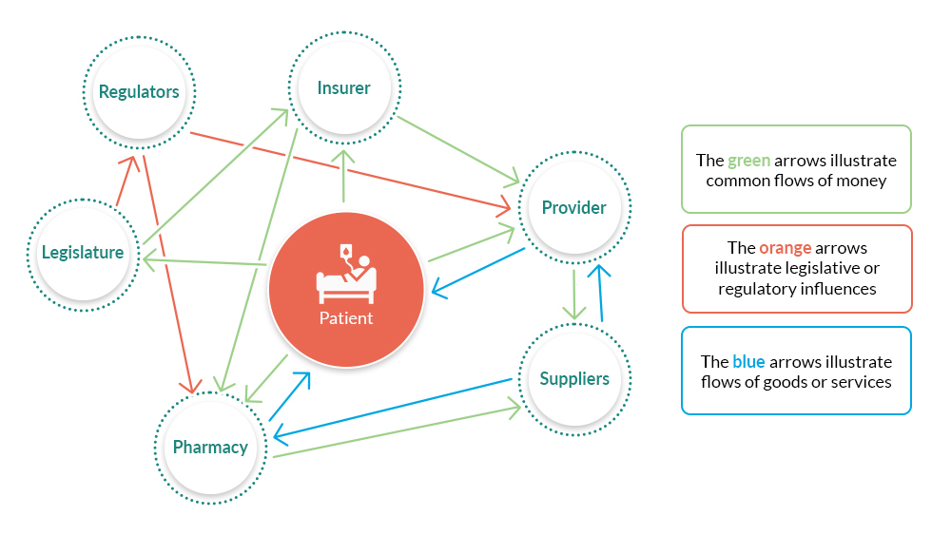
The Big Picture
Notes:
Health care in the US is not a simple relationship between a sick or injured person (usually referred to as the patient) and a party rendering medical care such as a physician or hospital (either often referred to by the term provider). There are a multitude of different participants in the delivery of medical care, most of which are not directly involved with treating an illness or injury and include insurers, regulators, and suppliers
Key Point: Health care is not like other types of purchases where the consumer makes a decision to buy something directly form a seller and pays that seller directly, such as with buying an appliance. Instead, a third party (“insurer”) makes the payment on behalf of the consumer (the patient) to the supplier of services (“provider”). This third party creates some extra work in health care that we may not see in other consumer industries.

Slide 13
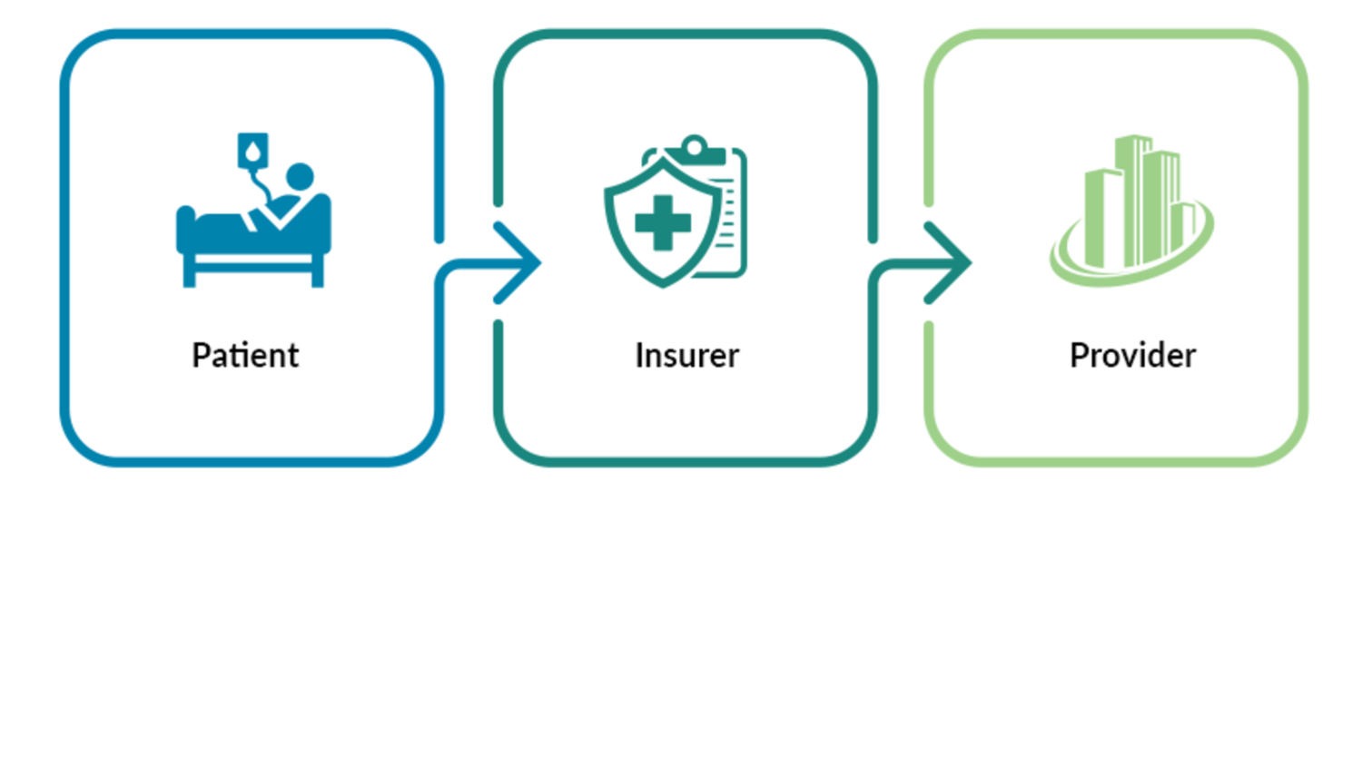
Financing the Healthcare System
Notes:
The revenue cycle in healthcare can be described as the flow of money between the patient, the insurer, and the provider of healthcare services. Depending on the type of insurance coverage a patient has (or if they have no insurance at all), the employer that provides insurance to the patient may also have a part in that description.

Slide 14
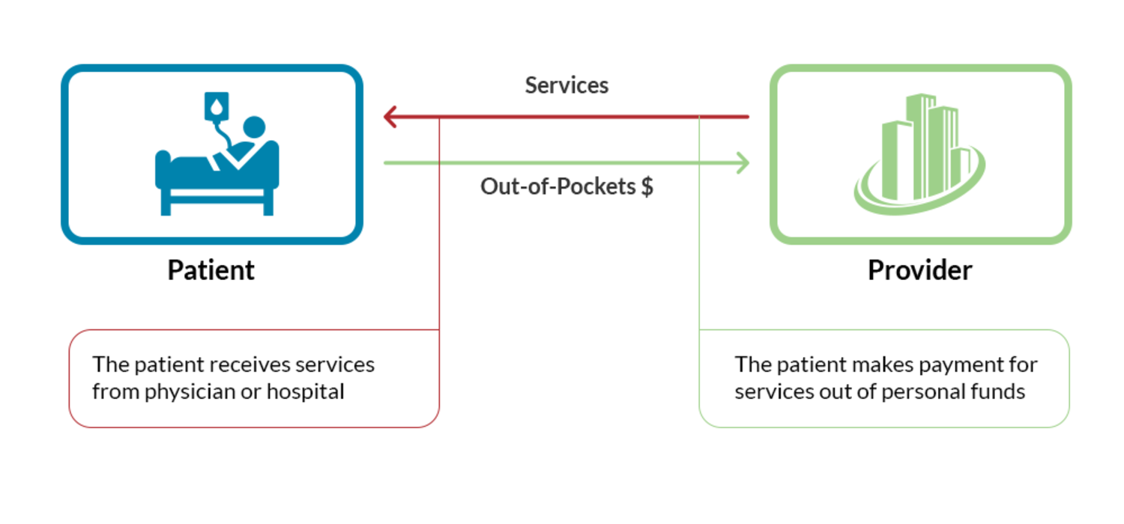
Financing the Healthcare System
The fundamental funding transaction
Notes:
While many persons in the US have health insurance, we will start with illustrating the most basic relationship – that between just the patient and the hospital or physician that provides services to them.

Slide 15
Polling Question # 2
Do you currently hold any other HFMA certifications?
Certified Revenue Cycle Representative (CRCR)
Certified Specialist Accounting & Finance (CSAF)
Other
I do not hold any other HFMA certifications

Slide 16
Financing the Healthcare System
PPACA and Healthcare Insurance
Health Insurance
Exchange
Broker
Doctors
Premium
Claims
Co-Pays
Hospital
Forms
Notes:
Prior to passage of the Patient Protection and Affordable Care Act (ACA), that insurance was usually provided by an employer to the employee as an additional form of compensation, known as an employee benefit. Since passage of the ACA, it is common for some patients to obtain insurance directly from an insurer when the patient does not get health insurance as an employee benefit.
Whenever the patient obtains health insurance - either through an individual plan or an employer-sponsored plan - insurers often require some out-of-pocket payment by the patient to go along with the insurance payment, usually as an incentive to the patient to use insurance only when needed

Slide 17
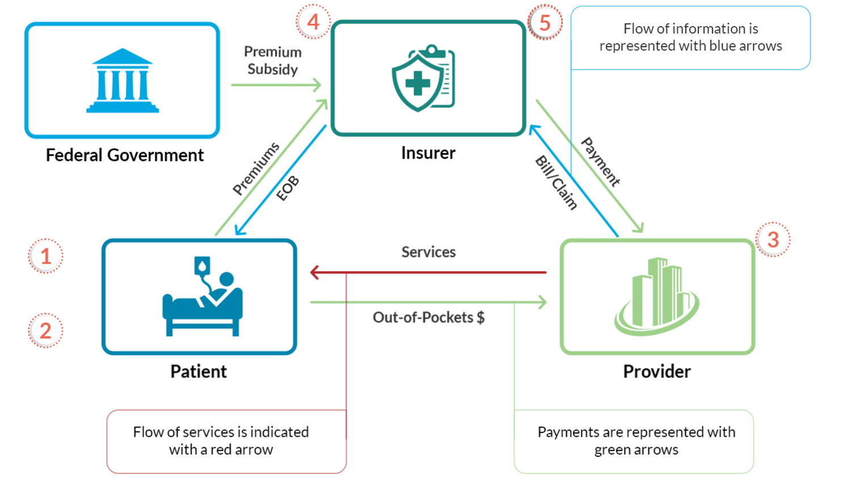
Financing the Healthcare System
Flow of Money and Services for a Patient with Self-Provided-Insurance
Notes:
Prior to passage of the Patient Protection and Affordable Care Act (ACA), that insurance was usually provided by an employer to the employee as an additional form of compensation, known as an employee benefit. Since passage of the ACA, it is common for some patients to obtain insurance directly from an insurer when the patient does not get health insurance as an employee benefit.
Whenever the patient obtains health insurance - either through an individual plan or an employer-sponsored plan - insurers often require some out-of-pocket payment by the patient to go along with the insurance payment, usually as an incentive to the patient to use insurance only when needed

Slide 18
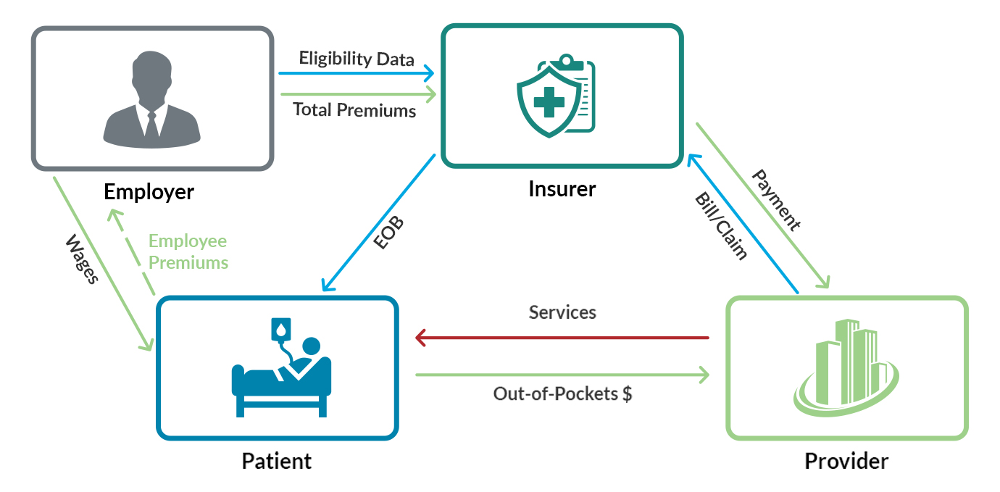
Financing the Healthcare System
Flow of Money and Services for a Patient with Employer Provided Insurance
Notes:
This illustration describes the normal flow of funds and services for a patient that has insurance provided by their employer – a situation that applies for about 149 million persons of ages less than 65 years, or about half of all persons working in the U.S.

Slide 19
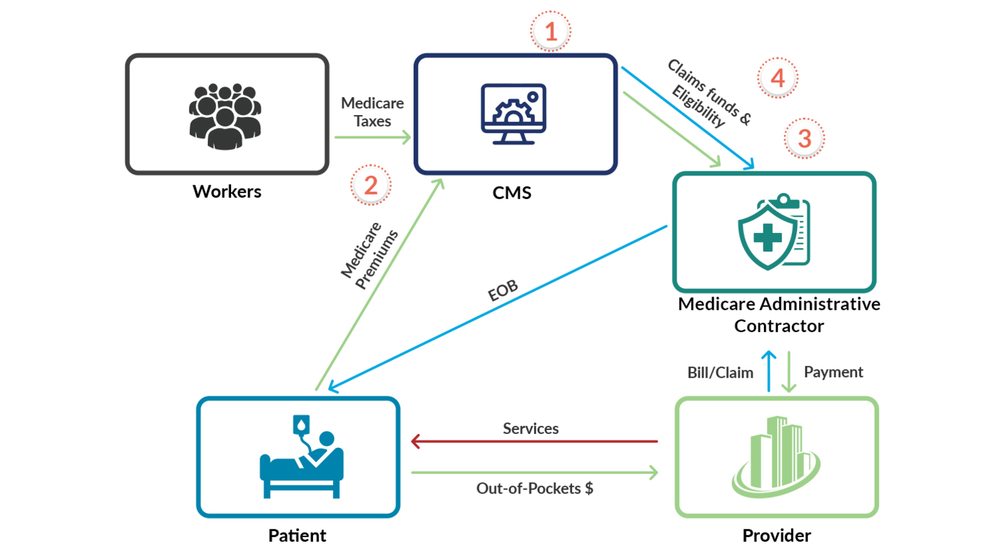
Financing the Healthcare System
Flow of Money and Services for a Patient with Medicare Parts A or B
Notes:
The federal government through the Centers for Medicare and Medicaid Services or CMS, oversee all parts of the Medicare program, including Medicare Part A and Medicare Part B. CMS receives Medicare payroll taxes from workers along with Part B premiums from patients and adds these funds to the Medicare Trust Fund. The Medicare Trust Fund is the overall pool of money used to finance the Medicare program. However, CMS relies on organizations in various regions around the US to administer payments on behalf of Medicare beneficiaries. Organizations acting on behalf of CMS to administer Medicare payments are known as a fiscal intermediary.

Slide 20
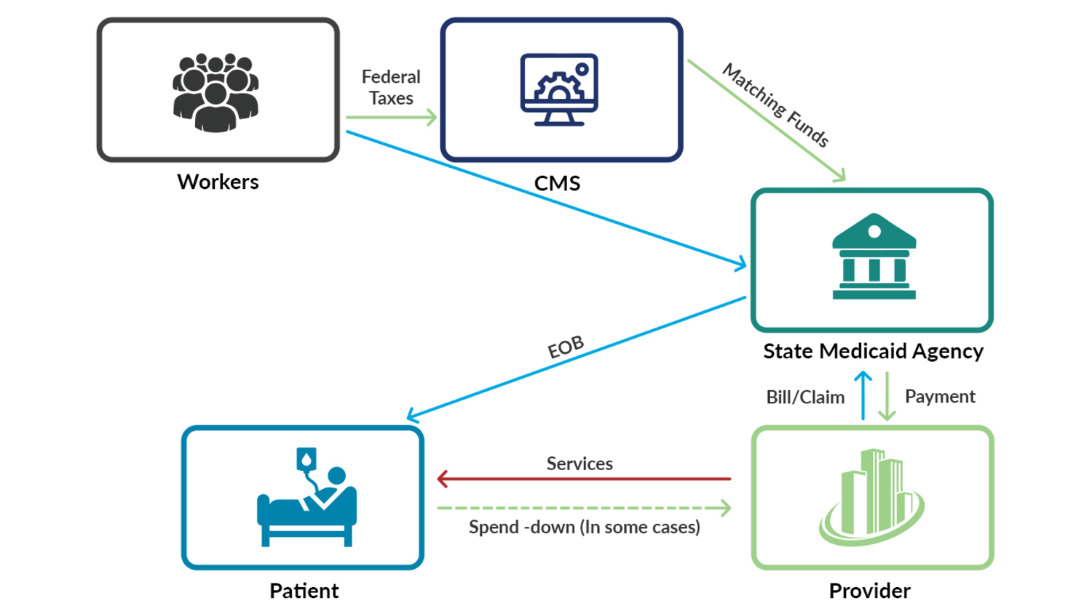
Financing the Healthcare System
Flow of Money and Services for a Patient with Medicaid
Notes:
There is an insurance program for the poor and medically needy that is operated as a joint program between the federal government (CMS) and the individual states known as Medicaid.
Each state has its own Medicaid program that is financed partially through tax revenues paid to each state and a contribution from CMS

Slide 21
Polling Question # 3
Do you know how many certifications HFMA offers?
3
5
6
8
Notes:
(6)
Certified Healthcare Financial Professional (CHFP)
Certified Revenue Cycle Representative (CRCR)
Certified Specialist Accounting & Finance (CSAF)
Certified Specialist Business Intelligence (CSBI)
Certified Specialist Payment & Reimbursement (CSPR)
Certified Specialist Physician Practice Management (CSPPM)

Slide 22
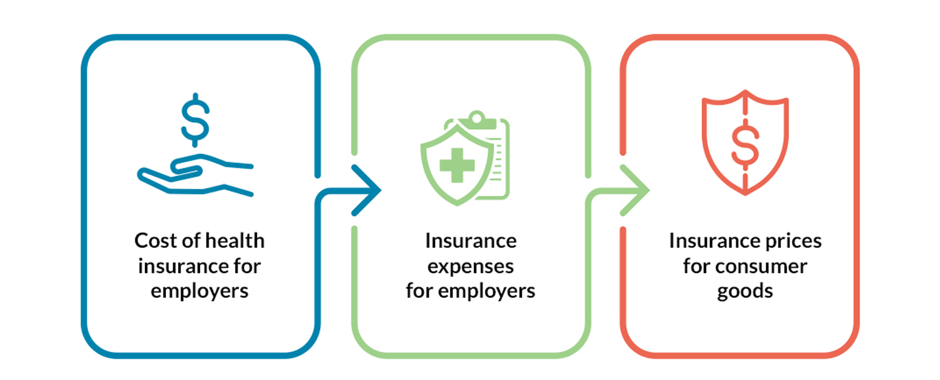
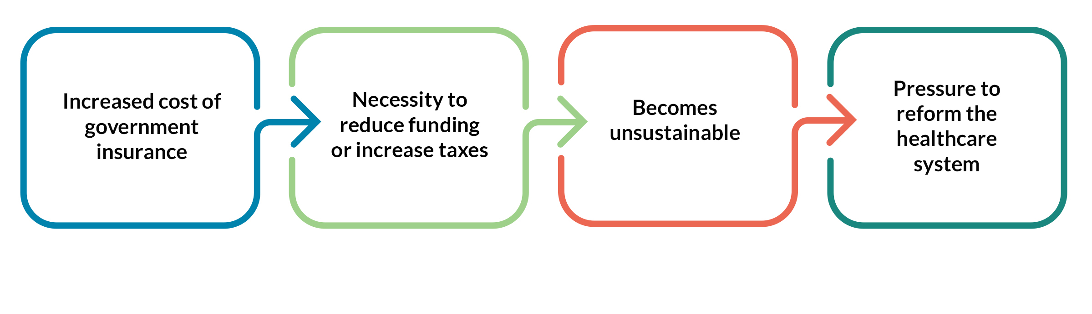
The Big Picture
Changes Intended to Reform the US Health Care System
Notes:
Given the relative size of the health care industry in the United States economy, health care has grown to the extent that there are concerns about health care taking resources away from other parts of the US economy.
Recall that some people in the United States obtain health insurance as a benefit of employment. However, the cost of health insurance increases the expenses for employers, which leads to increased prices for consumer goods and services. Similarly, increased cost of government insurance programs creates pressure on legislatures to reduce funding to non-health care programs or increase taxes. Generally, there is some concern that the volume of expenditures for health care services in the US is not sustainable over the long term. Therefore, there is some pressure on legislators in the US to reform the health care system.

Slide 23

Health Care Reform
Notes:
Much of the reform effort ultimately was aimed at reforming health insurance markets where major changes were applied to the way that health insurers operated with some changes to influence more persons to get access to health insurance coverage.

Slide 24
Key Provisions of the ACA
Medical –Loss Ratio
The Individual Mandate
Insurance Exchanges
The Employer Mandate
Accountable Care Organization (ACO)
Population Health
Bundled Payments
Notes:
Key provisions of the PPACA, more commonly known as the ACA:
Insurance plans were required to spend a minimum amount of collected revenues to pay for medical care of patients (called medical loss ratio)
More controversial changes implemented by PPACA were around the overall insurance marketplace. The individual mandate was a change to require individuals without employer-provided insurance to purchase health insurance through health insurance exchanges in each state or face tax penalties
The employer mandate was a provision of PPACA where employers with more than 50 employees to make health insurance benefits available to employee
PPACA also called for some structural changes in the delivery of health care services. Accountable Care Organizations (ACO) are an opportunity for various providers of care to work together to mange the health care of a select population of patients and to receive financial benefit from reducing the cost of care while improving the quality of care for those patients (called population health).
Related to the ACO was the addition of bundled payments to groups of providers for a single occasion of service to a specified patient. More on the bundled payment mechanism can be found in course 5 – Managing Financial Resources.

Slide 25
The “Triple Aim”
Health Care reform is intended to meet the triple aim
Of:
Quality outcomes
Reduced cost
Increased Patient safety and satisfaction with treatment

Slide 26
The Big Picture
The Role of Financial Management
in
Health Care Organizations

Slide 27
The Finance Function
Chief Executive Officer
Chief Financial Officer
Finance Directors and staff
Controller
Notes:
The finance function in many health care organizations is carried out under the direction of the chief financial officer (CFO). This is true in hospitals, health plans, and larger physician clinic entities. Some organizations may use the term controller to define the senior financial manager. Larger entities may have both a CFO as the senior leader in finance with a controller reporting to the CFO. Usually the finance function reports directly to the chief executive officer (CEO) of the business or to the owner in a smaller clinic setting.

Slide 28
Financial Management Activities
Accounting/bookkeeping
Treasury
Inventorying
Budgeting
Payroll
Accounts Payable
Financial Analysis and the Revenue Cycle
Insurers Add: Claims Processing and Contract Management
Notes:
Financial management in a health care organization usually entails activities including accounting/bookkeeping, treasury, inventory, budgeting, payroll, accounts payable, financial analysis, and revenue cycle. Further details on inventory and the revenue. Health insurance plans will usually include claims processing and contract management activities under the finance function.

Slide 29
Finance as a Strategic Function
Access to cost data + Access to clinical data through financial systems
Finance can discern trends, patterns and business activity “themes” in the data, providing useful business information to decision makers
Notes:
Since it has access to much of the data needed to manage costs and can access clinical data through its financial analysis activities, the finance function has adopted a much more strategic role in today’s health care business. Historically, finance has had much of a recordkeeping function through accounting for business transactions. However access to and understanding of that historical data has placed finance now in a leadership role to aid in setting the future direction of the health care business. However with that broader strategic perspective, the challenges to the health care CFO are both diverse and difficult to balance.

Slide 30
Current Pressing Issues
Value Based Purchasing (VBP)
Quality measurement
The shift from volume to value
Healthcare Technology
Access to Capital
Risk Contracting
Notes:
As the Value Based Purchasing provisions of PPACA have taken effect and some providers have seen significant reductions in payments for services, the impact of quality on payments has become critical.
However as the VBP provisions of PPACA have taken effect and some providers have seen significant reductions in payments for services, the impact of quality on payments has become critical.
At the same time that value is a priority in the health care industry, there is significant upward inflationary pressure on expenses – particularly in health care provider entities.
Health care technology is also exerting significant upward pressure on the operating expenses in this industry. While technological innovation in some areas such as computers or consumer electronics usually yields reductions in price to the buyer, such is not the case in health care. As new technologies enter health care, they generally cost more than in a prior iteration.
The demand for technology brings with it the need for resources to pay for it As pressures for lower costs limit growth on payments to health care providers, their ability to finance new technology can be greatly hindered. Not only that, but the priorities on what technologies to obtain are changing as emphasis on outcomes and costs increases on health care businesses
The advent of the ACO introduces the element of risk contracting to a health care provider entity (health insurance plans manage risk continually and so this is less of an issue in such businesses). The ACO places hospitals and physicians at some risk of financial loss if the cost of care to patients exceeds target levels set by insurers that contract with an ACO.

Slide 31
Polling Question # 4
How many years have you been a member of HFMA?
0-5
5-10
10-15
15+

Slide 32
Questions?
Notes:
*** If there is not enough time (at time or over time) then ask folks to bring their questions to the next session***
*Leave this slide up at the end.*
*The host will facilitate questions and answers.*
*The speaker will answer the questions to the best of their knowledge*

