Slide 1
Michigan HFMA Meeting WPS Medicare Audit Update December 7th, 2022 Chris Severson

Slide 2
Agenda
S-10 Uncompensated Care Audits
Secure-EDI/File Exchange/MoveIt
Rural Health Clinics
Bad Debts
Nursing and Allied Health
New Cost Report Documentation Requirements
WPS Website, Webinars, and YouTube Channel
Questions

Slide 3
S-10 Uncompensated Care Audits
Currently in second year of auditing 100% of DSH eligible hospitals
5th year of S-10 audits overall
FFY 2023 UCP Factor 3
FFY 2019 data
Audited 100% of providers
Averaging of years for later Factor 3’s
Finalized in FFY 2023 final rule
Average of FFY 2018 and 2019 used for FFY 2023 Factor 3
Average of FFY 2018, 2019, and 2020 used for FFY 2024 Factor 3

Slide 4
S-10 Uncompensated Care Audits
Currently auditing S-10 data for FFY 2020 year
Cost reporting periods beginning between 10/1/19 – 9/30/20
All Acute hospitals that qualify for DSH
Including SCH/MDH hospitals
FYEs 9/2020 – 3/2021 sent out 2/4/2022 with 3/4/2022 due date
FYEs 4/2021 – 8/2021 sent out 3/21/2022 with a 4/21/22 due date
All audits must be completed and submitted to CMS by December 31st.
Starting in February 2023, we will begin auditing FFY 2021 years
Cost reporting periods beginning between 10/1/20 – 9/30/21
All Acute hospitals that qualify for DSH
Including SCH/MDH hospitals

Slide 5
S-10 Uncompensated Care Audits
S-10 Lines
20 (Charity care charges for the entire facility)
22 (Partial payments by patients approved for charity care)
25 (Charges for patient days beyond an indigent care program’s length of stay)
26 (total bad debt “expense” for the entire hospital complex.)
Do not use “bad debt expense” under GAAP (i.e., allowance method)
Must be an actual write off
Regardless of whether that Medicare bad debt is yet allowable for bad debt reimbursement

Slide 6
S-10 Uncompensated Care Audits
S-10 Audits Info Requests
Financial Assistance Policy
How hospital personnel determine insurance status and charity care write offs
Including uninsured patients
Including non-covered services for Medicaid eligible and Indigent patients
Including Patients with coverage from an entity without a hospital contractual relationship

Slide 7
S-10 Uncompensated Care Audits
S-10 Line 20 Column 1 is for uninsured patients (including patients with insurance coverage with an entity that does not have a contractual relationship with the provider, as well as non-covered services for Medicaid/Indigent Care Program patients.)
S-10 Line 20 Column 2 is for insured patients, (including non-covered charges related to days exceeding the length of stay limit for patients covered by Medicaid/Indigent Care Programs.)

Slide 8
S-10 Uncompensated Care Audits
S-10 must exclude:
Any physician and other professional services.
Any amounts related to insurer or other third-party liabilities.
Bad Debts (Medicare or Non-Medicare) should not be reported in Line 20, as they factor into the amounts reported in line 26 instead.
Courtesy discounts are not the same as charity care discounts and are not allowed in this line.

Slide 9
S-10 Uncompensated Care Audits
S-10 Line 22 (Payments to offset Line 20)
S-10 Line 25 (Charges for Patient days beyond a Medicaid or indigent care program’s length of stay)
These are also part of line 20 column 2.
Subject to cost to charge ratio, unlike deductibles and coinsurance that are otherwise reported on line 20 column 2.

Slide 10
S-10 Uncompensated Care Audits
S-10 Line 26 (Total Bad Debt Expense for Entire facility)
Less:
Any physician and other professional services.
Any bad debts related to insurers or other third parties. Only bad debts related to amounts owed by patients should be included.
Underlying dates of service are irrelevant
Write off date determines what cost reporting period it is reported in.

Slide 11
S-10 Uncompensated Care Audits
Summary of Initial Info Requests:
Charity care policy that was in place for the period
A description of the process used when querying the records to identify the charge and payment amounts to be reported on line 20 and 22 (for each column)
Actual listing of such charges and payments.
Information on how the above rules are applied so that things such as fee schedule services, courtesy discounts, bad debts, etc. are not included as charity care charges.
Explanation of significant variances
Reconciliation from the amounts reported on the cost report for the various items to corresponding elements on your working trial balance and/or financial statements.

Slide 12
S-10 Uncompensated Care Audits
Summary of Follow-up Info Requests:
Detailed documentation for a sample selected from a list
Detailed bad debt listing for the amounts reported on line 26 (with any corresponding explanation of the process used to gather that data)
Potentially detailed documentation for a sample from the bad debt listing.

Slide 13
S-10 Uncompensated Care Audits
Query Logic Questionnaire
Much of the audit time is spent up front trying to get a “clean” listing without obvious errors
This minimizes having to extrapolate large error rates to the population that we sampled

Slide 14
S-10 Uncompensated Care Audits
WPS GHA Website
https://www.wpsgha.com/wps/portal/mac/site/audit/guides-and-resources/worksheet-s-10-charity-care-audits
https://www.wpsgha.com/wps/portal/mac/site/audit/guides-and-resources/worksheet-s-10-charity-care-audits
WPS GHA YouTube
https://youtu.be/bWQhRT8KljY = General training
https://youtu.be/NAPTlPsEgNE = Audit Templates and Questionnaire
https://youtu.be/VOm-wm0BReI = S-10 Webinar Part 1
https://youtu.be/tIKNeIhvjzo = S-10 Webinar Part 2
Others in later webinar listing

Slide 15
Secure-EDI/File Exchange/MoveIt
New URL everyone should be using is https://fe.wpsgha.com
Old secure-edi.wpsic.com accounts deactivated
New portal is otherwise same as old portal
Benefits
Larger file size limit (2GB vs. 15-20 MB)
No file type restrictions
Allowed for external contacts as well (not limited to providers)
Drawbacks
Due to security requirements, accounts quickly expire if not used
Easy to reset though, by auditor that you are working with
Each individual auditor that you want to connect with must first send you an “initiation” email.
Password only needs to be created by first one

Slide 16
Secure-EDI/File Exchange/MoveIt
https://www.wpsgha.com/wps/portal/mac/site/audit/guides-and-resources/audit-secure-edi-email-messaging-tool
Secure-EDI initiation email
Audit contact sends you first email (including your first temporary password)
Any other auditor you want to send documents to would have to first send you an initiation email of their own (no new password needed if account is already established.)
Accounts active for 20 days, but reset after each use
No long-term storage of files (usually around 30 days)
Auditors can handle your password resets, deactivations, etc.

Slide 17
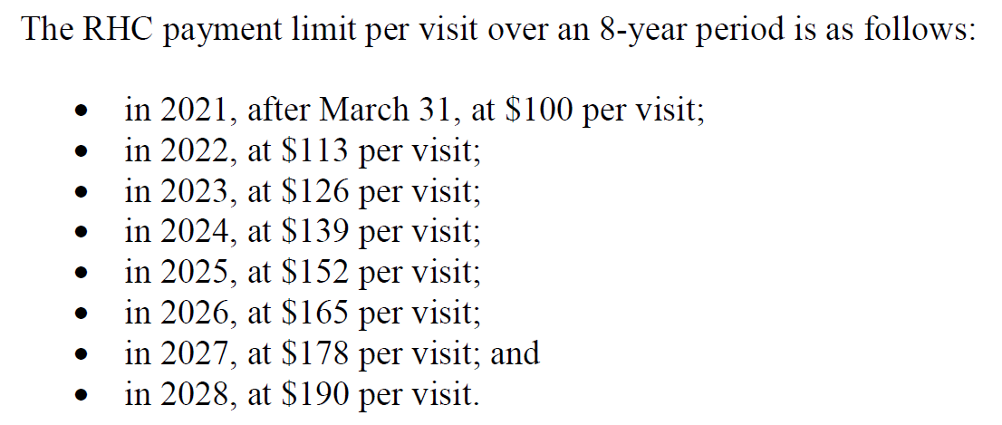
Rural Health Clinics (RHCs)
Consolidated Appropriations Act of 2021 (12/27/2020)
CR 12035 (10/29/2021) and CR 12185 (5/4/2021)
Newly certified RHCs January 1, 2021, and after are subject to per visit limit

Slide 18
Rural Health Clinics (RHCs)
Grandfathered RHCs (less than 50 beds as of 12/31/2020 and continue having less than 50 beds)
COVID exceptions
No change in certification
Base year per visit limit (2020 or 2021 if no rate established in 2020)
Rate updated each year
No consolidations of grandfathered and non grandfathered RHCs allowed
Questions over what rate to use for consolidated grandfathered units

Slide 19
Bad Debts
9/18/2020 Federal Register (FFY 221 Inpatient Prospective Payment System Final Rule)
https://www.govinfo.gov/content/pkg/FR-2020-09-18/pdf/2020-19637.pdf
Codified many bad debt policies into regulation
Clarifications of existing policy were retroactively effective
Changes in policy were prospective for cost reporting periods 10/1/ and after
WPS YouTube video going into detail on these changes
https://www.youtube.com/watch?v=LMa4at0wlRU

Slide 20
Bad Debts-Collection Agency
Bad debt not allowable for Medicare purposes until it has been completely returned from collection agency
Full amount collected from patient must be used to offset AR
Cannot be reported net of collection fee
Collection fee is separate administrative cost
Clarification = Retroactive

Slide 21
Bad Debts – Dual Eligible Patients
Must-Bill Policy
Must have Medicaid RA to allow a dual eligible bad debt
In this Federal Register, CMS also incorporated an alternative documentation set to be used in limited circumstances where a State does not process crossover claims or issue Medicaid RAs for certain provider-types.
In these cases, the provider must include the following documentation instead:
The State Medicaid notification evidencing that the State has no obligation to pay the beneficiary’s Medicare cost sharing or notification evidencing the provider’s inability to enroll in Medicaid for purposes of processing a crossover cost sharing claim,
documentation setting forth the State’s liability, or lack thereof, for the Medicare cost sharing, and
documentation verifying the beneficiary’s eligibility for Medicaid for the date of service.
Clarification = Retroactive

Slide 22
Bad Debts – Indigent Patients
CMS Policy at CMS Pub. 15-1§312
The patient's indigence must be determined by the provider, not by the patient; i.e., a patient's signed declaration of his inability to pay his medical bills cannot be considered proof of indigence
The provider should take into account a patient's total resources which would include, but are not limited to, an analysis of assets (only those convertible to cash, and unnecessary for the patient's daily living), liabilities, and income and expenses. In making this analysis the provider should take into account any extenuating circumstances that would affect the determination of the patient's indigence

Slide 23
Bad Debts – Indigent Patients, cont.
CMS made minor changes when codifying these into regulation.
Dropping need for liability and expense review
Regulatory changes prospective 10/1/20 FYB and after
Original policy is in place for all periods prior to that
Asset review still required
Have heard of conflicts with HRSA policy
No changes to CMS policy at this time

Slide 24
Bad Debts – Indigent Patients, cont.
Presumptive indigence not allowed for Medicare bad debt
It is allowed for total bad debt on W/S S-10
Deceased beneficiaries
Collection effort required to search for an estate
Must have tangible and contemporaneous evidence of estate review
Not just a note from provider representative that they searched for the estate
Bankrupt patients
Provider must document they have filed claim with bankruptcy courts where applicable
Bankrupt does not equal automatic indigence determination…review financial status at that time

Slide 25
Bad Debts – 120 Day Rule
CMS Pub. 15-I 310.2
“if after reasonable and customary attempts to collect a bill, the debt remains unpaid more than 120 days from the date the first bill is mailed to the beneficiary, the debt may be deemed uncollectible.”
Federal Register strengthen that a bit. Turned it into a harder “rule” as opposed to a guideline.
Only exception is for indigent patients (including dual eligible) 9/18/2020
Reiterated long-standing policy that any payment (even $1) that is made during 120-day period resets the 120-day clock.
Clarification = Retroactive

Slide 26
Bad Debts – Timely Billing Rule
Bill must be issued to patient shortly after death or discharge of patient.
Federal Register defines “shortly after”
120 days after the later of:
Date of Medicare RA
Date of RA from secondary payor
Date of notification that secondary payor does not cover services furnished to beneficiary
Revision = Prospective
However, WPS is implementing this change immediately
Timeframe was previously left up to MACs
This new timeframe is more lenient to providers

Slide 27
Bad Debts – Write-off and GAAP vs. Medicare
Prior rules required write-off involving an expense account
PRM-I §320
Allowance method (also required by GAAP)
Notably, the Medicare rules require the later write-off against AR to occur, not just the initial charge to expense.
FASB GAAP has now revised accounting treatment (ASU Topic 606)
Previously estimated bad debt amount to charge off against expense
Now will estimate bad debt amount to charge off against contra-revenue (implicit price concession)
Revision = Prospective
What to do about current periods that are not in line with GAAP?

Slide 28
Bad Debts – Contractual Allowances
CMS noticed providers writing off bad debts against contractual allowance (a different contra-revenue account)
Contractual allowance is amount that provider not legally entitled to
Should have instead been charged against an expense or now an implicit price concession contra-revenue account
CMS issued Medicare Learning Network Special Edition on 4/4/2019 to remind providers of this
Gave grace period up to last cost reporting periods beginning before 10/1/2019
Grace period now expired
CMS codified rule into regulation effective 10/1/2020 FYBs
Revision = Prospective

Slide 29
Nursing and Allied Health
CMS continuing to have MACs review Legal Operator requirements for NAH
42 CFR 413.85(f)
CMS Change Request 10552 (8/17/2018)
Directly incur the training costs
Directly control over program curriculum
Control administration of the program
Employ the teaching staff
Provide both classroom and clinical training
Issue degree or diploma (is not the only criterion)
https://www.wpsgha.com/wps/portal/mac/site/audit/guides-and-resources/reasonable-cost-payment-nah-education-programs-cost-report-documentation

Slide 30
CR 11642 (NAH Add-On and GME Managed Care Reduction)
https://www.wpsgha.com/wps/portal/mac/site/audit/guides-and-resources/nah-add-on-payment-and-gme-payment-reduction-for-ma
8/21/2020 Change Request 11642
Revised factors for both and required MACs to reopen all that could be reopened
We have developed calculation forms at the above website.
Also a YouTube video explaining the entire process.
Recently wrapped up Reopenings
Still has prospective impact

Slide 31
CR 11642 (NAH Add-On and GME Managed Care Reduction)
Non-Calendar Year Providers get two calculations
Using data from cost reporting periods ending in the federal fiscal year that is two years prior to the current calendar year.
1.) Subtract two years from the current calendar year(s) that your cost reporting period spans
12/31/2020 – 2 years = 12/31/2018
2.) Find the Federal Fiscal Year End that has the same year as the calendar year above
We would use FFY 2018 (10/1/2017 – 9/30/2018)
3.) Find the cost reporting period ending in the above Federal Fiscal Year

Slide 32
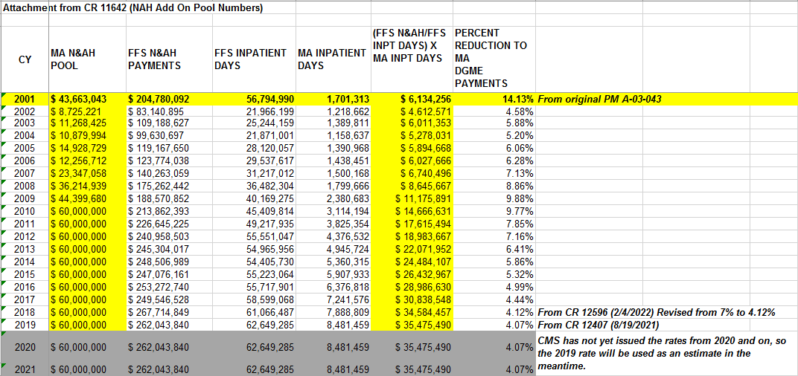
CR 11642 (NAH Add-On and GME Managed Care Reduction)
The factors that are used for the rest of the calculation already incorporate data from two year’s prior.
As such, if your current cost reporting period is CY 2017, then you need to pull the CY2017 factor
Don’t try to subtract two years, etc.

Slide 33
Cost Report Documentation Requirements
https://www.wpsgha.com/wps/portal/mac/site/audit/guides-and-resources/cost-report-documentation-requirements-templates
Includes electronic templates
https://youtu.be/gAAXSTNELy8
83 FR 41677 (August 17, 2018)
Effective for cost reporting periods beginning 10/1/2018 and after
All provider types; not just hospitals

Slide 34
Cost Report Documentation Requirements
GME/IME Interns and Residents (IRIS)
Medicare Bad Debts
Disproportionate Share Hospital (DSH) Eligible Days
Data elements on Worksheet S-10 Uncompensated Care
Charity Care and Uninsured Discounts required at acceptance
Total Bad Debts required for eventual S-10 audit
Home Office costs
Cost Statement must be filed with MAC that services the Home Office
All amounts must “correspond to” the data reported on the cost report.

Slide 35
Cost Report Documentation Requirements
Specific templates not yet required
Recommended though
Paperwork Reduction Act (PRA) Proposed Rule
Possible these will be in Transmittal 18 (2552-10 Form Set)

Slide 36
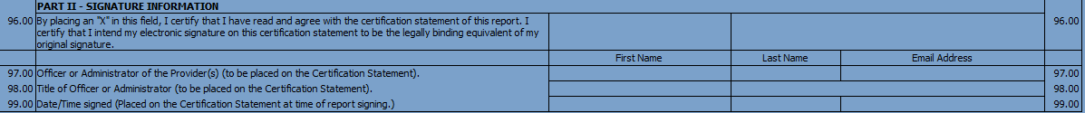
CMS Portal (MCRef)
Used for cost report submissions ONLY
Cannot submit documentation for desk review, audit, reopenings, etc.
E-signature vs. E-submission
Please make sure to send cover letter, rather than just a CD by itself.
If E-signed, the worksheet S should be at the front of the package

Slide 37
WPS Website, Webinars, and YouTube Channel
WPS Website
https://www.wpsgha.com/wps/portal/mac/site/audit/guides-and-resources/guides-and-resources
WPS YouTube Audit Playlist
https://www.youtube.com/playlist?list=PLmWbOYPskBJja8M_ylZQc4WYfRN2P7Q3M

Slide 38
WPS Website, Webinars, and YouTube Channel
Worksheet S-10 Uncompensated Care Training - 9/18/2019 60 mins.
https://youtu.be/bWQhRT8KljY
Cost Report Documentation and Templates Training - 1/14/2020 40 mins.
https://youtu.be/gAAXSTNELy8
Medicare Bad Debt Requirements - 3/3/2020 59 mins.
https://youtu.be/LMa4at0wlRU
Rural Health Clinic Productivity Standard Exceptions - 8/3/2020 19 mins
https://youtu.be/hXF0QuFQQYo
Worksheet S-10 Audit Templates and Questionnaire - 8/5/2020 37 mins
https://youtu.be/NAPTlPsEgNE
Change Request 11642 (Medicare Advantage Factors for NAH and Graduate Medical Education) - 10/13/2020 – 42 mins.
https://youtu.be/tS_3IgoNILQ

Slide 39
WPS Website, Webinars, and YouTube Channel
October 2020 WPS Quarterly Provider Audit Webinar Recording - 10/19/2020 92 mins.
https://youtu.be/UXiKrySLW0w
Secure-EDI Messaging Portal - 12/1/2020 12 mins.
https://youtu.be/hXWxqrTrFWk
January 2021 WPS Quarterly Provider Audit Webinar Recording - 1/29/2021 95 mins.
https://youtu.be/RjpszaKLnwk
Nursing and Allied Health (NAH) Legal Operator Status 3/15/2021 35 mins.
https://youtu.be/PrmOupXFvjE
S-10 Provider Webinar Part 1 (3/24/2021) – 4/1/2021 119 mins.
https://youtu.be/VOm-wm0BReI
S-10 Provider Webinar Part 2 (3/30/2021) - 4/1/2021 85 mins.
https://youtu.be/tIKNeIhvjzo

Slide 40
WPS Website, Webinars, and YouTube Channel
Provider-Based Physicians on the Cost Report - 8/17/2021 65 mins.
https://youtu.be/2Uav0rAILgY
Audit Sampling - 8/26/2021 30 mins.
https://youtu.be/WsMY5NQr3fk
September 2021 WPS Quarterly Provider Audit Webinar Recording - 9/17/2021 118 mins.
https://youtu.be/jXUsWVkFa0o
WPS Audit – Cost Assignment and Allocation - 10/1/2021 59 mins.
https://youtu.be/FmWFF2HWXXk
ESRD High Discharge Provider Training– 2/9/2022 32 mins.
https://youtu.be/5fCMBC6mris
2/17/22 WPS Provider S-10 Audit Webinar - 2/17/2022 121 mins.
https://youtu.be/eseYugPmqnA

Slide 41
WPS Website, Webinars, and YouTube Channel
SCH-MDH Volume Decrease Adjustment - 6/29/2022 33 mins.
https://youtu.be/ikNsb-ZpM2A
August 2022 – WPS Audit Provider Webinar Recording - 8/30/2022 125 mins.
https://youtu.be/wADM9fUyeBY
EHR Payment Reduction - 7/22/2021 69 mins.
https://youtu.be/Xug6DRkgT5Q
Home Office Costs and Allocation- 11/30/2022 41 mins.
https://youtu.be/LDUeP7nAtlg
SCH and MDH Qualifications– 11/30/2022 25 mins.
https://youtu.be/9QvHgIY7bgs

Slide 42
WPS Website, Webinars, and YouTube Channel
Planned for future
Desk Review/Audit Documentation
RHC Rates
More SCH/MDH Videos (Rate setting, payment mechanism, base years)
Swingbed Nursing Facility (SNF/NF) Rates

Slide 43
WPS Website, Webinars, and YouTube Channel
WPS Audit Webinars
October 2020
January 2021
March 2021 (2-part S-10 specific)
September 2021
February 2022 (2-part S-10 specific)
August 2022
One scheduled later in December 14, 2022
http://wpsghalearningcenter.com/confirm-course?courseid=ng8sFyptwD81

