Slide 1
Title Joe Schindler Vice President of Finance Minnesota Hospital Association
HFMA Regulatory Conference
November 3, 2022

Slide 2
Minnesota Hospital Association
Mission
Advance the health of individuals and communities through leadership, advocacy, and collaboration on behalf of Minnesota hospitals and health systems.
Vision
Minnesotans are healthy and have access to the right care at the right time in the right place.
Values
Integrity
Inclusive
Informed
Innovative

Slide 3
Workforce Shortage

Slide 4
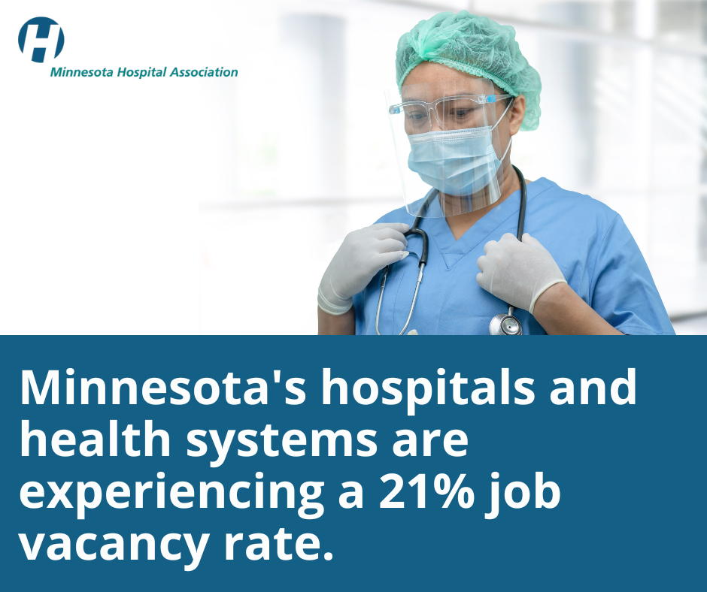
Notes:
There is an intense strain on the state’s hospitals and health systems:
In just one year, job vacancies have tripled – the overall vacancy rate in 2022 is about 21% - compared to only about 6% in 2021.
The exponentially rising labor and supply costs.
The need to rely on temporary staffing.
Hospitals are now also caring for patients who should be in a nursing home or group home.
The need to rely on temporary staffing.
Hospitals are now also caring for patients who should be in a nursing home or group home.

Slide 5
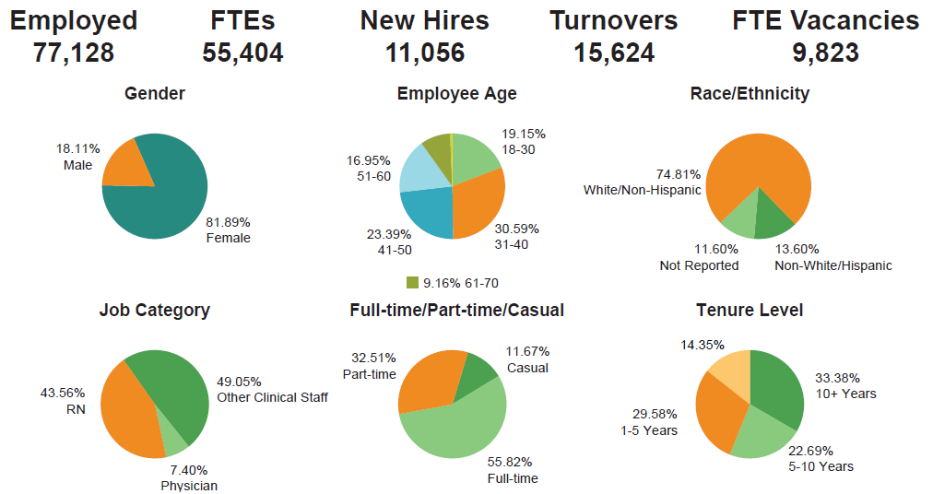
Top Line Numbers
Notes:
The Minnesota Hospital Association (MHA) annually collects demographic data on 40 direct patient care
jobs. This latest report examines 77,128 workers employed at 97 hospitals, health systems, clinics, and
other facility settings (laboratories, transportation, home health, and hospice services). The inaugural report
of this data was released in the spring of 2021. This report is based on 76% of MHA members, which include
the largest health systems to small rural hospitals, reporting but is reflective of the entire landscape of the
hospitals and health systems in Minnesota.

Slide 6
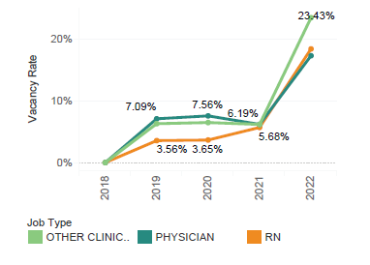
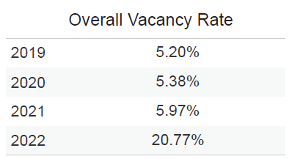
Vacancies
Notes:
An almost 250% one-year increase in job vacancy rates. In just one year, job vacancies have tripled – the overall vacancy rate in 2022 is about 21% - compared to only about 6% in 2021.

Slide 7
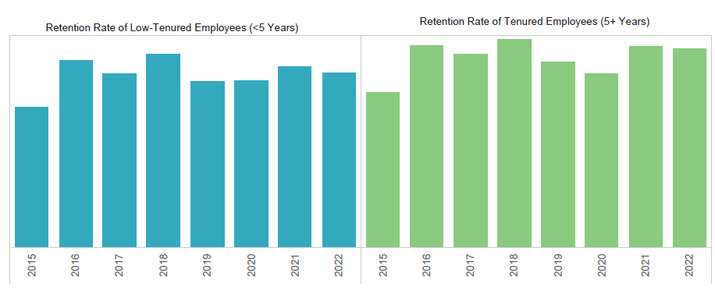
Staff Turnover
Notes:
For the eighth consecutive year, the data shows that employees with less than five years at their workplace represented the largest source of attrition or turnover, with 25%
leaving their role during the year. In contrast, only 14% of employees with more than five years of experience left their workplace.

Slide 8
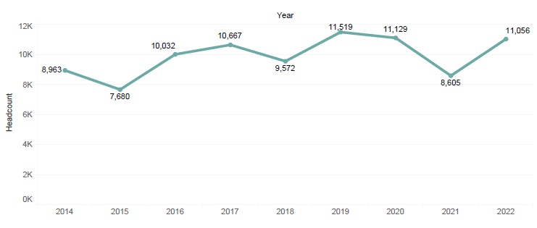
Recruitment and Retention
Notes:
The health care workforce welcomed 11,056 new hires in the state, almost equivalent to the 2019 number of 11,129. In this year’s report there is a note of good news. Hospitals and health systems were able to reduce
the gap between those exiting jobs and new hires by 71.43% since 2020.

Slide 9
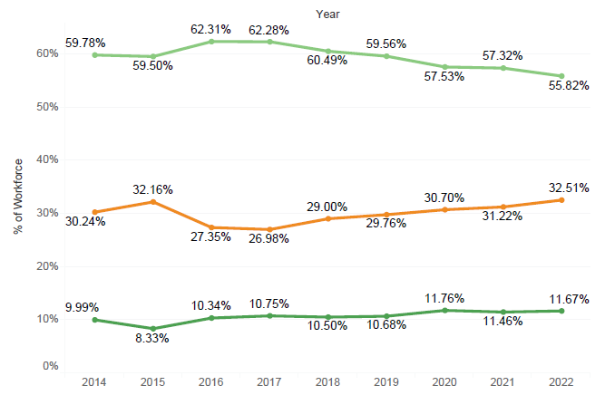
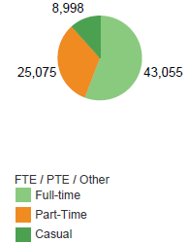
Transition to part time
Notes:
More professionals within health care are opting for a part-time work schedule, making it increasingly difficult for hospitals and health systems to meet operational needs. For the first time, over half (57%) of registered nurses (RNs) are not working full-time.
Overall, 44% of all hospital employees are less than full-time, up from 37% in 2016.
This trend is higher among select professional groups, including:
68% of nursing station technicians
64% of certified nursing assistants
Younger professionals are more likely to opt for part-time job status versus their more experienced colleagues.
While hospitals and health systems are proud to offer the trending part-time work schedules in order to retain staff, a hospital is the cornerstone of the community – and must be ready to serve patients 24/7/365.

Slide 10
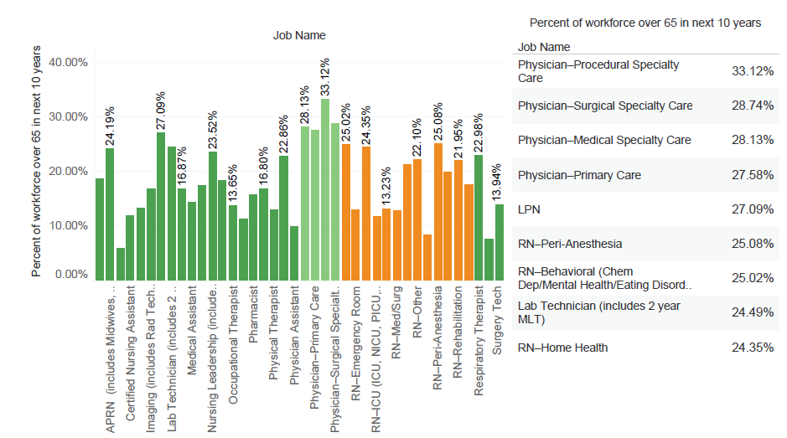
Retirements
Notes:
The operations and finances of Minnesota’s hospital and health systems are being additionally strained by retirements.
Physicians are projected to be the top occupational group at or above retirement age within ten years, followed by licensed practical nurses (27%), and peri-anesthesia RNs (25.1%).
This is on trend nationally. The Association of American Medical Colleges (AAMC) reports that more than two of every five active physicians in the U.S. will be 65 or older within the next decade.

Slide 11
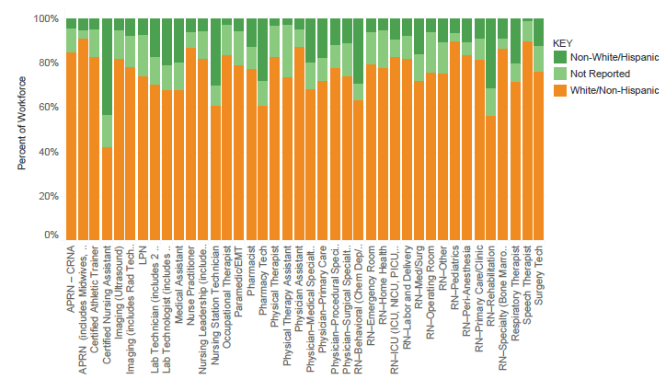
Racial and Ethnic Diversity Rate
Notes:
Minnesota’s hospitals and health systems have increased the number of black, indigenous, and people of color (BIPOC) representation by 140% since 2016. Black, Asian, and Hispanic-identifying health care staff saw the highest gains among BIPOC hires, with each group increasing in hire rate by more than 60%.

Slide 12
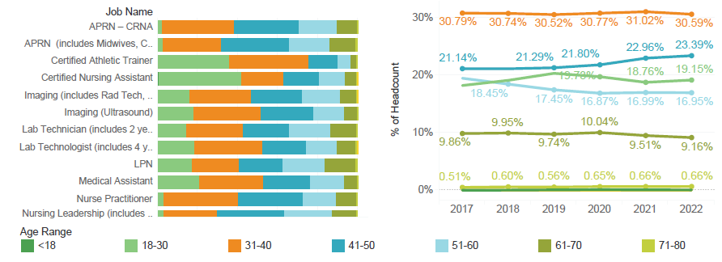
Age Composition
Notes:
The age composition of health care staff has remained relatively unchanged since 2017. Most of the workforce (54%) is between the ages of 31-50.

Slide 13
Financial State of Hospitals and Health Systems

Slide 14
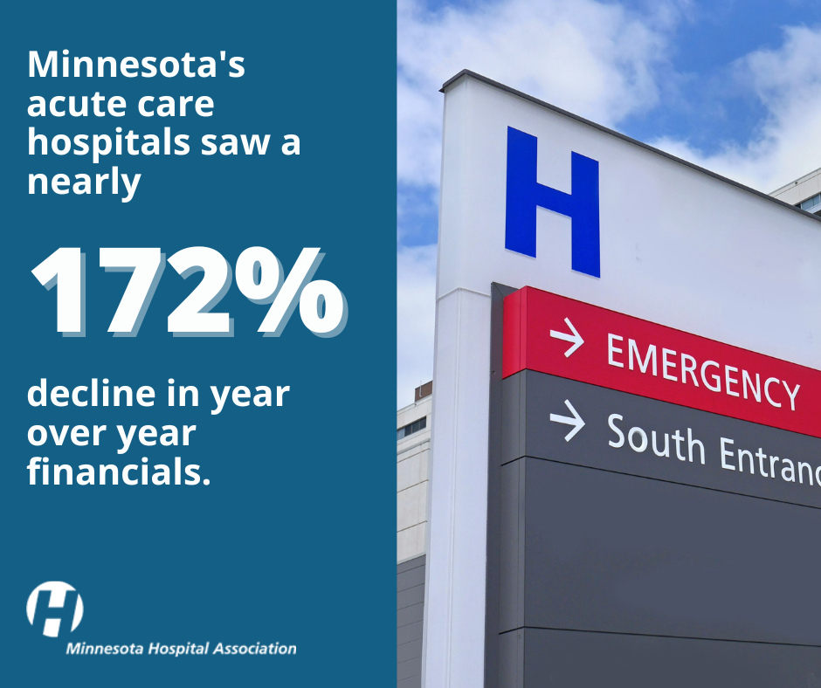
Notes:
These results are based on a survey conducted by
the Minnesota Hospital Association (MHA). We
received 32 survey responses accounting for 67
hospitals which represents about 53% of the 127
community acute care hospitals statewide.
For the first six months of 2022, operating margins are in the negative, at –1.5%, a 172% decline in year over year financials for acute care hospitals.

Slide 15
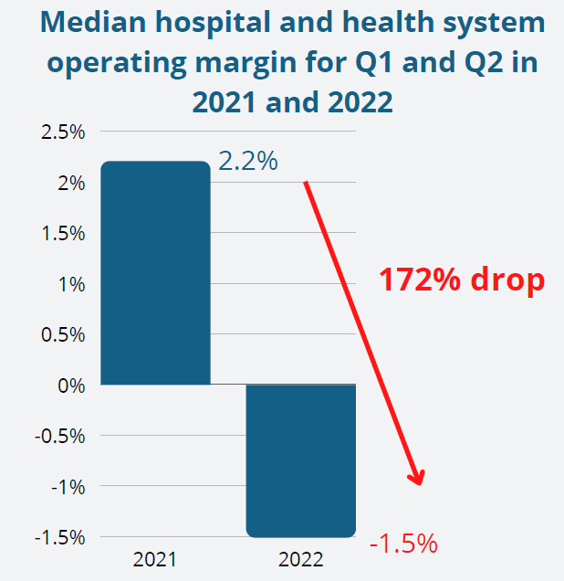
Operating Margin
Notes:
2022 has posed a severe financial strain
on Minnesota’s nonprofit hospitals. In our
MHA survey measuring the first two
quarters of 2022, the median operating
margin was -1.5% versus 2.2% for the
same period in 2021, a 172% drop year
over year..

Slide 16
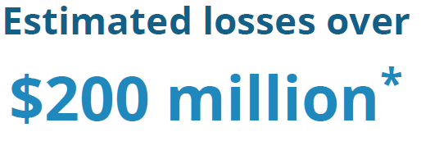
Operating Margin
*The 2022 survey response margin equates to a $104 million loss. When using this amount to estimate statewide losses, it would be over $200 million in just the first half of 2022.
Notes:
The 2022 survey response
margin equates to a $104 million loss.
When using this amount to estimate
statewide losses, it would be over $200
million in just the first half of 2022

Slide 17
Operating Margin
56% negative in 2022 vs.
41% in 2021
Notes:
Of the MHA survey respondents, 56%
reported a negative operating margin in
the first half of 2022 while 41% did so in
the same period in 2021. Minnesota’s
acute care hospitals are not alone in this
concerning downward trend. Kauffman
Hall reported that 52% of respondents in
their national survey had operating margin
losses in the first half of 2022, whereas
36% did in 2021.

Slide 18
Medicare and Medicaid
61% on
government-backed insurance programs
Notes:
To compound pandemic inflicted losses and
workforce shortages, the statewide median payer
mix of Medicare and Medicaid patients continues to
grow and pay well below the cost of care. The
number of patients on these government-backed
insurance programs grew to 61% of the
average hospital’s payer mix. Medicare
reimburses hospitals 20%, on average, below the
cost of care, while Medicaid reimburses at 27%
below cost. The lack of federal and state legislative
willingness to restructure these programs puts the
burden on the hospitals and health systems to bear
the cost.

Slide 19
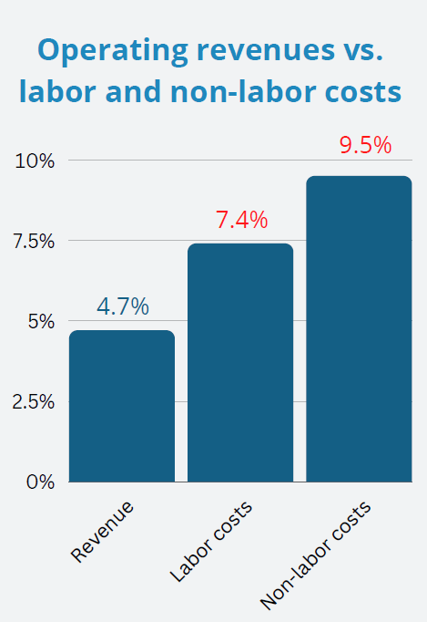
Operating Revenue and Costs
Notes:
Operating revenues did grow by an average of 4.7%.
However, labor expenses grew by 7.4% and nonlabor
costs grew by an average of 9.5%. That is
why operating margins are a better indicator of
financial stability. A positive operating margin is
necessary to ensure a robust statewide system of
care continues to serve patients, continue as the
community's lifeline, and attract and retain a skilled
workforce.

Slide 20
Advocacy

Slide 21
MHA’s Advocacy Priorities
Finance and reimbursement
Health care workforce
Mental health
Defense against mandates
Protecting the 340B Drug Pricing Program

Slide 22
2022 Elections on Nov. 8
Federal
State
Senators Klobuchar and Smith not up for re-election
All 8 congressional districts have an election for the House of Representatives
Very competitive in the 2nd congressional district – Incumbent DFL Angie Craig vs. Republican Tyler Kistner
Republicans expected to make significant gains across the country
Governor, attorney general, state auditor, and secretary of state on the ballot
All 201 legislative seats are up, 4-year term for state senators, 2-year term for state reps.
23 Senate races and 40 House races without an incumbent running
Minimum of 31% new legislators

Slide 23
2022 State Session Overview
Despite the fact the Tax Bill and the supplemental budget bills did not pass --- several key pieces of legislation did pass.
Reinsurance bill
A compromise package – replenishing the Unemployment Trust Fund and the Frontline Worker Pay bill
A Health & Human Services omnibus policy bill
A comprehensive mental health bill

Slide 24
MHA Priority: Frontline Worker Pay
Pleased with results (wish it had been sooner)
Burden of implementation on DOLI and not employers
Includes hospital dietary and environmental/janitorial
Spends $500 million, double the original $250 million
Eligibility:
Direct COVID care responsibilities – Income up to $350,000 for married couples, up to $175,000 for an individual
Income up to $85,000 for other filers
Must have worked at least 120 hours between March 15, 2020 and June 30, 2021
1,025,655 approved applications = $487.45/person

Slide 25
MHA Priority: Health Licensing Improvements
Streamlined the duplicative background study process
DHS COVID emergency background study compliance deadline extended from July 2, 2022 to January 1, 2023
90-day temporary permits for physicians and physician assistants

Slide 26
MHA Priority: Mental Health Funding
$92.7 million to fund mental health programs and initiatives
(Some funding is ongoing, some is one time)
$22.3 million to establish a State Competency Restoration Board
$10.1 million to district courts to pay for additional competency examination costs
$10.2 million for adult mental health grants
$9.6 million for grants for adult mobile crisis services
$2 million for school-linked behavioral health grants
$2 million or shelter-linked youth mental health grants
$1.6 million for educational loan forgiveness for mental health professionals
$1.2 million for a mental health urgency center pilot program
$1 million in grants to health care providers to develop mental health programming for their own health care employees

Slide 27
Other Provisions of Interest
Critical access hospital with attached nursing home construction moratorium exception located in Cook or Mahnomen County
22-bed hospital construction moratorium exception for Children's pediatric inpatient behavioral health services
A 5-year hospital construction moratorium exception for increased mental health bed capacity, either adding beds or building a new mental health hospital
A 144-bed hospital construction moratorium for a new mental health hospital located at the Bethesda hospital site

Slide 28
Bad Provisions that Didn’t Pass
Mandate that all hospitals must have a nurse staffing committee, comprised of 50% labor appointed representatives.
Creating an Affordability Board and Advisory Council charged with establishing health care spending growth targets and can create performance improvement plans and issue civil penalties.
Creating a Public Option through MinnesotaCare

Slide 29
Budget Disappointments
New scholarship program for allied health professionals
Laboratory technologists, Laboratory technicians, respiratory therapists, radiology technicians and surgical technicians
$800,000, with $24,000 going to Minnesota State for implementation and $776,000 going to $2,500 scholarships.
Long term care funding
Ambulance and non-emergency medical transportation – fuel adjustment allocation
$3.5 million for paying for sexual assault medical exams by the state, rather than from the counties

Slide 30
Looking to 2023 session and beyond…
Expand Psychiatric Residential Treatment Facilities – funding to maintain and expand capacity
Expand behavioral health care workforce
Educational opportunities, wages and waive/reduce clinical supervision requirements.
Increase reimbursement rates for Medicaid providers
Improve county-based processes and standardizations
Improve the provider licensing and credentialling process

Slide 31
Recently Enacted Federal Laws
Dr. Lorna Breen Act – March 2022
$135 million in funding to reduce and prevent suicide, burnout, and mental and behavioral health conditions among health care professionals.
Bipartisan Safer Communities Act – June 2022
$13 billion in funding for public safety and mental health programs
Inflation Reduction Act – August 2022
Allows Medicare to negotiate drug prices
Extends ACA premium tax credits for three more years

Slide 32
Lame Duck Priorities
“Lame duck session” = the period of congressional activity after the November election before the new Congress starts in January
Passing a final FY 2023 budget
Short-term continuing resolution extends funding levels through Dec. 16
Preventing additional Medicare payment cuts on top of -2% Medicare sequester
-4% PAYGO
-4% Medicare Physician Fee Schedule
Notes:
PAYGO = - 4%
• The Statutory Pay-As-You-Go (PAYGO) Act of 2010 requires across-the-board cuts for certain types of mandatory federal spending if new legislation increases the deficit. A PAYGO sequester has never gone into effect; Congress has always acted to waive the reductions.
• The COVID-19 relief bill, the American Rescue Plan Act, was passed in 2021 and triggered the reduction due to $1.9 trillion in spending.
• The Office of Management and Budget determined the increased spending should be offset by a -4% reduction in Medicare spending. Under PAYGO, Medicare payments cannot be cut more than 4%.
• The -4% Medicare payment cut was scheduled to go into effect in 2022 but was delayed for one year by the Protecting Medicare and American Farmers from Sequester Cuts Act, passed in December 2021.
• If Congress does not act, a sequestration order will be issued within 15 days of the end of the congressional session, and Medicare reimbursement will be reduced by -4% starting in 2023.
Medicare Sequestration = - 2%
• The Balanced Budget and Emergency Deficit Control Act of 1985 established the sequester as a tool to encourage agreement on budget policy. The payment cuts have been delayed or extended several times to offset the costs of new legislation and are now scheduled through FY2031.
• Medicare sequestration was temporarily delayed from May 2021 through March 2022 due to the COVID-19 pandemic. A -1% Medicare payment reduction was imposed from April 2022 through June 2022, and now the full -2% reduction is in effect.
Medicare Physician Fee Schedule Relief = - 4%
• In December 2020, Congress passed a one-time, one-year +3.75% increase in payments under the Medicare Physician Fee Schedule, to help ease the transition associated with significant coding changes.
• Given the ongoing financial challenges caused by the COVID-19 pandemic, The Protecting Medicare and American Farmers from Sequester Cuts Act included a +3% increase in payments under the Medicare Physician Fee Schedule through 2022.
• Due to the expiration of these temporary payment increases, the Centers for Medicare and Medicaid Services are proposing a -4.42% decrease in payments in 2023 for services under the Medicare Physician Fee Schedule. This includes the expiration of the 3% increase and a -1.42% budget neutrality adjustment.

Slide 33
Looking to 2023 and beyond…
Workforce development and education
Immigration visa reforms for international health care workers
Mental health payment parity
Preserving the 340B program – 2022 is the 30th Anniversary
Make telehealth flexibilities permanent
Congress passed legislation to extend Medicare coverage of telehealth services for 151 days after the end of the public health emergency, which is currently through Jan. 11, 2023

Slide 34
Medicare Inpatient Final Rule FY2023
Update inpatient PPS payment rates by 4.3% in FY 2023, which is 1.1% higher than proposed
Offset rates by 1.7% for outlier payments
Use FY 2018 and 2019 Worksheet S-10 data to determine the distribution of FY 2023 disproportionate share hospital (DSH) uncompensated care payments. CMS also adopted the use of a three-year average of S-10 data for FY 2024 and beyond
Distribute $10.4 billion in DSH payments
Permanently apply a 5% cap on any decrease in a hospital’s area wage index

Slide 35
Outpatient and Physician Fee Schedule
4.1% increased reduced by 0.3% productivity adjustment to 3.8%
Rural Emergency Hospital: New Medicare provider type
340B hospitals to have payments restored to ASP minus 6% for 2023
in lieu of ASP minus 22.5% for the years 2019 – 2022.
Payments for non-opioid products
Behavioral health services furnished remotely to beneficiary homes coverage

Slide 36
Medicare Rural Emergency Hospital (REH) provider type
A critical access hospital or small rural hospital with no more than 50 beds can convert to a REH and begin providing services starting January 1, 2023
In the 2023 proposed rule, CMS proposed a monthly facility payment of $268,294 for CY 2023 – approximately $3.2M annually for each facility
CMS also proposes to broadly consider all covered outpatient department services as “REH services” and would pay at the applicable OPPS payment rate plus 5%
National TA center Rural Health Redesign Center is available to help do financial modeling

Slide 37
Profile of Minnesota REH potential hospitals
16 hospitals show an avg daily census of less than 1.0.
20 hospitals shown an avg daily census between 1.0 and 2.0.
Swing Bed usage tends to help balance out the low IP census. Some use this more than others.
Outpatient mix of charges is generally over 80% for the low census group.
Medicare/Medicaid mix is also generally over 70% for the low census group.

Slide 38
MHA Federal Priorities
CMS offers guidelines on MDH and LVH designation requirements. On Thursday, the Centers for Medicare and Medicaid Services (CMS) released guidelines for facilities to follow to continue receiving Medicare Dependent Hospital (MDH) and Low Volume Hospital (LVH) payments through December 16, 2022. The designations were extended as part of a short-term continuing resolution (CR) which is set to expire December 16, 2022. Of note, a hospital may keep their LVH designation as long as they continue to meet both discharge criterion and the mileage criterion. To keep their LVH designation hospitals must send written verification of meeting these standards by November 16, 2022. For providers classified as an MDH, they will continue to hold their designation unless they chose to reclassify.

Slide 39
MedPac topics
Nov 3-4 meeting; Sampling of agenda:
Policy options for increasing Medicare payments to primary care clinicians
Aligning fee-for-service payment rates across ambulatory settings
Supporting Medicare safety-net hospitals
Standardizing benefits in Medicare Advantage plans: Non-Medicare supplemental benefits

Slide 40
Thank you!
Joe Schindler, vice president finance policy & analytics, Minnesota Hospital Association
(651) 659-1415
jschindler@mnhospitals.org

