Slide 1
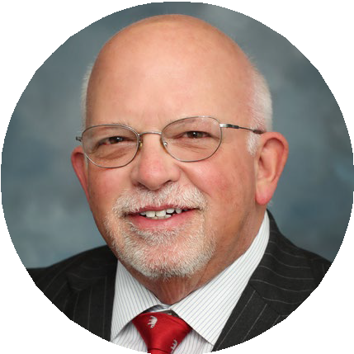
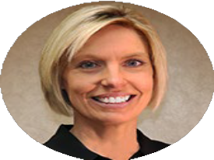





The Role of Data and Analytics in Healthcare: Using and Acting on Data to Grow Market Share
Thursday, October 6th, 2022; 9:50am – 10:50am ET Kentucky HFMA 2022 Fall Conference
Moderator Panelists
David
Miller
Melanie
Landrum
Travis Bailey
Dorian Herceg
Founding Partner
VP, Data and Health Info. Services
SVP, Administration & Chief Strategy Officer
Associate Chief Strategy Officer

