Slide 1
ARH Rural Home Hospital

Slide 2
Appalachian Regional Healthcare (ARH)
Top 10 Employer in Kentucky by Forbes Magazine
Not-for-Profit Health System Operating 14 Hospitals
Offers Multi-Specialty Physician Practices
Home Health Agencies
Home Medical Equipment Stores
Retail Pharmacies

Slide 3
ARH Mission
To improve health and promote well-being of all people in Central Appalachia in partnership with our communities.
ARH Vision
ARH will be the premier destination for quality care, a driver of advancement and development, and a leader in health for the communities we serve.
ARH Values
Trust – Innovation – Collaboration – Compassion – Service

Slide 4
Why Start a Rural Home Hospital Program?
Improves Outcomes
Lower Rates of Mortality
Lower Readmission Rates
Reduces Health Care Costs
Lower Average Length of Stay
Increases Bed Availability
Enhances the Patient Experience
Better Satisfaction of Patient and Family
Less Caregiver Stress

Slide 5
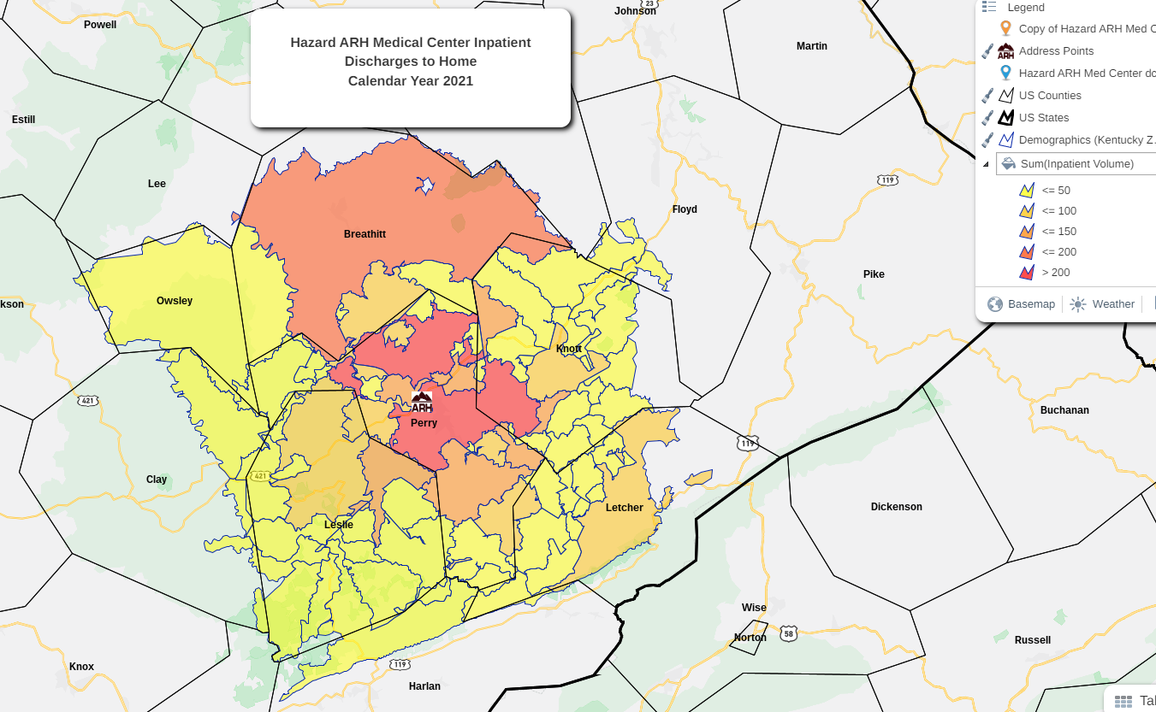
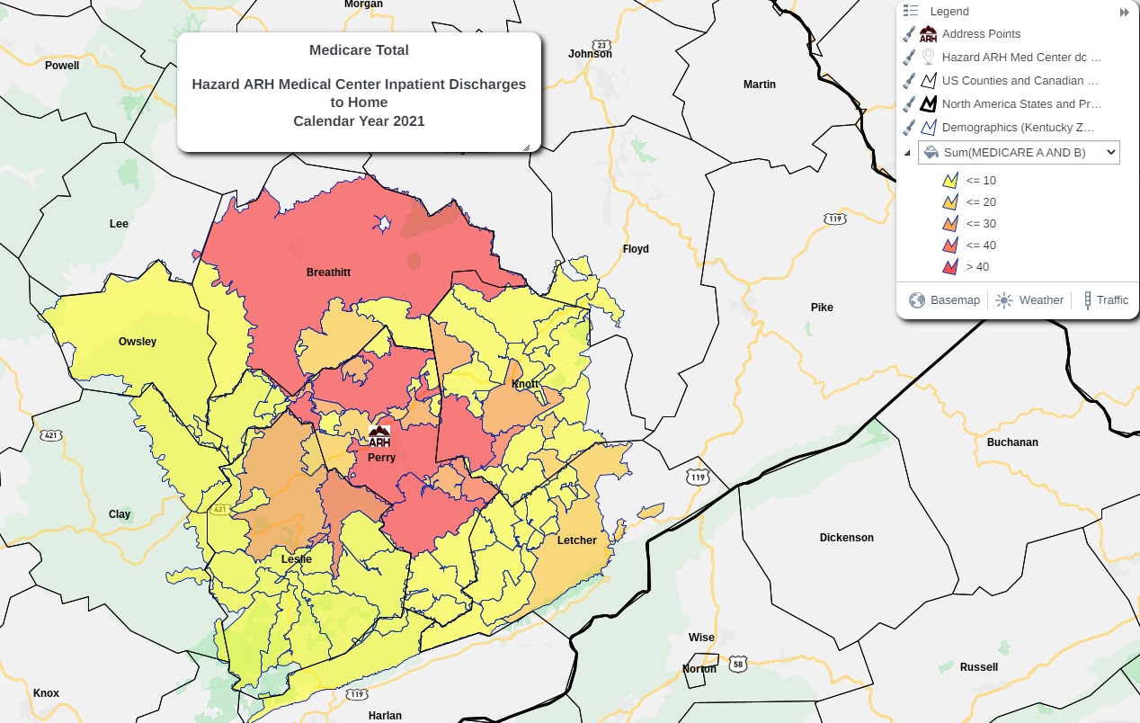
Rural Home Hospital Heat Maps

Slide 6
Staffing
Co Investigator – Team Lead for Study
Attending Physicians – Physician Groups with Admitting Privileges
Nurse Practitioner – Assisting with Admissions, Daily Tele-Health Visits, and Discharges
Nursing Director – Maintaining Oversight of Program and Staffing Requirements
Clinical Nurses – Providing Direct Care a Minimum of Twice Daily
Site Coordinator – Assisting with Identifying Patients who Meet the Criteria, Enrolling, Maintaining Data and Follow Ups
On-Call Staff – Paramedic or Nurse who can go to the Home 24/7 as Needed

Slide 7
Equipment
Communication & Connectivity, Essential Startup Supplies
Remote Monitoring Service
Cellular Phones
Laptops
Tablet
Cradlepoints
Satellite Terminal / Data Service Plan
Portable Printer
IV Pumps and Supplies
iStat Machine and Cartridges
AED
Oxygen Concentrators
EKG Machine
Glucometer

Slide 8
Flowcharts
Criteria / Eligibility
Admission
Transportation
Initial Visit
Documentation
Daily Visit
Decline / Decompensates
IV / Wound Vac Issues
Food Services
Lab
Pharmacy
Radiology
PT/OT/Speech

Slide 9
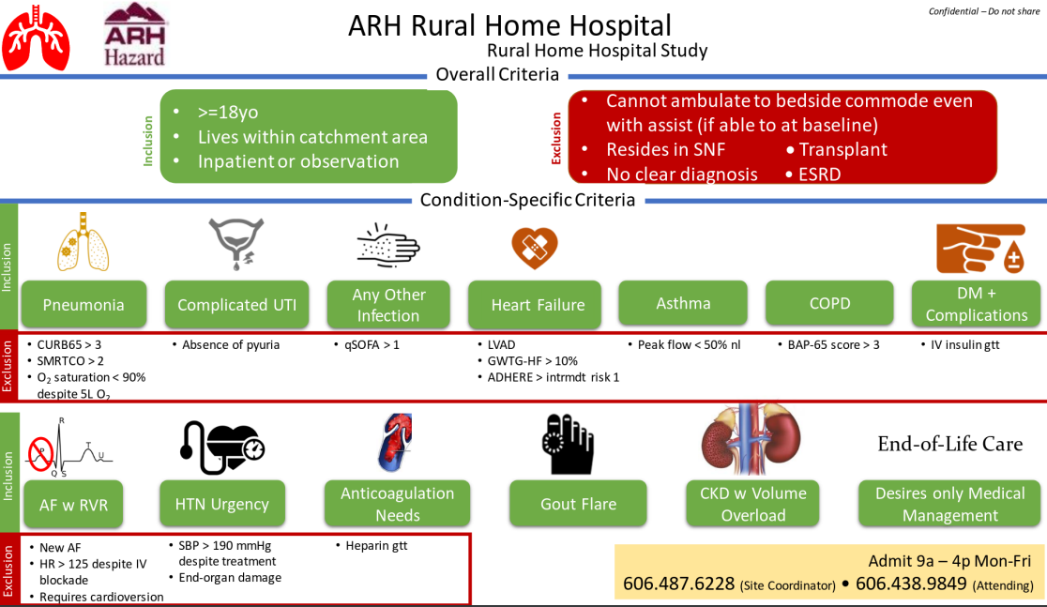

Slide 10
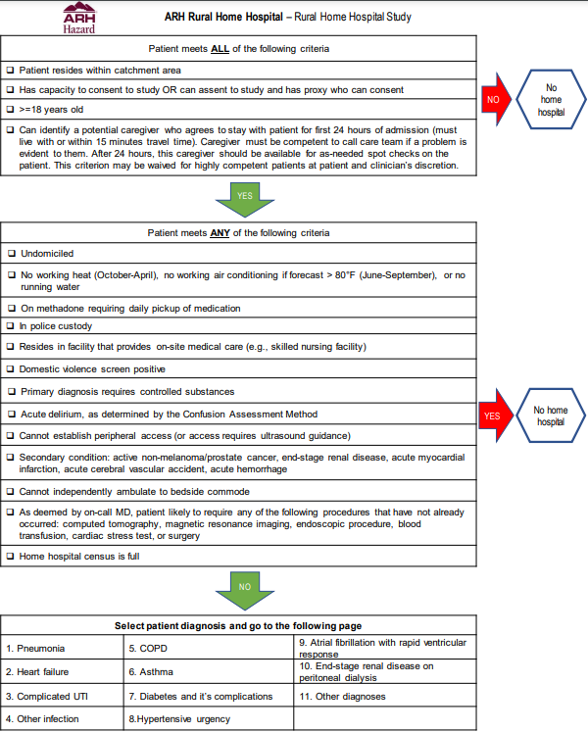
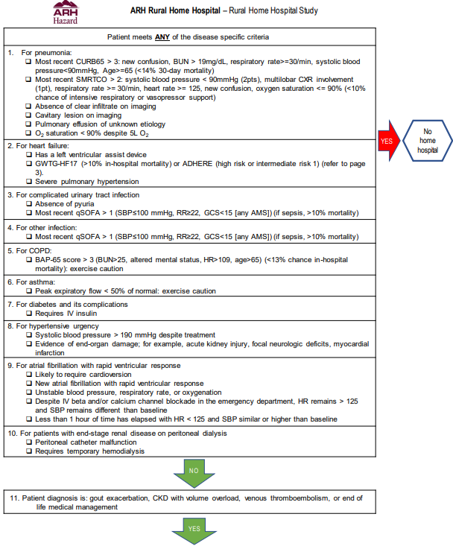
Rural Home Hospital Screening Criteria
ADMIT TO HOME HOSPITAL

Slide 11
CMS Waiver
ARH
Rural Home Hospital
Program
24/7 Availability and Remote Monitoring
2
Daily Nurse Visits
1 Daily Doctor Visit
Seamless Inpatient Care
Application
Interview
Determination
Reporting

Slide 12
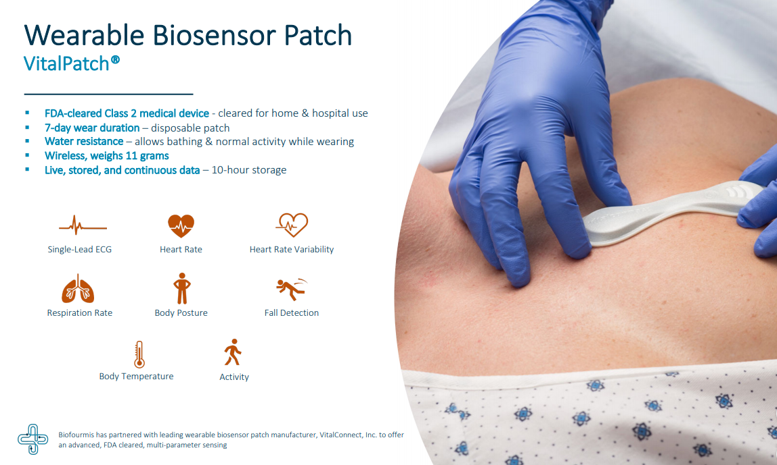
Caring for Our Patients
The patient will be equipped with a Biofourmis Virtual Bed which will include:
MDM Locked down cellular Samsung Tablet with patient app
FDA Cleared Vital Patch Sensor (See attached) Continuous Vitals Monitoring 24/7
FDA Cleared Peripheral Devices
Omron Blood Pressure 7000
Welch Allen Home Scale RPM-Scale100
Nonin 3230 Pulse Ox

Slide 13
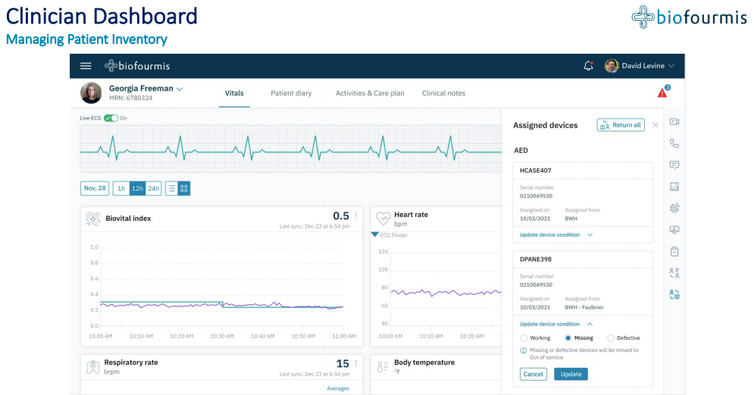
Caring for Our Patients

Slide 14
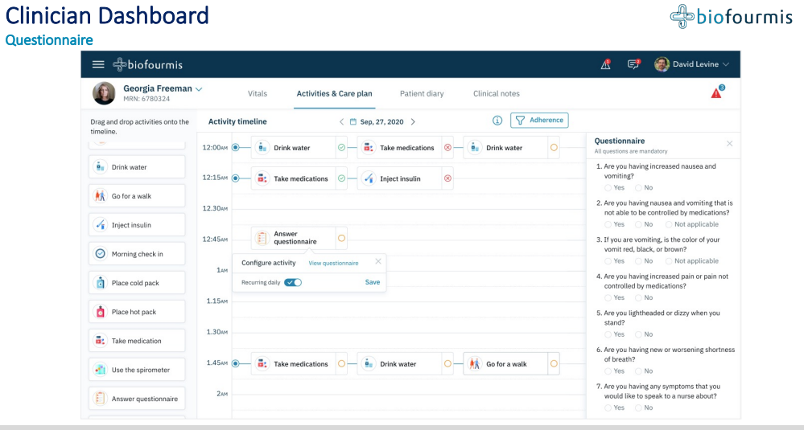
Caring for Our Patients

Slide 15
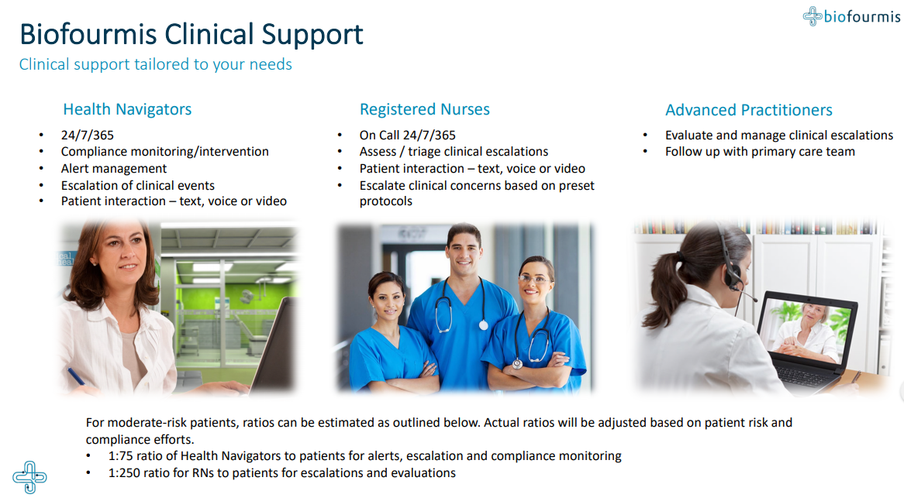
Caring for Our Patients

Slide 16
Thank You

