Slide 1
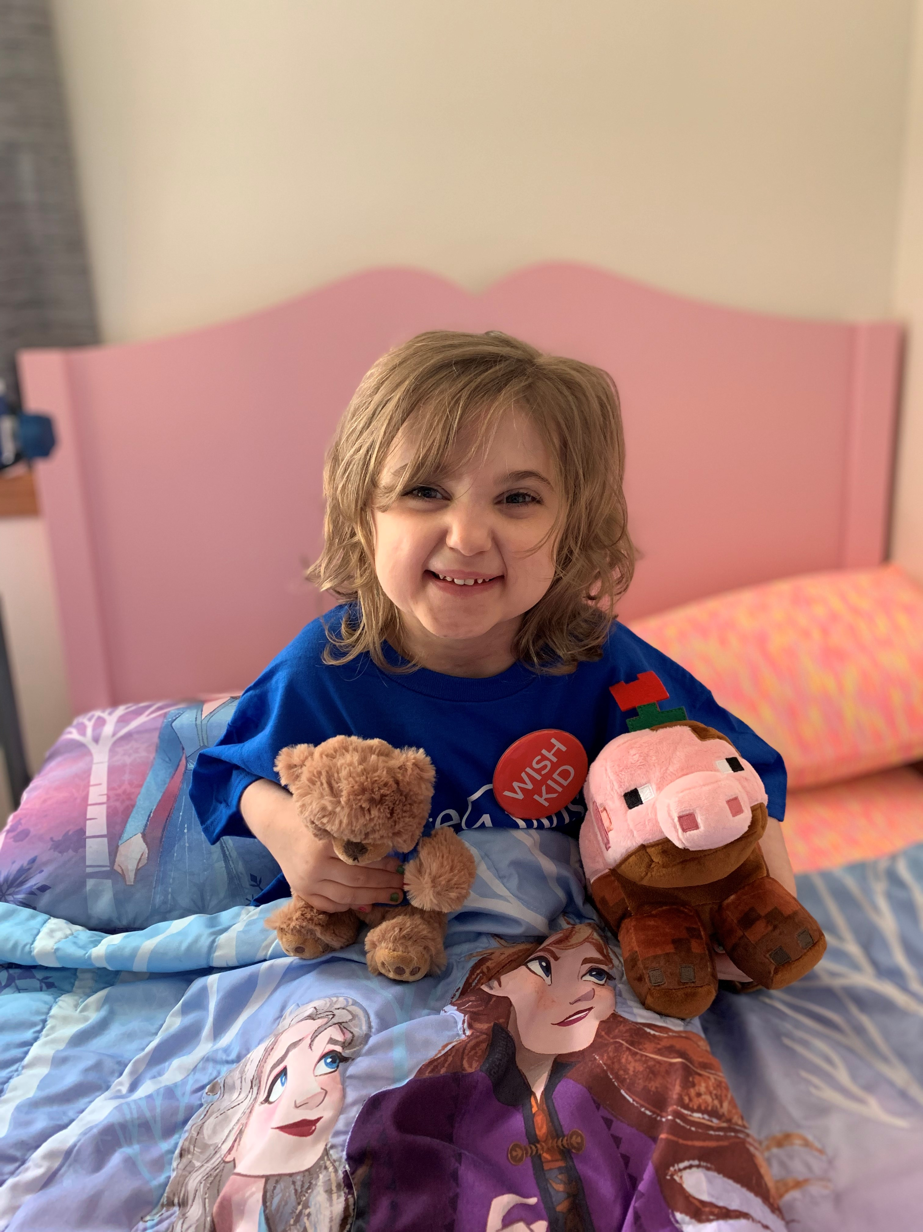
Reaching every eligible child
One Wish at
a Time
I wish to have
a shopping spree
Ahnna, 7
Heart transplant

Slide 2

Outline for today’s meeting
Make-A-Wish 101
Referral Process
Impact of a wish
Questions
Notes:
During this orientation video, we will explore the background of Make-A-Wish, including our mission, vision, and values, as well as our history. You’ll also learn about the impact of a wish on the wish child, the wish child’s family, volunteers and the community at large. Additionally, you will understand the eligibility criteria and the referral process. Finally, you’ll have a chance to explore some of the many volunteer roles available.

Slide 3
Together, we create life-changing wishes for children with critical illnesses.
OUR MISSION

Slide 4
To date
371 children waiting for a wish
are in our pipeline.
163 children
are in the process of being granted
their wish.
178 (about 52%) wishes
have been impacted by COVID-19.

Slide 5
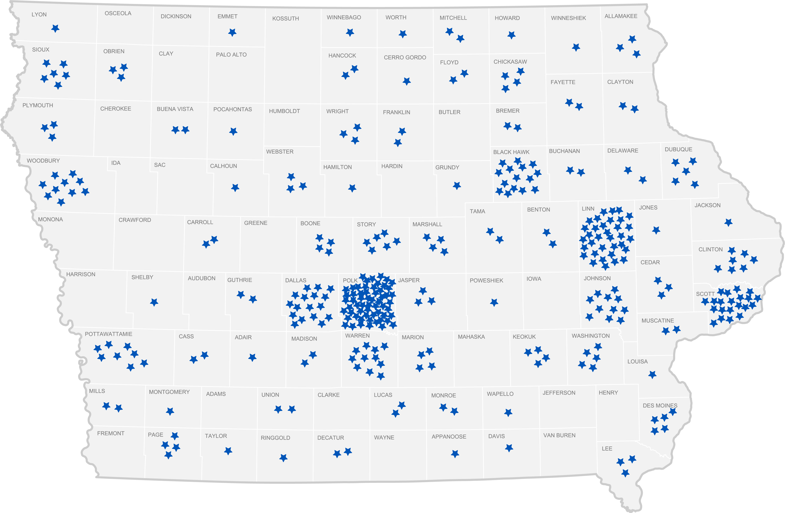
Where hope is needed
Wishes waiting across the state

Slide 6
Age & Gender
158 wish kids are female
183 wish kids are male
Older kids could age out of the program while waiting for their wish.
AGE

Slide 7
Critical conditions
Breakdown of wish kid conditions

Slide 8
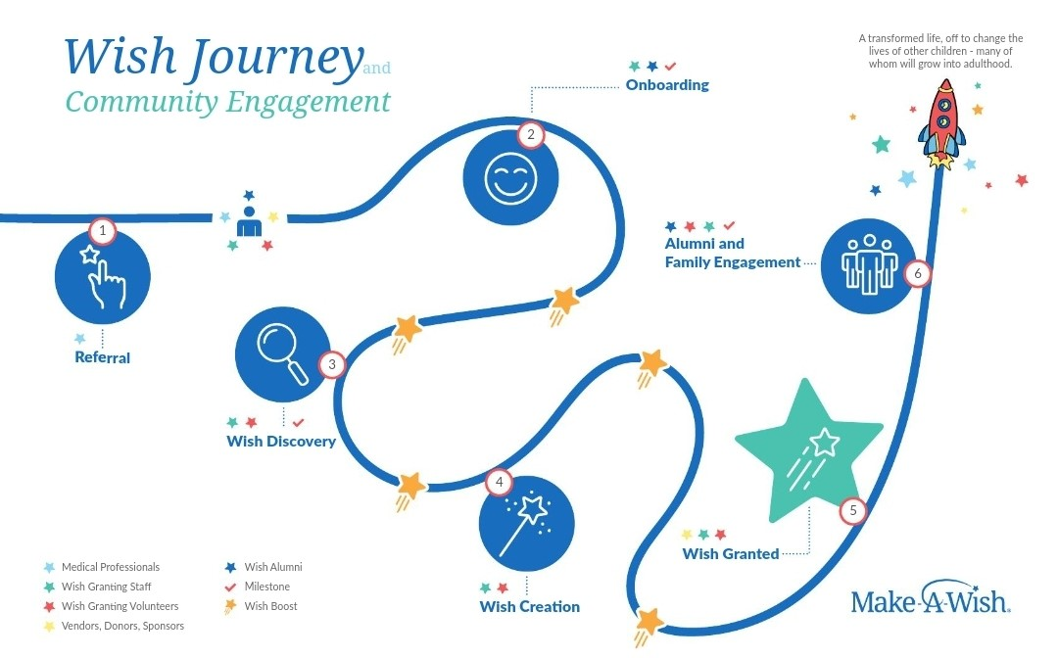
Notes:
Volunteering as wish granters

Slide 9
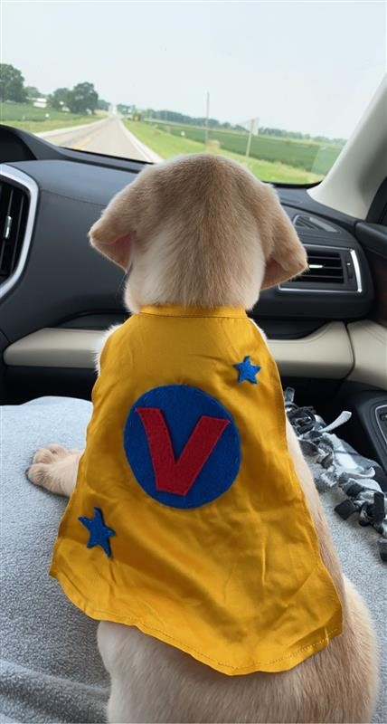
I wish to have a puppy
Bentley, 4
cancer
Types of wishes:
I wish to go…
I wish to have…
I wish to meet…
I wish to be…
I wish to give…

Slide 10

Eligibility

Slide 11
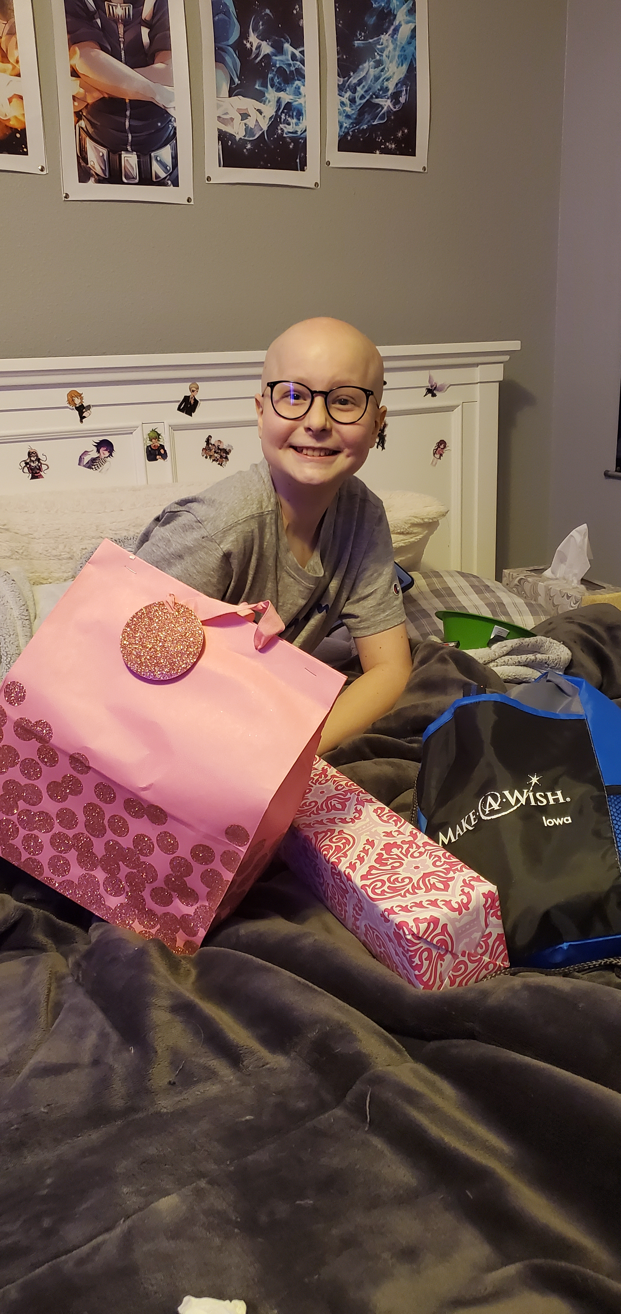
Who is eligible for a wish?
A child with a critical illness
who
has reached the age of 2½ and is younger than 18 at the time of referral
and
has not had a wish from another wish granting organization
is potentially eligible for a wish.
I wish to have a gaming computer
Makenna, 13
leukemia

Slide 12


www.md.wish.org
Make-A-Wish site exclusively for medical professionals.
Contains referral guidance sheets for the following specialties:
  Cardiology Metabolic Conditions
  Endocrinology Nephrology
  Gastroenterology Neurology
  Genetics Oncology
  Hematology Pulmonary
  Immunology & Rheumatology
  Infectious Disease
I wish to be a lumberjack
Colton, 4
brain tumor
12

Slide 13


Who can refer?
Family
The Child’s parent/legal guardian, the child, or a family member who has detailed knowledge of the child’s medical condition.
Medical Team
Member of the child’s healthcare team: physician, PA, Nurse, NP, Social Worker, or CCLS.
Who can share?
Anyone
We invite you to share information about Make-A-Wish with the family if you are not a family member or medical team member.
I wish to have a
playset
Steven, 5
congenital heart condition
13

Slide 14

Impact of a wish

Slide 15
Newly released impact study
The 2022 Wish Impact Study provides quantitative data to lend credibility to the anecdotal feedback heard regularly from wish families. The powerful results of the Wish Impact Study add to a growing body of research demonstrating how wish-fulfillment promotes mental and emotional well-being for children and their families who are facing trauma stemming from a critical illness.
I wish to have a
playset
Steven, 5
congenital heart condition
15

Slide 16

Behind the study….
The online study surveyed three groups of individuals: parents of wish kids, wish alumni (i.e., former wish recipients) and doctors. The parents and alumni who were surveyed experienced a wish between 2009 and 2019, allowing them to look back and assess the lasting, long-term impact of the wish. In total, 3,411 people completed the survey.
I wish to have a
playset
Steven, 5
congenital heart condition
16

Slide 17

From the Doctors…
Perhaps the most overwhelmingly positive feedback on the impact of a wish came from the pediatric doctors who participated in the study. More than 90% of the doctors said they witnessed their patients overcoming feelings of sadness, hopelessness, anxiety and depression after their wish. Furthermore, 95% of the doctors reported the wish improved their patients’ emotional and physical well-being. Most notably, 75% of the doctors went as far as to state that a wish could improve a child’s medical outcomes.
I wish to have a
playset
Steven, 5
congenital heart condition
17

Slide 18
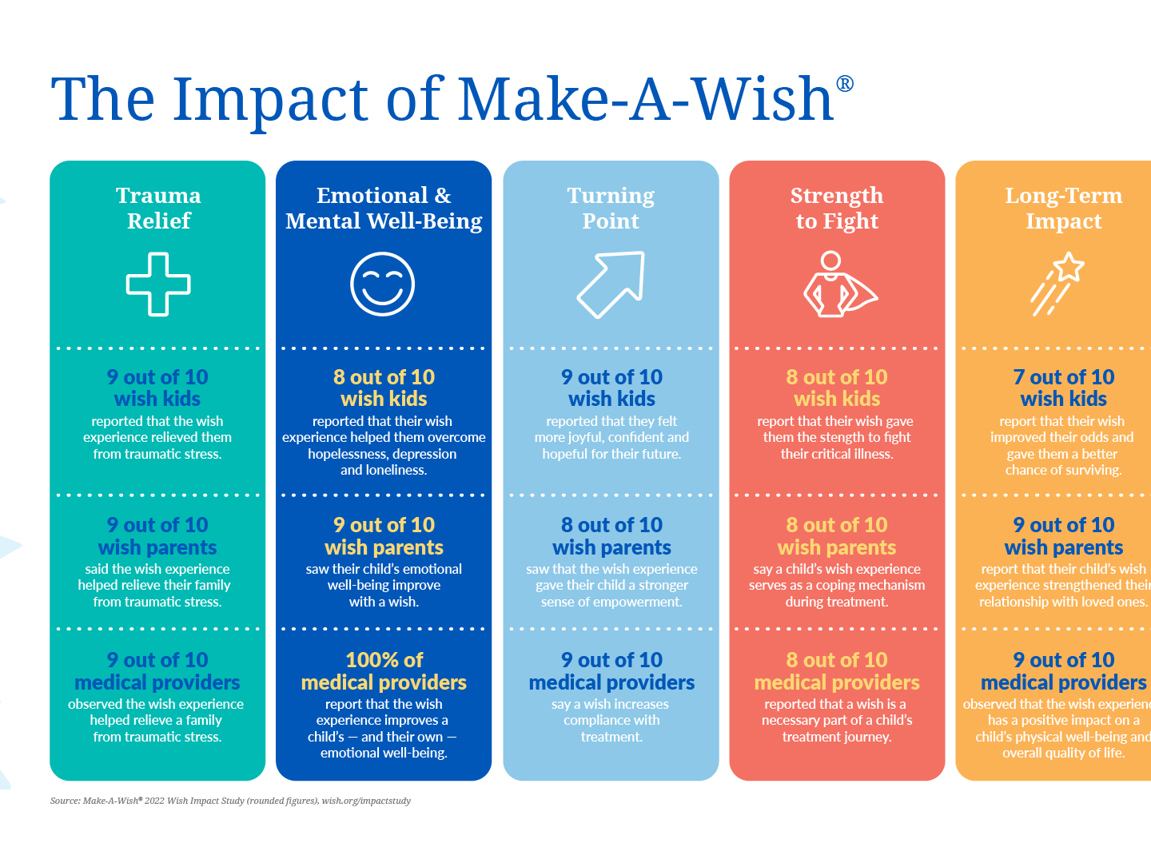

Slide 19
Read the full study here:
https://wish.org/impact-study

Slide 20
Lincoln’s Wish
https://www.youtube.com/watch?v=o8Aw7lzmdgU
Notes:
During this orientation video, we will explore the background of Make-A-Wish, including our mission, vision, and values, as well as our history. You’ll also learn about the impact of a wish on the wish child, the wish child’s family, volunteers and the community at large. Additionally, you will understand the eligibility criteria and the referral process. Finally, you’ll have a chance to explore some of the many volunteer roles available.

Slide 21
How will you help the 371 Iowa kids who are waiting?

