Slide 2

Recruitment & Retention – Healthcare staffing trends & best practices to address short- and long-term staffing shortages
July 13th, 2022

Slide 3
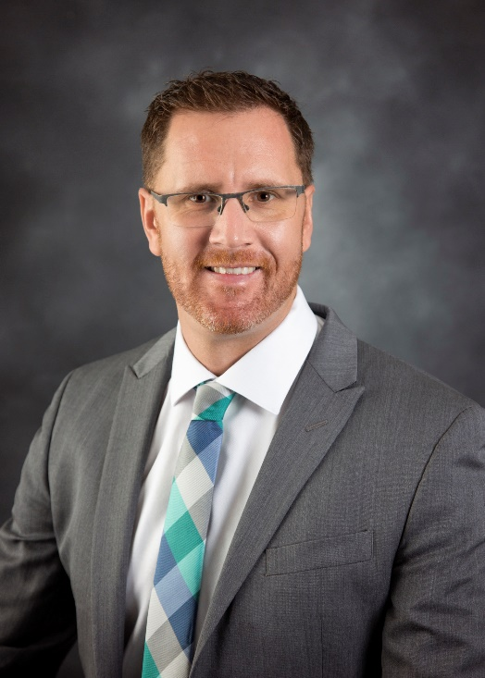
Presented by
Derek J Castaneda, Managing Director Healthcare Executive Search
Dcastaneda@seimjohnson.com

Slide 4
Staffing Trends, Recruitment, Retention
Impact of COVID 19
Healthcare’s Great Resignation
Baby Boomer Exodus
Nursing Staff
Physicians
Recruitment & Retention Best Practices
Culture

Slide 5
Labor Impact of COVID-19
COVID-19 didn’t create the healthcare staffing shortage, but the impact is worsened because of it.
  From 2017 to 2021, RN turnover rate increased from 17 to 26%.
  As of 3/2022, 29% of RNs likely to leave direct patient care, among those 15% intend to leave workforce altogether.
Burnout, stress, and mental health problems exacerbated.
Increased need for hospitalizations, while worker infections & turnover simultaneously limited labor supply.
Remaining workforce caring for patients with fewer staff, leaving them unable to properly support new staff leading to lower job satisfaction and higher turnover for both.
Labor issues expected next 5-10 yrs., largest segments Nursing, Primary Care Physicians, and lower-wage positions (support staff, home health, etc.).
Near-term labor supply issues met by limiting non-essential procedures, contracting with staffing agencies, increasing compensation/benefits, etc.
Constrained labor supply adding financial pressure, reimbursement rates not keeping pace with labor cost increases.

Slide 6
Healthcare’s Great Resignation
The Great Resignation—the mass exodus of unsatisfied workers—has hit few industries harder than healthcare.
According to some reports healthcare has lost an estimated 20% of its workforce, including 30% of nurses.
2022 – Nearly 3.1M have quit healthcare jobs, equivalent to almost 3% of the healthcare workforce each month (28% quit because of burnout).
Contributing Factors:
  Burnout (Pandemic, short staff, peak volume, high caseloads, concerns of safety/quality).
  Frequency of death & tragedy during peaks in COVID waves – Comprising medical integrity while caring for patients, increases the odds by threefold of intention to leave current position.
  Inflexible scheduling, lack of work/life balance.
  Organization driven by profitability.
  Politicization of healthcare decisions.
  Change of worker priorities.
  Giving up healthcare all together to pursue other interests.
  Early retirement.
  Vaccine mandate.
  Compensation, more flexibility.

Slide 7
Baby Boomer Exodus
Born 1946 to 1964, total 73M (make up 1/3 of the workforce), 40% (28.6M) retired by Sept 2020
By 2029, all Baby Boomers will be 65, totaling 1 out of 5 in the US
By 2029, most will be out of workforce.
56, Average age of Hospital C-Suite Leader across US, only 21% of Hospital CEOs appointed before age 45.
Ranks of Gen X workers are simply not enough, many millennials lack the needed work experience, foreign born workers often face immigration challenges, and flexible or remote workers aren’t appropriate for every role.
Generation X – 53M, Millennials 56M, in the workforce.
A quick glance at population data shows why the retirement of more baby boomers will create recruitment headaches in the years ahead, unless the age mix in your organization heavily tilts toward young workers.

Slide 8
Nursing Staff
US projected to experience a shortage of RNs expected to intensify as baby boomers age and the need for care grows. 10 to 20% nursing gap (200 to 450K shortage) by 2025
RN among the top for job growth through 2029 (Demand). RN workforce expected to grow from 3M in 2019 to 3.3M in 2029. Projects 176K openings each year.
Contributing Factors to the shortage:
  Nursing school enrollment not growing fast enough to meet demand, enrollment would have to more than double entering and staying in workforce every year for next 3 yrs. to meet demand.
  Nursing workforce is nearing retirement age, average for RN is 54 years old, more than 1M RNs will leave workforce by 2030 (1/3 of expected workforce)
  More RNs needed to care for aging population, by 2030 82M will be 65+
  Insufficient staffing raising stress level, driving RNs to leave the profession
  COVID-19, Long COVID, and chronic conditions will lead to a 1 – 12% increase in inpatient days by 2025.

Slide 9
Physicians
The U.S. faces a projected shortage of up to 124,000 physicians within 12 years, according to The Complexities of Physician Supply and Demand: Projections From 2019 to 2034 (PDF), a report released by the Association of American Medical Colleges (AAMC).
1981, US intentionally capped its physician supply fearing a surplus, which led to restricted govt funding for scholarships & residency training programs, and US Medical schools enacted a moratorium from 1980 to 2005, which limited the number of new medical schools and restricted medical school class sizes.
US had 1M+ physicians in 2020, up from 850K in 2010. The number of physicians is rising but not fast enough to keep up with demand.
US population projected to climb to 363M by 2034, 22.9M (2/3 of the growth) to be people over 65 who will require more care. The growth in the US population, and aging population are driving physician shortage projections.
Number of medical school students in the US has grown almost 37% over the past two decades, last year US Medical Schools saw a record number of applicants (62,443) representing a 17.8% jump from previous year.
Contributing factors to shortage:
  Many physicians retiring early, 52% of active physician workforce is 55 or older
  Overwhelmed with burdens and impediments of practicing medicine (EHR, prior auth., cost of meds, etc.)
  Large, aging population – Encountering more complex medical conditions.
  Total Baby Boomer Providers leaving Market 92K, Millennial Providers Entering 25K.
  Tough sell to convince a young doctor to move to a rural area.
  Candidate’s market, providers seeking opportunities for growth, complex cases, manageable workloads, location, competitive benefits/compensation.

Slide 10
Recruitment & Retention Best Practices
Given estimates that the labor supply issues will continue into the next decade, healthcare employers need to act now to address labor shortages today and in the future.
Quantify your workforce needs.
  Leverage analytics/technology to improve workforce planning efficiency.
  Reassess regularly as the situation evolves day to day.
Maximize.
  Enable to expansion of clinician-to-patient ratios by assigning clinical providers to the most specialized care and delegating non-specialized and personal care provision to supporting staff.
  Provide necessary training to support the return of clinical providers.
  Up-train staff with similar skill sets needed for specialized care and/or administrative duties.
  Be aware of workforce trends – plan to mitigate predicted shortages in specific categories.
  Consider new care delivery models.
  Consider technology solutions that simplify and accelerate administrative tasks – think about the long-term investment you need to make to be prepared for 2030.

Slide 11
Recruitment & Retention Continued
Recruit/Retain/Supplement your workforce.
  Partner with other hospitals to share staff.
  Engage healthcare workforce volunteers.
  Attract more people to clinical roles, partner with educational institutions by supporting training to increase the number of new grads entering the workforce.
  Seek out local, state, or federal grants related to recruitment/retention. Loan forgiveness, fellowships, etc.
  Create a rural residency program.
  Be driven to be an employer of choice.
    Regularly conduct employee satisfaction surveys.
    Find out what staff say about working for your organization. Pro’s? Con’s?
    Consider having HR partner with marketing to launch or revamp your employment brand.
    Offer employment arrangements to accommodate people at different life stages.
    Add telecommute, part-time hours, compressed workweeks, short sabbaticals, job sharing, project-based contracts, or temporary jobs to your workforce benefits.
    Millennials are drawn to transparent, collaborative organizations. This generation grew up with technology and likes access to information. Open organizations with open-book financial management and open-door hierarchies will be at an advantage to recruit Millennials.

Slide 12
Recruitment & Retention Continued
Recruit/Retain/Supplement continued.
  Be driven to be an employer of choice continued:
    Consider including foreign immigrants & nations in your workforce plan.
    Consider updating or implementing a thorough orientation process to include regular check-ins the first 12 months on the job.
    Understand your competitors, including McDonalds – What do you need to do to compete for all staff?
    Ensure supervisors, managers, directors, and executives are frequently checking in with team members – focused on health, well being
    If you conduct exit interviews, don’t want until someone resigns – solicit feedback and provide an avenue for information to move from the staff level to executive decision makers and the board.
    Provide learning & development opportunities
    Implement succession planning, career development
  Retain your baby boomer employees, offering retention bonuses, deferred compensation, etc.
  Remove barriers to delivering care – listen to your clinicians about what they need.

Slide 13
Recruitment & Retention Continued
Support the Healthcare workforce.
  Consider providing childcare, eldercare, and other resources to alleviate caretaking requirements as a barrier to staff availability.
  Consider implementing coaching & mentoring programs.
  Create peer support networks, install a staff member responsible for team wellbeing to be constantly thinking about how to improve the quality of experience for staff.
  Adjust shift schedules and lengths to maximize staffing and prevent burnout.
    Give staff more control over their schedules.
    Increased adoption of telemedicine has created opportunities for some healthcare workers to choose part-time or more flexible hours working from anywhere.
    New Technologies enabling a more flexible staffing approach, mobile apps uber like approach to connect workers with vacancies.
  Direct, personalized care is what clinicians consider one of the most valued aspects of their profession. Understand people are leaving because they can’t provide the level of care they want to deliver.

Slide 14
Presentation References
https://aspe.hhs.gov/sites/default/files/private/aspe-files/265686/homecarecovid.pdf
https://www.aacnnursing.org/news-information/fact-sheets/nursing-shortage
https://revcycleintelligence.com/news/200k-to-450k-nursing-shortage-expected-by-2025-without-action
https://www.forbes.com/sites/debgordon/2022/05/17/amid-healthcares-great-resignation-burned-out-workers-are-pursuing-flexibility-and-passion/?sh=10e318367fda
https://www.beckershospitalreview.com/workforce/the-great-resignation-for-healthcare-workers-is-unique-and-so-are-its-solutions.html
https://www.healthleadersmedia.com/human-resources/great-resignations-toll-healthcare
https://www.ama-assn.org/practice-management/sustainability/doctor-shortages-are-here-and-they-ll-get-worse-if-we-don-t-act

Slide 15
Q&A
Thank you!

