Slide 1
Can Politics be as Fatal as a Pandemic? A Look at the 2023 Political Landscape
Presented to the MS HFMA
August 19, 2022
Timothy H. Moore
President/CEO

Slide 2
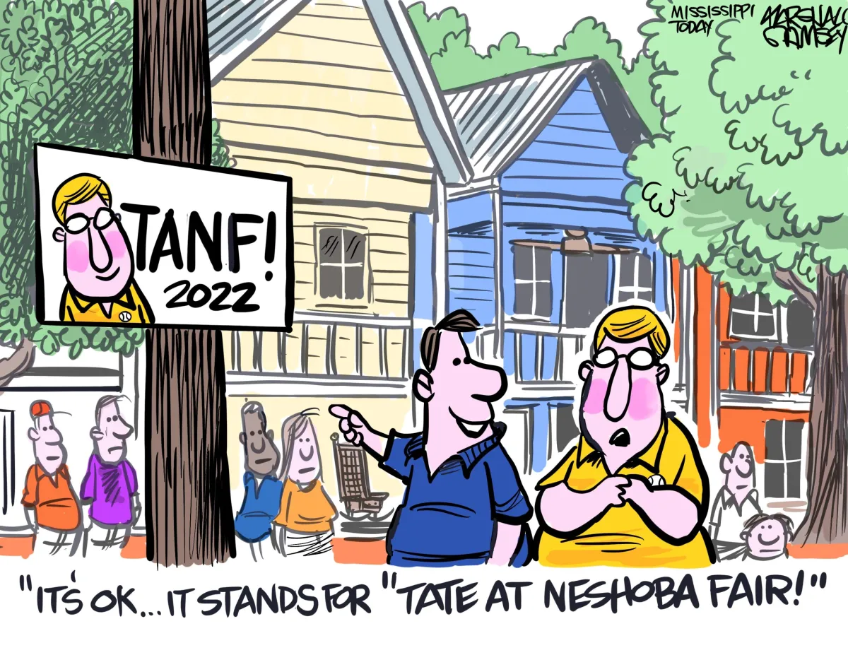
Ready or not the race has started, but who will be running?

Slide 3
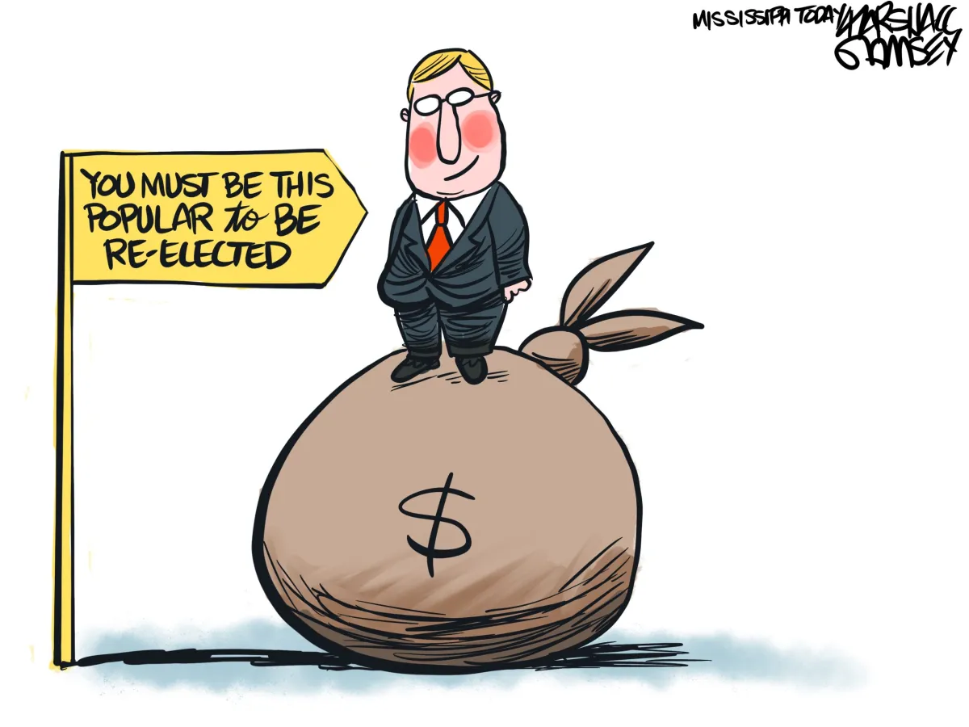
No question Governor Reeves will be seeking a second term and praying there is not another pandemic. Possibly the most unpopular Governor in history to seek reelection, according to the polls.

Slide 4
The Influence of the2023 Elections
Who, if anyone, will oppose incumbent Tate Reeves
Speaker—Philip Gunn
Attorney General—Lynn Fitch
Secretary of State– Michael Watson
Former Representative—Robert Foster
Commissioner—Brandon Presley

Slide 5
The Influence of the2023 Elections
Are less obvious state leaders giving thought to a run?
Chief Justice—Bill Waller Jr.
Mayor of Hattiesburg, former Representative—Toby Barker
Mayor of Vicksburg, former Representative—George Flaggs
Mayor of Oxford, Robyn Tannehill

Slide 6
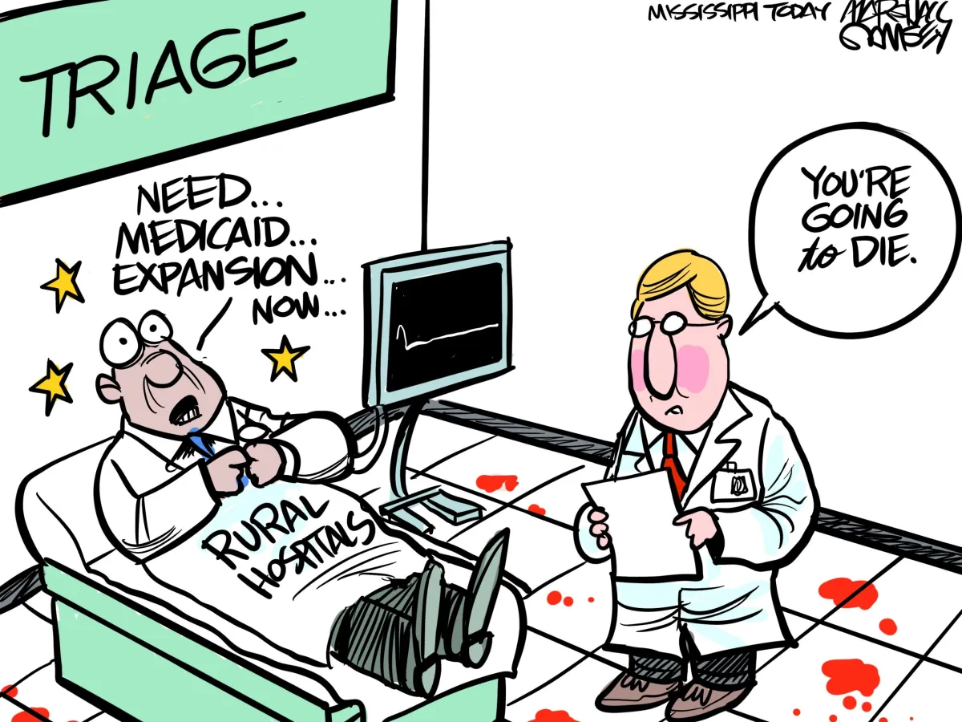

Slide 7
The Influence of the2023 Elections
Would any of these candidates have a different view of healthcare coverage for the working poor?
Is it in the best interest of our state to continue with the theory that POLITICS “trumps” POLICY ?
Is the climate becoming more inviting for Independent Candidates to gain support from Democratic and Republican moderates?

Slide 8
The State of Healthcare in Mississippi
This group could answer this question better than anyone else.
Our hospitals are struggling all over the state, many finding themselves in unprecedented hardship.
Long standing resilience may have deafened ears.

Slide 9
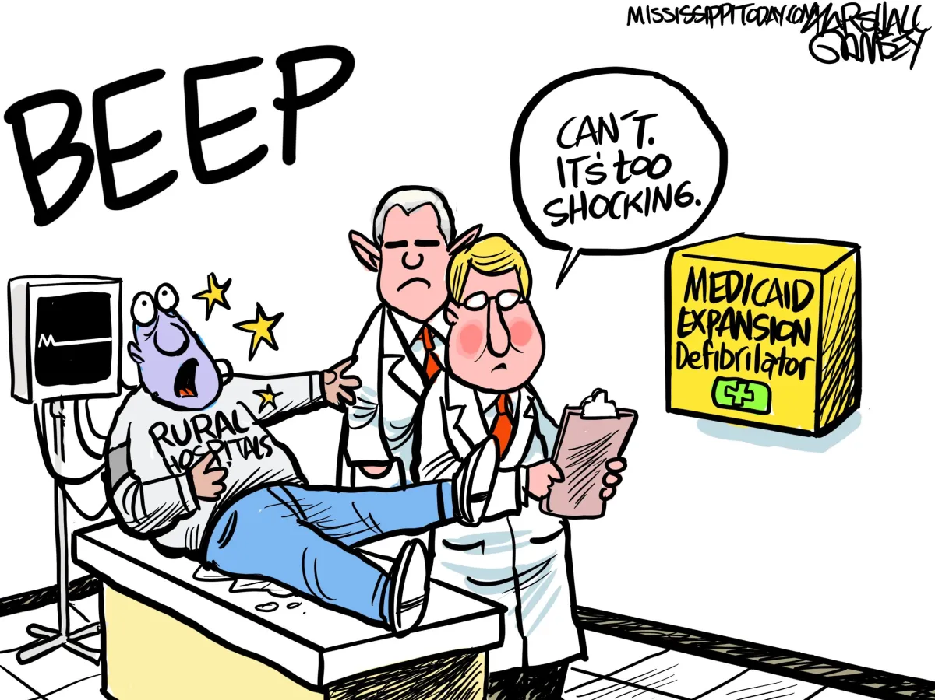

Slide 10
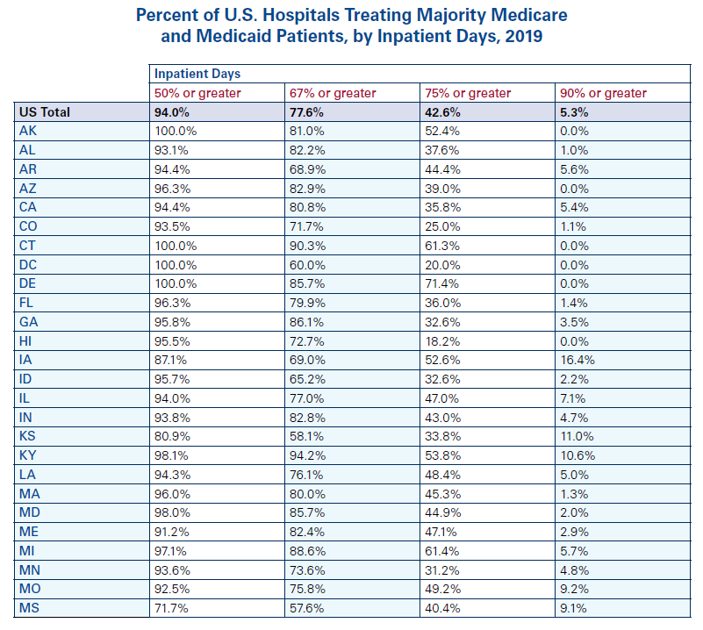
Medicaid Expansion- The Elephant in the Republican party no one wants to talk about. HB-1000
correction
MS 91% 60% 51% 21%

Slide 11
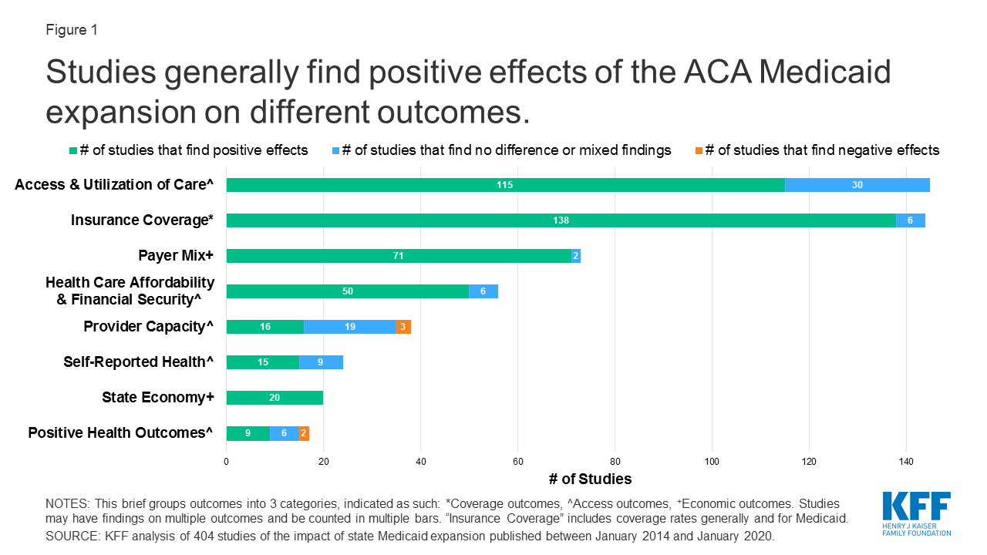
Medicaid Expansion- The Elephant in the Republican party no one wants to talk about. HB-1000

Slide 12
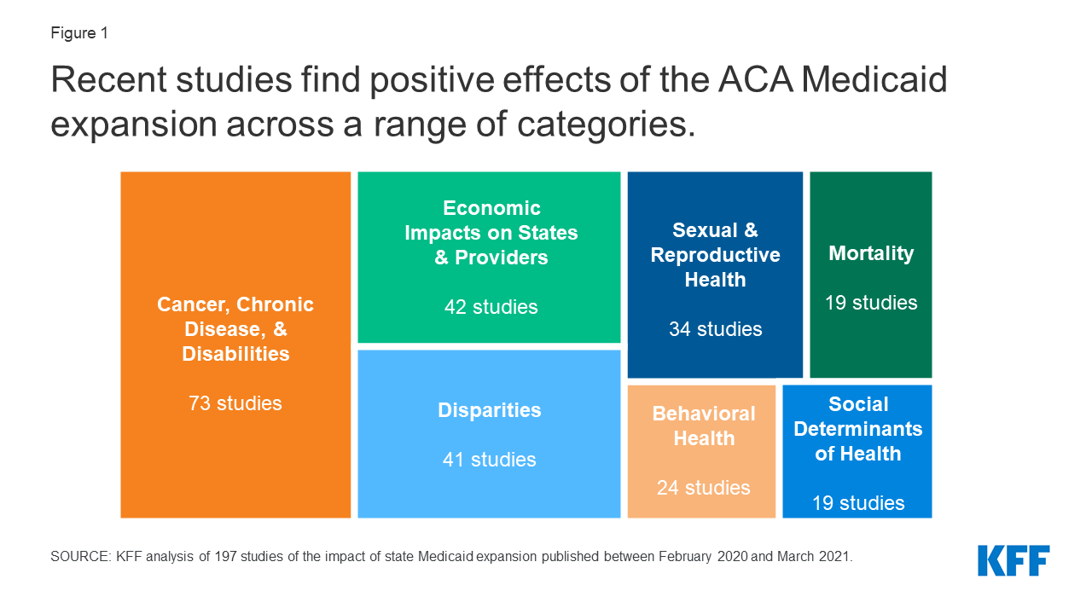

Medicaid Expansion- The Elephant in the Republican party no one wants to talk about. HB-1000

Slide 13
Insurance Reform-payor abuse has become unbearable
HB 803- The Healthcare Simplification Act
HB 586- The Mississippi Preauthorization Gold Card Act
SB 2907- The Healthcare Simplification Act

Slide 14
Certificate of Need- Understanding the importance and how to explain it to others.
Basic Economics
High demand and low supply creates high cost
Low demand and high supply creates low cost
Those who want to eliminate CON often claim that CON laws drive up the costs of healthcare and that eliminating CON would lower costs.
According to KFF inpatient cost (expenses) in Mississippi was the lowest in the nation in 2020 at $1,311 per day. (next closest Wyoming at $1,466)
Over the last 20 years the Mississippi average expense per inpatient day has increased 78% while the national average has increased 127%.
Fate on North Carolina Medicaid Expansion may depend on CON

Slide 15
Thank you
Remember the question:
“Can politics be as fatal as a pandemic?”

