Slide 1
Iowa HFMA Meeting
WPS Medicare Audit Update
July 14th, 2022
Chris Severson

Slide 2
Agenda
New Cost Report Documentation Requirements and PRA Package
DSH Issues
Bad Debts
Nursing and Allied Health
Provider-Based Physicians
S-10 Uncompensated Care Audits
File Exchange/Secure-EDI/MoveIt
WPS Website, Webinars, and YouTube Channel
Questions

Slide 3
New Cost Report Documentation Requirements
GME/IME Interns and Residents (IRIS)
Medicare Bad Debts
Disproportionate Share Hospital (DSH) Eligible Days
Data elements on Worksheet S-10 Uncompensated Care
  Charity Care and Uninsured Discounts required at acceptance
    Total Bad Debts required for eventual S-10 audit
Home Office costs
  Cost Statement must be filed with MAC that services the Home Office
All amounts must “correspond to” the data reported on the cost report.

Slide 4
New Cost Report Documentation Requirements
https://www.wpsgha.com/wps/portal/mac/site/audit/guides-and-resources/cost-report-documentation-requirements-templates
  Includes electronic templates
https://youtu.be/gAAXSTNELy8
83 FR 41677 (August 17, 2018)
Effective for cost reporting periods beginning 10/1/2018 and after
All provider types; not just hospitals

Slide 5
New Cost Report Documentation Requirements
Official Federal Register entry.
  https://www.govinfo.gov/content/pkg/FR-2022-06-22/pdf/2022-13278.pdf
CMS website with details of changes
  https://www.cms.gov/regulations-and-guidancelegislationpaperworkreductionactof1995pra-listing/cms-2552-10
Public comments due by 7/22/2022
Proposed to be effective for FYB on or after 10/1/2022

Slide 6
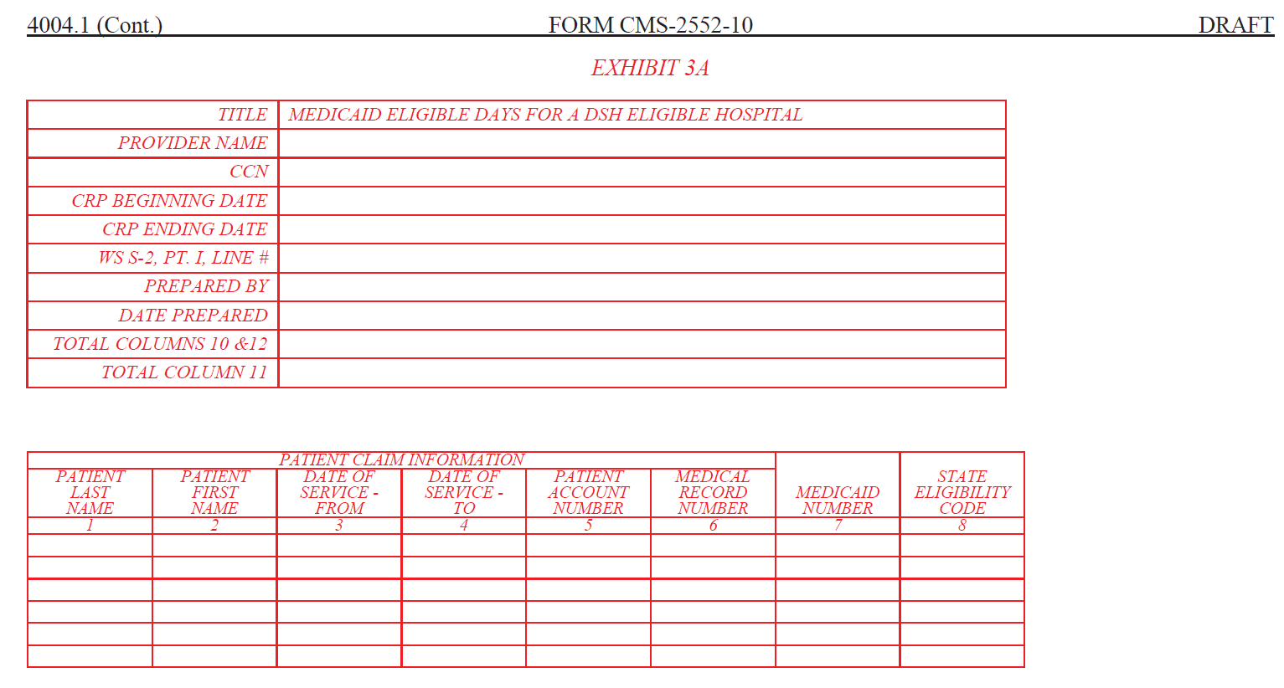
New Cost Report Documentation Requirements
  Medicaid Days

Slide 7
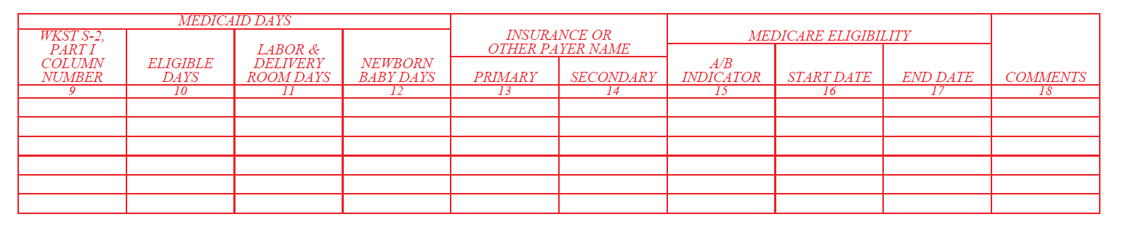
New Cost Report Documentation Requirements
  Medicaid Days

Slide 8
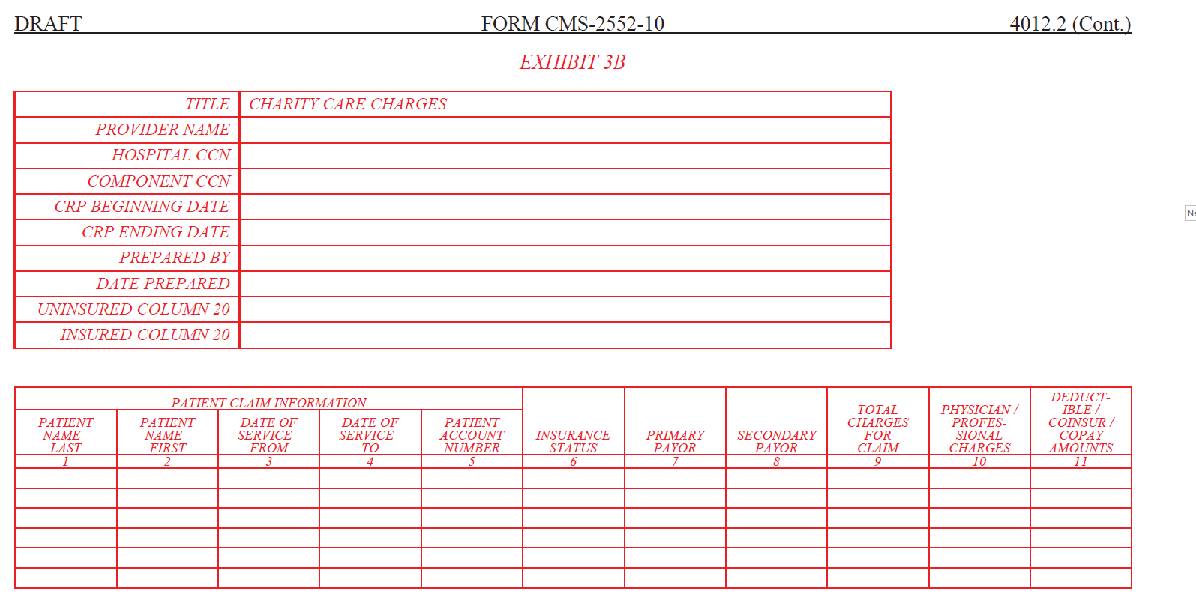
New Cost Report Documentation Requirements
  S-10 Charity Care Listing

Slide 9
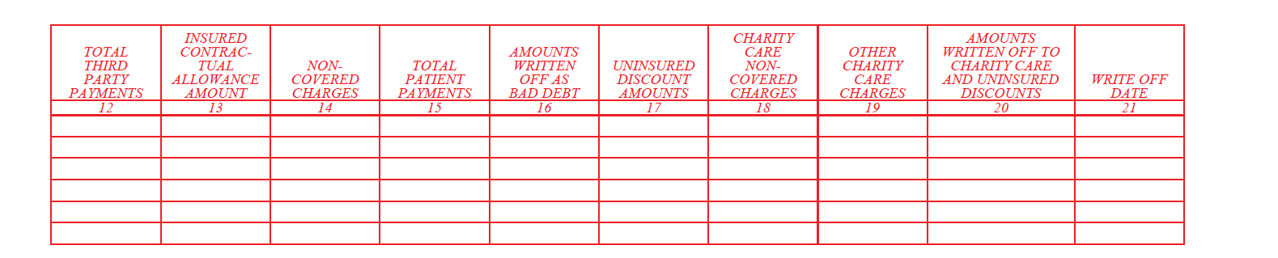
New Cost Report Documentation Requirements
  S-10 Charity Care Listing

Slide 10
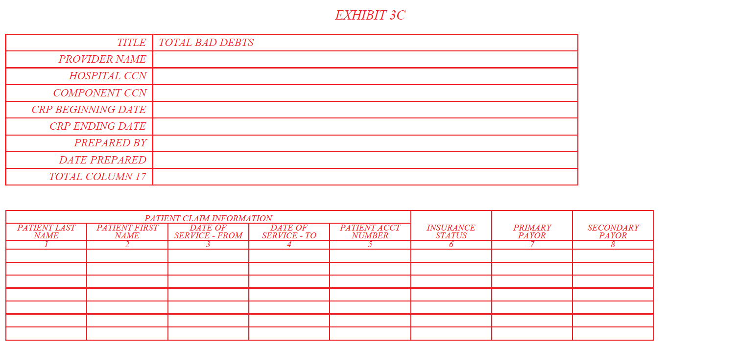
New Cost Report Documentation Requirements
  S-10 Total Bad Debt Listing

Slide 11
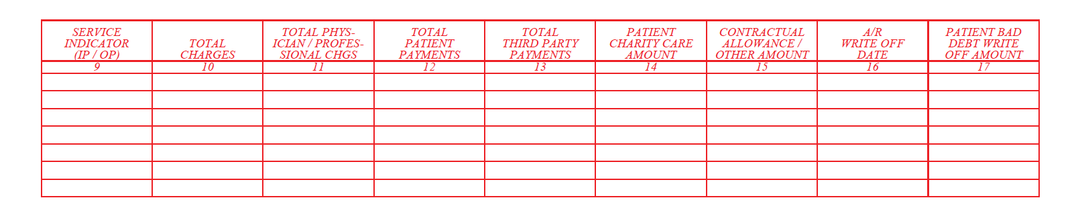
New Cost Report Documentation Requirements
  S-10 Total Bad Debt Listing

Slide 12
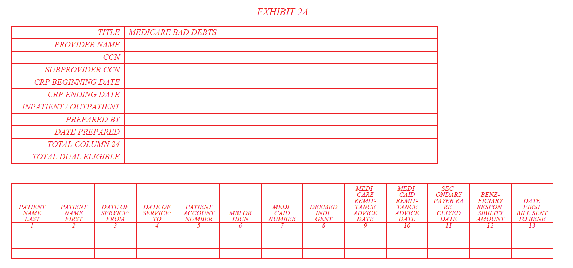
New Cost Report Documentation Requirements
  Medicare Bad Debts

Slide 13
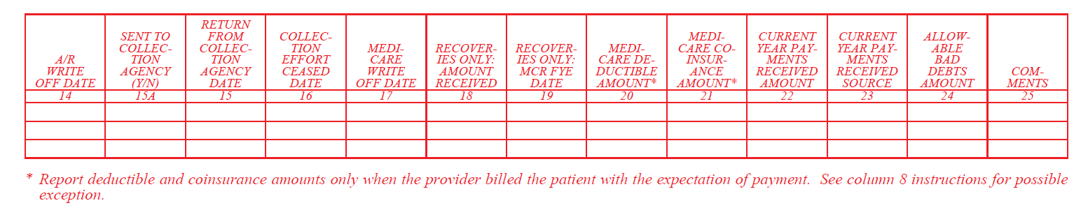
New Cost Report Documentation Requirements
  Medicare Bad Debts

Slide 14
DSH Issues
Many pending issues for years
  Allina Final Rule (Part C)
    After Allina Supreme Court Decision (06/30/2019)
    17-1484 Azar v. Allina Health Services (06/03/2019) (supremecourt.gov)
    CR 10487
  Total vs. Covered Days (Exhausted Benefits)

Slide 15
DSH Issues
Recent Empire Supreme Court Decision
  Decided June 24, 2022
  20-1312 Becerra v. Empire Health Foundation, for Valley Hospital Medical Center (06/24/2022) (supremecourt.gov)
  Patients “entitled” to Medicare Part A benefits are those qualifying for the program, regardless of whether they are currently receiving any benefits from it (i.e., due to Exhausted Benefits, Part C coverage,
  Empire challenged 2004 regulation that Medicare Part A entitled patients belong in the Medicare SSI ratio and not the Medicaid ratio
    Supreme Court agreed with HHS’s interpretation

Slide 16
DSH Issues
On 8/6/2020 CMS issued Proposed Rule in response to Allina Supreme Court decision on Part C Days
  https://www.federalregister.gov/documents/2020/08/06/2020-16896/medicare-program-treatment-of-medicare-part-c-days-in-the-calculation-of-a-hospitals-medicare
Proposed retroactive rulemaking to include Part C days in the Medicare SSI Ratio and NOT the Medicaid ratio
  Similar to current Supreme Court decision on Exhausted benefit days
Rule has not yet been finalized
  May see movement after Supreme Court decision
More to come

Slide 17
Bad Debts
9/18/2020 Federal Register (FFY 2021 Inpatient Prospective Payment System Final Rule)
https://www.govinfo.gov/content/pkg/FR-2020-09-18/pdf/2020-19637.pdf
Codified many bad debt policies into regulation
  Clarifications of existing policy were retroactively effective
  Changes in policy were prospective for cost reporting periods 10/1/ and after
WPS YouTube video going into detail on these changes
  https://www.youtube.com/watch?v=LMa4at0wlRU

Slide 18
Bad Debts-Collection Agency
Bad debt not allowable for Medicare purposes until it has been completely returned from collection agency
Full amount collected from patient must be used to offset AR
  Cannot be reported net of collection fee
    Collection fee is separate administrative cost
Clarification = Retroactive

Slide 19
Bad Debts – Dual Eligible Patients
Must-Bill Policy
  Must have Medicaid RA to allow a dual eligible bad debt
In this Federal Register, CMS also incorporated an alternative documentation set to be used in limited circumstances where a State does not process crossover claims or issue Medicaid RAs for certain provider-types.
  In these cases, the provider must include the following documentation instead:
  The State Medicaid notification evidencing that the State has no obligation to pay the beneficiary’s Medicare cost sharing or notification evidencing the provider’s inability to enroll in Medicaid for purposes of processing a crossover cost sharing claim,
  documentation setting forth the State’s liability, or lack thereof, for the Medicare cost sharing, and
  documentation verifying the beneficiary’s eligibility for Medicaid for the date of service.
Clarification = Retroactive

Slide 20
Bad Debts – Indigent Patients
CMS Policy at CMS Pub. 15-1§312
The patient's indigence must be determined by the provider, not by the patient; i.e., a patient's signed declaration of his inability to pay his medical bills cannot be considered proof of indigence
The provider should take into account a patient's total resources which would include, but are not limited to, an analysis of assets (only those convertible to cash, and unnecessary for the patient's daily living), liabilities, and income and expenses. In making this analysis the provider should take into account any extenuating circumstances that would affect the determination of the patient's indigence

Slide 21
Bad Debts – Indigent Patients, cont.
CMS made minor changes when codifying these into regulation.
  Dropping need for liability and expense review
Regulatory changes prospective 10/1/20 FYB and after
Original policy is in place for all periods prior to that

Slide 22
Bad Debts – Indigent Patients, cont.
Presumptive indigence not allowed for Medicare bad debt
  It is allowed for total bad debt on W/S S-10
Deceased beneficiaries
  Collection effort required to search for an estate
  Must have tangible and contemporaneous evidence of estate review
    Not just a note from provider representative that they searched for the estate
Bankrupt providers
  Provider must document they have filed claim with bankruptcy courts where applicable
  Bankrupt does not equal automatic indigence determination…review financial status at that time

Slide 23
Bad Debts – 120 Day Rule
CMS Pub. 15-I 310.2
  “if after reasonable and customary attempts to collect a bill, the debt remains unpaid more than 120 days from the date the first bill is mailed to the beneficiary, the debt may be deemed uncollectible.”
Federal Register strengthen that a bit. Turned it into a harder “rule” as opposed to a guideline.
  Only exception is for indigent patients (including dual eligible) 9/18/2020
Reiterated long-standing policy that any payment (even $1) that is made during 120-day period resets the 120-day clock.
Clarification = Retroactive

Slide 24
Bad Debts – Timely Billing Rule
Bill must be issued to patient shortly after death or discharge of patient.
  Federal Register defines “shortly after”
120 days after the later of:
  Date of Medicare RA
  Date of RA from secondary payor
  Date of notification that secondary payor does not cover services furnished to beneficiary
Revision = Prospective
However, WPS is implementing this change immediately
  Timeframe was previously left up to MACs
  This new timeframe is more lenient to providers

Slide 25
Bad Debts – Write-off and GAAP vs. Medicare
Prior rules required write-off involving an expense account
  PRM-I §320
  Allowance method (also required by GAAP)
  Notably, the Medicare rules require the later write-off against AR to occur, not just the initial charge to expense.
FASB GAAP has now revised accounting treatment (ASU Topic 606)
  Previously estimated bad debt amount to charge off against expense
  Now will estimate bad debt amount to charge off against contra-revenue (implicit price concession)
Revision = Prospective
What to do about current periods that are not in line with GAAP?

Slide 26
Bad Debts – Contractual Allowances
CMS noticed providers writing off bad debts against contractual allowance (a different contra-revenue account)
  Contractual allowance is amount that provider not legally entitled to
Should have instead been charged against an expense or now an implicit price concession contra-revenue account
CMS issued Medicare Learning Network Special Edition on 4/4/2019 to remind providers of this
  Gave grace period up to last cost reporting periods beginning before 10/1/2019
Grace period now expired
CMS codified rule into regulation effective 10/1/2020 FYBs
Revision = Prospective

Slide 27
Nursing and Allied Health
CMS continuing to have MACs review Legal Operator requirements for NAH
  42 CFR 413.85(f)
  CMS Change Request 10552 (8/17/2018)
Directly incur the training costs
Directly control over program curriculum
Control administration of the program
Employ the teaching staff
Provide both classroom and clinical training
Issue degree or diploma
https://www.wpsgha.com/wps/portal/mac/site/audit/guides-and-resources/reasonable-cost-payment-nah-education-programs-cost-report-documentation

Slide 28
Provider-Based Physicians
https://www.wpsgha.com/wps/portal/mac/site/audit/guides-and-resources/provider-based-physician-time-studies
Allocation Agreements
  Exceptions
    100% physician component
    100% provider component with evidence of no reassigned billing rights
Contemporaneous signatures required
  Whenever form is prepared

Slide 29
Provider-Based Physicians
Time Studies
  To support allocation agreements
  Alternative to ongoing time reports
  2 weeks per quarter
    No pre-approval needed
    PRM-I, §2182.3
      “where providers decide to employ time study techniques to substantiate either the allocation of physicians' time to services or the actual provider services hours figure used in the Reasonable Compensation Equivalent (RCE) computation, the provider may choose to employ the methodology described in subsection 2313.2.E, Special Applications, but the provider may not be required by the servicing intermediary to utilize that specific methodology.”
Contemporaneous signatures required
  Not waiting until end of year and looking back

Slide 30
Provider-Based Physicians
On-Call vs. Availability
  Off-site vs. On-Site
BOTH only allowed in Emergency Room!
Provider-Based Physician YouTube Video
https://youtu.be/2Uav0rAILgY

Slide 31
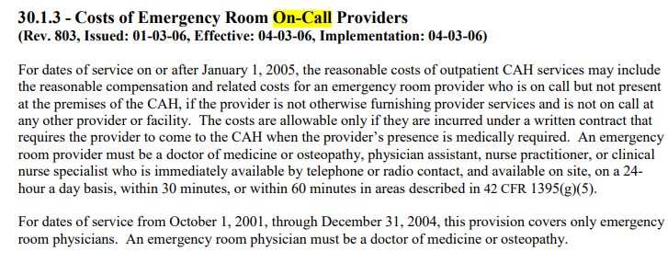
Provider-Based Physicians
On-Call
CMS Pub. 100-04, Chapter 3, §30.1.3

Slide 32
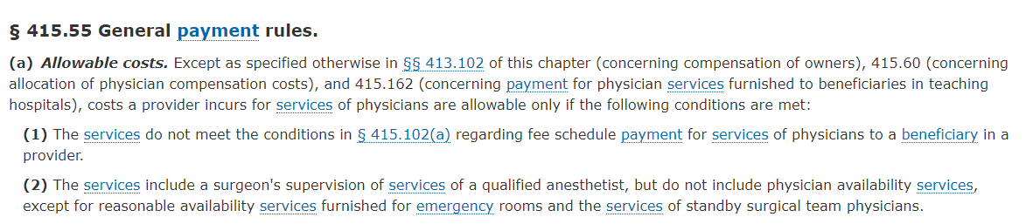
Provider-Based Physicians
Availability
CMS Pub. 100-04, Chapter 3, §30.1.3

Slide 33
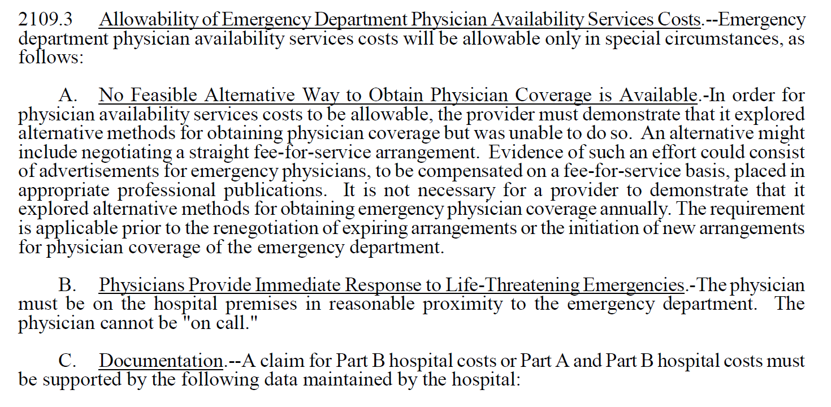
Provider-Based Physicians
Availability
CMS Pub. 100-04, Chapter 3, §30.1.3

Slide 34
S-10 Uncompensated Care Audits
Currently in third year of auditing 100% of DSH eligible hospitals
  5th year of S-10 audits overall
FFY 2021 UCP Factor 3
  FFY 2017 data???
  Audited sample of providers
FFY 2022 UCP Factor 3
  FFY 2018 data???
  Audited 100% of providers
  Awaiting final rule
FFY 2023 UCP Factor 3
  Averaged data???
  Audited 100% of providers
  Awaiting final rule IPPS FFY 2023

Slide 35
S-10 Uncompensated Care Audits
Currently auditing S-10 data for FFY 2020 year
  Cost reporting periods beginning between 10/1/19 – 9/30/20
    All Acute hospitals that qualify for DSH
    Including SCH/MDH hospitals
    Requests letter sent out in phases this year
    All audits must be completed and submitted to CSM by December 31st.

Slide 36
S-10 Uncompensated Care Audits
S-10 Lines
  20 (Charity care charges for the entire facility)
  22 (Partial payments by patients approved for charity care)
  25 (Charges for patient days beyond an indigent care program’s length of stay)
  26 (total bad debt “expense” for the entire hospital complex.)
    Do not use “bad debt expense” under GAAP (i.e., allowance method)
    Must be an actual write off
      Regardless of whether that Medicare bad debt is yet allowable for bad debt reimbursement

Slide 37
S-10 Uncompensated Care Audits
S-10 Audits Info Requests
Financial Assistance Policy
  How hospital personnel determine insurance status and charity care write offs
    Including uninsured patients
    Including non-covered services for Medicaid eligible and Indigent patients
    Including Patients with coverage from an entity without a hospital contractual relationship

Slide 38
S-10 Uncompensated Care Audits
S-10 Line 20 Column 1 is for uninsured patients (including patients with insurance coverage with an entity that does not have a contractual relationship with the provider, as well as non-covered services for Medicaid/Indigent Care Program patients.)
S-10 Line 20 Column 2 is for insured patients, (including non-covered charges related to days exceeding the length of stay limit for patients covered by Medicaid/Indigent Care Programs.)

Slide 39
S-10 Uncompensated Care Audits
S-10 must exclude:
  Any physician and other professional services.
  Any amounts related to insurer or other third-party liabilities.
  Bad Debts (Medicare or Non-Medicare) should not be reported in Line 20, as they factor into the amounts reported in line 26 instead.
  Courtesy discounts are not the same as charity care discounts and are not allowed in this line.

Slide 40
S-10 Uncompensated Care Audits
S-10 Line 22 (Payments to offset Line 20)
S-10 Line 25 (Charges for Patient days beyond a Medicaid or indigent care program’s length of stay)
  These are also part of line 20 column 2.
  Subject to cost to charge ratio, unlike deductibles and coinsurance that are otherwise reported on line 20 column 2.

Slide 41
S-10 Uncompensated Care Audits
S-10 Line 26 (Total Bad Debt Expense for Entire facility)
  Less:
  Any physician and other professional services.
  Any bad debts related to insurers or other third parties. Only bad debts related to amounts owed by patients should be included.
Underlying dates of service are irrelevant
  Write off date determines what cost reporting period it is reported in.

Slide 42
S-10 Uncompensated Care Audits
Summary of Initial Info Requests:
  Charity care policy that was in place for the period
  A description of the process used when querying the records to identify the charge and payment amounts to be reported on line 20 and 22 (for each column)
  Actual listing of such charges and payments.
  Information on how the above rules are applied so that things such as fee schedule services, courtesy discounts, bad debts, etc. are not included as charity care charges.
  Explanation of significant variances
  Reconciliation from the amounts reported on the cost report for the various items to corresponding elements on your working trial balance and/or financial statements.

Slide 43
S-10 Uncompensated Care Audits
Summary of Follow-up Info Requests:
  Detailed documentation for a sample selected from a list
  Detailed bad debt listing for the amounts reported on line 26 (with any corresponding explanation of the process used to gather that data)
  Potentially detailed documentation for a sample from the bad debt listing.

Slide 44
S-10 Uncompensated Care Audits
Query Logic Questionnaire
Much of the audit time is spent up front trying to get a “clean” listing without obvious errors
  This minimizes having to extrapolate large error rates to the population that we sampled

Slide 45
S-10 Uncompensated Care Audits
WPS GHA Website
https://www.wpsgha.com/wps/portal/mac/site/audit/guides-and-resources/worksheet-s-10-charity-care-audits
https://www.wpsgha.com/wps/portal/mac/site/audit/guides-and-resources/worksheet-s-10-charity-care-audits
WPS GHA YouTube
https://youtu.be/bWQhRT8KljY = General training
https://youtu.be/NAPTlPsEgNE = Audit Templates and Questionnaire
https://youtu.be/VOm-wm0BReI = S-10 Webinar Part 1
https://youtu.be/tIKNeIhvjzo = S-10 Webinar Part 2
Others – See final slides

Slide 46
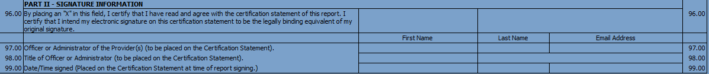
CMS Portal (MCRef)
Used for cost report submissions ONLY
  Cannot submit documentation for desk review, audit, reopenings, etc.
E-signature vs. E-submission
Please make sure to send cover letter, rather than just a CD by itself.
  If E-signed, the worksheet S should be at the front of the package

Slide 47
File Exchange/Secure-EDI/MoveIt
Started using this last summer
  Mainly for S-10 Audits, but can be used for anything
Fewer restrictions and obstacles than old WPS Secure Messaging Portal
Allow for external contacts as well (not limited to providers)
Larger file size limit (2GB vs. 15-20 MB)
No file type restrictions

Slide 48
Secure-EDI (MoveIt)
https://www.wpsgha.com/wps/portal/mac/site/audit/guides-and-resources/audit-secure-edi-email-messaging-tool
File Exchange initiation email
  Audit contact sends you first email (including your first temporary password)
  Any other auditor you want to send documents to would have to first send you an initiation email of their own (no new password needed if account is already established.)
  Accounts active for 20 days, but reset after each use
No long-term storage of files (usually around 30 days)
Auditors can handle your password resets, deactivations, etc.

Slide 49
WPS Website, Webinars, and YouTube Channel
WPS Website
  https://www.wpsgha.com/wps/portal/mac/site/audit/guides-and-resources/guides-and-resources
WPS YouTube Audit Playlist
  https://www.youtube.com/playlist?list=PLmWbOYPskBJja8M_ylZQc4WYfRN2P7Q3M

Slide 50
WPS Website, Webinars, and YouTube Channel
Worksheet S-10 Uncompensated Care Training - 9/18/2019 60 mins.
https://youtu.be/bWQhRT8KljY
Cost Report Documentation and Templates Training - 1/14/2020 40 mins.
https://youtu.be/gAAXSTNELy8
Medicare Bad Debt Requirements - 3/3/2020 59 mins.
https://youtu.be/LMa4at0wlRU
Rural Health Clinic Productivity Standard Exceptions - 8/3/2020 19 mins
https://youtu.be/hXF0QuFQQYo
Worksheet S-10 Audit Templates and Questionnaire - 8/5/2020 37 mins
https://youtu.be/NAPTlPsEgNE
Change Request 11642 (Medicare Advantage Factors for NAH and Graduate Medical Education) - 10/13/2020 – 42 mins.
https://youtu.be/tS_3IgoNILQ

Slide 51
WPS Website, Webinars, and YouTube Channel
October 2020 WPS Quarterly Provider Audit Webinar Recording - 10/19/2020 92 mins.
https://youtu.be/UXiKrySLW0w
Secure-EDI Messaging Portal - 12/1/2020 12 mins.
https://youtu.be/hXWxqrTrFWk
January 2021 WPS Quarterly Provider Audit Webinar Recording - 1/29/2021 95 mins.
https://youtu.be/RjpszaKLnwk
Nursing and Allied Health (NAH) Legal Operator Status 3/15/2021 35 mins.
https://youtu.be/PrmOupXFvjE
S-10 Provider Webinar Part 1 (3/24/2021) – 4/1/2021 119 mins.
https://youtu.be/VOm-wm0BReI
S-10 Provider Webinar Part 2 (3/30/2021) - 4/1/2021 85 mins.
https://youtu.be/tIKNeIhvjzo

Slide 52
WPS Website, Webinars, and YouTube Channel
EHR Payment Reductions- 7/22/2021
https://youtu.be/Xug6DRkgT5Q
Provider-Based Physicians on the Cost Report- 8/17/2021
https://youtu.be/2Uav0rAILgY
Audit Sampling – 8/26/2021
https://youtu.be/WsMY5NQr3fk
September 2021 WPS Quarterly Provider Audit Webinar Recording (9/17/2021)
https://youtu.be/jXUsWVkFa0o
WPS Audit - Cost Assignment and Allocation (10/1/2021)
https://youtu.be/FmWFF2HWXXk
ESRD High Discharges (2/9/2022)
https://youtu.be/5fCMBC6mris
WPS Provider S-10 Audit Webinar (2/17/2022)
https://youtu.be/eseYugPmqnA
SCH-MDH Volume Decrease Adjustment (6/29/2022)
https://youtu.be/ikNsb-ZpM2A

Slide 53
WPS Website, Webinars, and YouTube Channel
WPS Audit Quarterly Webinars
  October 2020
  January 2021
  March 2021 (2-part S-10 specific)
  September 2021
  February 2022 (S-10 Webinar)
  Will be scheduling one for late July/Early August

