Slide 1
Consumerism in a Post-COVID-19 World
Empowering Patients in their Financial Journey

Slide 2
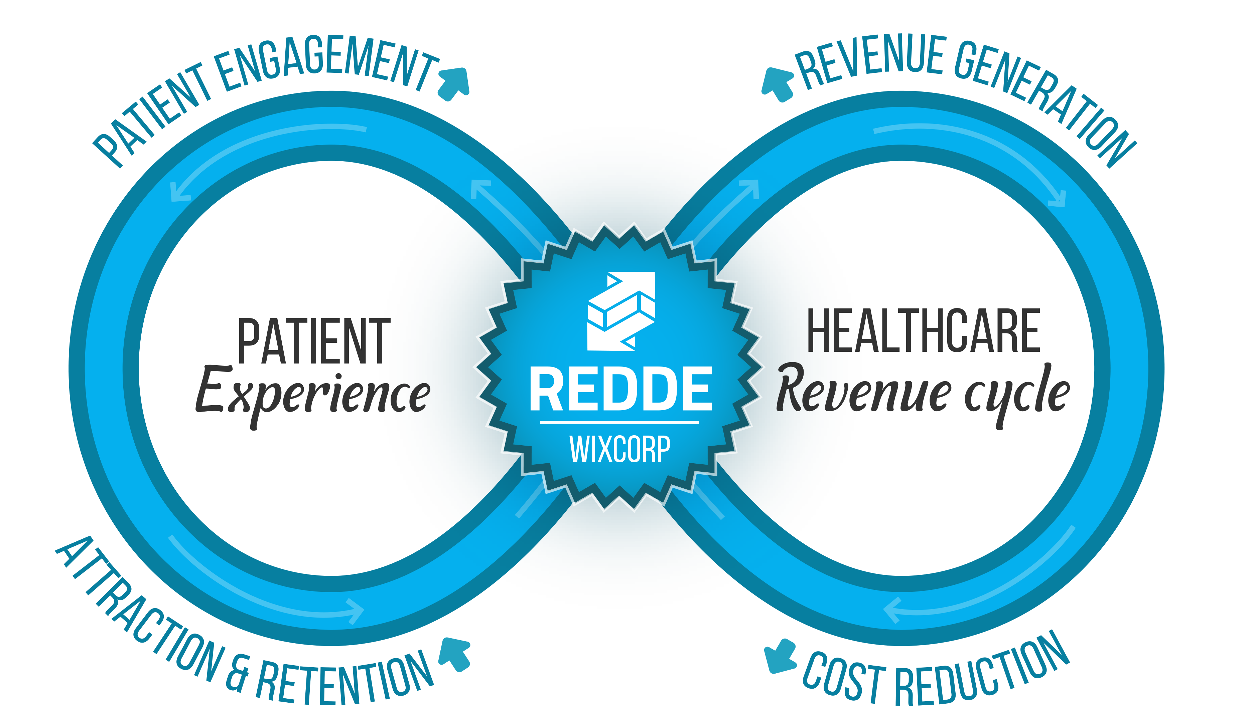
Wixcorp
 Salt Lake City
 Patient-Facing RCM Solutions

Slide 3

Consumerism
/kənˈso͞oməˌrizəm/
noun
The protection or promotion of the interests of consumers. ^{ƒ}
ƒ Oxford Languages Dictionary

Slide 4

Patient Digital Experience: Pre-COVID-19
Main Frustrations ^{ƒ}
Time/Effort to set up access
Managing multiple portals
Understanding the interface
Incorrect information
15%
13.5%
accessed the portal more than twice. ^{β}
ƒ GAO Congressional Report “HHS Should Assess the Effectiveness of Its Efforts to Enhance Patient Access to and Use of Electronic Health Information”, March 2017
β ONC “Individuals’ use of online medical records and technology for health needs”, April 2018

Slide 5



CORONAVIRUS

Slide 6
“we have vaulted five years forward in consumer and business digital adoption in a matter of around eight weeks.”
Banks have transitioned to remote sales and service teams and launched digital outreach to customers to make flexible payment arrangements for loans and mortgages. Grocery stores have shifted to online ordering and delivery as their primary business...Doctors have begun delivering telemedicine, aided by more flexible regulation. Manufacturers are actively developing plans for “lights out” factories and supply chains. The list goes on. ^{ƒ}
ƒ McKinsey, “The COVID-19 recovery will be digital: A plan for the first 90 days”

Slide 7

Temporary Solutions
Wixcorp - Consumerism in a Post-COVID19 World
7

Slide 8

Temporary Solutions: Telehealth
Opportunity
McKinsey estimates $250 billion in patient care could potentially be virtualized down the road.
That’s an increase from the ~$3 billion in visits being done virtually prior to the pandemic. ^{ß}
Reality
92% of Providers with a current Telehealth solution did not plan to stay with that platform long term. *
Many providers are using apps like Zoom or Teams that are not integrated with the rest of their processes/tech.
ß McKinsey “Telehealth: A quarter-trillion-dollar post-COVID-19 reality?“
* SR Health survey, May 2020

Slide 9

Temporary Solutions: Communication
Opportunity
Prior to the pandemic, hospitals were increasingly implementing text messaging solutions and depending on texting to drive more of their communications. COVID-19 has further spurred usage of texting. ^{ƒ}
Reality
Use of Pagers in healthcare has remained relatively consistent since 2011, and was one of the top four devices used in response to the pandemic. ^{Β}
ƒ Becker’s Hospital Review “8 ways hospitals are using text messaging to navigate the pandemic”, February 2021
β Spok “The State of Healthcare Communications” July 2020

Slide 10

How many of you are still using a fax machine as your primary channel for receiving referrals?
To submit a referral, the provider simply faxes over their paperwork and then we….
Wait, a fax machine…I’ve never seen one of those!
How do they even work?
Hospital Referrals Processor
New Business Development Director

Slide 11

Now they’ve tried it, there’s no going back…
Wixcorp - Consumerism in a Post-COVID19 World
11

Slide 12
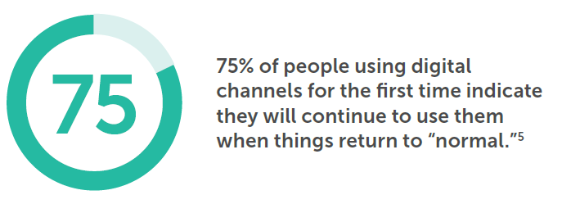
Online and mobile banking has increased 85%.
More than half of U.S. primary schools started the year completely virtual.
61% of consumers surveyed say they’ve had at least one telehealth appointment.
“All Digital… whether we like it or not.”
Medallia: “2020 Hindsight: 5 Digital Customer Experience Lessons”

Slide 13


CX Trends for 2022 and Beyond
#1
Virtual care changes the competitive landscape.
The Point A patient’s decision on where to receive care is less impacted by things like geography, hours of operation, and schedule availability. With the rise of virtual care, you are competing nationally.
Your ability to attract and retain patients is moving digital.
#2
Telehealth and Remote Care Will Change…A Lot
The Point: Don’t get comfortable with your current digital engagement and telehealth channels. As the industry refines these channels, they will change dramatically. You should also prepare now for new engagement channels to emerge.

Slide 14
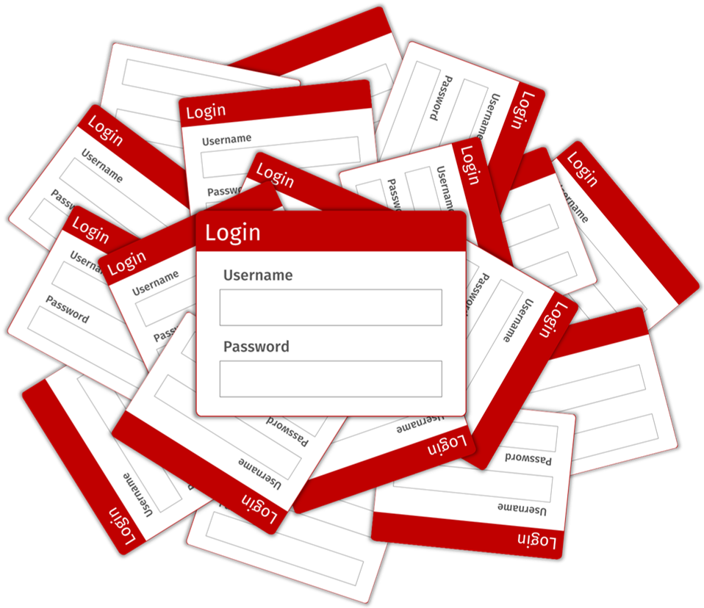

CX Trends for 2022 and Beyond
#3
Customers expect more functionality with fewer logins.
The Point Whether it is banking, shopping, or even entertainment; patients are used to having one omni-channel platform to manage everything from.
With that baseline in place, patient expectations for healthcare are high. Numerous study’s have shown that patients are willing to change healthcare providers for a better experience.
#4
The patient wants to be in the driver’s seat.
The Point: With today’s fast-past lifestyle, dual-income households, and prevalence of internet connected devices, patient’s are used to managing their own needs when and how they want.
What that means for healthcare providers is you need to make all your systems/processes patient-facing and available for self-service.

Slide 15
Best Practices
What are some of the patient trends you are seeing?

Slide 16


Are You Prepared For Disruption?
















⇨



Slide 17








What Does Disruption Look Like?
Transportation
Communication
Music
Entertainment

Slide 18

Leverage Technology to Change the Model
What is the secret to disruption?

Slide 19
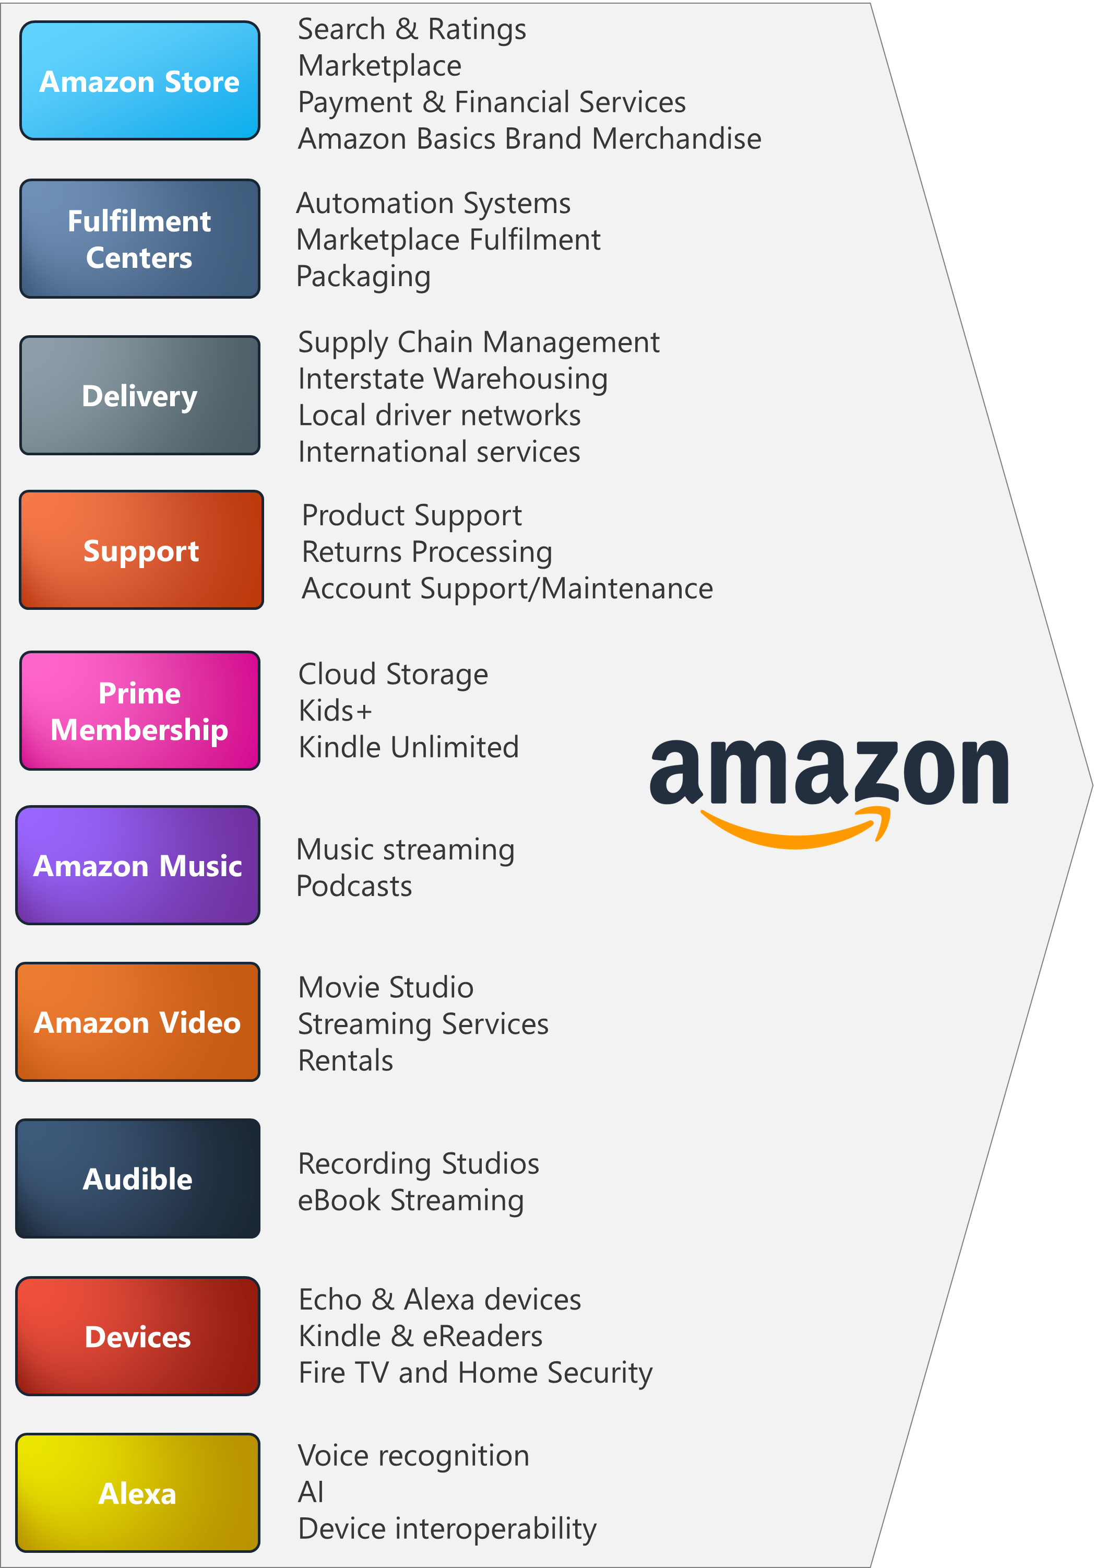
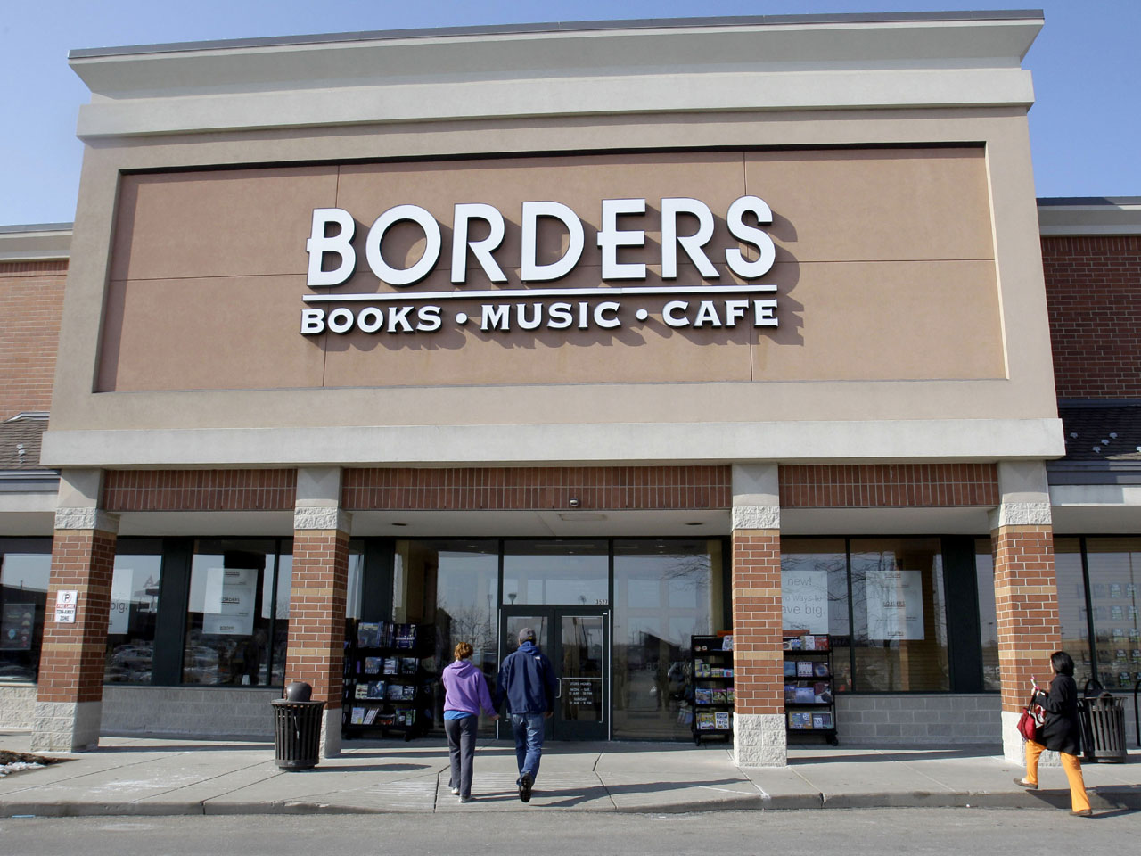
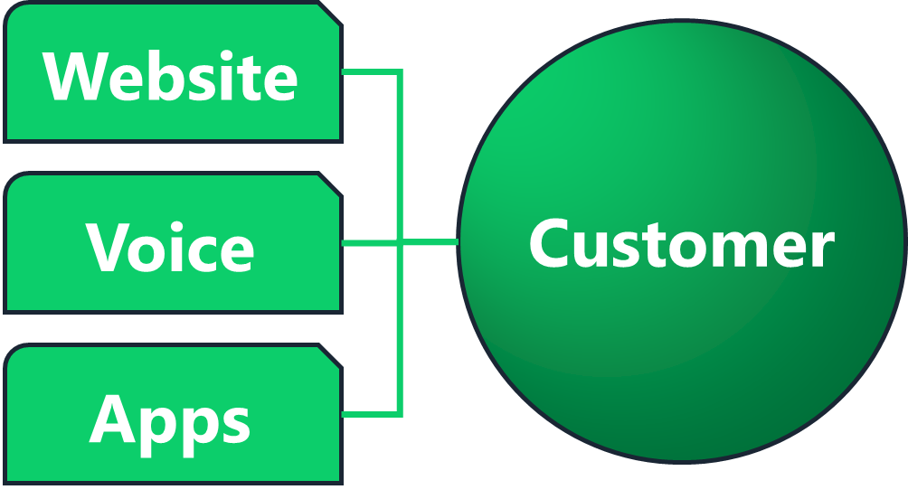
Self-serviced
Omni-channel Experience
vs.

Slide 20
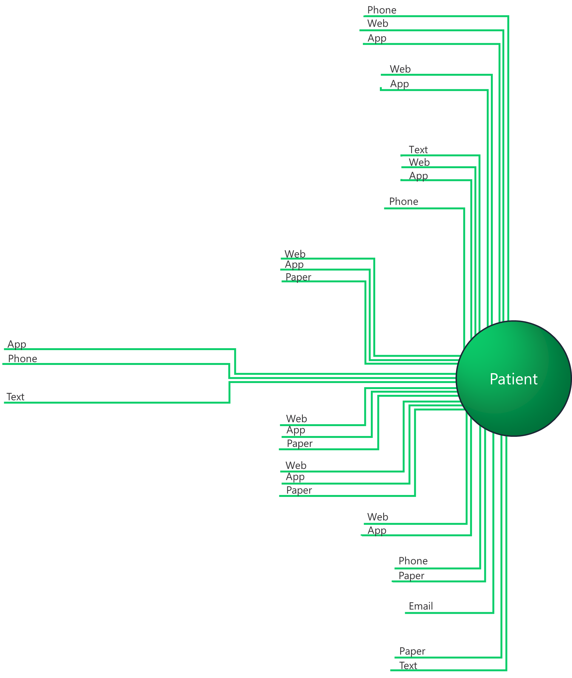
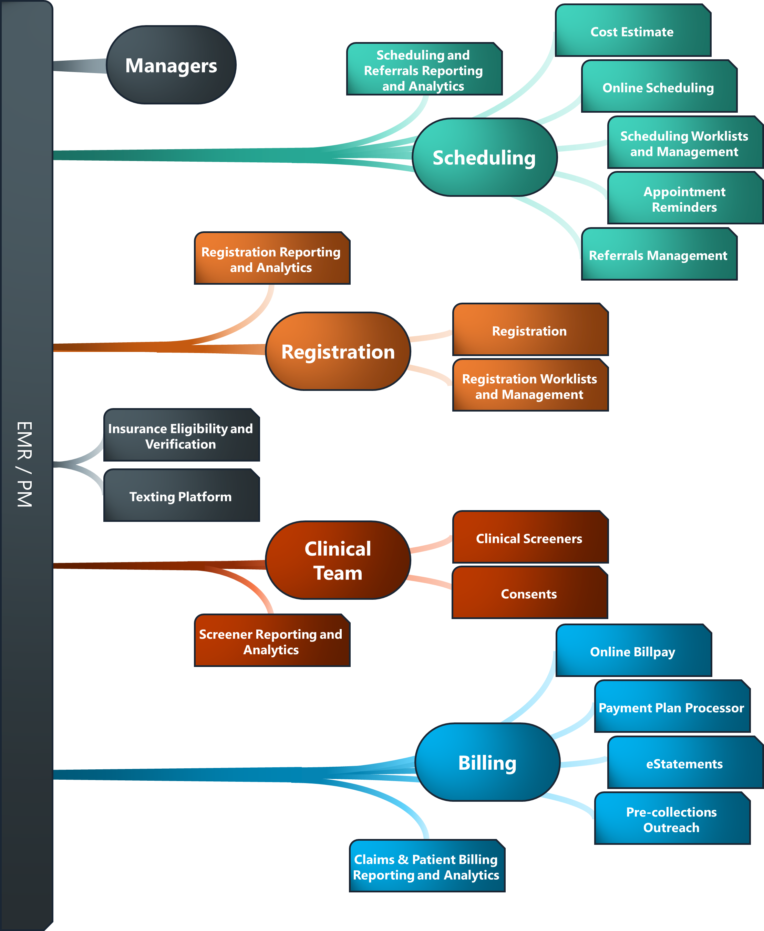
Current Patient Experience
Notes:
If you were the patient, would you feel in control?

Slide 21
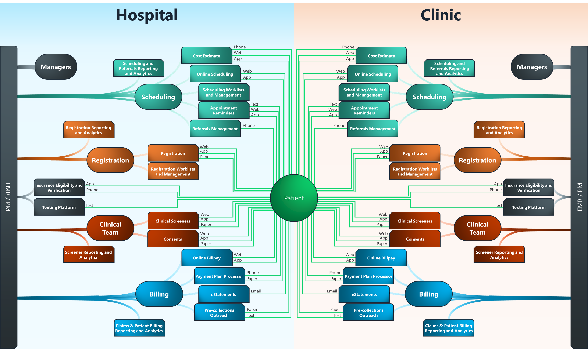
Notes:
If you were a consumer, what would you think about this?

Slide 22
“The disparate legacy systems, inflated costs for ‘addon’ modules and licensing restructures for CRM systems are making orchestration decisions more and more financially painful, not to mention being resource heavy for our continuous improvement programs.”
Claire Hill
Customer Experience Director
at Studio Retail Limited

Slide 23
“Healthcare is in need of radical simplicity!”
Geeta Wilson
Enterprise Vice President, Digital Experience & Product Engineering at Anthem, Inc.

Slide 24
Best Practices
How have you tried to simplify patient processes?

Slide 25
Creating Custom Experiences
How do you build a simplified, self-serviced, omni-channel experience for your patients and team?

Slide 26
Traditional Thinking
Registration
Clinical
Good Experience
Discharge
Billing

Slide 27
Systemic Thinking
Registration
Clinical
Good Experience
Discharge
Billing

Slide 28


Traditional Approach
Patients want to pay their
medical bills online.

Slide 29




Systemic Approach
Patients expect an engaging mobile experience to understand and pay their medical bills.

Slide 30

Patient Journey Map

Slide 31
Patient Journey Mapping Session
PATIENT FINANCIAL JOURNEY 
Insurance Verification

Cost Estimation
Schedule Request
Patient Billing




Registration


Slide 32
Patient Journey Mapping Session
People
Business Process
Technology
3rd Party Vender
Patient’s Emotion
Need
Employees
Contractors
Manager
SME
Manual Process
Automated Process
Digital Process
Paper Process
Software
Website
Portal
Devices
Vender Services
Frustrated
Confused
Concerned
Delighted
Surprised
New Processes
New Software
New Devices
New Services

Slide 33
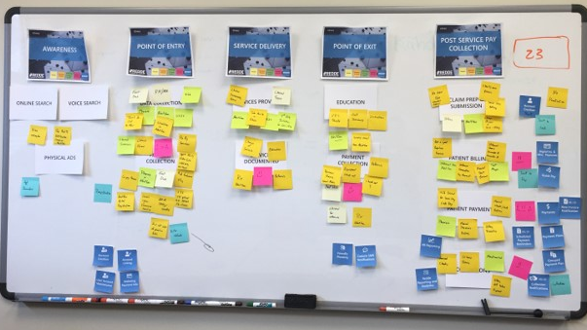

Slide 34

Summary
Patients are frustrated with the lack of digital resources available
Patients are looking for “Radical Simplicity”
Healthcare needs to provide patients with a self-service omni-channel experience
Patient Journey Mapping is one way to help you understand your current state, define your future state, and build a blueprint to get there.

Slide 35

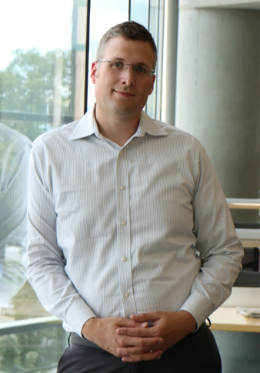
Questions?
Eric Wixom
 (610) 803-1429
 Eric Wixom
 Eric@Wixcorp.com
Thank You!

