Slide 1

Connecting the Dots Between Revenue Cycle and Reimbursement
Michigan Great Lakes HFMA Spring Reimbursement Meeting

Slide 2
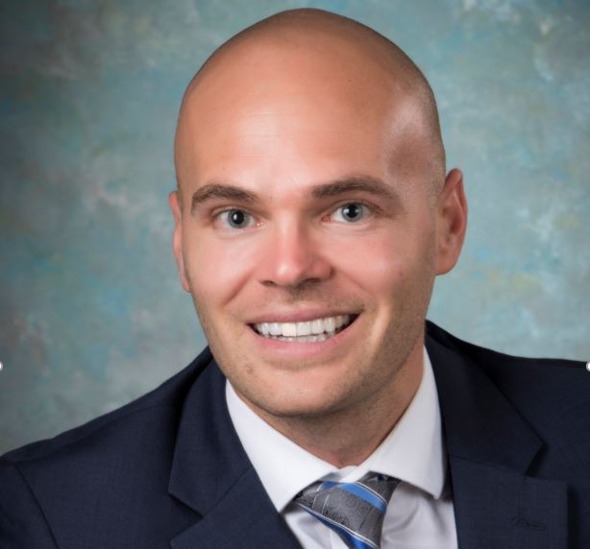
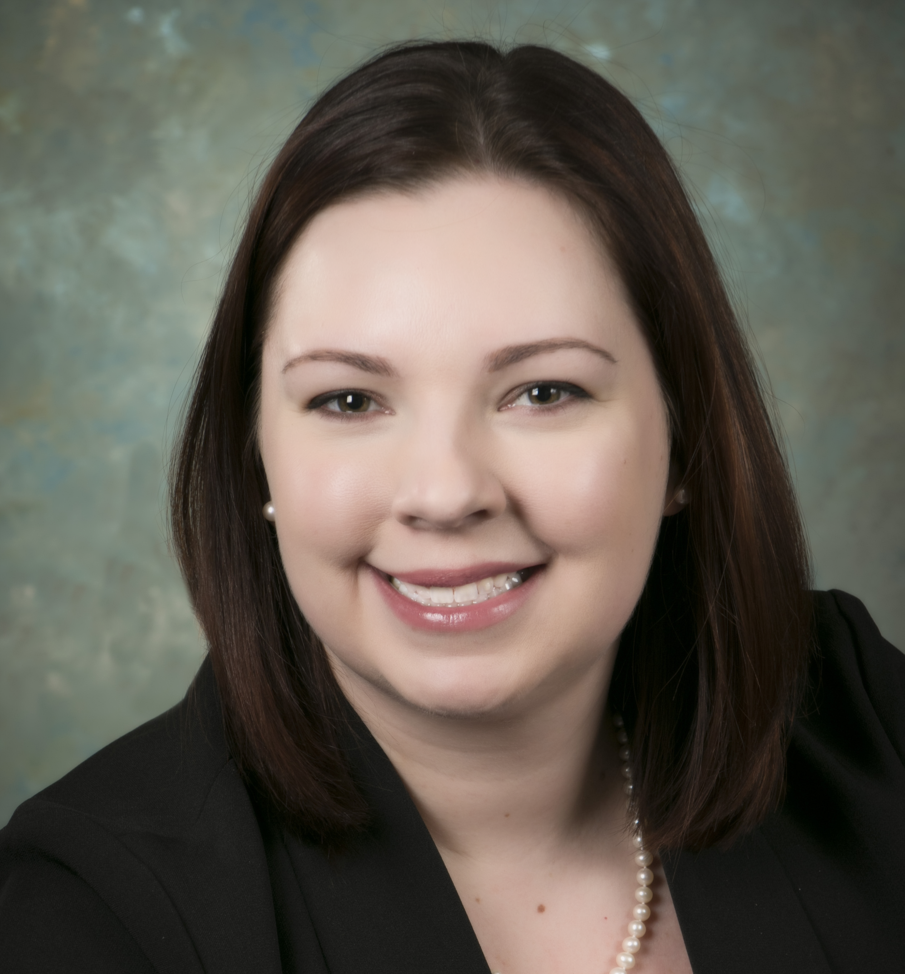
With You Today
Jesse Parker
Director, Reimbursement
(989) 387-1766
JParker@TheRybarGroup.com
Julie Hardy
Director, Revenue Cycle
(810) 853-6171
JHardy@TheRybarGroup.com

Slide 3
Revenue Cycle + Reimbursement
Revenue Cycle
Appointing to zero balance
Enrollment and credentialing
Payer negotiations
Chargemaster
Utilization review
New services
Reimbursement
Cost report preparation and filing
Work with regulatory auditors
Settlements
FY 21 is last year BCBSM will have settlements
Contractual allowance calculation
Annual budget

Slide 4
Front-End Revenue Cycle
At the time of registration, validate the patient’s eligibility for Medicaid or charity care if self-pay
Medicaid volumes impact Medicare DSH
Medicaid eligibility should be checked multiple times per year
Point of service collections
Advanced Beneficiary Notices (ABNs)
Prior authorizations

Slide 5

Vignette #1

Slide 6
Verifying Medicaid Eligibility
At year end, an acute care hospital with less than 50 beds was below the DSH threshold at 14.1%
After year end, they compiled list of self-pay patients who could potentially be eligible for Medicaid benefits, which brought them to the required 15% threshold
If needed, it can be checked before the cost report settlement is finalized
As a result of the follow-up, the hospital qualified for DSH and Uncompensated Care Payment totaling $350,000

Slide 7
Chargemaster
Charges need to be applied to the correct department for both the CDM and cost report
Charges can be mapped by revenue code or department code
Charges must match to expenses for the cost report

Slide 8
Vignette #2

Slide 9
Increasing CDM Charges
The charges were increased significantly to make up for a lack of an increase in prior years, but the volumes stayed consistent
This resulted in the cost-to-charge ratio plummeting from .620 to .213
Hospital had to pay back $2.4 million to Medicare

Slide 10
Shadow Billing
“No pay” or “information only” claims submitted to the MAC for Medicare Advantage patients
For supplemental Indirect Medical Education (IME), Graduate Medical Education (GME) and Nursing Allied Health Education (NAHE) payments
It’s important for hospitals to perform this not only for acute care patients, but also IPF, IRF and any other distinct part units
This is more important now than ever as we’re seeing a shift from traditional Medicare to Medicare Managed Care

Slide 11
Vignette #3

Slide 12
Shadow Billing
A teaching hospital with an IPF DPU did not previously bill Medicare for IPF patient days
After fiscal year end, identified this issue with initial PS&R report 118
Medicare allows for patients to be billed up to 365 days from discharge date
Through subsequent shadow billing, increased Medicare HMO days by 800 (2% of total patient days)
As a result, GME reimbursement was increased by $100,000 due to increased Medicare utilization

Slide 13
Teaching Hospitals
Primary care exception
Residents moonlighting
IME calculation
Want to make available bed count lower, resident count higher (renovations, unusable rooms)

Slide 14

Questions

Slide 15


Contact Us
Julie A. Hardy, MSA, RHIA
Director, Revenue Cycle
The Rybar Group, Inc.
(810) 853-6171
JHardy@TheRybarGroup.com
Jesse C. Parker, CPA
Director, Reimbursement
The Rybar Group, Inc.
(989) 387-1766
JParker@TheRybarGroup.com
To learn more, visit:
www.TheRybarGroup.com
https://www.linkedin.com/company/the-rybar-group/

