Slide 1
Leveraging Employee Satisfaction Survey to Increase Staff Participation
Brian Weber
System Vice President, Decision Support
National Decision Support
04/13/2022 for HFMA in Des Moines IA

Slide 2
Brian Weber Introduction
Brian Weber – System Vice President – Financial Services, Common Spirit Health
Current responsibilities
  Experience: 8 years at CHI now CSH, 30 years in healthcare
  Responsible for Financial and Decision Support systems including: Oracle/Hyperion platform, EPSi Decision Support System, PDS Physician Information Tool, and Lawson GL system.
  He also leads the integration team for CHI Connect which is also our Lawson platform for HR, Payroll, Supply Chain, AP, and GL.
  Scope Includes hospitals and physician enterprise for CSH across 21 states
Education
  Graduated from Louisiana State University with a Bachelor of Science in Quantitative Business Analysis and a Masters in Statistics.

Slide 3
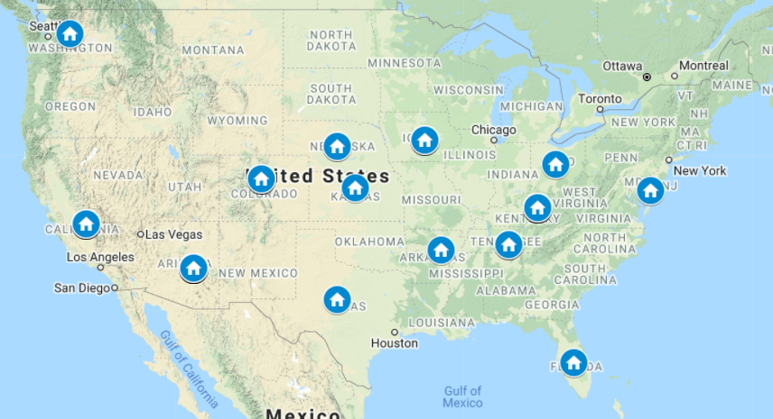
CSH Financial Services Team Map
Includes
total of 48 staff
on 6 teams
in 14 states
all 100% remote

Slide 4
Employee Initiatives

Slide 5
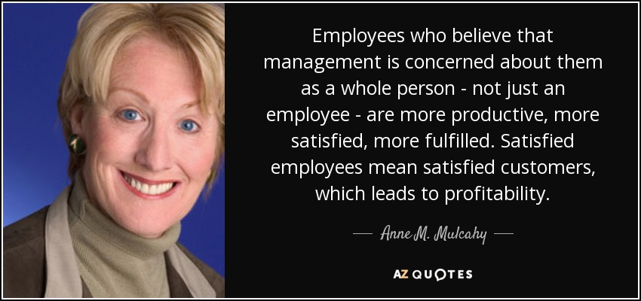
Key to Employee Engagement: Listen

Slide 6
Financial Services Employee Initiatives
How the initiatives were identified
  Annual Employee Survey
    focused on areas with a score on the heat map of
      Needs Improvement
      Monitoring - if an individual question was low overall for a an individual team.
  Created a Project: Initiative development and implementation
    Listening Tour with each of the six teams
    Developed initiatives to address issues that resulted in lower score
    Leadership reviewed and approved initiatives and timeline
    Roll out call to share plans with the full team

Slide 7
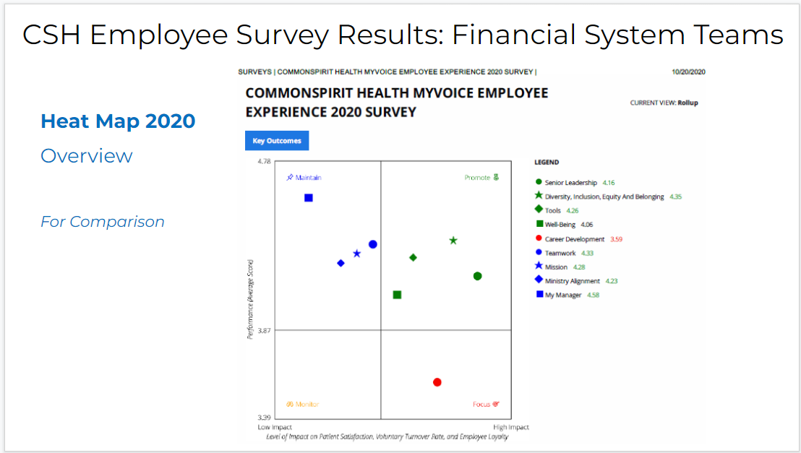
Financial Services Employee Initiatives

Slide 8
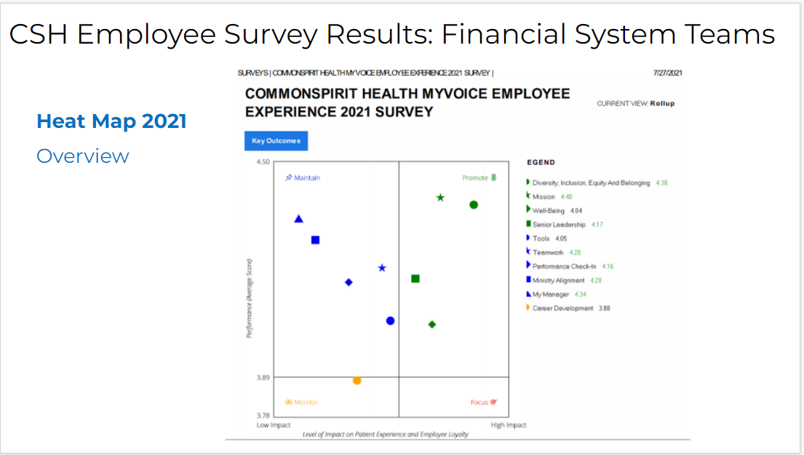
Financial Services Employee Initiatives

Slide 9
Financial Services Employee Initiatives
Learning Library
  2021 implemented, and 2022 expanding the number of moderators from 2 to 3 in order to include all six of the Financial Services teams.
  Moderators prepare and survey the 6 teams for topics that would be helpful to have documented in Learning library, and gather that documentation.
  Develop and highlight the documentation on Divisions and Markets with the Global Ledger updates, include facilities, number of beds, specialty units, and physician enterprise footprint in each market with a map.
Speakers from other teams:
  Updates from other Accounting focused groups: CHI and Dignity Health Accounting teams in April 2022
  Updates from Markets that have significant changes: Pacific NW on Va Mason planned for July 2022

Slide 10
Financial Services Employee Initiatives
Financial Services Professional Development policy from 2021 that includes
  Encourage and budget for staff at all levels
    Joining a Professional Development group
      Department will reimburse upto $445 per person, per year
    Attending Professional Development Classes
      40 hours or 5 days to attend classes per calendar year on work time with supervisor approval. Additional time would need to be on PTO
    Volunteering to support Local/Regional/National branch of Professional development group
      counts against the same list of the Professional Development classes.

Slide 11
Virtual Socials

Slide 12
Virtual Socials - How do they work?
Rotate the staff who are on the Planning Team
  Include representatives from all of the teams
  Team works with Brian and Melissa, which provides face to face time with leadership
Keep it intentionally inclusive and festive
  include food, music, sports, culture and time for team to share
Timeline
  2 months before event: start planning 60 min
  1 month before event: complete planning 30 min
  Event: 1 hr.

Slide 13
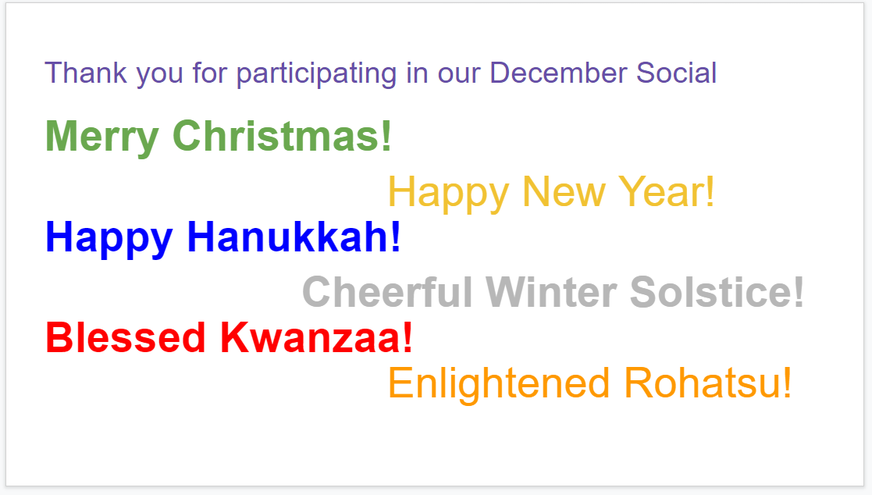
Virtual Socials: Intentional Inclusion

Slide 14
Virtual Socials - Themes
Jimmy Buffet Beach time
Football Tailgating
Celebrating all of the Winter holidays
Baseball Spring Training

Slide 15
Activities

Slide 16
Virtual Socials - Activities
Christmas fun
  scavenger hunt
Jimmy Buffet Beach time
  Name the movie and the year released from a scene in the film
Football Tailgating
  Trivia about football teams and their mascots
  Spirit Challenge - wearing team gear
Celebrating all of the Winter holidays
  Winter Holiday Jeopardy (with the answer in form of a question)
  Spirit Challenge - holiday sweater/hat/shirt
Baseball Spring Training
  sending a box of Cracker Jacks to each of the team members
  Baseball Bingo

Slide 17

Virtual Socials - Activities- Christmas
- Scavenger hunt

Slide 18
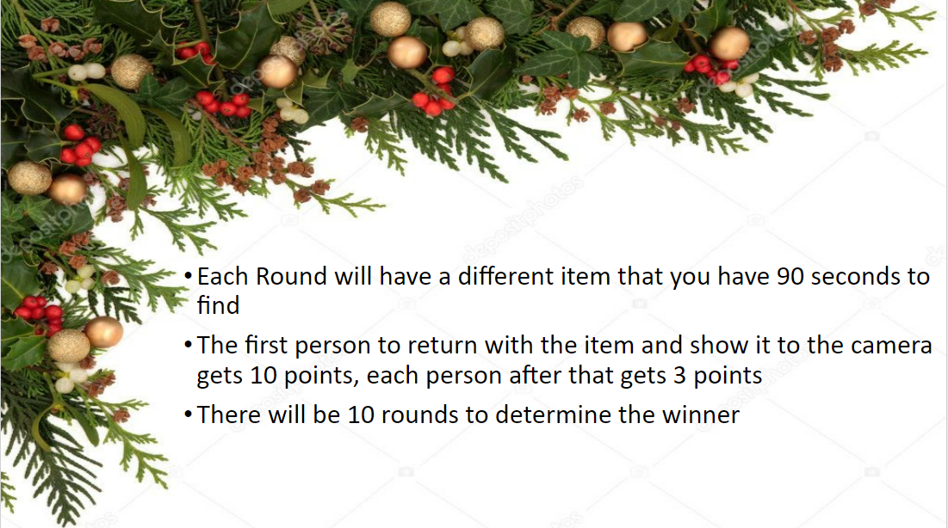
Virtual Socials - Activities- Christmas
Because the game is played with 50 people on Zoom, we have found that listing the rules helpful to keep us all on the same page

Slide 19
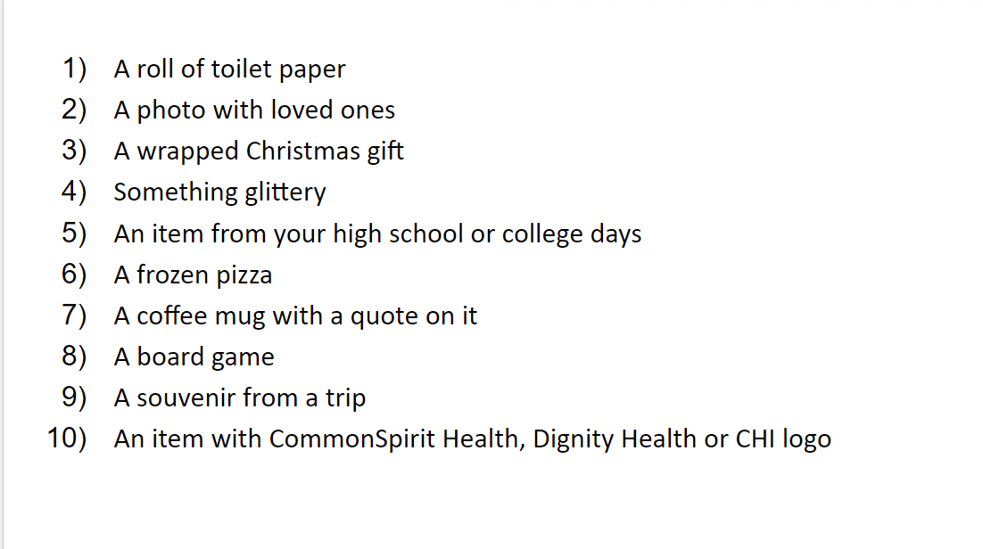
Virtual Socials - Activities- Christmas
This is the list that we used for that particular scavenger hunt.
Another time we did one that was beach themed. Also very popular.

Slide 20
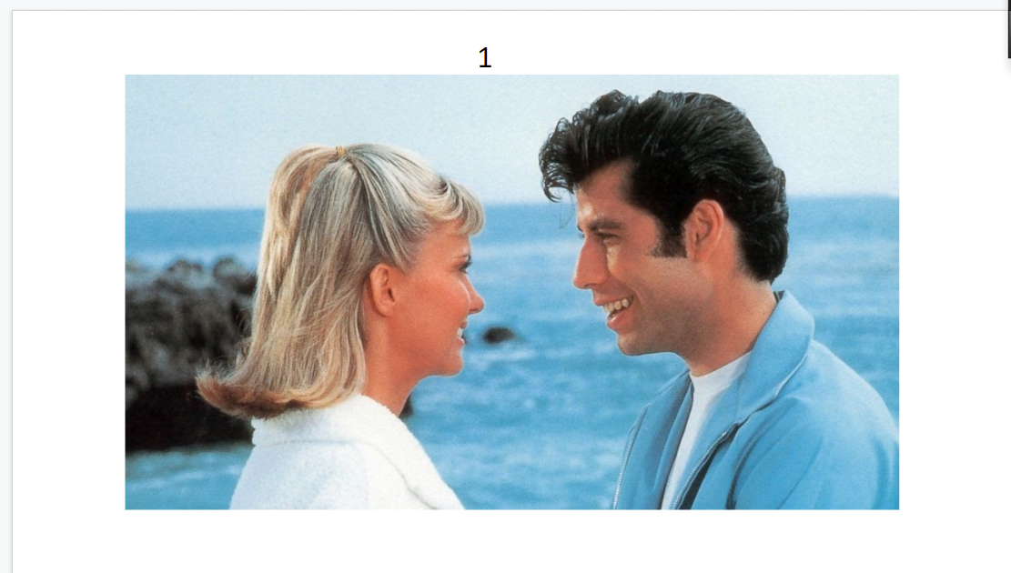
Virtual Socials - Activities- Jimmy Buffett
the trivia where staff member showed a picture from a movie and folks had to guess the movie and the year.

Slide 21
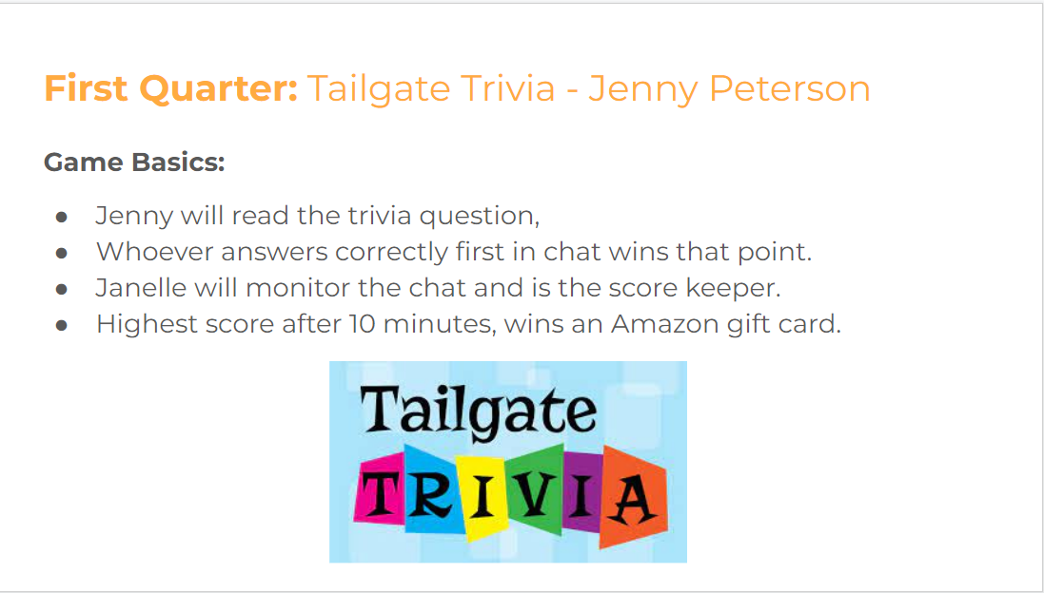
Virtual Socials - Activities- Football Tailgate

Slide 22
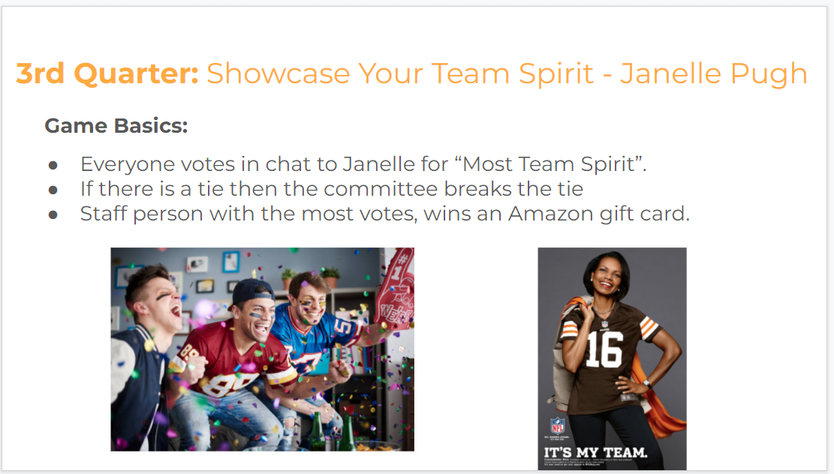
Virtual Socials - Activities- Football Tailgate

Slide 23
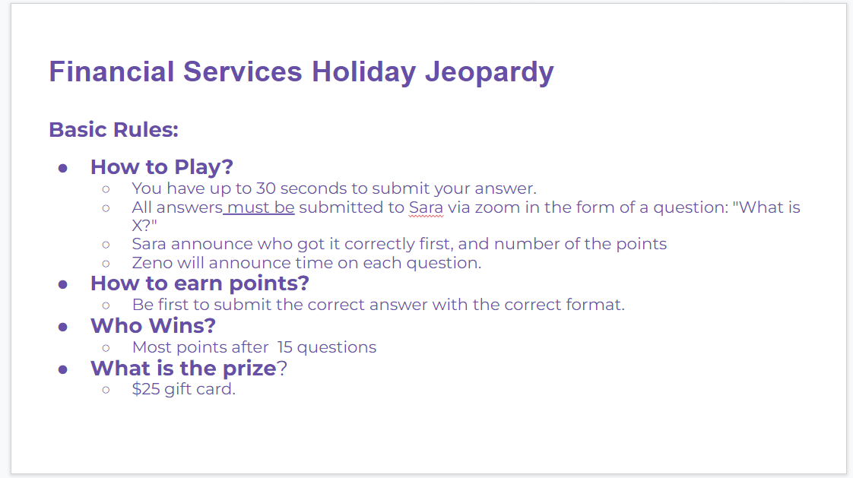
Virtual Socials - Activities-Winter holidays

Slide 24
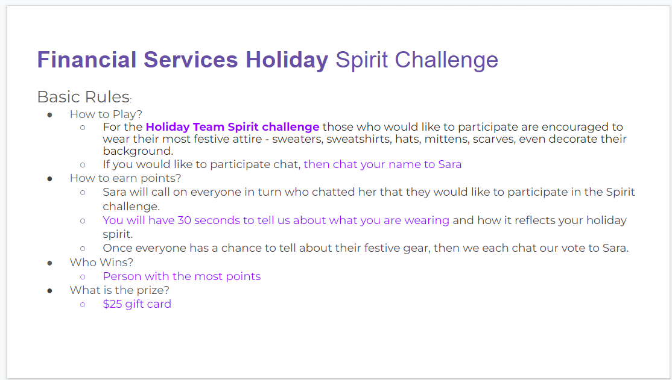
Virtual Socials - Activities- Winter Holidays

Slide 25
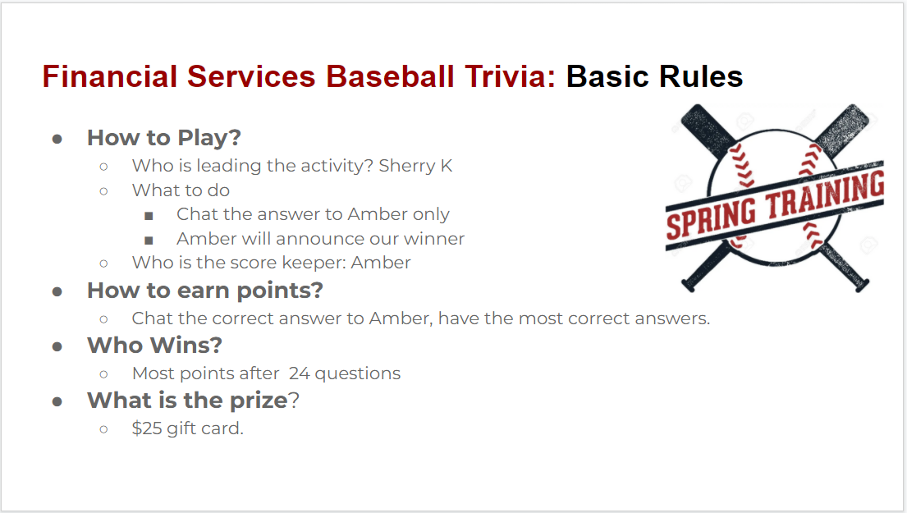
Virtual Socials - Activities-Spring Training

Slide 26
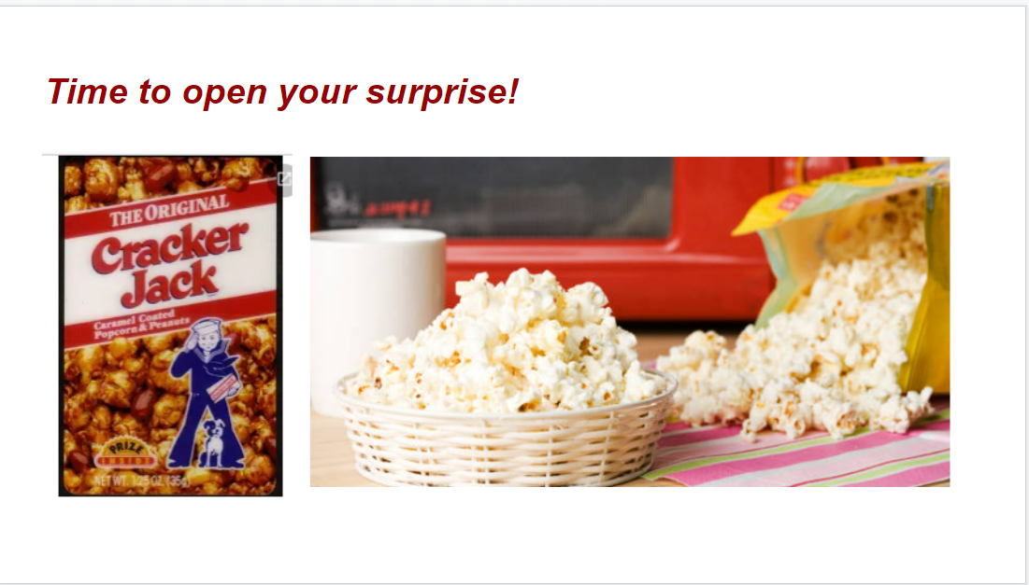
Virtual Socials - Activities-Spring Training

Slide 27
Thank you.

