Slide 1
Change Healthcare Pre-Authorization and Medical Necessity Opportunities

Slide 2

Overview
1
Survey At-a-Glance
2
Claims Denials
3
Pre-Authorization and Medical Necessity Opportunities
4
Utilization
Management
5
Demographics

Slide 3
Survey At-a-Glance
Claims denials
61 percent of hospitals indicate greater than 4 percent of first-pass claims result in denials
51 percent note an increase in pre-authorization/medical necessity denials
Pre-authorization and medical necessity pain points
Complex payer rules
Lack of authorization automation
Needed innovations
Standardization
Full automation
Preauthorization waivers
Utilization management
Aligned with revenue cycle in inpatient admissions/medical necessity and retroactive or modified authorizations

Slide 4
Claims Denials

Slide 5
Greater Than 4 Percent First-Pass Claims Result in Denials
What percent of your total first-pass claim submissions to any/all payers result in denials? (individual submission to an individual payer)
Percent of first-pass claim submissions resulting in denials
11%
18%
31%
34%
6%
FROM 10% OR HIGHER
FROM 7% TO 9.9%
FROM 4% TO 6.9%
FROM .4% TO 3.9%
LESS THAN .5%
61%

Slide 6

Percentage of Inpatient/Observation Denials Due to Pre-Authorization/Medical Necessity
Of inpatient/observation claims that are denied, what percentage are due to challenges with pre-authorization and/or medical necessity?
Percentage of Inpatient/Observation Claims Due to Challenges With Pre-Authorization and/or Medical Necessity
FROM 6% TO 15%
FROM 16% TO 25%
LESS THAN 5%
29%
16%
26%
OVER 45%
FROM 36% TO 45%
FROM 26%
TO 35%
14%
8%
7%
29%

Slide 7
Almost One-Quarter Indicate >25% of Outpatient Denials are Due to Pre-Auth/Medical Necessity
Of outpatient claims that are denied, what percentage are due to challenges with pre-authorization and/or medical necessity?
55%
39%
72%
56%
78%
78%
30%
20%
10%
23%

Slide 8
More Than Half Indicate Pre-Authorization/Medical Necessity Denials are Going Up
Have the quantity of claims denials due to pre-authorization/medical necessity increased or decreased during the last 12 months?

Slide 9
Pre-Authorization and Medical Necessity Opportunities

Slide 10
Pre-Authorization and Medical Necessity Pain Points

Slide 11
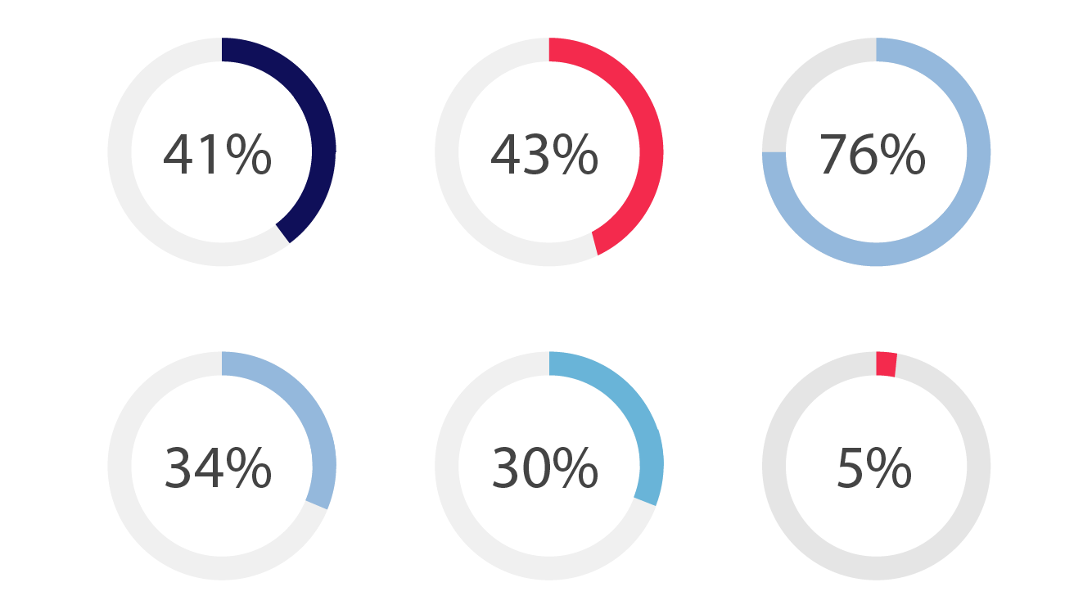
Standardization, Full Automation, Preauthorization Waivers Most Important Innovations
Most Important Innovation For Pre-Authorization
and Medical Necessity
Waiver of health plan pre-authorization requirement for certain procedures supported
Full automation of
pre-authorization workflow
in the hospital
Standardization of
pre-authorization requirements across health plans
Interfacing clinical guidelines software with front-end revenue cycle software for determining
Workflow integrated into EMR workflows rather than health-plan-specific websites/portals
Other

Slide 12
Utilization Management

Slide 13
Utilization Management Aligns With Revenue Cycle
Utilization management has aligned with revenue cycle in inpatient admissions/medical necessity and retroactive or modified authorizations
Utilization Management Has Aligned With Revenue Cycle Management
96%
41%
31%
16%
1%

Slide 14
Demographics

Slide 15
Demographics
Size of
Hospital (%)
<100 beds 34%
100-299 28%
300-499 15%
>500 24%
Hospital
Location (%)
Rural 21%
Urban 41%
System 39%
155 Responses
138 Complete
17 Partial Complete
16% Response Rate
77% Completion Rate
Revenue Cycle Leaders in Hospitals and Health Systems; May 2017

