Slide 1
Population Health: Aligning an Organization’s Business and Financial Model
An HFMA Forum Networking Event
April 28, 2016, 10:00 – 11:00 a.m. Central (8:00 – 9:00 a.m. Pacific/9:00 – 10:00 a.m. Mountain/11:00 a.m. – 12:00 p.m. Eastern)
Scott Vasey
Senior VP, Strategy
Visiting Nurse Service of New York
Rose Madden-Baer
DNP, RN, MHSA, BC-PHCNS, CPHQ, COS-C, CHCE
Senior VP, Population Health Management and Clinical Support Services
Visiting Nurse Service of New York
Nilesh Chandra
Managing Consultant, Healthcare
PA Consulting

Slide 2
Agenda and Learning Objectives
Rethinking the Population Health Business Model
A Case Study: Visiting Nurse Service of New York’s Population Health Strategy
Q&A Discussion
Learning objectives:
Develop programs and business capabilities that are easy to scale
Align incentives and total costs for providers and payers
Work with revenue cycle leaders to implement changes
Establish a scalable portfolio of programs that deliver value to patients, payers and providers

Slide 3
Introductions
Scott Vasey, Visiting Nurse Service of New York
Rose Madden-Baer, Visiting Nurse Service of New York
Nilesh Chandra, PA Consulting Group

Slide 4
Rethinking the Population Health Business Model
An HFMA Forum Networking Event
April 28, 2016
Nilesh Chandra
Managing Consultant, Healthcare
PA Consulting

Slide 5

About PA Consulting
We are an employee-owned firm of over 2,500 people, specialising in consulting, technology and innovation.
25 PRINCIPAL OFFICES
    Americas
    Europe
    Nordics
    Gulf
    Asia Pacific
8 INDUSTRY SECTORS
    Healthcare
    Energy and Utilities
    Financial services
    Government
    Lifesciences
    Defence and security
    Consumer and Manufacturing
    Transport and logistics

Slide 6


Providers are taking on increasing financial risk with the shift toward value
Nurse
Pharmacy
Payer
Hospital
Nurse
Provider Network
PCP
Patient coordinates care
PCP
Pharmacy
Payer
Other
From fee-for-services…
…to accountable care
Access
While
ensuring
Cost
Quality

Slide 7
Polling Question #1
What is your organization’s status in terms of implementing a population health program?
We have not started developing a population health strategy.
We are just beginning to develop a population health strategy.
We run a few pilot programs but have not scaled them across the enterprise.
We have developed a strategy but are having trouble in running successful programs at enterprise-scale.
We have a developed population health strategy and run successful programs across the enterprise.

Slide 8
Most population health programs start as small pilots that mask complexity and risk
Readmission reduction program
Some of these programs are –
Difficult to scale up
Narrow in their focus
Not benchmarked against external competition
Not setup for rapid re-tooling in response to changing industry trends and customer needs
Bundled payments for surgery
Care coordination
Community based care
The challenge is – How to develop a structured portfolio of solutions that can be easily adapted to meet a wide variety of payer needs?

Slide 9
Effectively integrating new capabilities requires rethinking the business model
All of the elements of a business model are interlinked. Making a change in one area requires re-thinking assumptions across the others and making appropriate adjustments.
Patient engagement
Governance and
controls
Culture
and
leadership
Clinicians
and
license
IT applications and technology
Care delivery processes
Infrastructure
and
facilities
Sourcing
and skills
Point of care

Slide 10
Clearly understanding inter-relationships allows you to innovate and scale up faster
CULTURE
CARE QUALITY & OUTCOMES
CLINICIAN EFFECTIVENESS
CLINICIAN PRODUCTIVITY
TECHNOLOGY INVESTMENTS
PATIENT SATISFACTION
INCENTIVES
PROCESS INTEGRATION
COST OF CARE
PATIENT ATTRIBUTION
CARE MODEL ASSUMPTIONS
STAFFING MODEL

Slide 11
VNSNY Approach to Population Health
An HFMA Forum Networking Event
April 28, 2016
Scott Vasey
Senior VP, Strategy
Visiting Nurse Service of New York
Rose Madden-Baer
DNP, RN, MHSA, BC-PHCNS, CPHQ, COS-C, CHCE
Senior VP, Population Health Management and Clinical Support Services
Visiting Nurse Service of New York

Slide 12
Visiting Nurse Service of New York
Visiting Nurse Service of New York (VNSNY) is the oldest and largest not-for-profit home healthcare organization in the United States
About 65,000 patients under direct or managed care on any given day
  More than 2.2 million visits per year
17,000 employees including more than 2,000 registered nurses and licensed practical nurses, more than 500 rehab therapists, more than 350 social workers, and more than12,000 home health aides and health coaches.
  Clinical staff speak 50+ languages
Utilization management, care management, and population health analytics
Delivery System Reform Incentive Payment (DSRIP) Performing Provider System (PPS) support: Participate with 14 PPSs; On committees with seven
Health home and behavioral health transitions
Research & Innovation Center
CHOICE Health Plan (Medicare Advantage, Managed Long-Term Care [MLTC], Dual, Fully Integrated Duals Advantage [FIDA], Special Needs Plans [SNP])

Slide 13
Polling Question #2
How important is home health care in your population health strategy?
Very important
Important
Of minimal importance
Not important at all

Slide 14
VNSNY Approach to Population Health
“Necessity is the mother of all invention”
  Market is evolving and we needed to be ahead of it
We needed a new approach to managing quality, cost, and the patient experience, utilizing 120+ years of experience
  A cultural shift – bottom up and top down
  Use of our data
  Alignment of partners
  Optimization of the services along the care continuum
  Integration of value-based care and payment
“Don’t let perfection be the enemy of good” – lessons learned
  Aligning discharge diagnosis with treatment conditions
  Aligning risk stratification with program objectives
  Focus on care transitions and seamless handoffs
  Evolve the workflows and processes

Slide 15
Polling Question #3
Are you participating in a bundled-payment arrangement?
Yes
No, but planning to in the future
No, and do not foresee participating in one in the future
Not sure

Slide 16
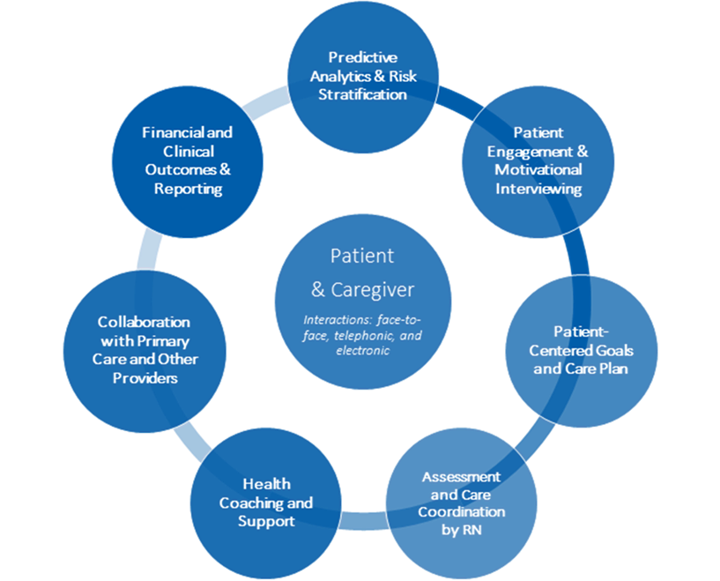
Population Care Management provides comprehensive and patient-centered care

Slide 17
Experience with Bundles
We are a risk-bearing provider for a 90-day cardiac post-acute bundle
  VNSNY shares in upside and downside risk for all patients admitted to VNSNY with a recent hospitalization for heart failure or MI
  Our population care coordinators provide ongoing assessment and care coordination throughout the 90-day episode
  VNSNY has successfully reduced readmission rates and overall episode cost in preliminary data from our first full risk-bearing year (Q1-Q2 2015)
We are the lead post-acute provider for a large NYC hospital’s cardiac and orthopedic bundle
  Codesigned clinical pathways leveraging our expertise in clinically and socially complex patient care
  Developed a health information exchange for the transfer of clinical visit data between VNSNY and the hospital providers
  Established enhanced communication pathways between VNSNY and hospital care coordinators
  Helped the hospital to significantly reduce episode cost through skilled nursing facility (SNF) avoidance programs and readmission reduction strategies
We are a preferred post-acute provider for an orthopedic specialty hospital’s joint replacement bundle
  Developed customized home care episode utilization reporting and population analytics
  Achieved the hospital’s targets for timeliness of care, readmissions, and other quality metrics

Slide 18


Successful Population Health Model at VNSNY
Triggering Hospitalization Traditional Home-Care Episode Remainder of 90-Day Episode
Patient & Family
VNSNY Co-Care 90 Team
Social Worker
Hospital-based RN liaison
Home Care Nurse
Health Coach
RN Population Care Coordinator
NP
Home Care Therapist
Psych NP
Pharmacist
Other Providers
Referring MD
Other Care Managers
Primary Care Physician
Specialist Physicians
Post-acute facilities
Community-based orgs
D/C Planner

Slide 19

Closing thoughts for the road ahead ….
Population health is a business model – approach it as a business transformation
Design for open integration of process and technology
Design for scale and adaptability

Slide 20

Questions & Answers
Ask the speakers a question or share your
population health experiences. Just type your question or comment into the Q&A box on your computer screen.

Slide 21
Contact Information
Scott Vasey
Senior VP, Strategy
Visiting Nurse Service of New York
212-609-1557
Scott.Vasey@vnsny.org
Rose Madden-Baer, DNP, RN, MHSA, BC-PHCNS, CPHQ, COS-C, CHCE
Senior VP, Population Health Management and Clinical Support Services
Visiting Nurse Service of New York
212-609-5796
Rose.Madden-Baer@vnsny.org
Nilesh Chandra
Managing Consultant, Healthcare
PA Consulting
617-838-7196
nilesh.chandra@paconsulting.com

