Slide 1
Board Overview:
Acquisition Model and Considerations
A tool from HFMA’s Value Project Toolkit: hfma.org/valueproject

Slide 2
Contents
Affiliation/Acquisition Models
Market, Community and Organizational Considerations
Process Options
Partner Evaluation Considerations
As Options Are Narrowed …

Slide 3
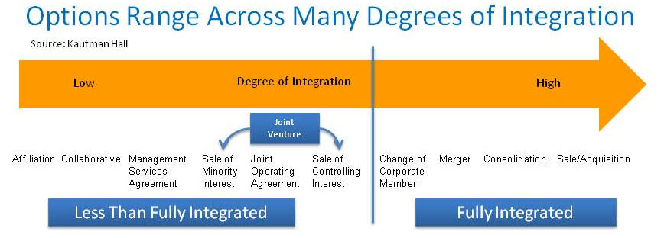
Affiliation/Acquisition Models
A wide and growing range of options and sub-options
Structure follows function (where do we need to go)
  Models to the right are necessary for favorable access to capital
  Less integrated models (to the left) retain more control at the community level and are more reversible
  Either end of the continuum can be effective in gaining efficiencies and in accessing large enough populations to manage care effectively and assume risk

Slide 4
Affiliation/Acquisition Models
How do the potential models match up with an organization’s strategic objectives? For example:
  Expand geographic footprint
  Diversify operations
  Invest in electronic health record and other elements of population health management infrastructure
  Gain system-wide economies (such as supply chain or revenue cycle savings)
  Gain regional economies (such as ensuring a logical mix of primary care physicians, specialists, other facilities and programs, etc.)

Slide 5
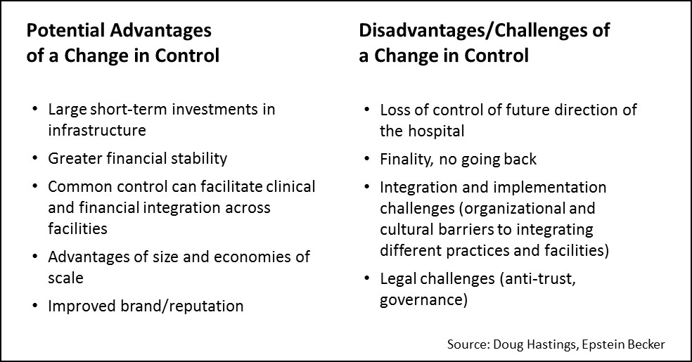
Acquisition/Affiliation Models
The key differences are between models that do or don’t require a change in control

Slide 6
Market, Community and Organizational Considerations
What are our biggest needs or goals from acquisition/affiliation?
What do we expect our competitors to do next?
What are our options for acquisition/affiliation?
  … in our region?
  … outside of our region?

Slide 7
Market, Community and Organizational Considerations (continued)
Do we have a need/opportunity to enter more than one form of consolidation (e.g., one, for one purpose nationally and another for another purpose in our region)?
What are the implications of our acquisition/affiliation options for
  Our key physician groups?
  Our patients/projected members?
  Our employees/staff?
  Our employers and other key stakeholders?

Slide 8
Process Options
Identify / Approach / Evaluate Potential Partners on Our Own
  A less formal process.
  Pros: less up front cost. More personal contact between potential partners may be preferable in some cases.
  Cons: may overlook a potential partner, or information to evaluate a potential arrangement. Some potential partners may prefer having an “outside” intermediary.
Work with an Independent Consultant to Identify / Approach / Evaluate Potential Partners
  A more formal process involving soliciting detailed proposals from potential partners in response to a letter of interest. Presentations and follow up questions occur.
  Pros: Leveraging the experience of a consultant that specializes in these types of organizational transactions.
  Cons: More costly up front.

Slide 9
Partner Evaluation Considerations
The type of acquisition model proposed (e.g., sole substitution; full acquisition; 75%/25% joint venture, etc.)
Details of financial proposals
Regulatory and image issues
Ability of partners to deliver on our strategic initiatives
Relationship issues

Slide 10
As Options Are Narrowed …
Perform Due Diligence (legal, financial, regulatory and compliance)
Conduct Business Planning
  Vision
  Approach/Organizational Structure
  Capitalization
  Governance (powers, roles and responsibilities, etc.)
  Management Structure and Initial Management
  Early Initiatives and Priorities
  Financial Projections
Execute Definitive Agreement (standard and negotiated terms)

